Slide 1




Climate response to COVID-19 aerosol emission reductions
A testbed to understand superfast atmospheric circulation
adjustments to regional aerosol forcing
Nora Fahrenbach and Massimo Bollasina (N.L.S.Fahrenbach@sms.ed.ac.uk)
School of GeoSciences, University of Edinburgh, UK

Slide 2
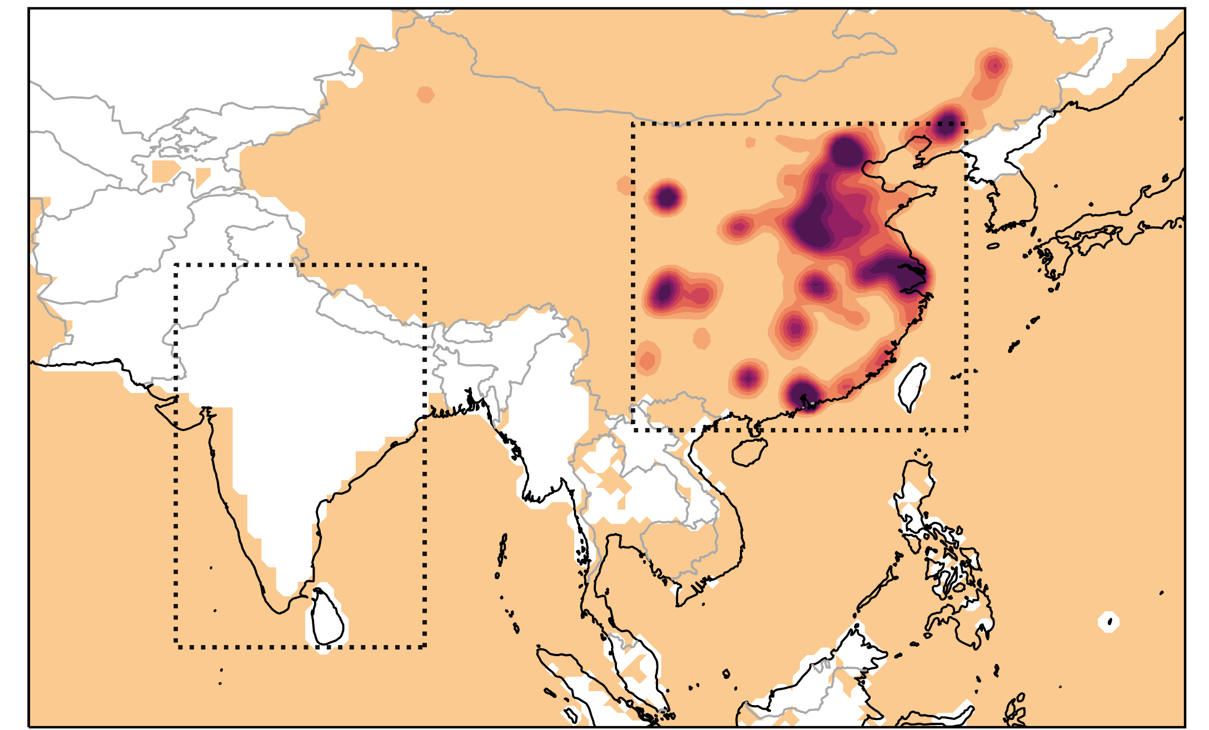
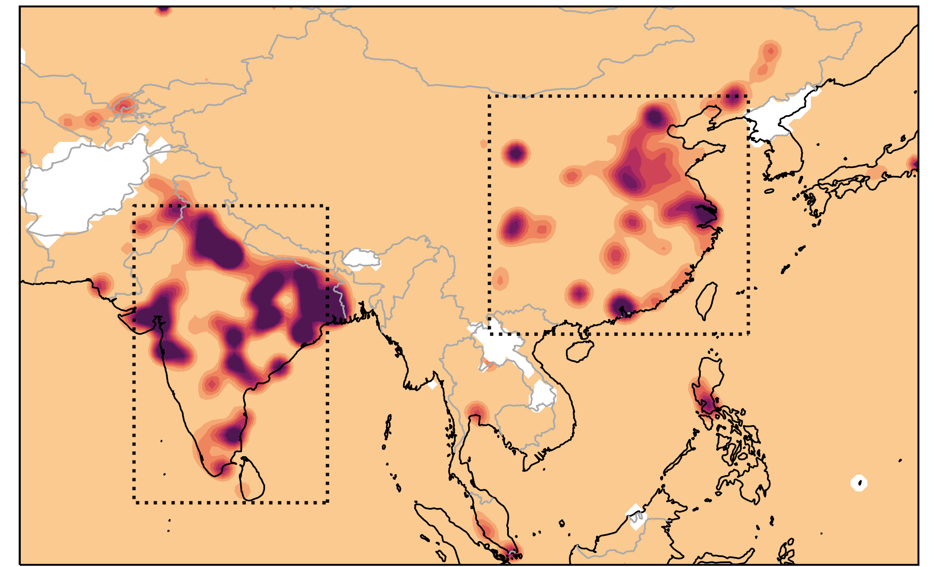
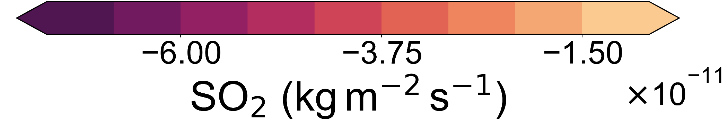
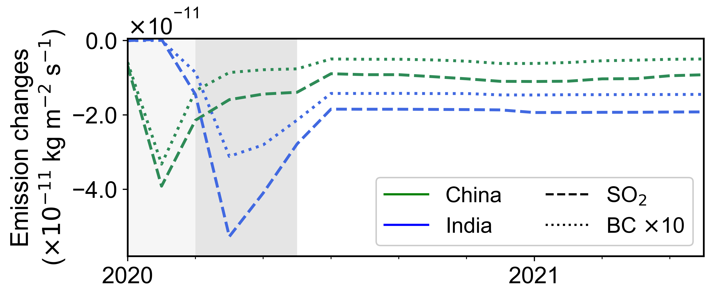
SIMULATING COVID-19 CLIMATE
JF 2020
MAM 2020
10x CovidMIP models
Baseline: SSP2-4.5 scenario
Emissions: Mobility-based estimates until June 2020
Largest aerosol reductions over China in JF 2020 & over India in MAM 2020
JF
MAM
(CovidMIP protocol: Lamboll et al. 2021)

Slide 3
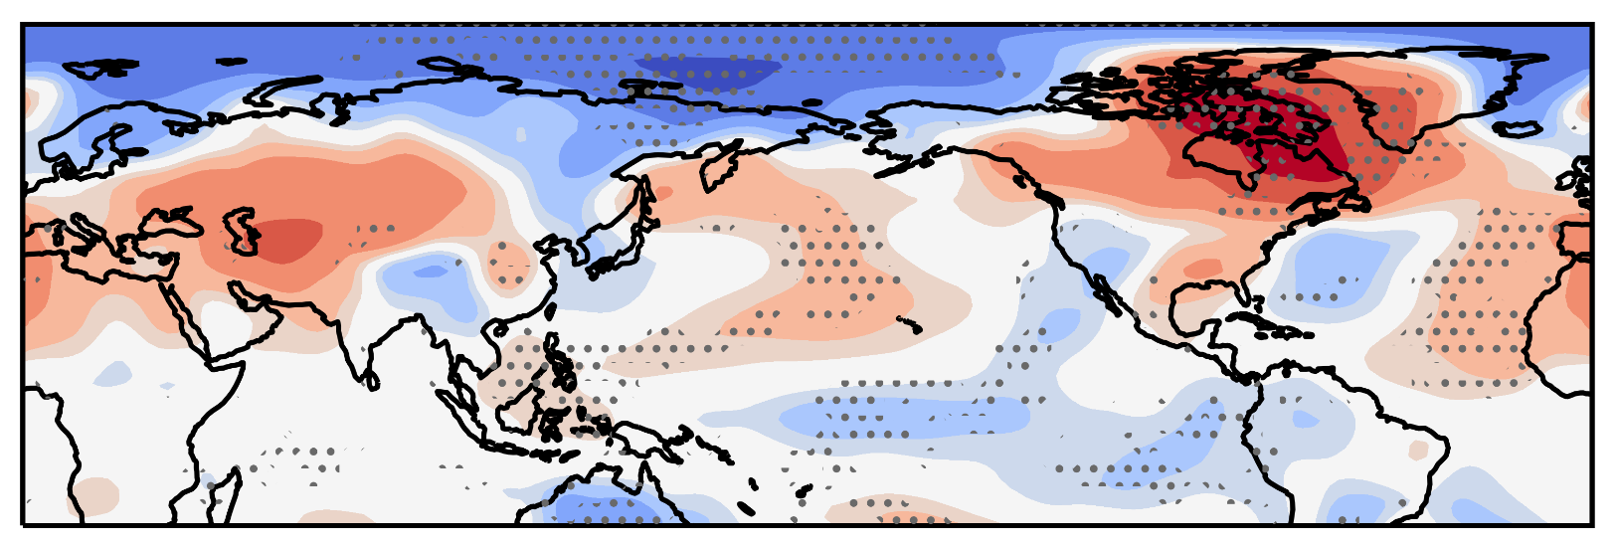
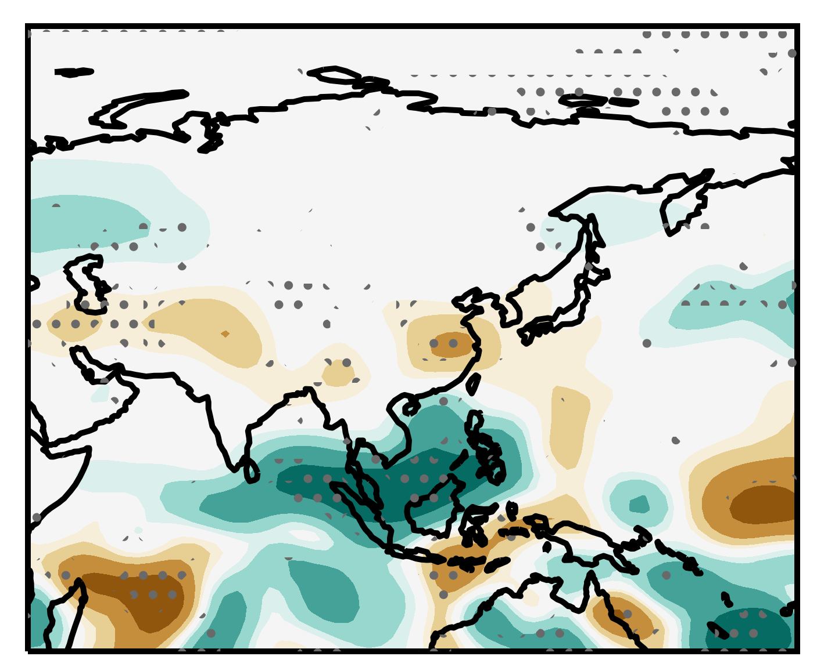
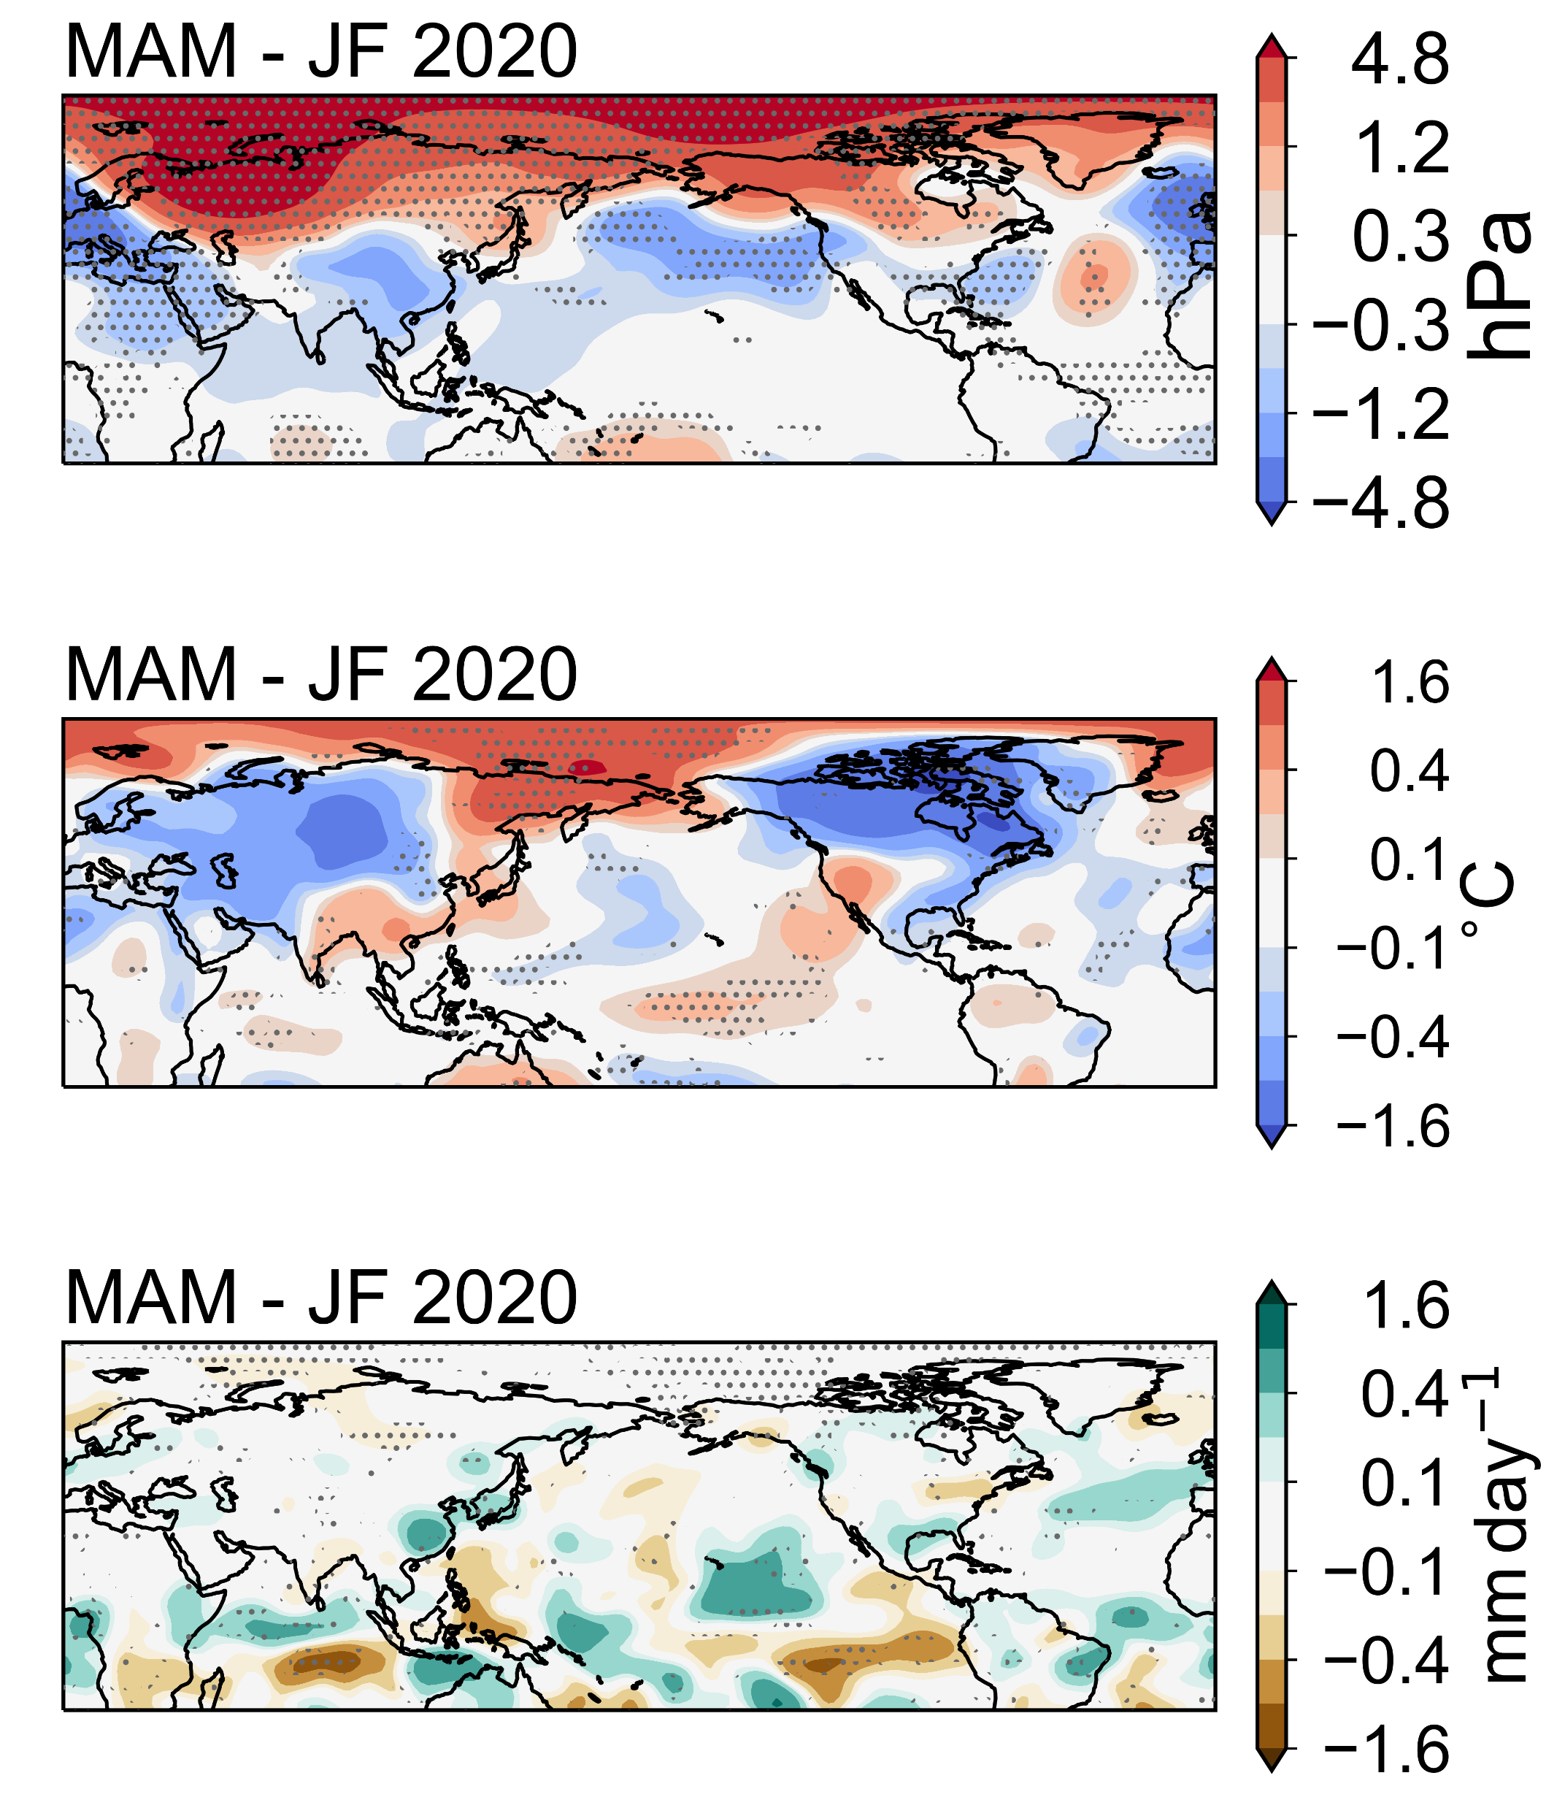


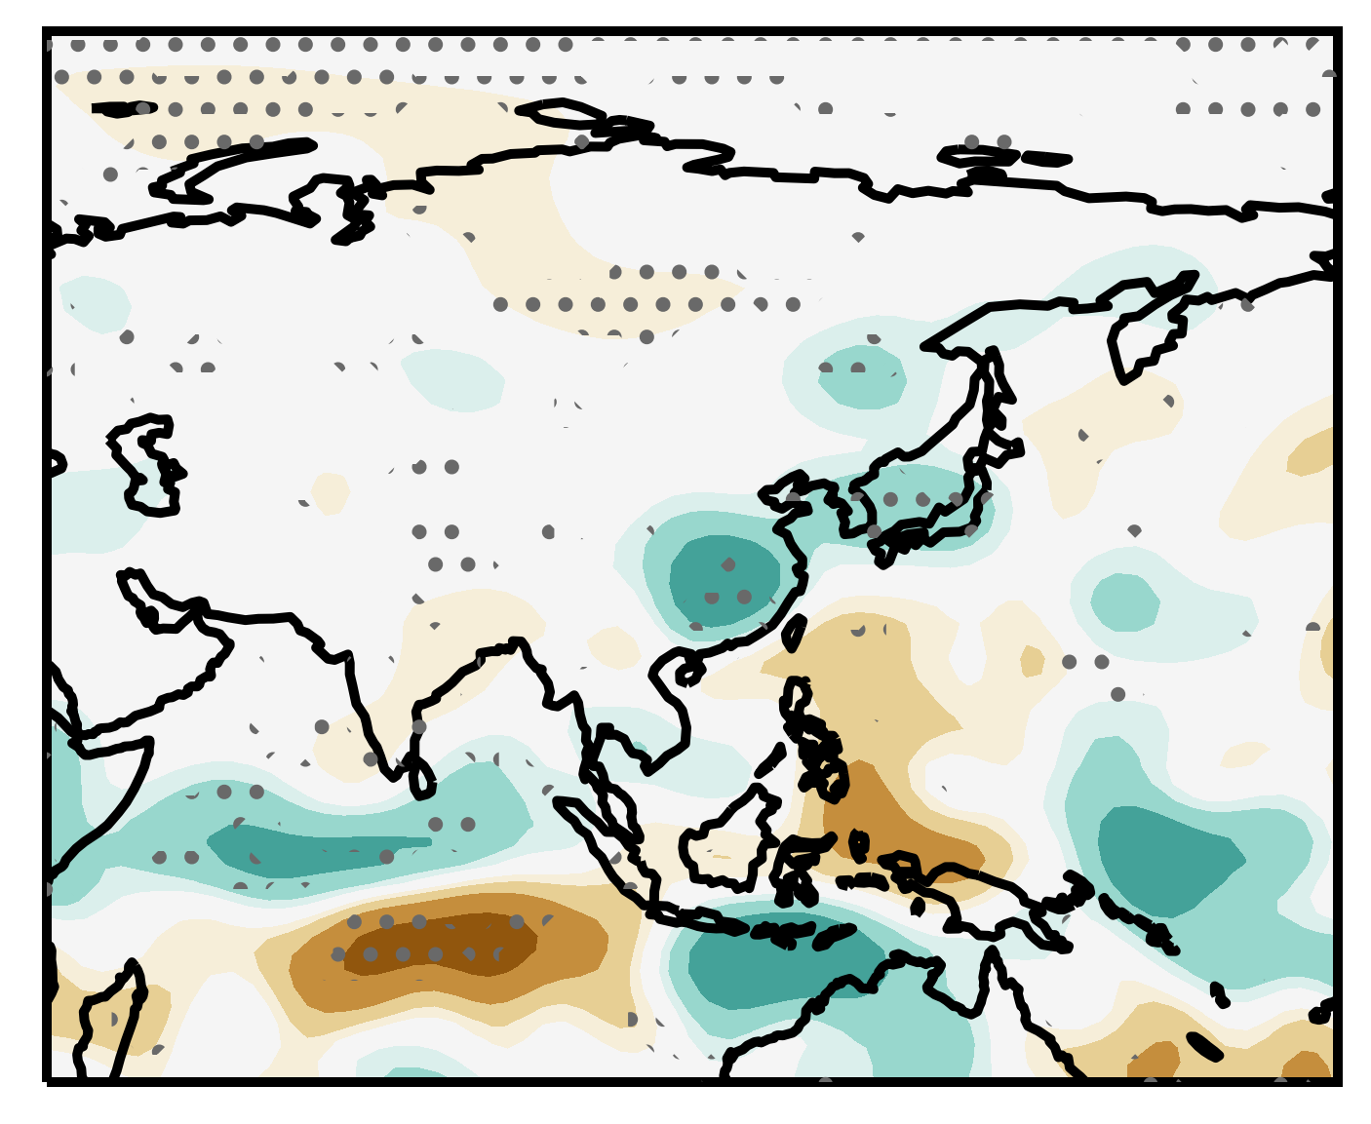
CLIMATE RESPONSE TO REGIONAL AEROSOLS
JF 2020: Temperature (°C)
Precipitation (mm/day)
MAM 2020
Contrasting imprint of regional aerosols from China and India
(Fahrenbach and Bollasina 2022, ACP submitted)
Notes:
Overall, we find a reversal of the hemispheric-wide climate pattern which we were able to link to a shift of the main emission reduction region from China to India.

Slide 4
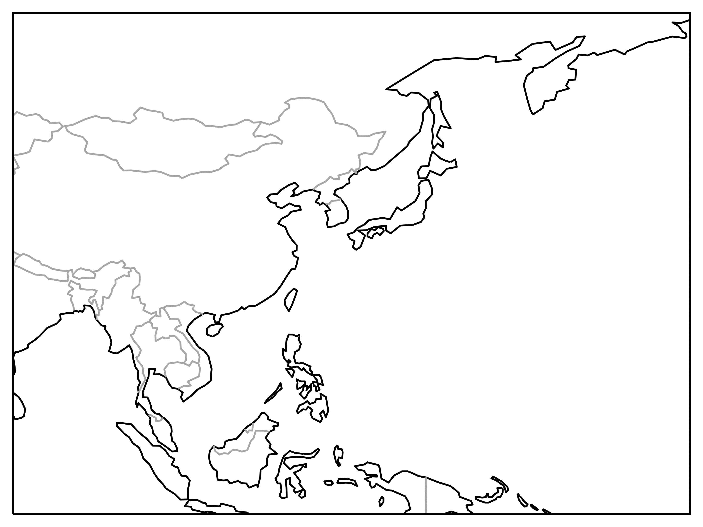







MECHANISM OF REMOTE ANOMALIES (JF)
250 hPa
Rossby waves
Surface
L
(Fahrenbach and Bollasina 2022, ACP submitted)
Notes:
Mechanism “for”?? Or “of” → if change for both

Slide 5
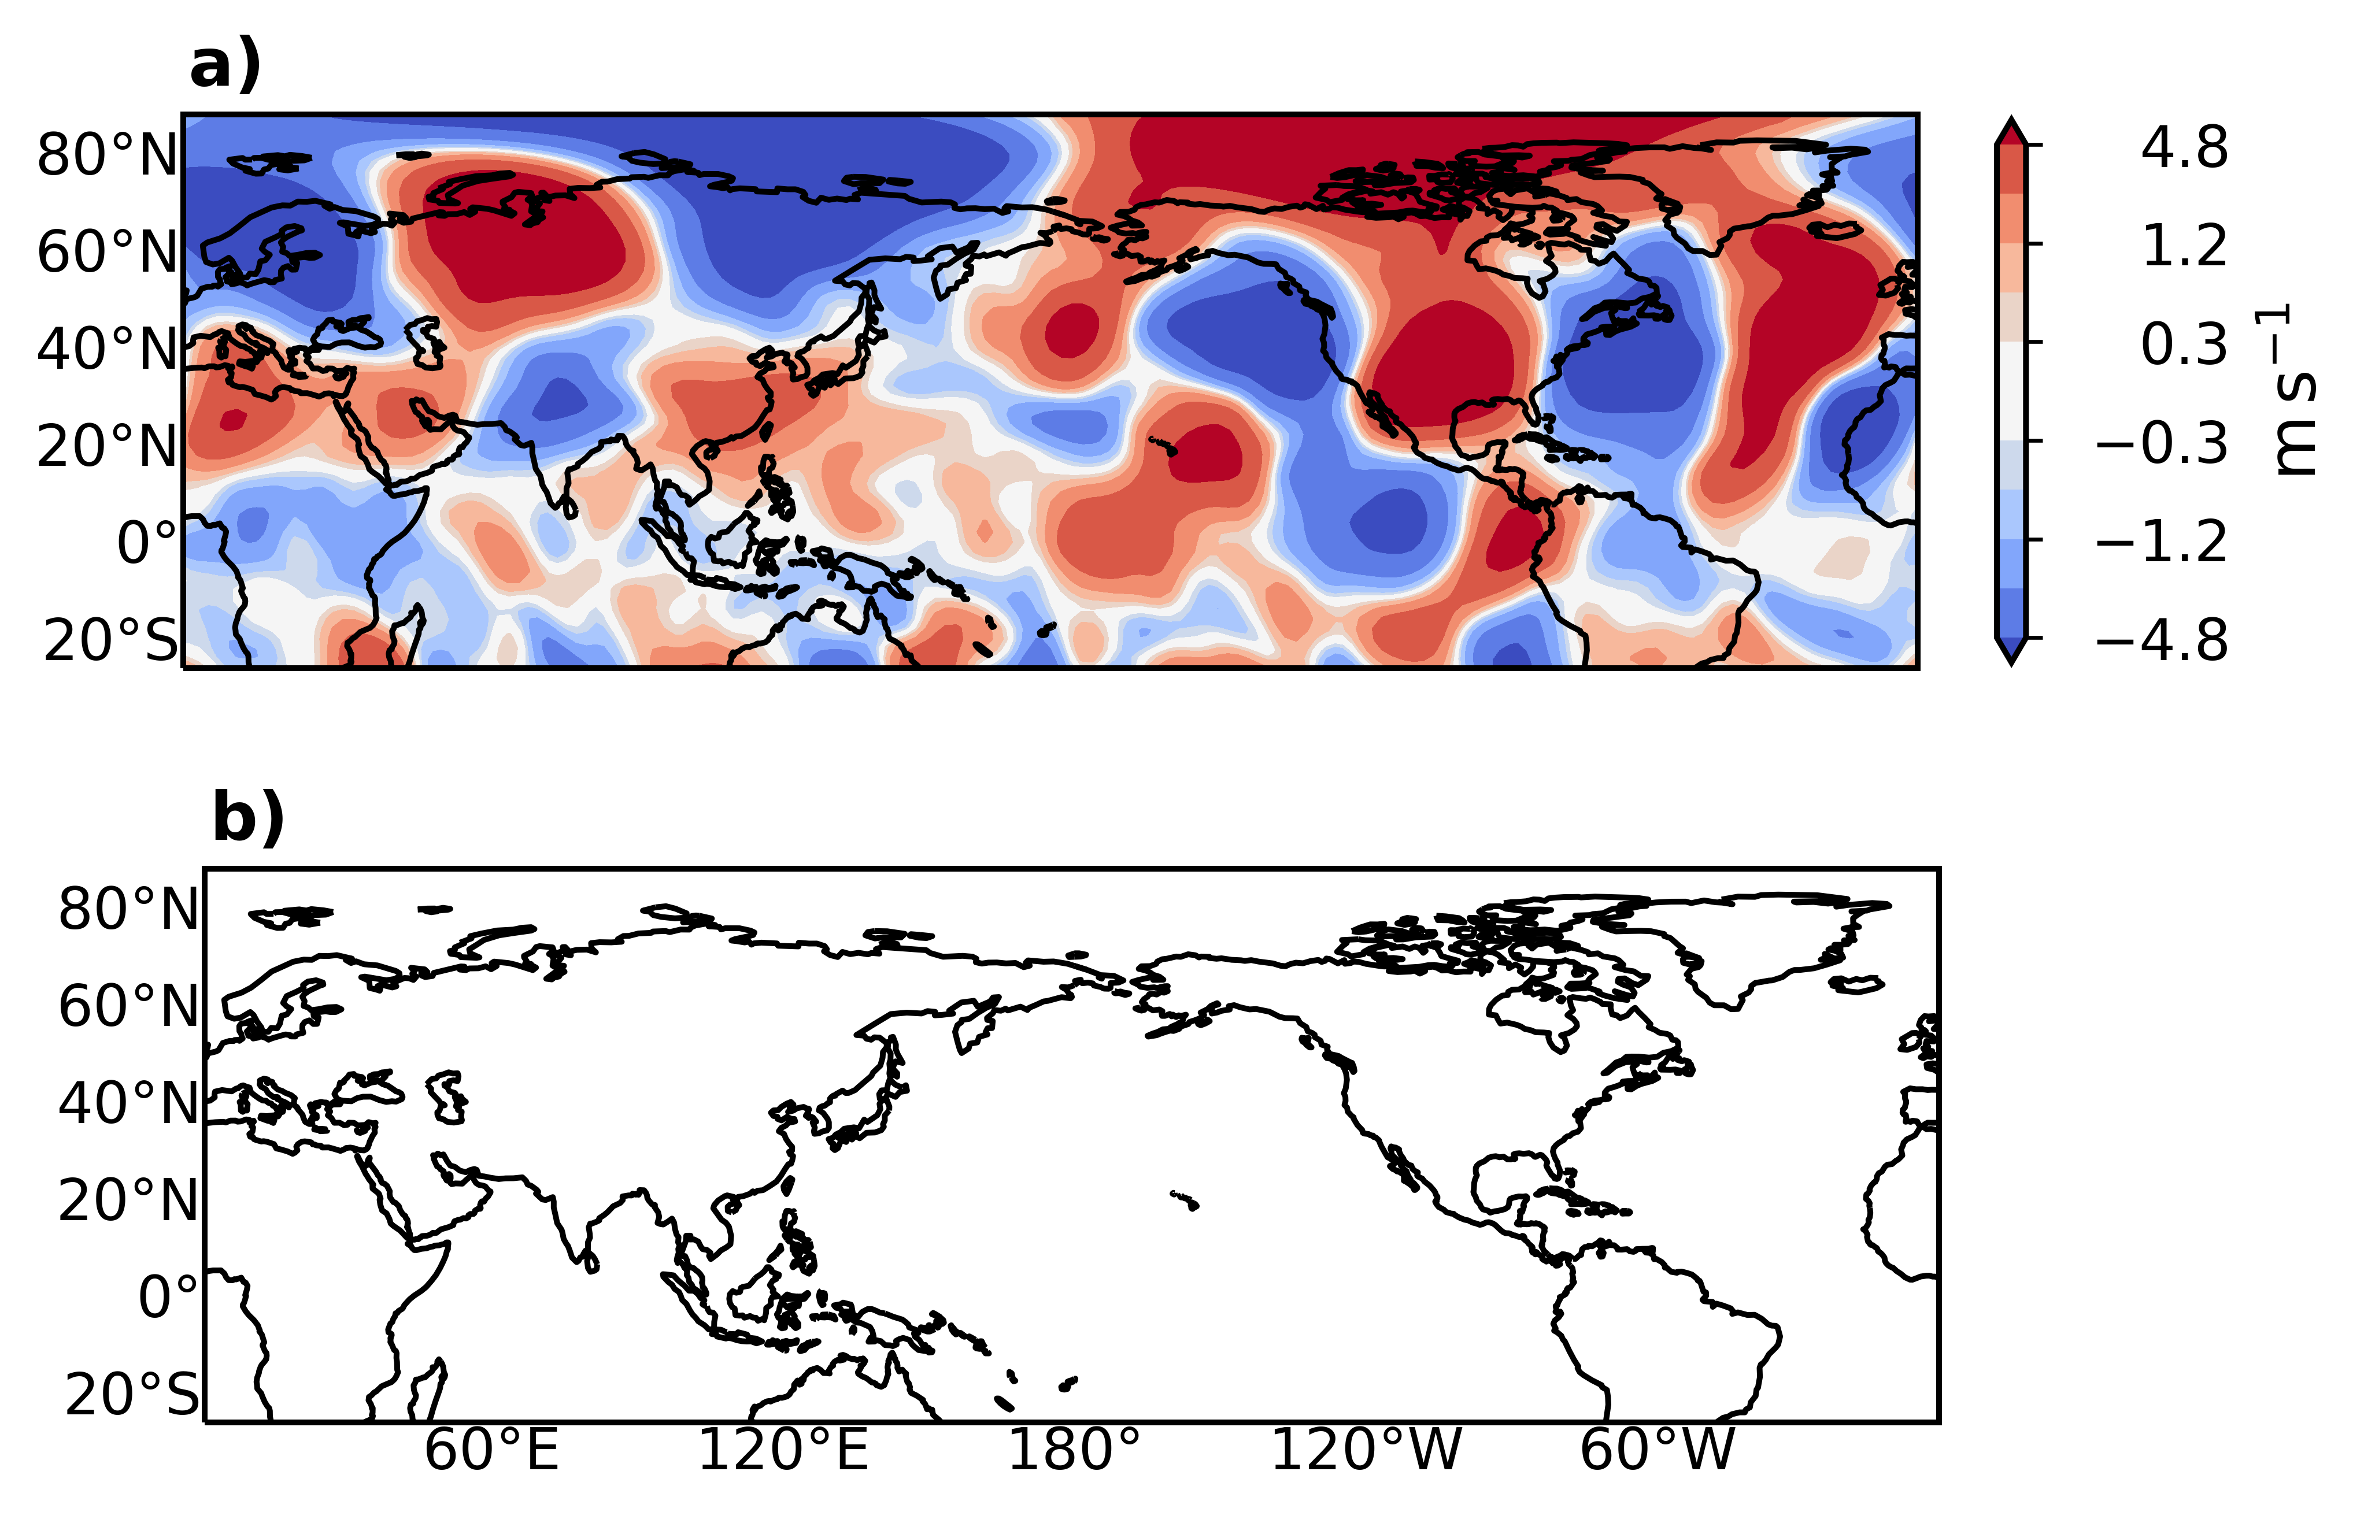
MECHANISM OF REMOTE ANOMALIES (JF)
250 hPa
Rossby waves
v at 250hPa (m s⁻¹)
Aerosol-induced Rossby waves drive remote climate impacts
Notes:
So, our results show that Rossby waves extend the influence of regional aerosols and drive remote climate responses
Furthermore, we find that this mechanism for the generation of Rossby waves does not only operate on slow equilibrium timescales -as found by previous studies- but already establishes on superfast, transient timescales.

Slide 6


KEY FINDINGS
Novel analysis of superfast response using CovidMIP
Contrasting climate imprint of regional aerosols
Remote aerosol response via global circulation adjustments
Reducing the large uncertainty in climate projections to rapidly changing Asian aerosol emissions
For more details: Nora Fahrenbach
N.L.S.Fahrenbach@sms.ed.ac.uk

