Slide 1
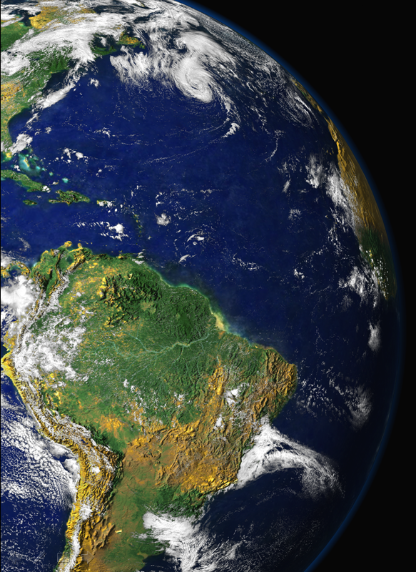
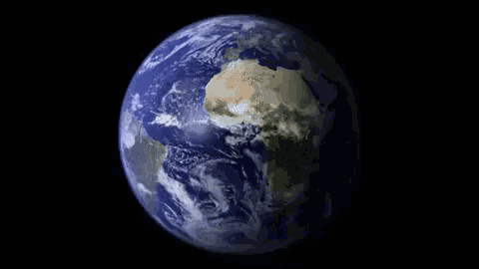
EGU session BG1.4 – Amazon forest – a natural laboratory of global significance, room 2.95 on Tuesday, 24 May 2022, 15:58 CEST
Deforestation and climate change: The multiple pressures over Amazonian forests
Paulo Artaxo
Instituto de Física, Universidade de São Paulo
Artaxo@if.usp.br

Slide 2
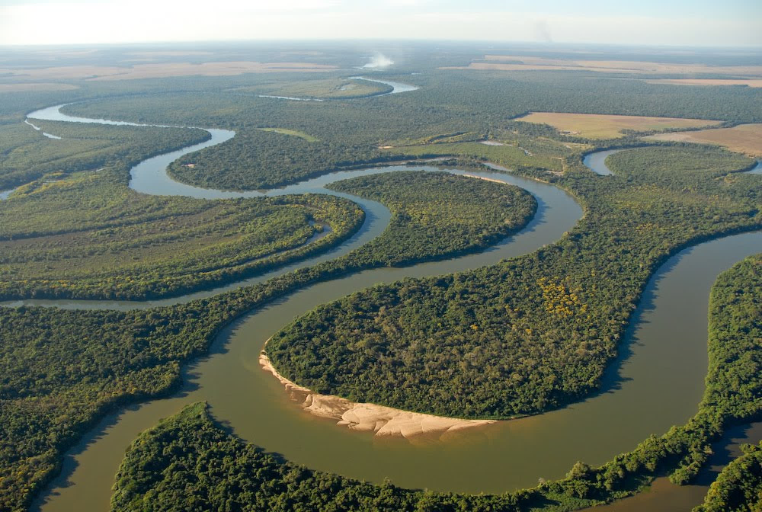
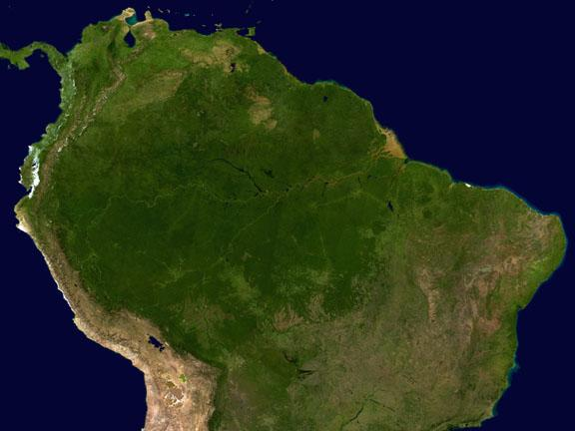
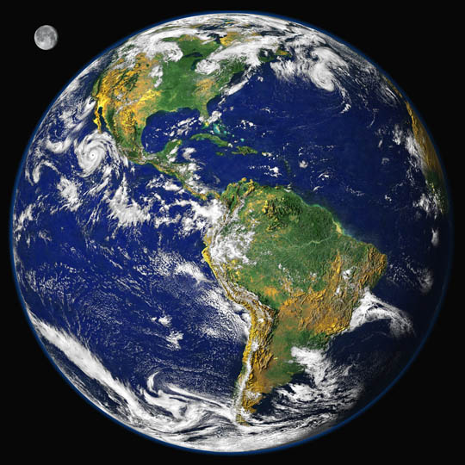
Amazonia and Global Climate Change:
A two-way process
Deforestation and climate change

Slide 3
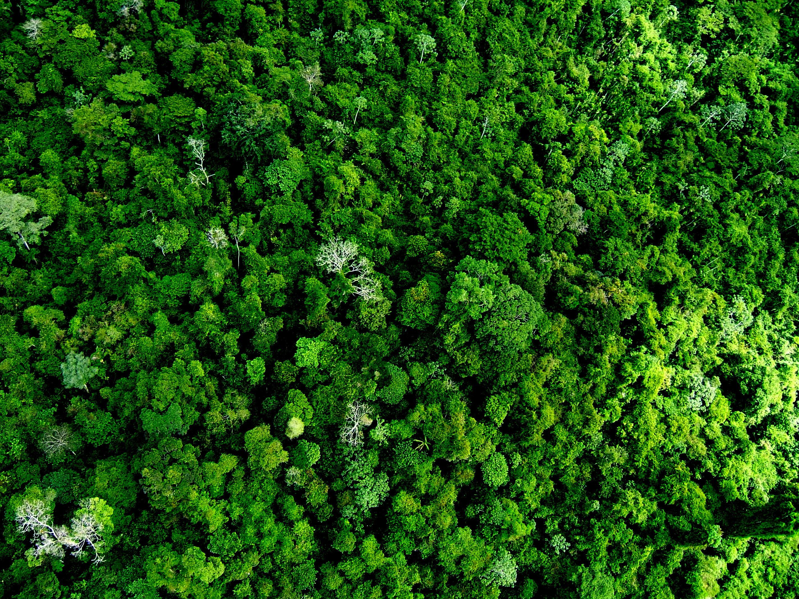
Brazilian Economy based on agribusiness that is vulnerable to Climate change in the next years.
Lots of hydropower generation is vulnerable to climate change.
8500 Km of coastal areas are vulnerable to sea-level rise.
Northeast semi-arid region can be unliveable in a few years
Brazil has unique opportunities in the world
Has a huge potential to reduce emissions without any penalty for the society
Has a solar and wind power generation capacity no other country has
Has a large biofuel program in place
Has a large potential to absorb carbon, with income generation through carbon markets
Brazil has significant vulnerabilities to Climate change

Slide 4
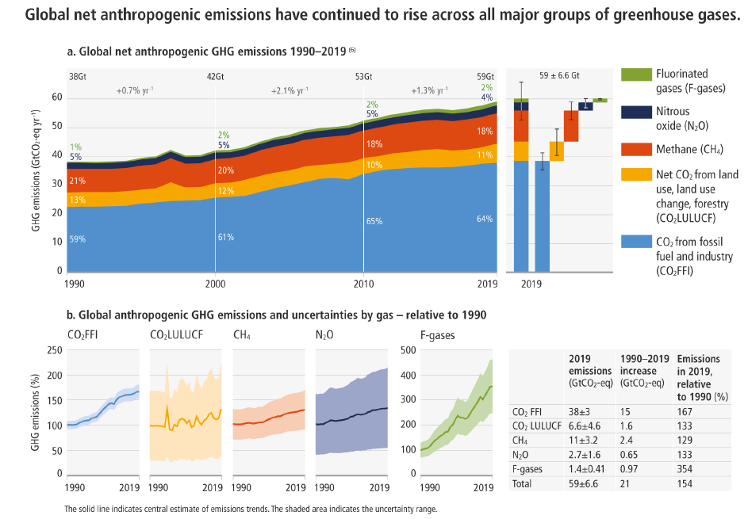

Slide 5
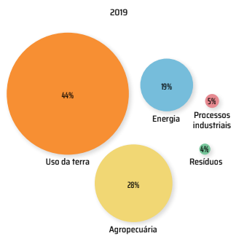
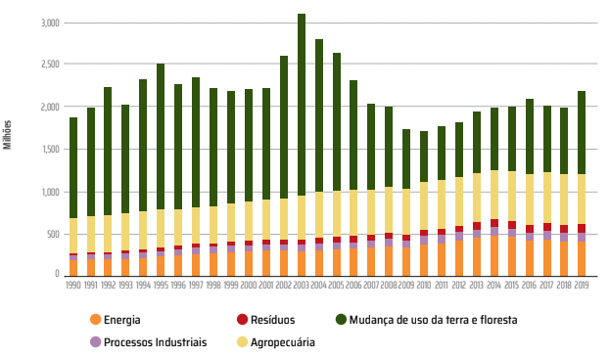

Emissions of greenhouse gases in Brazil
Land-use change responsible for 44% of GEE emissions in 2019
44%
(MUT)

Slide 6
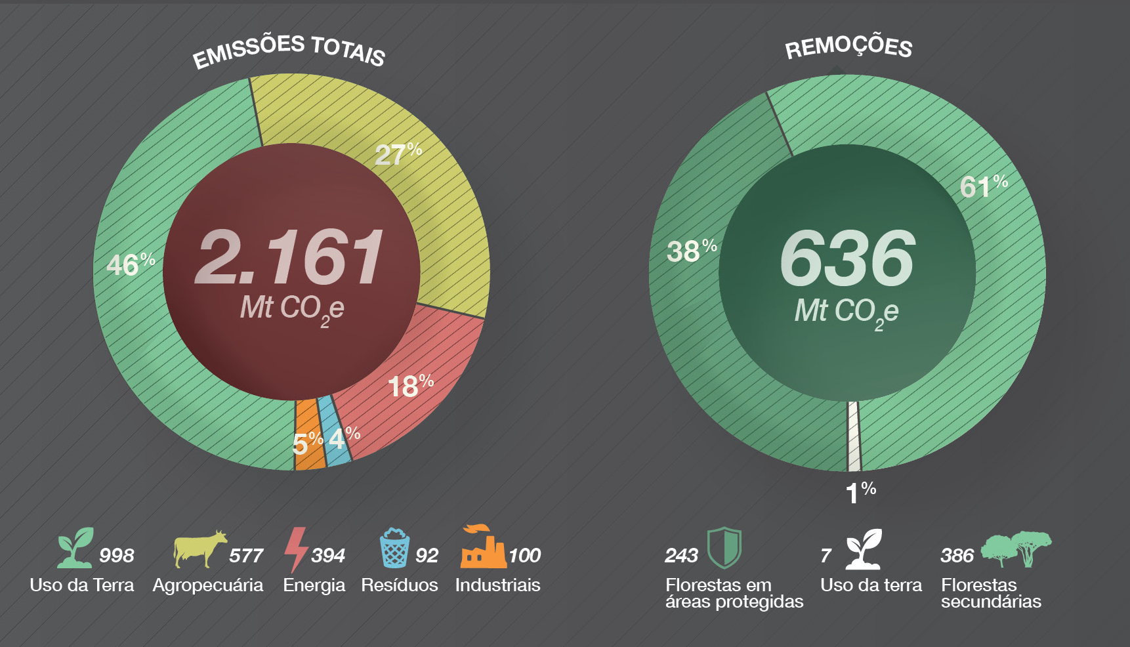
Greenhouse gases emissions and removals in Brazil in 2020
Great opportunity for Brazil, unique in the world
http://seeg.eco.br/infografico

Slide 7
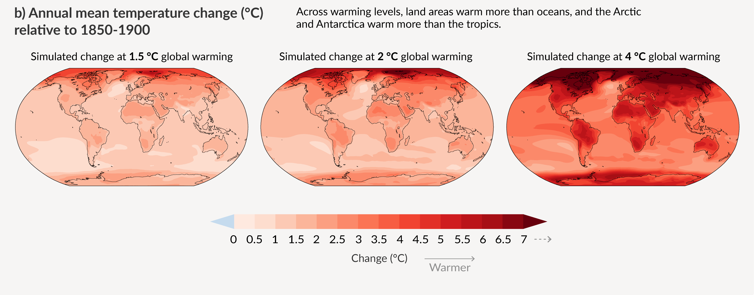
With every increment of global warming, changes get larger in regional mean temperature, precipitation and soil moisture

Slide 8
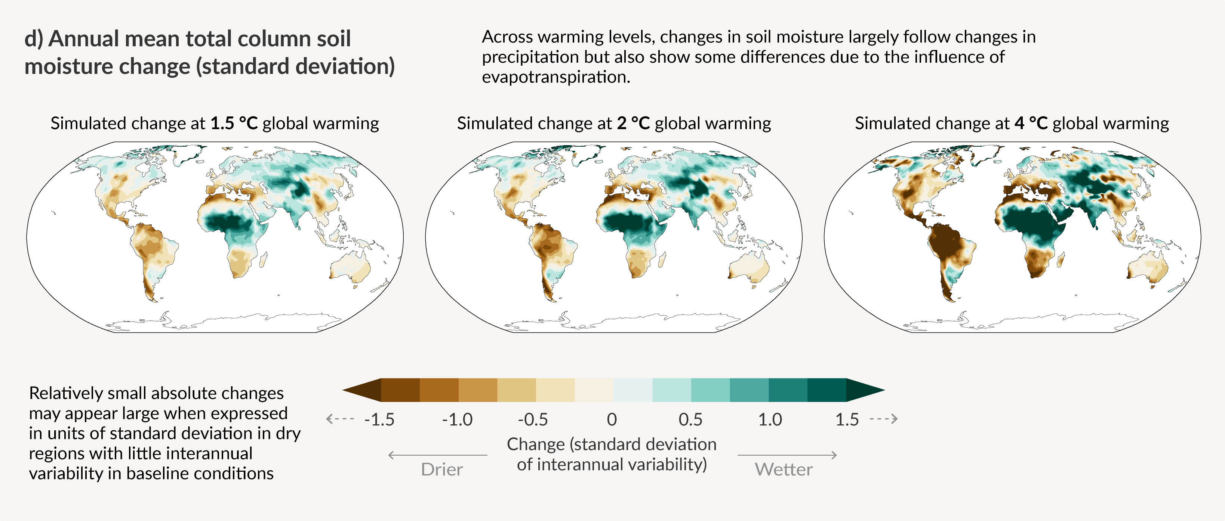
Soil humidity with 4 degress warming

Slide 9
Amazonia is critical for the water vapor transport to Central and South Brazil

Slide 11
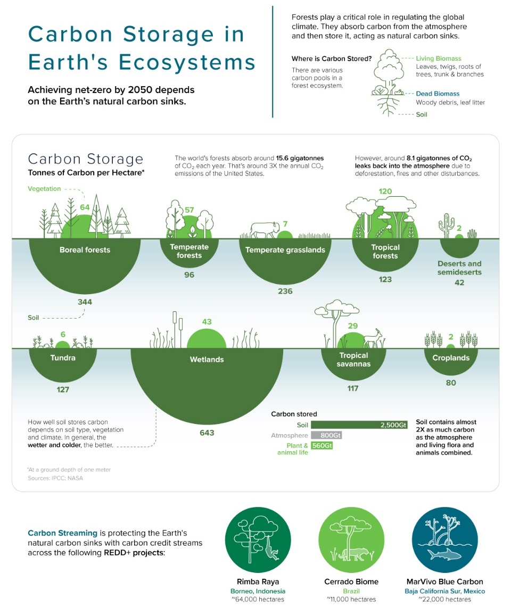
Achieving net-zero by 2050 depends on the Earth’s natural carbon sinks
Amazonia is critical for that, because it contains 120 billion tons of carbon

Slide 12
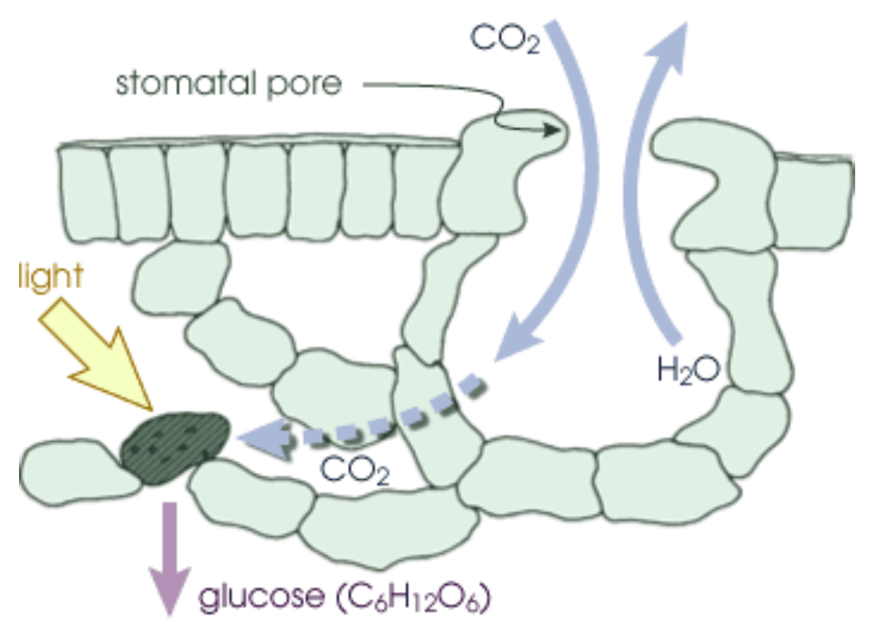
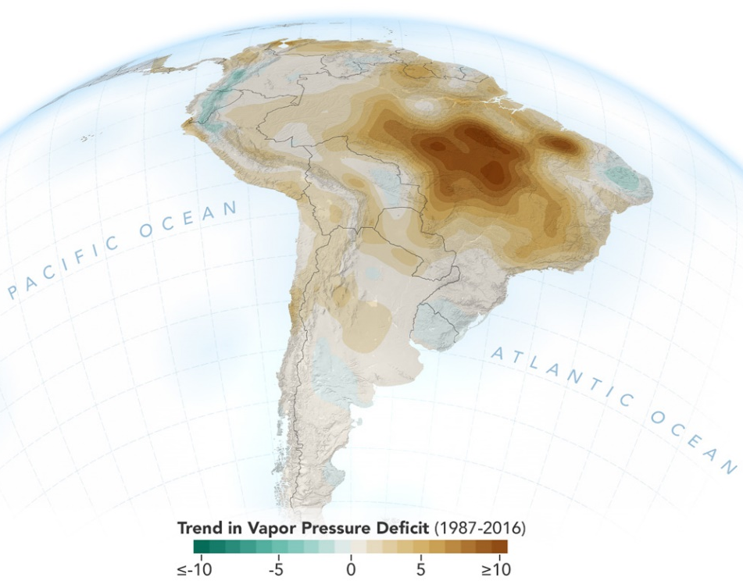
Increase in the Vapor Pressure Deficit: Decrease in evapotranspiration in Amazonia
O déficit da pressão de vapor ou VPD é a diferença entre a quantidade de umidade no ar e quanta umidade o ar pode conter quando está saturado
O aumento da VPD combinado com o decréscimo da fração evaporativa são as primeiras indicações de mecanismos de feedback positivos na Amazônia.
Barkhordarian et al., Nature Scientific Reports, doi : 10.1038/s41598-019-51857-8, 2019

Slide 13
Above Ground Biomass Change (Mg C ha⁻¹)
Durante 2010–2019,a Amazônia brasileira teve uma perda bruta cumulativa de 4,45 Pg C contra um ganho bruto de 3,78 Pg C, resultando em uma perda líquida de biomassa de 0,67 Pg C. A degradação florestal (73%) contribuiu três vezes mais para a perda bruta de biomassa do que o desmatamento (27%), Isso indica que a degradação florestal se tornou a maior processo que leva à perda de carbono.
Yuanwei Qin et al., Nature Climate Change, Maio de 2021

Slide 14
Balanço de carbono na Amazônia: desmatamento e mudança climática
Chuva decrescente
Temperatura aumentando
Amazonia pode já estar se tornando uma fonte importante de carbono
Balanço de carbono para a região de Alta Floresta de 2010 a 2018
Total Carbon Balance: +0.32 PgC y⁻¹
Fire Carbon Balance: +0.20 PgC y⁻¹
NBE (Net Biome Exchange) C Balance: +0.11 PgC y⁻¹
Gatti et al., Nature, 2021

Slide 15
What IPCC say about Amazonia?
Source or sink of carbon?
IPCC AR6 TS pg. 122

Slide 16
Long-term thermal sensitivity of Earth’s tropical forests: Threshold: 32.2 °C.
Long-term change in carbon stocks due to temperature effects alone for
global surface air temperature warming of 2°C
(%)
Spatial variation in tropical forest carbon.
Sullivan et al., Science 368, 869–874 (2020)

Slide 17
Amazonia is key to global Sustainability
Thanks!!!

