Slide 1









MISR Arctic and Antarctic Sea Ice Albedo 2000-2019:
Product Creation and Trend Analysis
Laura Aguilar¹, Jan-Peter Muller², Michel Tsamados³, Thomas Johnson², Said Kharbouche²
Geography Department, University College London, Gower Street, London, WC1E 6BT, UK
Imaging Group, Mullard Space Science Laboratory (MSSL), Department of Space I\& Climate Physics, University College London, Holmbury St. Mary, Dorking, Surrey RH5 6NT, UK
Earth Sciences Department, University College London, Gower Street, London, WC1E 6BT, UK

Slide 2
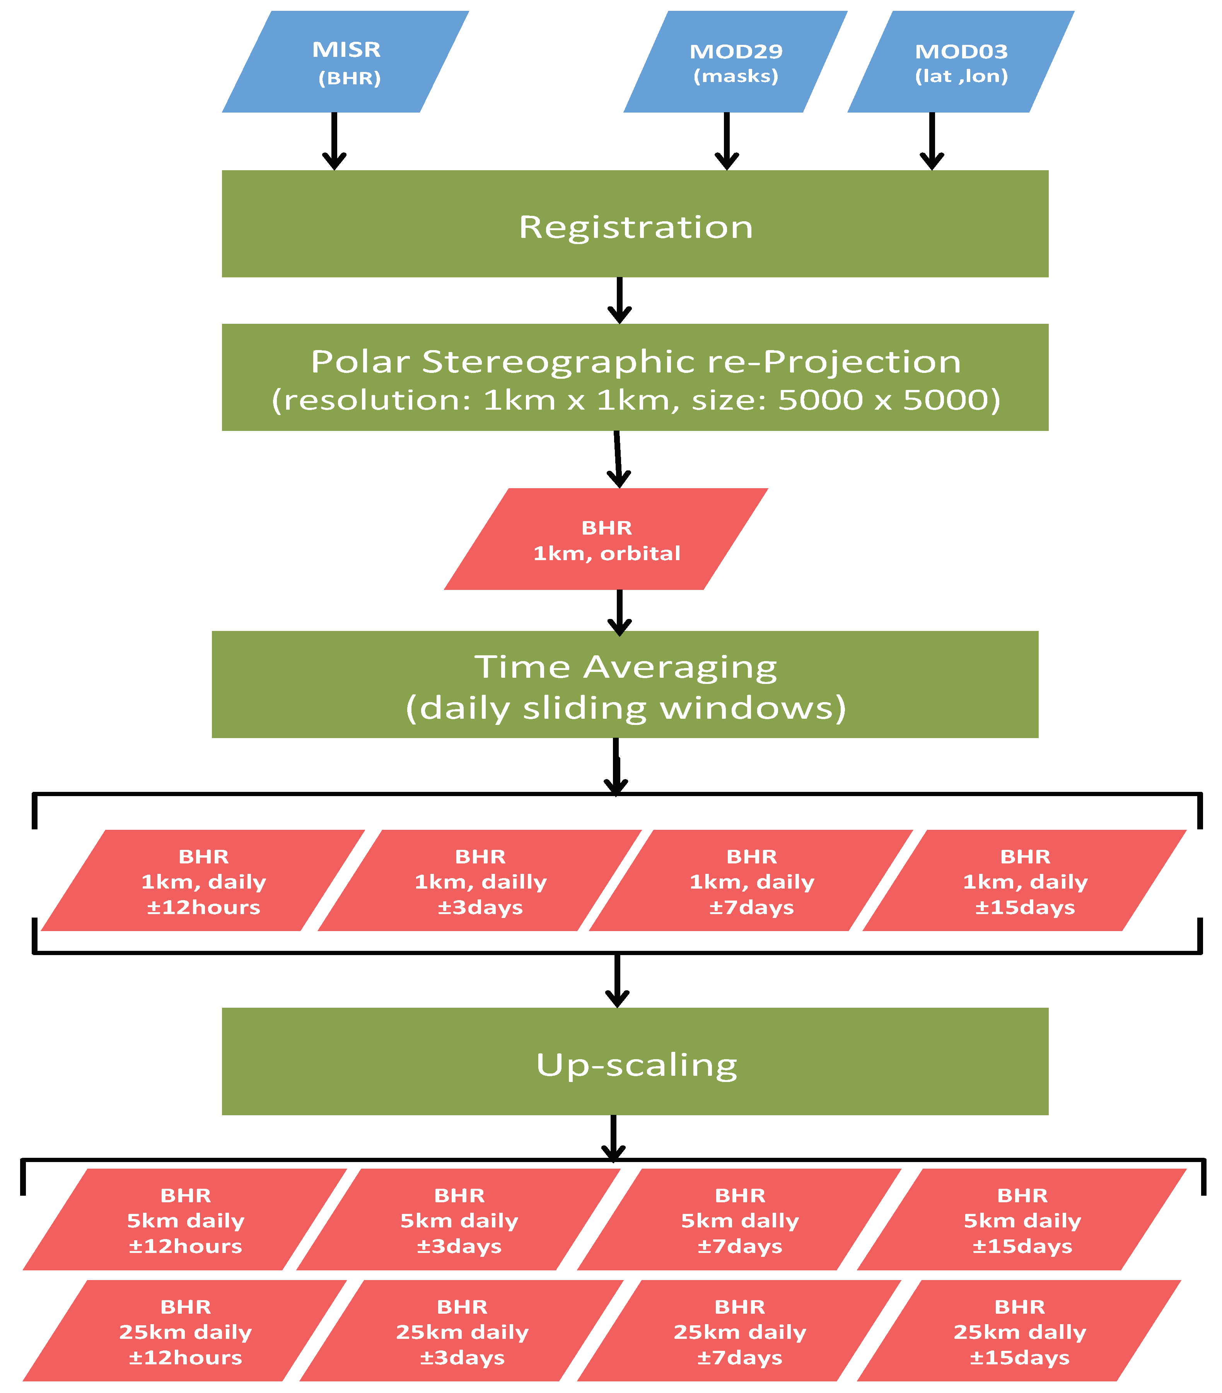
Sea Ice Albedo production Flowchart
Merging of 3 products:
MISR L2AS: red, green, blue, NIR spectral bandwiths (2% absolute radiometric uncertainty) at 1.1km resolution.
MOD29: Surface Temperature and Ice Extent products containing MOD35 Cloud Mask. 1km resolution.
MOD03: geolocation product. 1km resolution.
Final output products:
BHR Orbital swaths.
BHR daily sliding windows for the 4 spectral bands and statistics.
Total of 12 daily Sea Ice BHR products, with different averaging time window (31days, 15days, 7days and 1 day) and spatial resolutions (1km, 5km, 25km).
Blue: input products
Green: process
Red: final output products

Slide 3
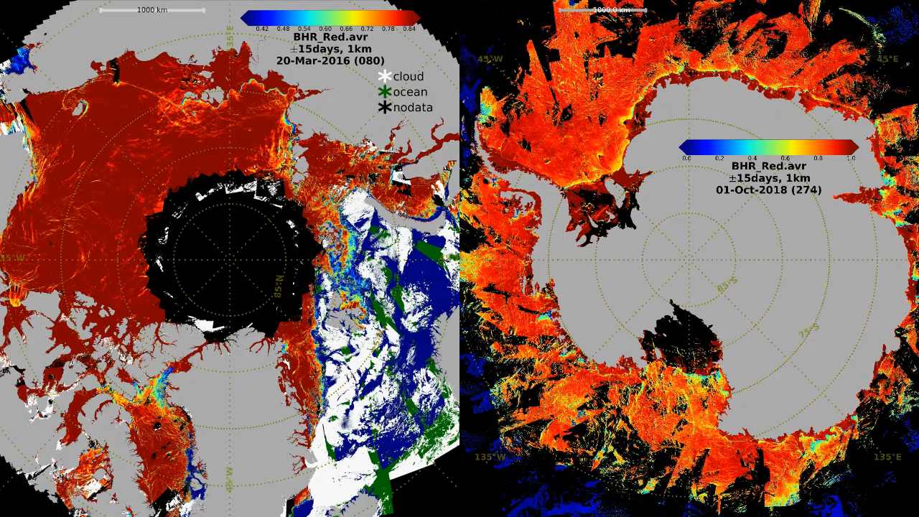
31 days average BHR_{Red} pre-melt season for the Arctic (2016) and Antarctic (2018-2019), at 1km resolution.

Slide 4
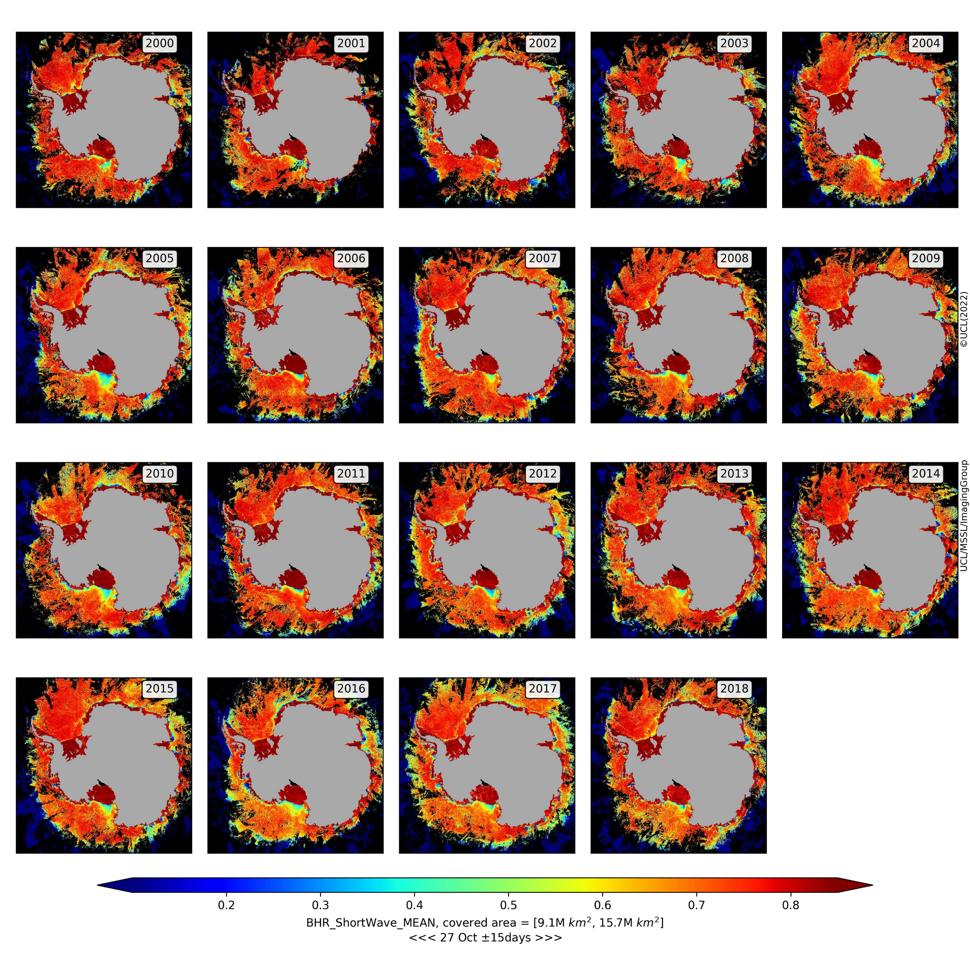
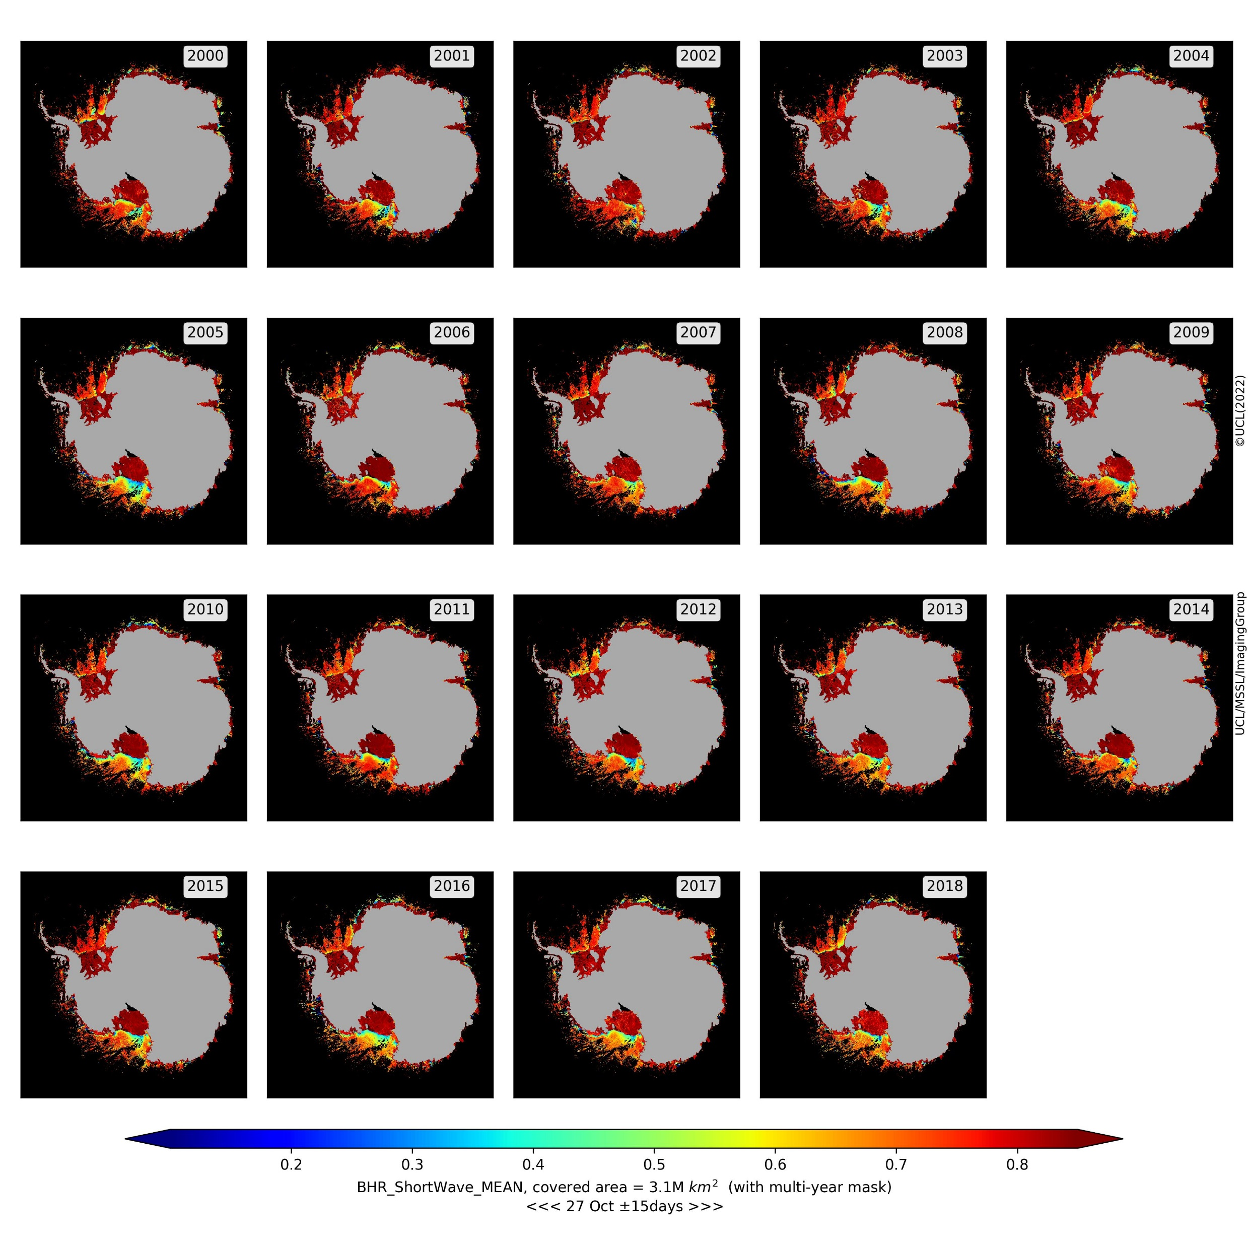
Antarctic 31 days average BHR_{Shortwave} multi-year result for the 27th Oct (2000-2018), pre-melt onset, at 1km resolution.
Unmasked
Masked

Slide 5
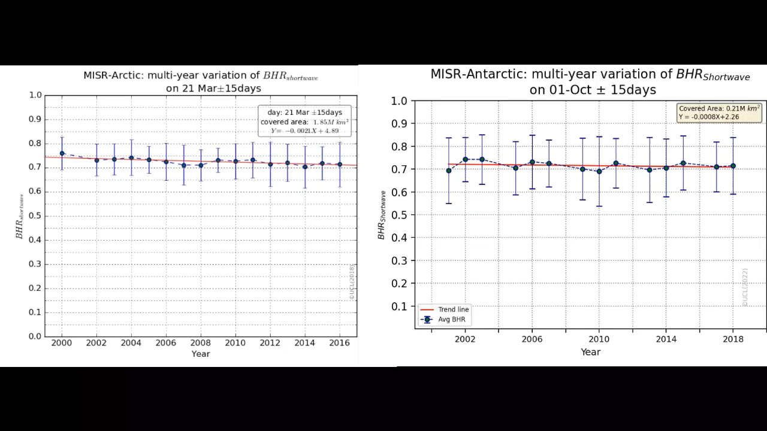
Average BHR_{Shortwave} trendlines for the Arctic (2000-2016) and Antarctic (2000-2019).

Slide 6
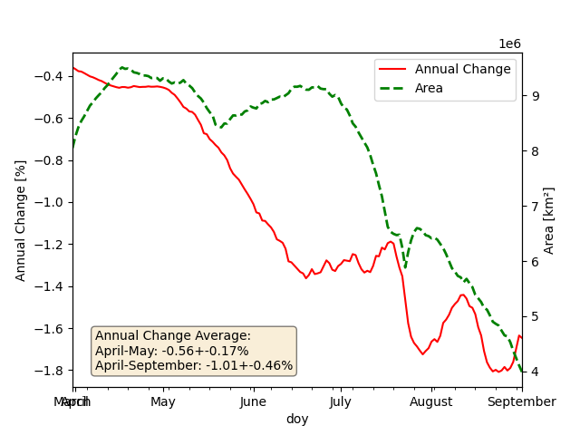
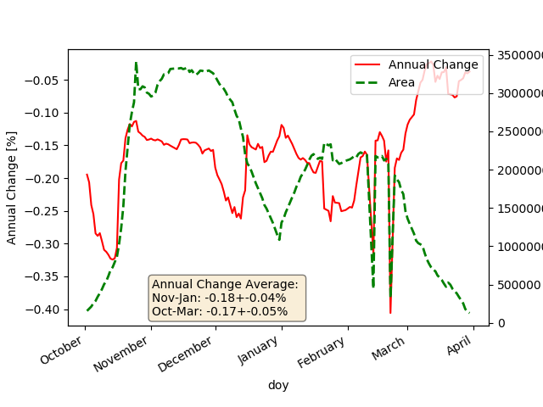
Annual Change of BHR_{Shortwave} for the Arctic and Antarctic before the onset of melt period and for the entire period.
Arctic (2000-2016)
Antarctic (2000-2019)

Slide 7
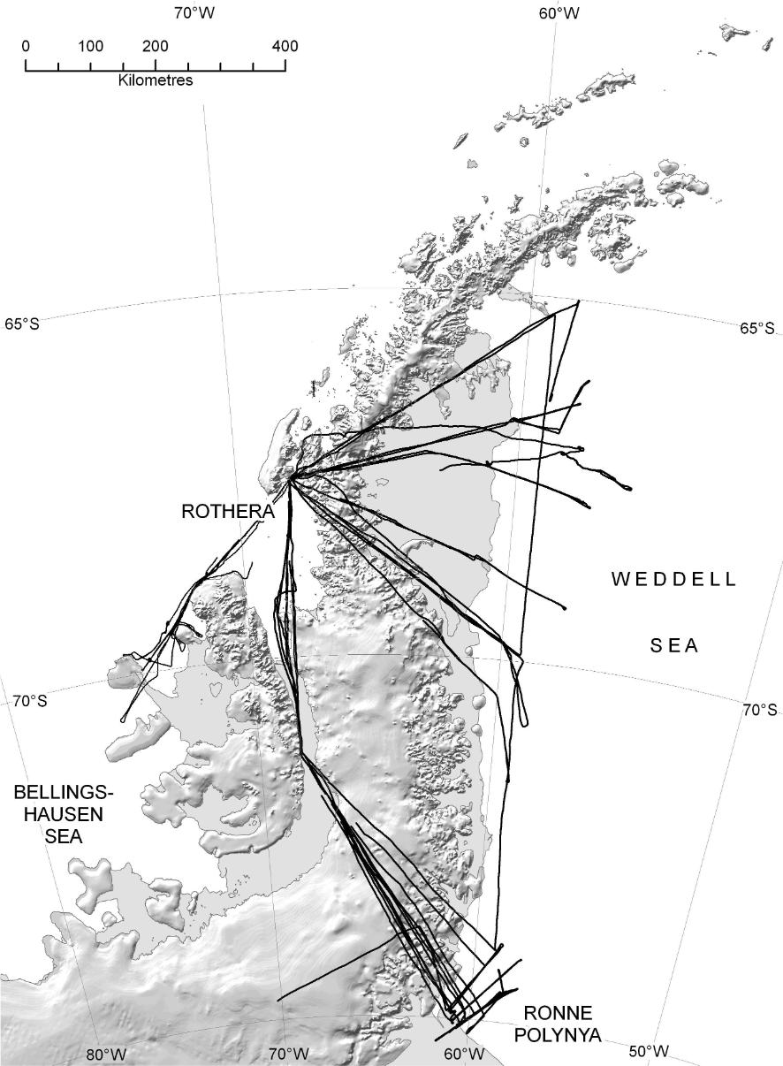
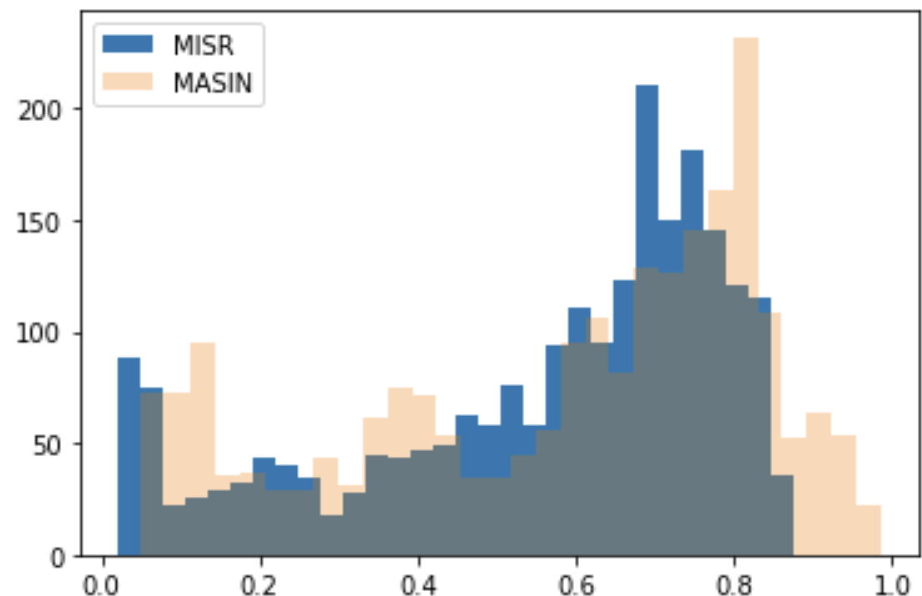
Sea ice Albedo validation using Aircraft measurement intercomparison: Antarctica (SW)
R² = 0.72
2,200 1km matchups over 8 flightlines
Courtesy of BAS: Weiss et al., (2012), The Cryosphere, 6, 471-479, doi:10.5194/tc-6-479-2012
Aguilar, Tsamados, Johnson, Weiss, Muller et al. (in preparation)

Slide 8

Primary Conclusions
Future work
12 New multi-source satellite derived broadband BHR sea ice albedo products.
Arctic (2000-2016) BHR shortwave annual change of -1.01 +- 0.41%.
Antarctic (2000-2019) BHR shortwave of annual change of -0.17+-0.05%.
Antarctic validation so far shows R²=0.71.
High accuracy sea ice albedo product to be used in climate models.
Secondary Conclusions
Accelerated data fusion processing chain.
Averaged BHR shortwave multi-year results.
Multiyear masking may be too restrictive for Antarctic compared to Arctic.
Cloud frequency analysis shows more prominent cloud presence in South pole vs. North pole.
Annual change % for subregions in Antarctic should lead to more conclusive results.
High confidence in annual change calculation methodology -> in line with literature.
Production of Antarctic sub-regional Annual change % and comparison with literature.
Median Filtering to surpass the multiyear pixel restriction over the Antarctic and subsequent underestimation of sea ice albedo.
Validation of Antarctic product to be continued with all available flight lines.
Correlation with sea ice Extent products/results from literature.
Quantisation of MODIS cloud mask product error propagation.
Comparison with CLARA-SAL2 25km resolution product.
The data in netCDF4 (CF) format can be downloaded from: http://www.qa4ecv-land.eu/get-polar-sea-ice.php.
Previous Arctic products can also be found at:
Dataset Record: QA4ECV Polar sea-ice spectral albedo (2000-2016) (ceda.ac.uk)
Contact: laura.aguilar.17@ucl.ac.uk

