Slide 1
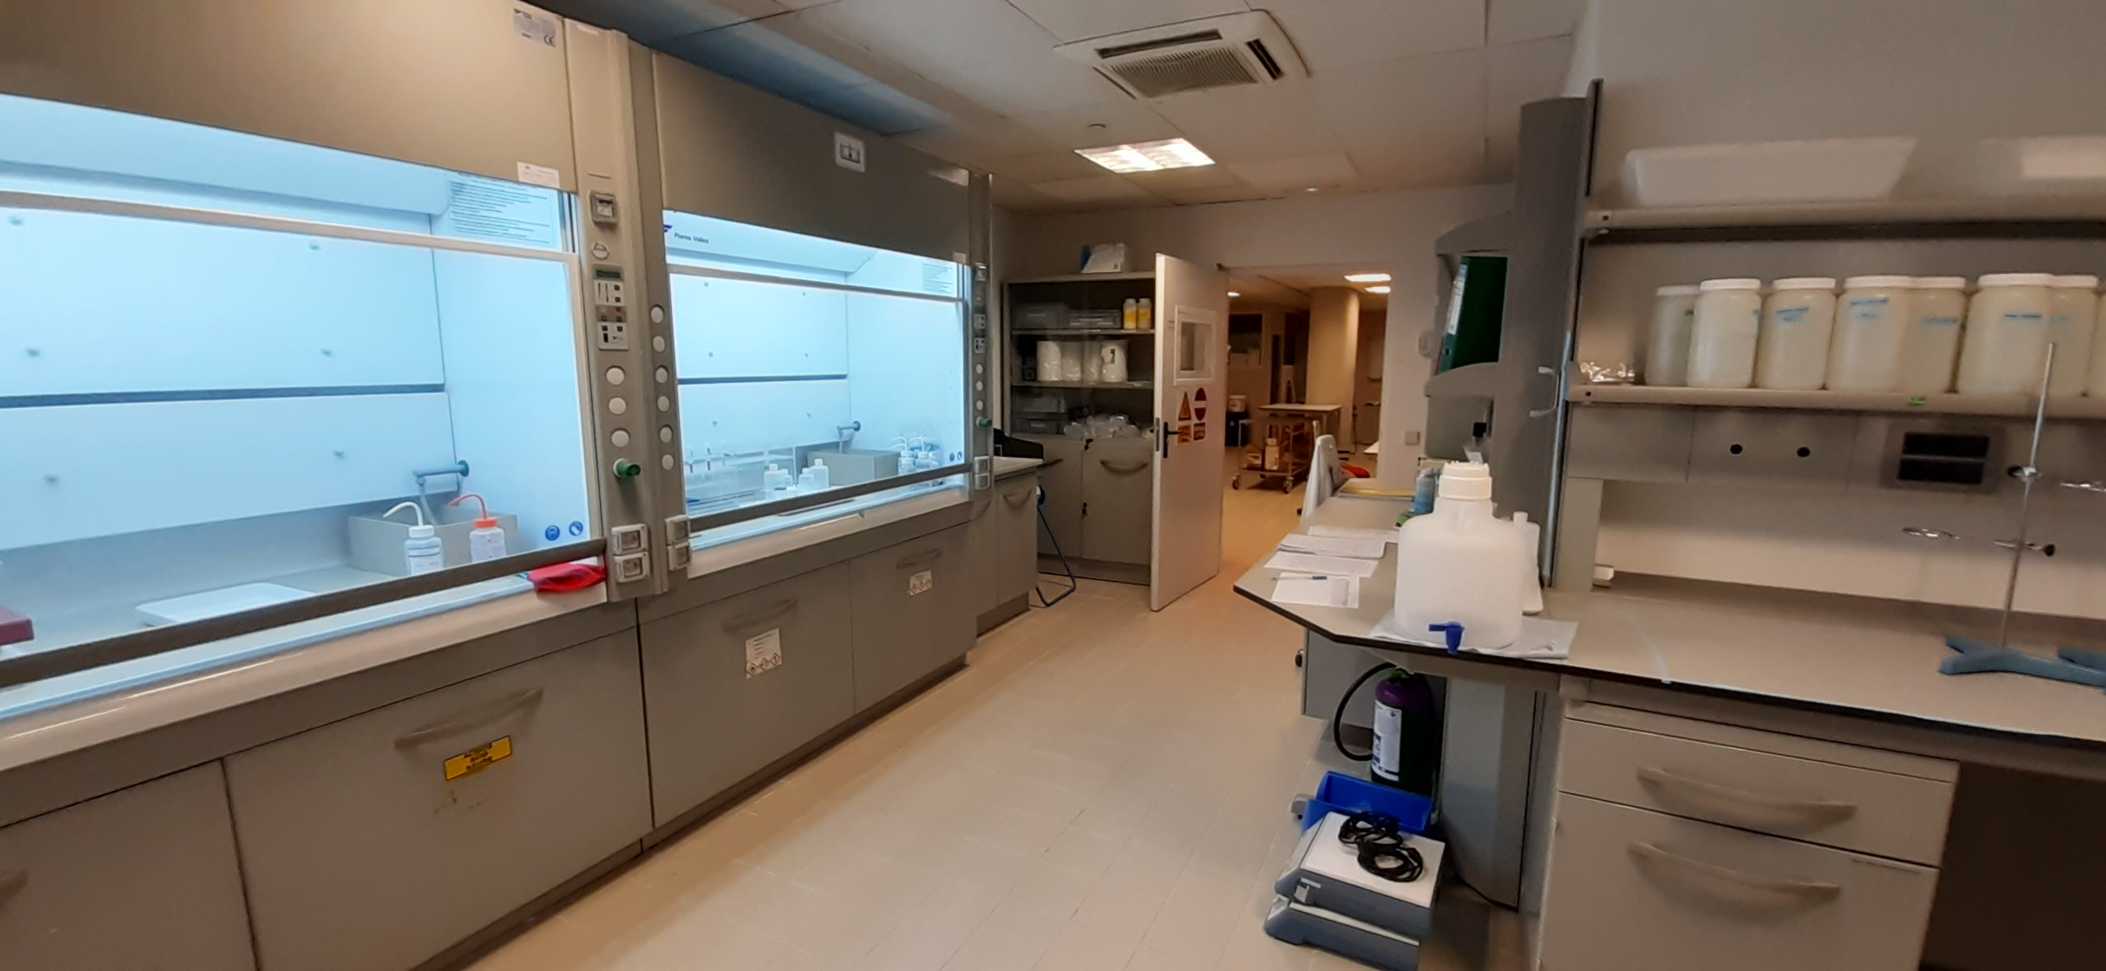
New cosmogenic nuclide dating laboratory in CENIEH, Spain Toshiyuki Fujioka (toshiyuki.Fujioka@cenieh.es), L. Miguens, J. Iglesias, F. Jiménez, M.I. Sarró, J.M. Parés CENIEH, Burgos, Spain
Take home:
First, routine, full chemistry lab for cosmogenic nuclides in Spain
Focus on ²⁶Al/¹⁰Be burial dating and meteoric ¹⁰Be
Competitive access every year
Budget friendly
Consultation on lab development & application, e.g., ¹⁰Be, ²⁶Al, ⁵³Mn, ²¹Ne, ³⁶Cl
GM2.5 What’s new with cosmogenic nuclides? EGU 2022, 26/5/22

Slide 2
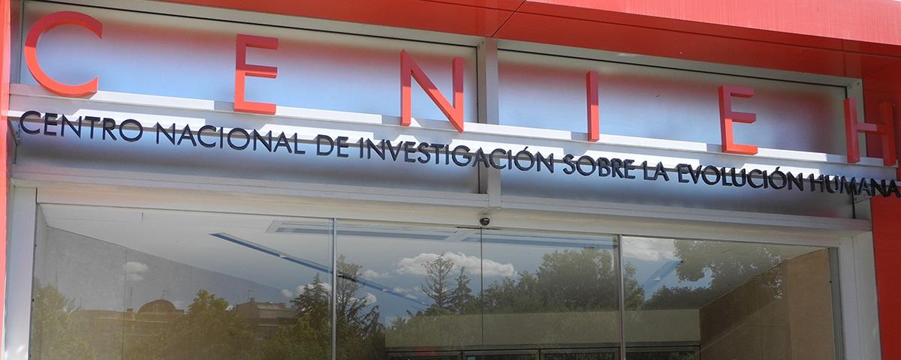
CENIEH = National Research Center on Human Evolution
ARCHAEOLOGY
PALEOBIOLOGY
GEOCHRONOLOGY & GEOLOGY
ESR
OSL
Paleomagnetism
U-series
Cosmogenic nuclides
HUMAN EVOLUTION
EARTH SCIENCES
Landscape
Environment
Paleoclimate
Tectonics
Natural disaster (Geohazard)
…

Slide 3
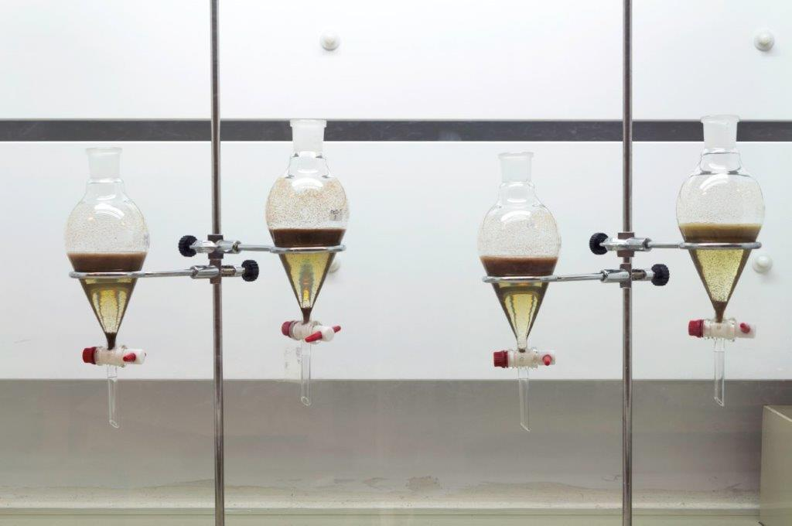
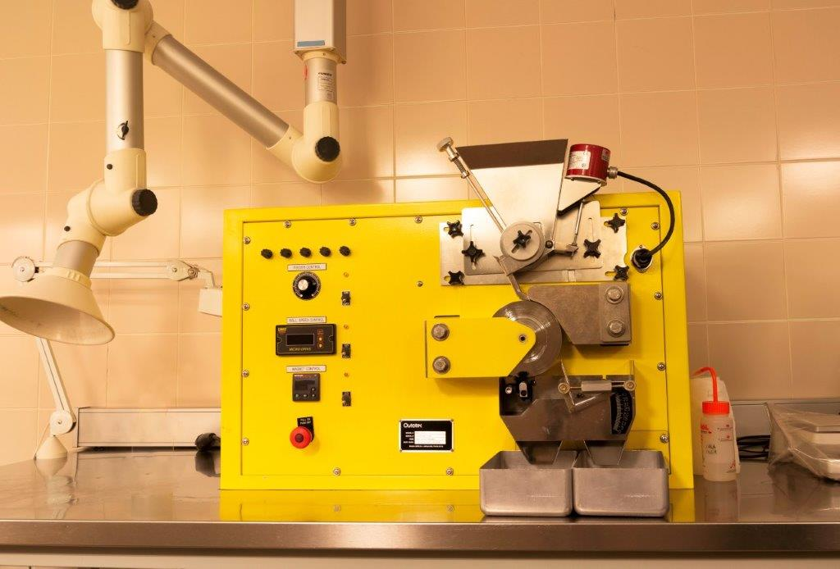
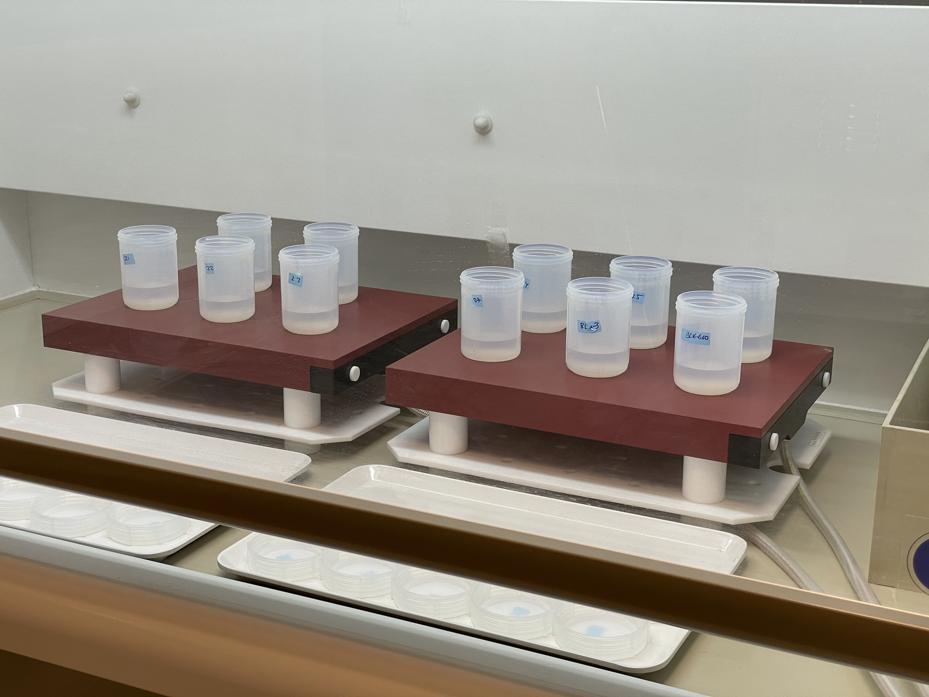
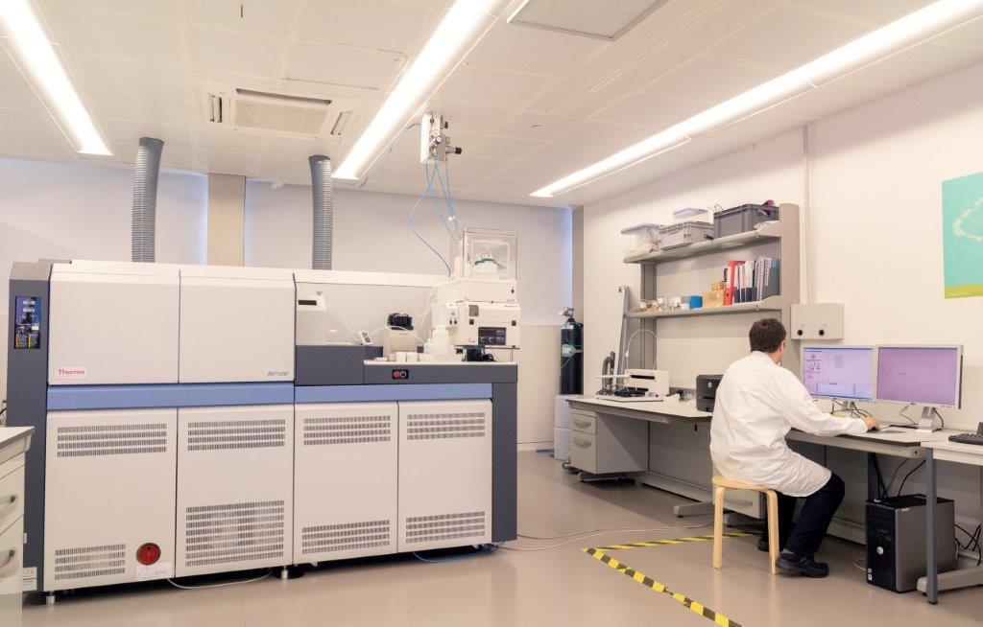
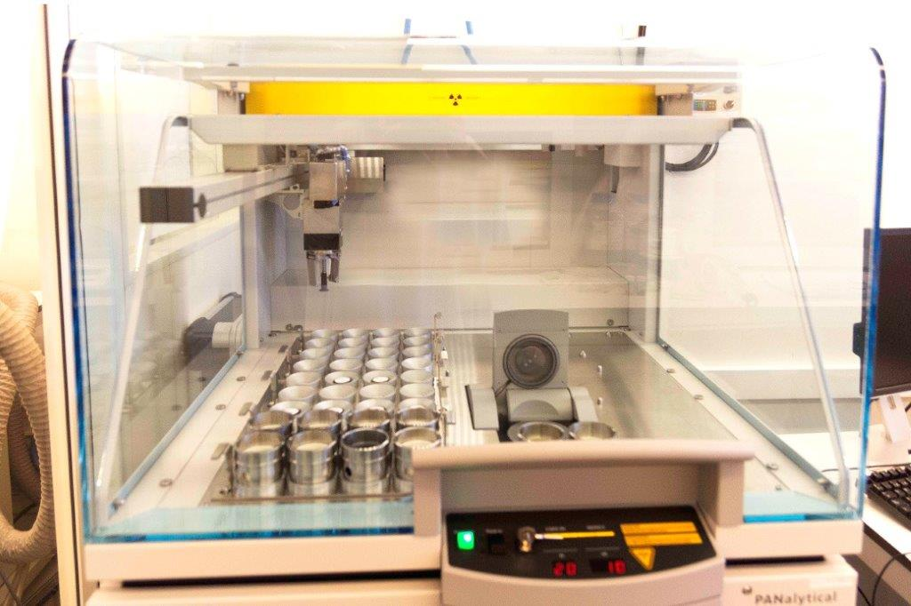
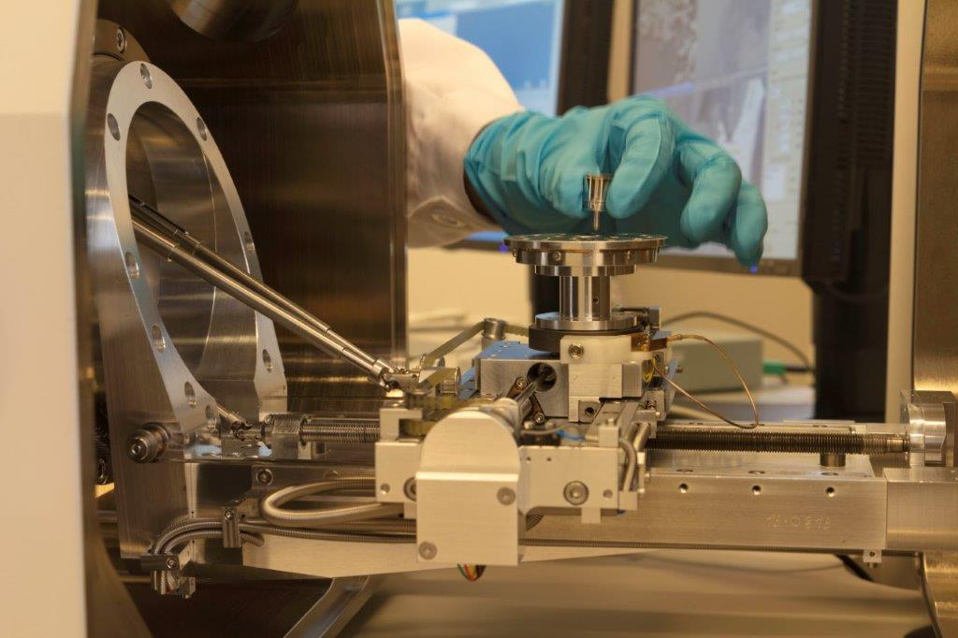
Quartz extraction & Be-Al separation at CENIEH
Quartz extraction from rock, sediment, artefacts
• Crushing & sieving
• Magnetic separation
• Density separation
• Acid leaching (e.g., aqua-regia, H₂SiF₆, HF)
• Magnetite powder
Methods are selected & modified, depending on material types, approaches (exposure, burial, erosion) and age-range, to optimise process time.
Heavy-liquid density separation
Magnetic separator
Be-Al extraction
• Dissolution in HF
• HF fuming (boron elimination)
• Anion & cation exchange chromatography modified from Stone/Ditchburn’s H₂SO₄-HCl method (Fe, Ti elimination & Be-Al separation)
• pH control with suprapur NH₃(aq.)
• Intrinsic Al measured by in-house ICP-OES
Currently, Be- and Al-hydroxides are sent to AMS facilities for calcination & press into AMS holder. This last step is under development in CENIEH.
2 x 180 cm-wide scrubber fume hoods
Savillex vessels & Teflon-coated graphite hotplate
for HF evaporation
Ancillary analysis
Supporting facilities are available in CENIEH, including:
• Laser diffraction grain size analyser
• ICP-MS, -OES
• XRD, XRF, Raman spectroscopy
• SEM
• Thin section
ICP-MS (Neptune & Element) & ICP-OES lab
XRF, XRD, Raman spectrometry lab
SEM, micro CT lab

Slide 4
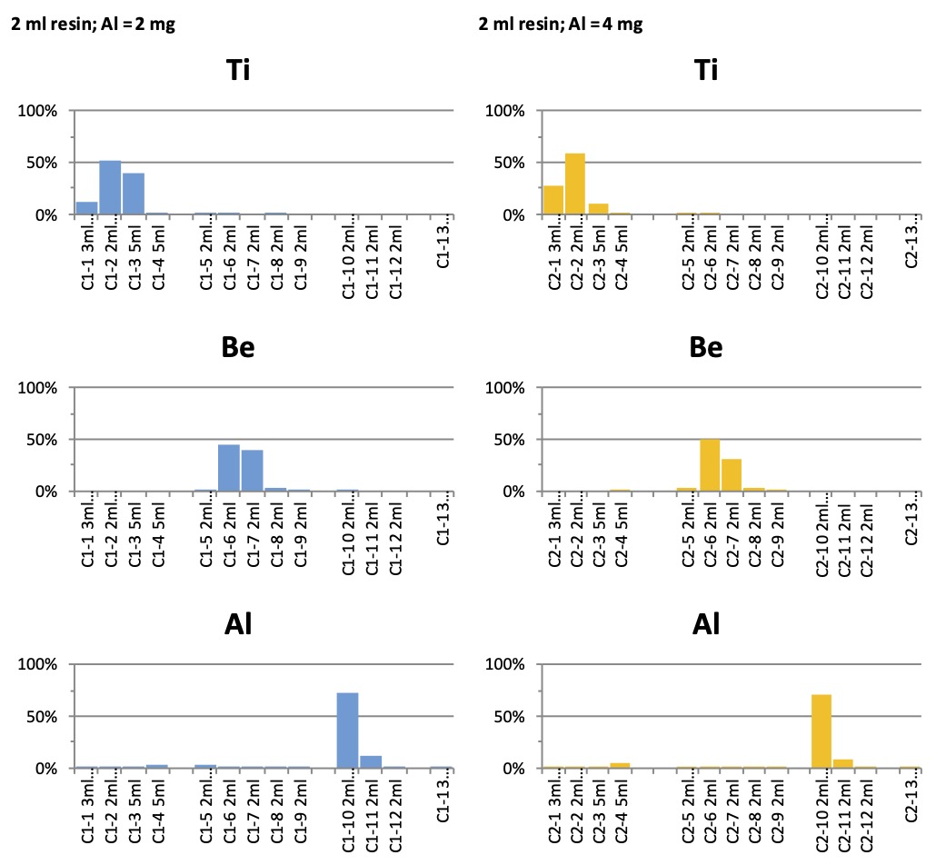
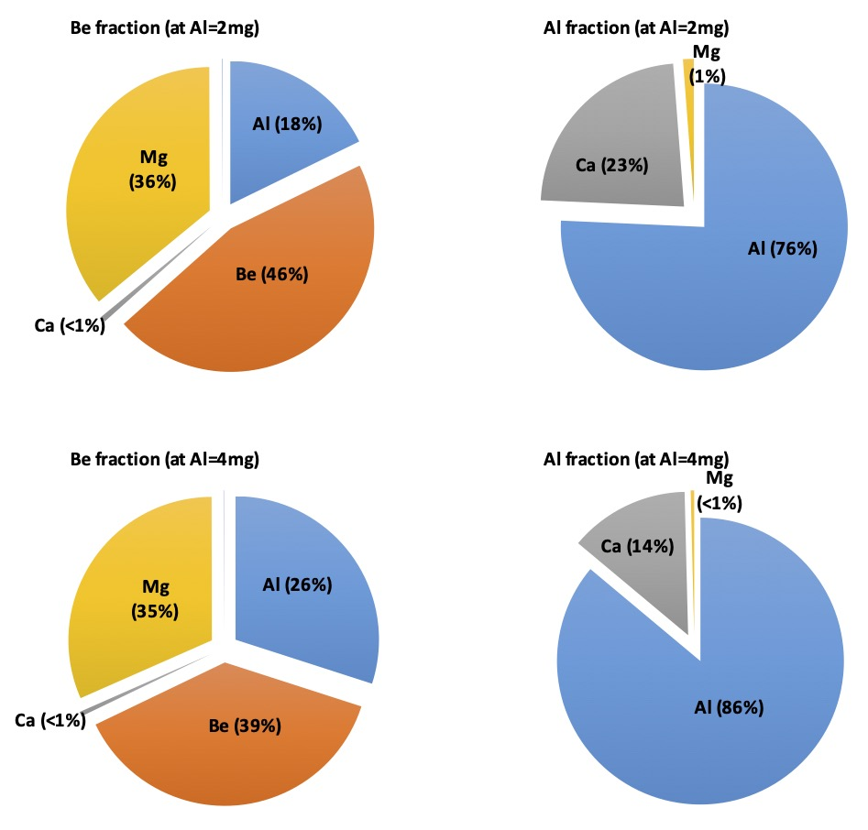
Procedure tests
Be blank tests
Cation exchange test
Final oxide inventory
Direct ppt (solutions were sent to established AMS labs for oxidation)
Cation exchange onward
Direct ppt at CENIEH
Full procedural blanks
Commercial spikes
Mineral
spikes
Standard batch & process time:
• 9 sample + 1 blank per batch
• 20 g quartz (w/ Al <200 ppm) & 300 ug ⁹Be spike
• Quartz extraction time, ~1 week to 2 months
• Be-Al extraction time, < 3 weeks
Performance:
• Final BeO contains Mg (~35%) & Al (~20-25%)
• Final Al₂O₃ contains Ca (15-25%)
• Initial results proved BeO oxide purity, where BeO– ion source output is generally ~40-80% of standard materials in the same AMS run
⁹Be carriers & chemistry procedural background
• Several commercial Be standards & non-commercial mineral spikes (beryl, phenakite) were tested
• Mineral spikes are excellent (¹⁰Be/⁹Be ~4 e-16)
• Some commercial spikes acceptable (~ 5 e-15)
• CENIEH milli-q & suprapur NH₃ do not raise background
• Procedural blanks are also good (¹⁰Be/⁹Be ~2-4 e-15) with likely ¹⁰Be source prior to cation column (i.e., quartz dissolution, HF fuming and/or anion column)
Column chemistry (adopted from J. Stone (2001), Ditchburn & Whitehead (1994))
Anion exchange (using Biorad 1-x8 200-400# resin):
• >99% Fe is isolated from Be and Al
Cation exchange (using Biorad 50W-x8 200-400# resin):
• >99% Ti is isolated from Be and Al
• Beryllium & aluminium yields are ~90-95%
• ~5% Al is leaked into Be fraction?

Slide 5
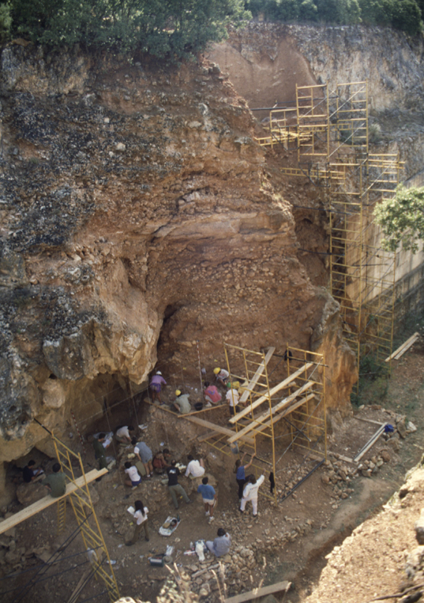
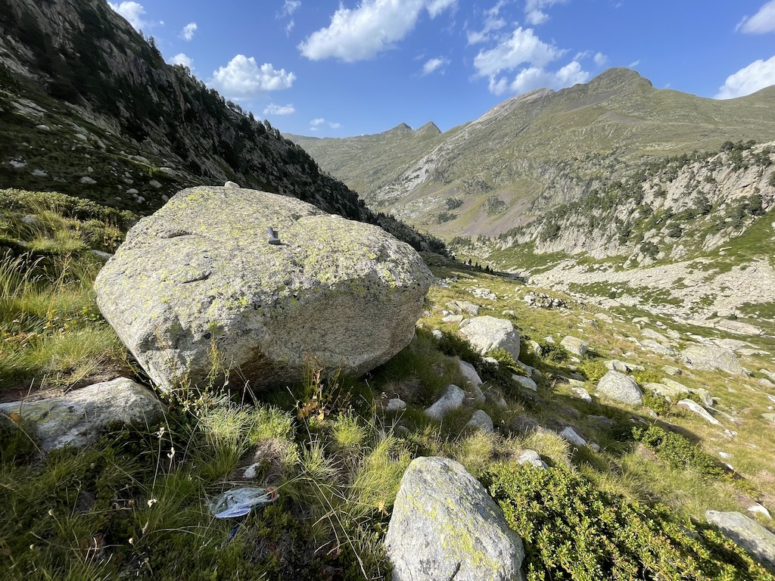
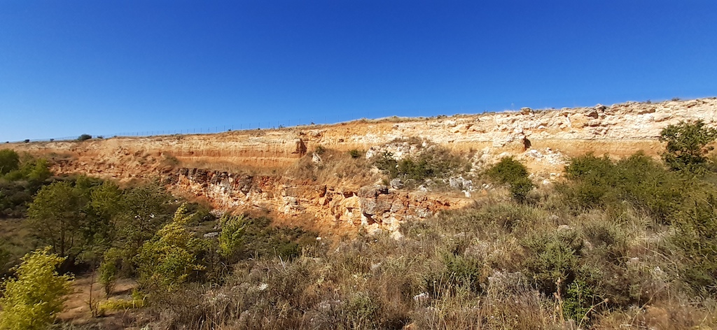
Gran Dolina, Atapuerca
ATAPUERCA [collaboration w/ CENIEH, IPHES Tarragona, Uni Complutense de Madrid]
• Multi-level cave complex
• 1.2 m.y. human evolution (including oldest Euro human fossil & H. antecessor)
• Approach with cosmogenic (simple & isochron) burial dating
• Combined with other dating methods, e.g., OSL, ESR, p-mag
• Correlation with fluvial terraces
Paleoclimate history in Pyrenees [collaboration w/ IPE Zaragoza]
• Glacial history in central Pyrenees since 60 ka through Holocene & Little Ice Age
• Approach with cosmogenic exposure dating
• Combined with ¹⁴C, OSL in glacial lake deposits
• Implication to paleoclimate conditions in the context of Atlantic & Mediterranean influence
PROJECTS
Glacial boulder, Aneto, central Pyrenees
Late Miocene terrace, upper Duero River
Archaeological/Paleoanthropology
• Oldowan-Acheulean transition, long-term human evolution (H. habilis & H. erectus) & paleoclimate reconstruction in East Africa (e.g., Olduvai Gorge, Lake Tanganyika) [collab. w/ CENIEH, Spanish Research Council Madrid, ICDP]
• Pan-Mediterranean human migration & settlement (e.g., Armenia, Israel, Argeria, Morocco) [collab. w/ CENIEH, IPHES Tarragona, Nat. Acad. Sci. Armenia, Uni Haifa Israel]
• Arrival & distribution of Acheulean culture in Iberian Peninsula in mid Pleistocene [collab. w/ CENIEH]
Landscape evolution in northern Iberian Peninsula [collaboration w/ CENIEH, National Museum Madrid]
• Duero & Ebro basin, endorheic-exorheic transition, incision & fluvial terraces during Plio-Pleistocene
• Approach with cosmogenic (simple & isochron) burial dating
• Combined with other dating methods, e.g., OSL, ESR, p-mag

Slide 6
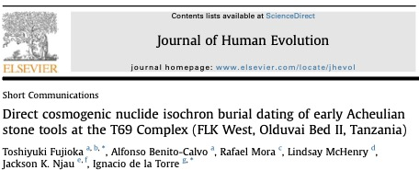
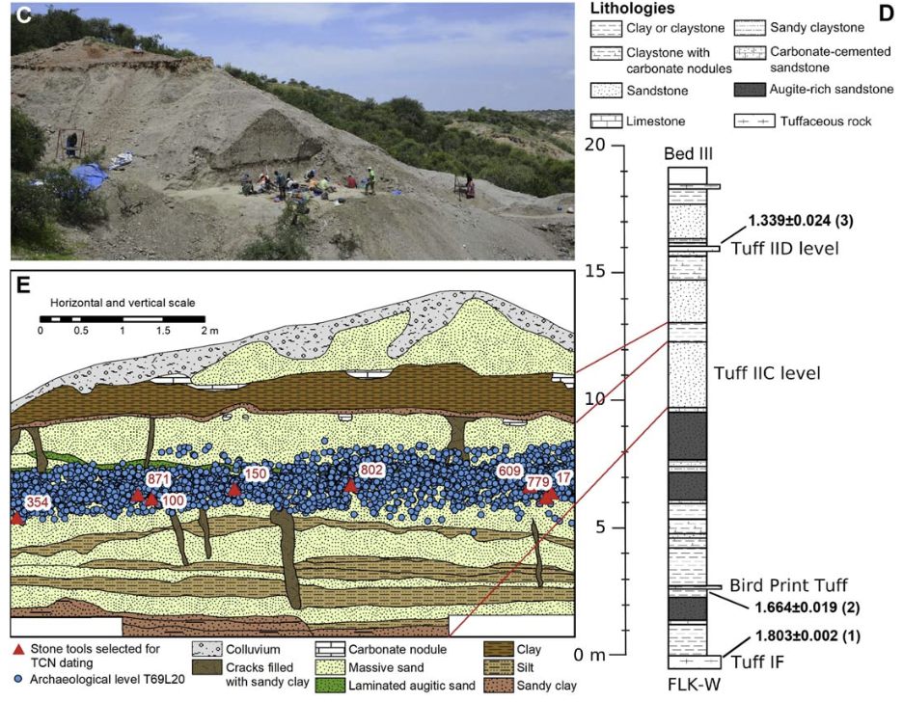
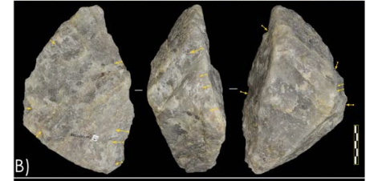
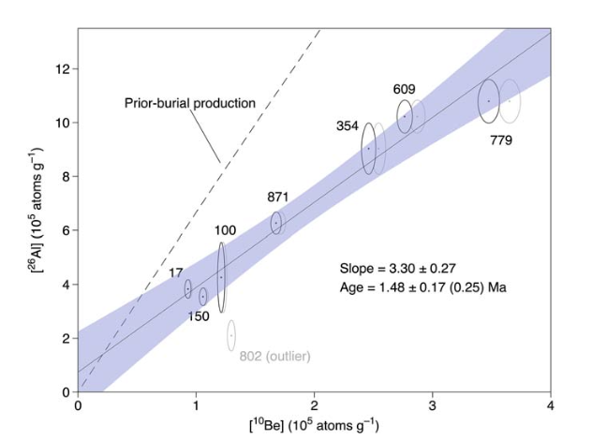
1.48 ± 0.25 Ma
Advantage:
- Overcome uncertainties of ‘simple’ cosmogenic burial dating
- Direct dating = Improved reliability (cf. ESR on teeth)
Disadvantage:
- Destructive
- Labor intensive

Slide 7
Contact: Email: (toshiyuki.Fujioka@cenieh.es) Twitter: @ToshiFujioka Instagram: toshifujioka_cosmogenic Facebook: Toshiyuki Fujioka
Take home:
First, routine, full chemistry lab for cosmogenic nuclides in Spain
Focus on ²⁶Al/¹⁰Be burial dating and meteoric ¹⁰Be
Competitive access every year
Budget friendly
Consultation on lab development & application, e.g., ¹⁰Be, ²⁶Al, ⁵³Mn, ²¹Ne, ³⁶Cl
Acknowledgement:
• CEREGE: Régis Braucher, ASTER Team
• DREAMS: Anton Wallner, Silke Merchel, Konstanze Stuebner, Georg Rugel, Johannes Lachner
• SUERC: Derek Fabel, Ángel Rodés
• CologneAMS: Steven Binnie
• CNA Sevilla: Jóse María López Gutiérrez, Elena Chamizo

