Slide 1






Session NH9.6: Drought risk, vulnerability and impact assessment: achievements and future direction, 24 May 2022
Understanding impacts of drought on landscape
and the environment in the Horn of Africa
Natalia Limones, University of Seville, Spain. natalialr@us.es
Marthe Wens, Institute for Environmental Studies, Vrije Universiteit Amsterdam, NL. marthe.wens@vu.nl
Rhoda Odongo, Institute for Environmental Studies, Vrije Universiteit Amsterdam, NL. rhodaachieng.odongo@vu.nl
Anne Van Loon, Institute for Environmental Studies, Vrije Universiteit Amsterdam, NL. anne.van.loon@vu.nl
Hans De Moel, Institute for Environmental Studies, Vrije Universiteit Amsterdam, NL. hans.de.moel@vu.nl

Slide 2
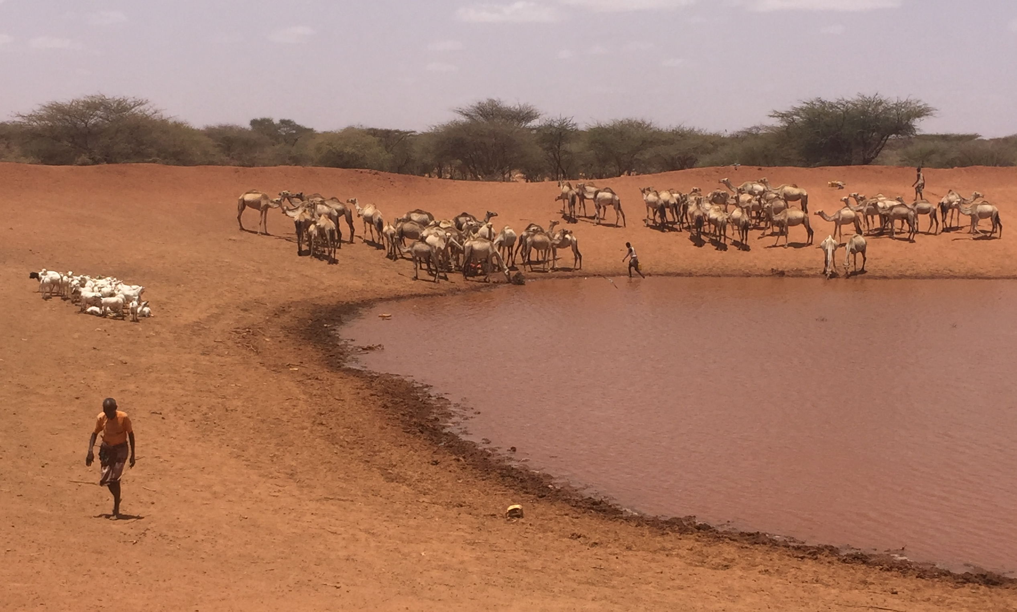
Understanding impacts of drought on landscape
and the environment in the Horn of Africa
Understanding impacts of drought on landscape
and the environment in the Horn of Africa
RATIONALE
Droughts cause major impacts on the Horn of Africa Drylands, but the factors that determine the magnitude of these impacts are not well understood.
Environmental and landscape impacts→ overlooked because they are not immediate, or their direct or indirect linkage to drought is not apparent.
However, drought-induced natural resource depletion and landscape degradation can lead to future socioeconomic problems
OBJECTIVES
Study environmental drought impacts and its drivers in Ethiopia, Kenya and Somalia.
Link anomalies in environmental variables (RS) to anomalies in hydrometeorological variables.
Test machine learning approaches to estimate the chance of experiencing environmental and landscape impacts, specifically: degradation or loss of vegetation cover, significant land-use changes, increased number and severity of fires, poor air quality events related to dust concentration and anomalies in surface water presence in surface water bodies.

Slide 3
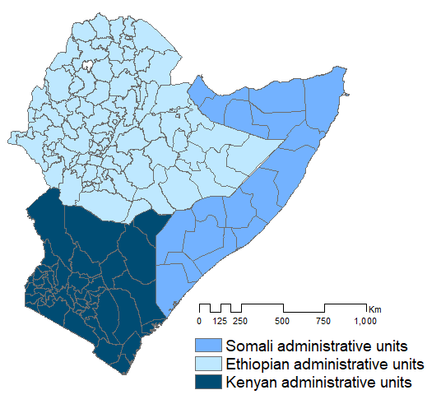
Understanding impacts of drought on landscape
and the environment in the Horn of Africa
STUDY AREA
All the information on drought indices and drought impacts is aggregated at the level of each of the 157 administrative units in Somali (admin. level 2), Ethiopian (admin. level 3), and Kenyan territory (admin. level 2)

Slide 4
Understanding impacts of drought on landscape
and the environment in the Horn of Africa
IMPACT DATA: Remote Sensing open-source datasets
NDVI & EVI→NDVI & EVI changes and anomalies: MOD13A1.006 Terra Vegetation Indices 16-Day, Global, 500m. 2000-2021, Monthly timestep
Net Primary Production→ WAPOR Dekadal Net Primary Production (NPP), Africa, 250m. 2009-2021. Dekadal timestep
Damage to plants.
Anomalies in…
Land use cover→Copernicus Global Land Cover Layers: CGLS-LC100. Bands for measuring changes & impacts in different covers: Tree-cover fraction, bare-cover fraction, crops-cover fraction and shrub-cover fraction. Global, 100m, 2015-2019, Yearly timestep
Increased number and severity of fires→MCD64A1.006 MODIS Burned Area, Global, 500m. 2000-2021, Monthly timestep
Anomalies in air quality (e.g. excessive dust)→Sentinel-5P NRTI AER AI: Near Real-Time UV Aerosol Index, Global, Around 1km, 2018-07-to 2021-11, Daily timestep
Anomalies in surface water presence → GSWE JRC Monthly Water History, v1.3, Global, 30m, 1984-2021, Monthly timestep

Slide 5


METHODOLOGY
SDHI:
SPI 1,3,6,12,24,48
SPEI1,3,6,12,24,48
SSMI1,3,6,12,24,48
SDIS1,3,6,12,24,48
Standardized Drought Hazard Indices (SDHI) construction and post-treatment (bio physical drivers)
Correlation SDHI & remotely sensed impact series, aggregated per admin unit, deseasonalized. Exploration with lag times/delays.
Impact events series generation from RS observed drought disaster data, as FFT solves binary decision tasks → convert the data in times series of presence /absence of impact→ thresholds -0.5 and -1 σ
FFTs (Phillips et al., 2017) and FFFs creation with maximized specificity to predict if a certain threshold of impact (predictand) is exceeded or not→ Define the hydro-meteo conditions (SDHI, predictors) under which a concrete impact (threshold) can be expected → simple yet efficient algorithm, low risk of overfitting, easy to interpret. Exploration with lag times/delays.

Slide 6
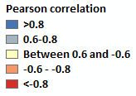
Understanding impacts of drought on landscape
and the environment in the Horn of Africa
Significant correlations and spatial patterns found between SDHI drought indices (predictors) and landscape and environmental variables
Pearson correlation Mean SPEI 1 in the year and Crop fraction in the pixels
Pearson correlation SSMI Index 1 and EVI
Pearson correlation SPI 24 and Dust presence

Slide 7
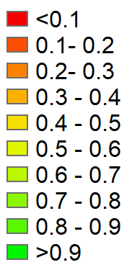
Sensitivity of the best performing
FFT is limited in some of the admin. units,
and for some impacts
Sens. of the best tree for detecting NPP anomalies <-0.5 σ
Sens. of the best tree for detecting anomalies in the burned area >0.5 σ
Sens. of the best tree for detecting anomalies in the presence of aerosols >0.5 σ
Sens. of the best tree for detecting NPP anomalies <-1 σ
Sens. of the best tree for detecting anomalies in the burned area >1 σ
Sens. of the best tree for detecting anomalies in the presence of aerosols >1 σ

Slide 8
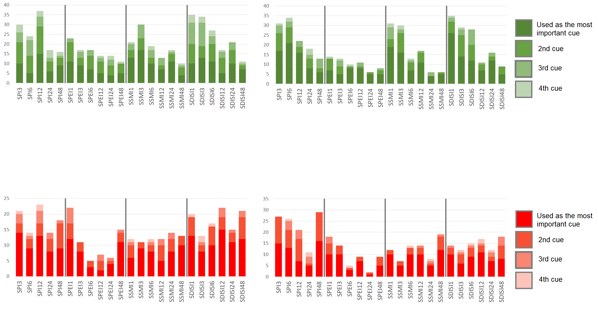
The variables (cues) used in the most accurate
FFT trees reveal the importance of each SDHI
Cues for detecting NPP anomalies <-0.5 σ
Cues for detecting NPP anomalies <-1 σ
Similar use of the cues for the two thresholds, with nuances
Shorter timescales of drought are the most used
Less use of the SPEI drought indices in the prediction FFT, importance of discharge indices
Cues for detecting anomalies in the burned area > 0.5 σ
Cues for detecting anomalies in the burned area > 1 σ
Distinct use of the cues for the two thresholds, more importance of SPI for severe anomalies
Balanced importance of different timescales of drought, long-term droughts are important
Less use of the SPEI drought indices in the prediction FFT, for mild anomalies the rest of varieties are used

Slide 9
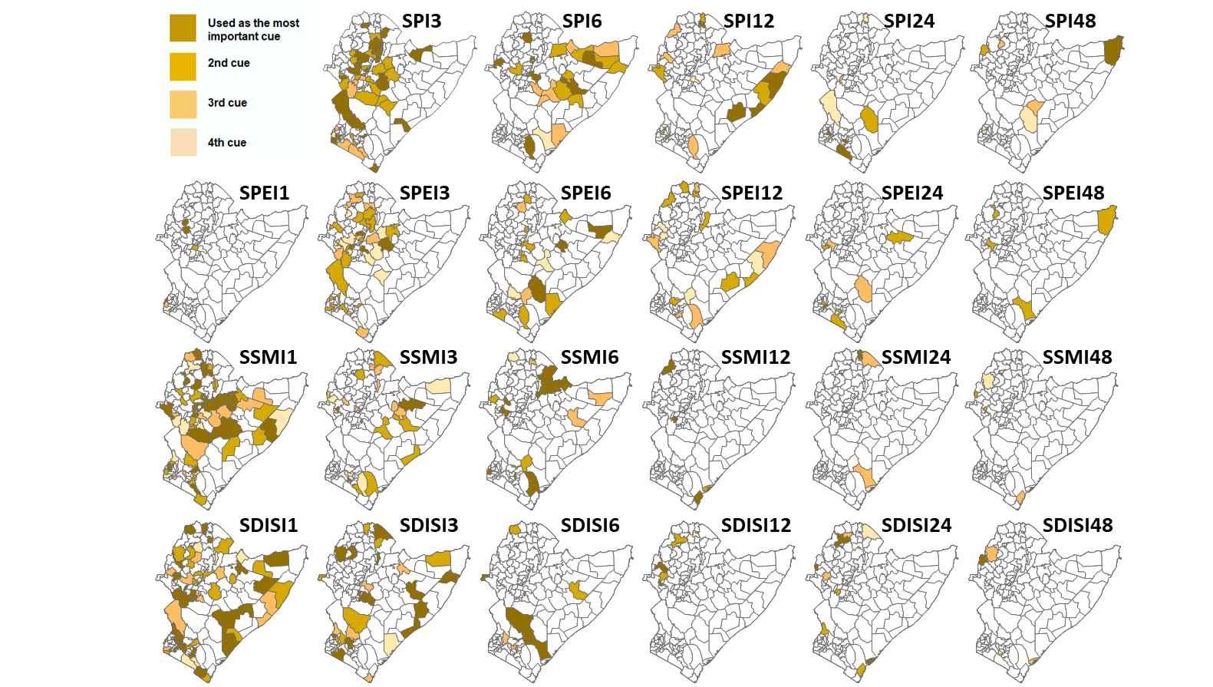
For each impact type, there are recognizable spatial patterns in the use of SDHI in the FFT
Variables (cues) intervening in the most accurate tree of each administrative
unit detecting NDVI anomalies <-1σ, and their position in the tree

Slide 10
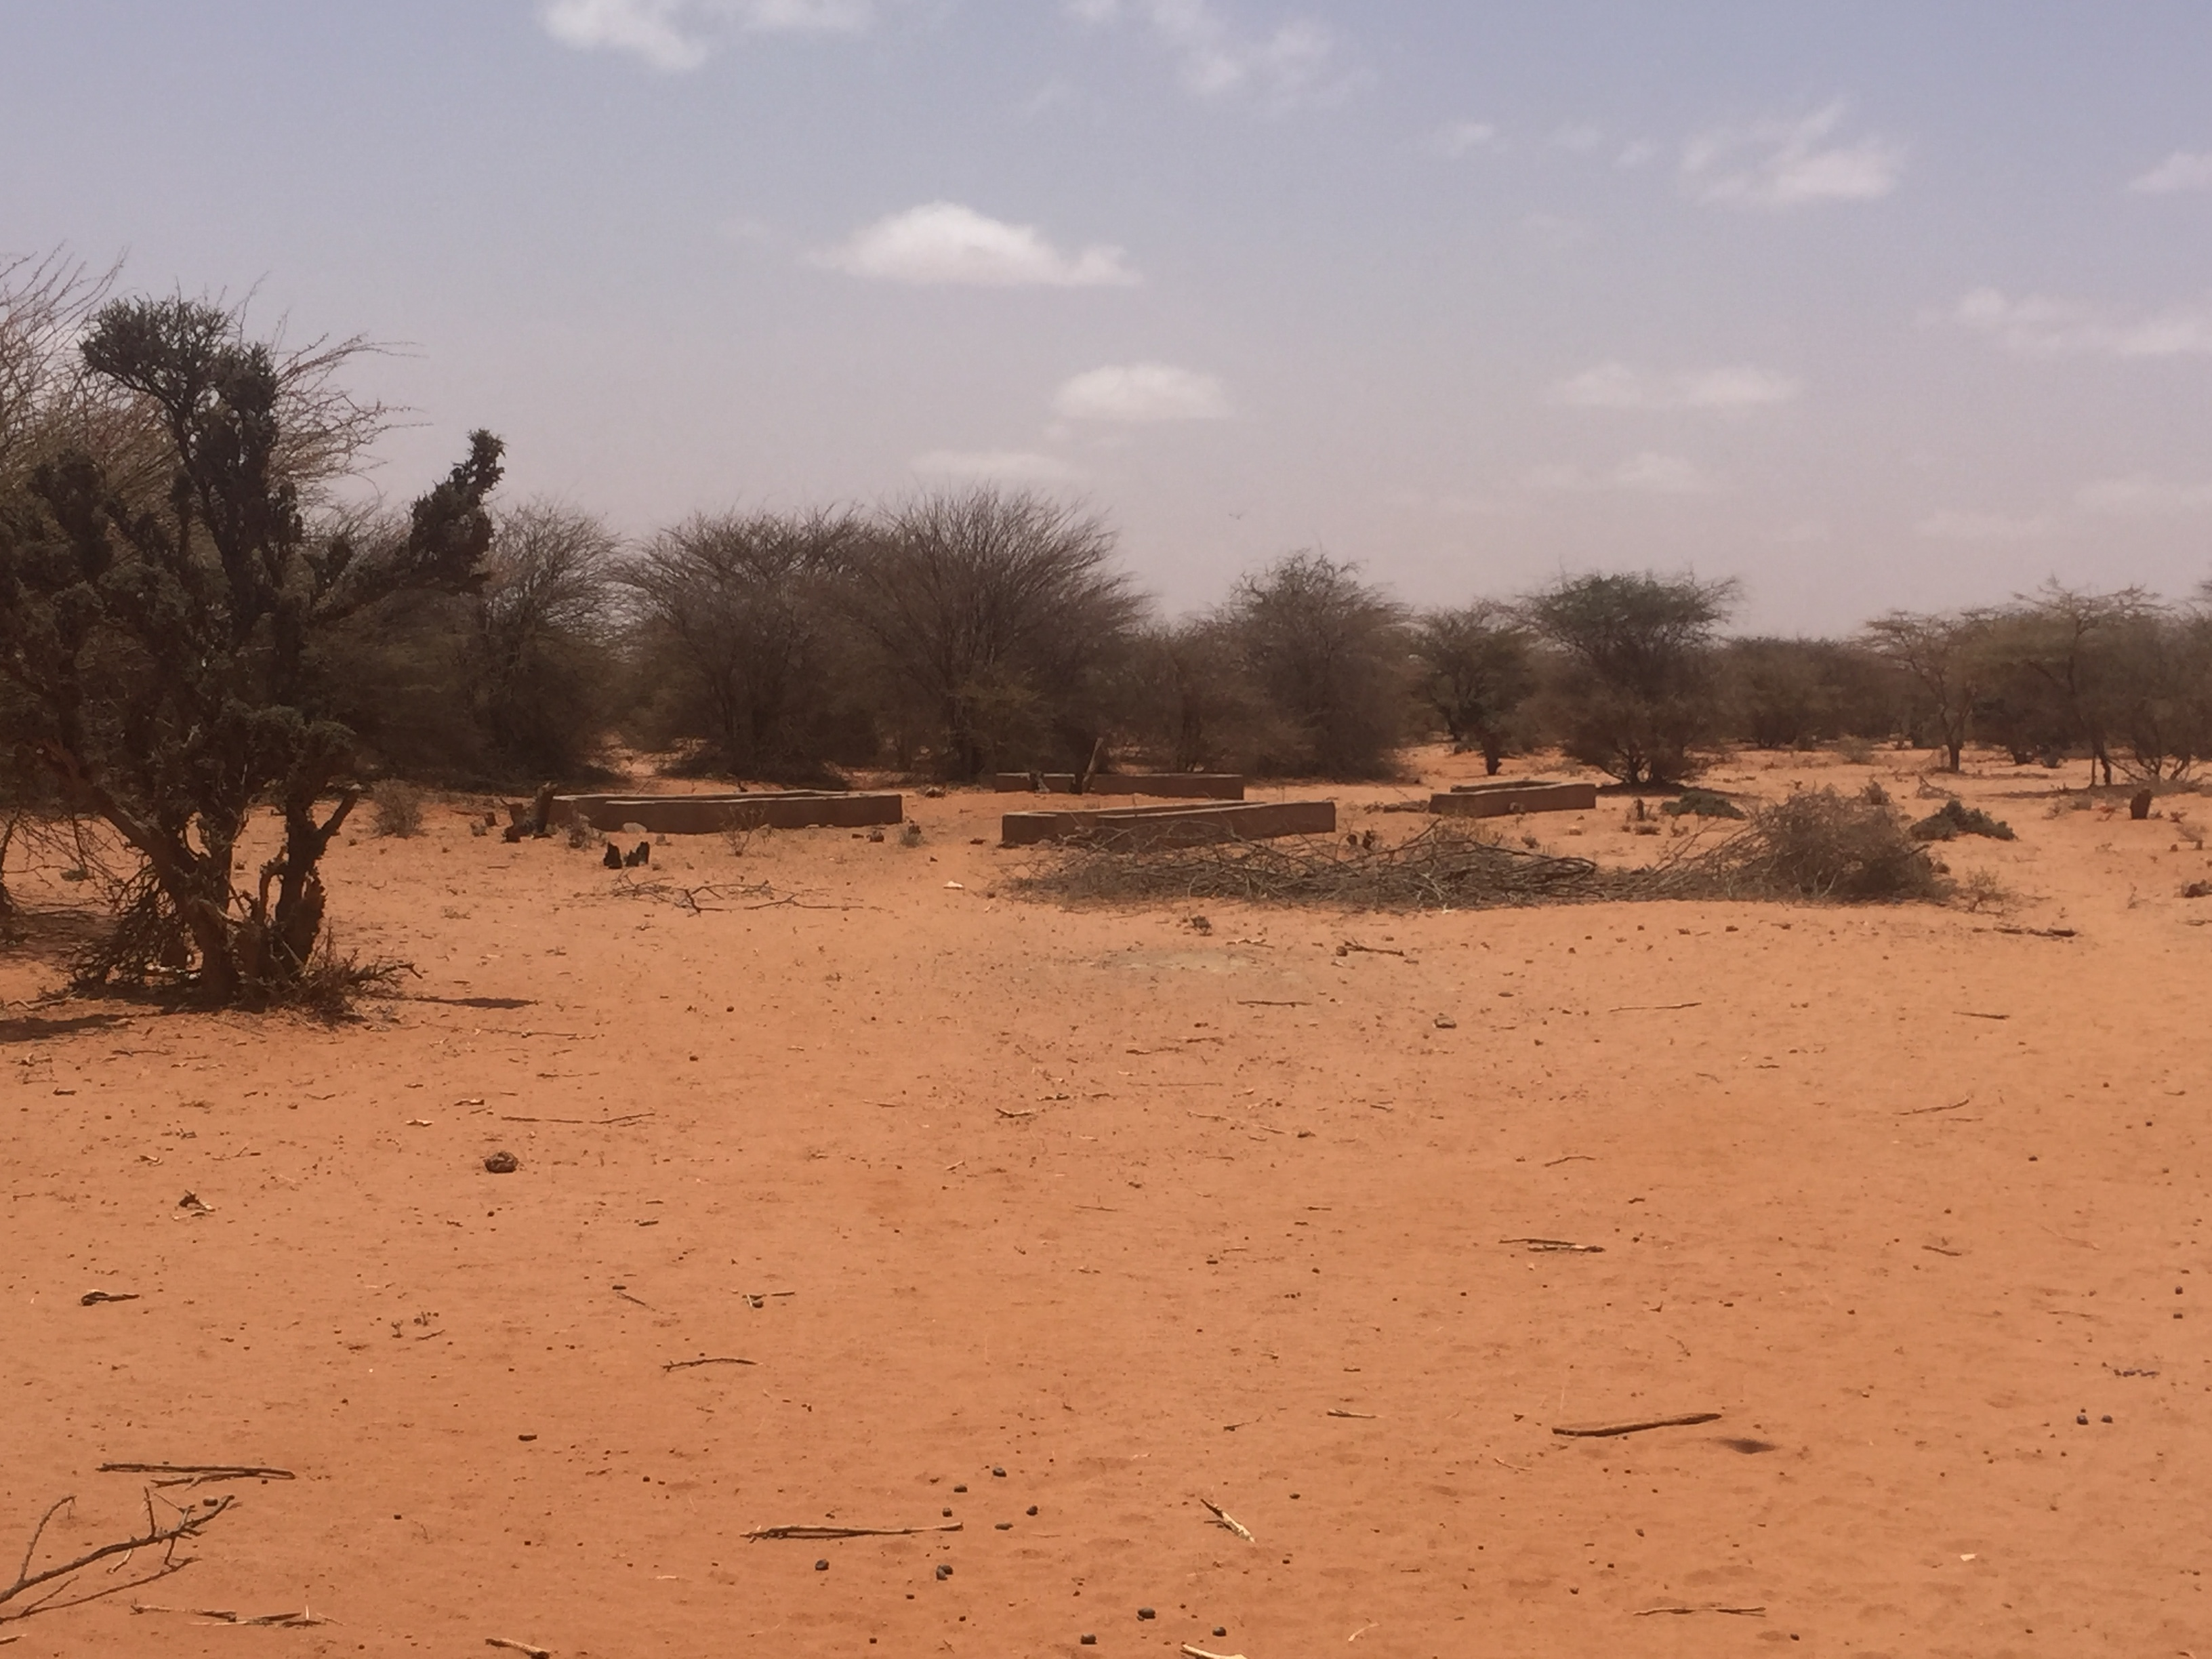
Understanding impacts of drought on landscape
and the environment in the Horn of Africa
NEXT STEPS & FUTURE WORK
1. Creation of FFF with adequate predictive capacity to define the array of different droughts leading to impacts in each place
2. Cluster FFT, FFF and interpretation of results
3. Test Geographically Weighted Regression and comparison with the previous results
4. Exploration and interpretation of co-occurrence of impacts and sequential patterns

Slide 11
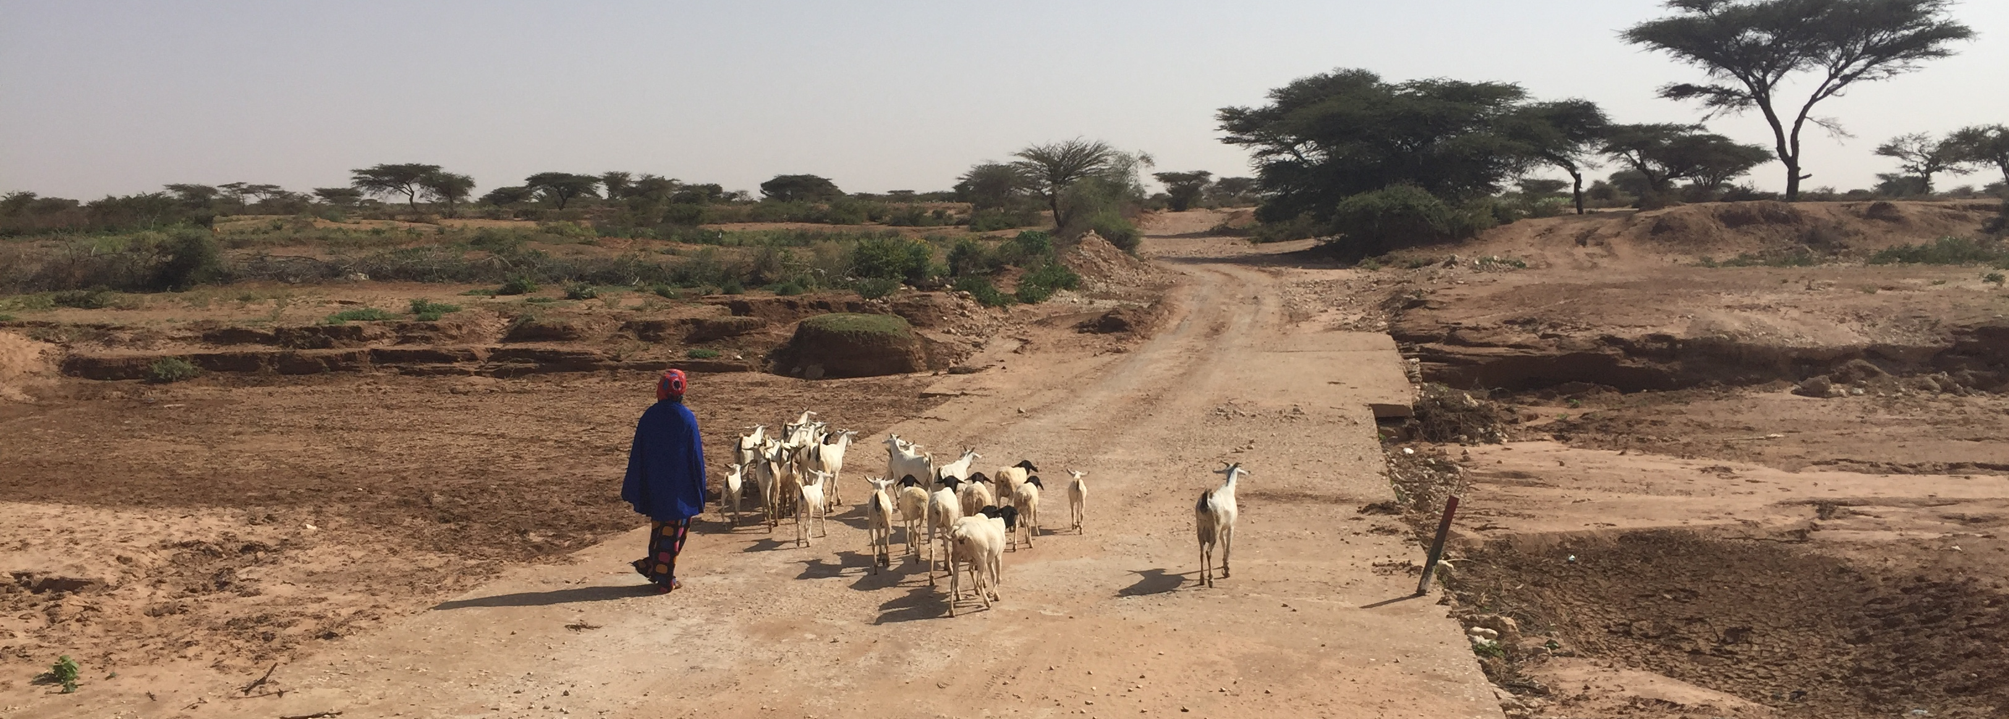
THANK YOU!
Contact: natalialr@us.es

