Slide 1




Sequential sampling of VOCs AND atmospheric oxidation products in East-Antarctica
department Of Green CHEMISTRY AND TECHNOLOGY
EnVOC
Preben Van Overmeiren – EGU General Assembly – 23/05/22
Andy Delcloo, Karen De Causmaecker, Alexander Mangold, Kristof Demeestere, Herman Van Langenhove, and Christophe Walgraeve

Slide 2
Why VOCs In Antarctica?
Volatile organic compounds (VOCs) are understudied in Antarctica
Extremely limited year-round information
Transformation to secondary organic aerosol (SOA) and cloud condensation nuclei (CCN)
Direct influence - radiative forcing
Indirect effect - clouds (albedo) and surface mass balance (SMB)
VOC
Biogenic or anthropogenic
OVOC
Lower volatility
SOA
Condensation
Reactive uptake
CCN
Present as trace gas
Atmospheric oxidation product
Cloud formation
microphysics
Mineralization
Atmospheric oxidants
•OH or O₃
Deposition

Slide 3
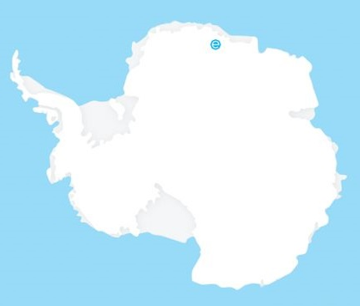
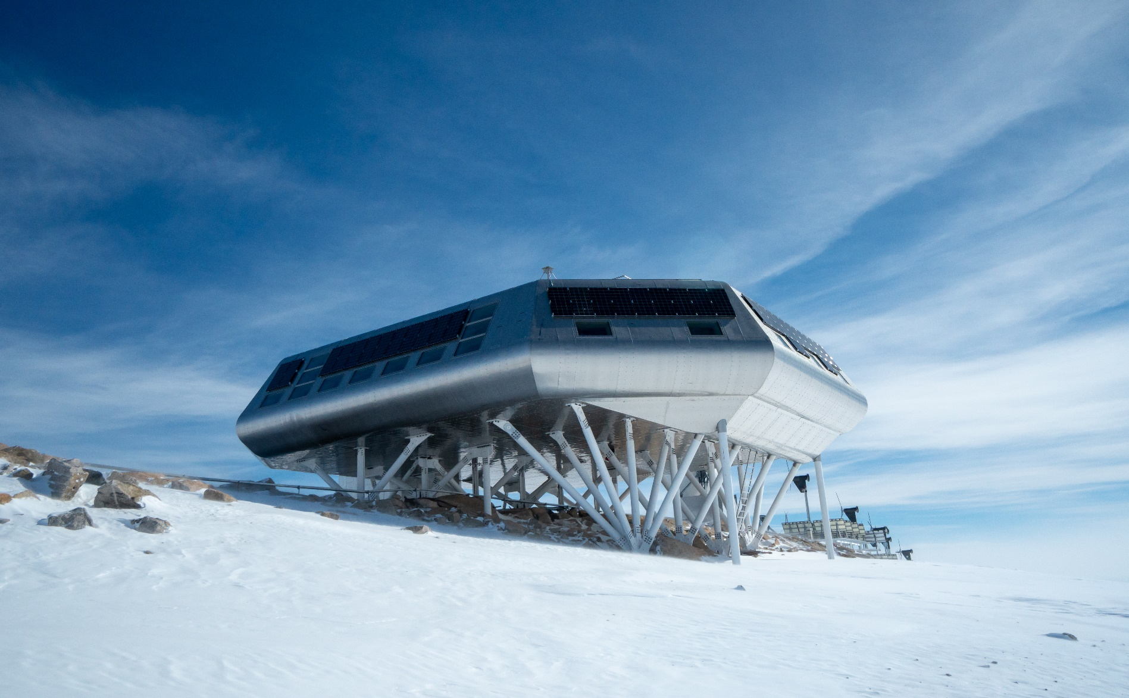

The Princess Elisabeth Station
Zero emission station build in 2009
Location: Sør Rondane mountain range
Queen Maud Land, East-Antarctica, 1380m asl
Atmospheric monitoring for over 10 years
Only summer operation
Remote access instrumentation

Slide 4

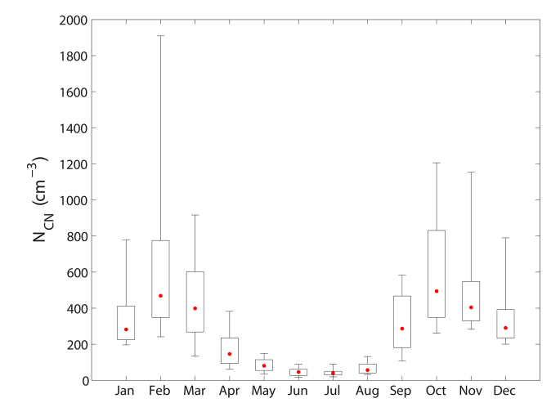
Why VOCs In Antarctica?
Passive sampling during 2017-2018 showed the occurrence of +- 70 (O)VOCs
Photochemical activity of these compounds? (polar day-night)
Link with the seasonal variation of aerosols measured
Wex, H. et al. CCN measurements at the Princess Elisabeth Antarctica research station during three austral summers, Atmos. Chem. Phys., 19, 275–294, https://doi.org/10.5194/acp-19-275-2019, 2019.

Slide 5

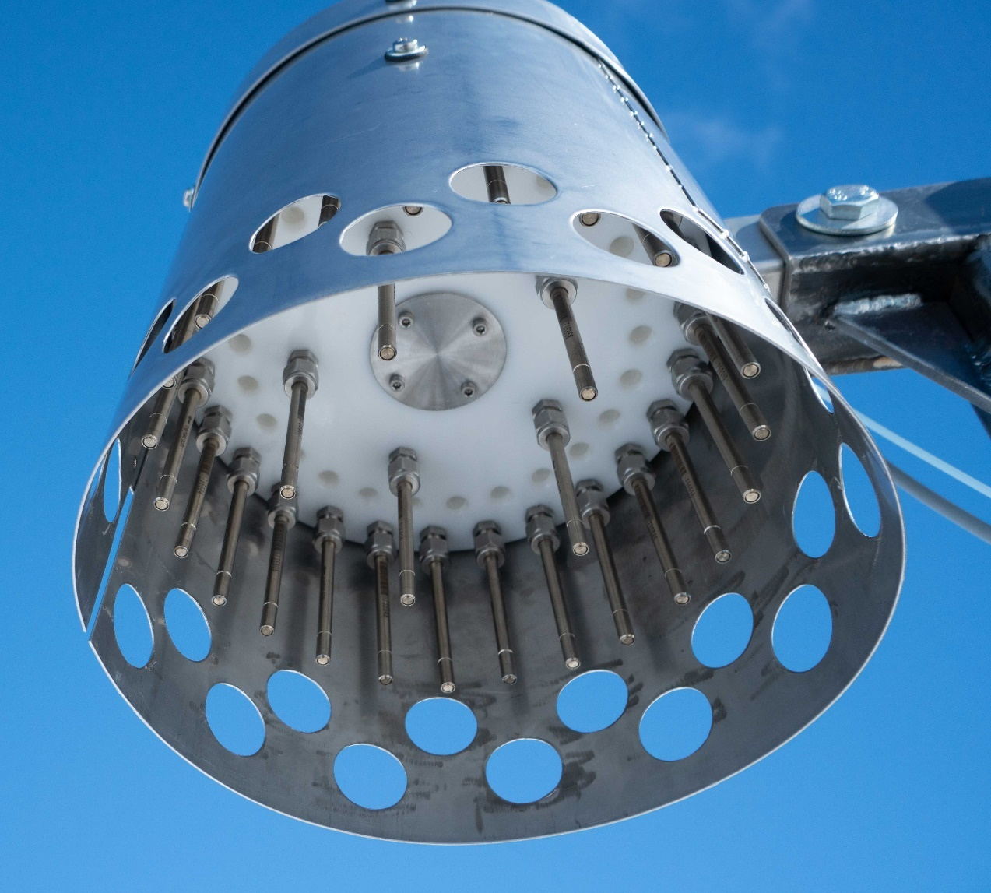
Instrument – ATS-50 and Analysis
Autonomous sampler required to gather year-round data
No auto-sampler commercially available
Specific conditions (-40°C, high windspeeds, blowing snow)
In-house developed system
ATS-50
Capable of 50 samples
25 samples used – bi-weekly samples
Tenax TA sorbent tubes with diffusion limiting
Operated 2 years (19-20 & 20-21)
Analysis on TD-GC-MS and TD-PTR-TOFMS

Slide 6
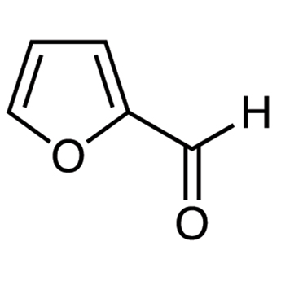
Seasonal variation of Furfural
Unique dataset created (60 VOCs)
Some compounds show interesting trends
Furfural
Associated with biomass burning and high •OH reactivity (J. B. Gilman, 2015)
SOA formation via maleic acid
Graph removed as it contained sensitive data

Slide 7
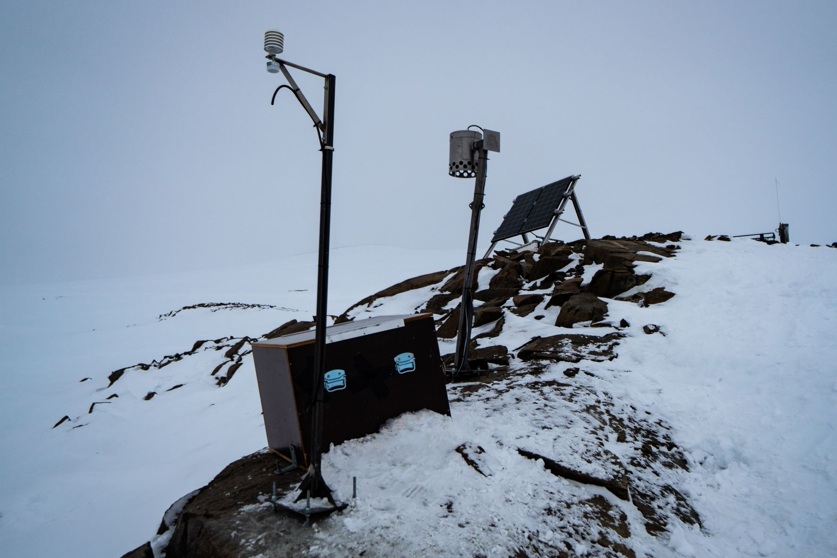
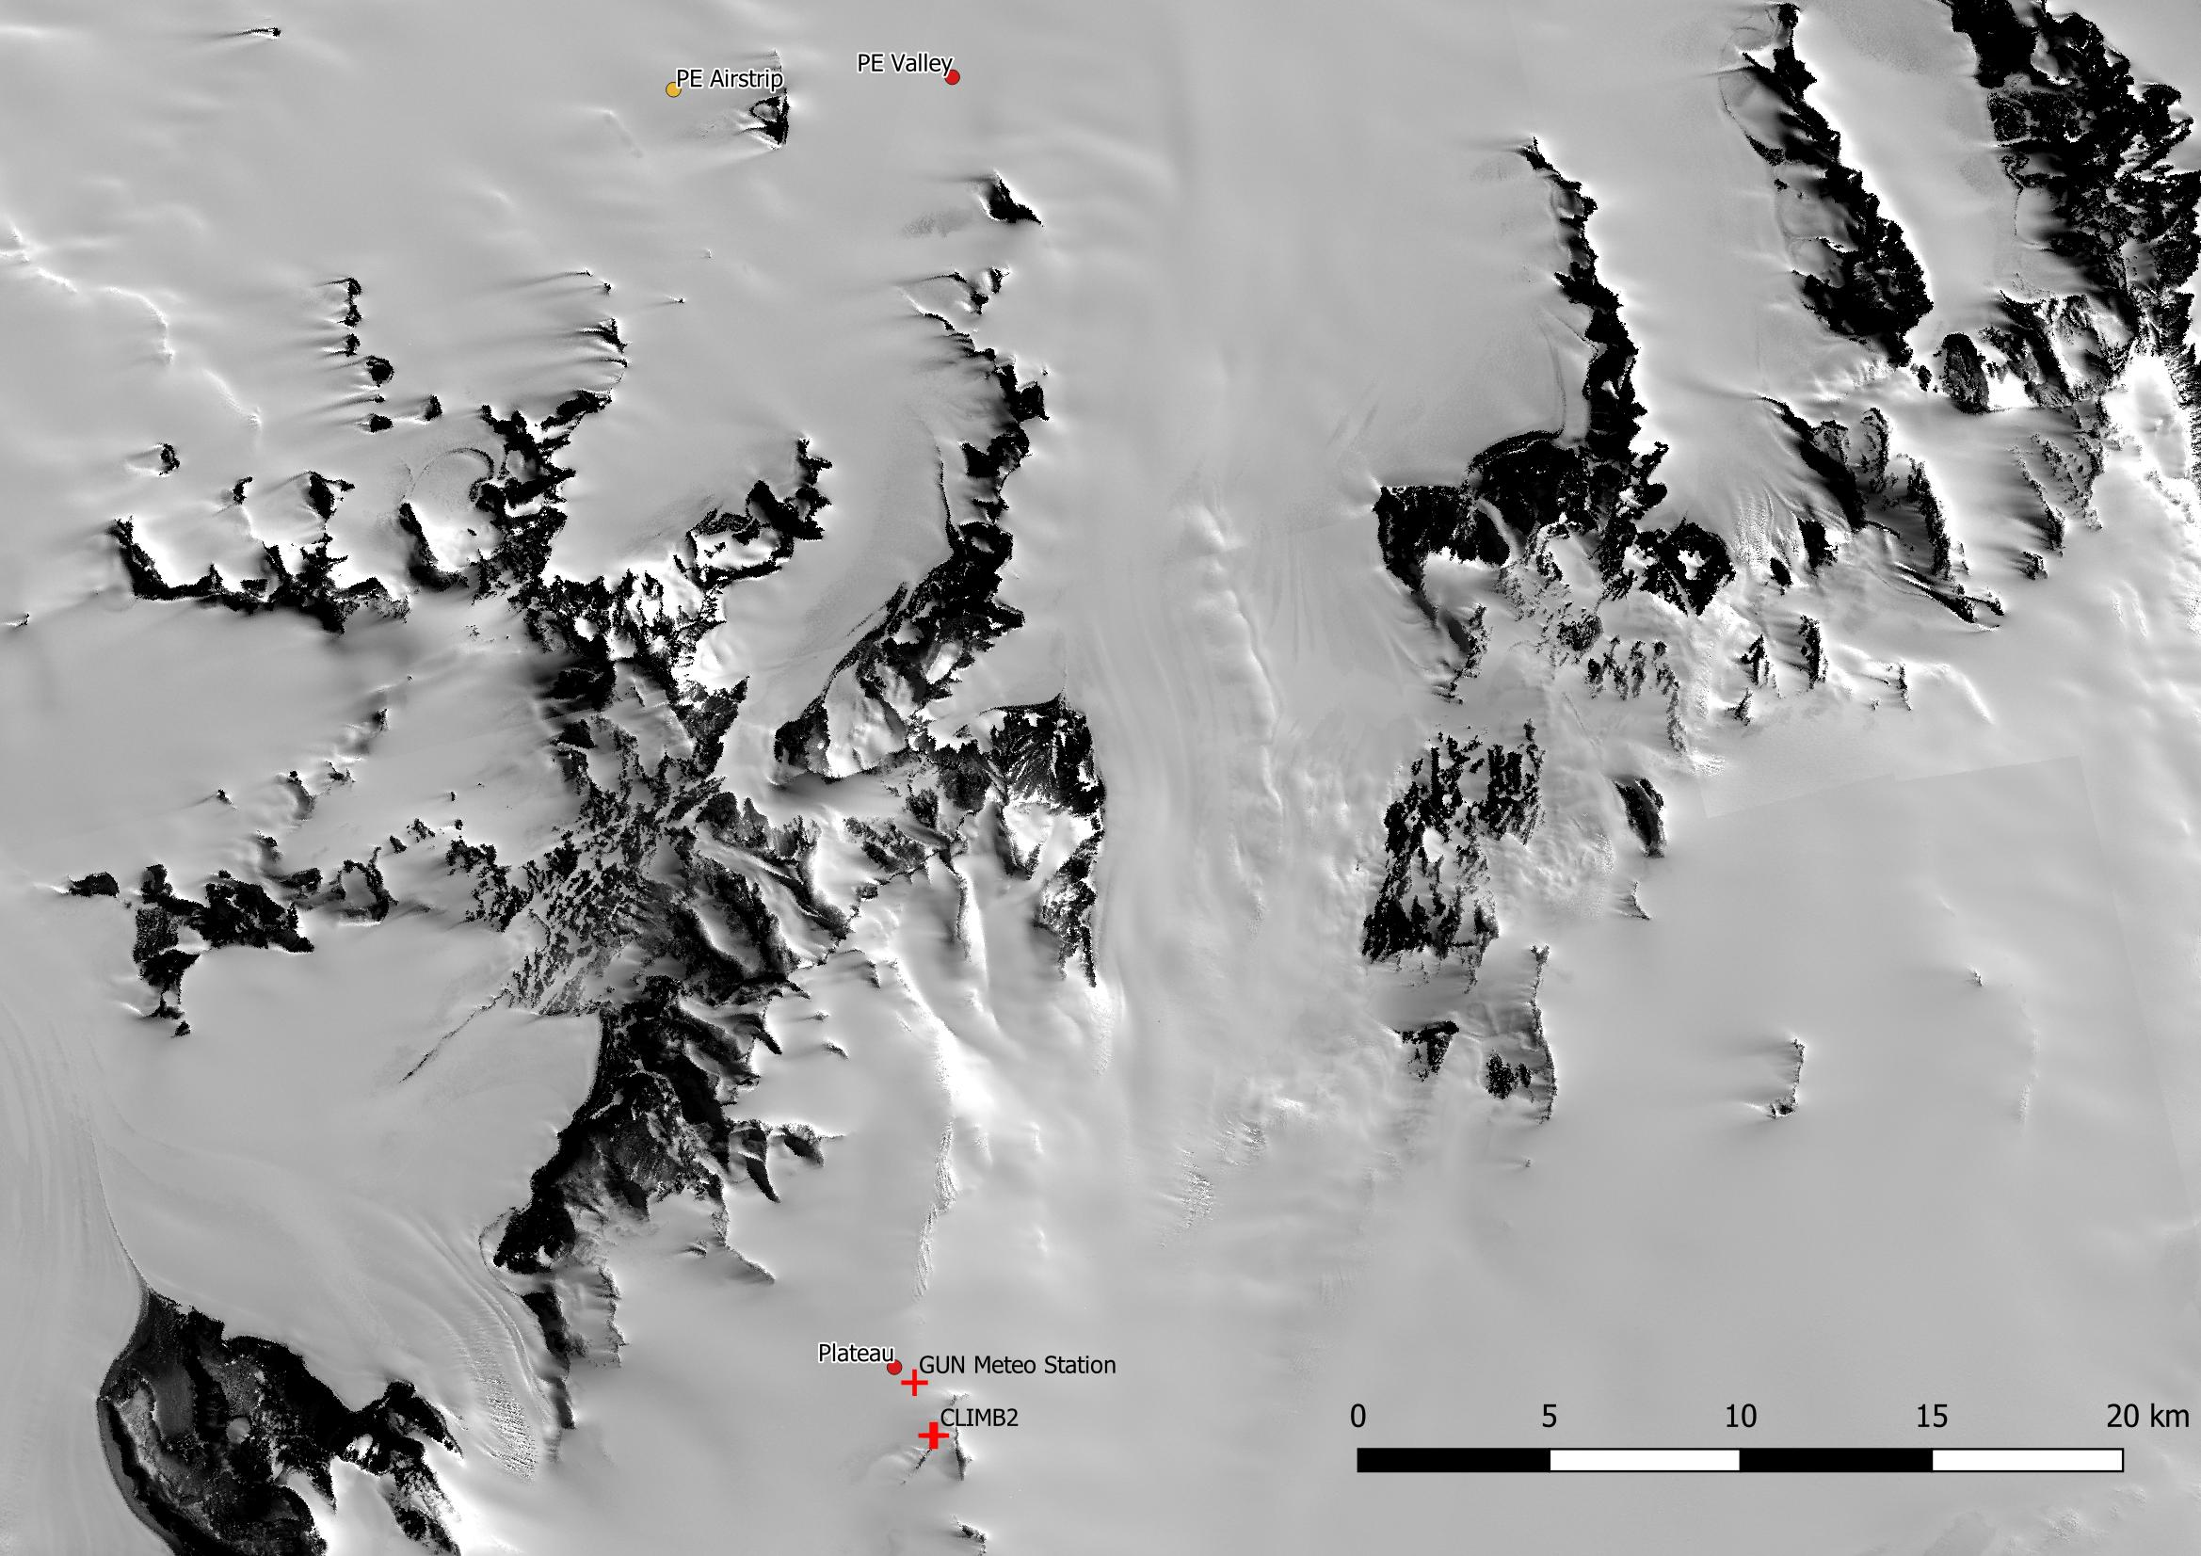
Prospects
‘Remote’ atmospheric observatory (CLIMB project)
On Antarctic plateau – 2400m asl
Sustainable energy
Location without anthropogenic activity
Instruments:
Meteostation
ATS-50 with 50 samples (weekly)
Optical particle sizer

Slide 8
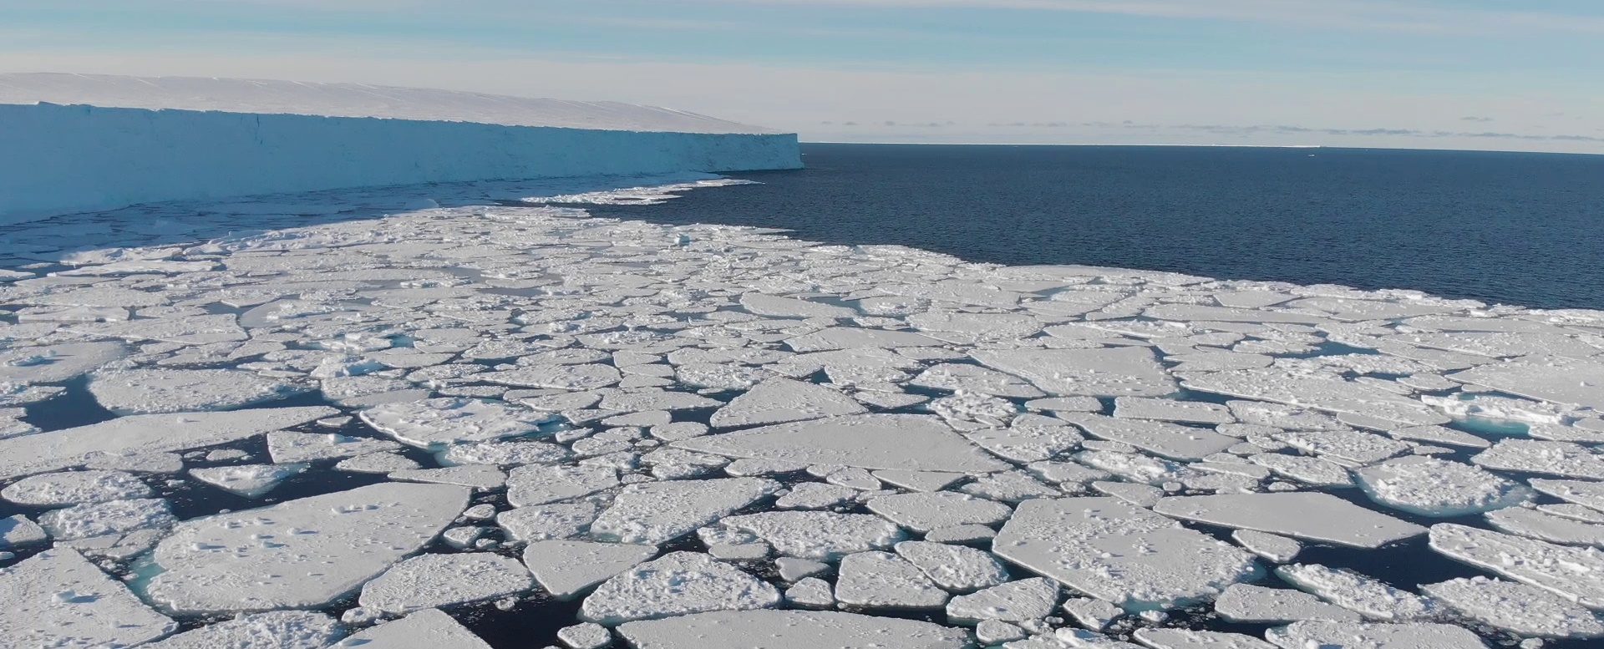



Preben Van Overmeiren PhD Student @ EnVOC Preben.VanOvermeiren@ugent.be +32 9 264 99 24 prof. dr. ir. Christophe Walgraeve prof. dr. ir. Kristof Demeestere em. prof. dr. ir. Herman Van Langenhove www.ugent.be/bw/gct/en/research/envoc
Ghent University @ugent Ghent University

