Slide 1




Importance of land-cover data-set spatio-temporal resolution on water budget modeling in highly irrigated areas, Telangana, India
Abhilash Kumar Paswan
INSPIRE Fellow, CSIR- NGRI Hyderabad, India
Credits: Sylvain Ferrant, Adrien Selles, V.M.Tiwari, Shakeel Ahmed

Slide 2
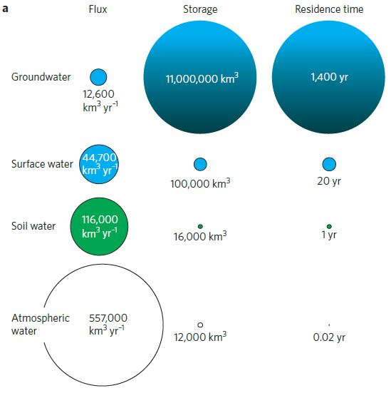
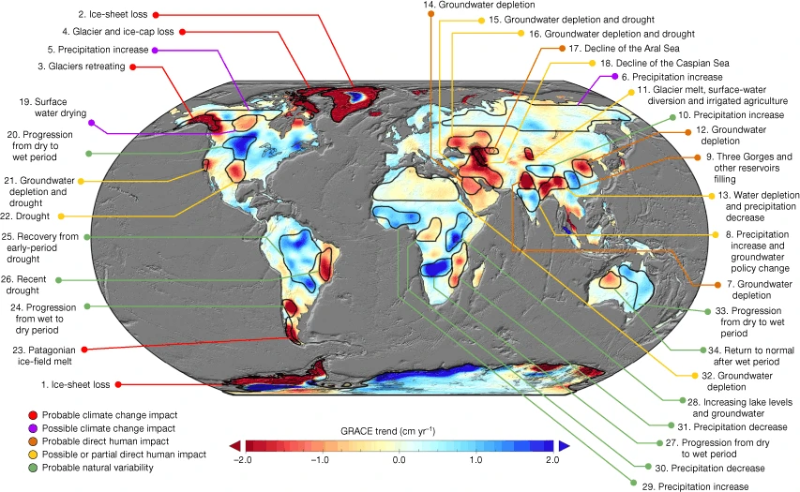
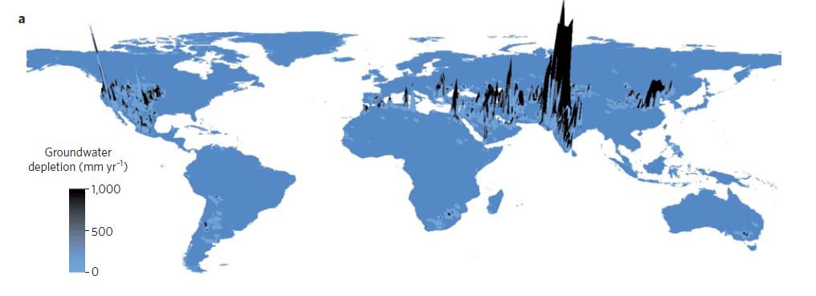

Global Scenario of Fresh Water
Source: Rodell et. al, 2018
Groundwater abstraction is high in India compare to other nation.
EGU-22
Source: Hertig and Gleeson, 2012

Slide 3
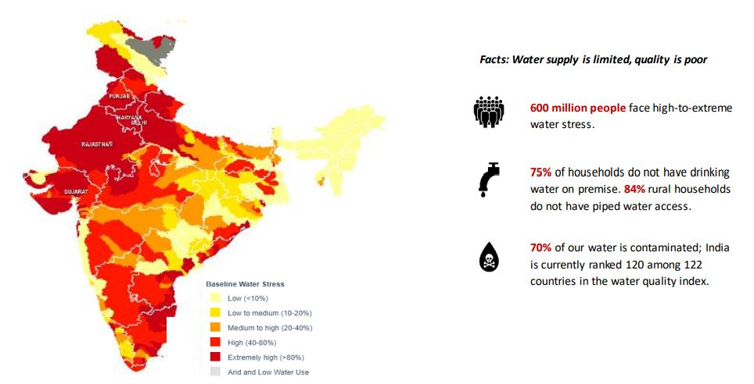
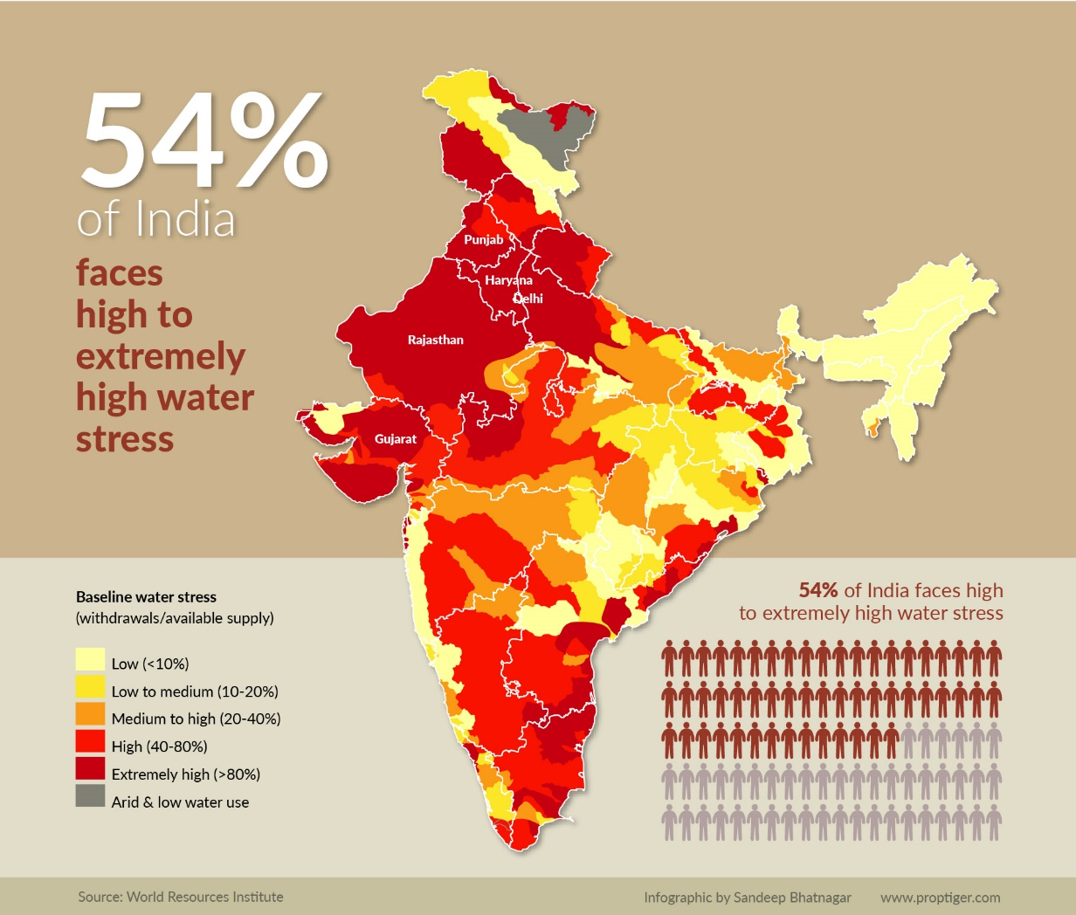
Source: Niti Aayog (CWMI -2018/19)
India’s Water Status

Slide 4
Objective : Simulation of water budget (SWAT Modeling)
Task-1
Develop the understanding of the importance of land-cover data-set spatio temporal resolution on water budget modeling.
LULC : IWMI (500m)-2000
NRSC (56m)- 2007
Sentinel (10 m)-2015-19
Task -2
Develop the understanding of irrigation practices on water budget modeling.
Forcing variables: irrigation practices.
Focused crop: Paddy
Task -3
Computation of water budget variables and its validation.
Runoff, Evapotranspiration, Irrigation return flow, Groundwater extraction, etc.
How far high resolution land use map could influence the model performance?
How much stressed is caused by irrigation on aquifer ?

Slide 5
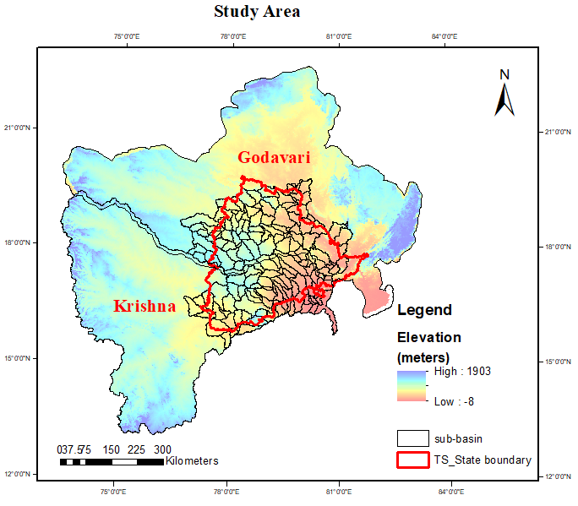
Study Area (Part of Godavari and Krishna River Basin)
Godavari River Basin: (Lower Godavari)
Watershed Area: 78334.32 sq. Km
No. of Sub-basin: 87
Area Covered : Northern TS
Average Rainfall: 1169mm
Krishna River Basin: (Lower Krishna)
Watershed Area: 64538.51 sq. Km
No. of Sub-basin: 79
Area Covered : Southern TS
Average Rainfall: 869mm

Slide 6
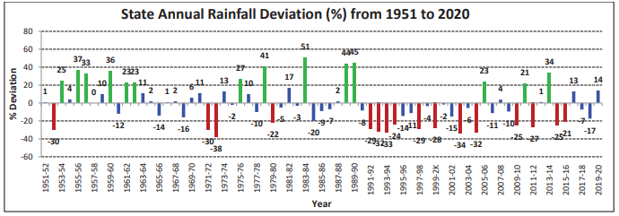
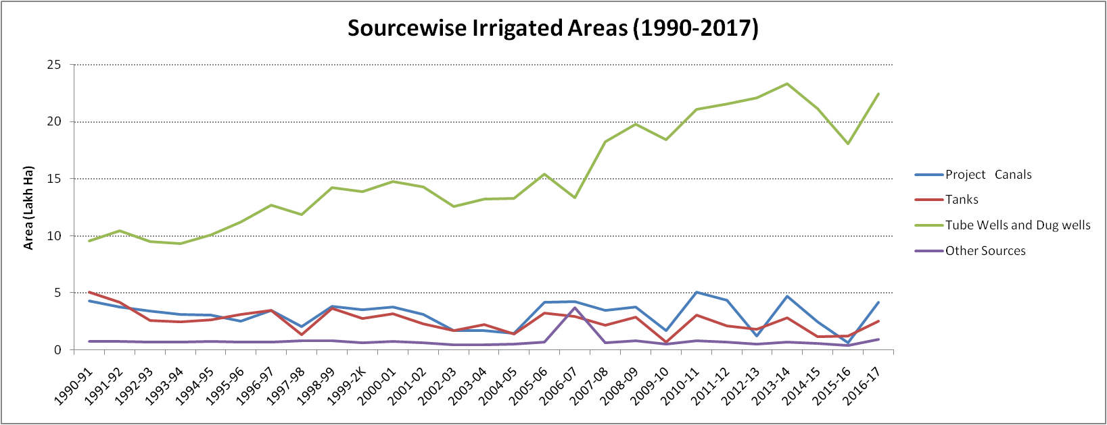
Rainfall pattern and Irrigation dependence
Frequency of drought years has increased
Irrigation dependencies on GW has been doubled

Slide 7
Lacuna of the hydrological modeling system
Assumes idealized/virgin basin conditions
- Storage structures( such as reservoirs, water harvesting system), irrigation diversion, hydraulic interventions are not included.
Irrigation water requirements are not taken into account for the hydrologic process simulations
- Varying water conditions for crop usually ignore.
Cropping cycle copying from long-term vegetation index
-variability in cropping cycle during normal year, wet year and dry year is difficult to incorporate.
The present study address this lacuna:
Model development incorporating all major hydraulic interventions (such as reservoir incorporation including irrigation diversions).
Dynamic simulation of irrigation water requirement based on crop demand (in this case Rice is focused one).
Development of crop management input based on seasonal cycle over the study area.
EGU-22

Slide 8

Soil and Water Assessment Tool (SWAT) (Arnold et. al, 1998, 2011)
a process based, continuous, eco-hydrological river basin or watershed model, computationally efficient.
designed to predict the impact of land use, climate change, sediment and contaminant transport, etc. on hydrology.
subdivides a watershed into sub-basin connected by stream network, and further delineates HRUs (hydrologic response unit) comprising unique combinations of land cover and soils within each sub- basin.
enable users to study long-term impacts.
simulate hydrological cycle based on water balance equation.
Water balance in SWAT: (Neitsch et. al, 2011)
Input Datasets
DEM: SRTM 90 m
Landuse: IWMI (500m) Sentinel (10m)
Soil: FAO
Meteorology: IMD
Stream flow: CWC
Reservoir: India-wris
Future Climate: CMIP6
SW_{t} = final soil water content at time “t” (mm H₂O),
SW_{o} = initial soil water content on day i (mm H₂O), t is the time in days,
R_{day} = amount of precipitation on day i (mm H₂O),
Q_{surf} = amount of surface run off on day i (mm H₂O),
E_{a} = evapotranspiration on day (i) (mm H₂O),
w_{seep} = amount of water entering the vadose zone from the soil profile on day i
(mm H₂O)
Q_{gw} = amount of return flow on day i (mm H₂O).
R_{day}, E_{a}, W_{seep} represents the vertical flow whereas Q_{gw} , Q_{surf} are the horizontal flow water budgets respectively.
EGU-22

Slide 9
Work-flow Chart- SWAT Modeling
DEM
LULC
Soil
Slope
Flow direction and accumulation,
Stream network
Reclassification
Reclassification
Reclassification
Inlet/point source addition
Overlay
Watershed Delineation
Hydrological response unit (HRUs)
Sub-basin parameter Calculation
Meteorological data
Reservoir Addition
Forcing variables
Model Simulation
Calibration and validation
Sub-basin, HRUs
Statistical analysis of results
EGU-22

Slide 10
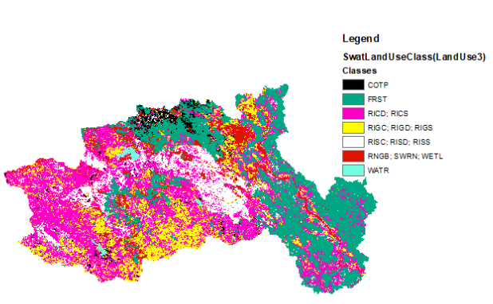
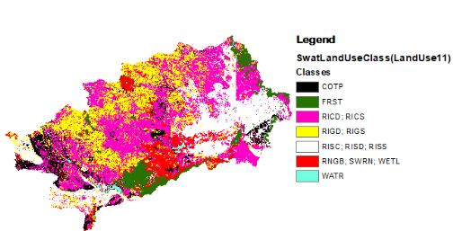
Input: Land Use (500m)
Godavari
Krishna
Total Rice Extent : 62.03%
RISS - 5.61
RISD - 5.90
RISC - 0.46
RIGS - 8.93
RIGD - 5.45
RICS - 32.88
RICD - 2.80
Modeling simplification:
Two crop is growing (Rabi and Kharif ) in a single year.
Sources of irrigation of conjunctive crops are same.
Total Rice Extent: 77.33%
RISS – 11.40
RISD – 9.22
RISC – 0.94
RIGS – 17.98
RIGD – 3.42
RICS – 18.30
RICD – 16.07
Nomenclature: RI – Rice; S – Surface, G – Groundwater; C - Conjunctive (S+G); S - single, D- Double; C - Continuous
EGU-22

Slide 11
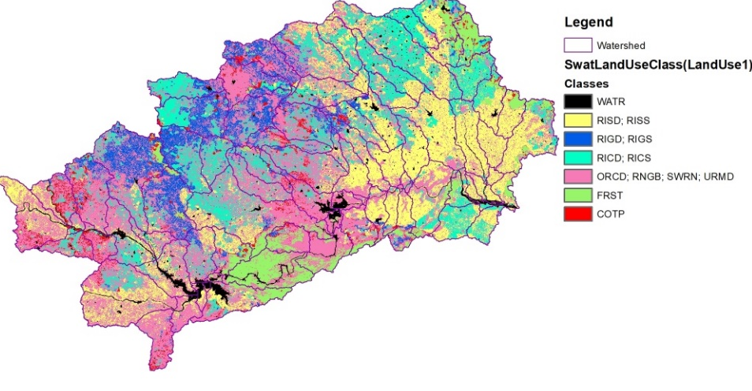
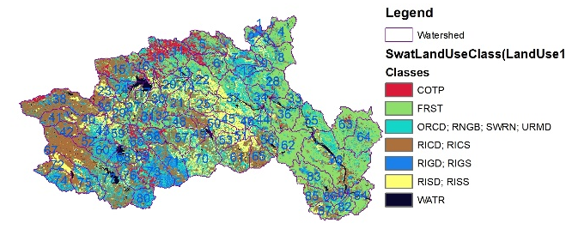
Input: Land Use (56m)
Godavari
Krishna
Total Rice Extent : 40.79%
RISS – 4.84
RISD – 7.90
RIGS – 3.0
RIGD – 1.38
RICS – 14.31
RICD – 9.36
Total Rice Extent : 43.9%
RISS – 1.48
RISD – 18.44
RIGS – 4.55
RIGD – 2.44
RICS – 8.11
RICD – 8.88
Nomenclature: RI – Rice; S – Surface, G – Groundwater; C - Conjunctive (S+G); S - single, D- Double; C - Continuous
EGU-22

Slide 12
Irrigation practices over study area
IWD-IWU Calculation
IWD: Irrigation water demand
IWD = (amount of daily water supply x crop area x no. of days) / (total area of subbasin)
IWU: Irrigation water use
IWU = (amount of simulated irrigation used by crop x crop area)/ (total area of subbasin)
Management Operations:
Kharif: 9 mm daily from July 3 to Oct 14 (104 days)
Rabi : 12mm daily from Jan 3 to Apr 14 (101 days)
#All the management applied at HRUs level.
For single crop in a calendar year annual water supply is 936 mm.
For single crop in a calendar year annual water supply is 2160 mm.

Slide 13
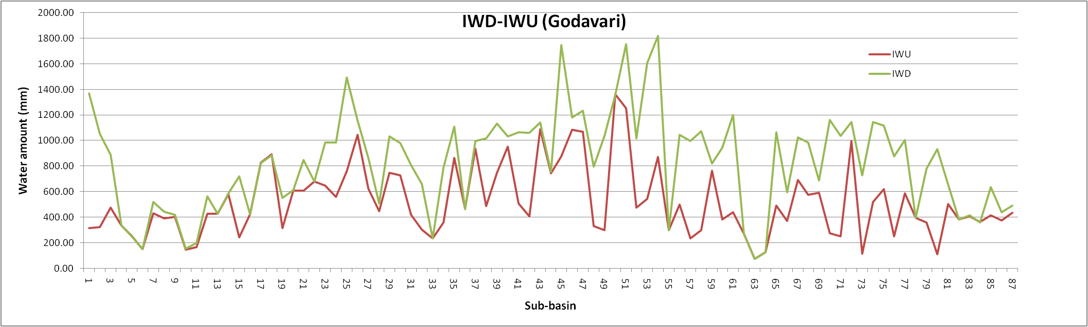
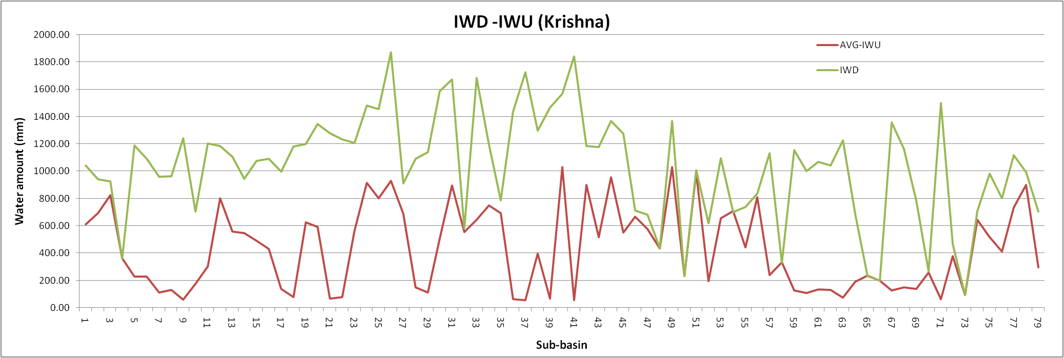
IWD-IWU characteristics at both basin
What does this stress signify?

Slide 14
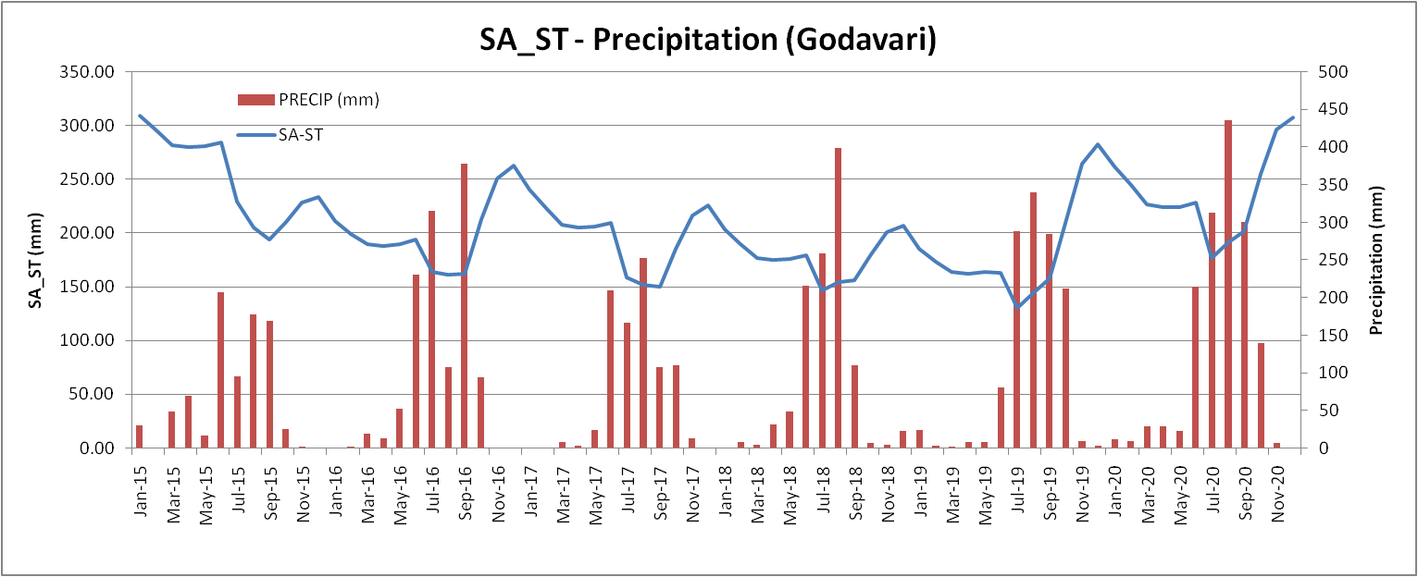
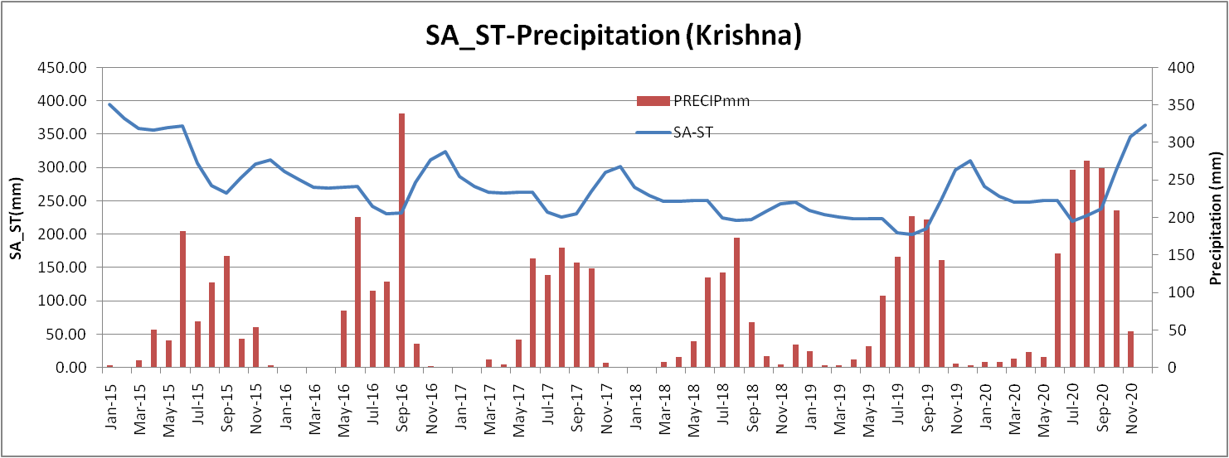
Available WL simulation at shallow aquifer
EGU-22

Slide 15
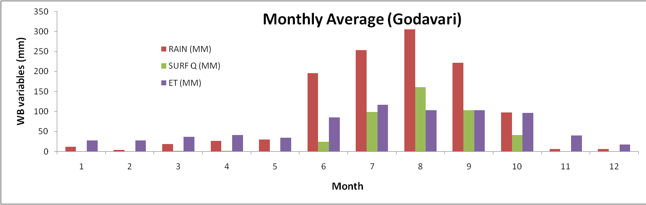
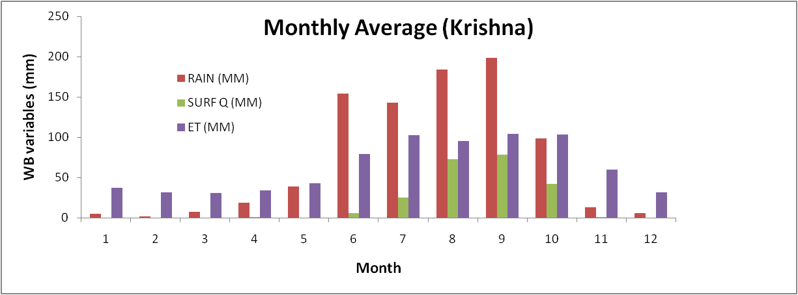
Major Annual Water Flows
Godavari:
Rainfall: 1167 mm
AET: 724.8 mm
Discharge: 430 mm
GW recharge: 438 mm
Water stress day ~ 32
Krishna:
Rainfall: 868.5 mm
AET: 750.6 mm
Discharge: 225.65 mm
GW recharge: 280 mm
Water stress day ~ 38

Slide 16
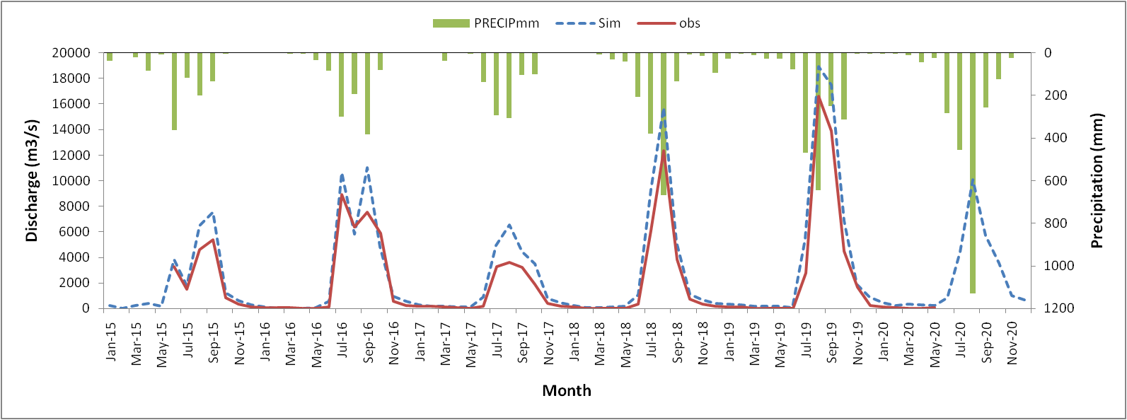
Conclusion and way forward …..
Flow is dominated mainly due to the variability in rainfall (southwest monsoon).
Water stress during Rabi is more than Kharif and is spatially distributed.
Krishna is more stressed (Southern TS) than Godavari (Northern TS).
EGU-22

Slide 17
“Strike off the water problem,
Before ….
the water strike you off ”
Thank You!!
EGU-22

