Slide 1
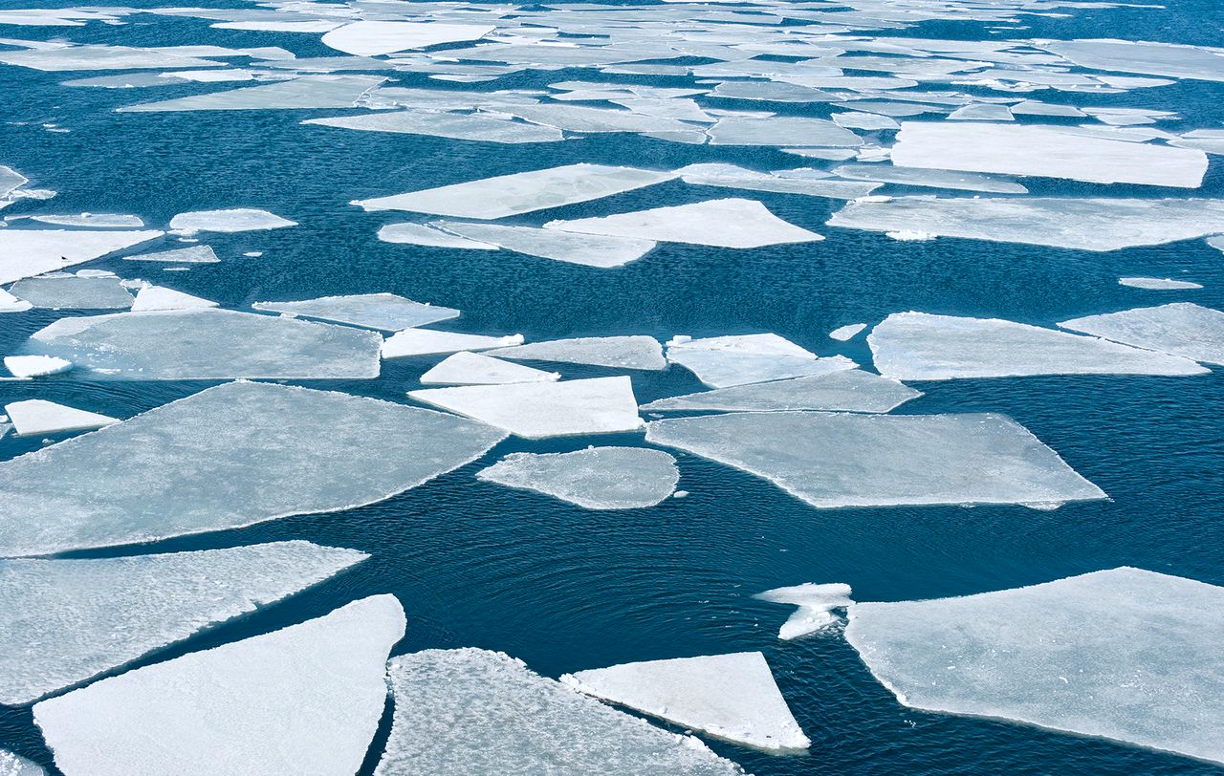
HOW SENSITIVE ARE AEOLUS LIDAR SURFACE RETURNS (LSR) TO THE TYPES OF SURFACE?
Lev Labzovskii, Gerd-Jan van Zadelhoff, David Donovan, Jos de Kloe, Damien Josset
27.05.2022
EGU General Assembly 2022

Slide 2
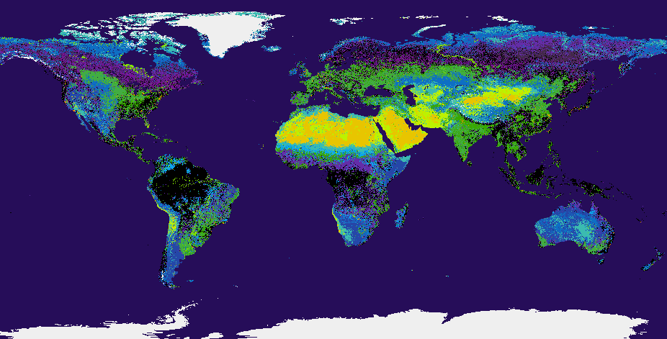
MOTVIATION OF THE STUDY
Motivation: There is no perfect instrument, which can resolve the changes of land cover to constitute the core for providing land cover classification
Aim: To elucidate the sensitivity of lidar surface returns from Aeolus satellite As Aeolus performs observations at UV (348 nm) and at the unprecedented non-nadir angle (~37.5º)
GET: https://github.com/globalmaps/gm_lc_v3
Land Cover (GLCNMO) - Global version - Version 3
Potential Implications:
Sensitivity of UV returns to surface gradient -> key lesson for future missions
High spatio-temporal coverage of snow-covered Arctic and Antarctic areas

Slide 3
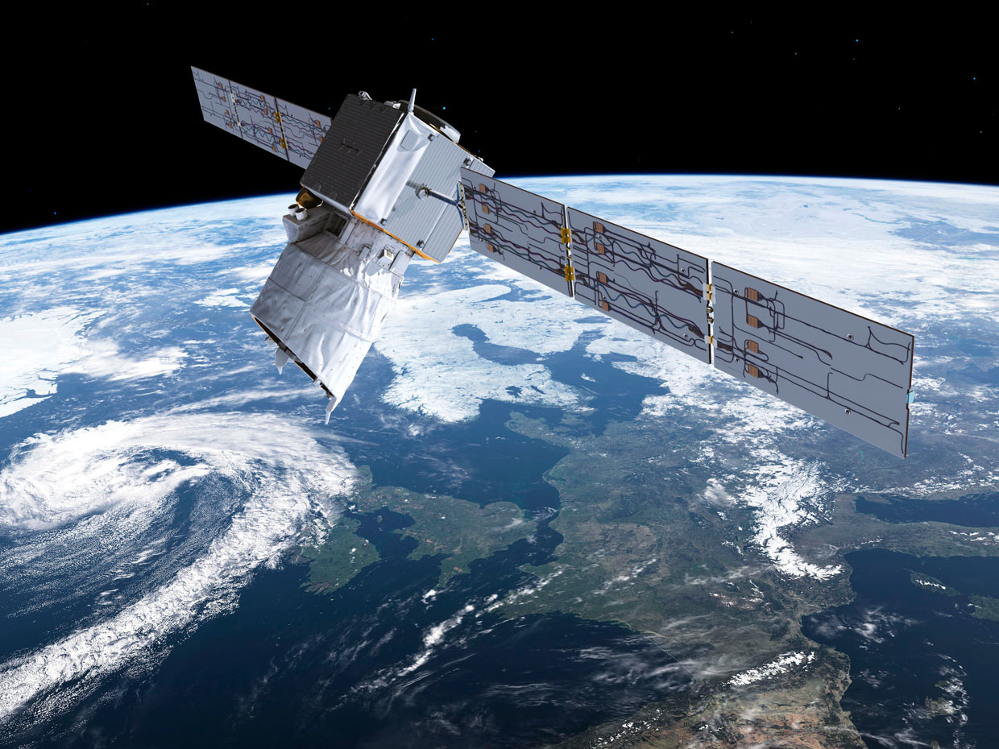

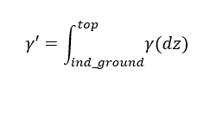
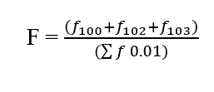
DATA AND METHODOLOGY
AEOLUS SATELLITE
Instrument: ALADIN (Atmospheric Laser Doppler Instrument) onboard Aeolus
Wavelength: ~355 nm
Period: Intensive Observation Period (IOP: 14 – 23 September 2019), Spring 2019
Input data: L1B data: DEM, Angle information AEL PRO_L2: Attenuated Backscatter Coefficient, Extinction Coefficient (for masking)
Ground detection –> ESTIMATING LSR (index ground)
  Elevation Angle
  Azimuth Angle
  DEM – bottom bin altitude
  Altitude bin (Aeolus)
  SIAB* - Surface Integrated Attenuated Backscatter
  SIAB error
  Flagging (AEL_PRO)
index ground
  SIAB* (LSR)
  Flagging

Slide 4
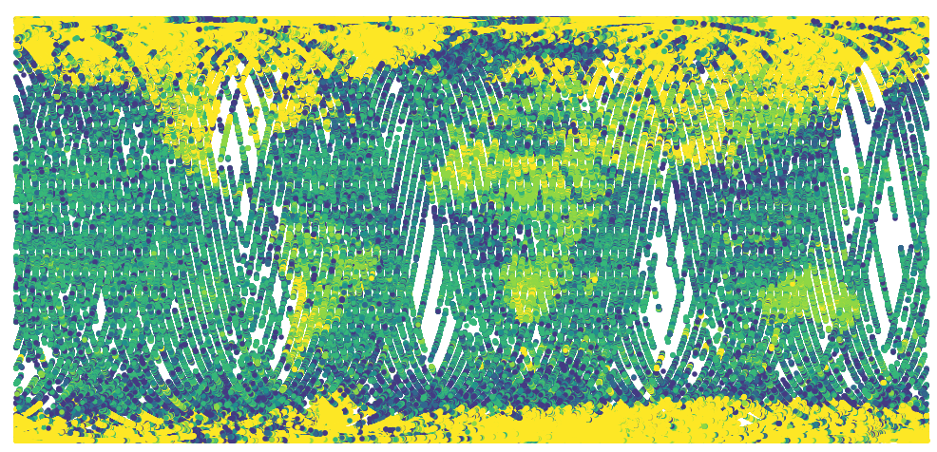
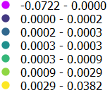
EARLY INDICATORS OF LSR USEFULENESS FOR LAND COVER STUDIES
MARCH – APRIL – MAY 2019
Lidar Surface Returns / Surface Integrated Attenuated Backscatter (sr⁻¹)
LSR(sr⁻¹)
Clear indications of water-land gradient in LSR and bright-dark surface LSR gradients
Strongest UV returns over white surface (Albedo > 0.90 for fresh snow [Varotsos et al., 2014; Weiler, 2017])

Slide 5
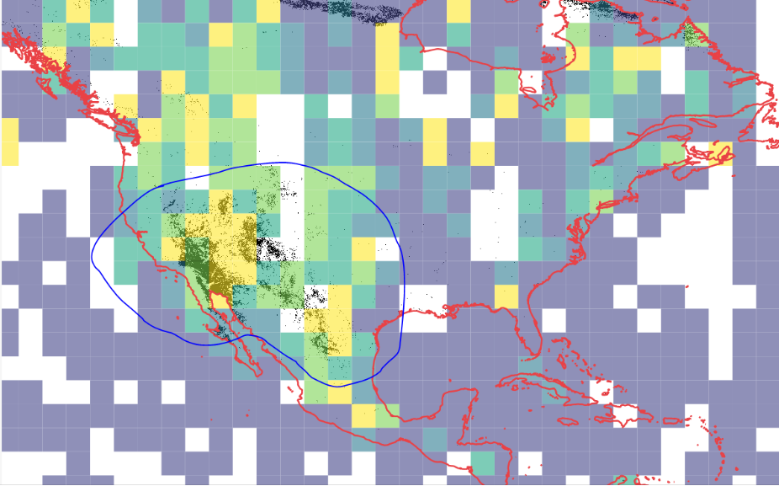
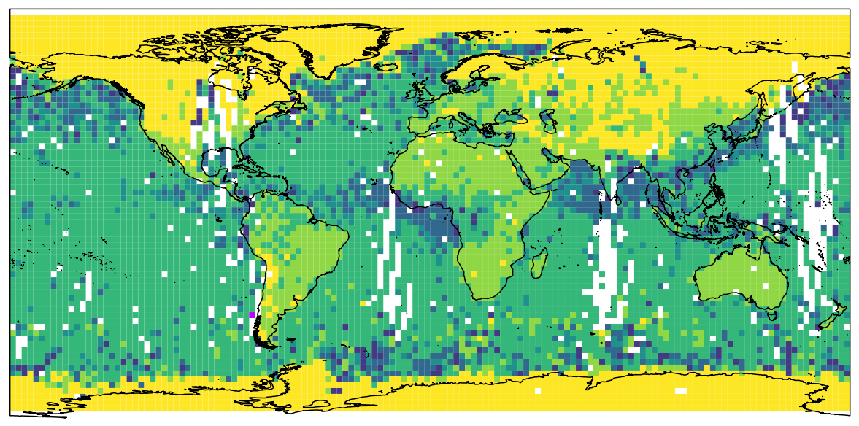
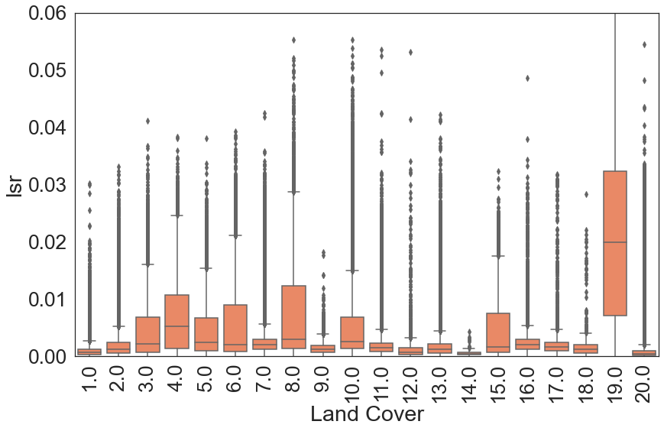
LSR DEPENDING ON THE LAND COVER TYPE
MARCH – APRIL – MAY 2019 (2.5º x 2.5º grid)
1 Broadleaf Evergreen Forest
2 Broadleaf Deciduous Forest
3 Needleleaf Evergreen Forest
4 Needleleaf Deciduous Forest
5 Mixed Forest
6 Tree Open
7 Shrub
8 Herbaceous
9 Herbaceous, Tree/Shrub
10 Sparse vegetation
11 Cropland
12 Paddy field
13 Cropland Other Vegetation
14 Mangrove
15 Wetland
16 Bare area, consolidated (gravel,rock)
17 Bare area, unconsolidated (sand)
18 Urban
19 Snow Ice
20 Water bodies
LSR(sr⁻¹)
LSR GRADIENT BETWEEN ARID AND VEGETATION-RICH AREAS
SEPTEMBER 2019
The strongest returns come from snow/ice the weakest come from water bodies (2% of snow signal)
The most stable signals come from snow/ice and bare, sparse vegetation areas

Slide 6
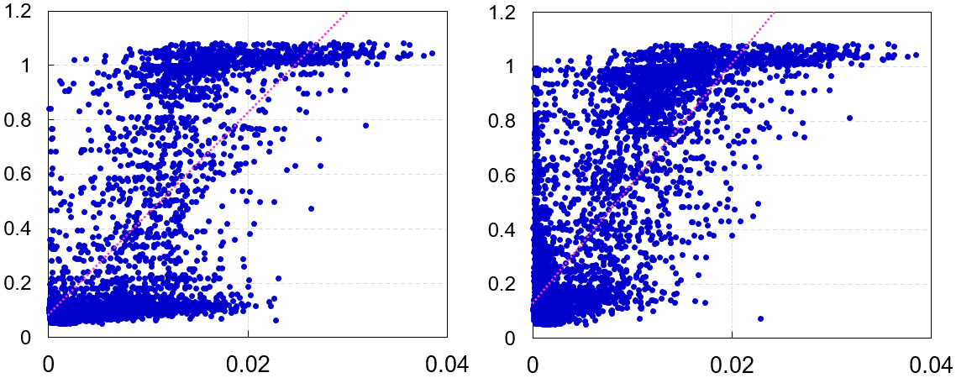
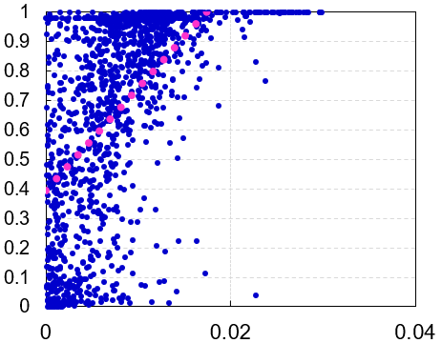
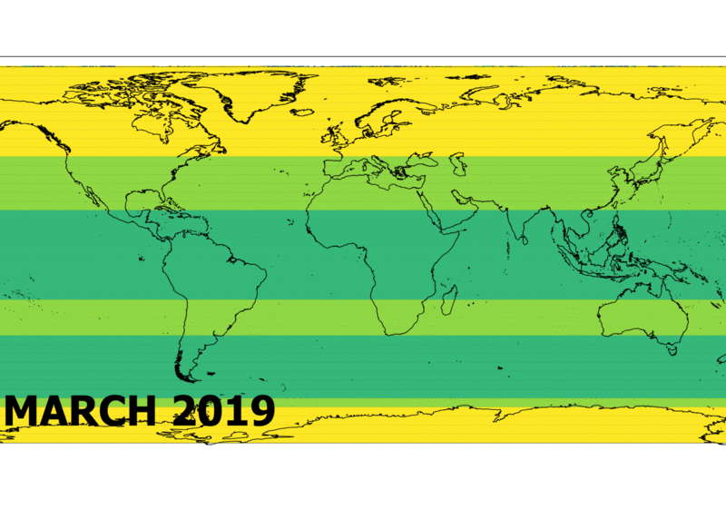
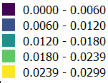
LSR VERSUS LER AND SNOW COVER
TROPOMI: SNOW-FREE LER
TROPOMI: LER WITH SNOW-ICE
MERRA-2: SNOW COVER
LER
SNOW COVER (FRACTION)
r = 0.85
r = 0.64
r = 0.80
LSR(sr⁻¹)
LSR(sr⁻¹)
LSR(sr⁻¹)
LSR(sr⁻¹)
High agreement between LER (Lambertian
Equivalent Reflectance) and Aeolus LSR, especially for snow
Clear dependence of LSR to snow cover
Stripe-based gridding -> Clear dependence of snow
disappearance

Slide 7
CONCLUSIONS AND FUTURE PLANS
CONCLUSIONS
Aeolus LSR is certainly sensitive to surface type worldwide
  Water / Land can be determined from the magnitude of signal
  Snow / No-snow surface is also quantifiable
  Bright / Dark surface -> seasonal analysis needed
Strongest returns -> Snow and ice
Weakest and noisiest -> Water bodies (2% of snow signal)
Good agreement between LSR and Lambertian equivalent reflectance and snow cover
OPEN QUESTIONS
Seasonal variability and sensitivity to vegetation -> To be determined
Bridge between Aeolus-based SIAB quantities and Lambertian equivalent reflectance is needed
What kind of product is useful for land cover community from Aeolus?

Slide 8

THANK YOU FOR
YOUR ATTENTION

Slide 9
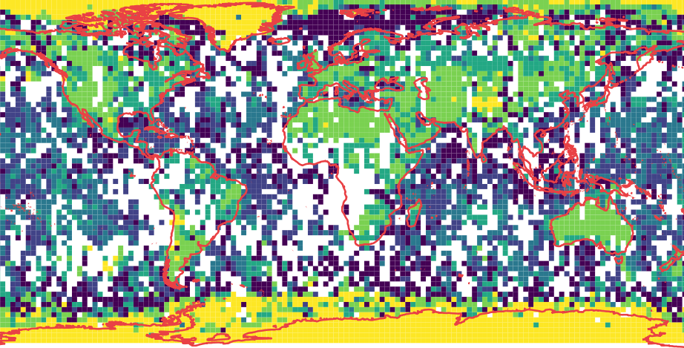
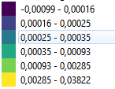
LSR WITH RELATION TO LAND COVER: FIRST 10 DAYS OF IOP
Lidar Surface Returns / Surface Integrated Attenuated Backscatter (sr⁻¹)

