Slide 1
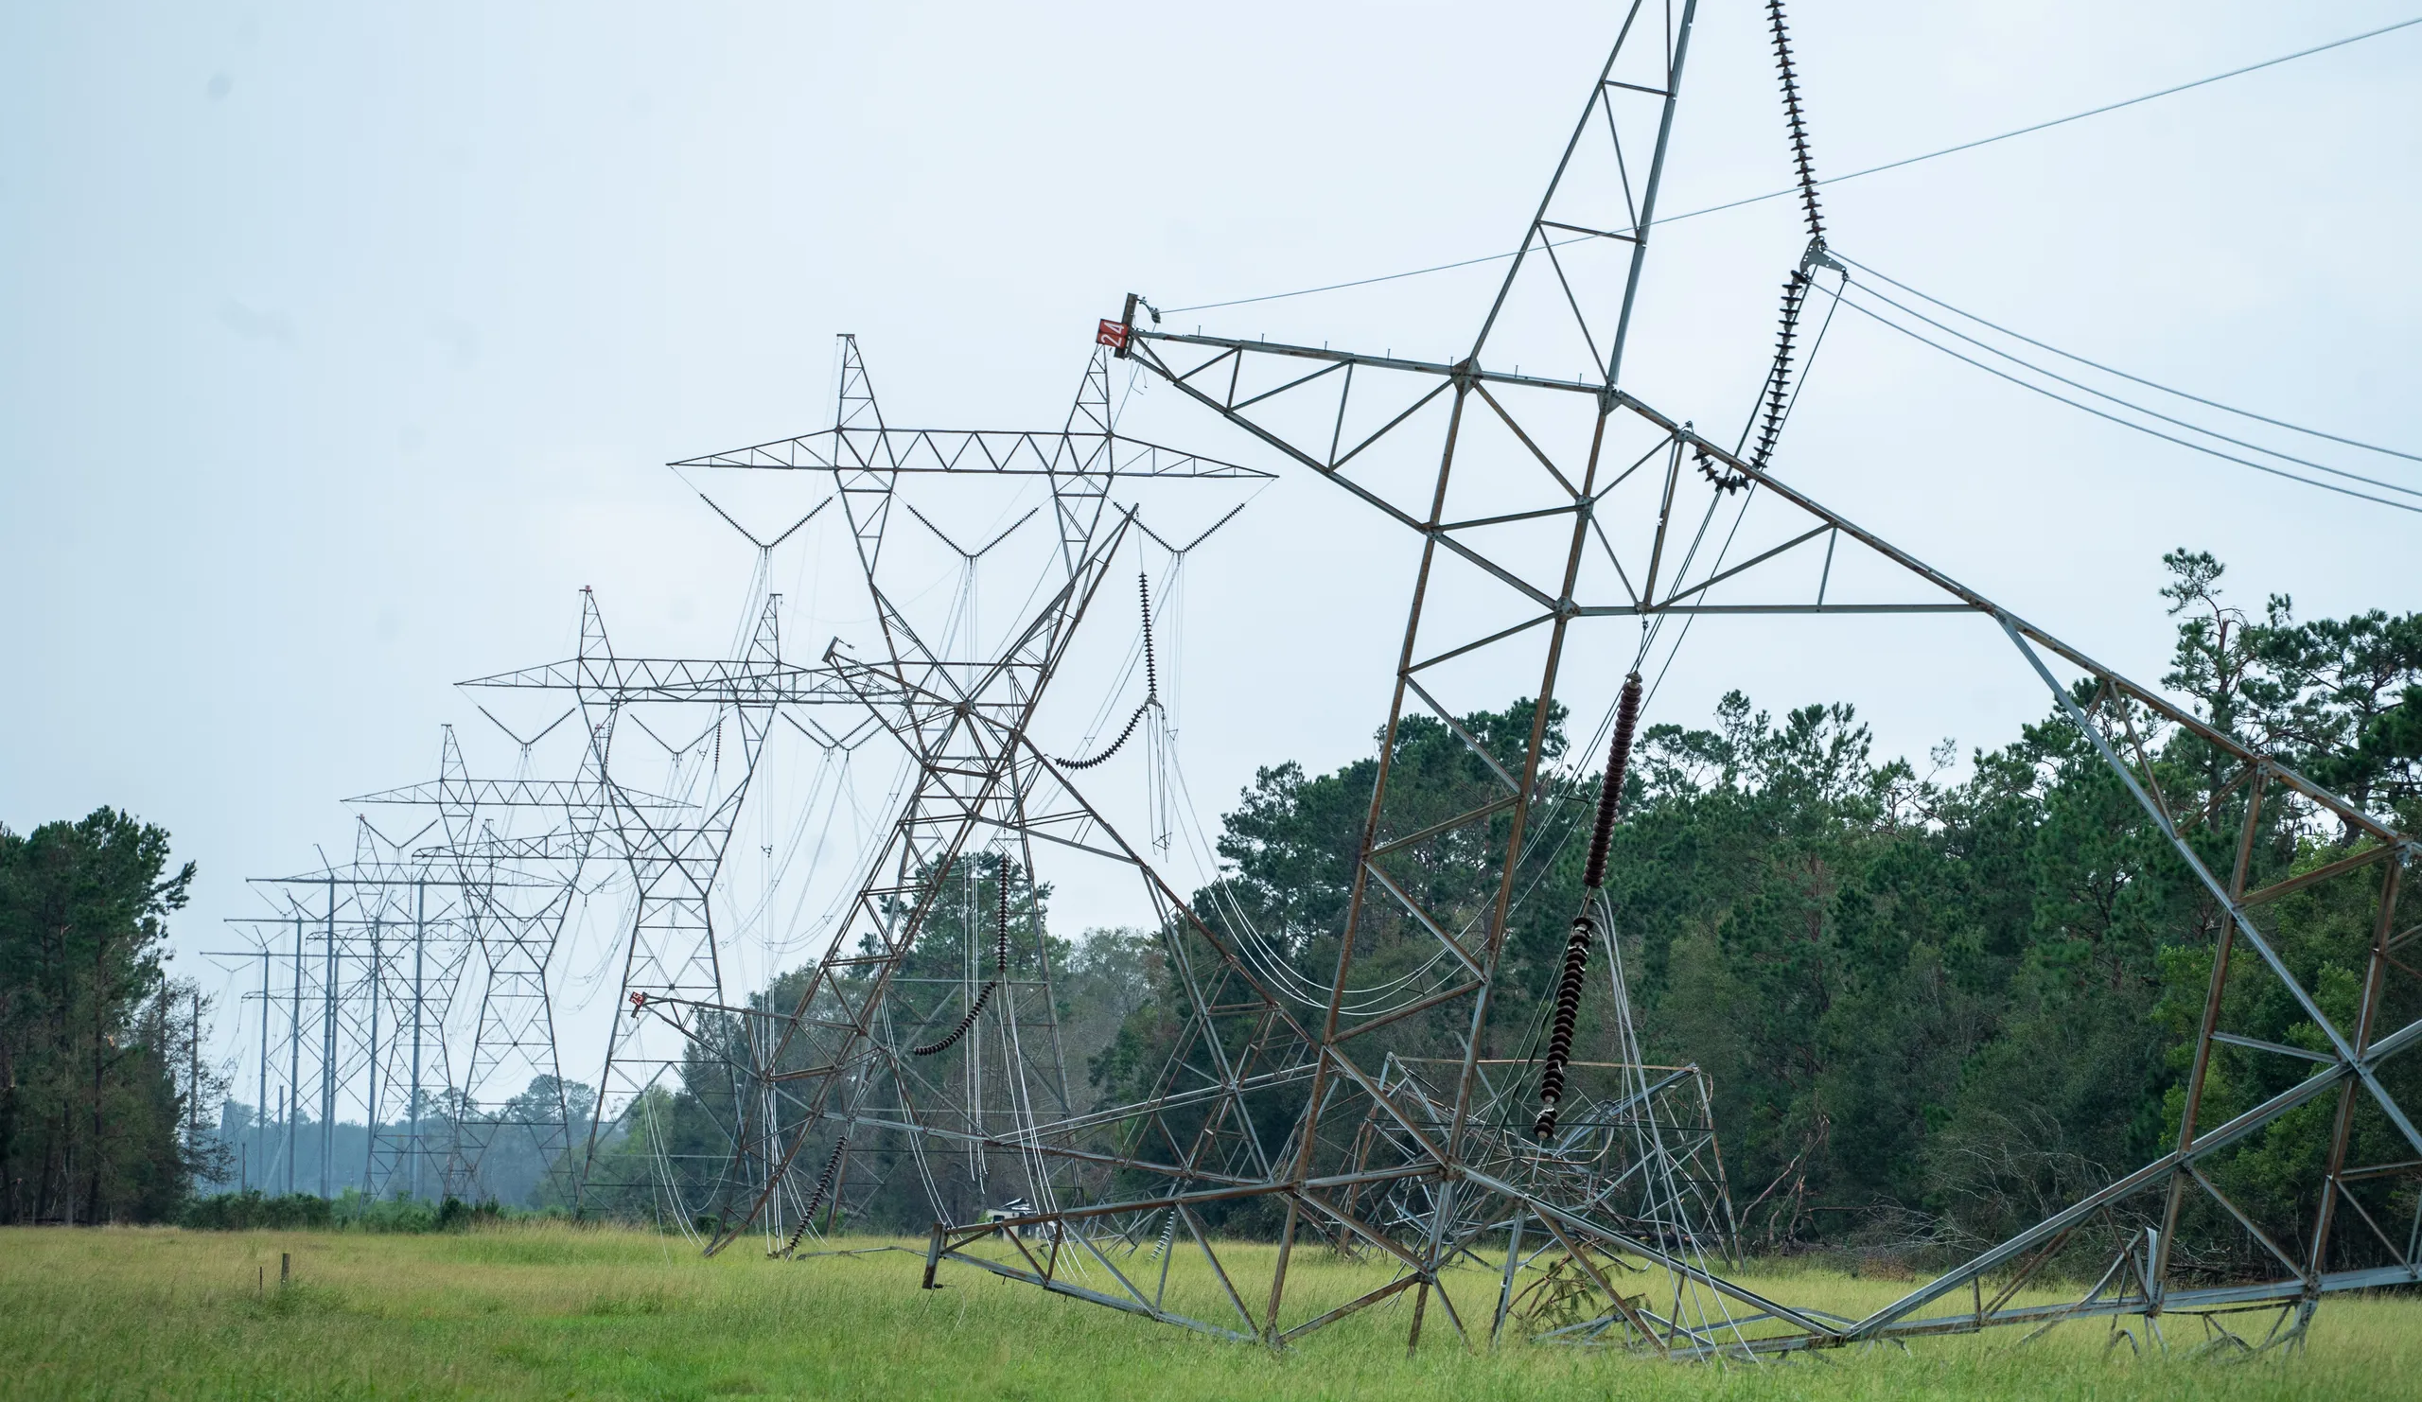



Deep Learning Based Mapping of Power Grids
EGU NH 10.3 – May 2022
Source: https://www.gannett-cdn.com/presto/2020/09/02/USAT/c599e7de-11ec-4bf4-bdd3-d07ffcfe4dae-Hurricane_Laura_Entergy_6.jpg?width=2560
Mengqi Ye (mengqi.ye@vu.nl), Elco Koks, Philip Ward

Slide 2
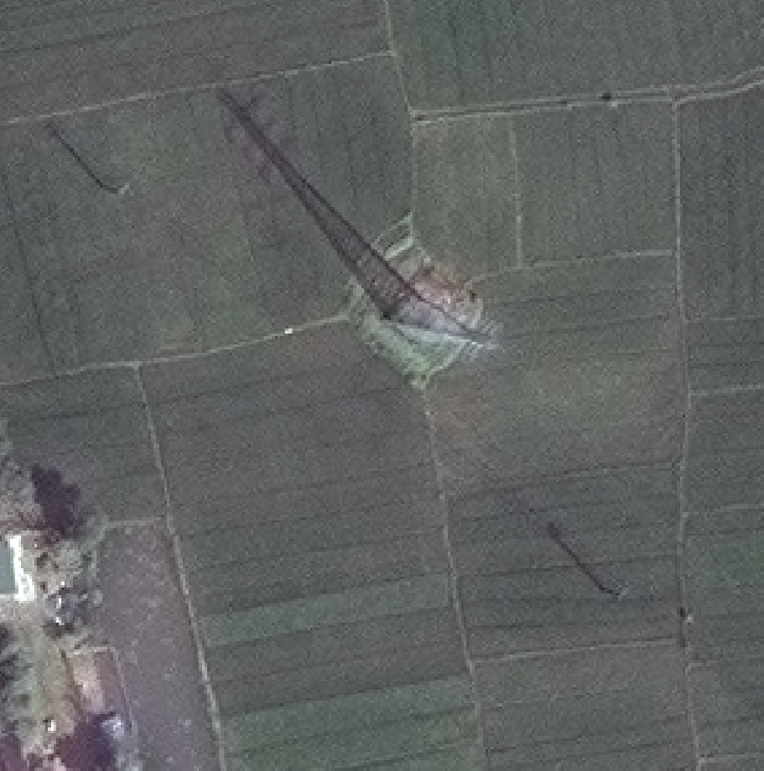
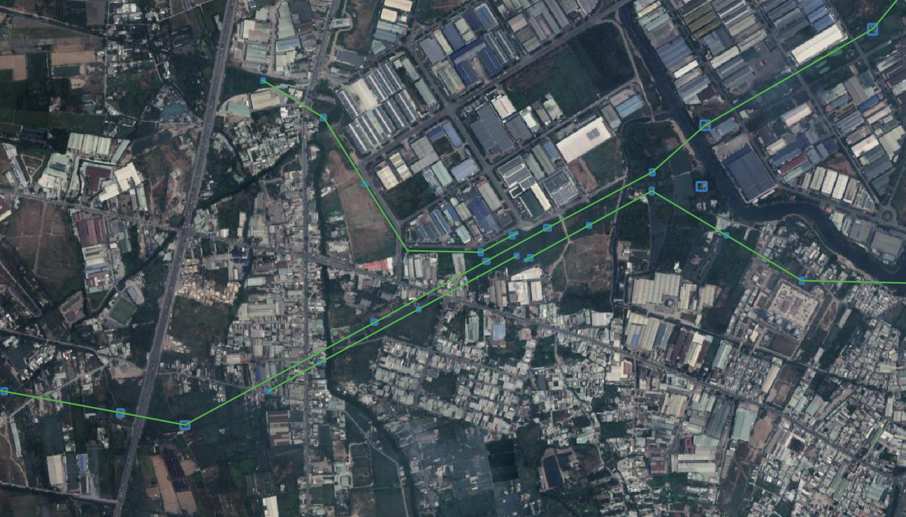
Why it is challenging to map power grids …
Weak visual features
Lack of benchmark training dataset
The structure of the expected output

Slide 3

Workflow
High-resolution satellite imagery
Data collection and preparation
Power infrastructure ground-truth data
Deep learning architecture
Detect power towers/poles
Segment power lines
Extract predicted power infrastructure

Slide 4
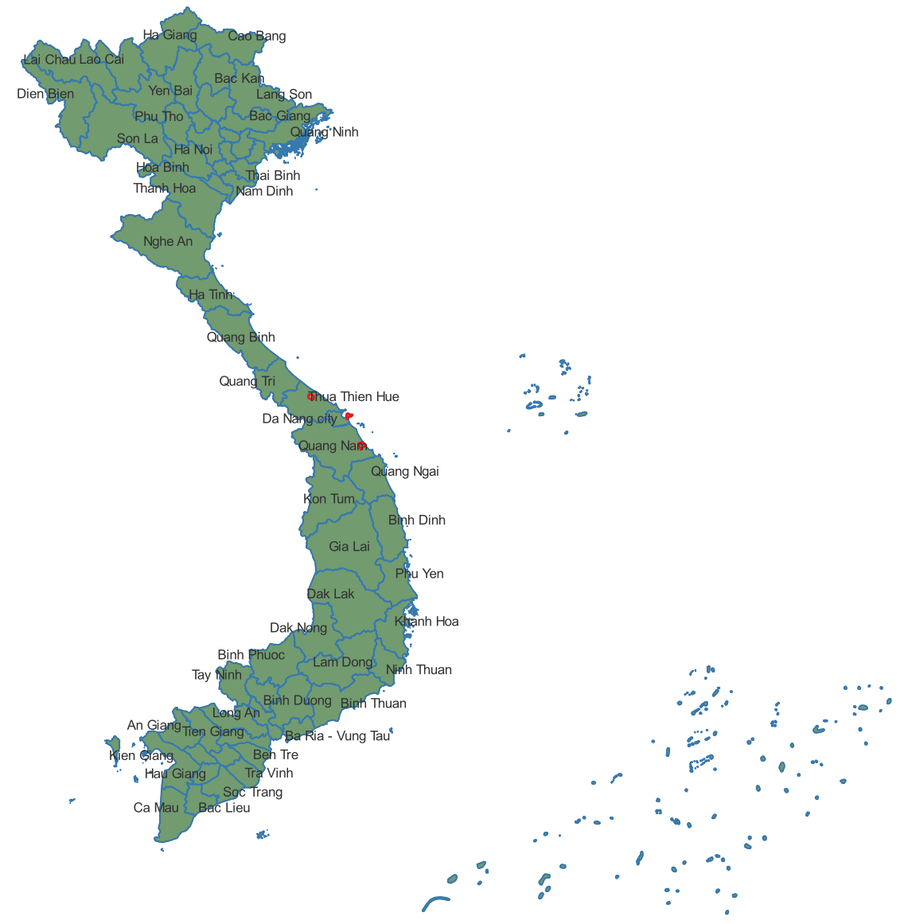
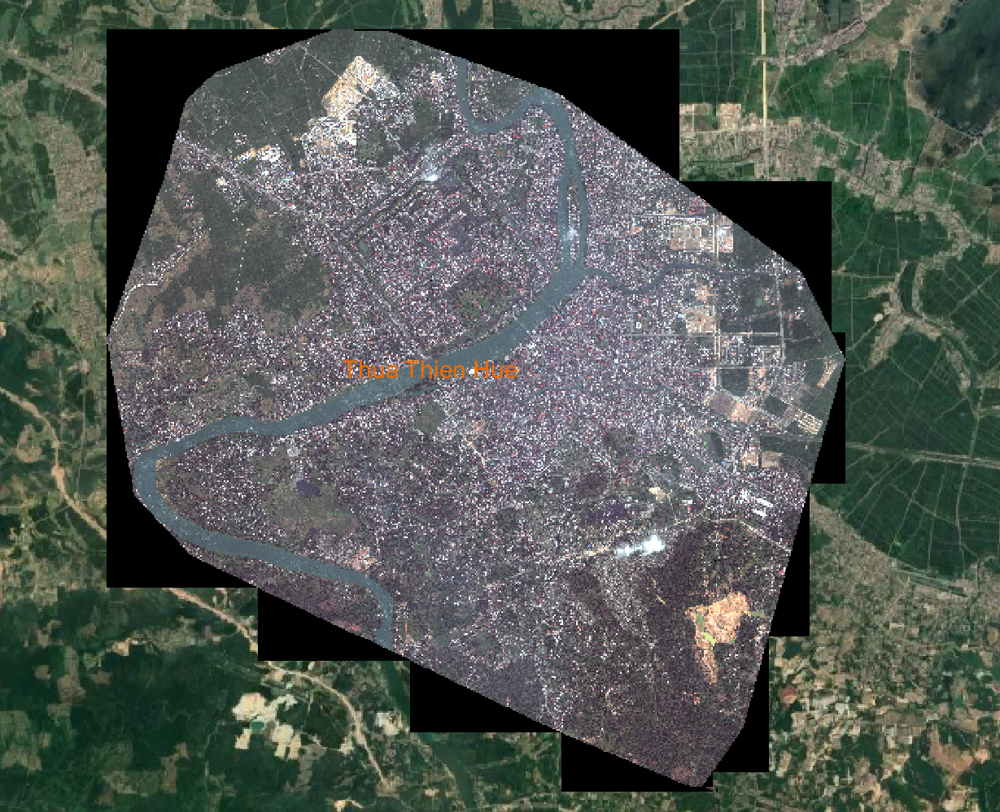
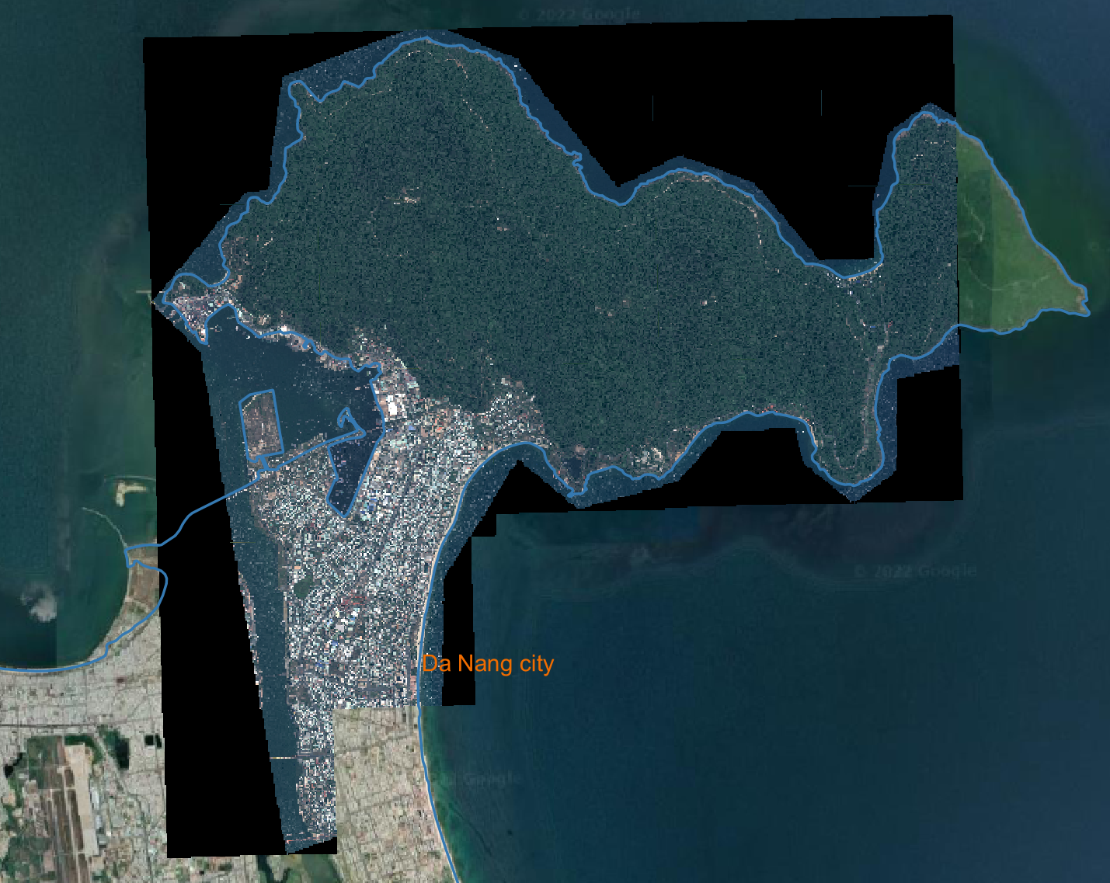
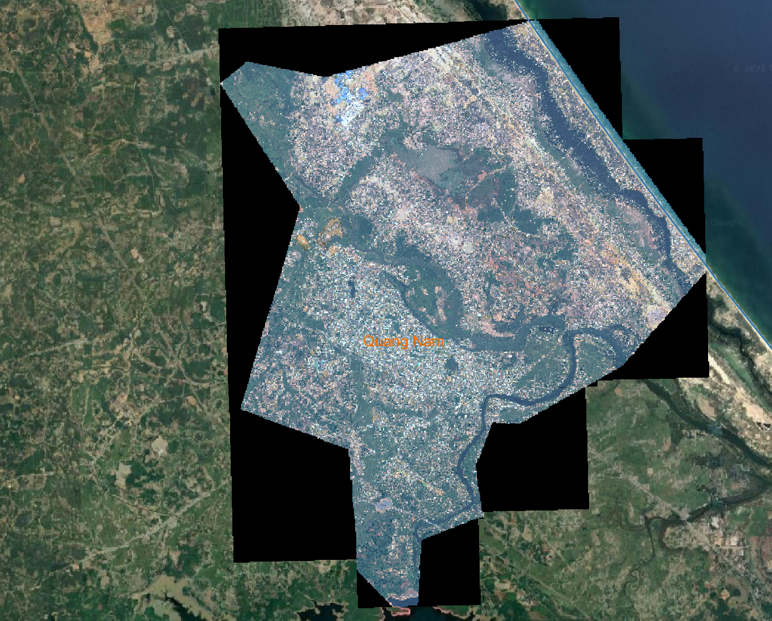
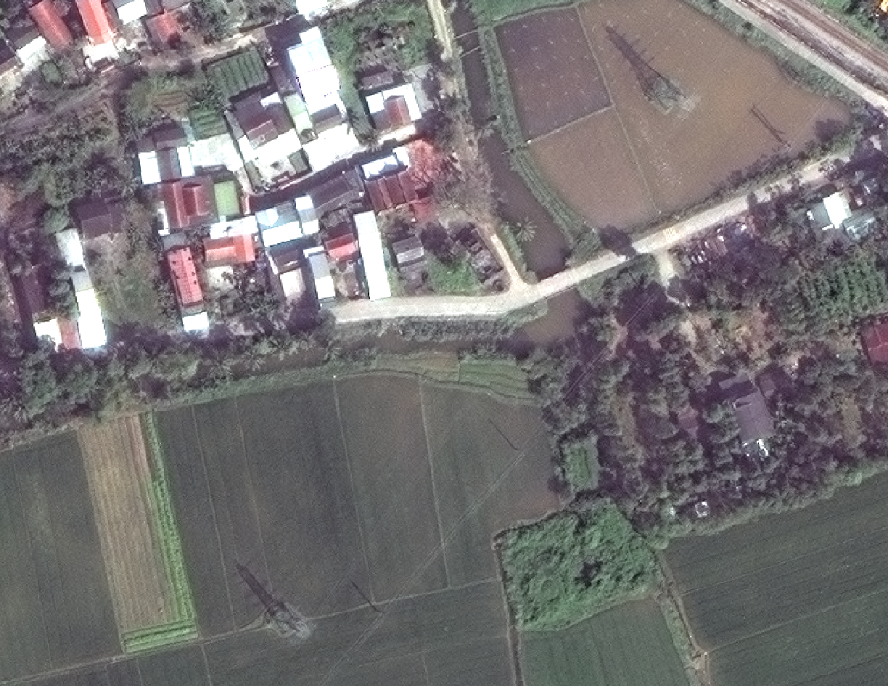
WorldView-3 imagery
Thua Thien Hue
Da Nang
Quang Nam
~230 km²
High-resolution: 30cm, 40cm
Urban and rural areas, inland and coastal areas

Slide 5
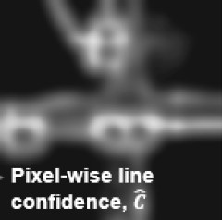
Prediction examples
Tower detector
Line segmentation
Huang et.al., 2021

Slide 6
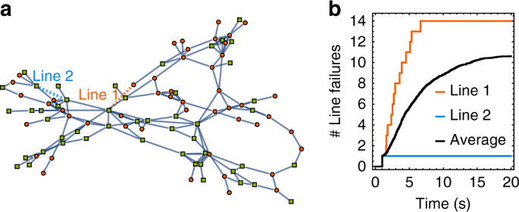
These results can be used to …
Schäfer et.al., 2018
Espinoza et.al., 2016

Slide 7
Mengqi Ye
mengqi.ye@vu.nl

