Slide 1

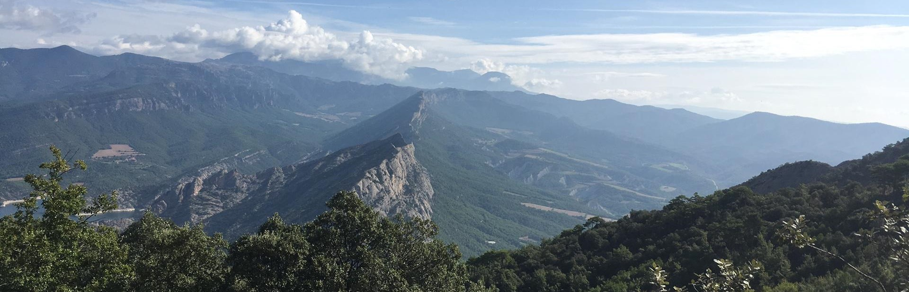




Geological characterization of the Oliana anticline, an analog of a geothermal reservoir (South Pyrenees)
^{Pedro Ramirez-Perez}
^{Irene Cantarero}
^{Daniel Muñoz-López}
^{Gabriel Cofrade}
^{David Cruset}
^{Jean-Pierre Sizun}
^{Anna Travé}

Slide 2
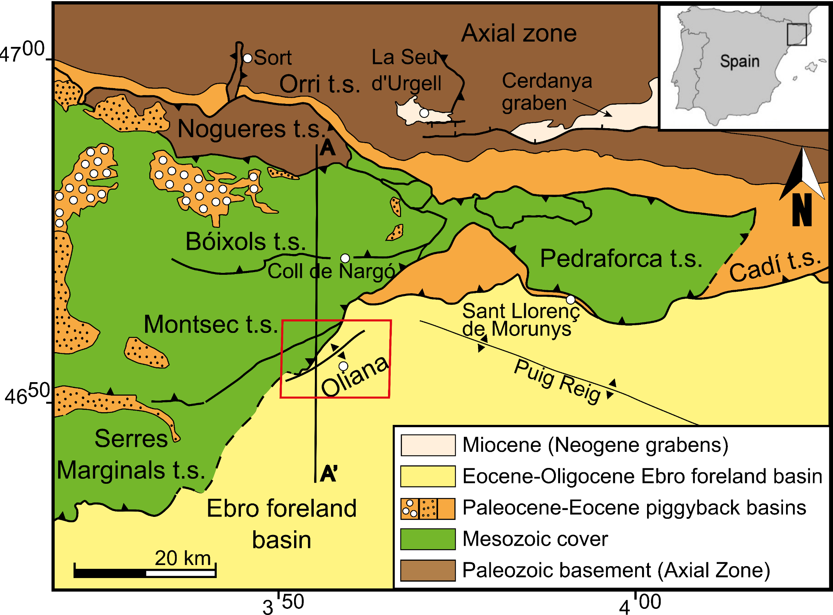
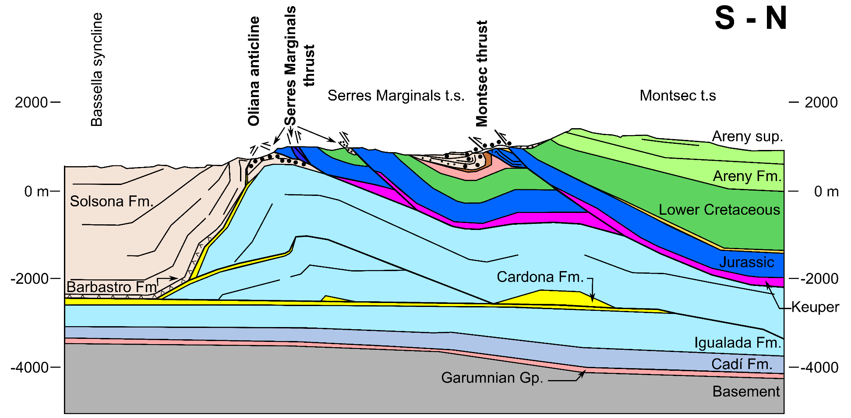
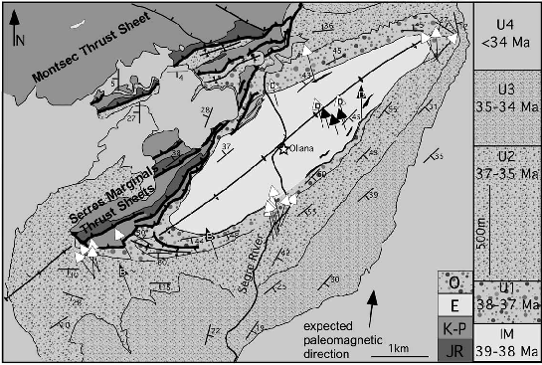
Geological setting
A
A
B
Vergés (1993)
B
Vergés (1993)
Sussman et al.,(2004)

Slide 3
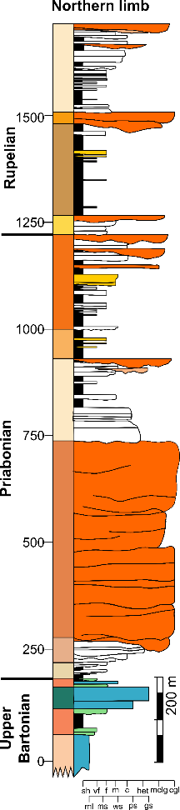
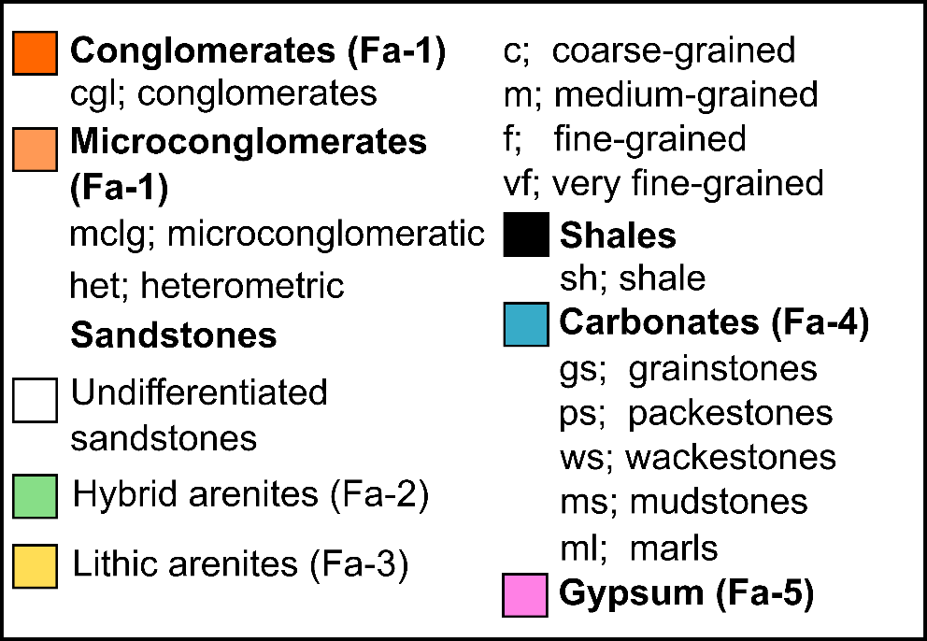
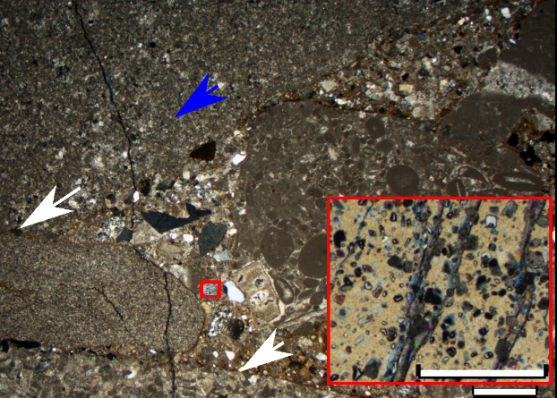
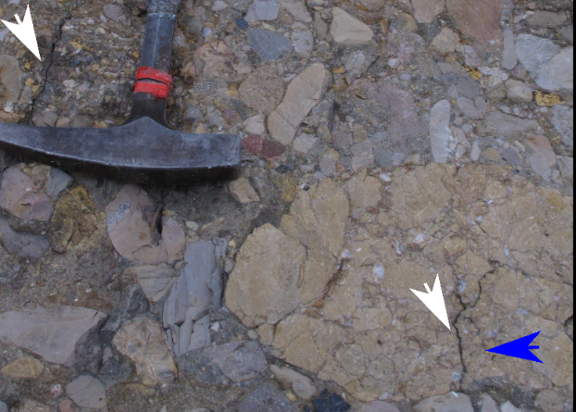
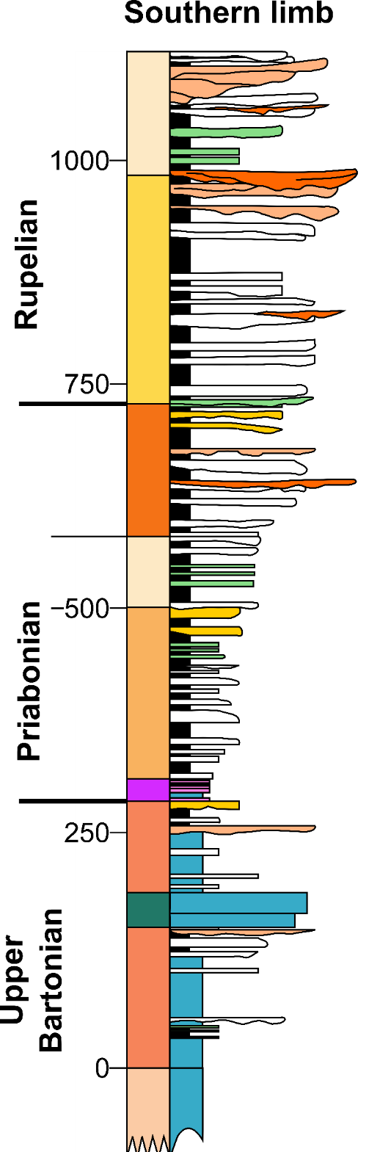
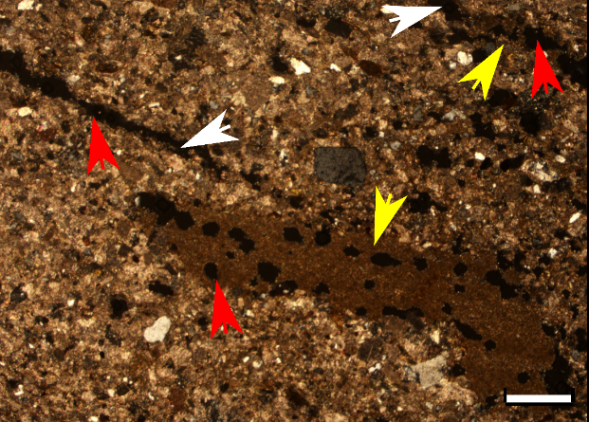
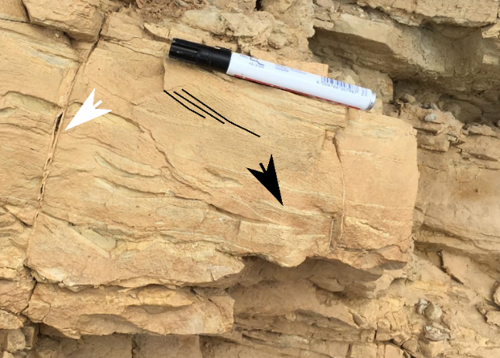
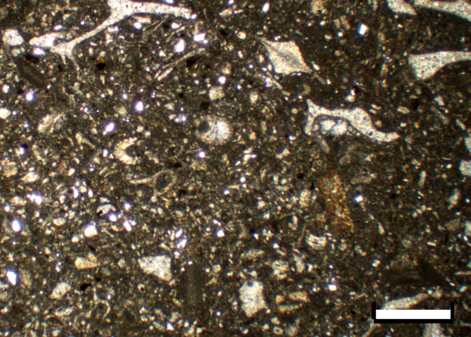
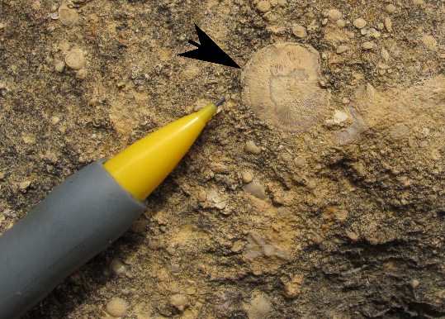
Petrology
Fa-1. Proximal facies
N=48 samples
n=63 thin sections described
Five sedimentary facies (Fa-1 to 5): conglomerates (Fa-1), hybrid arenites (Fa-2), lithic arenites (Fa-3),
carbonates (Fa-4) and evaporites (Fa-5).
Fa-1 to 3: fold limbs. Proximal alluvial facies (conglomerates) at the northern limb and distal facies (sandstones) at the southern limb of the fold.
Fa-4 and 5: restricted to fold core.
XL
Fa-2. Distal facies
XL
Fa-4. Core facies
PL
Limestone and dolostone clasts
Porosity
XL, Crossed Nicols
PL, Parallel Nicols
Open fractures and grain contact
Micrite (matrix)
Sedimentary structures/bioclasts
*Scale bar indicates 1 mm in all the cases

Slide 4
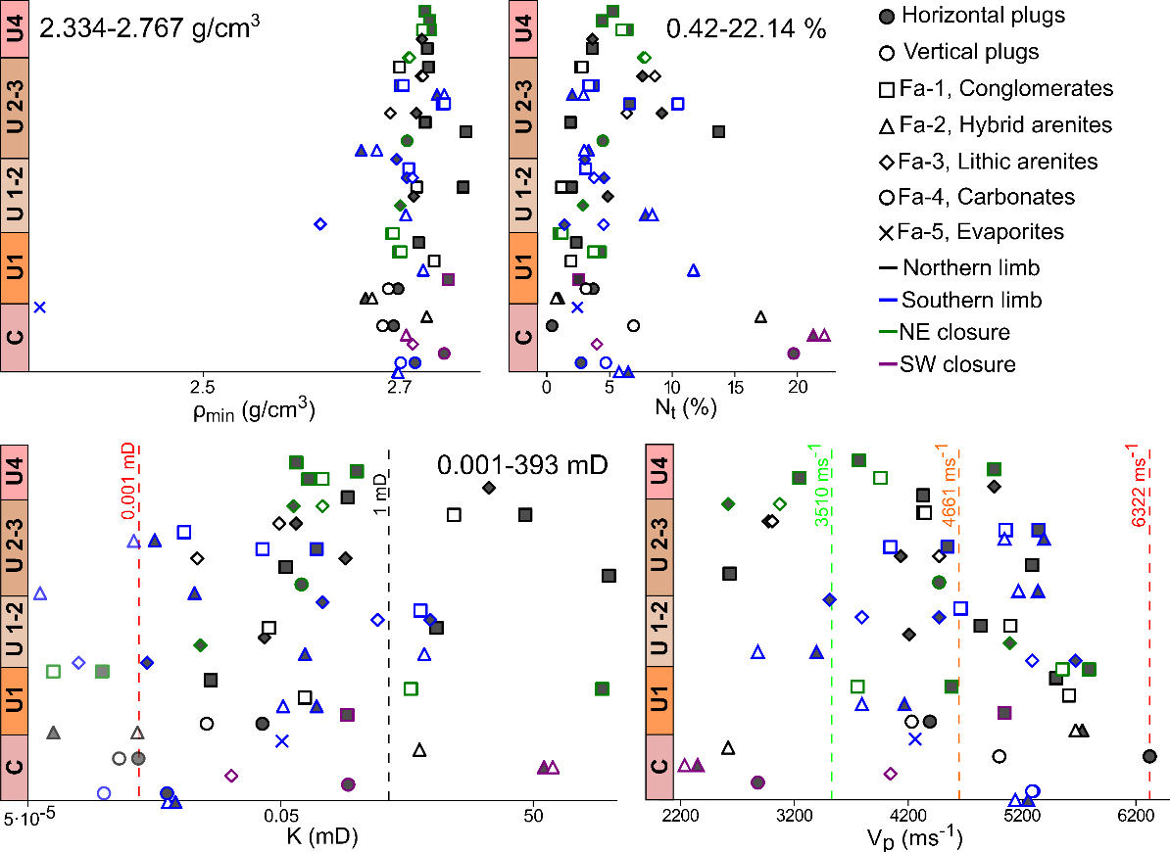
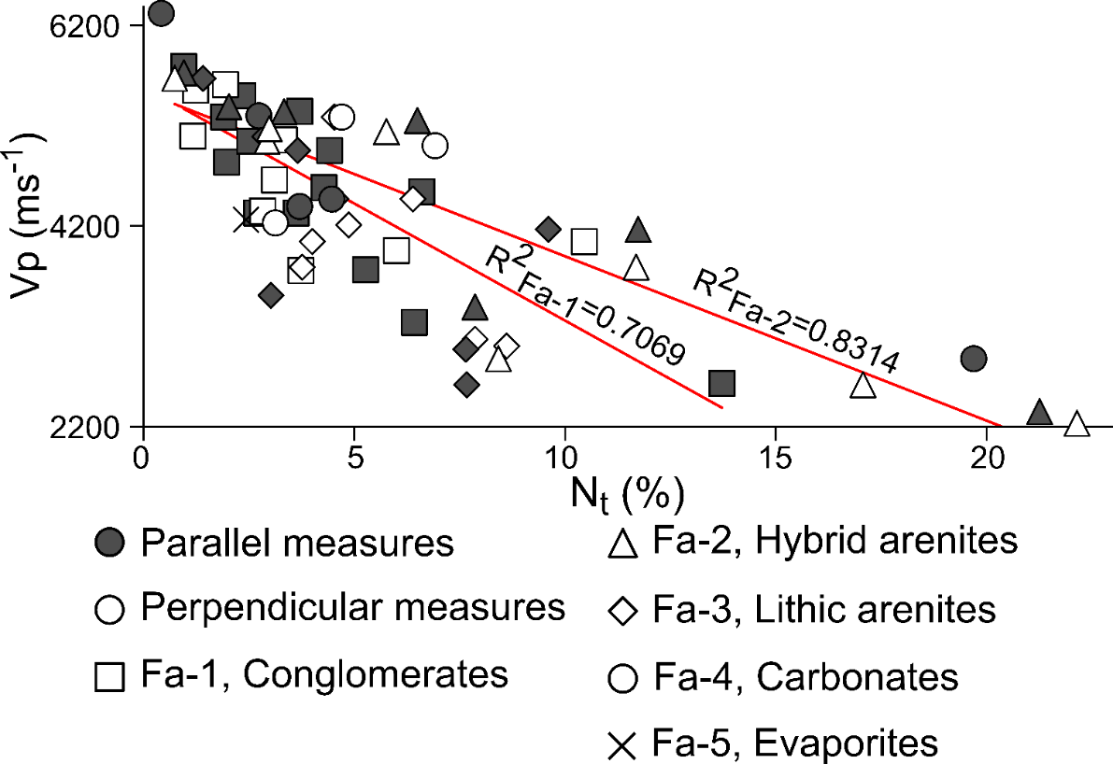
Petrophysics
Mineral density, porosity, permeability and acoustic velocity
N=40 samples
n=62 measured values
(36 bed-parallel and 26 bed-perpendicular)
Uncommon permeabilities are generally explained by porous geometries. Fracture and stylolite porosities are highly connected and led to increased permeabilities, while dissolution generates isolated vug porosity that led to low permeabilities. Cementation also modifies the porosity of rocks.
*ρ_{min}=mineral density; N_{t}=porosity, K=permeability, v_{p}=acoustic velocity

Slide 5
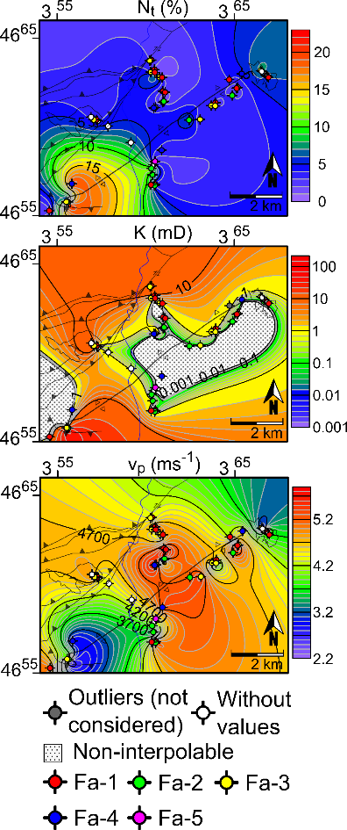
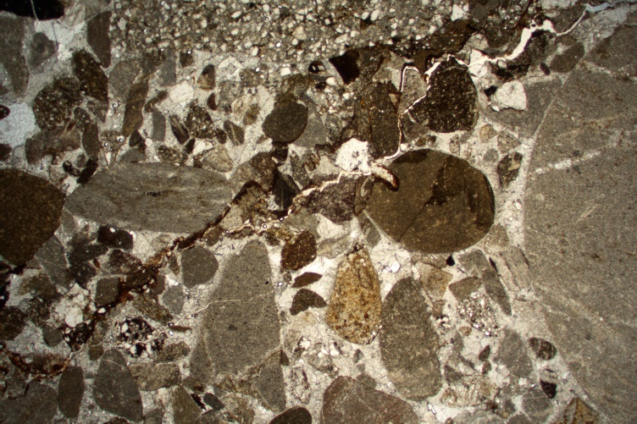
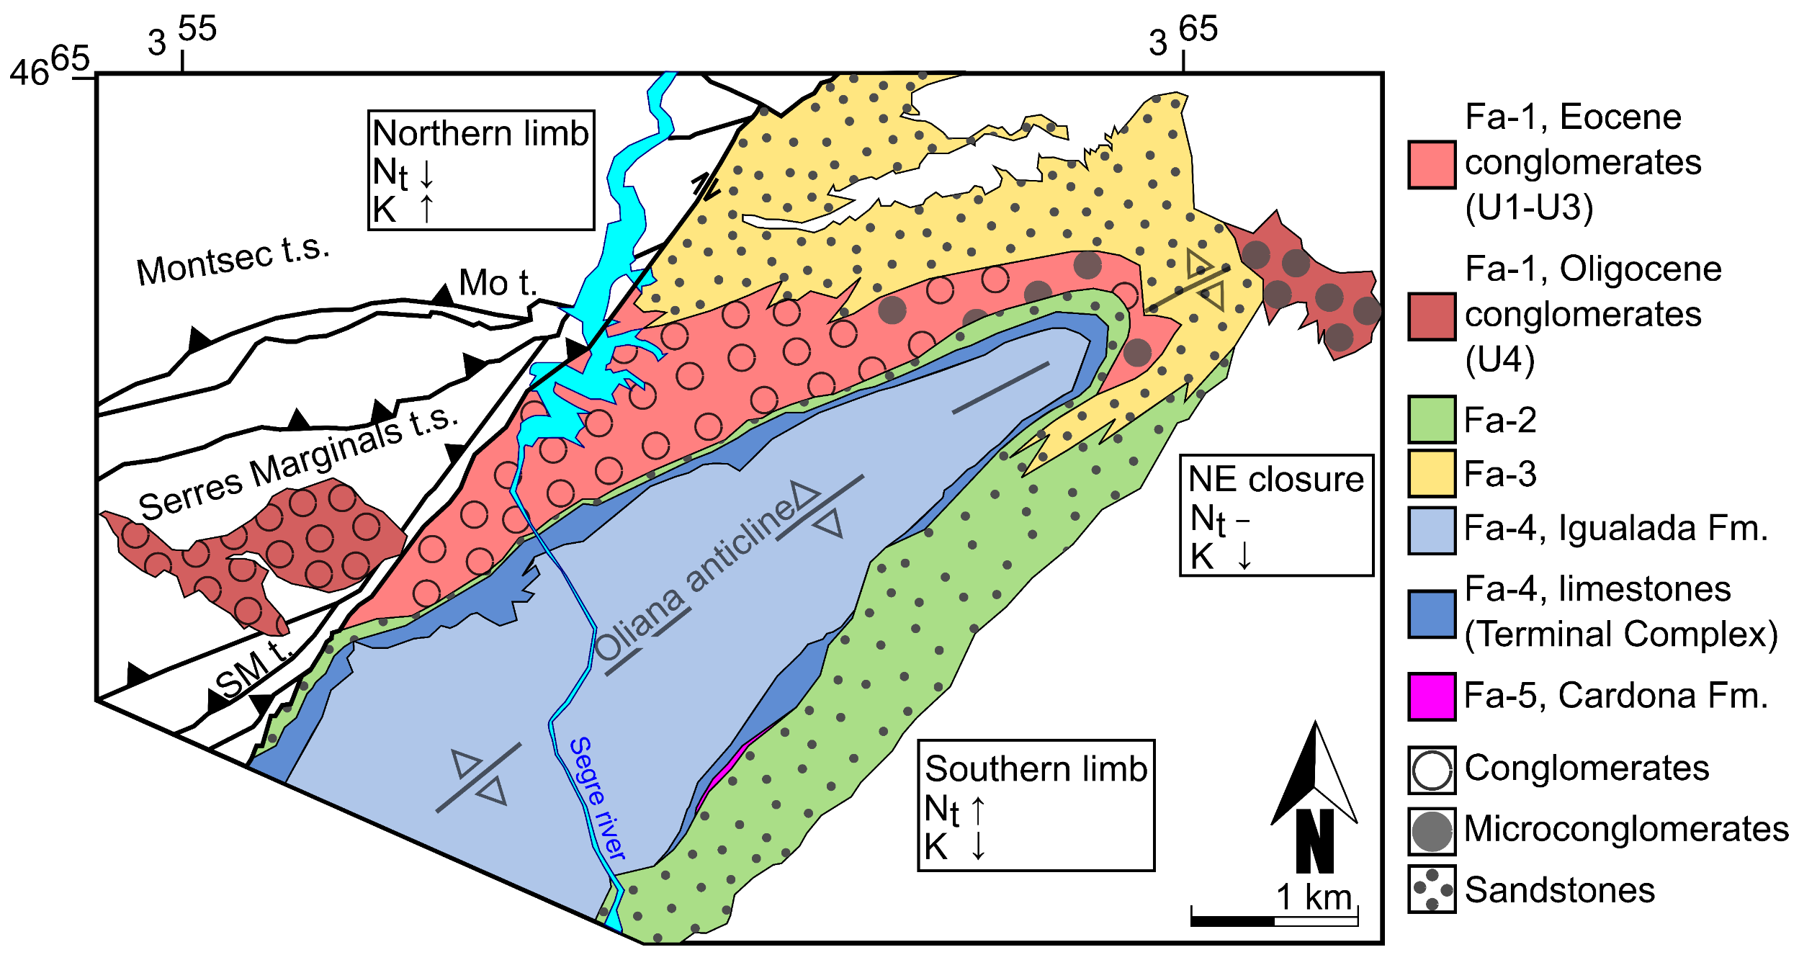
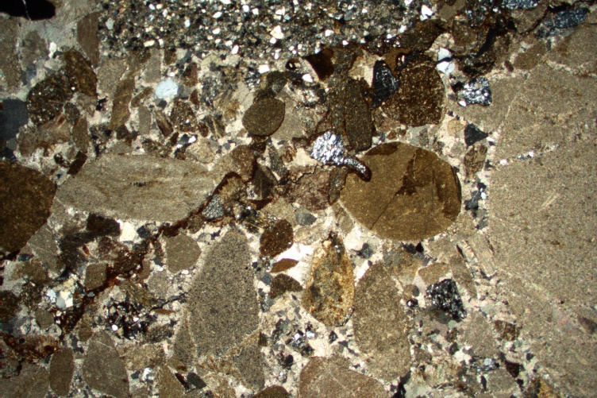
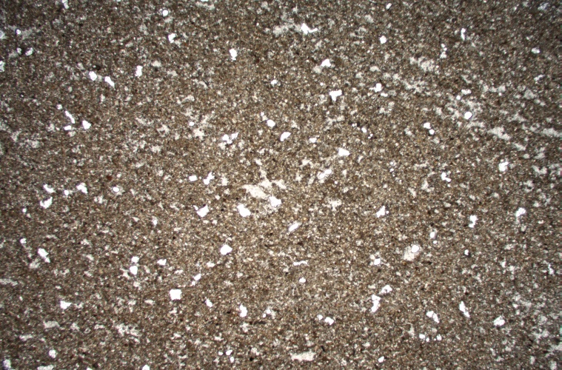
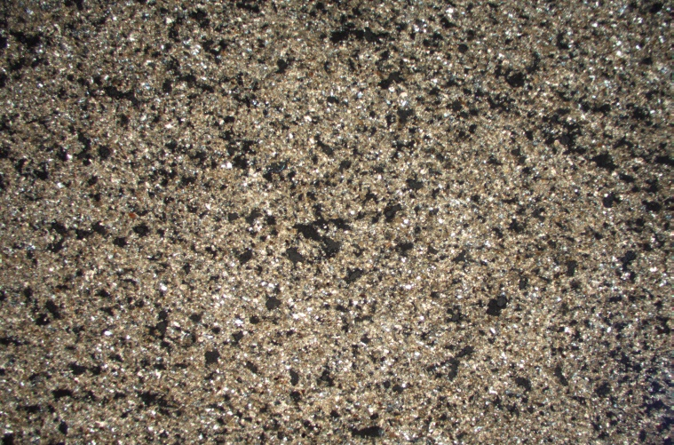
Petrophysical characterization of the Oliana anticline
A
A
B
B
Northern limb → fracture and stylolite porosity = high permeability
intense calcite cementation = reduced porosity
Main explanatory factors: tectonic stresses and fluid circulation.
Southern limb → vug porosity (dissolution) = generally low permeability
little calcite cementation = no porosity destruction
Main explanatory factors: increased dissolution due to more carbonate composition and thinner grain size.

Slide 6
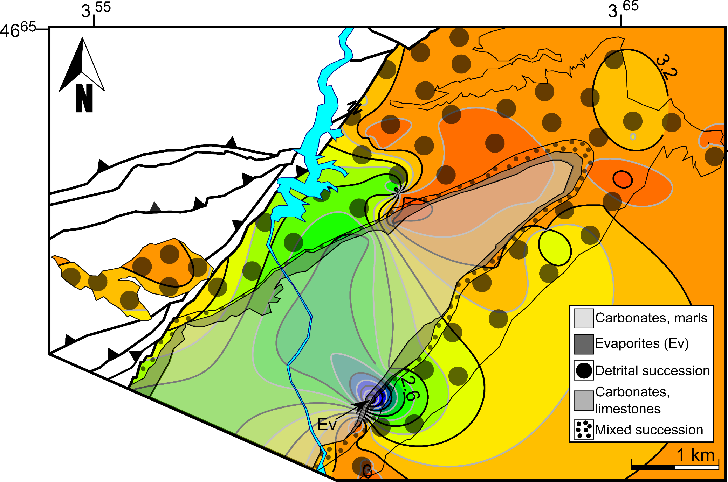
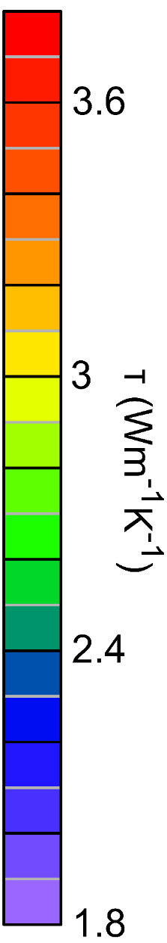
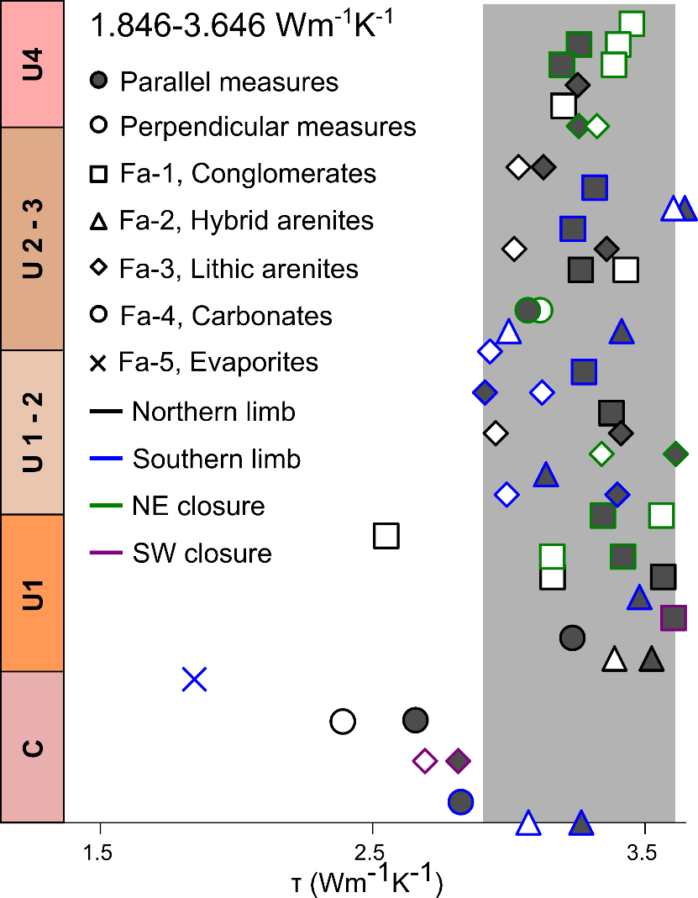
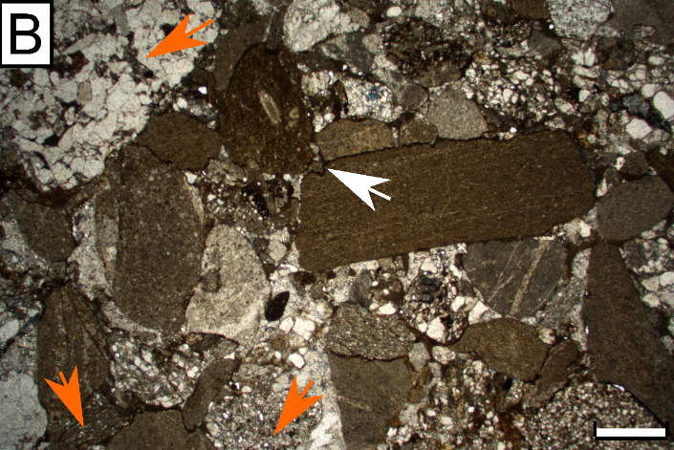
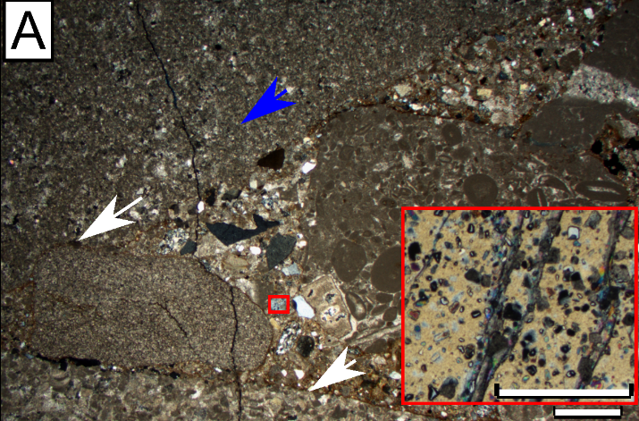
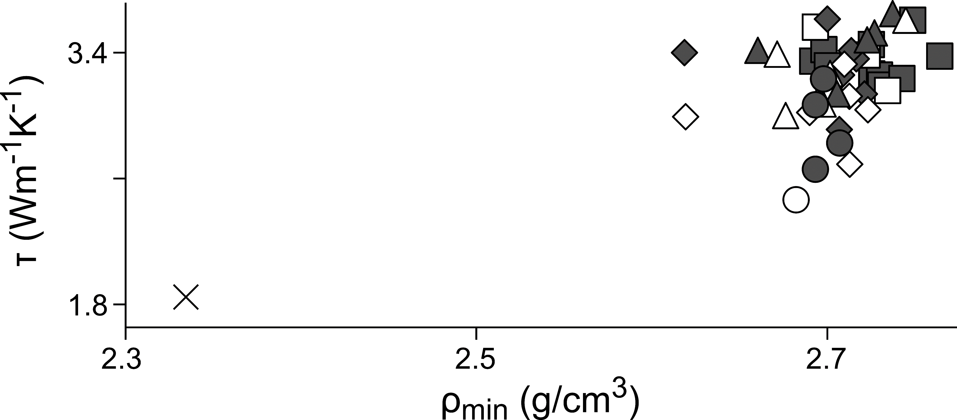
Petrothermal characterization of the Oliana anticline
Thermal conductivity
N=35 samples
n=55 measured values
(34 bed-parallel and 21 bed-perpendicular)
Correlation of variables
Rock composition explains the measured thermal conductivity change.
Fold core→ carbonates, low conductive zone.
Fold limbs → detrital rocks, high conductive zone.
The most conductive components (quartz and dolostone) depend on
the structural unit that was uplifted and eroded during the formation
of each synorogenic unit → indirect control of thrusting over petrothermics.
*ρ_{min}=mineral density; τ=thermal conductivity

Slide 7
Conclusions
The Oliana anticline will constitute a petrothermal reservoir because of the low rock permeability (in the order of 10⁻¹⁹ to 10⁻¹³ m³.
Thrusting controlled the petrophysics of the Oliana anticline. The most permeable and least porous fold sector is the northern limb, because of the intense fracturing and calcite cementation delivered from tectònic stresses and fluid circulation. In contrast, the Southern limb displays low permeabilities and high porosity because of the lack of fracturing and calcite cementation in this sector.
Thrusting indirectly controls the composition of the detrital succession in Oliana leading to changes in the thermal conductivity of sandstones and conglomerates of different synorogenic units.

Slide 8
Thank you for your attention!
Please, don´t hesitate to contact me with any questions:
pramirezperez@ub.edu
How to cite: Ramirez-Perez, P., Cantarero, I., Muñoz-López, D., Sizun, J. P., and Travé, A.: Geological characterisation of the Oliana anticline, an analogue of a geothermal reservoir (South Pyrenees), EGU General Assembly 2022, Vienna, Austria, 23–27 May 2022, EGU22-12104, https://doi.org/10.5194/egusphere-egu22-12104, 2022.

