Slide 1




SPATIO-TEMPORAL VARIATIONS IN MICROPLASTIC PRESENCE AND COMPOSITION IN THE SEDIMENTS OF THE R. THAMES (UK) AND ITS TRIBUTARIES
Karolina Skalska¹, Annie Ockelford², James Ebdon¹, Andrew Cundy³, Alice Horton³
¹University of Brighton, UK, ²Environment Agency, UK, ³University of Southampton, UK
Contact: k.skalska@brighton.ac.uk

Slide 2
Study methods: sample collection
Seasonal collection of sediment samples from 13 sites across the R. Thames catchment
Sites categorised according to surrounding land use (rural, urban, industrial)
Triplicate sediment samples collected across the river transect (inner bank, mid-channel, outer bank)
A total of 7 sampling events: Jul-19, Jan-20, Mar-20, Aug-20, Mar-21, Aug-21, Dec-21 (total = 185 sediment samples analysed as part of the study)
Sampling sites monitored across the R. Thames catchment

Slide 3
Study methods: sample analysis
Visual sorting under a binocular light microscope (100g/sample)
µATR/ATR-FTIR analysis (n = 475 particles)
1 – 5 mm
Sample sieving (3-5kg/sample)
Microscopic analysis
63 µm – 1 mm
Density flotation with NaCl (100g/sample)
SEM analysis (n = 12 particles)

Slide 4
Results: spatial variations in MP concentrations
Range: 0 – 4,241 items kg⁻¹ d.w., average: 67 items kg⁻¹ d.w.
MP concentrations significantly higher at urban and industrial locations vs. rural sites (Kruskal-Wallis, p = 0.00008)
Rural
Urban
Industrial
MP concentrations detected at the studied sites across 2019-2021
MP concentrations categorised by surrounding land use (combined rural, urban, industrial sampling sites)

Slide 5
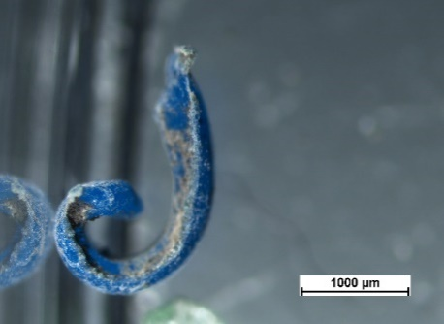
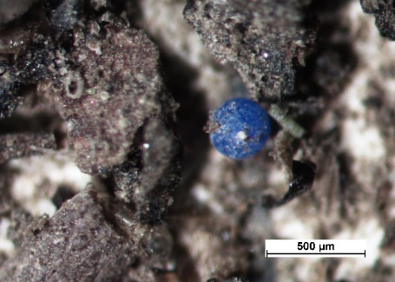
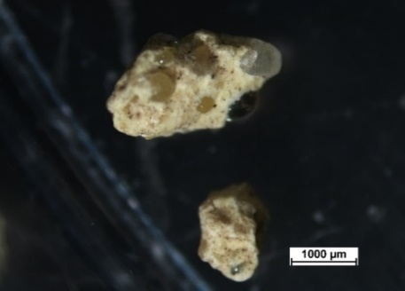
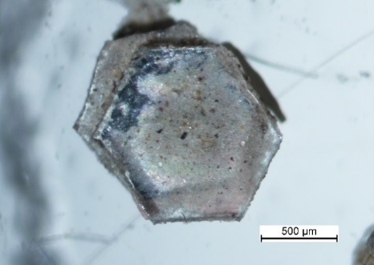
Results: spatial variations in MP shape
Fragments most abundant, but surrounding land-use influenced the detected MP shapes: beads still used for industrial applications and present at industrial sites
Raw plastic pellets (‘nurdles’)
Curved fragment (abrasion)
‘Industrial’ MP
Film
Road marking fragments
Glitter
Glass spheres
‘Rural’ MP
‘Urban’ MP

Slide 6
MP in sediment: spatial variations in MP composition
Rural and urban sites dominated by PE (polyethylene)
Industrial sites: a variety of polymers with industrial applications
ATR/µATR-FTIR data (n = 475 particles)
PE – polyethylene, Acrylates (poly(ethyl methacrylate) (PEMA), poly(methyl methacrylate) (PMMA), poly(butyl methacrylate) (PBM), poly(ethyl acrylate) (PEA)), PBT – poly(butylene terephthalate), PDP – poly(diallyl phthalate), PVP – poly(vinyl pyrrolidone), PVA – poly(vinyl alcohol), PP – polypropylene, PS – polystyrene, PVDC - Poly(Vinylidene Chloride), PCT – poly(1,4-cyclohexanedimethylene terephthalate), PA – polyamide/Nylon 6, PC – polycarbonate, PAA – polyacrylamide, EVA - ethylene-vinyl acetate, PVC – poly(vinyl chloride), PB – polybutylene, PVS – poly(vinyl stearate), PVF – poly(vinyl fluoride), PVCA - poly(vinyl chloride/vinyl acetate)

Slide 7
Results: intra-site spatial variations in MP concentrations
Detailed flow-integrated sampling conducted in Aug-21
  3 samples taken from each morphological compartment (inner bank, mid-channel, outer bank) from 4 sampling sites
No trends in MP accumulation across the river channel (Kruskal-Wallis; p = 0.83)
However, substantial variation in MP concentrations (max SD = 82 items kg⁻¹ d.w. within a single compartment)
  Highlights the need for taking replicate samples
Significant relationship between MP and fine sediment (63 – 250 µm) (Spearman; p = 0.0048), as well as FPOM (Spearman; p = 0.001)
  Promising proxies for tracking MP movement? Ongoing research efforts
Correlation between MP concentration and FPOM (fine particulate organic matter) content (based on %Loss-on-Ignition) in sediment samples from Aug 2021 (n = 54 samples)

Slide 8
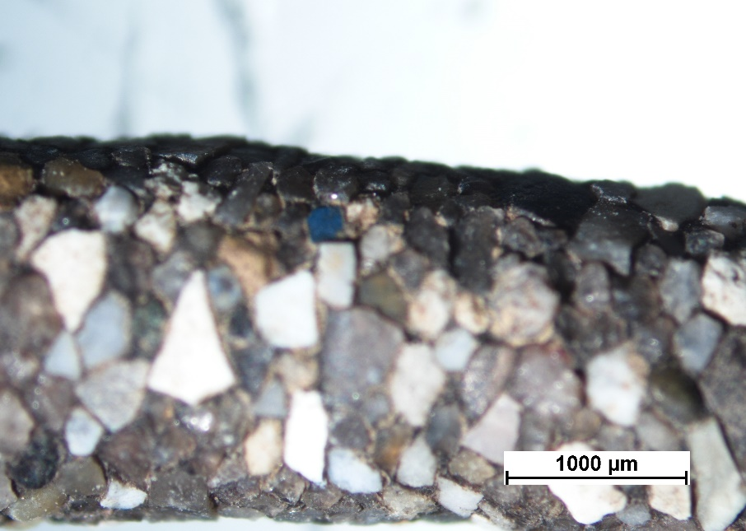
Results: MP interactions with the environment
Evidence of MP degradation (A), biofouling (colonisation by microorganisms) (B), aggregation (C) and incorporation into caddisfly shells (D)
Degradation, biofouling and aggregation all lead to changes in MP density, influencing their movement through rivers
Skalska et al., 2020
A
B
C
D

Slide 9
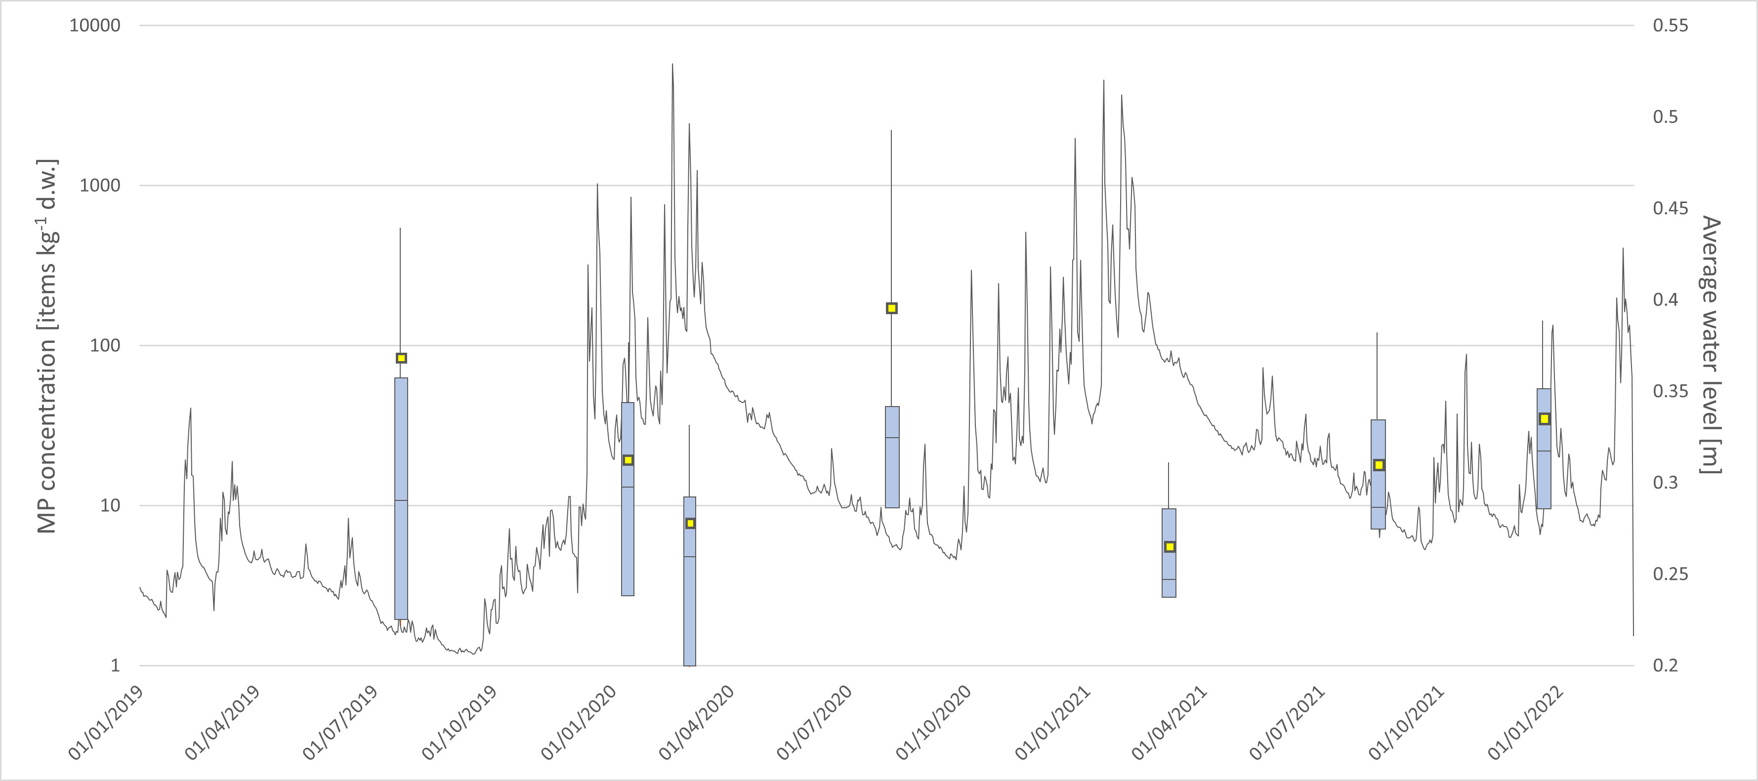
Results: temporal variations in MP concentrations
Maximum
MP remobilisation
(>τ_{c})
MP accumulation
(<τ_{c})
Average
75%
Median
25%
Minimum
‘First flush’?
Temporal changes in MP concentrations in R. Thames catchment sediment over 2019-2021 (n = 185 samples)
Low flow period
High flow period
MP concentrations increased over low-flow periods and gradually decreased during winter flooding; however, increased concentrations occurred early in the winter (Dec 2022) despite the high flows (continued accumulation/‘first flush effect’)
MP gradually remobilised from sediment later on in the hydrograph, once critical shear stress (τ_{c}) required to remobilise them is achieved

Slide 10
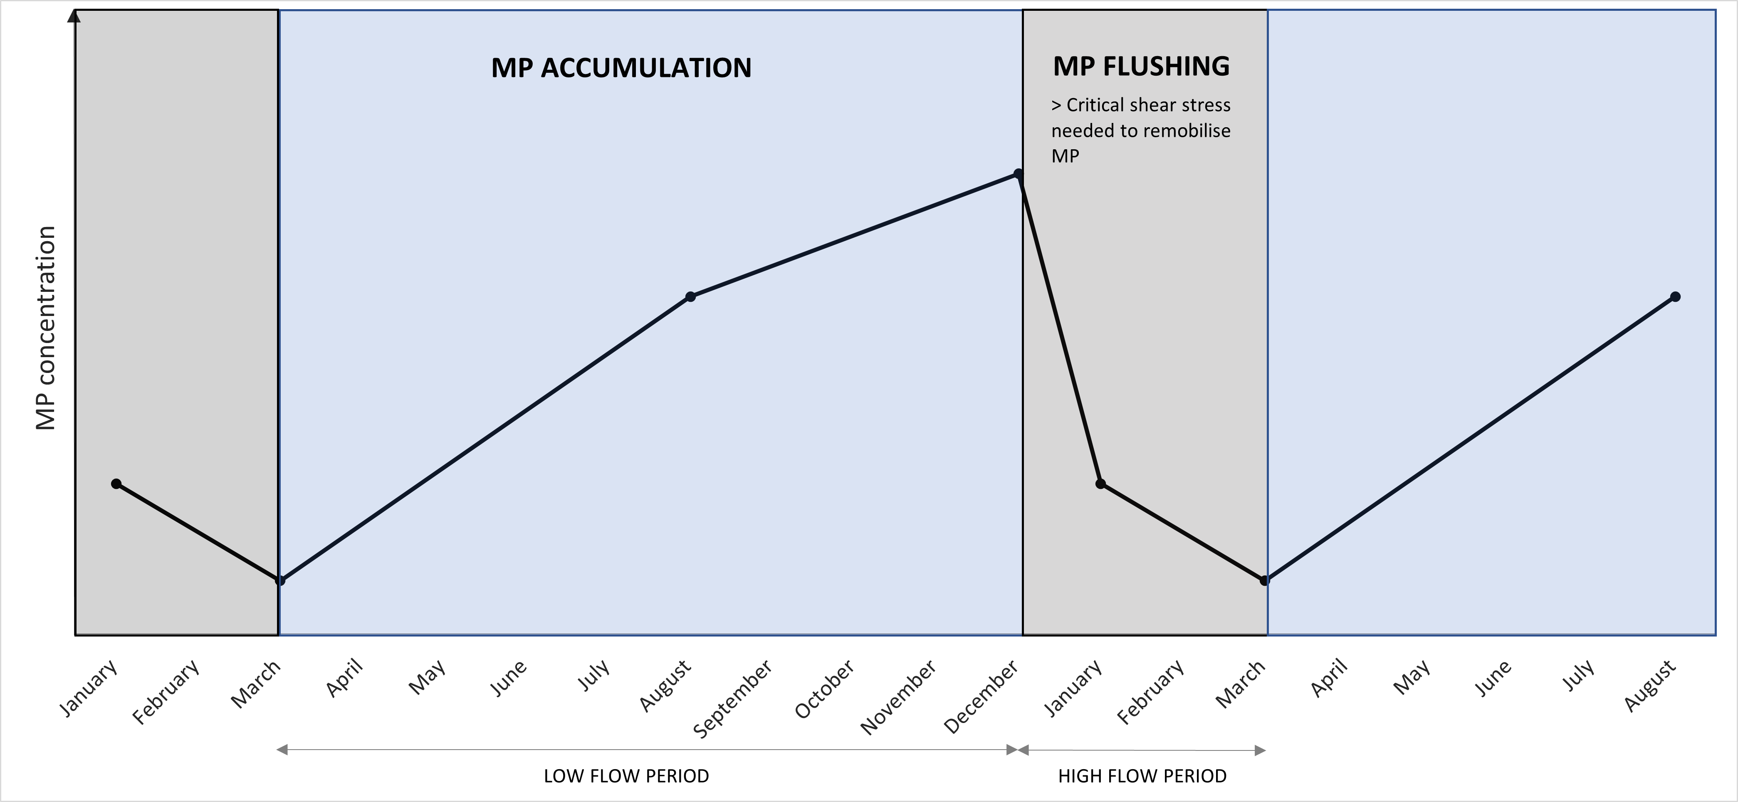
Results: temporal variations in MP concentrations (a conceptual model)
< Critical shear stress needed to remobilise MP
‘First flush’ effect
HIGH FLOW PERIOD
LOW FLOW PERIOD
MP accumulation persists until early winter
These trends may not hold true for riverbeds composed of different sediment fractions

Slide 11
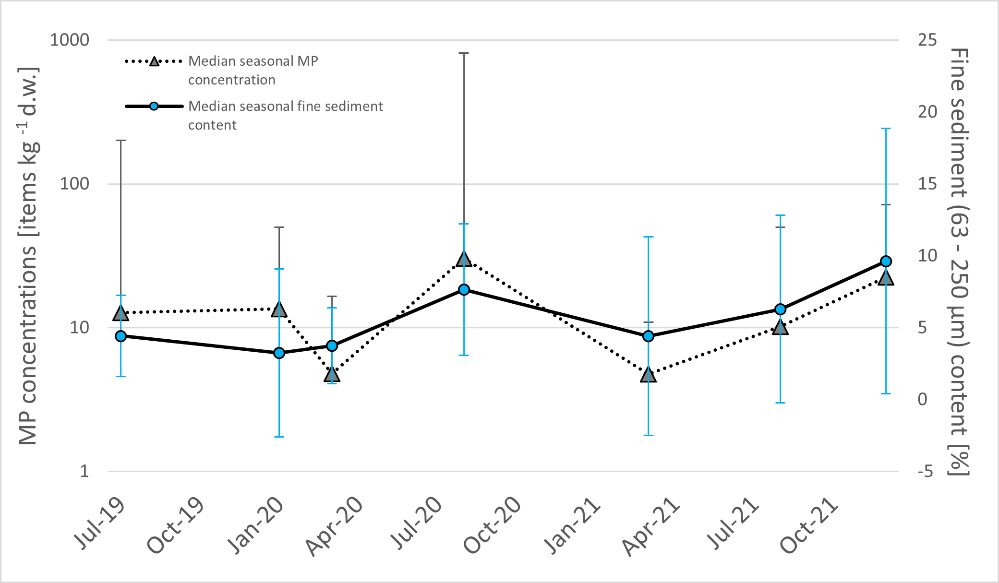
Results: fine sediments as a proxy for MP tracking?
Temporal variations in fine sediment grain content followed that of MP concentrations, although the relationship was not statistically significant (Spearman; p = 0.42)
However, changes in MP levels were more pronounced (in agreement with experimental studies which suggest MP are remobilised earlier than sediment grains; Waldschläger & Schüttrumpf, 2019)

Slide 12
Results: spatial variations over time
Although MP concentrations were significantly higher at urban and industrial location relative to rural sites regardless of sampling season, the long-term trend of MP concentrations increasing in the order of industrial>urban>rural was concealed during high-flow periods (e.g., Mar-21, Dec-21)

Slide 13

Take home messages
Temporal differences larger than generally assumed
  Need for higher-resolution temporal sampling, esp. given the predicted changes to flooding patterns
  What you get depends on when you sample!
Coarse-granular river beds represent different environments to fine sediments
  More studies needed to assess MP remobilisation from river beds of different grain size composition
  The potentially different time-scales required to flush MP from coarse vs. fine sediments should be accounted for in global MP transport models
Getty Images

