Slide 1



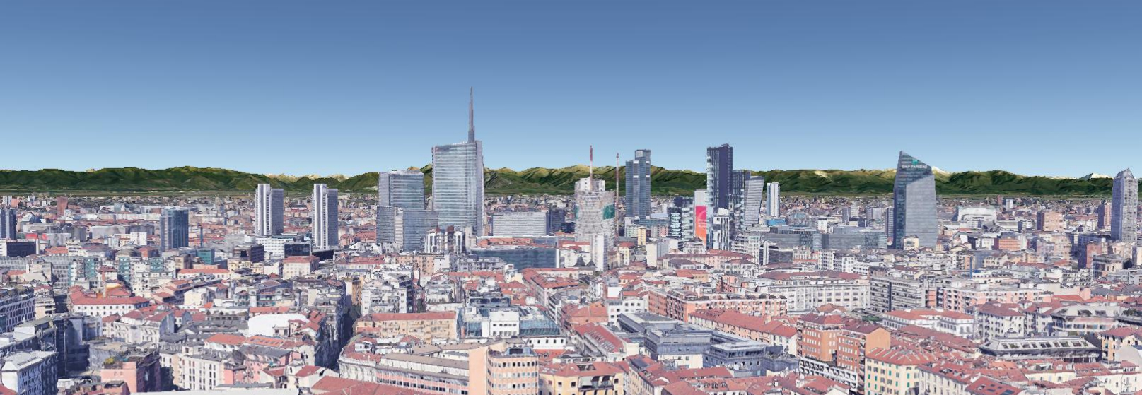
METHODOLOGIES FOR SURFACE DEFORMATIONS ANALYSIS AT REGIONAL SCALE
Fumagalli M., Previati A., Rigamonti S., Frattini P., Crosta G.B.
University of Milano-Bicocca
Dept. of Earth and Environmental Sciences (DISAT)
Notes:
Good morning everyone!
This presentation is about our methodology to analyze surface deformations at regional scale.

Slide 2




Rationale
Aims of the work
-- Unravel spatial and temporal trends of ground deformation over a large alluvial basin
-- Build a conceptual model of the ground deformation related to piezometric fluctuations
-- Validation of the hypothesis by means of a hydro-mechanical model
Fumagalli M., Previati A., Rigamonti S., Frattini P., Crosta G.B. Methodologies for surface deformations analysis at regional scale 27/05/2022, Vienna
Notes:
The aims are:
Reveal spatial and temporal trends of ground deformation in a highly urbanized area
Build a conceptual model for the different ground motion styles in the area
Validate the ground deformation by a simple hydromechanical model

Slide 3
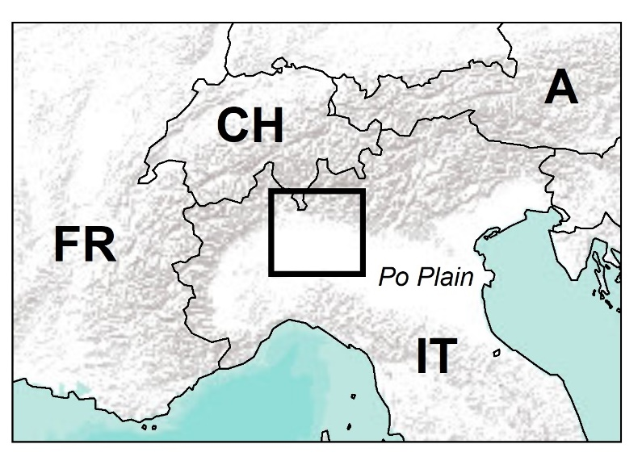
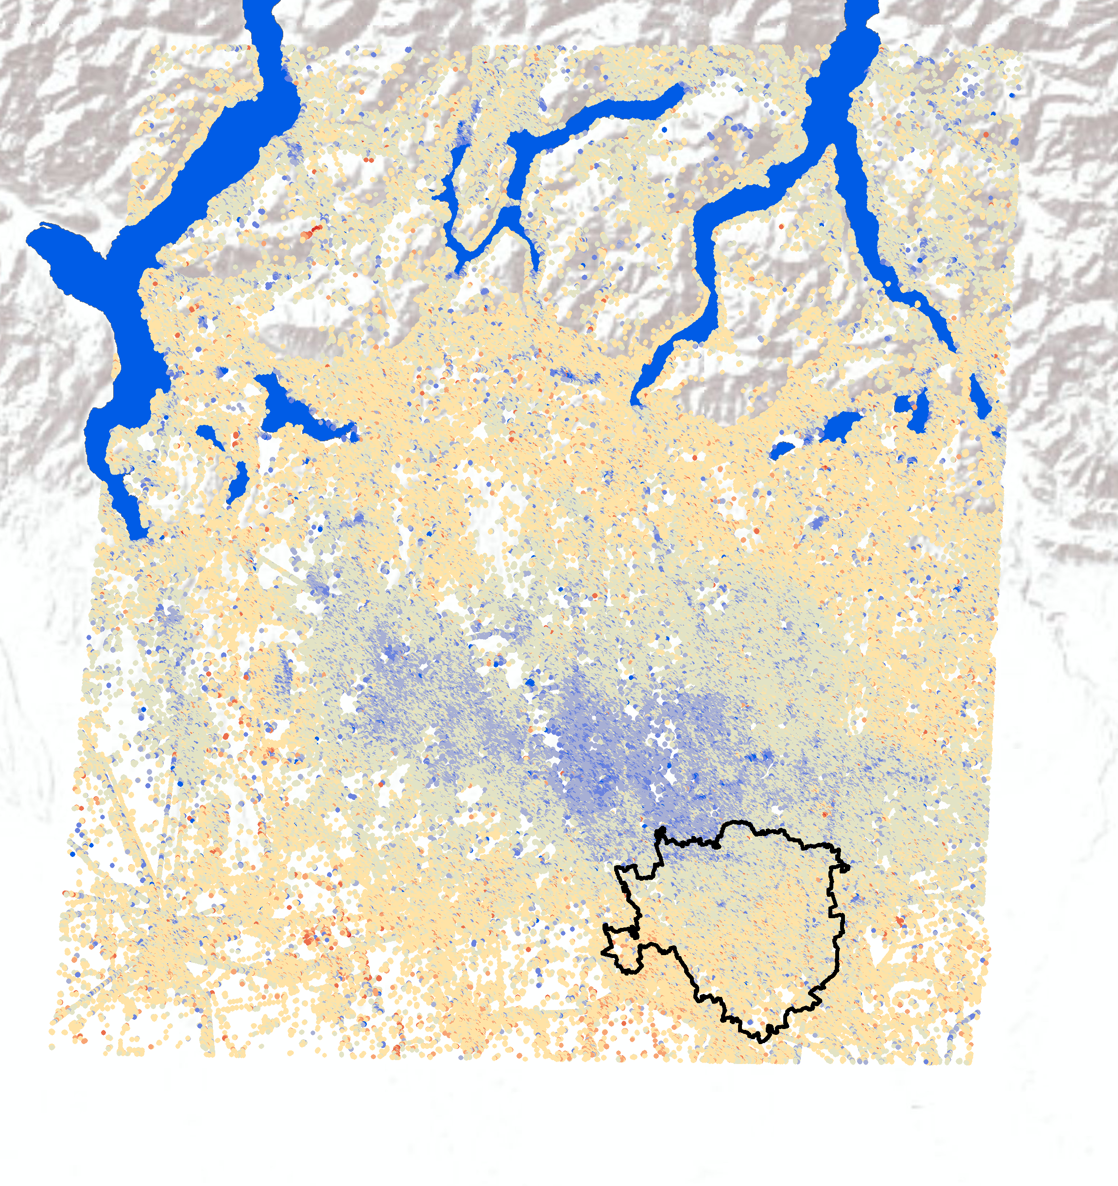


Study area → PS-InSAR Dataset
Sentinel-1A/B PS-InSAR data:
Revisiting time 6 days
Avg. PS distance 20m
Time range 2015-2021
Number of PS 866,316
Time series pre-processing
PS vertical velocity (mm/y)
+ 5
4 months moving mean
10 km
- 5
Fumagalli M., Previati A., Rigamonti S., Frattini P., Crosta G.B. Methodologies for surface deformations analysis at regional scale 27/05/2022, Vienna
Notes:
We are in the upper part of the Po plain, north of Milan city: the geological context is a sequence of medium to coarse-grained layers (sands and gravels) interebedded by fine layers.
We analyzed the spatial distribution of ground motion from a dataset of InSAR PS obtained from SENTINEL data with a rivisting time of 6 days.
Looking at the map, we can observe a wide gently subsiding area oriented NW-SE at the rate of -3/4 mm/yr.

Slide 4
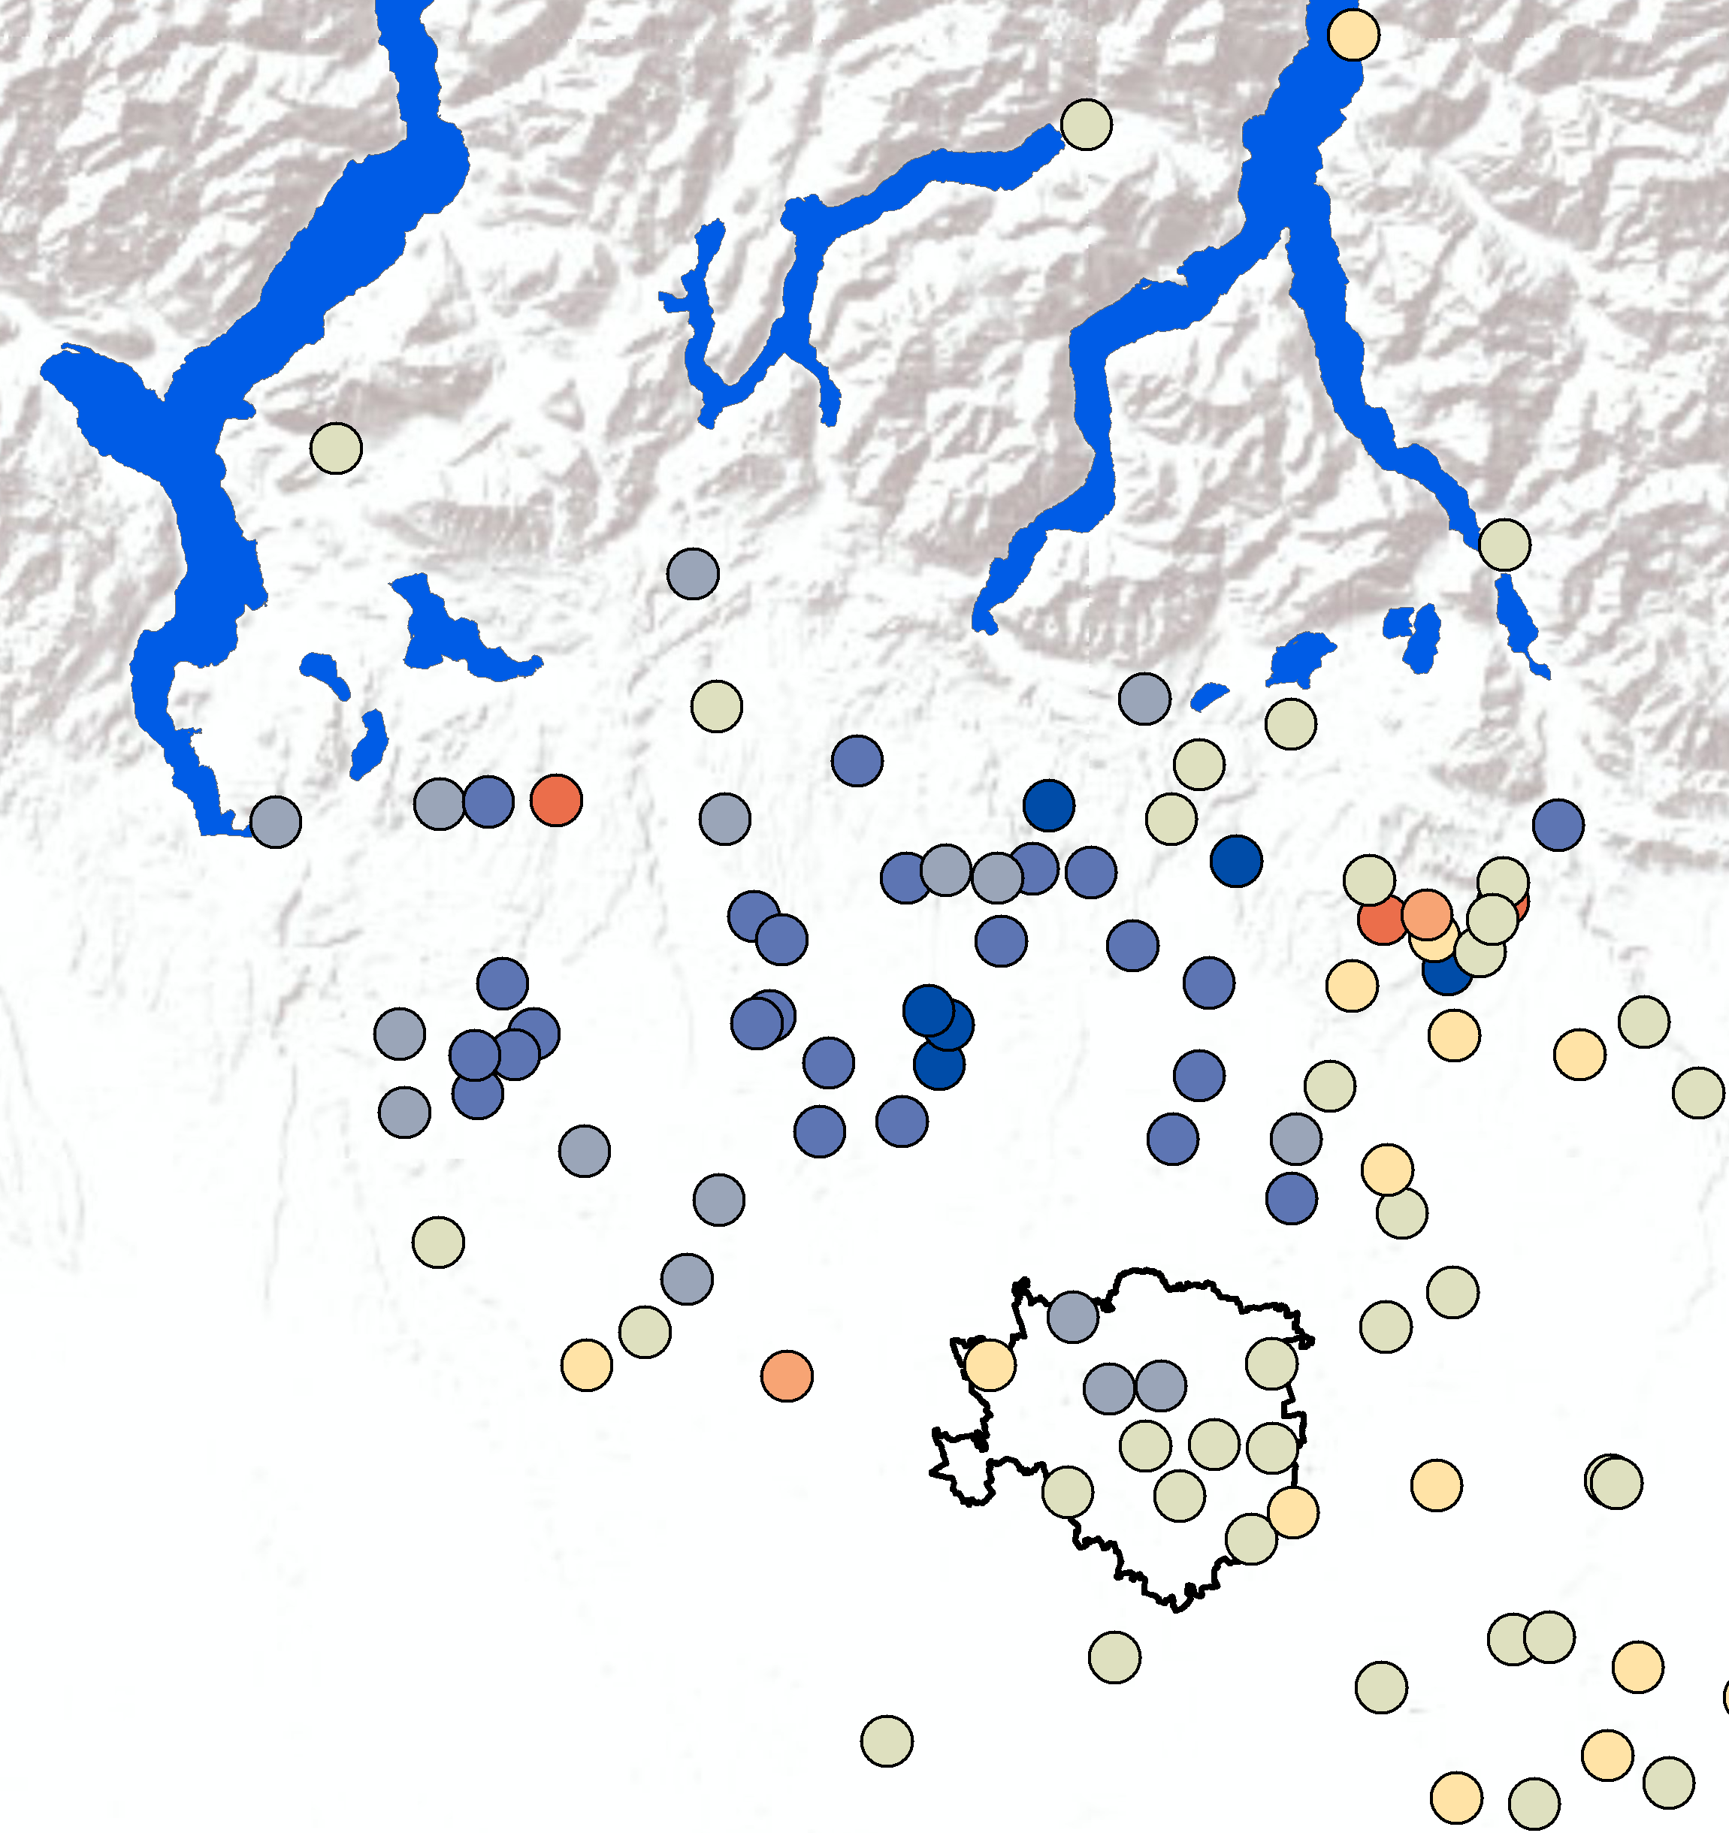
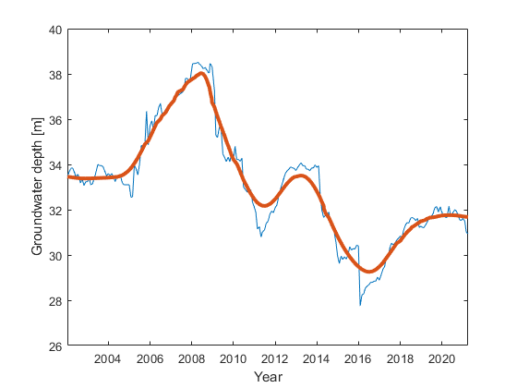
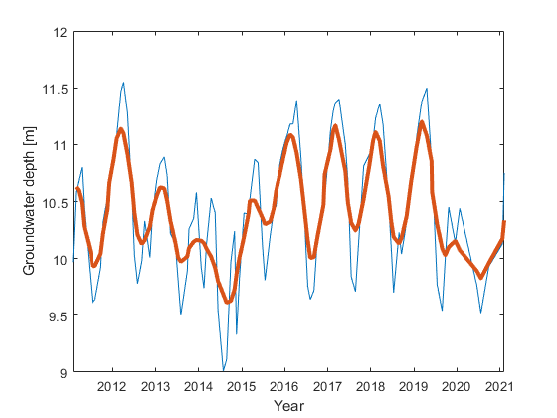
Study area → Piezometric Dataset
Piezometric data:
Revisiting time 1-4 months
Avg. distance 10km
Time range 2015-2021
Number of points 102
Time series pre-processing
Outlier removal
Moving mean
Groundwater
Fluctuation
(m/y)
+ 2.5
10 km
- 2.5
Fumagalli M., Previati A., Rigamonti S., Frattini P., Crosta G.B. Methodologies for surface deformations analysis at regional scale 27/05/2022, Vienna
Notes:
Similarly, as we expect the observed ground motion to be related to aquifer pressure changes.
We collected about 100 piezometric time-series from the regional agency and we adopted similar pre-processing techniques.
To confirm the correlation between groundwater fluctuations and ground motion we adopted the following workflow:

Slide 5
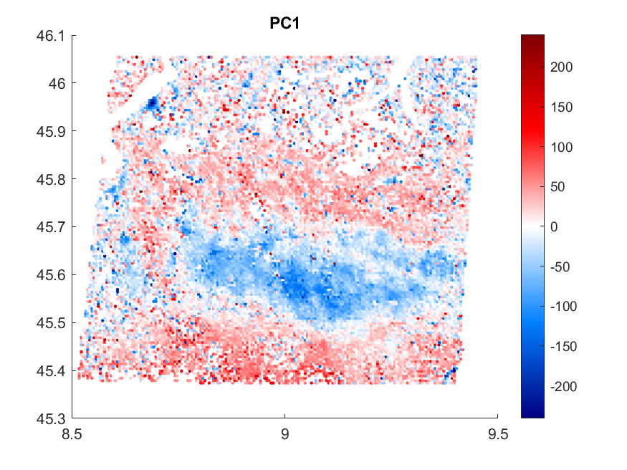
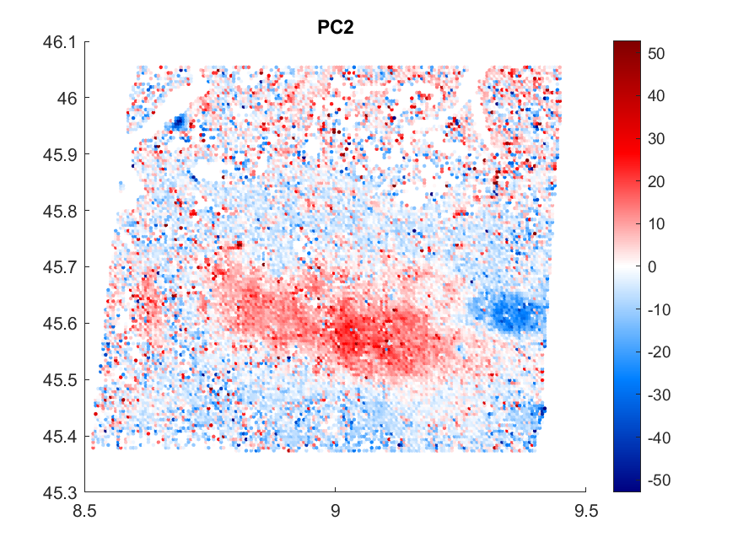
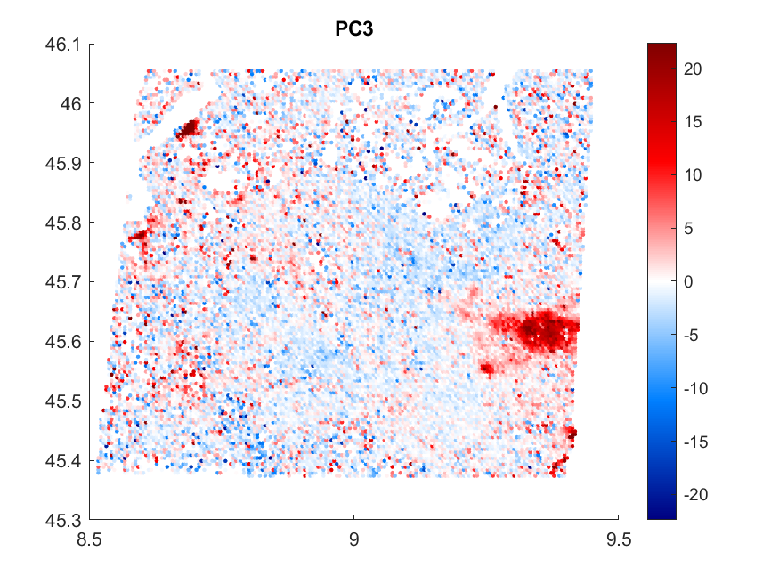
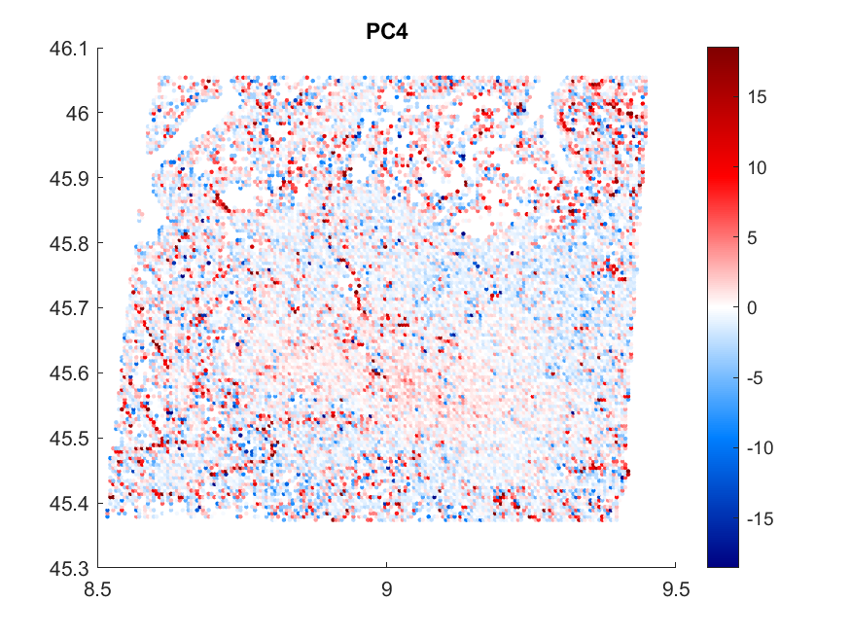
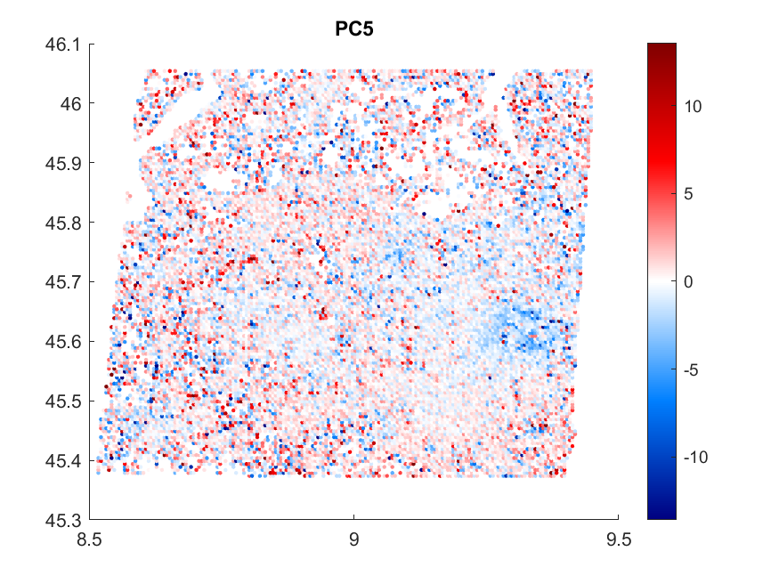
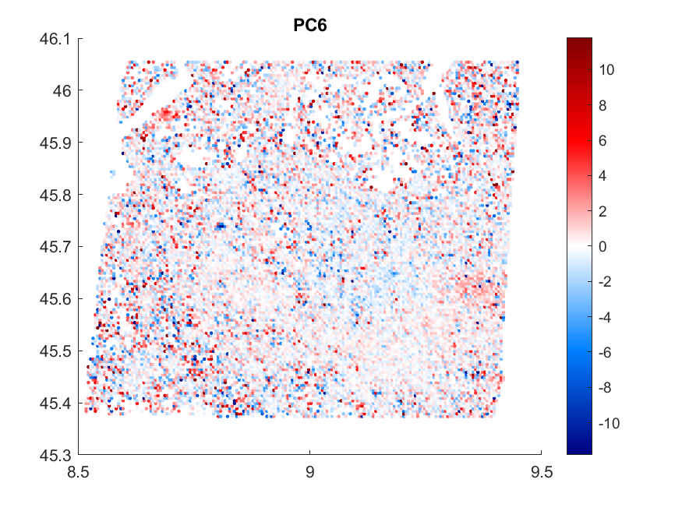
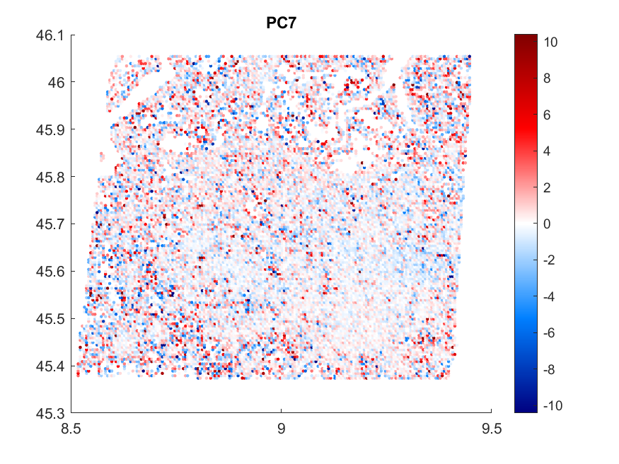
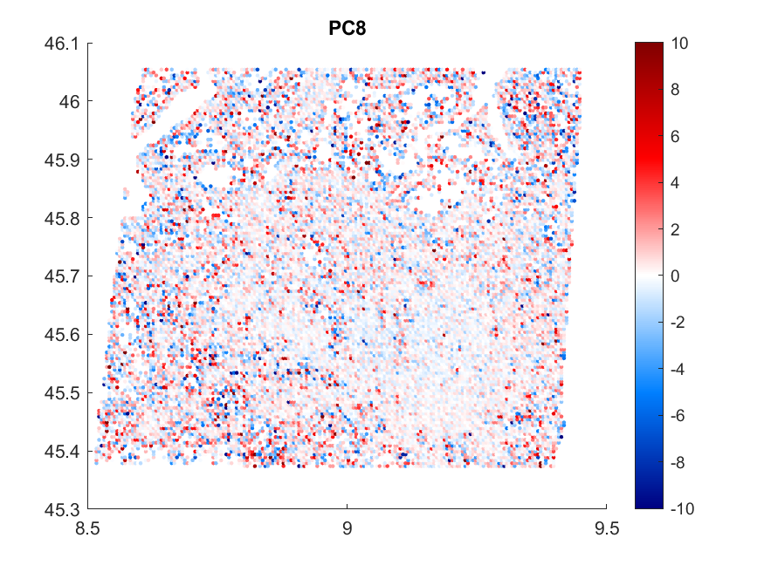

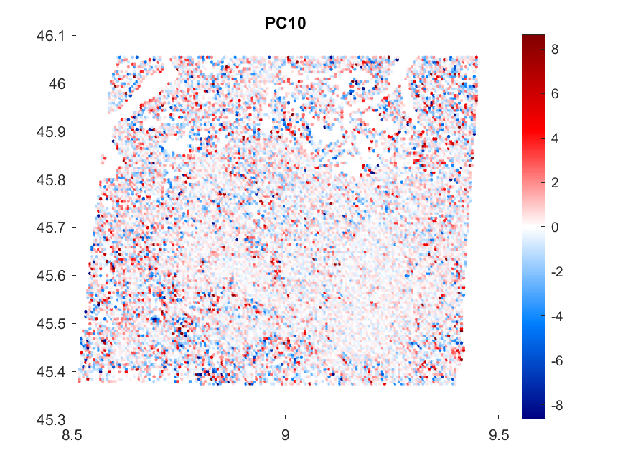
Multivariate analysis
Beyond the PS velocity…
Multivariate analysis
PCA / ICA
Fumagalli M., Previati A., Rigamonti S., Frattini P., Crosta G.B. Methodologies for surface deformations analysis at regional scale 27/05/2022, Vienna
Notes:
First, due to the large number of PS and to the variety of motion styles in the area we performed a PC analysis in temporal mode, meaning that the variables are the sampling dates and each PS is an observation.
From the loading plots we observe 1) linear, 2) rebounding and 3) periodic motion styles with different frequencies

Slide 6
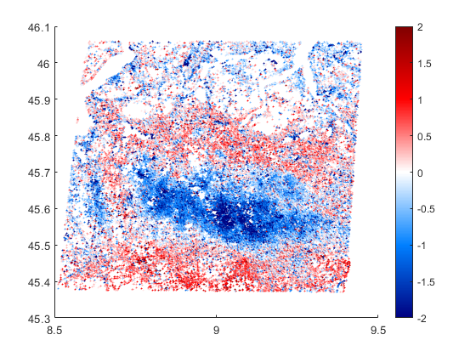
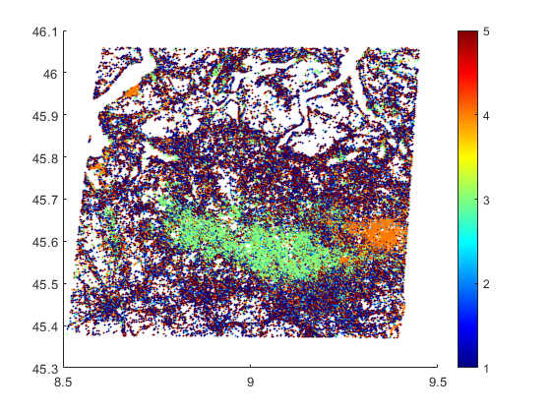
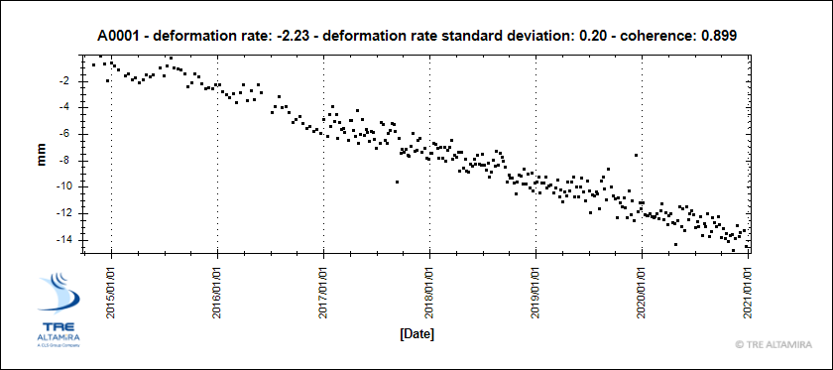
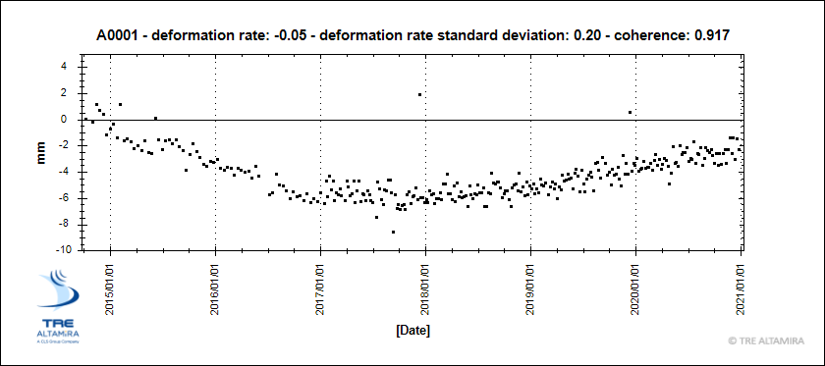
Multivariate analysis → Identification of different ground motion areas
Beyond the PS velocity…
PS Velocity
5 Clusters
Multivariate analysis
PCA / ICA
Clustering algorithm
K-Means - 10 PC
Fumagalli M., Previati A., Rigamonti S., Frattini P., Crosta G.B. Methodologies for surface deformations analysis at regional scale 27/05/2022, Vienna
Notes:
But… to reveal significant spatial patterns we performed an additional k-means cluster analysis on the scores of the first 10 PC
Surprisingly, a new spatial distribution other than the main one was discovered with a rebounding ground motion style.

Slide 7
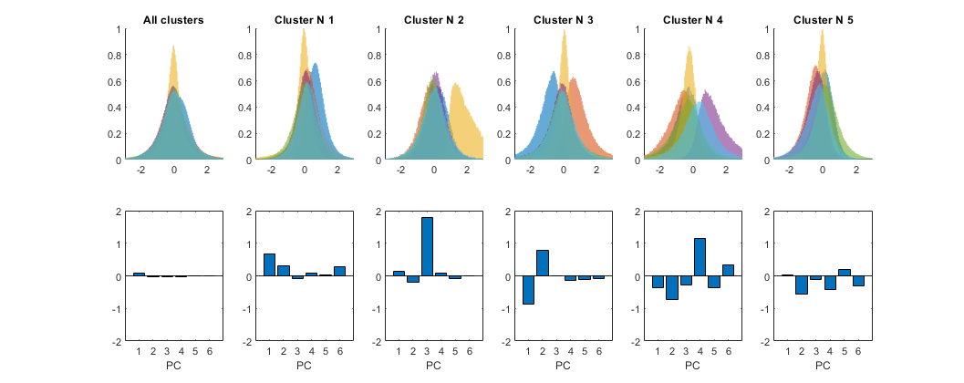
Multivariate analysis → Identification of different ground motion areas
5 Clusters
PC scores distribution in each cluster
Beyond the PS velocity…
Multivariate analysis
PCA / ICA
Median of PC scores in each cluster
All
Noise
Noise
Clustering algorithm
K-Means - 10 PC
Periodic
Linear
Rebound
Thermal deformation (structures)
Regional land subsidence
(GW lowering)
Local land subsidence
(GW fluctuation)
Fumagalli M., Previati A., Rigamonti S., Frattini P., Crosta G.B. Methodologies for surface deformations analysis at regional scale 27/05/2022, Vienna
Notes:
Extracting the median of the scores of each PC in each cluster, we can identify the dominant components for each cluster.
The advantage here is that we can reduce the dimension of the dataset obtaining a simpler interpretation in three most important motion styles in the area.

Slide 8
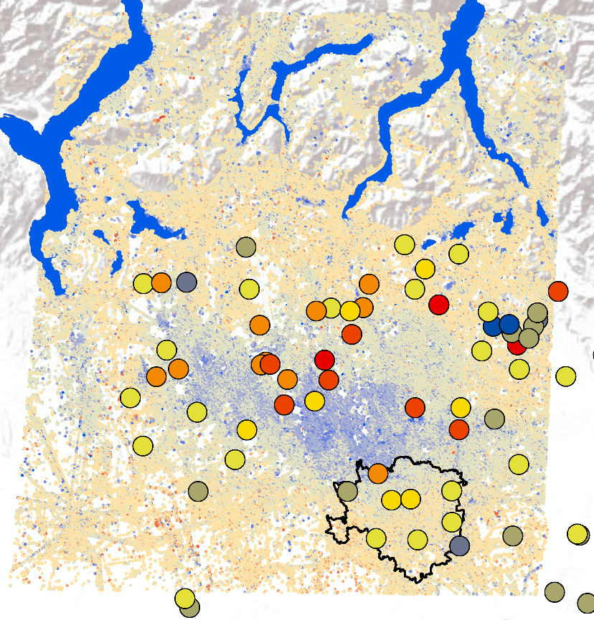

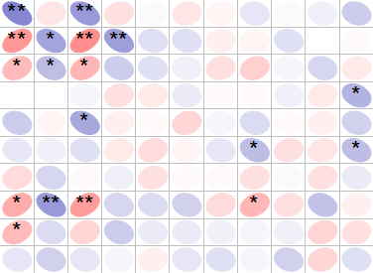
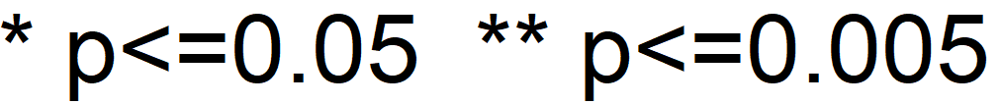
Correlation analysis → Ground motion VS Groundwater fluctuation
GW PC1
Scores
+ 2 σ
A
cross-section
A
- 2 σ
Water
level
A’
PS vertical velocity (mm/y)
+ 5
Aquifer bottom
A’
- 5
PC1
PC2
PC3
PC4
PC5
Ground Motion Time Series
PC6
PC7
Spearman’s R
PC8
+1
PC9
PC10
-1
PC1
PC2
PC3
PC4
PC5
PC6
PC7
PC8
PC9
PC10
Groundwater Time Series
Fumagalli M., Previati A., Rigamonti S., Frattini P., Crosta G.B. Methodologies for surface deformations analysis at regional scale 27/05/2022, Vienna
Notes:
To reveal which ground motion style is due to groundwater fluctuations, we performed a correlation matrix between the principal components of PS and piezometric data.
Note that the linear and rebounding (PC1 to 3) motion styles are correlated significantly with piezometric fluctuations, while the periodic motion style (PC4) is not corretaled.
This might be related to thermal effects of structures where PS are pointing.
Finally, we decided to focus on the linear deformation signal wich is very well correlated in space and time as shown in the cross-sections.

Slide 9
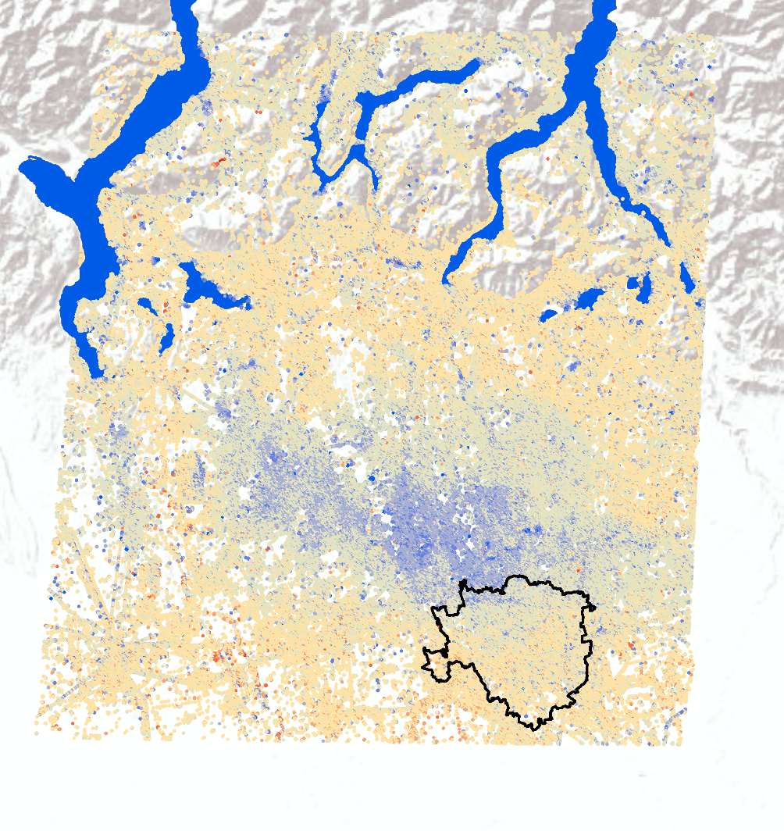
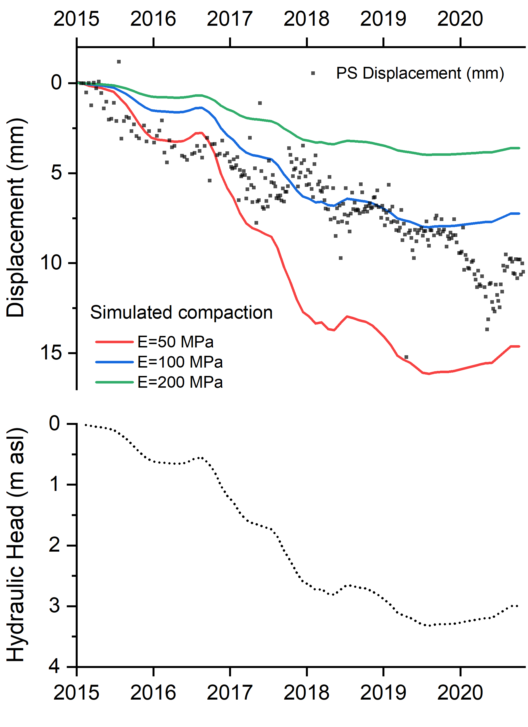
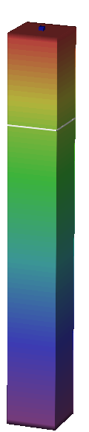
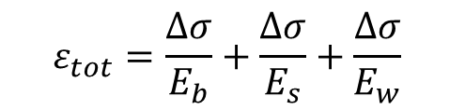


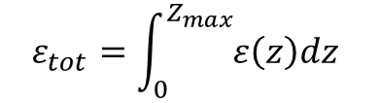

Hydromechanical model – 1D
Elastic deformations in porous media
$$ε_{tot}=\frac{∆σ}{E_{b}}+\frac{∆σ}{E_{s}}+\frac{∆σ}{E_{w}}$$
Effective stress-dependent porosity
$$φ\left(σ^{′}\right)=1−{(1−φ_{0})}^{\left(1−\frac{σ^{′}}{σ_{c}^{′}}\right)}$$
1 m
Preisig et al. (2013)
$σ_{C}^{′}=−E_{b} ln$ ($1−φ_{0}$)
78 m
$ε=φ\left(σ_{T1}^{′}\right)$ - $φ\left(σ_{T0}^{′}\right)$
$$ε_{tot}=\int_{0}^{Z_{max}}{ε\left(z\right)dz}$$
1D
Fumagalli M., Previati A., Rigamonti S., Frattini P., Crosta G.B. Methodologies for surface deformations analysis at regional scale 27/05/2022, Vienna
Notes:
We adopted a simple 1D hydromechanical model based on the assumption that deformations in the elastic range are mainly due to bulk porosity changes due to effective-stress variations.
The best fit was obtained with and elastic modulus of 200 Mpa for the main subsiding zone.

Slide 10
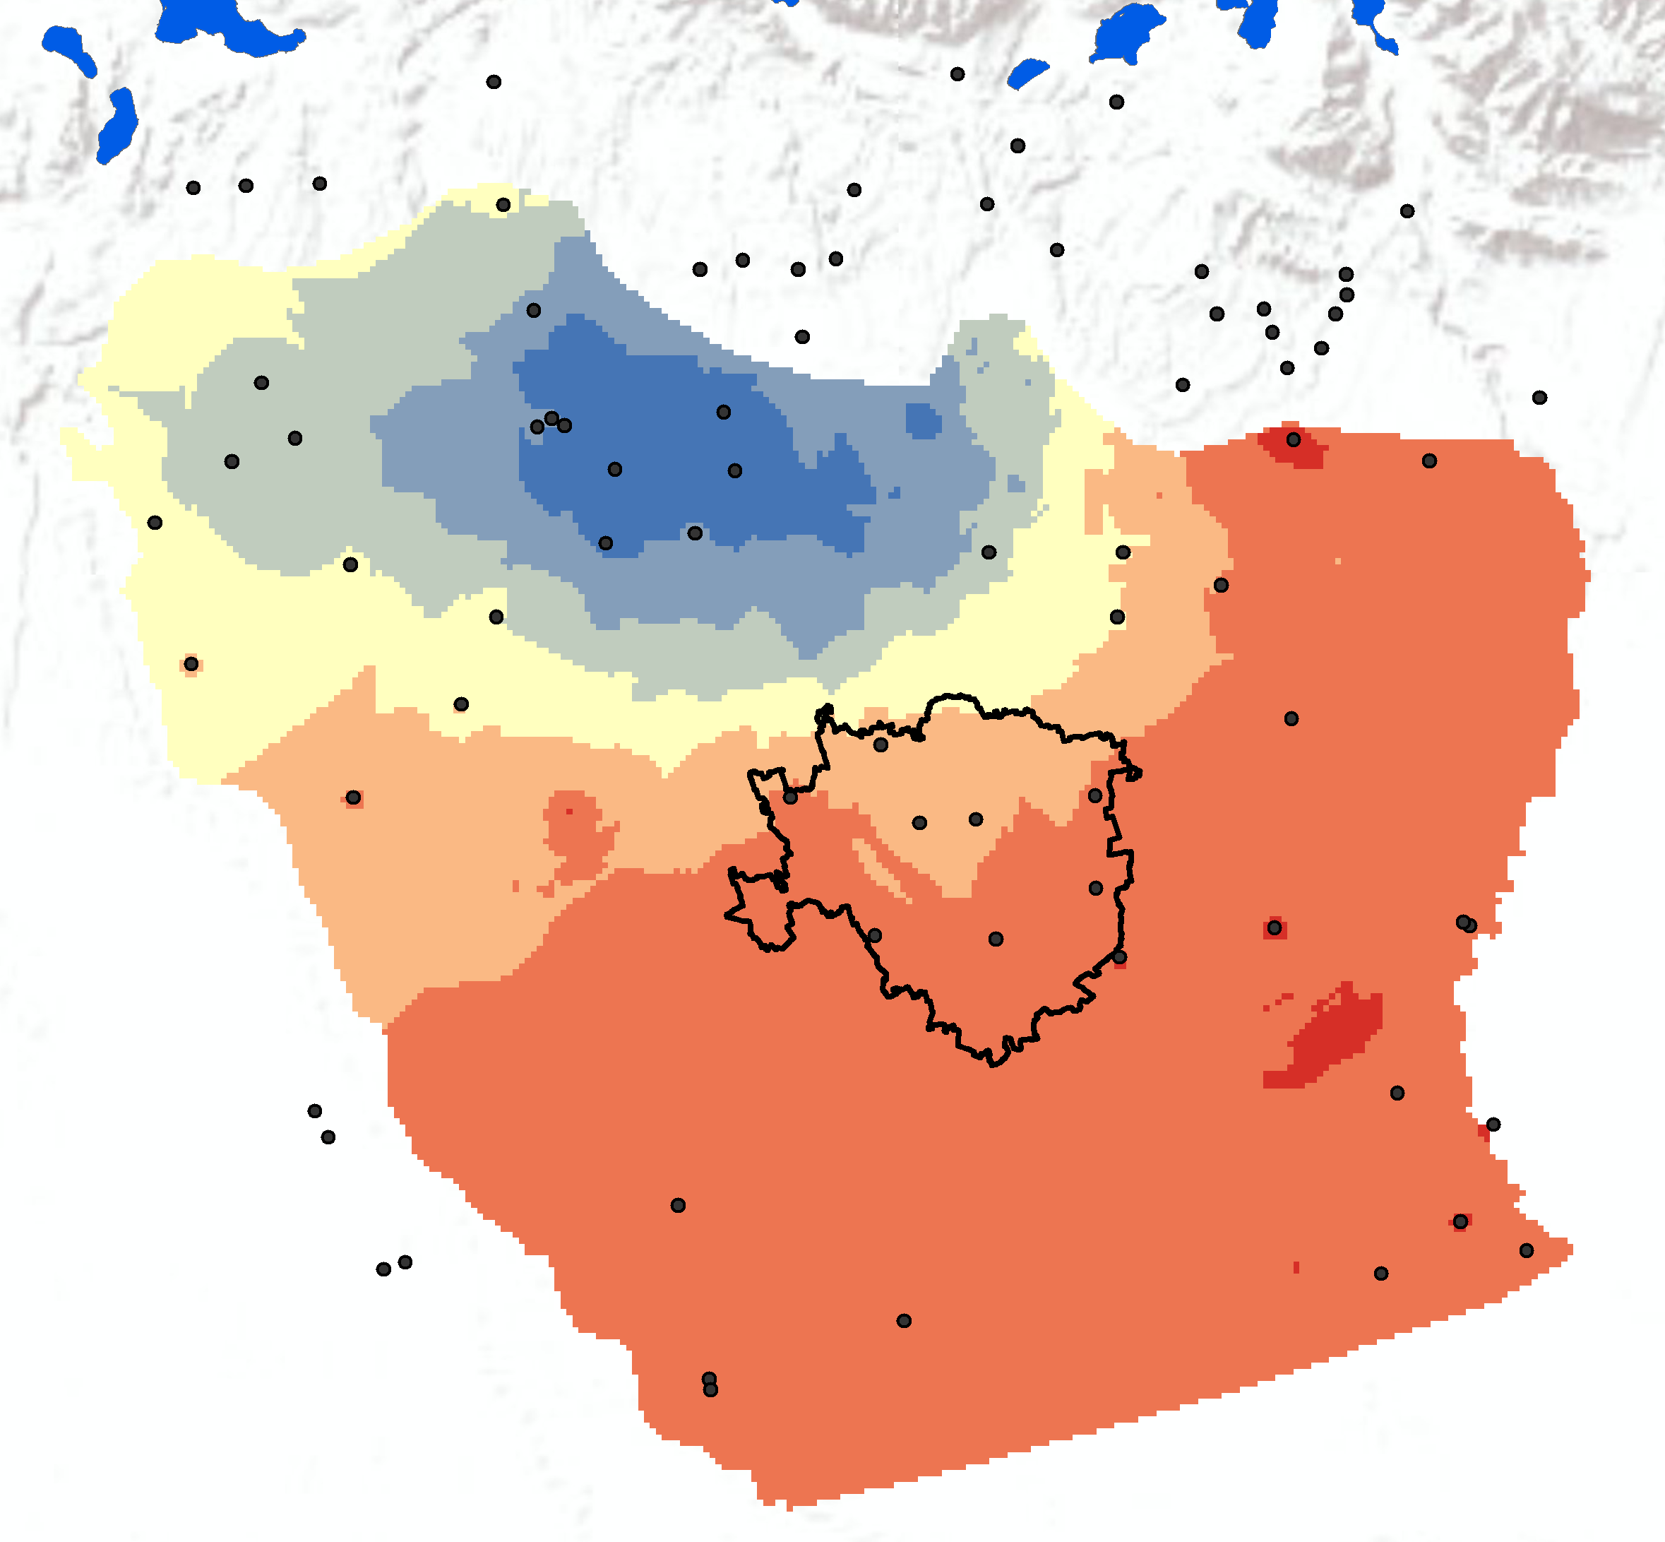
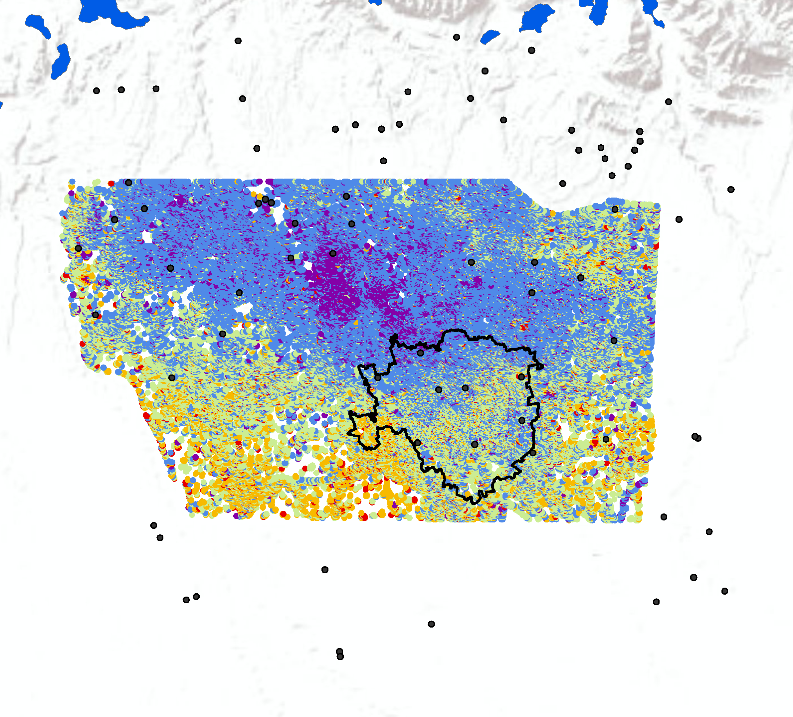
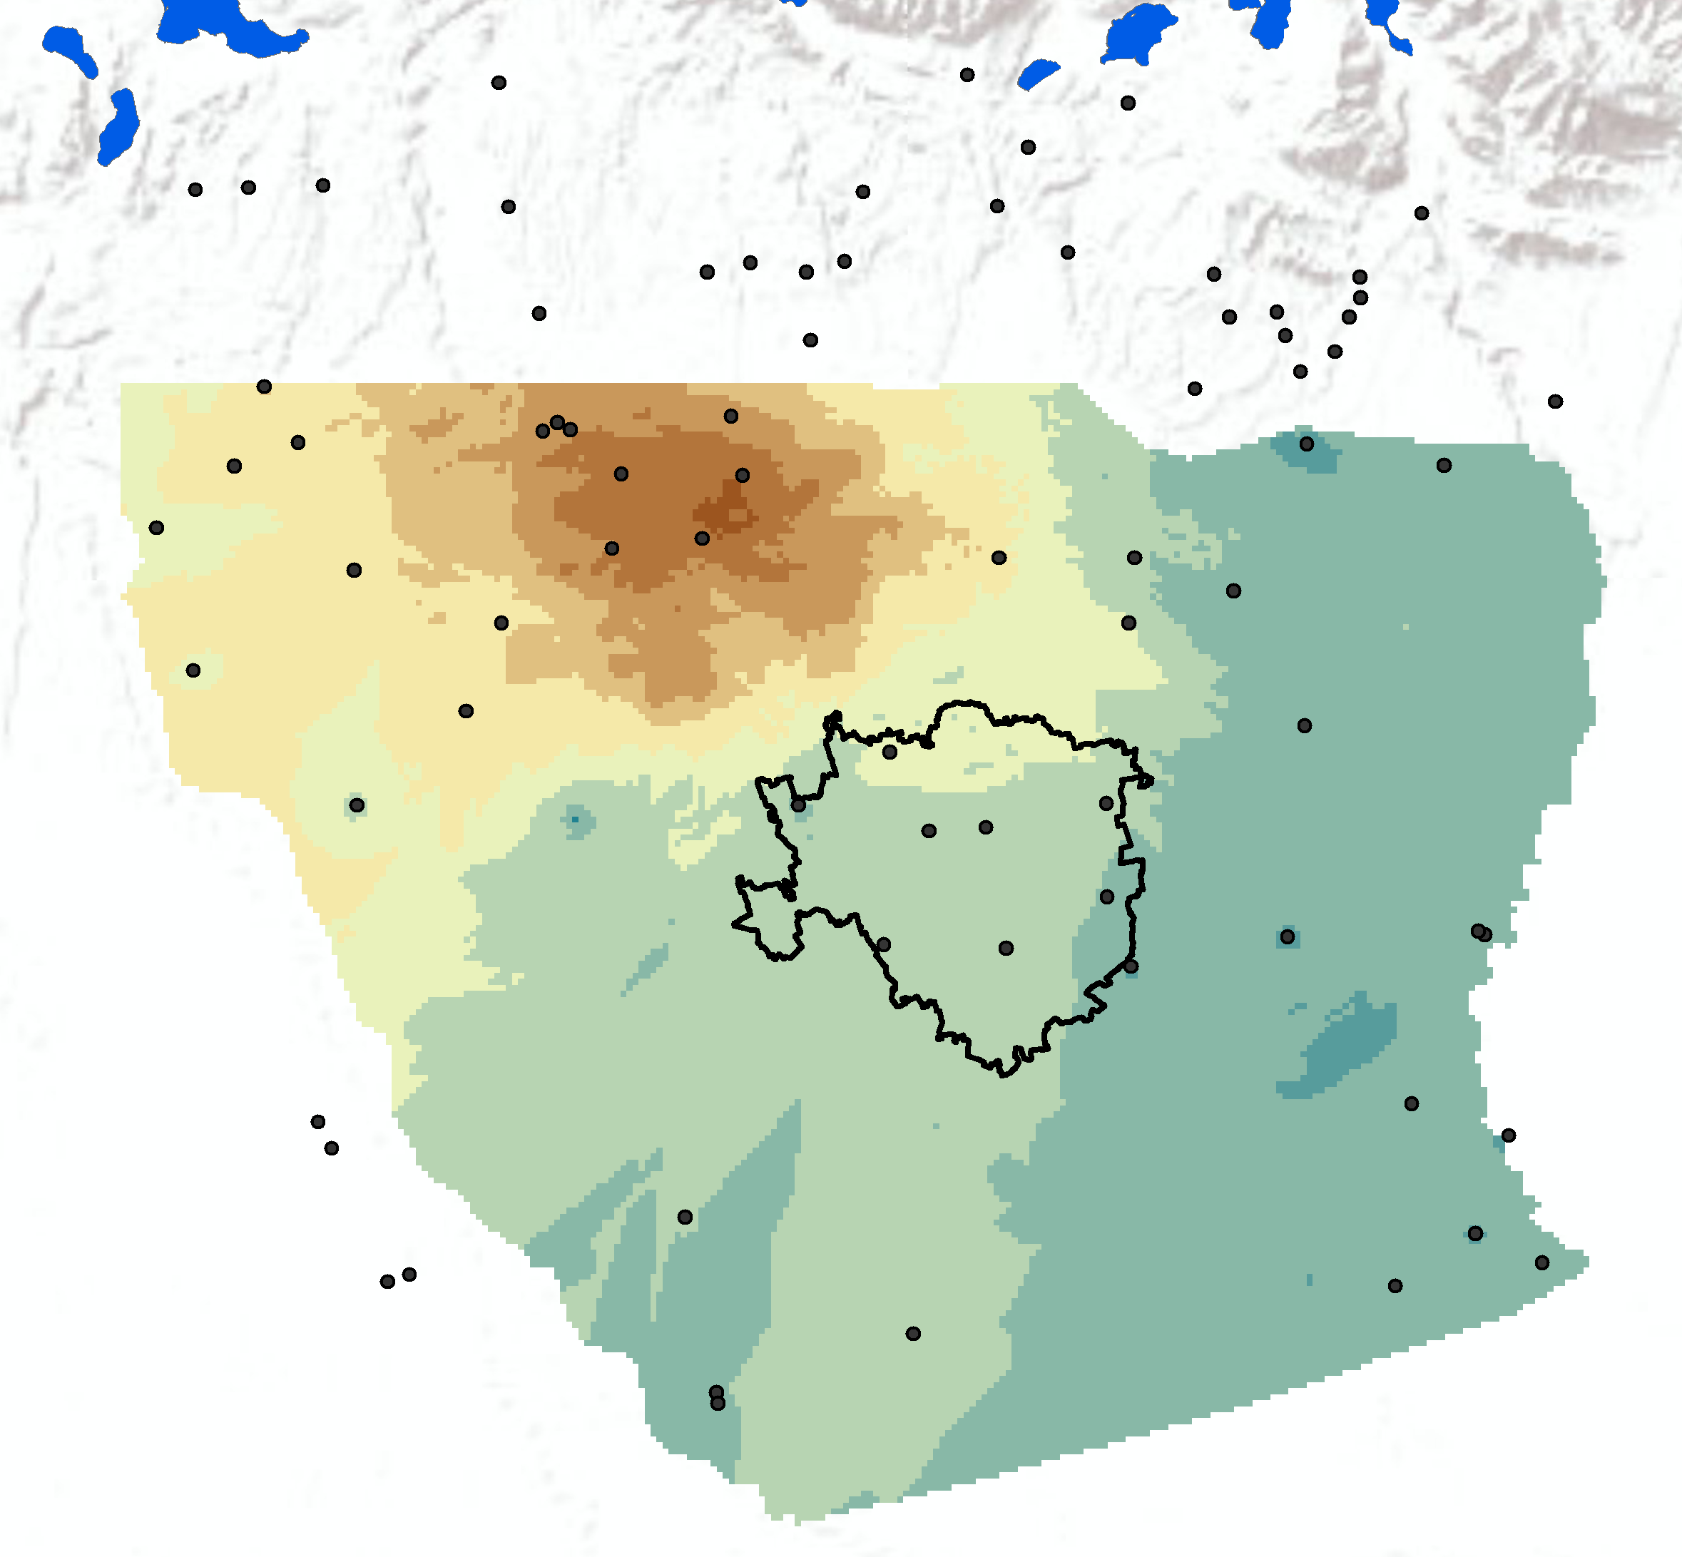



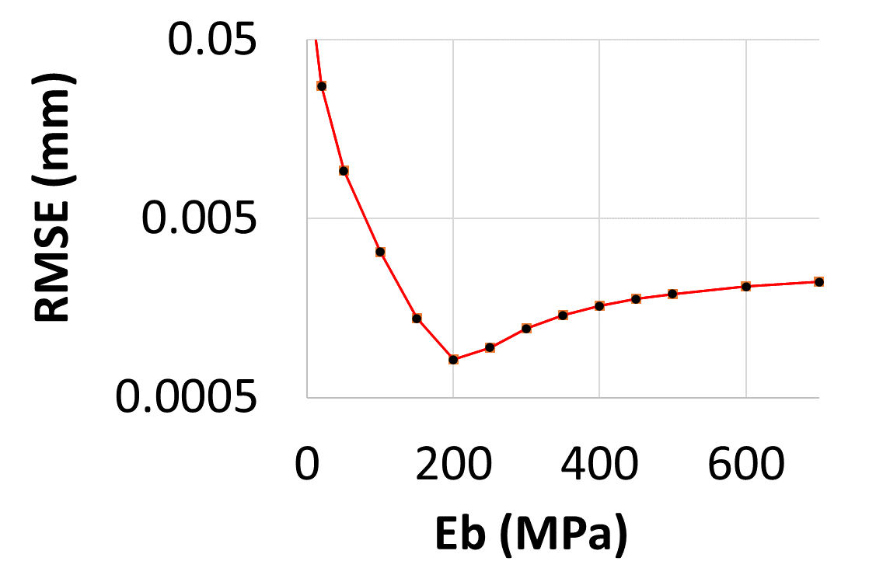
Hydromechanical model – Spatially distributed
Measured GW Fluctuation
Calculated Ground Displacement
Measured Ground Displacement
(m)
(mm)
(mm)
0
0.005
0.001
-5
-0.005
-0.014
Piezometric data
Global RMSE
Fumagalli M., Previati A., Rigamonti S., Frattini P., Crosta G.B. Methodologies for surface deformations analysis at regional scale 27/05/2022, Vienna
Notes:
Finally, we calculated the best parameters for the entire area by deriving the root mean square error between calculated and measured displacement for each PS.

Slide 11
THANK YOU FOR YOUR ATTENTION!
Fumagalli M., Previati A., Rigamonti S., Frattini P., Crosta G.B.
University of Milano-Bicocca
Dept. of Earth and Environmental Sciences (DISAT)

