Slide 1
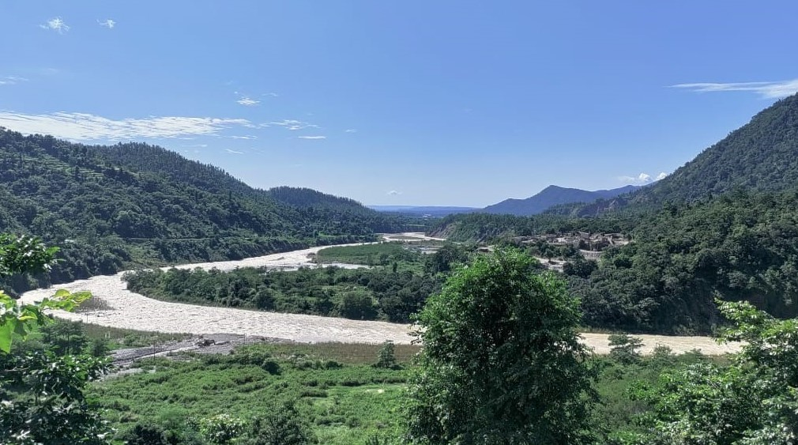





Session GM4.4 – ‘Biogeomorphology and Earth surface dynamics across scales: from long-term landscape evolution to short-term interactions and future applications’
Quantifying the basal accretion-induced erosion rate variability – A numerical landscape evolution modeling approach
Sayan Das, Dirk Scherler, Sanjay Kumar Mandal

Slide 2
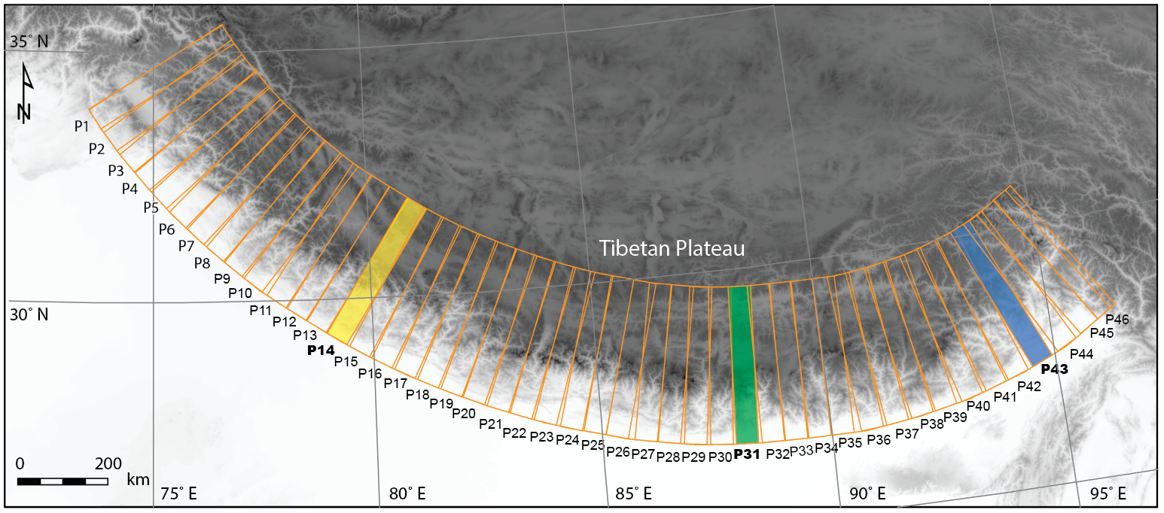
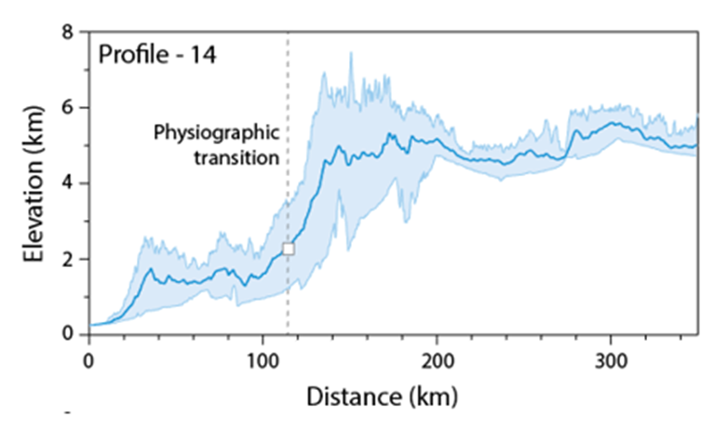
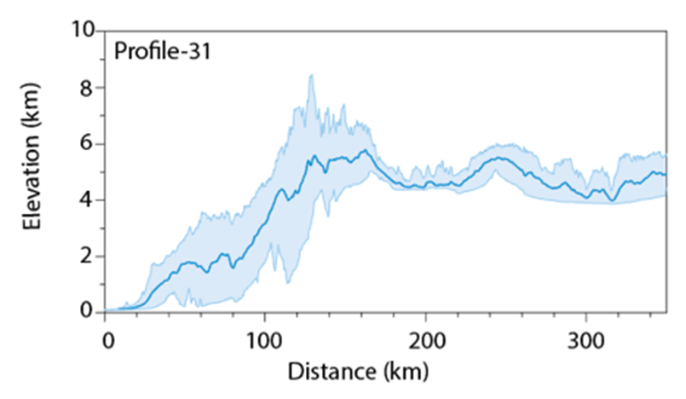
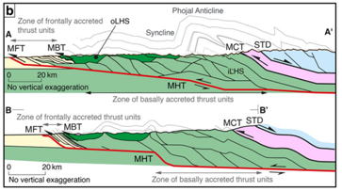
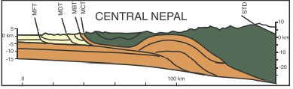
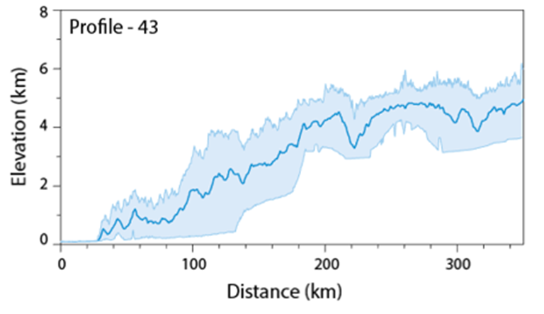
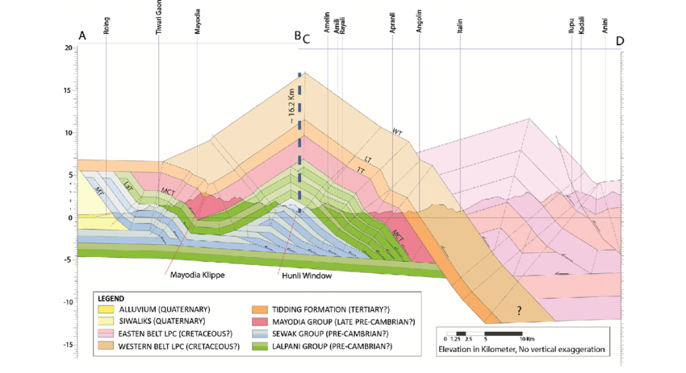
OBJECTIVE
N-W Himalaya
Central Nepal
Source: Dr. Sanjay Kumar Mandal
Response of Himalayan Topography to the tectonic control of basal accretion over the last ~10 Myr?
Impact on precipitation pattern and its subsequent effect on the landscape evolution.
What are the possible reasons behind the non-uniform surface manifestation of the basal accretion due to duplex formation over a mid-crustal ramp is non-uniform across the Himalaya?
Source: Mercier et al., 2017
Source: Mandal et al., 2021
N-E Himalaya
Source: Ningthoujam et al., 2015
Fig.1 A) DEM of the Himalayan range and & the elevation profile of the highlighted swaths across the Himalaya with balanced cross sections.

Slide 3
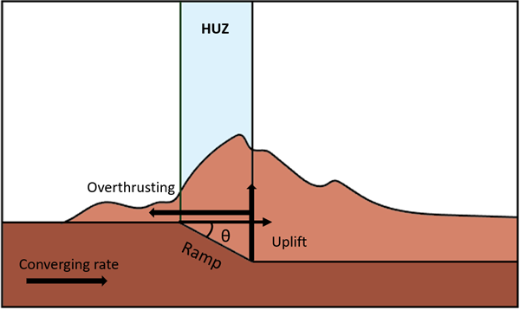

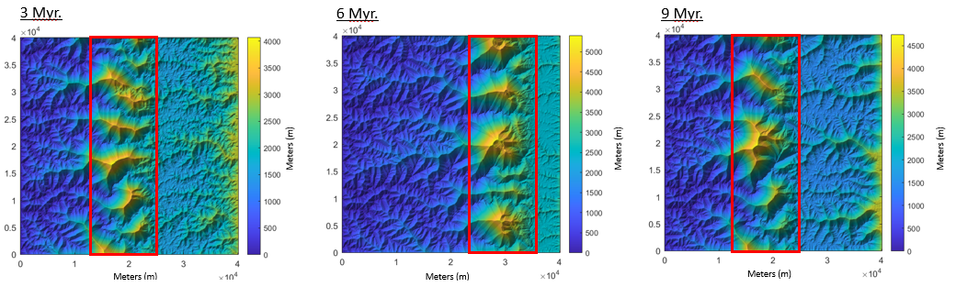
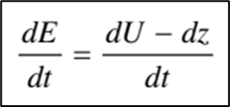
METHODOLOGY
Duplex Model
Developed on the Topo Toolbox Landscape Evolution Model (TTLEM) in MATLAB (Campforts et al., 2017; Schwanghart & Scherler, 2014, Mandal et al., 2021).
The river incision is controlled using the Stream Power Incision Model (SPIM).
Here m and n are constants and K is a lumped
parameter called erodibility.
The spatially averaged erosion rate, E, integrated over the timestep length, is calculated using the adjacent equation.
Here dE/dt is the erosion rate, U is the uplift and
dz/dt reflects the change in elevation.
Meters (m)
Meters (m)
Meters (m)
Meters (m)
Meters (m)
Meters (m)
Fig.2 A) A simple schematic diagram of the model showing the application of basal accretion on the topography. B) Simulations generated by the Duplex model for 3, 6 and 9 Myr cases respectively.

Slide 4

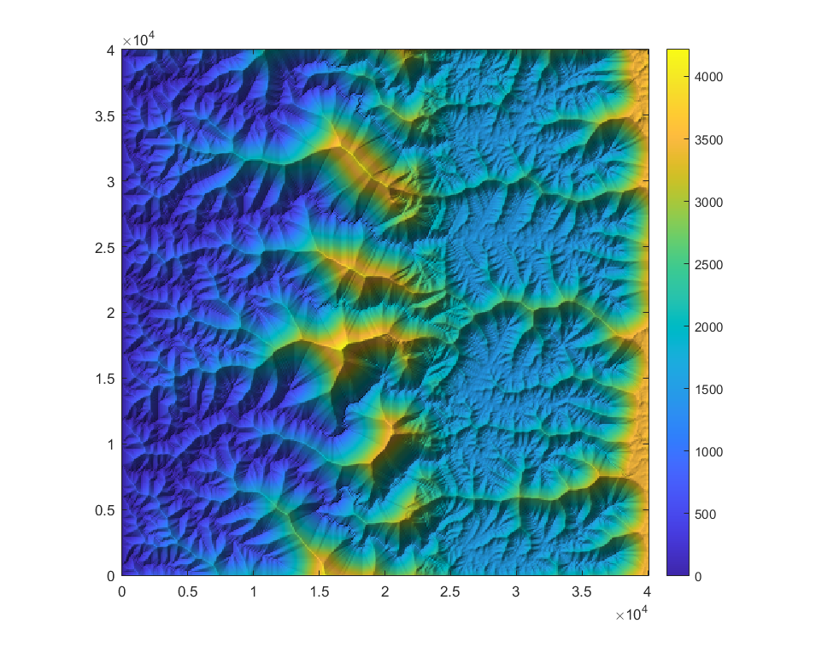
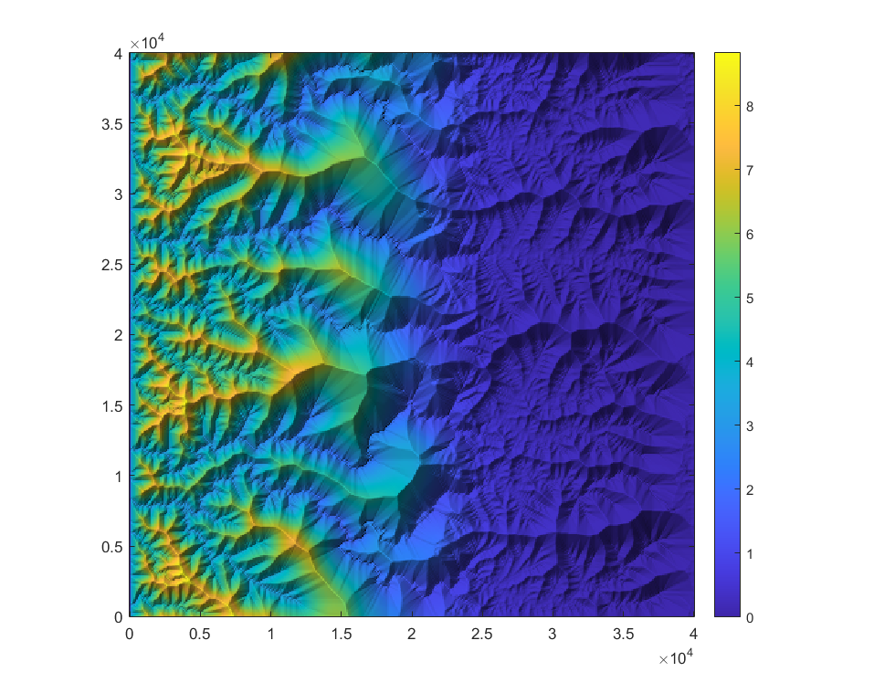


The incoming water is divided into vapour and cloud water content based on the nature of the topography.
Orographic Precipitation Model
The model comprises of 2 vertically integrated components- vapour and cloud water (Hergarten & Robl, 2022).
Qv is the vapour component and Qc is the cloud water component. With advection along x-axis, we have
Where F is the advective flux per unit width and v is
advection velocity.
Considering dispersion along y axis, the vertically integrated moisture balance equation for both components is
Sv/c is the source term and a function of a parameter β. For vertically integrated cloud content, β is of the form –
Where, βo and Ho reflect sea-level conditions.
Influx
The distribution in the subsequent rows is carried out based on the 2 components of the first row and the elevation at each cell.
Meters (m)
m/year
Meters (m)
Meters (m)
Fig.3 A) A simple schematic diagram depicting the working principle of the model. B) An example of model topography and its subsequent orographic precipitation distribution.

Slide 5
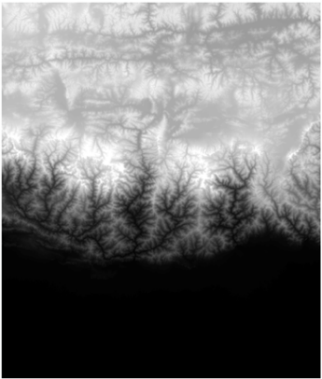
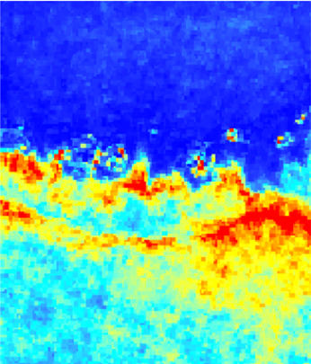
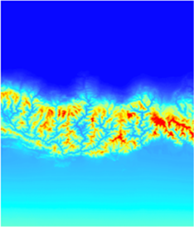
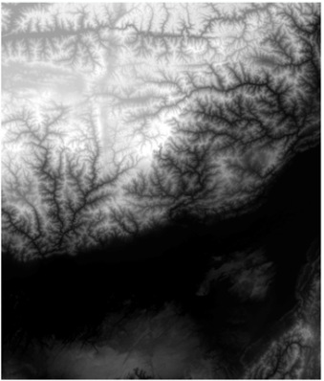
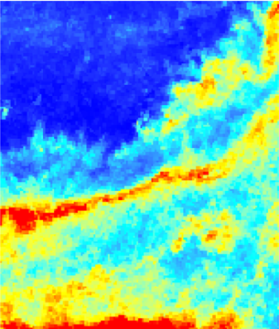
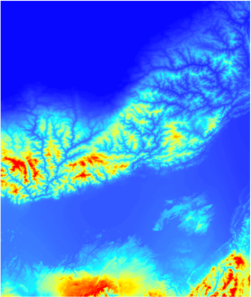
RESULTS & DISCUSSION
Location of Sample Area | Reference topography | TRMM 2b31 Rainfall Pattern | Model generated Rainfall Pattern
SRTM 90m- Grid 5407 Eastern Nepal & Sikkim Himalaya
SRTM 90m- Grid 5507 North-Eastern Himalaya
Source: CGIAR-CSI SRTM 90m Database
Source: Bookhagen & Burbank, 2006

Slide 6

List of Experiments:
We designed the following experiments to address our objective-
Defining the migration velocity allows us to control the time period of accretionary cycle of the mid-crustal ramp. The migration velocity parameter is varied along with the variation in precipitation parameter.
Variation of HUZ width at the surface is representative of the same-sized ramp dipping at varying angles which can be correlated to the thickness of sediment layer above it.
Duplex Model parameters:
Migration Velocity (mm/yr) | Time Period of Accretion (Myr)
40 | 0.5
20 | 1
10 | 2
6.67 | 3
Orographic Precipitation Model Parameters:
 | SRTM - 5206 | SRTM - 5307 | SRTM - 5407 | SRTM – 5507 | Hergarten
Dimensions | 5570 x 4733 | 5214 x 4434 | 4977 x 4228 | 4727 x 4016 | 2500 x 4000
Ref. height | 2500 | 2000 | 2000 | 2000 | 2000
ϵ | 0.5 | 0.6 | 0.5 | 0.7 | 0.75
q_{in} | 3 | 6 | 5 | 5 | 1*
Applied q_{in} * | 1 | 1 | 1 | 1 | 1
L_{l} | 1800 | 1500 | 1500 | 1500 | 500
Applied L_{l} ** | 130 | 115 | 120 | 130 | 80
High Uplift Zone (HUZ) width (km)
5
10
15
* Value taken as per requirement
**$\sim \left\lfloor \frac{Observed Ll∗Model Dimension }{RL Dimension}\right\rfloor$

Slide 7
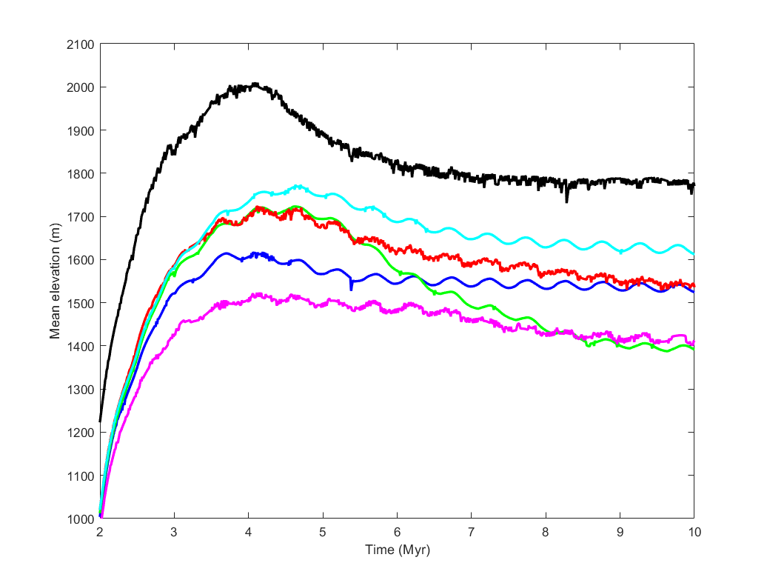
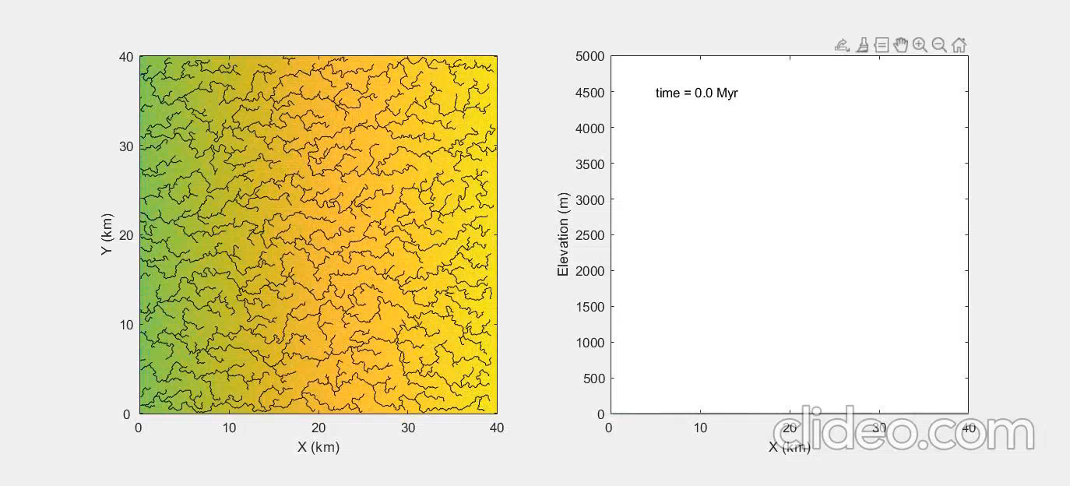
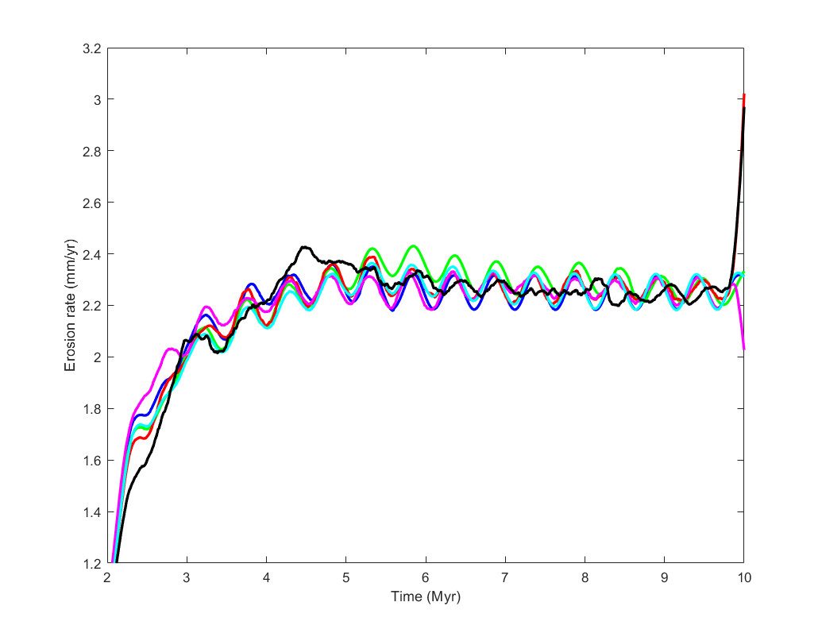


Migration velocity of mid-crustal ramp = 40 mm/yr
Time period of accretionary cycle = 0.5 Myr
Mean Elevation (m)
Time (Myr)
Color | Legend | Description
 | 5206 | Precipitation parameters based on SRTM- 5206
 | 5307 | Precipitation parameters based on SRTM- 5307
 | 5407 | Precipitation parameters based on SRTM- 5407
 | 5507 | Precipitation parameters based on SRTM- 5507
 | Hergarten | Precipitation parameters taken from Hergarten & Robl (2022)
 | No precipitation | No orographic precipitation considered
Erosion rate (mm/yr)
Time (Myr)

Slide 8
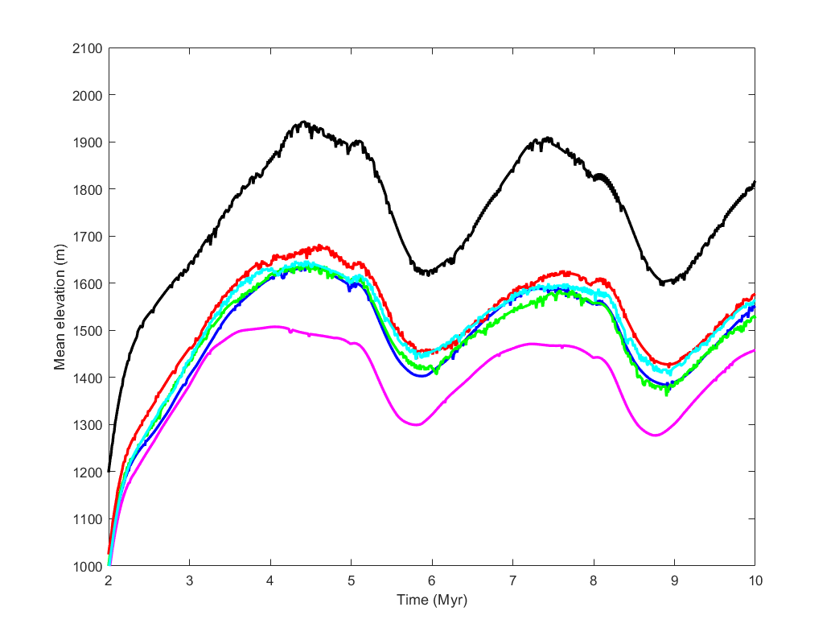
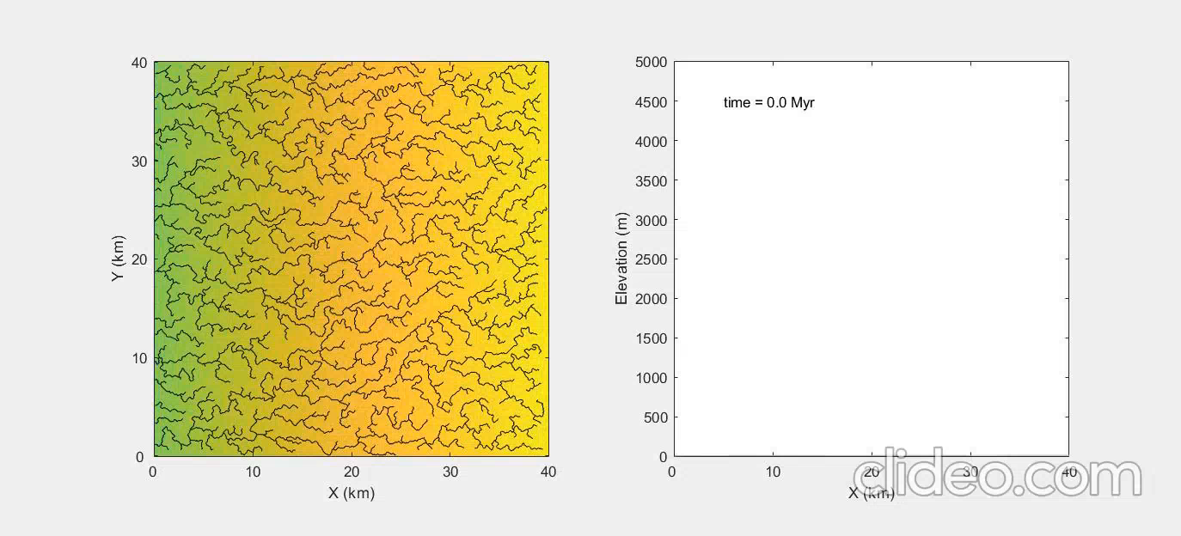
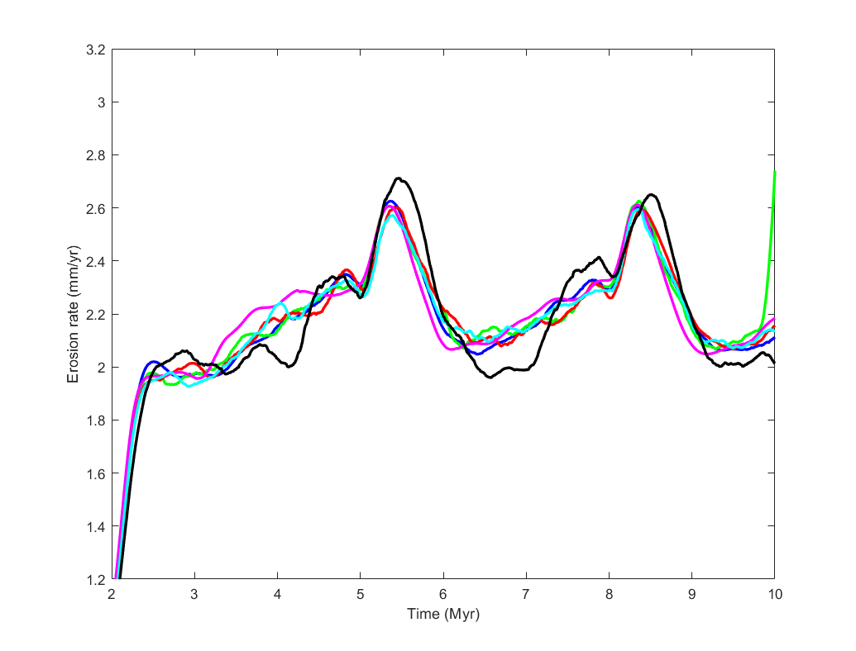
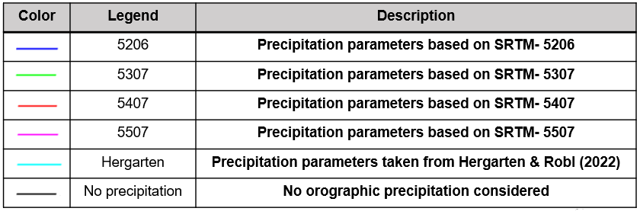
Migration velocity of mid-crustal ramp = 6.67 mm/yr
Time period of accretionary cycle = 3 Myr
Mean Elevation (m)
Time (Myr)
Erosion rate (mm/yr)
Time (Myr)

Slide 9
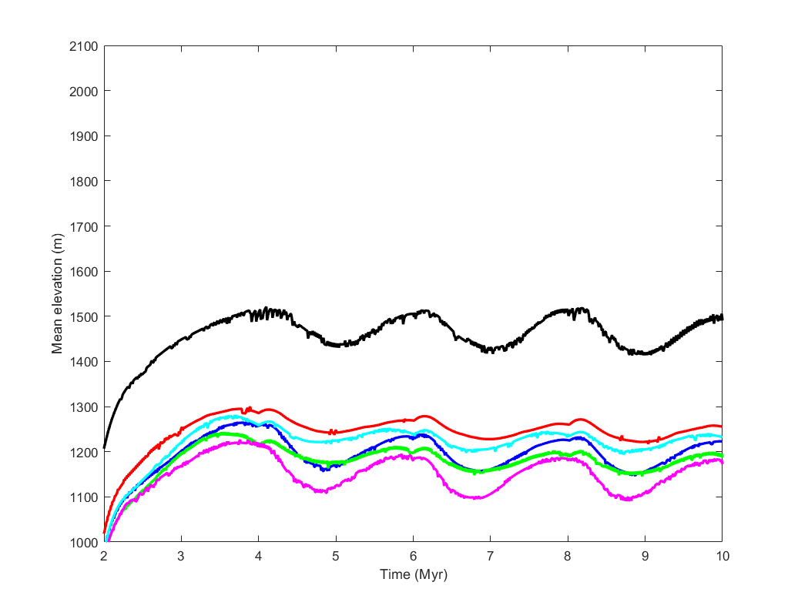

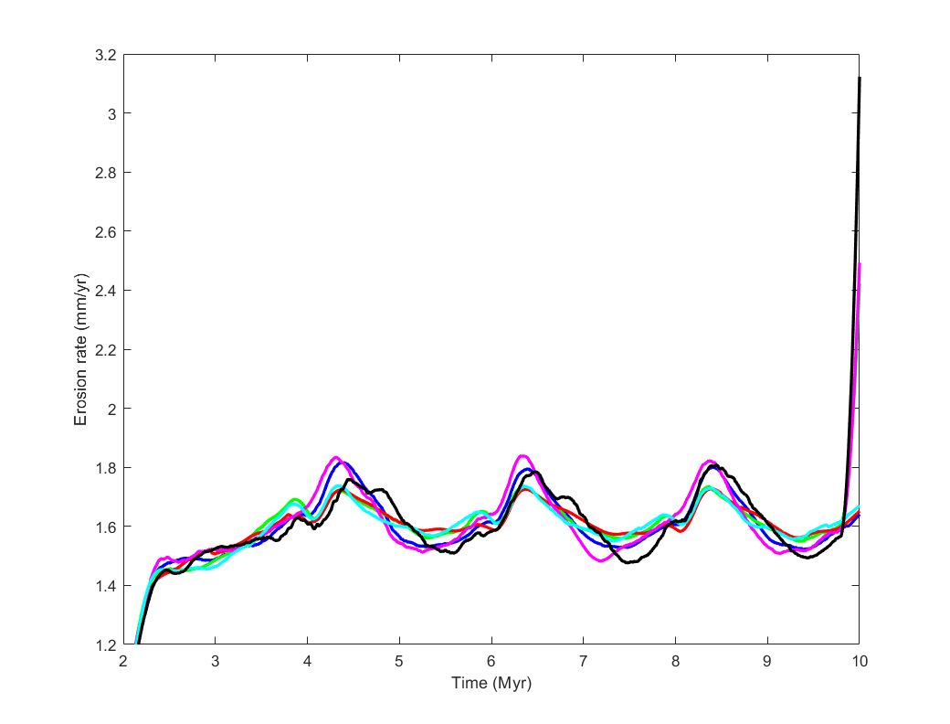
Width of High Elevation Zone (HUZ) = 5km
Mean Elevation (m)
Time (Myr)
Erosion rate (mm/yr)
Time (Myr)

Slide 10
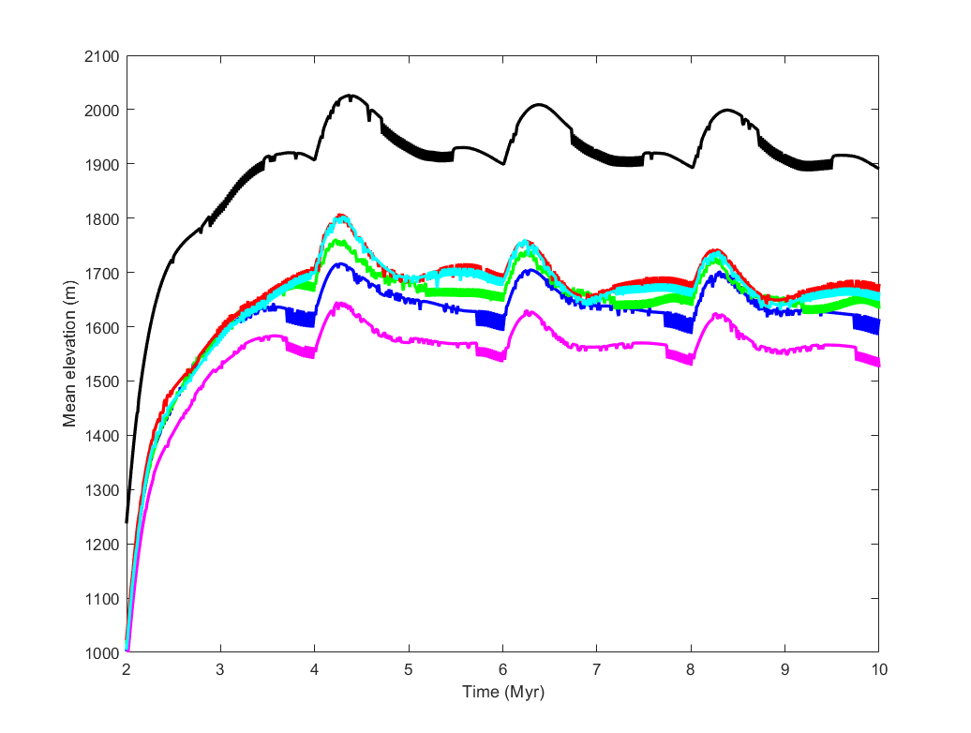

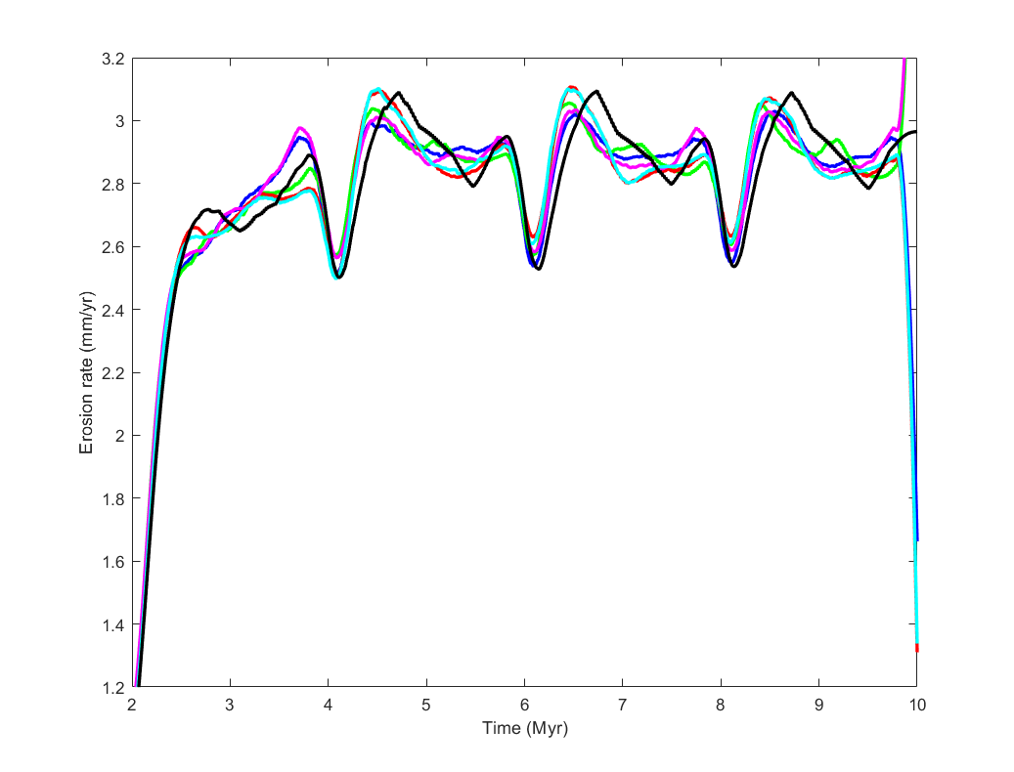
Width of High Elevation Zone (HUZ) = 15 km
Mean Elevation (m)
Time (Myr)
Erosion rate (mm/yr)
Time (Myr)

Slide 11
CONCLUSION
We were able to study the changes to topography caused by the application of basal accretion induced development of duplex system over the mid-crustal ramp.
The introduction of orographic precipitation model results in a more accurate distribution of water volume through out the model.
The mean elevation pattern is subdued when compared to non-precipitation case due to extensive erosion and the erosion rate patterns show cyclicity over deep time.
The 2 Myr accretion cycle with 10 km HUZ has exhibited the best results in regulating the topography and preserving the cyclic nature of erosion rates.
Faster migration velocity does not give the topography enough time to reach steady state before it is perturbed again which leads to generation of noise and loss of cyclicity.
Larger HUZ width causes large sections of the topography to experience high uplift rates leading to an over all increase in erosional rates.
The effect of changes in precipitation pattern over erosion rate variation is transient in nature.
The non-uniformity of surface expression of the basal accretion process could be attributed to either a gentler dip of the ramp or a decrease in the migration velocity or both.

Slide 12
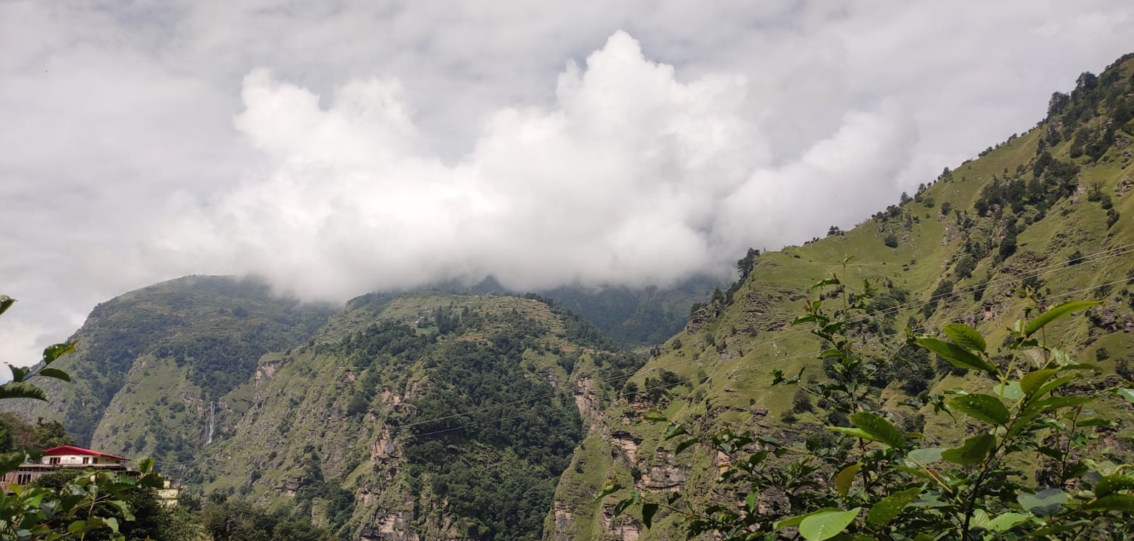
THANK YOU

