Slide 1
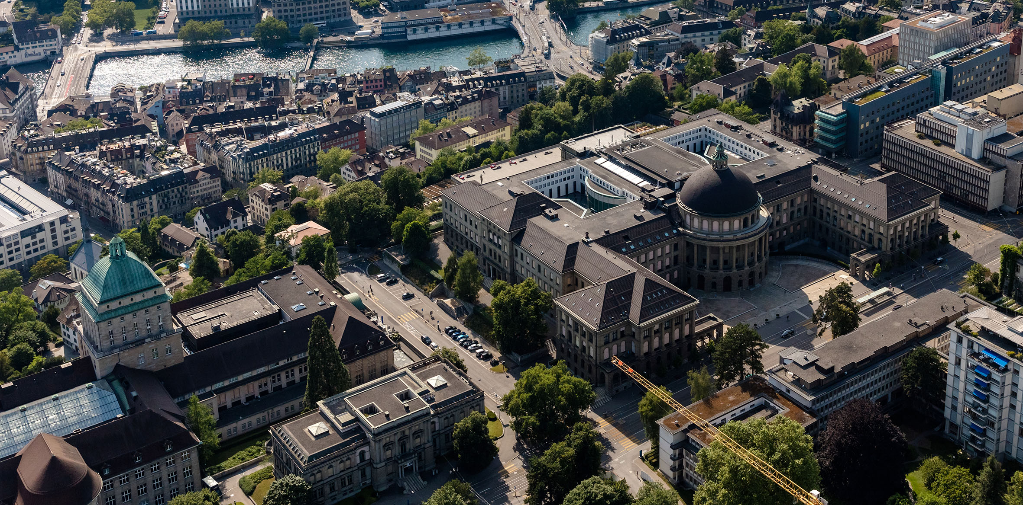


Systematic Calibration of A Convection-Resolving Model: Application over Tropical Atlantic
Shuchang Liu, Christian Zeman, Silje Lund Sørland, Christoph Schär
Shuchang.liu@env.ethz.ch
27.05.2022

Slide 2
Introduction of the Systematic Calibration
Framework
Construct an emulator with quadratic functions based on limited model simulations.
Traverse the parameter space with the emulator.
Choose the optimum parameter setting based on predefined scores.
(Liu et al., in prep)

Slide 3
Introduction of the Systematic Calibration
Framework
Advantage
Promising in constraining parameterization-related uncertainty with transparency and reproducibility.
Construct an emulator with quadratic functions based on limited model simulations.
Traverse the parameter space with the emulator.
Choose the optimum parameter setting based on predefined scores.
(Hourdin et al., 2017)

Slide 4
Introduction of the Systematic Calibration
Framework
Advantage
Promising in constraining parameterization-related uncertainty with transparency and reproducibility.
Construct an emulator with quadratic functions based on limited model simulations.
Traverse the parameter space with the emulator.
Choose the optimum parameter setting based on predefined scores.
(Hourdin et al., 2017)
Model performance can still be improved with systematic calibration even after expert tuning.

Slide 5
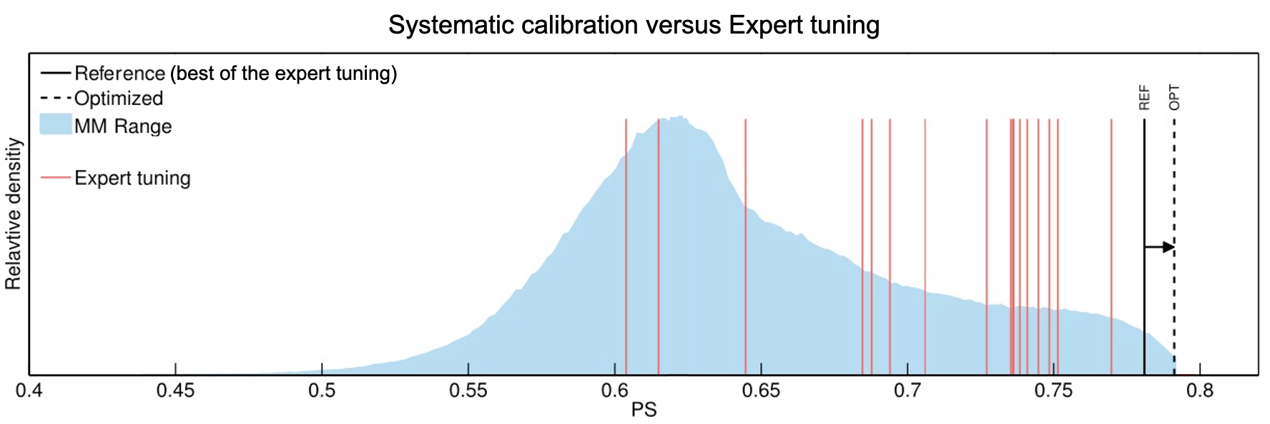
Introduction of the Systematic Calibration
Framework
Advantage
Promising in constraining parameterization-related uncertainty with transparency and reproducibility.
Construct an emulator with quadratic functions based on limited model simulations.
Traverse the parameter space with the emulator.
Choose the optimum parameter setting based on predefined scores.
(Hourdin et al., 2017)
Model performance can still be improved with systematic calibration even after expert tuning.
(Bellprat et al., 2012)

Slide 6
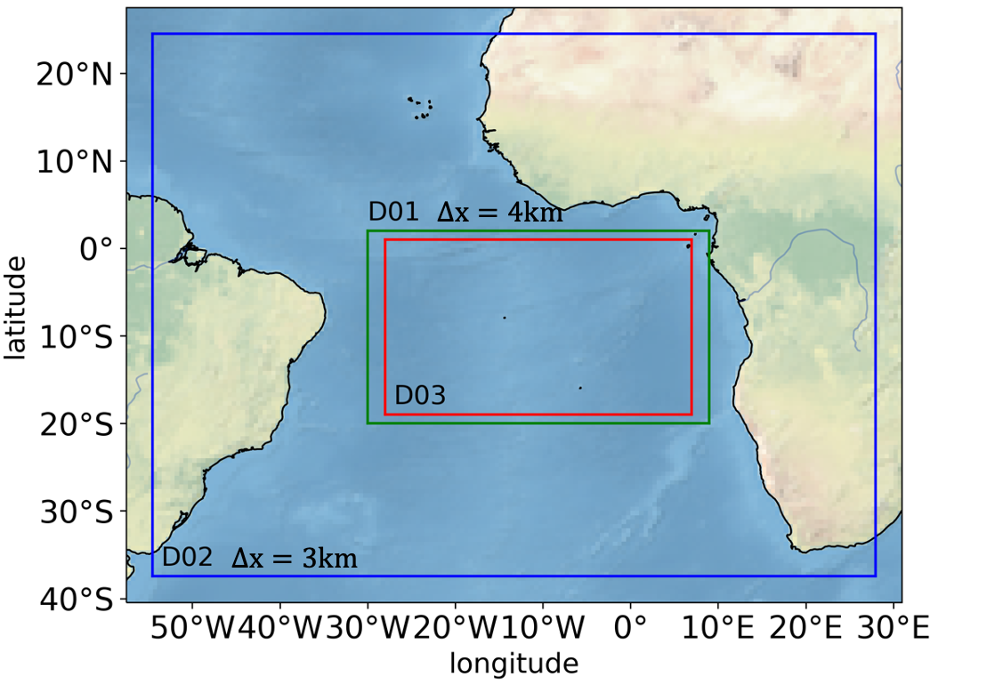
Calibration configurations
Domains
Model: COSMO version 6.
Simulation time: Feb., May, Aug., Nov. in 2016.
Evaluation fields: top of atmosphere outgoing longwave/shortwave radiation, surface latent heat flux.
Parameters: qi0, tur_len, clc_diag, rat_sea, cloud_num.
Boundary condition: ERA5 reanalysis data (sea-surface temperature is prescribed).
(Liu et al., in prep)

Slide 7
Calibration Results
Number of experiments
(Liu et al., in prep)

Slide 8
Calibration Results
Number of experiments
(Liu et al., in prep)

Slide 9
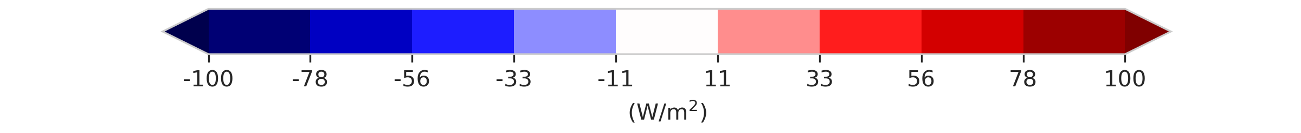
Validation
Optimum
Default
Observation
The calibration significantly improves the performance even in a different year, with a larger domain and slightly higher resolution.
Results averaged over four months (Feb., May,, Aug., Nov.) in 2006
(Liu et al., in prep)

Slide 10
Conclusion
Cloud-related model performance at the km-scale is significantly improved through systematic calibration.
The calibrated parameter setting is robust among different years.
The calibration is independent of the target model and fields and thus could be easily applied to other models and research domains.
(Liu et al., in prep)

Slide 11
Backup slides

Slide 12
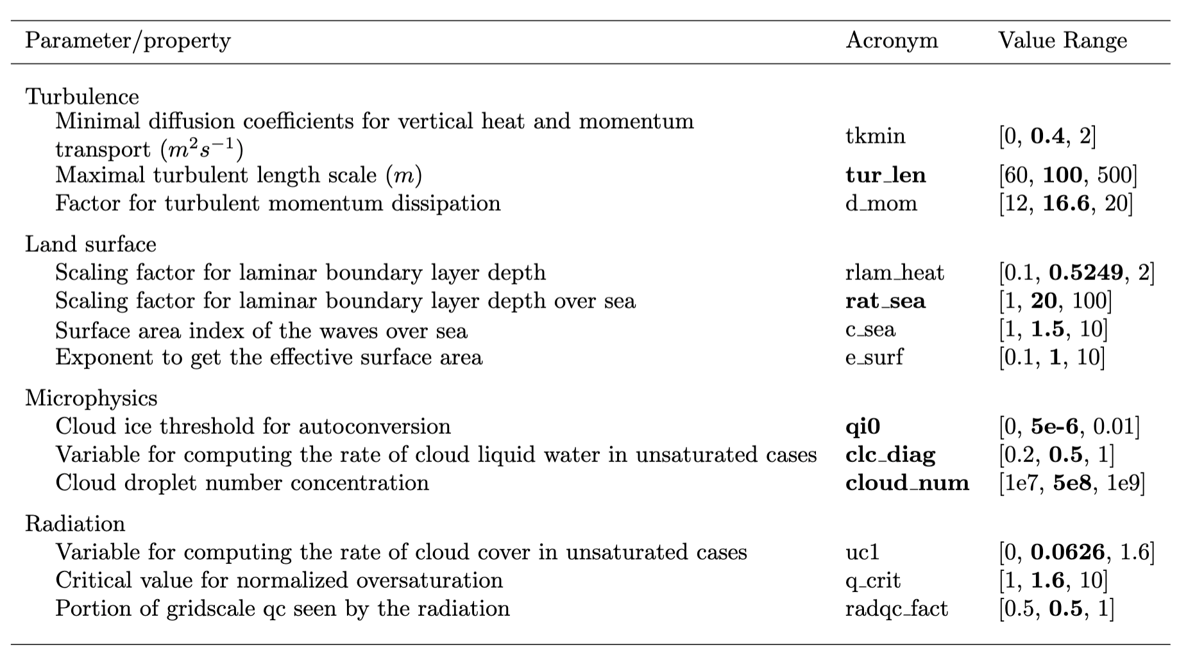
Perturbed parameters. The parameters selected for calibration are denoted in bold. The range covers the parameter values explored. The bold entries denote the default values in simulations. The same values have also been used by Hentgen et al. (2020)
(Liu et al., in prep)

Slide 13
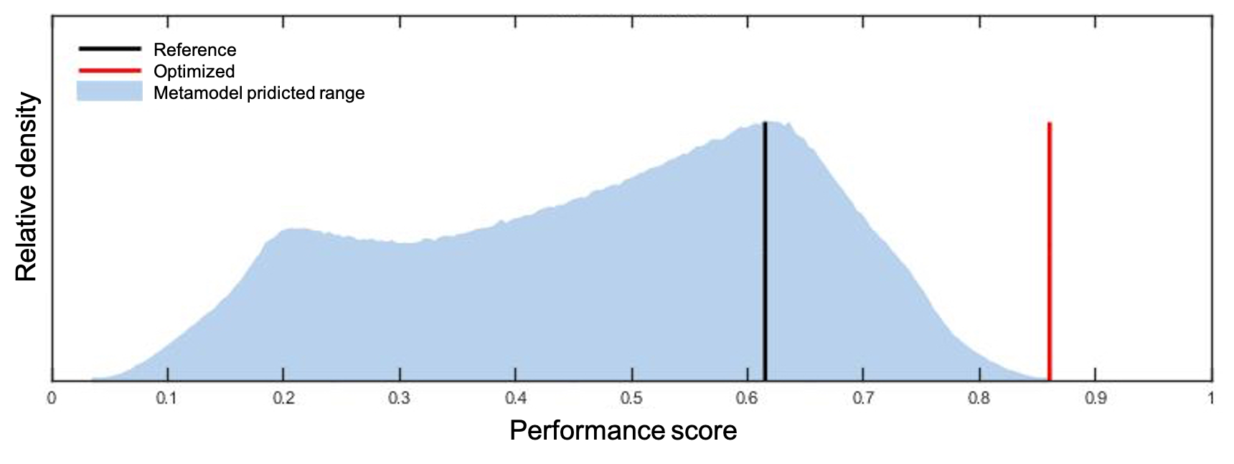
Calibration Results
(Liu et al., in prep)

Slide 14
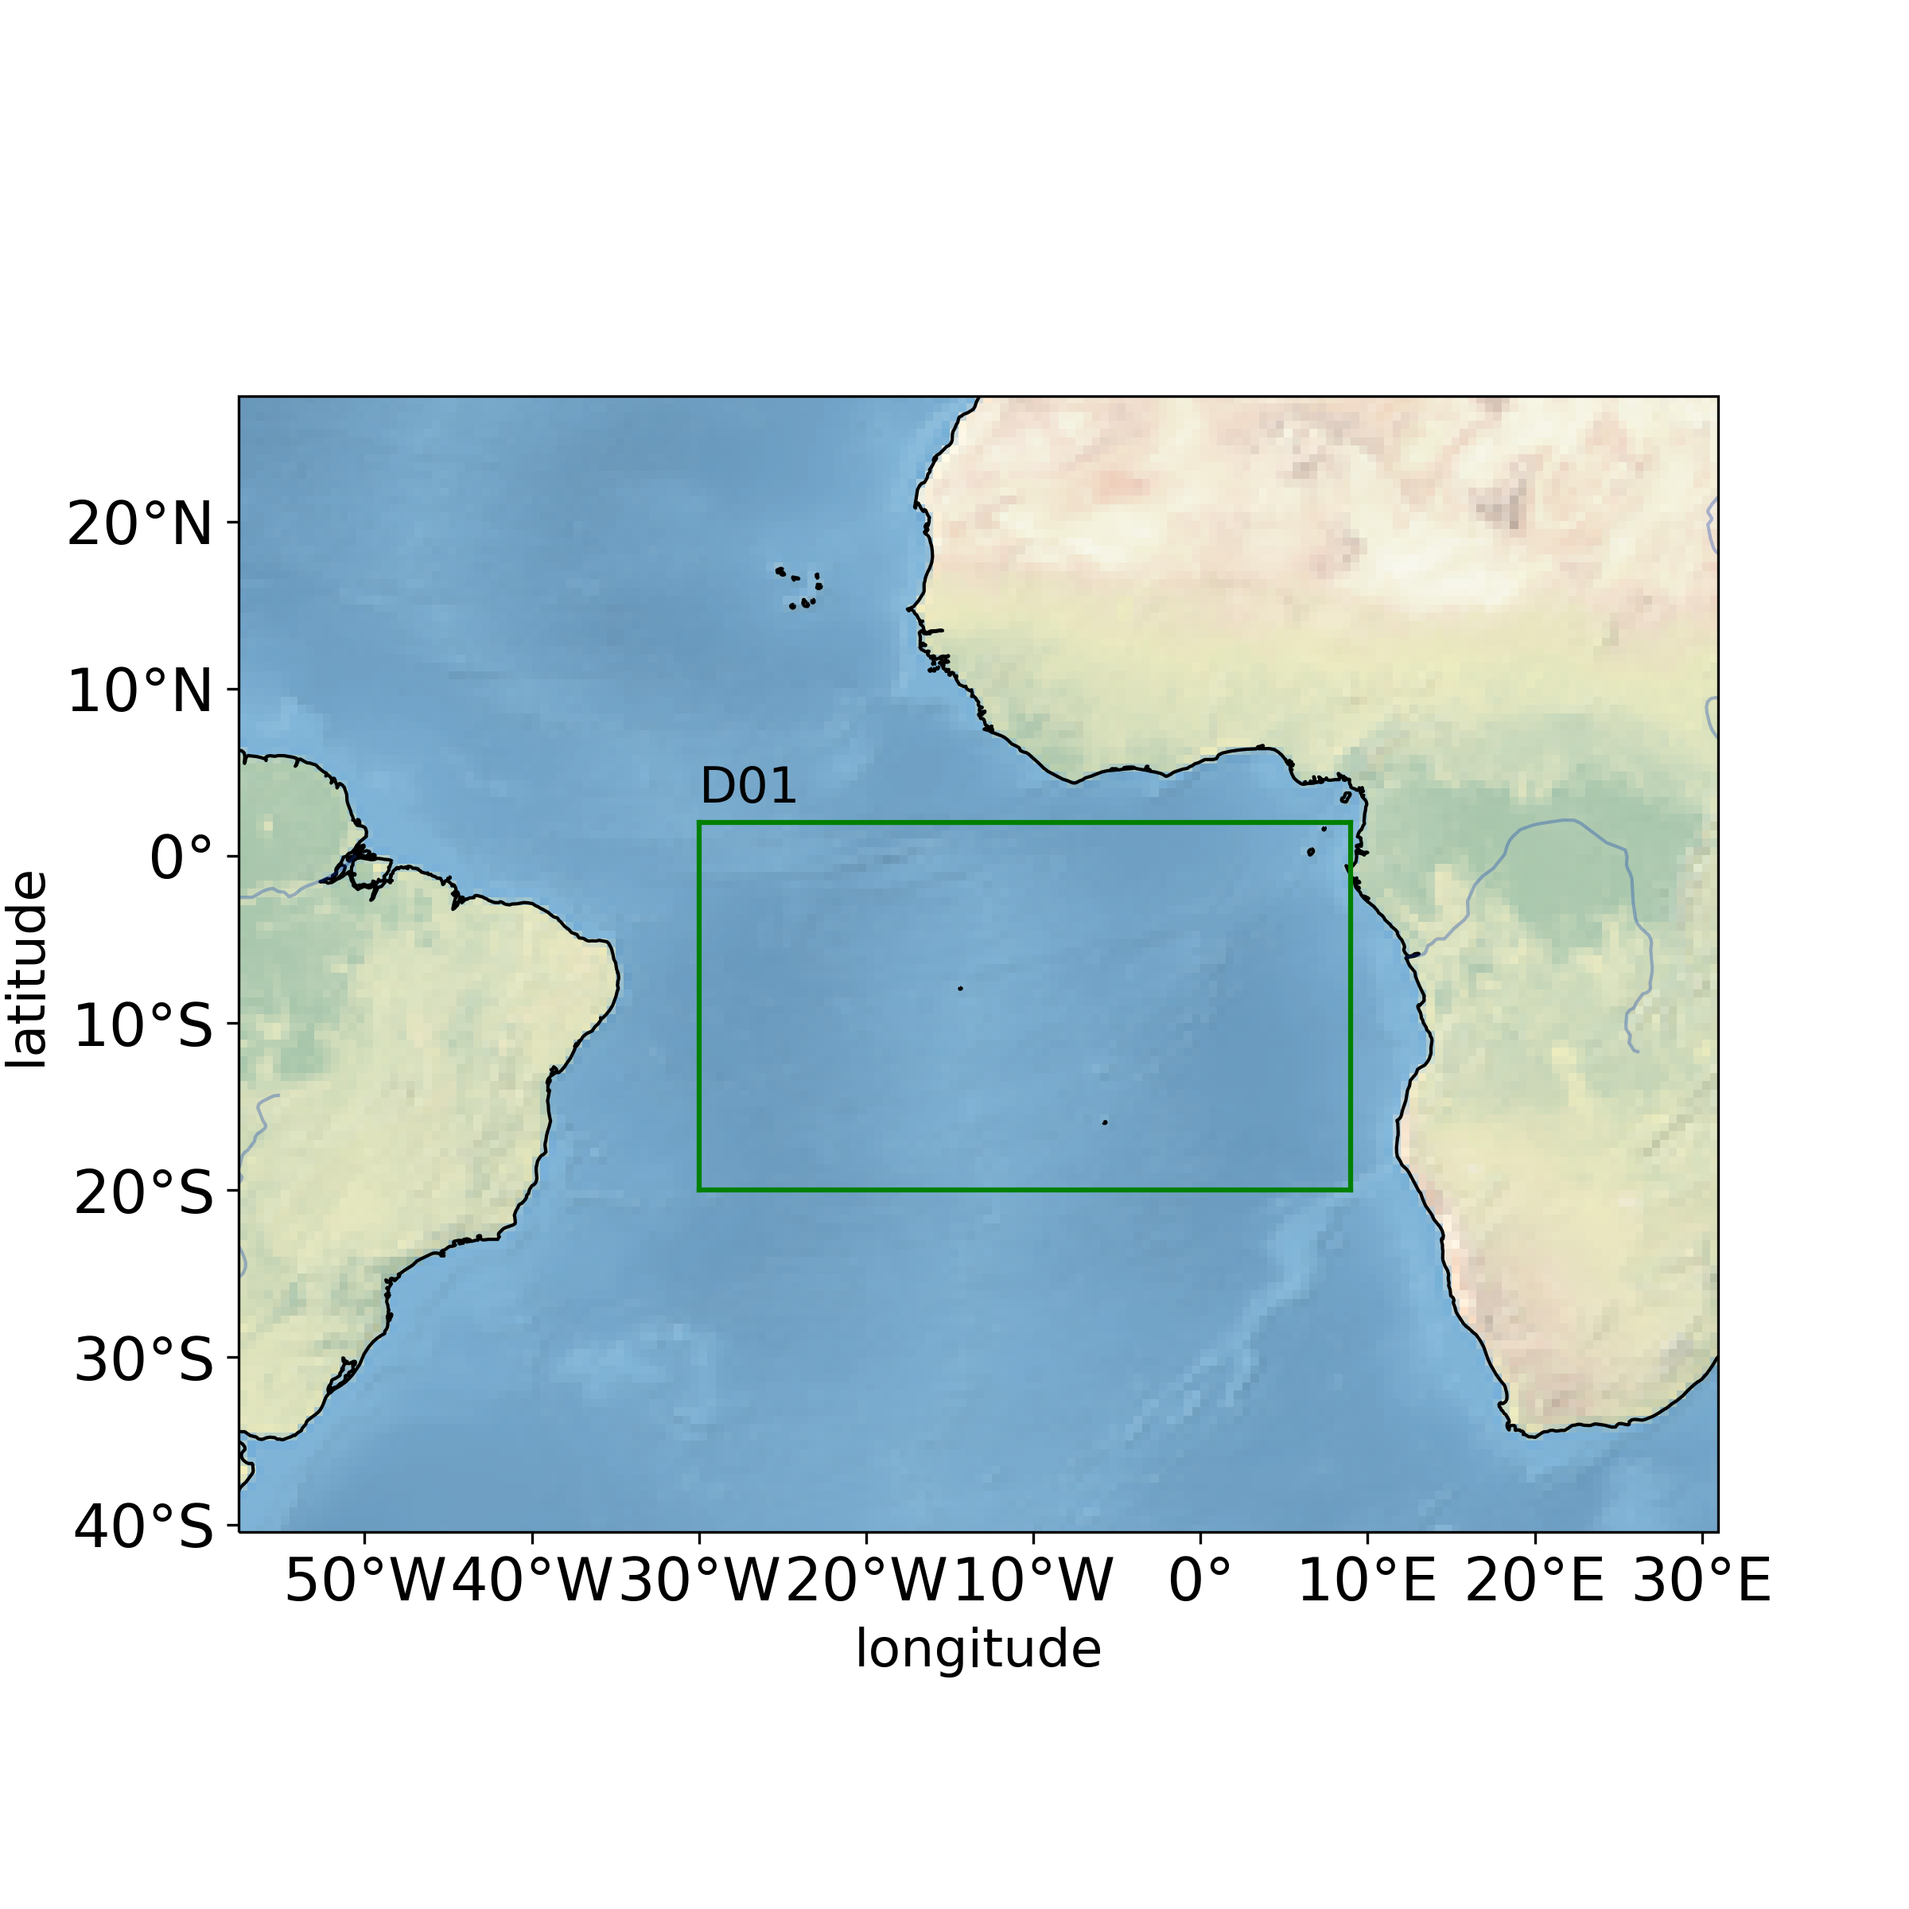

Validation:
different year
same domain & resolution
Comparison of daily bias in 2013
$$∆x=4km$$
(Liu et al., in prep)

Slide 15
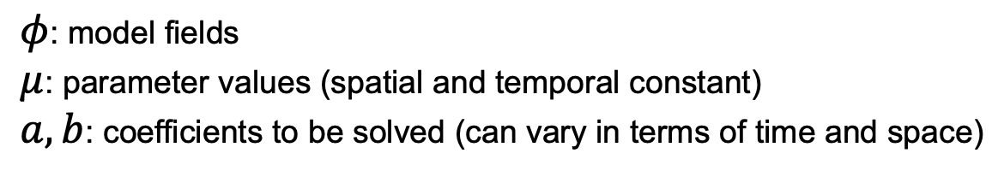
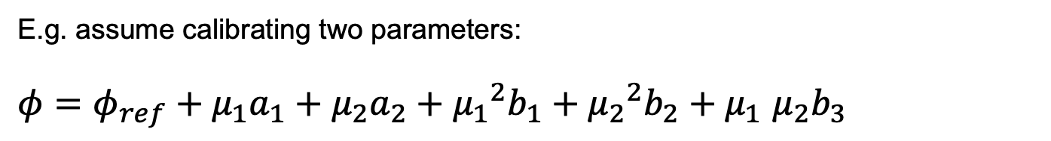
Emulator: metamodel with quadratic function
E.g. assume calibrating two parameters:
$φ=φ_{ref}+μ_{1}a_{1}+μ_{2}a_{2}+{μ_{1}}^{2}b_{1}+{μ_{2}}^{2}b_{2}+μ_{1}$ $μ_{2}b_{3}$
$φ$: model fields
$μ$: parameter values (spatial and temporal constant)
$a, b$: coefficients to be solved (can vary in terms of time and space)
(Bellprat et al., 2012， Voudouri et al., 2018)
Parameter space sampling: 3,000,000 parameter sets sampled with Latin hypercube design
(Liu et al., in prep)

