Slide 1




A new methodology for Standard Evapotranspiration classification over mesoscale regions:
Application and evaluation of SOM over remotely sensed data
Maria Solis-Aulestia, Ph.D.
Israel Pineda, Ph.D.
Elisa Piispa, Ph.D.
Scott Williams, Ph.D.
https://github.com/yachaytech/computational-agriculture

Slide 2

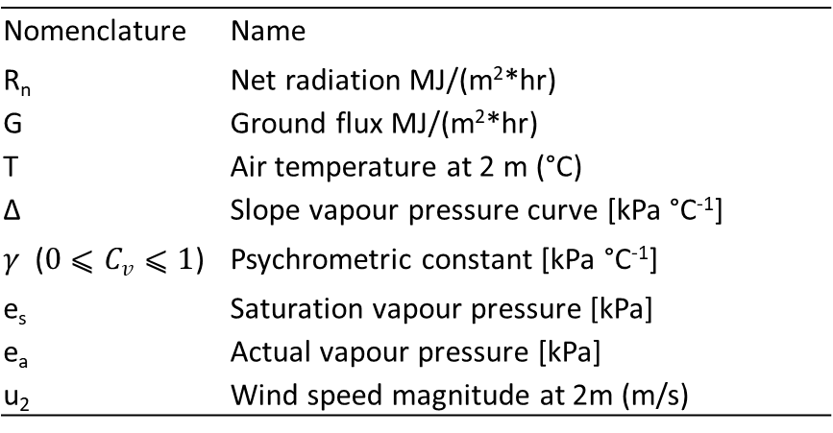
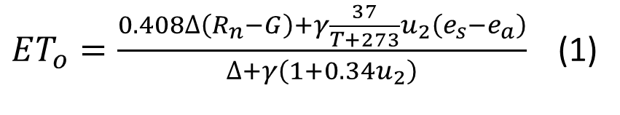
Standard Evapotranspiration (Eto)
Hourly Penman-Monteith equation
$ET_{o}=\frac{0.408∆\left(R_{n}−G\right)+γ\frac{37}{T+273}u_{2}\left(e_{s}−e_{a}\right)}{∆+γ\left(1+0.34u_{2}\right)}$ (1)
Table 1. ETo equation variables.
Nomenclature | Name
R_{n} | Net radiation MJ/(m²*hr)
G | Ground flux MJ/(m²*hr)
T | Air temperature at 2 m (°C)
∆ | Slope vapour pressure curve [kPa °C⁻¹]
$γ$ ($0⩽C_{v}⩽1$) | Psychrometric constant [kPa °C⁻¹]
e_{s} | Saturation vapour pressure [kPa]
e_{a} | Actual vapour pressure [kPa]
u₂ | Wind speed magnitude at 2m (m/s)

Slide 3
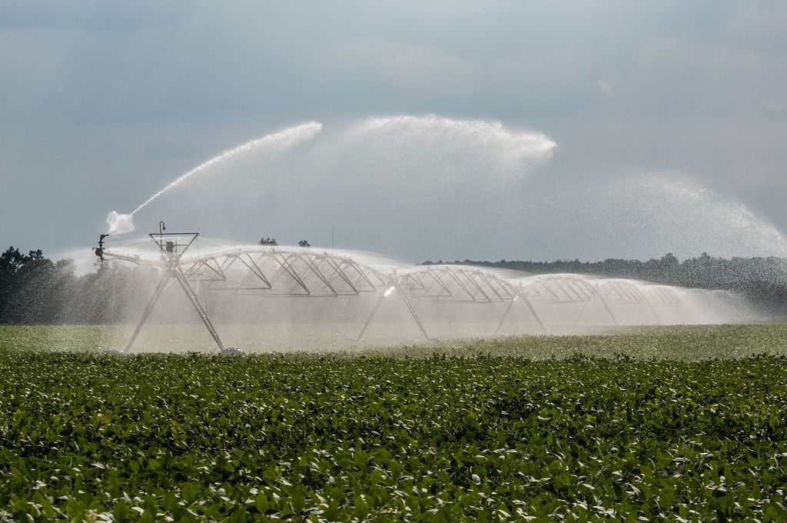
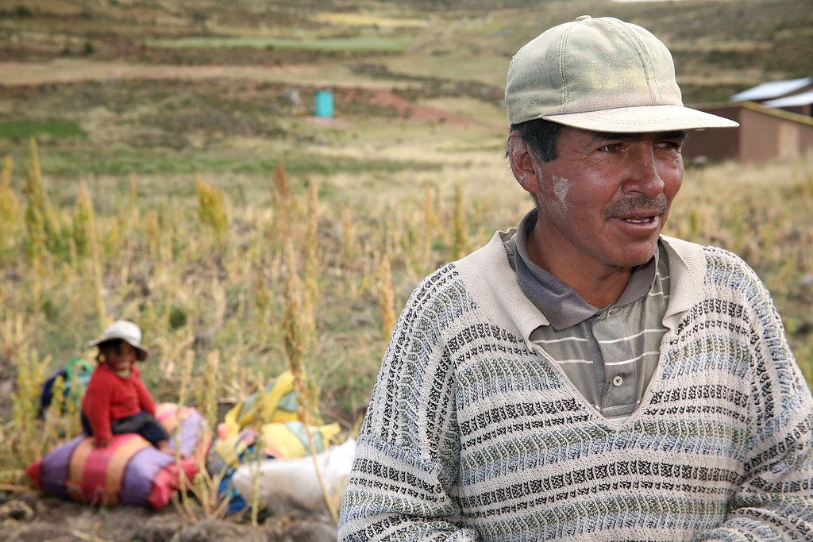
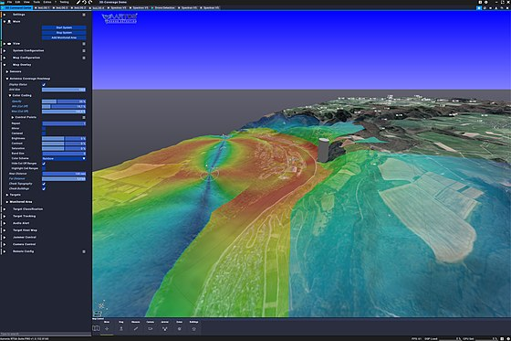
Meso-scale
Temporal resolution
Spatial resolution
Data availability
This Photo by Unknown Author is licensed under CC BY-NC-ND
This Photo by Unknown Author is licensed under CC BY-NC-ND
This Photo by Unknown Author is licensed under CC BY-SA

Slide 4
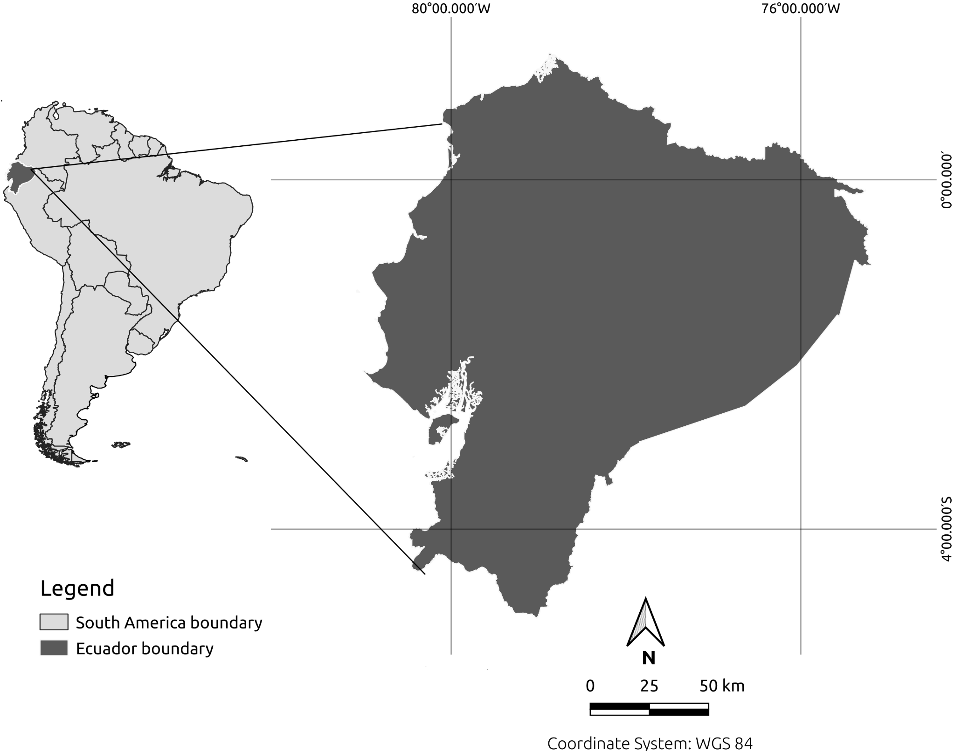


Remotely Sensed Data – meso-scale numerical weather prediction
WRF raw output variables
1.
5-Years data: 2017 – 2021
Weather, Research and Forecasting model (WRF-ARW) 4.3.
Re-analysed 0.25° Global Forecast System data (GFS; NOAA).
3.3 km resolution.
Pre-process variables to PM equation.
Normalize.
Figure 1. Study area – Ecuador

Slide 5
Remotely Sensed Data - mesoscale numerical weather prediction
WRF raw output variables
Self Organizing Maps (SOM)
1.
2.
5-Years data: 2017 – 2021
Weather, Research and Forecasting model (WRF-ARW) 4.3.
Re-analysed 0.25° Global Forecast System data (GFS; NOAA).
3.3 km resolution
Pre-process variables to PM equation.
Normalize.
Clustering.
Unsupervised ANN.
Operator defined parameters.

Slide 6
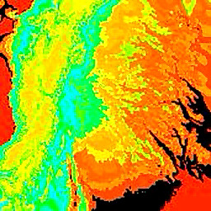
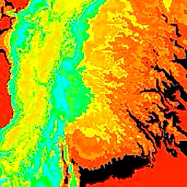
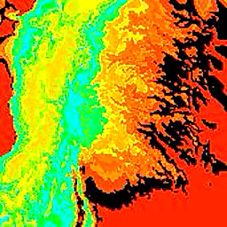
Apply SOM (MiniSom; Python On-Line Imaging – POLI)
  Test parameters:
    1. Number of epochs (2 – 5)
      2. Learning rate (0.007 – 0.01)
  Yearly runs: 10 runs per combination of parameters set per year.
  5-years aggregated runs: 2 sets of 10 runs using the best performing parameters in the yearly runs.
Figure 2. Example of Eto clustering maps for different dates

Slide 7
Remotely Sensed Data - mesoscale numerical weather prediction
WRF raw output variables
Self Organizing Maps (SOM)
Classified Eto Maps
1.
2.
3.
5-Years data: 2017 – 2021
Weather, Research and Forecasting model (WRF-ARW) 4.3.
Re-analysed 0.25° Global Forecast System data (GFS; NOAA).
3.3 km resolution.
Pre-process variables to PM equation.
Normalize.
Clustering.
Unsupervised ANN.
Operator defined parameters.
Repeatability.
Cramer’s V index.

Slide 8
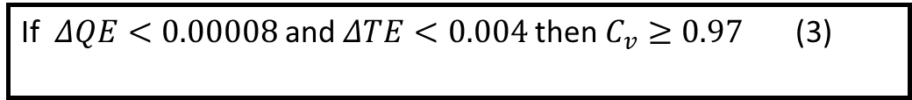
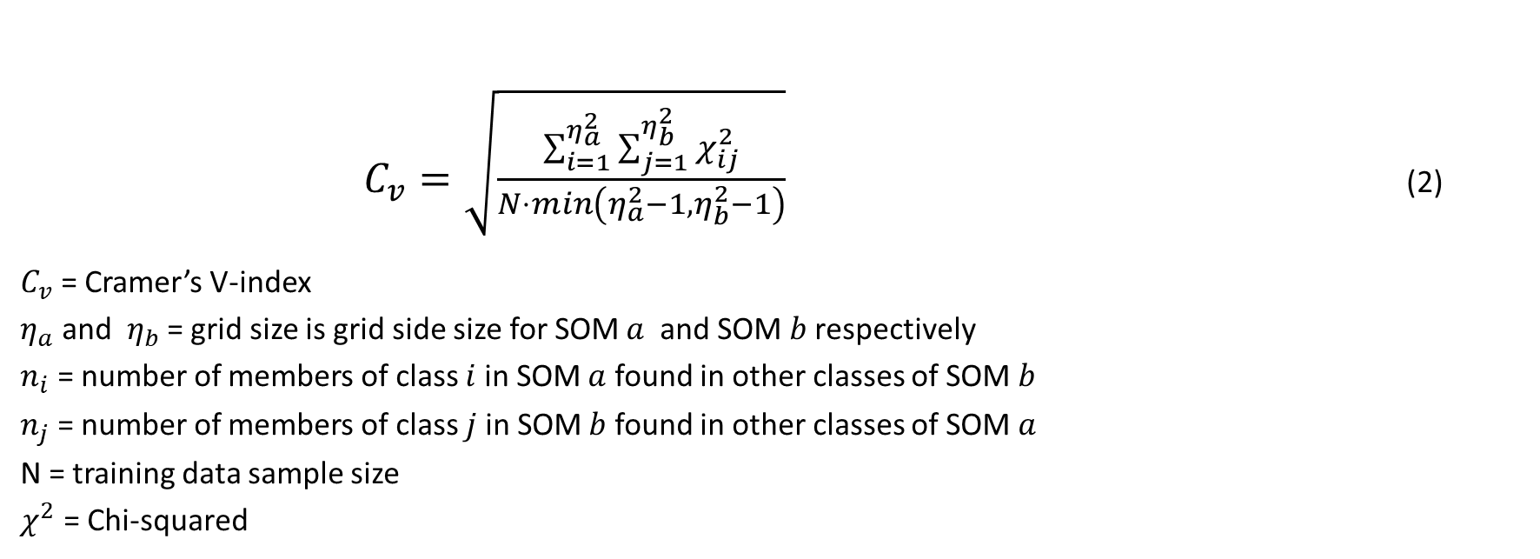
Test methodology repeatability by quantifying similarity (𝐶𝑣)
Apply Cramer’s V-index (𝐶𝑣) between test runs.
Record differences between Quantification and Topographic errors (QE; TE).
10 test runs → 45 comparisons.
        $C_{v}=\sqrt{\frac{\sum_{i=1}^{η_{a}^{2}}{\sum_{j=1}^{η_{b}^{2}}{χ_{ij}^{2}}}}{N⋅min\left(η_{a}^{2}−1,η_{b}^{2}−1\right)}}$ (2)
$C_{v}$ = Cramer’s V-index
$η_{a}$ and $η_{b}$ = grid size is grid side size for SOM $a$ and SOM $b$ respectively
$n_{i}$ = number of members of class $i$ in SOM $a$ found in other classes of SOM $b$
$n_{j}$ = number of members of class $j$ in SOM $b$ found in other classes of SOM $a$
N = training data sample size
$χ^{2}$ = Chi-squared
If $ΔQE<0.00008$and $ΔTE<0.004$then $C_{v}≥0.97$ (3)

Slide 9
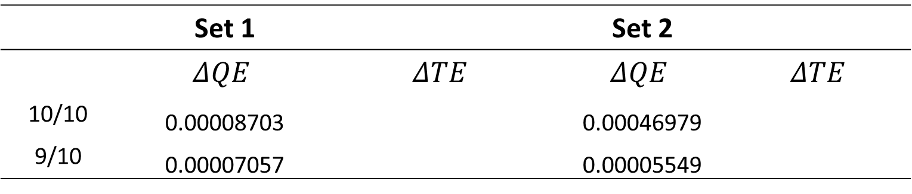
Results
Yearly results:
  12 sets achieved the selection criteria (3) for all 10 runs (45 comparisons).
5-years aggregated results:
  2 sets of 10 runs using number of epochs = 4 and learning rate = 0.00724
  9/9 → 𝐶𝑣 = 0.99
Table 2. 5-years aggregated results
 | Set 1 |  | Set 2
 | $$ΔQE$$ | $$ΔTE$$ | $$ΔQE$$ | $$ΔTE$$
10/10 | 0.00008703 |  | 0.00046979
9/10 | 0.00007057 |  | 0.00005549

Slide 10
Conclusions
New methodology to characterize Eto categories or classes.
The learning rate of 0.00724 and a number of epochs of 4 were considered as repeatable parameters after 10 consecutive runs.
Number of epochs is the most computational intensive parameter and we sought to minimize it.
Yearly results: 10/10 repeatable runs.
5-years aggregated results: 9/10 repeatable runs. 1 was considered an outlier.

Slide 11
Future research
Test new parameters.
Characterize Eto ‘climate’, where the climate definition would be a pixel frequency of weather classes over the 5 years.
Ground truthing:
  With Reliable weather station data if available
  ET flux towers
  Test WRF accuracy

Slide 12
Acknowledgements
Imbabura High Performance Cluster. Yachay Tech University, Ecuador purchased under contract no. 2017-024 (SIE-UITEY-007-2017).
Spein executing WRF.
Microsoft Azure. Grant No. AI4E-1885-R9G8-21020902
Special thanks to the HPC administrator Professor Duncan John Mowbray for his help
Thank you!
For any questions, please
contact me to maldsolmj@hotmail.com

