Slide 1


The effect of magnetic field direction during the low-temperature oxidation of titanomagnetite bearing TRM on paleointensity determinations
Grachev Roman
Lomonosov Moscow State University, Faculty of physics.
Notes:
I would like to begin by thanking you for this opportunity to present my report. This is my first speech in English longer than 5 minutes, I hope I will be able to convey my results, my thoughts clearly. I will do my best.

Slide 2
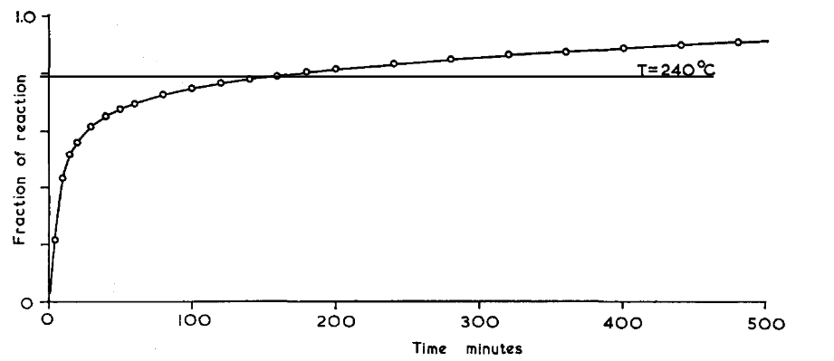


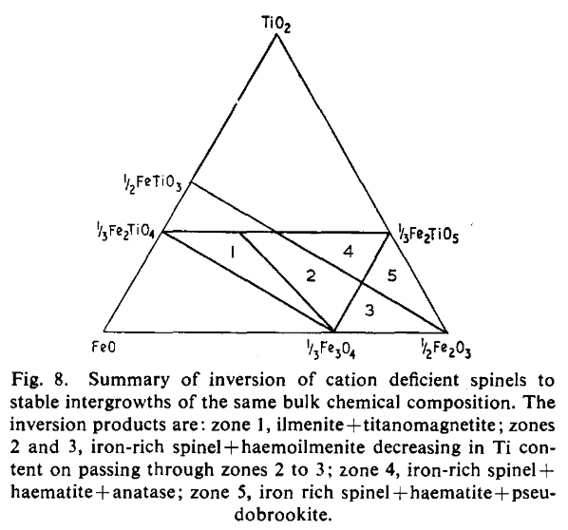


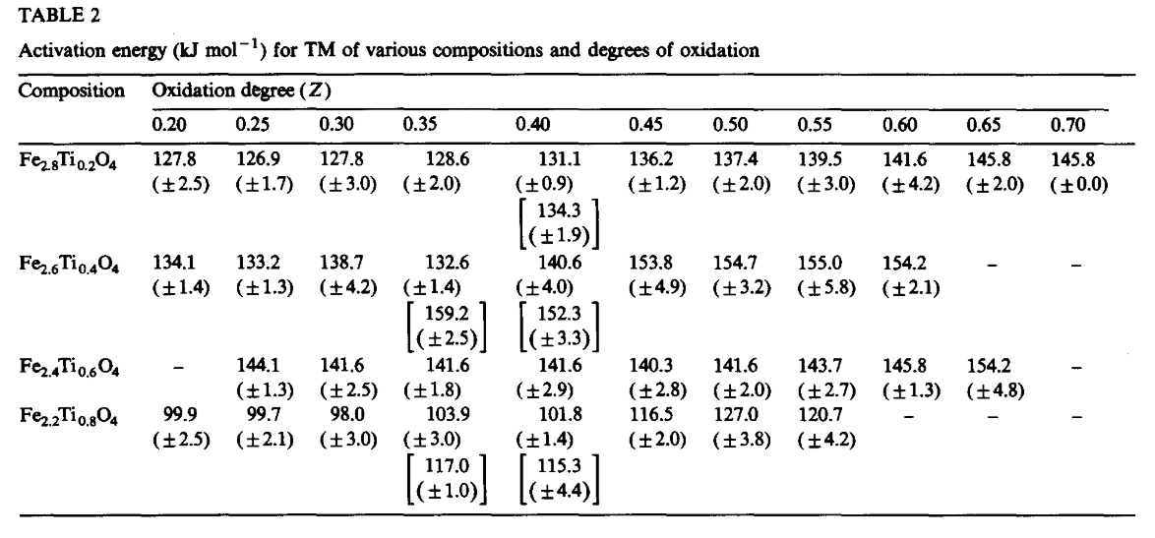
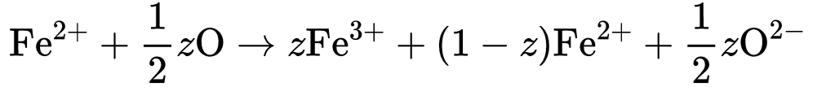
Kinetics of the titanomagnetite single-phase oxidation
[O`Reilly 1970]
[A. K. Gapeev, S.K. Gribov 1989]
Where Z is the degree of titanomagnetite single-phase oxidation
[O`Reilly 1970]
[Nishitani 1983]
Notes:
Its well known one of The main carriers of the natural remanement magnetization (NRM) of igneous rocks — titanomagnetites (TM) – are not thermodynamically stable in the conditions of the earth's surface.
This leads not only to the destruction of the primary magnetization, which stores information about the evolution of the ancient magnetic field of the Earth, but also to the creation of secondary magnetization of different genesis, for example VRM, CRM and others. Of all the processes that can undergo during the life of a titanomagnetite, single - phase oxidation has been studied in sufficient details.
2. Titanomagnetite is a solid solution of magnetite and ulvoshpinel. When titanomagnetite is oxidized, a cation deficient titanomaghemite is formed. The single-phase oxidation reaction is characterized by a reaction of this form, where Z is the degree of single-phase oxidation
3. The kinetics of single-phase oxidation has been considered in many papers and is described by the Arenius equation. In the article Gapeev Gribov, the values of the activation energy were obtained depending on the ulvospinel content in titanomagnetite. With an increase in the titanium content in the titanomagnetite, the activation energy on the contrary decreases.

Slide 3
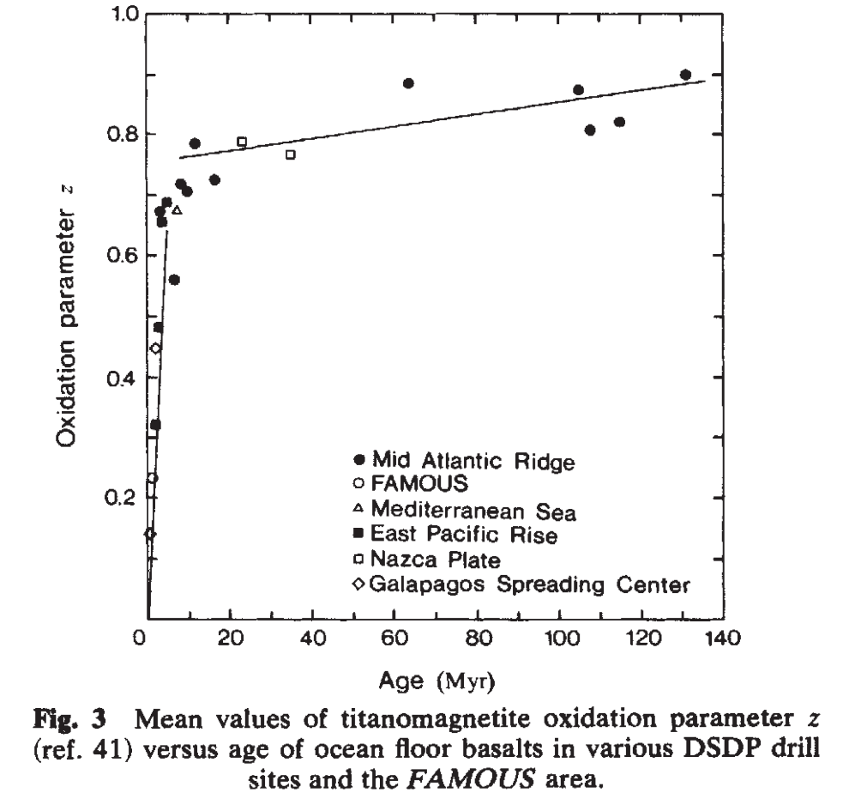
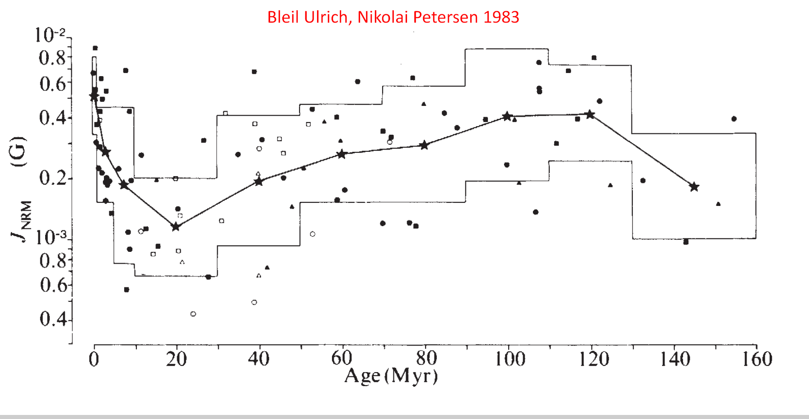
Magnetization variation with age in oceanic basalts
Notes:
According to the work [Bleil, Petersen 1983] low-temperature oxidation is main reason of a decrease of NRM of the ocean floor basalts with its increasing age during first 10-20 million years.
2. The mechanism underlying the sea floor oxidation of titanomagnetite is Fe-migration out of the spinel lattice. Titanium is not affected by this migration process.
In this case the Fe/Ti ratio in the spinel lattice should decrease
3. It is obvious that single-phase oxidation is a phenomenon that must be considered in paleomagnetic studies to obtain relevant data…

Slide 4
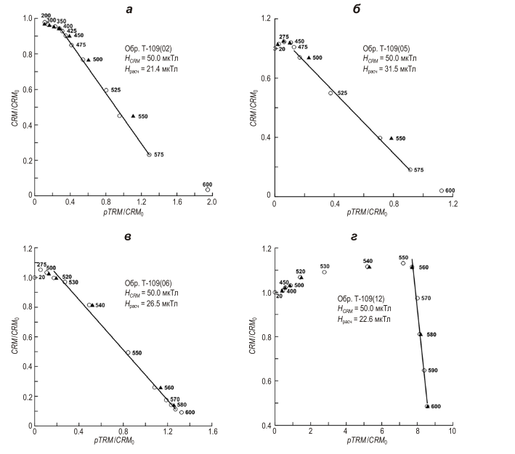
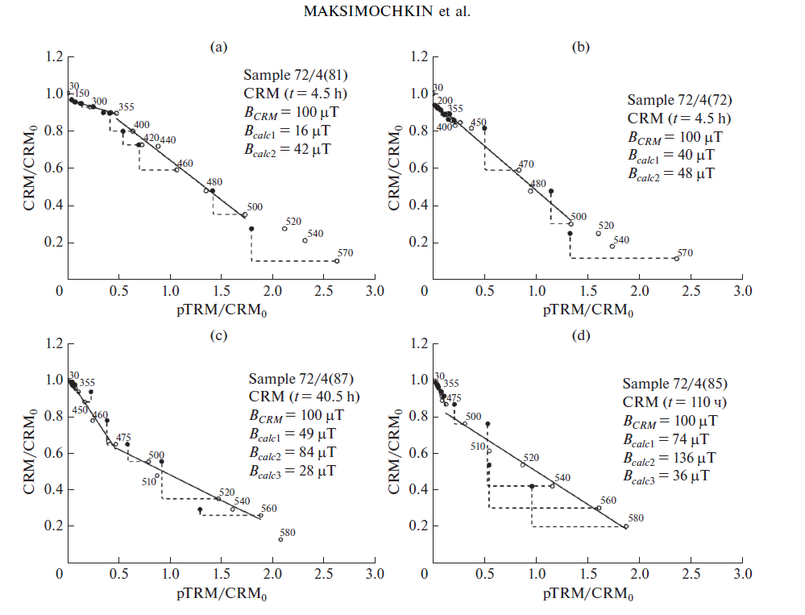
Can we get the correct value of the paleointensivity from rock samples in which the main carrier of NRM is single-phase oxidized titanomagnetite?
«We conclude that low and medium degrees of oxidation of single-domain titanomagnetites should not change the original NRM directions of submarine basalts nor the pattern of magnetic
stripes over the oceans.»
[Özden Özdemir and David J. Dunlop 1985]
[Gribov 2016]
[Maksimochkin 2020]
[Kelso et al. 1991] have done pH-dependent hydrothermal alteration experiments of synthetic titanomagnetite and observed a CRM acquisition along the ambient field direction during oxidation.
Self-reversal phenomenon has to be taken into account since it has been demonstrated that low-temperature oxidation can produce a self-reversal magnetization in basalts (Krasa, 2003; Doubrovine and Tarduno, 2004; Krasa et al., 2005).
Notes:
The question arises «Can we get the correct value of the paleodirection and paleointensivity from rock samples in which the main carrier of NRM is single-phase oxidized titanomagnetite»?
In the work[Özden Özdemir and David J. Dunlop 1985] it was shown that on single-domain synthesized titanomagnetites, the direction of the CRM formed during low-temperature oxidation is co-directed with the direction of the primary TRM and it does not depend on the direction of the weak (within 100 µT) magnetic field.
[Kelso et al. 1991] have done pH-dependent hydrothermal alteration experiments of synthetic titanomagnetite and observed a CRM acquisition along the ambient field direction during oxidation.
At the present moment, it is known that the direction of the secondary CRM formed as a result of single-phase oxidation coincides with the direction of the initial magnetization if the reaction temperature is less than Tc, and is co-directed with the magnetic field if the reaction temperature is greater than Tс of the magnetic grains. Although there are known and physically explained cases of antiparallel magnetization of rocks, the so-called self-reversal of magnetization
As for the value of the paleointensity determined from single-phase oxidized titanomagnetite, there is much more uncertainty here…
It is shown that the Thellier method allows us to determine the magnitude of the magnetic field of the CRM method turned out to be underestimated relative to the true value by 30-60 %. however, it was found that according to the graphic constructions of the Arai–Nagat of the Tellier - Coe heating procedure, CRM does not differ from TRM. In the paleomagnetic aspect, this means that igneous rocks containing highly oxidized titanomagnetite can be a source of significant error in the determination of the Paleointensity of the geomagnetic field in past
The conditions for obtaining chemical magnetization in the model experiments described in the literature still differ from the natural ones. The annealing of basalt samples was carried out at temperatures above the Curie temperature of TM, whereas in nature the oxidation of TM and the formation of CRM occurs below this temperature on TM grains with primary heat-sufficient magnetization.The present work is devoted to filling this gap
Since complete oxidation was never reached in their experiments, the NRM always retained some memory of the original thermoremanent magnetization (TRM). These

Slide 5
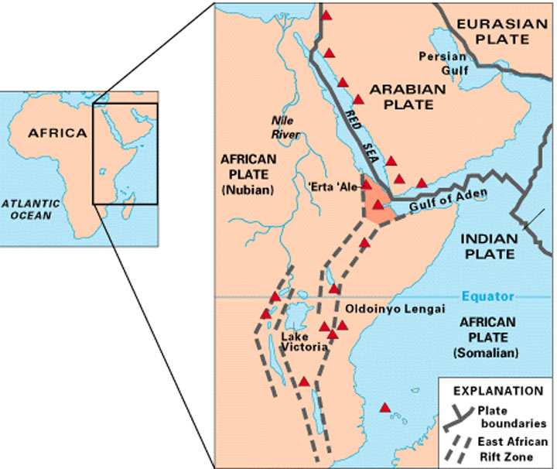
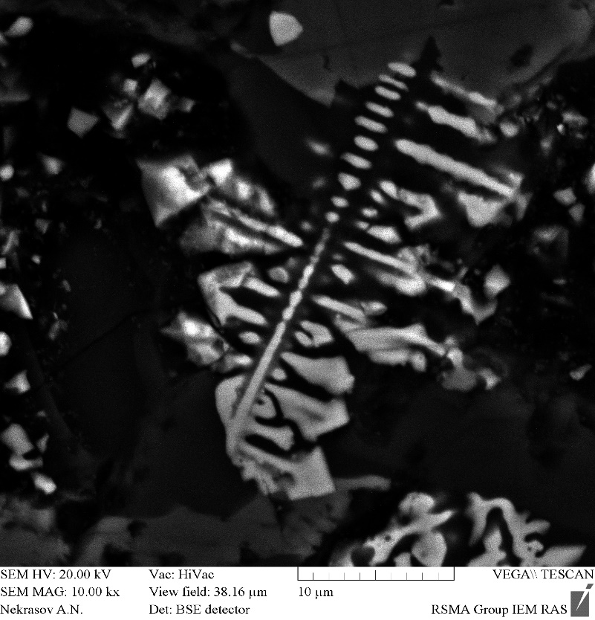

Modeling object — basalt P72/4 from the Red Sea rift zone
Sample P72/4 from the Red Sea rift zone was chosen as the object for laboratory modeling of the titanomagnetite low temperature single-phase oxidation
The main carrier of NRM is titanomagnetite (xFe₂TiO₄—(1-x)Fe₃O₄) with an ulvoshpinel x content of about ~0.5(0.48), lattice constant a=8.4545 A
The values of the NRM vary within 18.2—22.5 µA∙m²/g, susceptibility k_{o} (0.5-0.6), the parameter Q_{n} 80-105, where Q_{n} was calculated using the formula $Q_{n}=NRM/(40∙k_{o})$
Phase and structural characteristics of the P72/4 basalt sample in the initial state
NRM, µA∙m²/g | k_{o}·10ˉ², SI units/g | Q_{n} | H_{c}, mT | H_{cr}, mT | H_{cr}/H_{с} | I_{rs}, A/m | I_{s}, A/m | M_{rs}/M_{s} | *T_{c} (k) | *T_{c} (I_{0.24})
19.7 | 0.54 | 91 | 17.3 | 22.1 | 1.28 | 890 | 2400 | 0.37 | *260 | *255
*the table shows the median T_{c}. The Curie temperatures of the grains in the initial state range from 200-360°С
Notes:
For the experiments, we used a piece of basalt P72 / 4 from the Red Sea rift zone, extracted during the 30th voyage (1980) of the NIS "Akademik Kurchatov" and kindly provided to us by the leading researcher of the IO RAS A. A. Schrader, a member of this expedition.
The P72/4 basalt sample was well studied by us. The main magnetic mineral responsible for the natural residual magnetization (NRM) of basalt P72/4 is homogeneous titanomagnetite (TM) with a content of ulvospinel (Fe2TiO4) of about 50%, the lattice constant TM a=8.4545 A. The TM grains have a skeletal, irregular shape (Fig. 2), indicating a high magma cooling rate characteristic of oceanic basalts. Their maximum size does not exceed 6-8 microns. By hysteresis characteristics, and the Day criterion [Day, 1977], the magnetic structure of the ferrimagnetic grains of sample P72/4 corresponds to the pseudodomain (PSD) state.
Titanomagnetite grains are characterized by a Curie temperature spectrum in the range from 200 to 360C. The median value of the Curie temperature is shown in the table

Slide 6
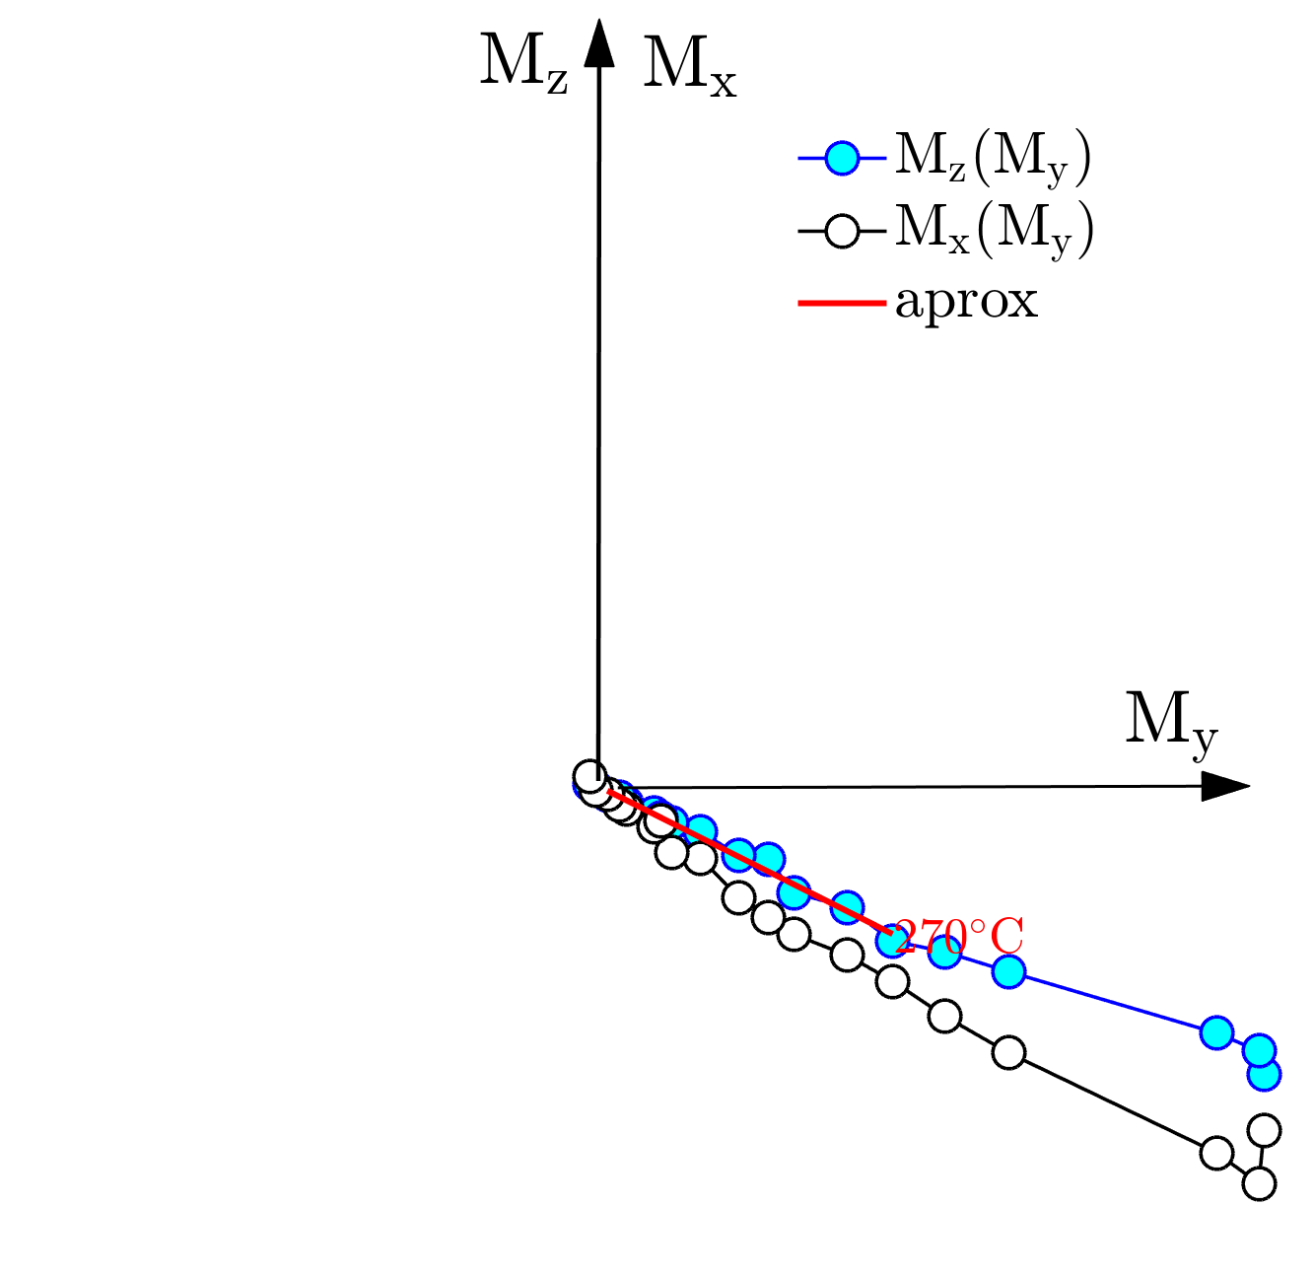
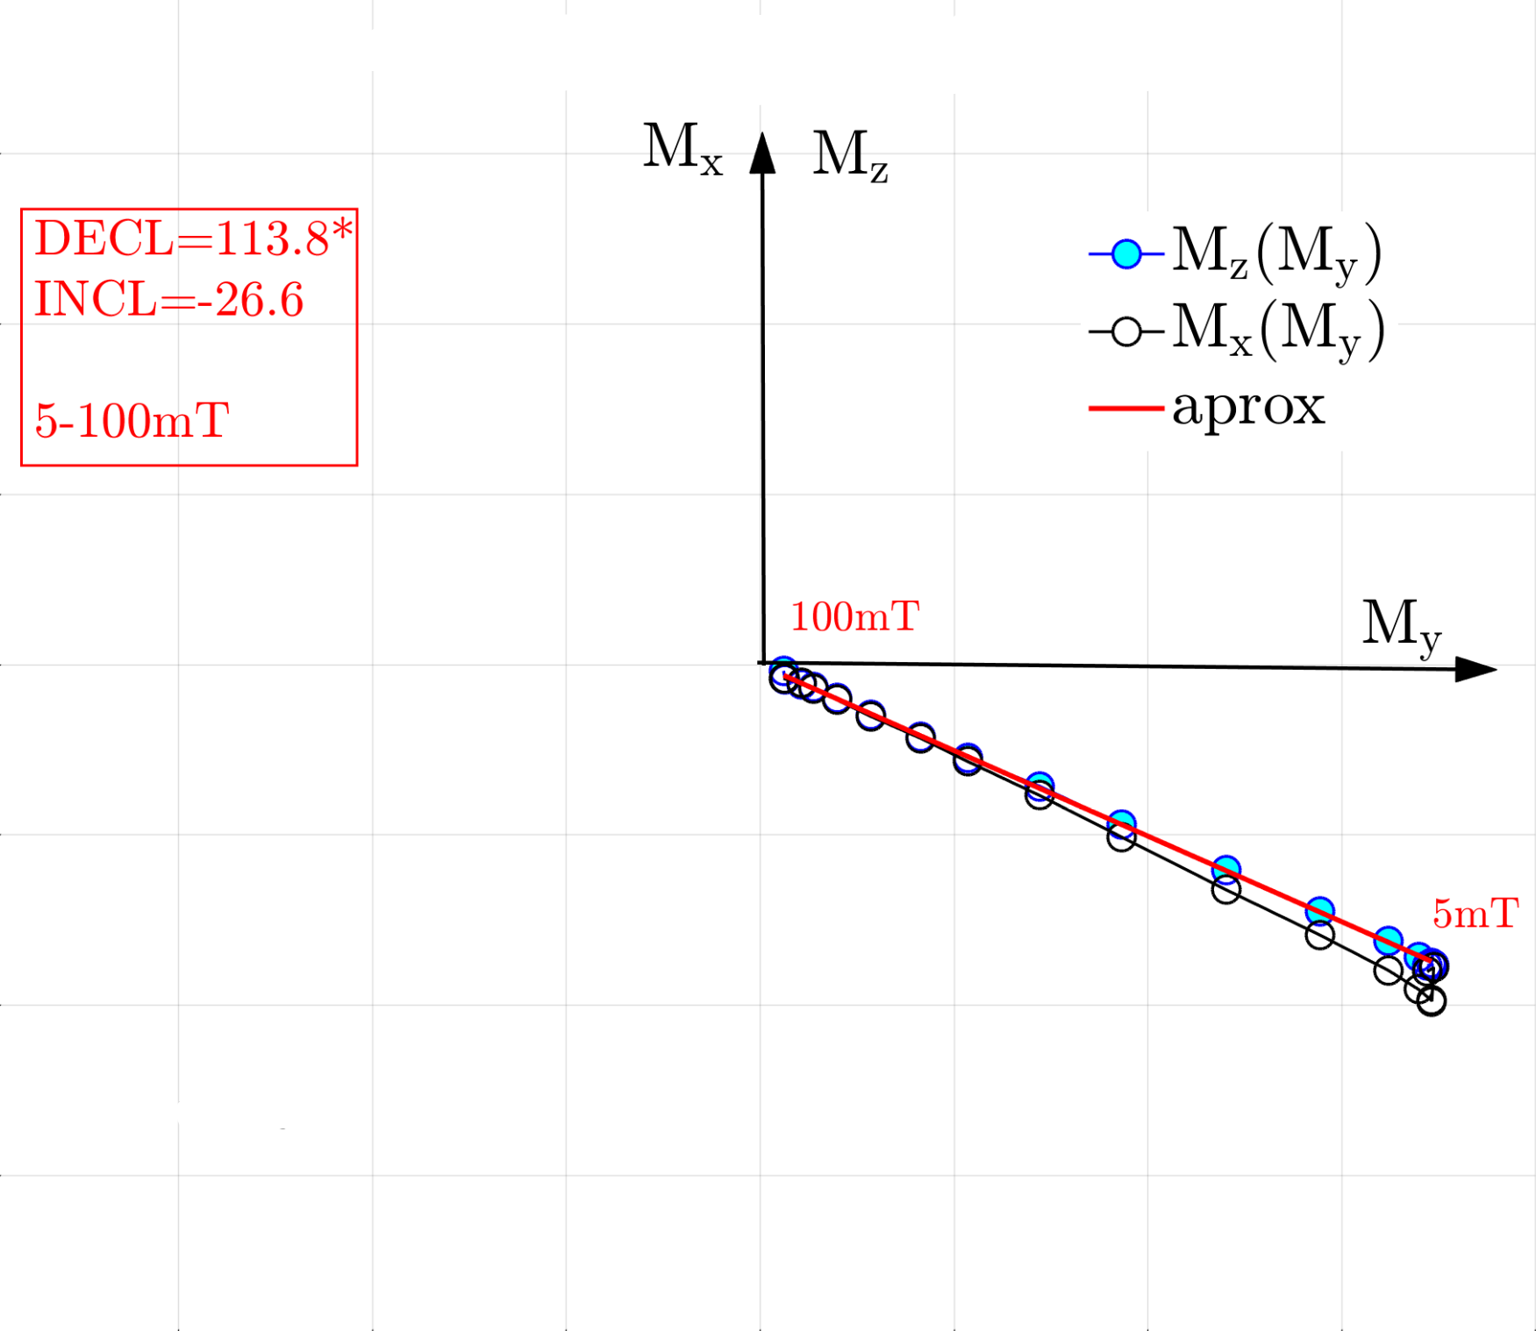
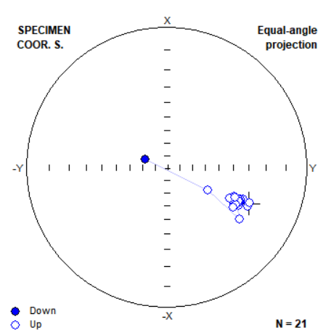
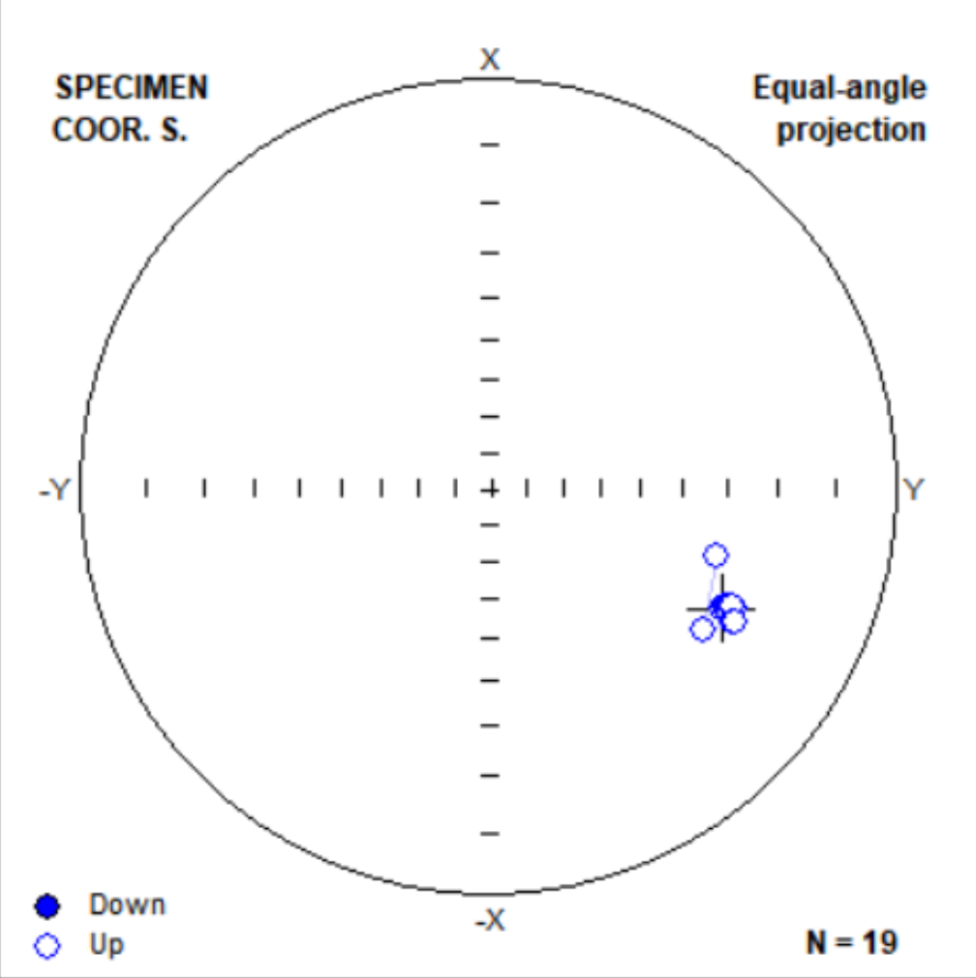
Thermal (on the left) and alternating magnetic field (on the right) demagnetization experiment results of the basalt P72/4 in NRM state
1
2
1
2
1
2
3
4
3
4
3
4
Notes:
The Zijdervild diagram (Figure 1), obtained from both thermal cleaning (left) and demagnetization by an alternating magnetic field, is characterized by a single linear section, which indicates a one-component composition of the NRM
The range of unlocking temperatures(Figure 4 on the left) is quite wide. The main deblocking temperatures are in the range from 190 to 400 °C with a maximum in the range of 250-260 °C
The spectrum of coercive forces is much narrower (Figure 4-right) with a maximum at 15 MT
Thus, basalt titanomagnetite is homogeneous and suitable for laboratory modeling of single-phase oxidation

Slide 7
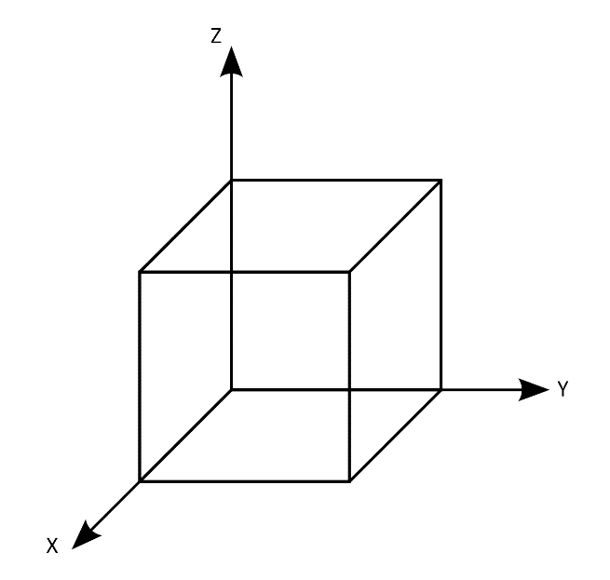
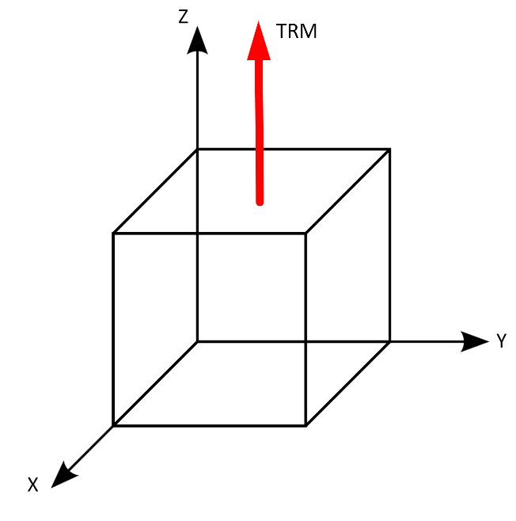
Sample preparation technique
STEP 1: Сubic P72/4 basalt samples with an edge face of 1 cm were demagnetized by temperature(TD) when heated in an argon atmosphere up to 400°C. After which, all heated sample were additionally demagnetized by an alternating magnetic field(AFD)
STEP 2: Demagnetized samples were reheated to 400°C in an argon atmosphere and cooled in a magnetic field with an induction of 50 µT to room temperature. The direction of the magnetizing field co-directed with the Z axis in the sample coordinate system
STEP 3: Then again, samples were reheated to the reaction temperature T_{an} =260 °C and cooled at B=0. Thus the original laboratory paleomagnetic signal was enclosed in a magnetization with blocking T=260-400C
Now we have the initial paleomagnetic signal enclosed in a range of blocking temperatures from 260 to 400C. This magnetization is our laboratory initial magnetic state
Notes:
briefly description of the experiment scheme and the samples preparation technique. Sample preparation included the following steps
first of all, the samples must be demagnetize. STEP 1 Сubic P72/4 basalt samples with an edge face of 1 cm were demagnetized by temperature(TD) when heated in an argon atmosphere up to 400°C. After which, all heated sample were additionally demagnetized by an alternating magnetic field(AFD)
Then STEP 2: Demagnetized samples were reheated to 400°C in an argon atmosphere and cooled in a magnetic field with an induction of 50 µT to room temperature. The direction of the magnetizing field coincided with the Z axis in the sample coordinate system
STEP 3: Then again, samples were reheated to the reaction temperature T_{an} =260 °C and cooled at B=0. Thus the original laboratory paleomagnetic signal was enclosed in a magnetization with blocking T=260-400C
4. Now we have the initial paleomagnetic signal enclosed in a range of blocking temperatures from 260 to 400C. This magnetization is our laboratory initial magnetic state

Slide 8
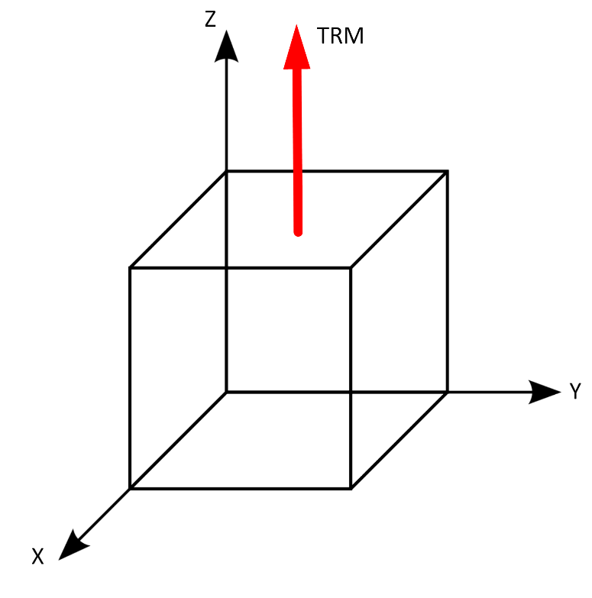
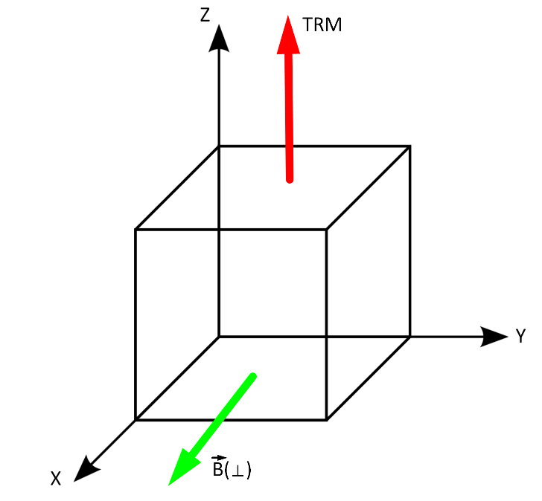
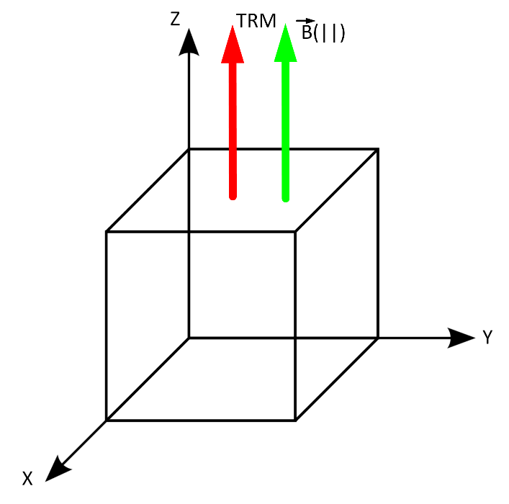
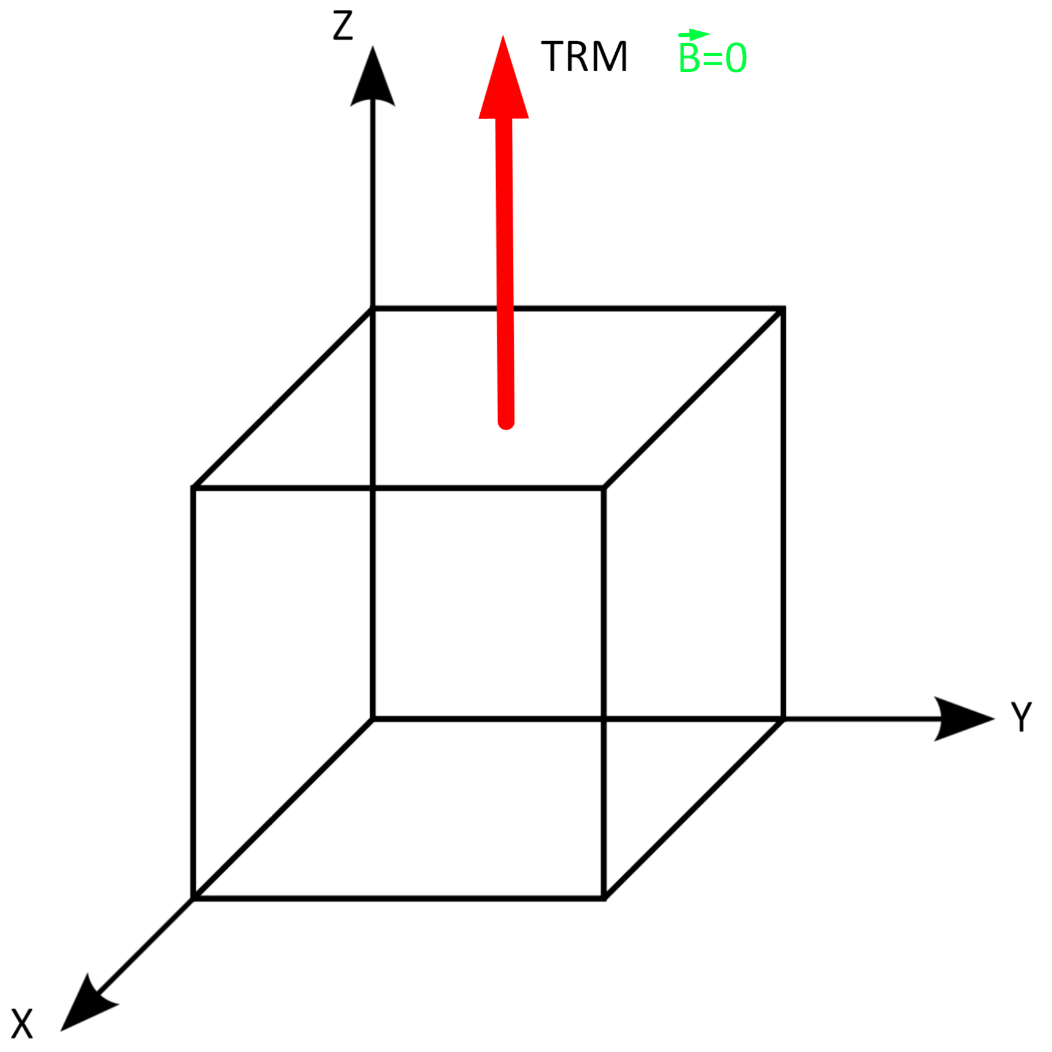
Annealing experiments
Experimental conditions
- Annealing temperature: T_{an}=260 °C
- Annealing time: t=12.5, 100, 400 and 1300 hours
- Magnetic field induction creating TRM: B_{TRM}=50 µT
- Magnetic field induction during annealing: B_{an}=50 µT
For some samples, the direction of the magnetic field B_{an} was directed perpendicular(⊥) to TRM along the Ox axis.
For another samples, the direction of the magnetizing field B_{an} was co-directed(∥) with TRM along the Oz axis
Third group of samples were annealed with magnetic field induction B_{an}=0 µT
Notes:
Аfter that, the samples were subjected to annealing in a magnetic field with an induction of Ban = 50mkTl at a constant temperature of Tan = 260 ° C for 4 annealing times t = 12.5, 100, 400 and 1300 hours, respectively. The annealing temperature was selected based on the results of preliminary experiments. Before annealing, the samples were divided into three groups
First group, the direction of the magnetic field B_{an} was directed perpendicular(⊥) to TRM along the Ox Axis.
Second group, the direction of the magnetizing field B_{an} was co-directed(∥) with TRM along the Oz axis
Third group of samples were annealed with magnetic field induction B_{an}=0 µT to control the magnetization relaxation process
Let's move on to the experiments results

Slide 9
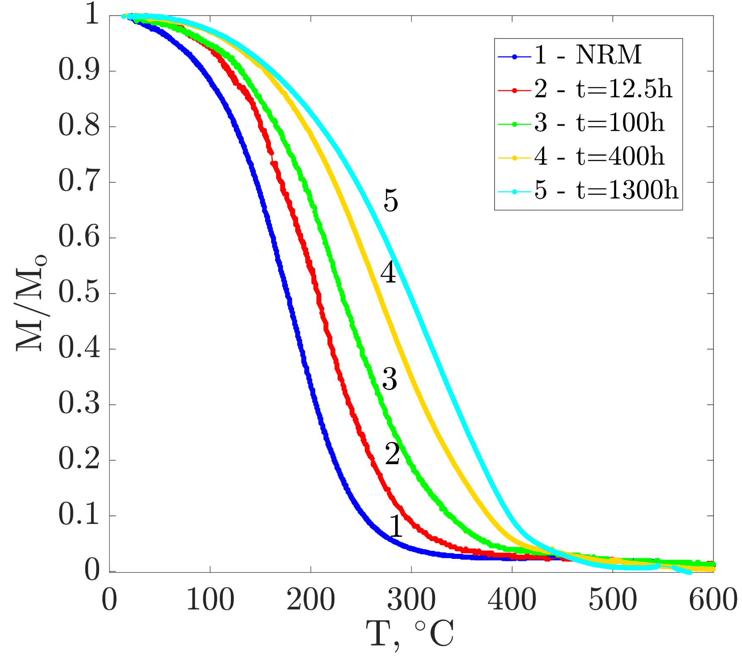
Phase and structural characteristics after annealing at T_{an}=260 °C in air for a time
t=0-1300 hours. Thermomagnetic analysis(TMA)
Magnetic susceptibility k(T) Argon
Magnetization I_{0.24}(T) Air
1
2
Notes:
it is necessary to make sure that the single-phase oxidation process takes place.
The results presented in Fig. 1 and Fig. 2 show that with an increase in the annealing time, the Magnetic susceptibility k(T) and magnetization in the field of 0.24 T M(T) heating curves are shifted towards higher temperatures relative to the initial state, which indicates an increase in the Curie temperature Tc TM of grains (Table 2) and, accordingly, their single-phase oxidation.
The heating and the cooling curve of TMA according to Magnetic susceptibility from temperature do not coincide. Given that the experiment was conducted in an argon atmosphere, this is due to the homogenization of titanomaghemite to titanomagnetite when heated above the mixing temperature in the low partial pressure of oxygen. This effect is also a sign of the single-phase nature of oxidation

Slide 10
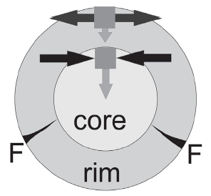
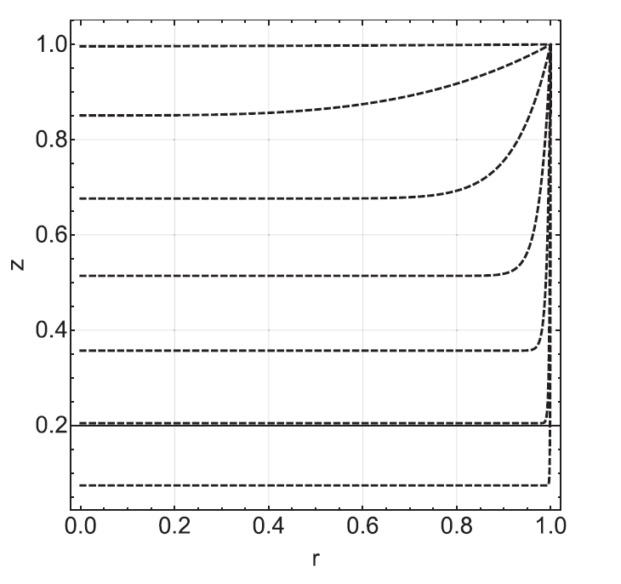
Evolution of the deblocking temperature spectrum from the annealing time
[K. Fabian and V. Shcherbakov 2020]
Notes:
On this slide, you can see the dependence of the blocking spectrum in the initial state (blue color) in comparison with the spectrum of blocking temperatures after annealing (pink color). The blue color shows their intersection.
1.As can be seen from the figure, even after a short annealing for 12 hours at a temperature of 260, a magnetization with high blocking temperatures(450-460 degrees Celsius) is formed
2. With the annealing time increases, the breadth of the blocking temperature spectrum decreases, it will become narrower, which is consistent with a recent publication [Fabian Scherbakov 2020]
There is a strongly oxidized shell(or rim) and a not significantly less oxidized core. As the defectiveness of the titanomagnetite increases during annealing, this inhomogeneity is smoothed out

Slide 11
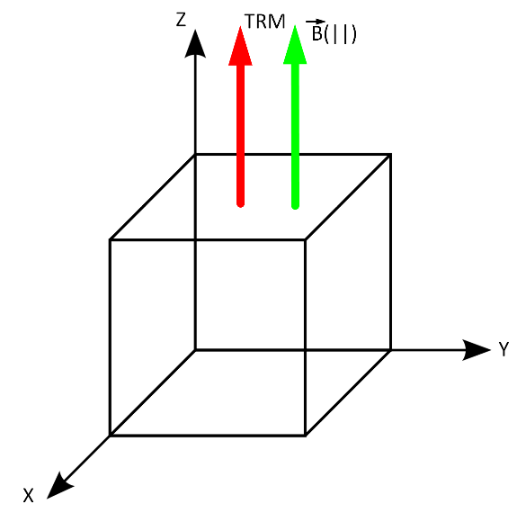

Arai-Nagata diagrams based on the results of the Thellier–Coe procedure of the samples annealed in the magnetic field B_{an} ∥ TRM
Experimental conditions
- Atmosphere: argon
- pTRM creation magnetic field : B_{lab}=50 µT
where k is the coefficient of linear approximation of the data in the Arai–Nagata diagram
t, hours | 0 | 12 | 100 | 400 | 1300
Z*_{Tc} | 0 | 0.15 | 0.3 | 0.6 | 0.65
B_{calc1}, µT | 52 | 52.5 | 52.5 | 48.5 | 60
B_{calc2}, µT | — | 12.5 | 15 | 15.5 | 19.5
B_{lab}, µT | 50 | 50 | 50 | 50 | 50
Notes:
For samples annealed in a magnetic field parallel to the TRM the paleointensity was determined by the Tellier Coe method with check points procedure. The experiment was conducted in an argon atmosphere. According to the results of the experiment, Arai Nagata diagrams were constructed I should immediately note that the quality of the results obtained in these states was pleasantly surprised
For all annealing times, a break on Arai-Nagata diagram can be noted at a temperature of 360-380 degrees Celsius. This break splits the diagonal into two linear sections. The first of which allows us to determine the paleointensivity corresponding to modern quality criteria
The value of the paleointensivity was close to the laboratory value of the field, which indicates that the paleointensivity for single-phase oxidized titanomagnetite was determined correctly. This is the case for all annealing times and, accordingly, the degrees of oxidation of titanomagnetium, except for t=1300 hours
the second linear section is characterized by a much lower slope, but there are not enough points to get a high-quality result

Slide 12

Arai-Nagata diagrams based on the results of the Thellier–Coe procedure of the samples annealed in the magnetic field B_{an} ⊥ TRM
Experimental conditions
- Atmosphere: argon
- pTRM creation magnetic field : B_{lab}=50 µT
where k is the coefficient of linear approximation of the data in the Arai–Nagata diagram
t, hours | 0 | 12 | 100 | 400 | 1300
Z*_{Tc} | 0 | 0.15 | 0.3 | 0.6 | 0.65
B_{calc1}, µT | 52.5 | 69 | 51.5 | 41 | 41
B_{calc2}, µT | — | 12.5 | 15 | 15.5 | 19.5
B_{lab}, µT | 50 | 50 | 50 | 50 | 50
Notes:
For samples annealed in a magnetic field perpendicular to the TRM the paleointensity was determined by the Tellier Coe method with check points
1. As in the case of pre-existing states, for all annealing times, a break on Arai-Nagata diagram can be noted at a temperature of 360-380 degrees Celsius.
2. the quality of the result for samples annealed in the magnetic field is approximately the same, but the calculated values of the paleointensivity did not coincide with the laboratory value of the magnetic field. The coincidence took place only for one annealing time and was apparently random
3. In general, it can be noted that the value of the paleointensivity determined from single-phase oxidized titanomagnetite below the Curie temperature is much closer to the true value, as opposed to if the oxidation occurred at a temperature above the Curie temperature. In the literature, there is a significant (several times) underestimation of paleointensivity
4. It is possible that the key to success was precisely these experiments-conducting the Tellier-Coe procedure in an argon atmosphere, at a low partial pressure of oxygen. And although in this case the homogenization of titanomagnetite is inevitable, it takes place at temperatures higher(about 450 and higher) than the oxidative decomposition observed during the Tellier experiment in air at significantly lower temperatures

Slide 13
MAIN RESULTS
The decrease of the Curie temperature after heating the basalt samples to 600°C in argon is an indicator of the presence of single-phase oxidized titanomagnetite. Based on the difference in the Curie temperatures in the initial state and after sample's heating to 600°C in argon, it is possible to estimate the oxidation degree Z of the titanomagnetite in situ.
The value of the paleointensity determined from the titanomagnetite that has experienced low-temperature (below the Curie temperature) single-phase oxidation depends on the direction of the B_{an} acting during the oxidation process:
2.1 If the B∥TRM, the calculated value of B_{calc} is close to the laboratory value of the magnetic field induction B_{lab}.
2.2 In the case of B_{an} ⊥TRM, the results of determining the paleintensivity are significantly more different from the «true» one. The error reaches 30%

Slide 14
Thank you for your attention

