Slide 1










SSS7.4. Innovative and holistic approaches to prevent, assess and mitigate soil pollution: integrating natural solutions with advanced data analysis and digital tools
DEVELOPMENT CAPACITY OF A BIODIVERSE PASTURE ON TECHNOSOLS FOR THE REHABILITATION OF MARGINAL LANDS (SALINE SOILS AND MINING WASTE)
Antonio Aguilar-Garrido¹, Patrícia Vidigal², Ana Delaunay Caperta², and Maria Manuela Abreu²
¹ Departamento de Edafología y Química Agrícola. Facultad de Ciencias. Universidad de Granada. Granada, Spain. antonioag@ugr.es
² Linking Landscape, Environment, Agriculture and Food (LEAF) Research Centre. Associated Laboratory TERRA. Instituto Superior de Agronomia (ISA). Universidade de Lisboa. Lisbon, Portugal.
Grant FPU-18/02901
Notes:
Hello to everyone,
I am Antonio Aguilar Garrido from the University of Granada, Spain.
Thank you for the opportunity to present our research entitled “Development capacity of a biodiverse pasture on Technosols for the rehabilitation of marginal lands (saline soils and mining waste)”.

Slide 2
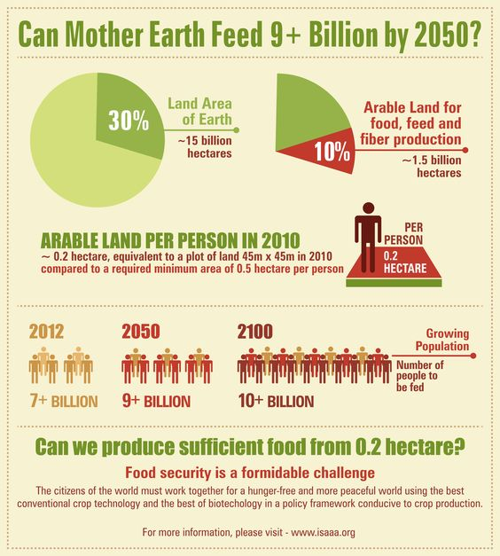
PRODUCTIVE AND SUSTAINABLE FARMING SYSTEMS
↑ Drought
↑ Temperature
↑ Population
Unsustainable farming systems
Notes:
In the coming years, food demand will increase sharply, driven by the population growth. Moreover, the increase in food production will require more available land area, which could lead to biodiversity loss and increased greenhouse gas emissions.
Thus, it becomes imperative to ensure more productive but also sustainable farming systems.

Slide 3
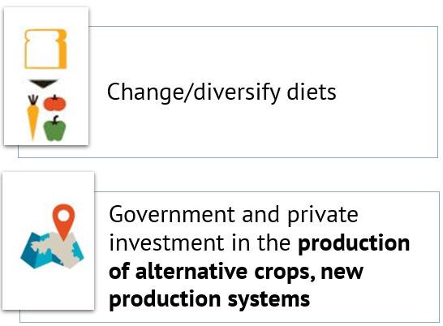

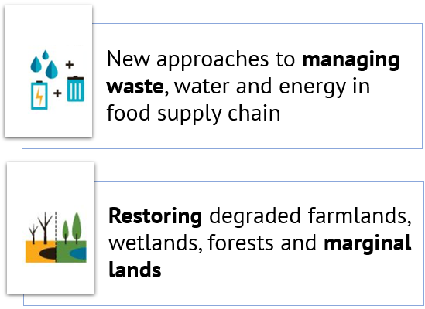
We need to innovate in how we eat and farm
Author: P. Vidigal
Salinity
Author: P. Vidigal
Drought
Author: P. Vidigal
Contaminated areas
Notes:
Thus, we need to innovate in how we eat and farm.
There are several actions to do that. For example, diversifying diets … but also, by restoring marginal lands such as contaminated areas or saline soils.

Slide 4

MARGINAL AREAS
IN SITU PHYTOTECHNOLOGIES
TECHNOSOLS
AGRICULTURAL AND LIVESTOCK ACTIVITIES
Notes:
In this sense, integrated green biotechnologies such as the combination of Technosols and in situ phytostabilisation could be effective in the rehabilitation of marginal areas and their conversion to agricultural and livestock activities while protecting the food chain.

Slide 5
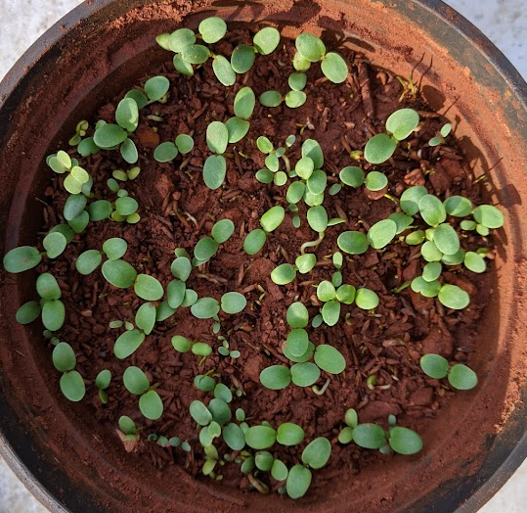
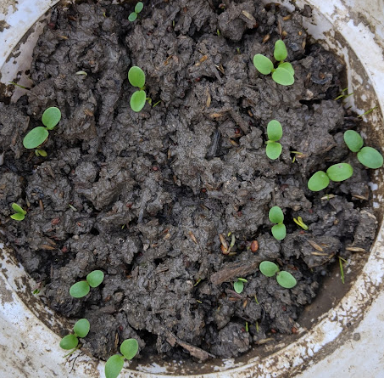
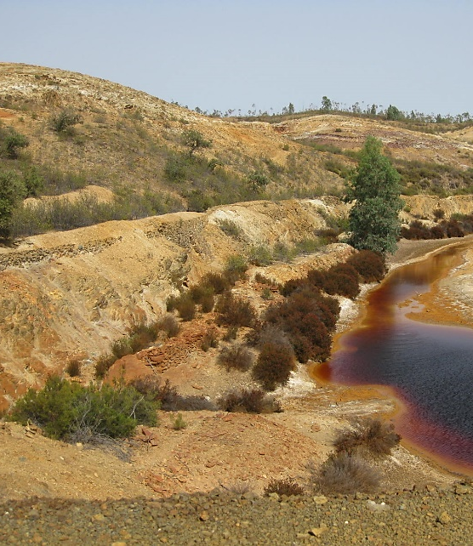
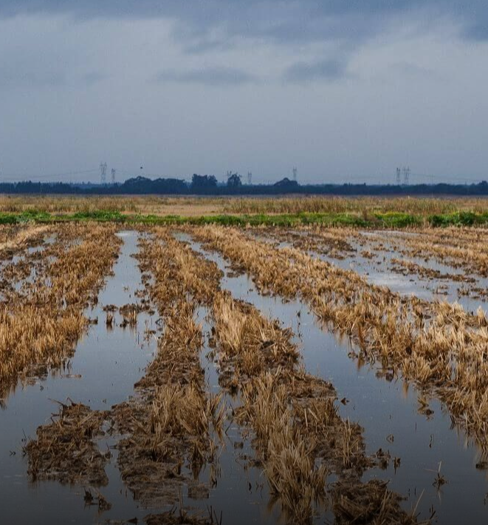



Sludge and waste kieselguhr from breweries + Sand + Gravel limestone + Residual biomass pruning
(Cortinhas et al., 2021)
GOSSAN WASTE
SALINE SOILS
Contaminated areas
Salinity
Author: A. Aguilar-Garrido
Author: A. Aguilar-Garrido
TECHNOSOL-GOSSAN
(TG)
TECHNOSOL-FLUVISOL
(TVF)
Author: M. Abreu
© Foge Comigo!
SÃO DOMINGOS | PT
TAGUS ESTUARY | PT
Leguminous plants
Trifolium sp. (T. michelianum var. paradana Savi, T. vesiculosum var. cefala Savi, T. resupinatum var. nitrofolus L., and T. squarrosum L.)
Medicago sp.
Gramineous plants
Lolium multiflorum Lam
Cortinhas, A. et al. (2021) ‘Conservation of a critically endangered endemic halophyte of West Portugal: A microcosm assay to assess the potential of soil technology for species reintroduction’, Frontiers in Ecology and Evolution, 9(May), pp. 1–11. doi: 10.3389/fevo.2021.604509.
Notes:
To verify this hypothesis, we studied the development of a biodiverse pasture in two Technosols. One is made from a saline Fluvisol collected in the Tagus Estuary and, other from gossan waste of the São Domingos mine. Both with a mixture of organic and inorganic amendments.
The pasture is composed of leguminous plants of the genus Trifolium sp. and Medicago sp., and gramineous plants such as Lolium multiflorum Lam.

Slide 6
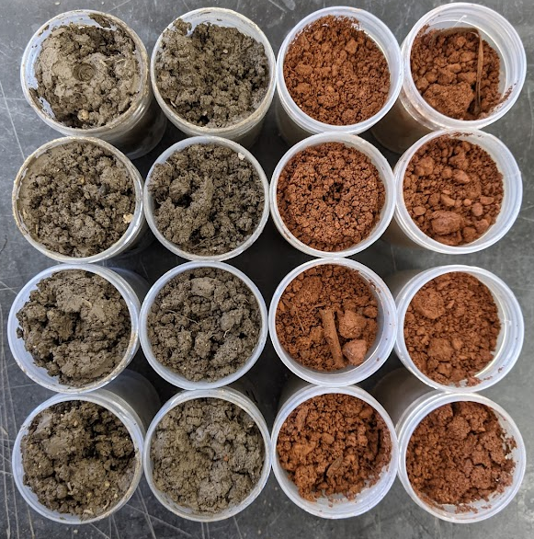


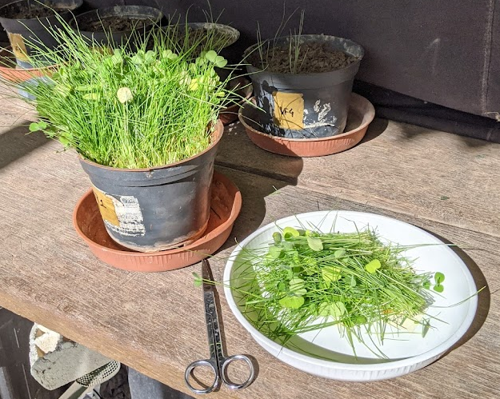






V (pots) = 1.5 dm³
5 g seeds per pot
t = 2 months
GOSSAN WASTE
(G)
FLUVISOL
(FV)
1st and 2nd cut
Total concentration of PHEs* in shoot
Nutrients in shoot
Dry biomass of shoot and root (2nd)
EC_{1:2.5}: 7.9 dS/m
Exchangeable sodium 25%
CONTROL OF PHEs CONTAMINATION
CONTROL OF SALINITY AFFECTION
Author: A. Aguilar-Garrido
As: 9.1 g kg⁻¹
Pb: 29.6 g kg⁻¹
t₀ and t_{f}
Soil properties
(pH, EC, C_{org}, N_{T}, P_{Ext} and K_{Ext})
Macro/micronutrients
Available fraction of PHEs*
Aggregate stability (t_{f})
Enzymatic activities (dehydrogenase, β-glucosidase, phosphatase, cellulase, urease and protease)
TECHNOSOL-GOSSAN
(TG)
TECHNOSOL-FLUVISOL
(TVF)
Author: A. Aguilar-Garrido
2 cuts (1 and 2 months) ~ Livestock grazing
* Potentially Harmful Elements (PHEs)
Notes:
The microcosm assay consisted of four treatments: Fluvisol (VF) with a high EC and exchangeable sodium, that it’s the control of salinity; and its Technosol (TVF). Gossan waste (G) with high concentrations of PHEs, control of contamination; and its Technosol (TG).
Two cuts of the pasture were made to simulate grazing (after one month and another one at the end of the experiment after two months).
Different analyses were carried out on both plant and soil over time.

Slide 7
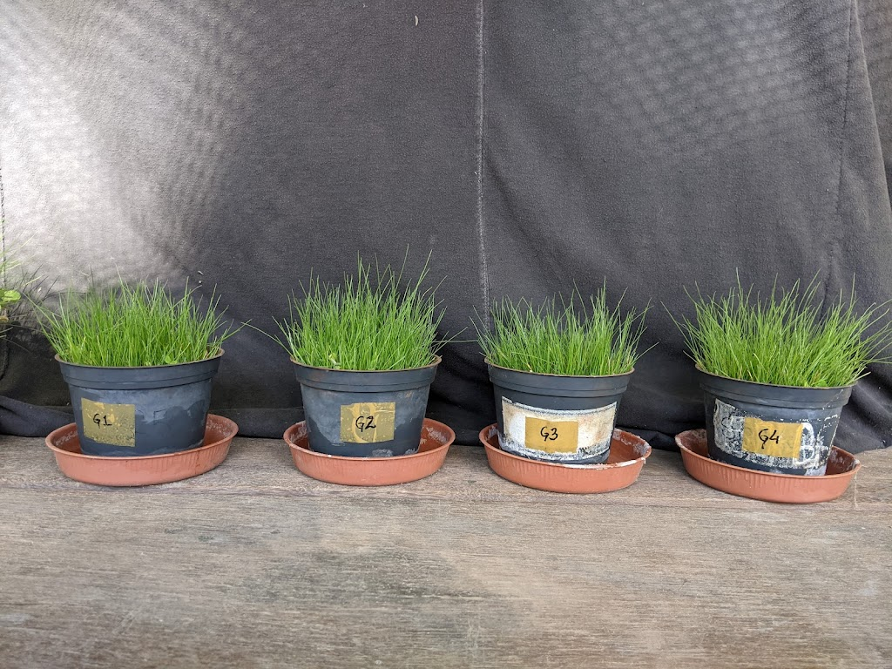
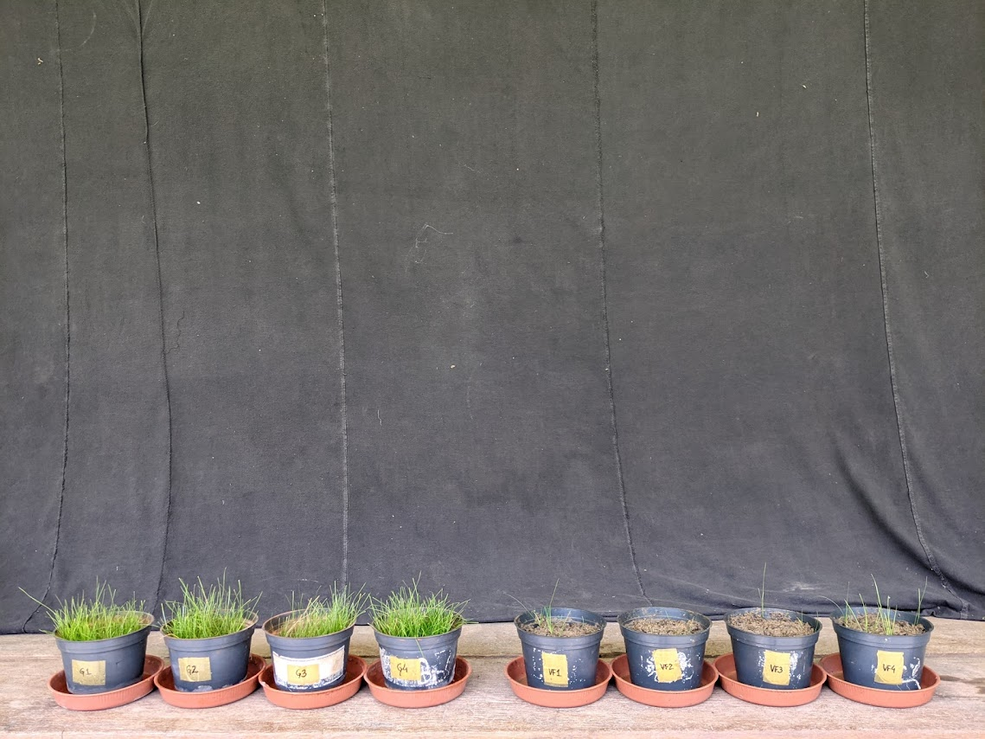
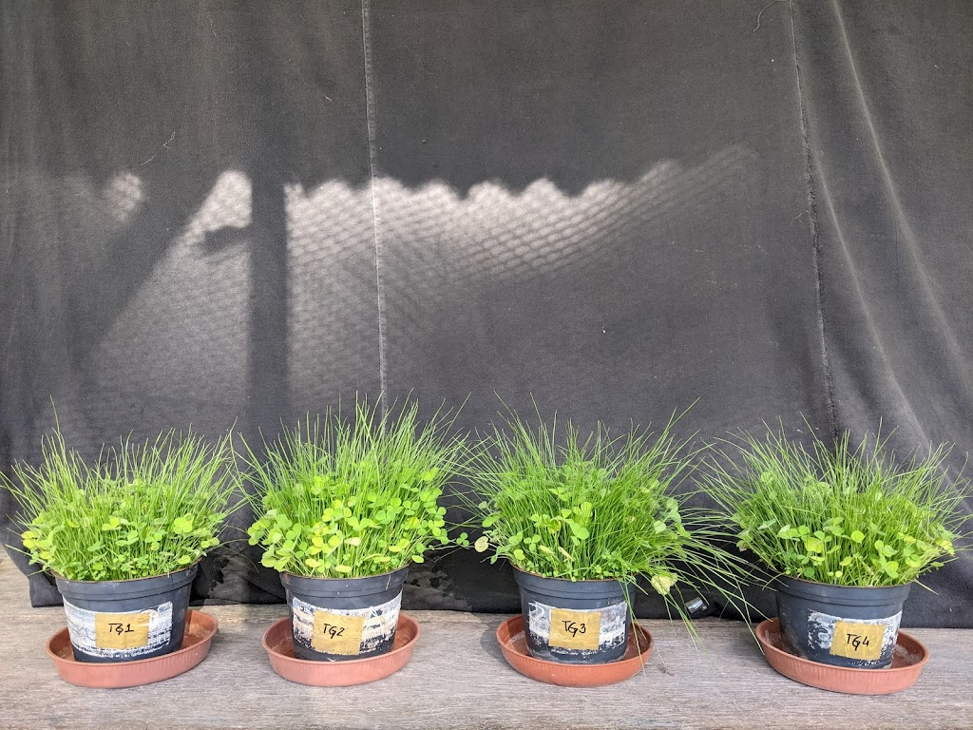
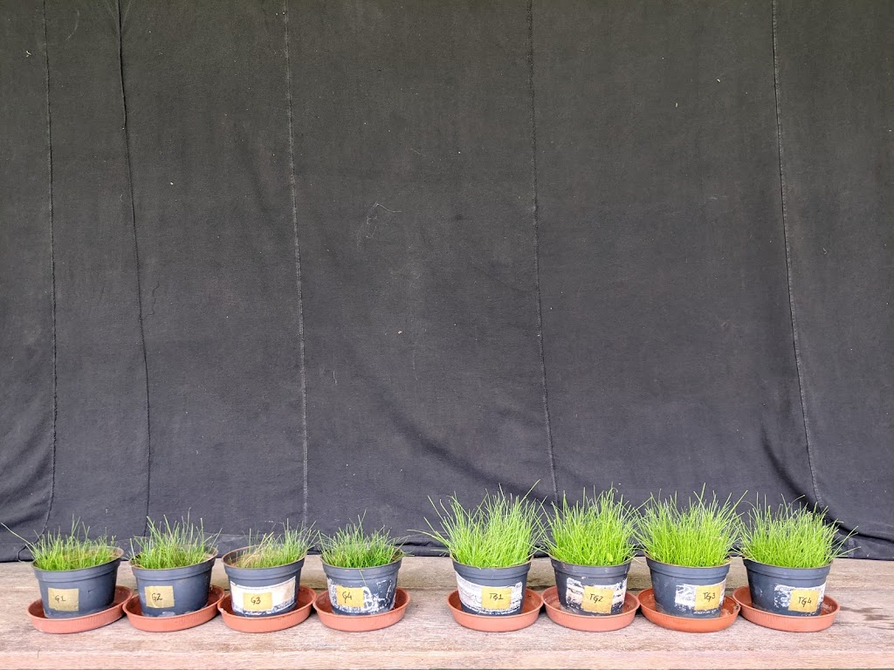
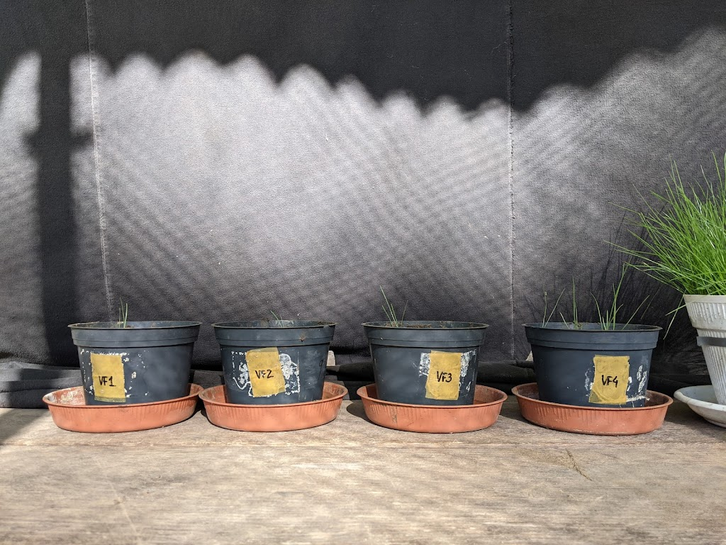
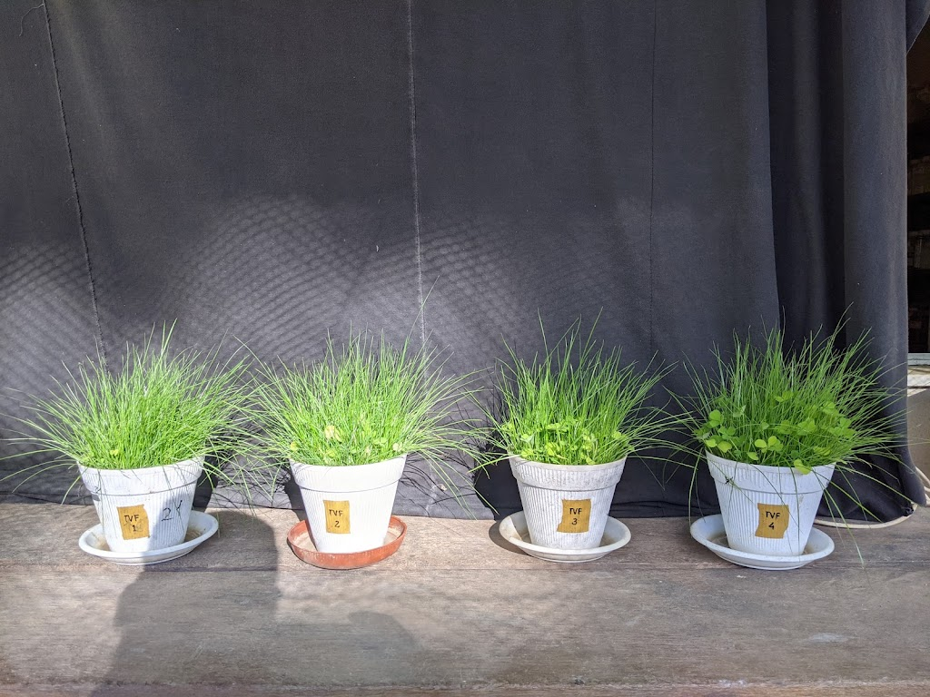
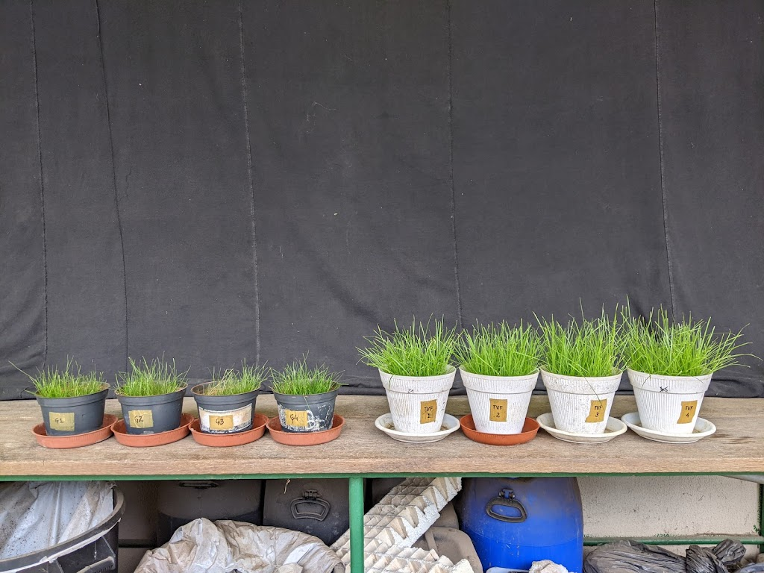
1st cut
2nd cut
Author: A. Aguilar-Garrido
G
G
TG
TG
VF
VF
TVF
TVF
Notes:
Today, we are going to present just results of the plants. Here we can see the development of the pasture in the different treatments just before the first and second cut. There are clear differences.
For example, in Fluvisol there is no plant growth. While in its Technosol yes.
In gossan waste the pasture growth is dominated by gramineous over leguminous. In both Technosols, pasture growth is extraordinarily improved and more biodiverse, with the presence of as many leguminous as gramineous.
Between the first and second cut, Lolium multiflorum has kept growing to similar sizes as in the first cut, while the leguminous have not regrown as efficiently again.

Slide 8
Figure 1. Development of the pasture (dry biomass) in the gossan mine waste, saline-affected Fluvisol and Technosols.
G – Gossan waste; TG – Technosol-Gossan; VF – Fluvisol; TVF – Technosol-Fluvisol. Lower case letters indicate significant differences between the control (G or VF) and the respective Technosol (TG or TVF) in each time; and capital letters indicate significant differences in each treatment with respect to time (1st and 2nd cut) (U test Mann-Whitney).
Notes:
In this graph we can see that the Technosols significantly improved the pasture development respect to the controls. And that the biomass produced after the first cut was lower.

Slide 9

Figure 2. Total concentrations of potential hazardous elements (PHEs) in shoot of pasture plants grown in gossan mine waste, saline-affected Fluvisol and Technosols (in mg kg⁻¹).
As
Sb
Pb
Zn
G – Gossan waste; TG – Technosol-Gossan; VF – Fluvisol; TVF – Technosol-Fluvisol. Lower case letters indicate significant differences between the control (G or VF) and the respective Technosol (TG or TVF) in each time; and capital letters indicate significant differences in each treatment with respect to time (1st and 2nd cut) (U test Mann-Whitney).
Notes:
It is also observed that the pasture developed on the Technosol-Gossan accumulates less potentially harmful elements in shoots than in the control.

Slide 10

MARGINAL AREAS
IN SITU PHYTOTECHNOLOGIES
TECHNOSOLS
EFFICIENT INTEGRATED BIOTECHONOLOGY
AGRICULTURAL AND LIVESTOCK ACTIVITIES
Notes:
Thus, yes, an integrated biotechnological approach involving Technosols and pastures could be a useful green technology to convert marginal lands into food production areas suitable for grazing and/or production of forage.

Slide 11
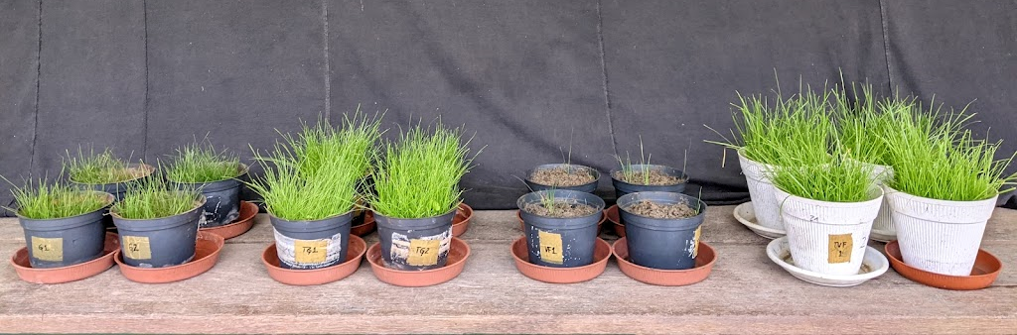
Author: A. Aguilar-Garrido
Antonio Aguilar-Garrido, Patrícia Vidigal, Ana Delaunay Caperta, and Maria Manuela Abreu
Grant FPU-18/02901
Notes:
Thank you so much for your attention.

