Slide 1
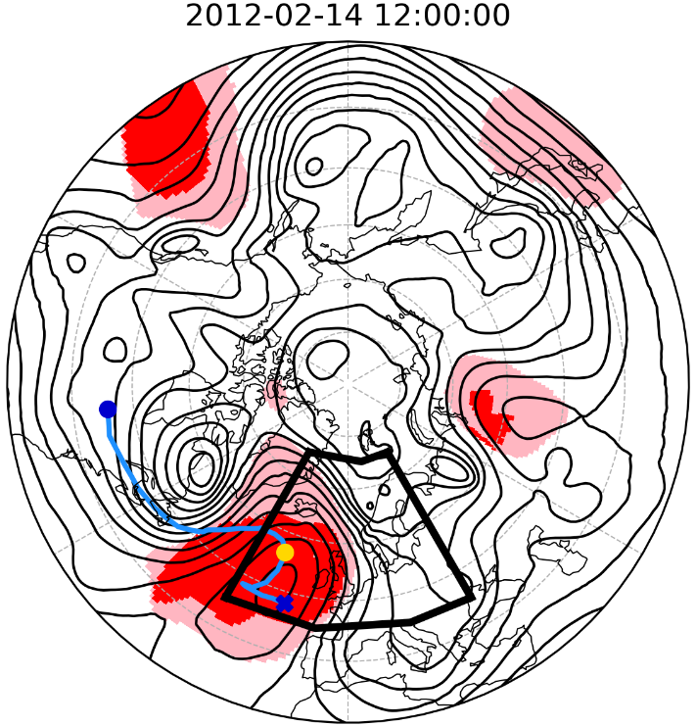



Atmospheric Blocking and the Contribution of Transients to its Onset, Decay, and Maintenance
Additional Display Material
Charlie Suitters¹
Oscar Martínez-Alvarado^{1,2}, Kevin Hodges^{1,2}, Reinhard Schiemann^{1,2}, Duncan Ackerley³
1: Department of Meteorology, University of Reading, UK
2: National Centre for Atmospheric Science, Department of Meteorology, University of Reading, UK
3: Met Office, Exeter, UK

Slide 2
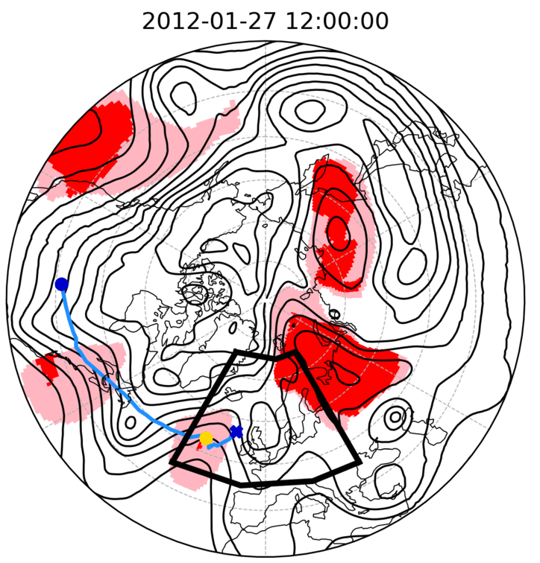
Case Study
Black lines = Z500
Red shading = blocked grid points (meeting 5-day persistence)
Pink shading = “instantaneous” blocking (persistence not met)
Blue line = AC transient tracks
Blue dot = Transient start
Blue cross = Transient end
Yellow dot = Transient position at valid time

Slide 3
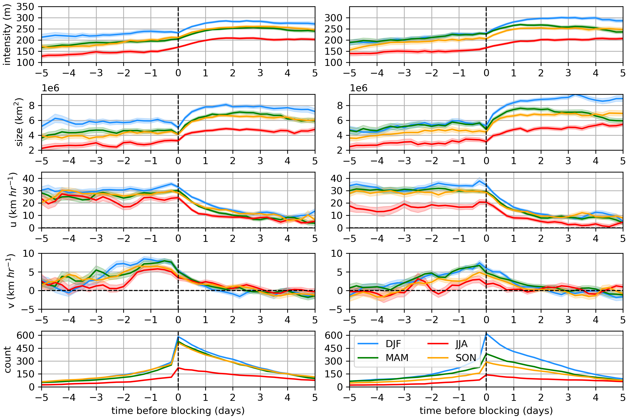
Further AC Transient Statistics – All Seasons, Euro-Atlantic and North Pacific
Euro-Atlantic
North Pacific
Transient
strength (m)
Transient
strength (m)
Transient
area
(10⁶ km²)
u
(km h⁻¹)
v
(km h⁻¹)
Number of transients

Slide 4
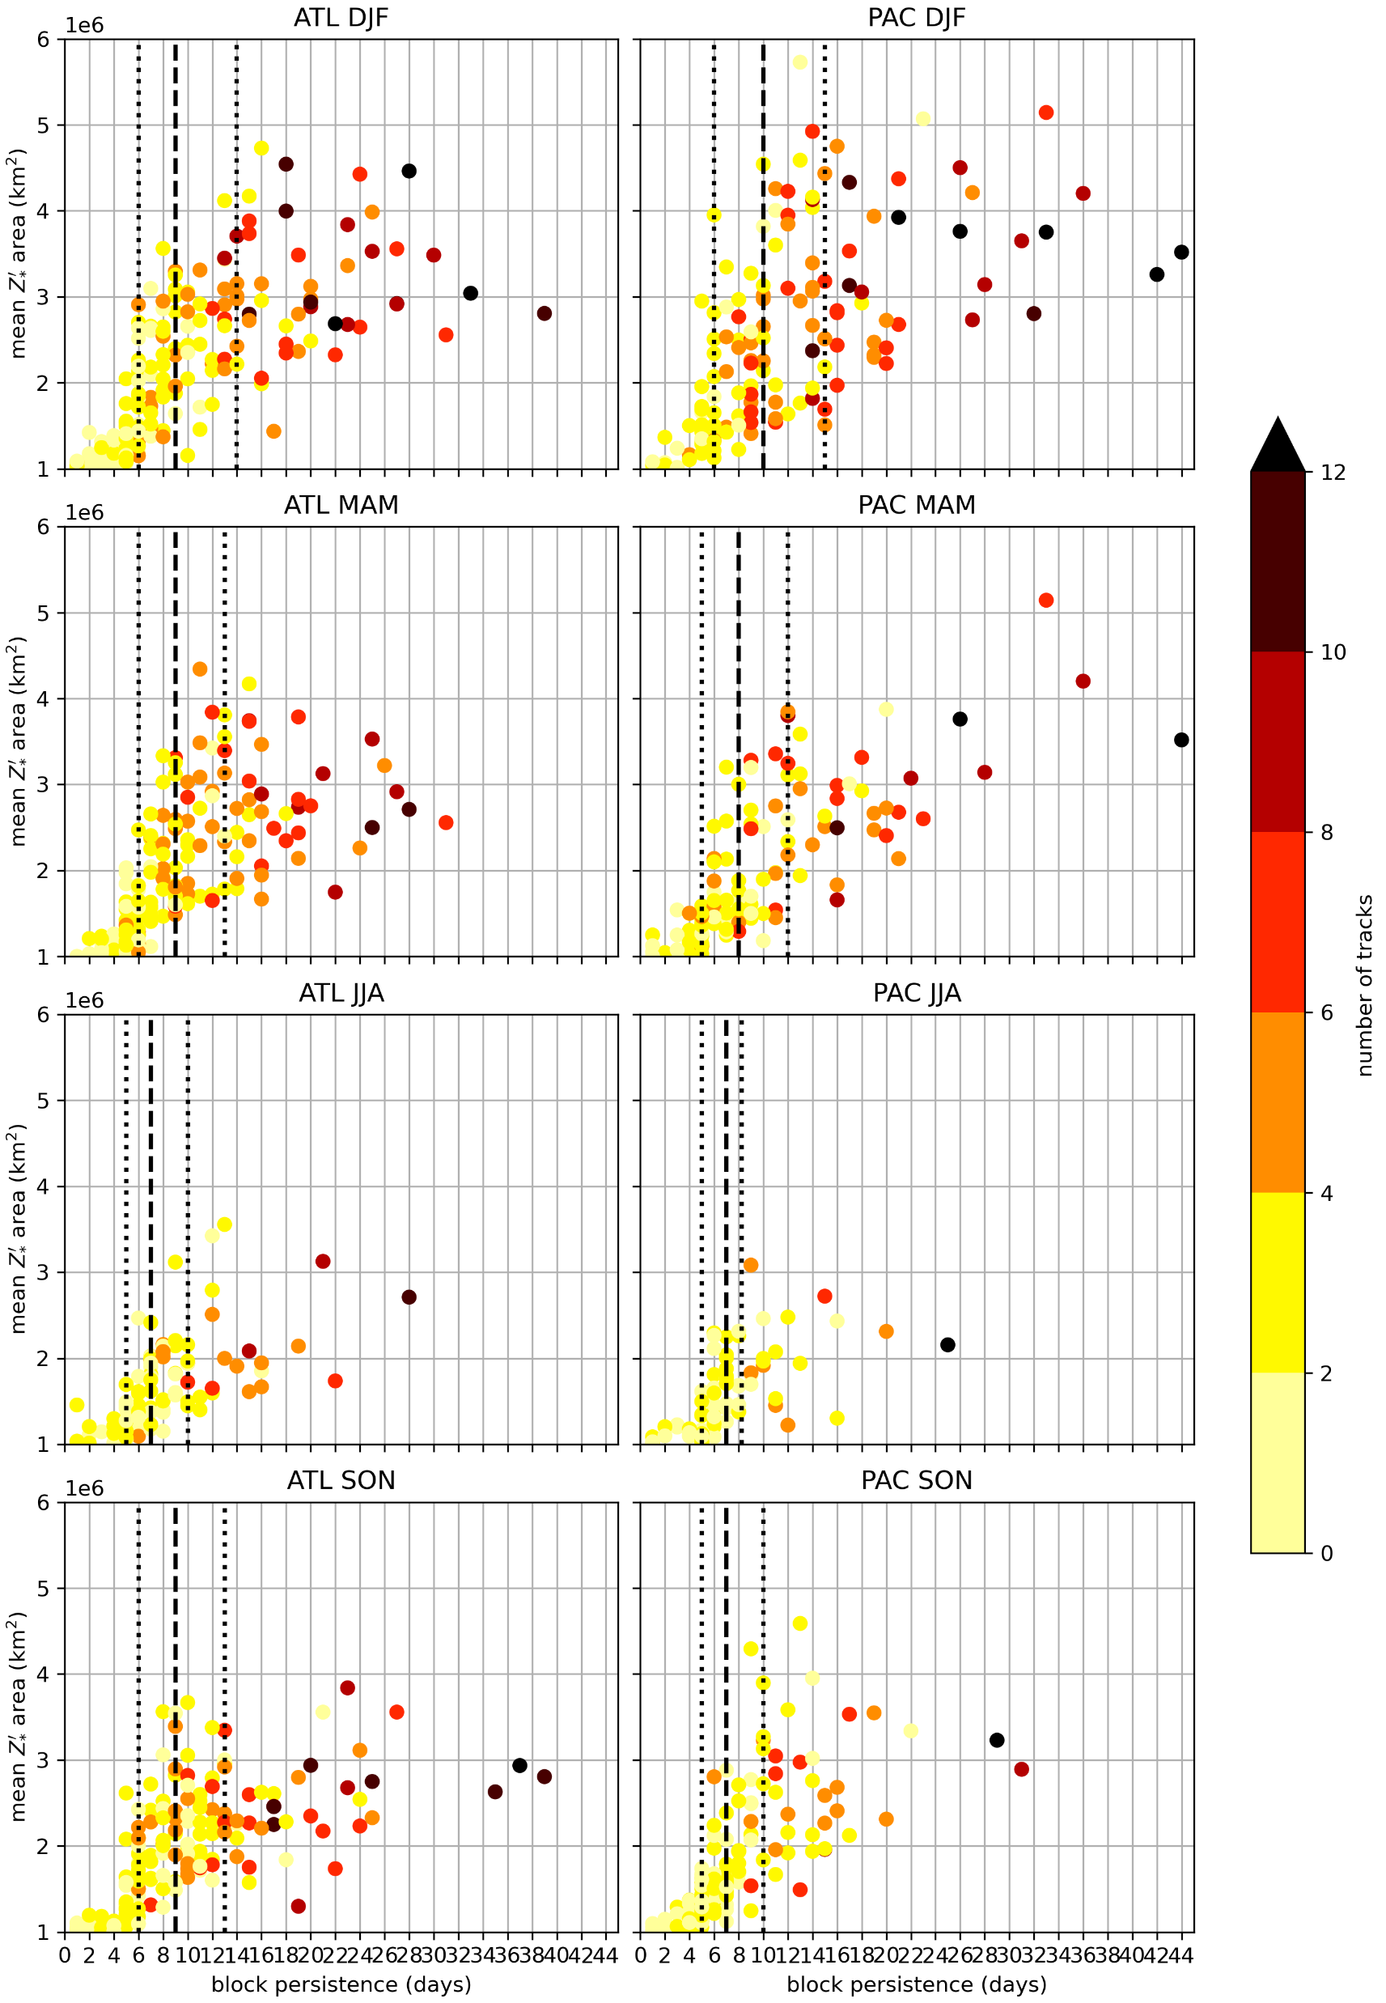
Further Relationships between Number of Tracks and Block Persistence – all seasons, Euro-Atlantic and North Pacific

