Slide 1


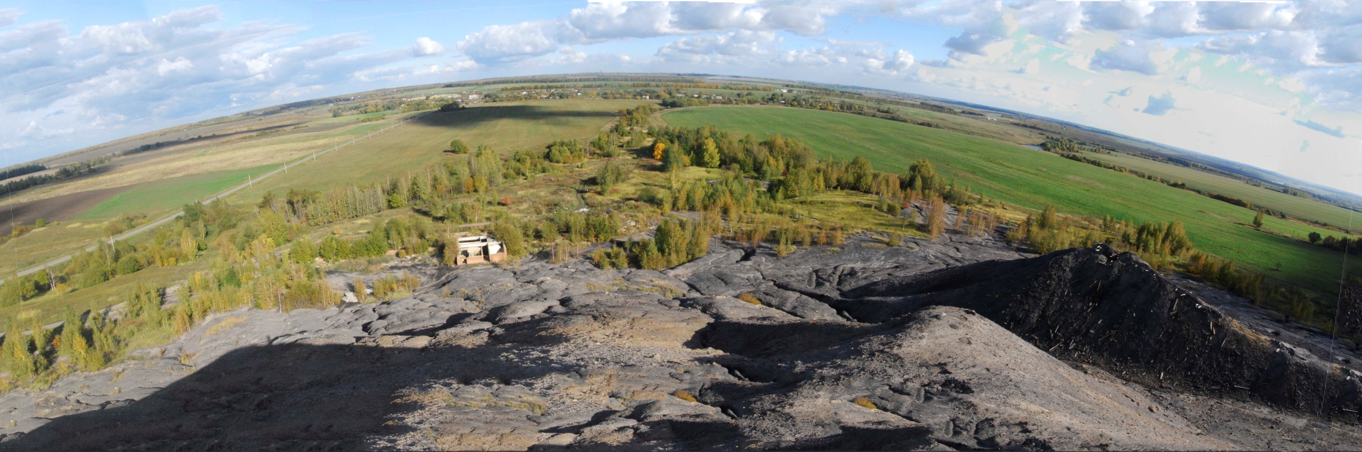

Lomonosov Moscow State University
Faculty of Geography
Department of Geochemistry of Landscapes
Geochemical transformations in liquid and solid phases of forest-steppe soils in the affected area of Moscow brown coal basin (Russia)
Alexander Kostin (alexanderk640@gmail.ru), Pavel Krechetov, Olga Chernitsova and Elena Terskaya, Lomonosov Moscow State University, Department of Geography, Moscow, Russian Federation

Slide 2
Purpose
The aim of the study was to examine the post-mining evolution of natural soils under the impact of supply of technogenic material from the spoil heaps and changes of the terrain (formation of dump tailings, as well as subsidence areas over the mined space) in abandoned sulfur coal mining areas.
We had to:
to identify factors and mechanisms of сhanges in elemental composition and soil properties;
to determine general patterns and define specific processes of transformation of soil morphology and mineralogical composition impacted by technogenic material from the spoil heaps and formation of mine subsidence;
to conduct a comparative analysis of chemical composition of liquid and solid phases of natural and technogenically transformed soils affected by technogenic fluxes from waste sulphide-bearing dumps and mine subsidence

Slide 3
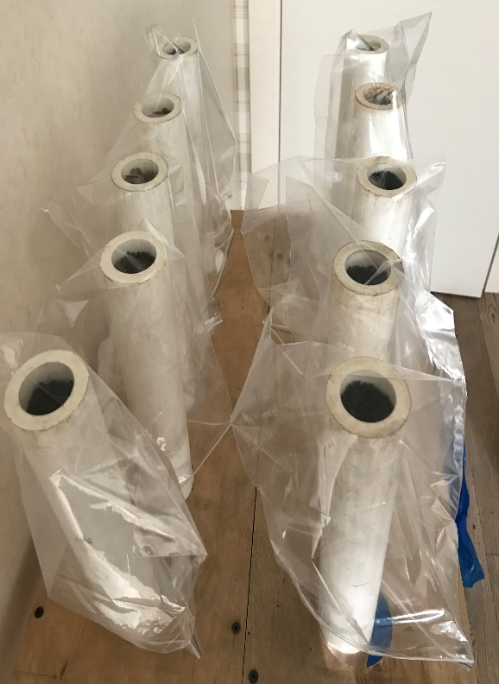
Laboratory methods
Parameters | Methods and equipment
рН | Potentiometric method
SOM | Bichromate oxidation method
Total content of elements in soil samples | X-ray fluorescence spectrometry
Total content of elements in soil solutions | AES-ICP detection
Exchangeable cations (in 1М KCl-extracts): Са²⁺ и Mg²⁺ H⁺, Al³⁺ Fe²⁺, Fe³⁺ | EDTA titration Acid-base titration UV-Vis spectroscopy
Cation and anion composition (Ca²⁺, Mg²⁺ Na⁺, K⁺, SO₄²⁻, Cl⁻ HCO₃⁻, H⁺, Al³⁺ | High-performance liquid chromatography Acid-base titration
Hydrolytic acidity (in 1M CH₃COONa-extracts) | Acid-base titration
Content of carbonates | Gas-volumetric method
Mineralogical composition | X-ray diffractometry
The unit for ethanol displacement of soil solutions

Slide 4
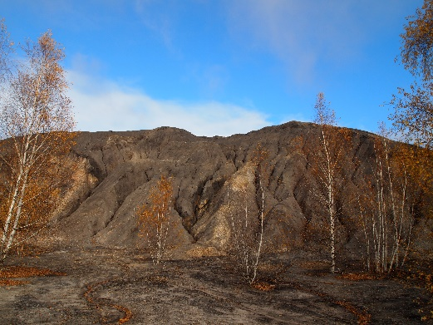
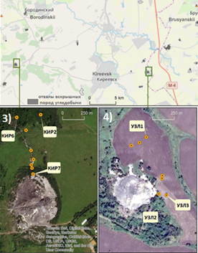
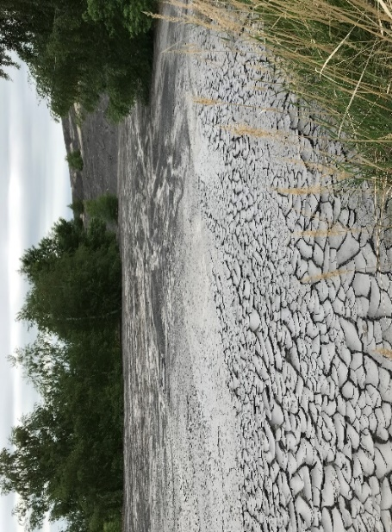
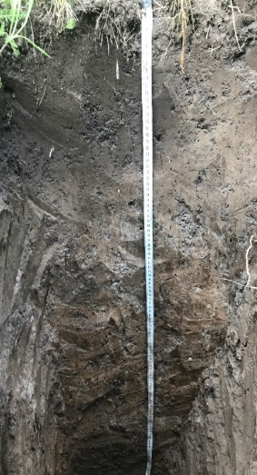
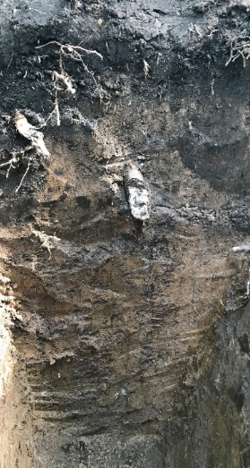
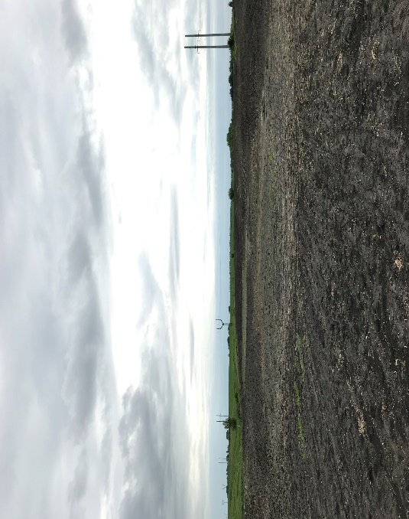
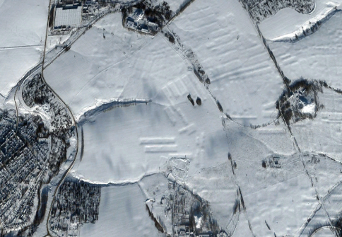
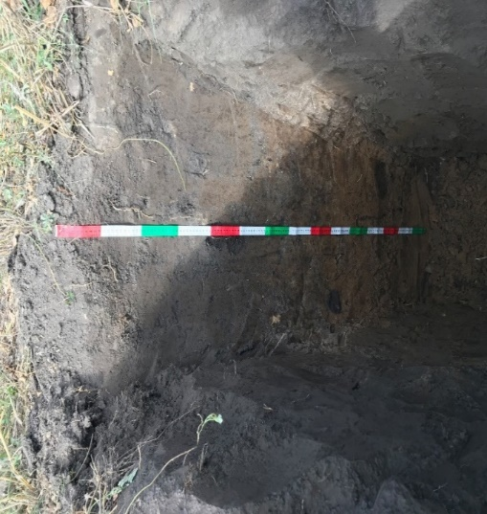
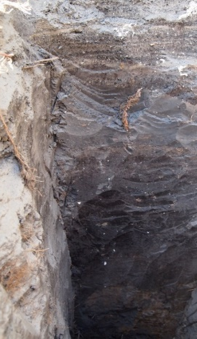
Study odjects – antropogenic spoil heaps (waste dumps), mine subsidence and technogenically transformed soils
AREA OF STUDY (53.89-53.94°N, 37.56-38.24°E)
Tula» site
Greyzemic Phaeozem
(natural site)
Greyzemic Phaeozem
(Carbonic, Gypsic,
Novic, Thionic)
«Tula» site
«Uzlovaya» site
Conical spoil heap and dump tailing at the «Uzlovaya» site
Haplic Phaeozem
(natural site)
Haplic Phaeozem (transformed)
Subsidence area near spoil heap located to the south of the «Uzlovaya» site

Slide 5
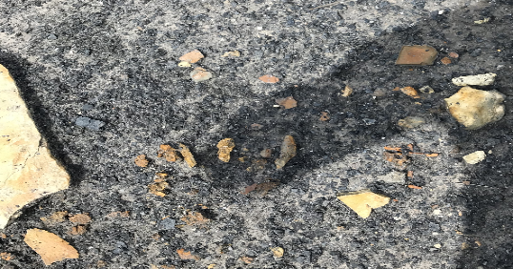
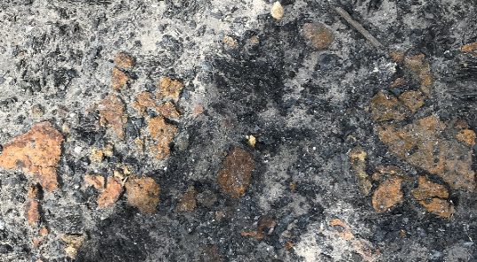
Formation of chemical composition of erosion products of sulphude-bearing dumps
1)Biochemical oxidation of sulphides
1) 2FeS_{2(s)} + 7O₂ + 2H₂O
2Fe²⁺ + 4SO₄²⁻+ 4H⁺
Pyrite (marcasite)
Fe³⁺ + 2H₂O
2)* 2Fe²⁺ + O₂ + 4H⁺
3) FeS_{2(s)}+ + 14Fe³⁺+ 8H₂O
15Fe²⁺ + 2SO₄ + 16H⁺
4) Fe³⁺ + 3H₂O
Fe(OH)_{3(s)} + 3H⁺
2) Acid hydrolysis of clay minerals (aluminosilicates)
Pyrite and marcasite concretions in overburden rocks («Kireevskaya» coal mine)
NaAl₃SiO₈+ 6H⁺+ 2H₂O 3K_{0,33}Al_{2,33}Si_{3,67}О₁₀OH + 10H₄SiO₄+ 6K⁺+ Q
рН=2-2,5
3) Acid dissolution
Al(Si₄O₁₀)(OH)₈+ 6H⁺ 4Al³⁺ + H₄SiO₄+8H₂O
Saline crust
composed of Fe and Al-hydrated sulfates
* The reaction is going with the participation of Fe-oxidizing thionic bacteria (Thiobacillus ferrooxidans, Thiobadilus thiooxidans)

Slide 6
Chemical properties of waste dumps, dump tailings and acid mine drainage (AMD)
 | Site | Сoal deposit | рН | TDS, μS/cm | Composition of readily soluble salts (mmol_{c}/dm³) |  |  |  |  |  |  | Titratable acidity (mmol_{c}/dm³) |  | Fe, mmol_{c}/dm³
 |  |  |  |  | HCO₃⁻ | Cl⁻ | SO₄²⁻ | Ca²⁺ | Mg²⁺ | K⁺ | Na⁺ | H⁺ | Al³⁺ | Fe²⁺ | Fe³⁺
Waste dumps | « Tula» | Skuratovskoe | 2.3 | 21400 | ND¹ | ND | 250 | 360 | 9.8 | 0.04 | 10.8 | 591.8 | 34.2 | 47.7 | 61.3
 | «Uzlovaya» | Dedilovo-Uzlovskoe | 2.5 | 9800 | « | 0.2 | 104.2 | 15 | 5.9 | 0.1 | 8.7 | 147.3 | 39.1 | 3.8 | 103.8
Dump tailings | «Tula» | Skuratovskoe | 3.8-4.4 | 481-3360 | ND | 0.1-2.8 | 2.0-30.1 | 1.4-33.2 | 0.2-6.1 | 0.1-0.5 | 0.1-1.4 | 0,4-3,6 | 0,1-6,6 | 0,1-0,6 | 0,3-1,6
 | «Uzlovaya» | Dedilovo-Uzlovskoe | 3.7-4.4 | 333-2400 | ND | 0.1-1.7 | 0.8-26 | 1.9-40,3 | 0.2-2.4 | 0.1-0.3 | 0.1-0.5 | 0,4-4,3 | 0,1-11,5 | 0,1-1,3 | 0,1-2,6
AMD | «Tula» | Skuratovskoe | 5.3 | 998 | 0.1 | 0.2 | 9.3 | 10.7 | 1.2 | 0.1 | 0.5 | 0.2 | ND | ND | ND
 | «Uzlovaya» | Dedilovo-Uzlovskoe | 3.3 | 1584 | 0.2 | 0.03 | 15.2 | 25.3 | 1.5 | 0.03 | 0.1 | 2.6 | ND | 29.2 | 6.5
*ND^{1 –} not detected

Slide 7
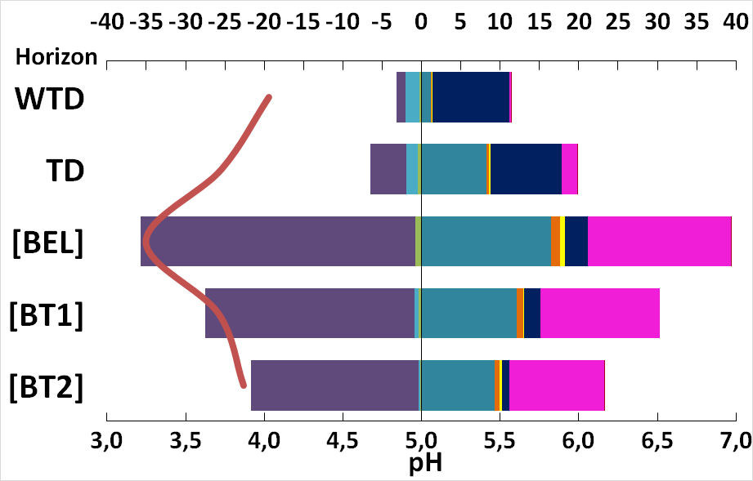
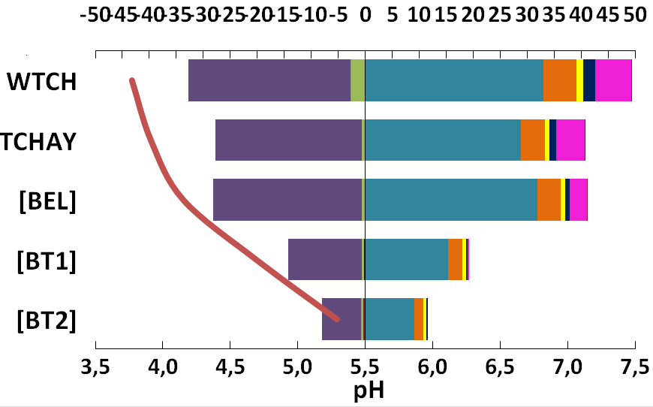
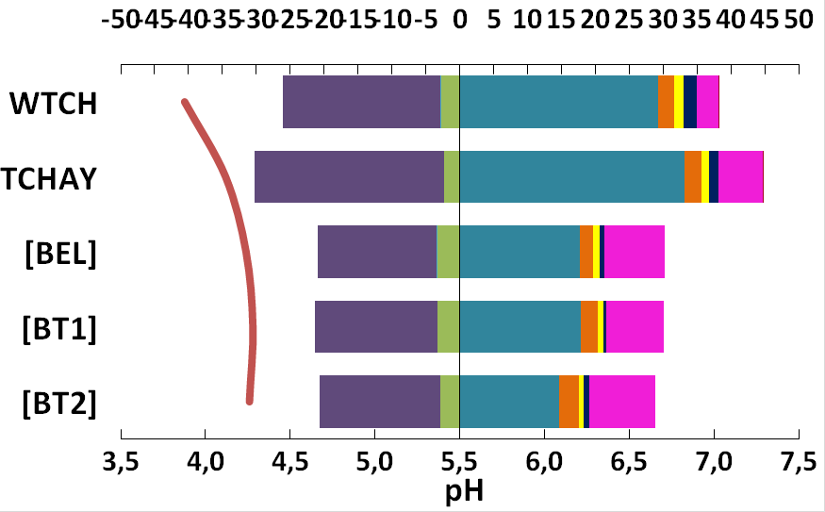
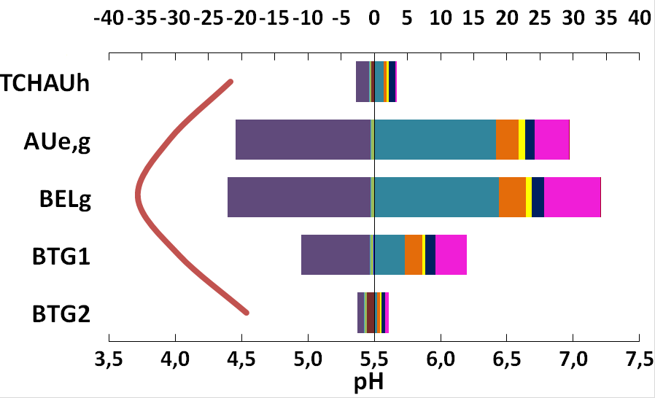
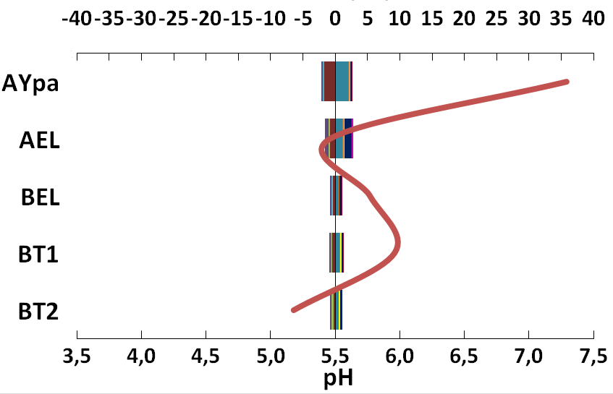
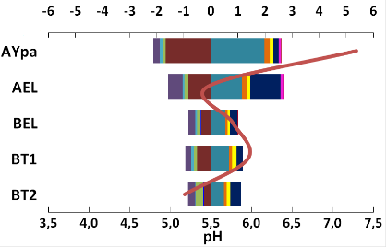
Сomposition of soil liquid phase, cmol_{с} L⁻¹
Greyzemic Phaeozems (transformed)
SO₄-Al-Ca salt
composition
SO₄-Ca salt
composition
Mine tailing in the vicinity of the spoil heap
Middle part of the dump tailing
Greyzemic Phaeozems (natural)
SO₄-Ca salt
composition
HCO₃-Ca
salt composition
SO₄-Ca salt
composition
Far part of the dump tailing
Mine subsidence

Slide 8
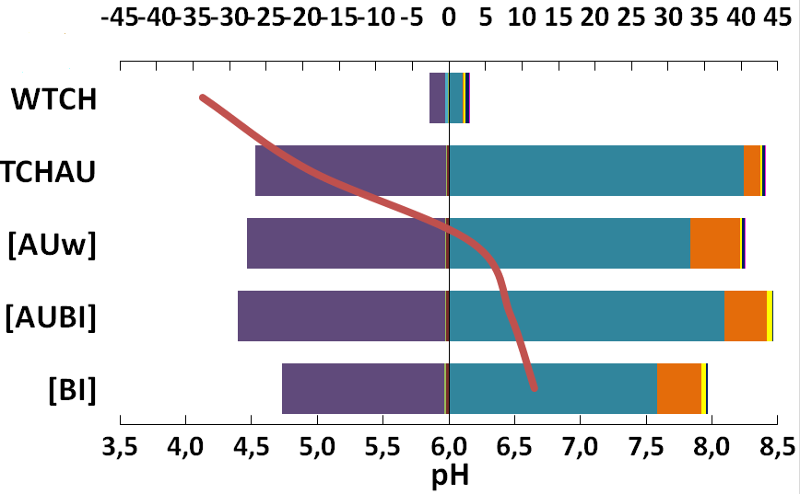
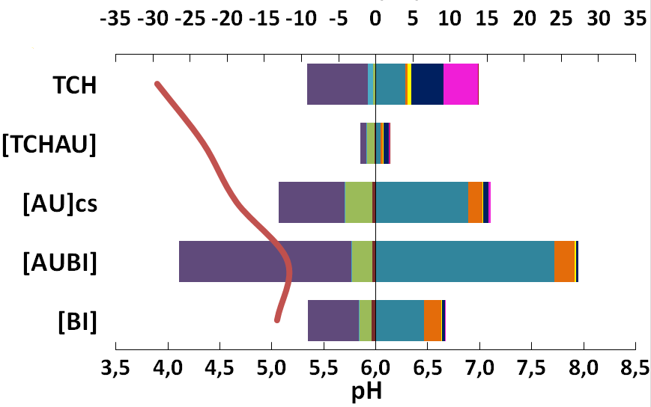
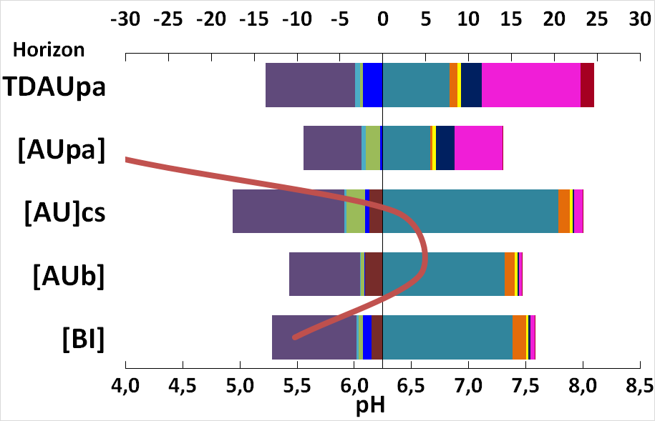
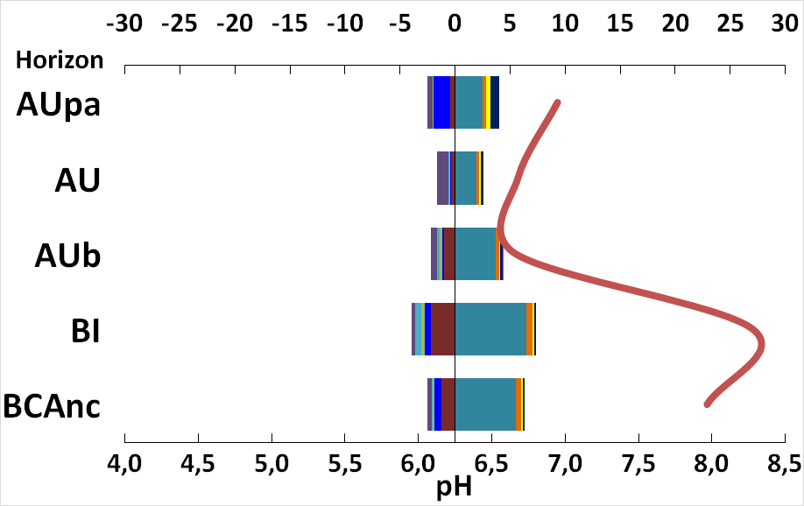
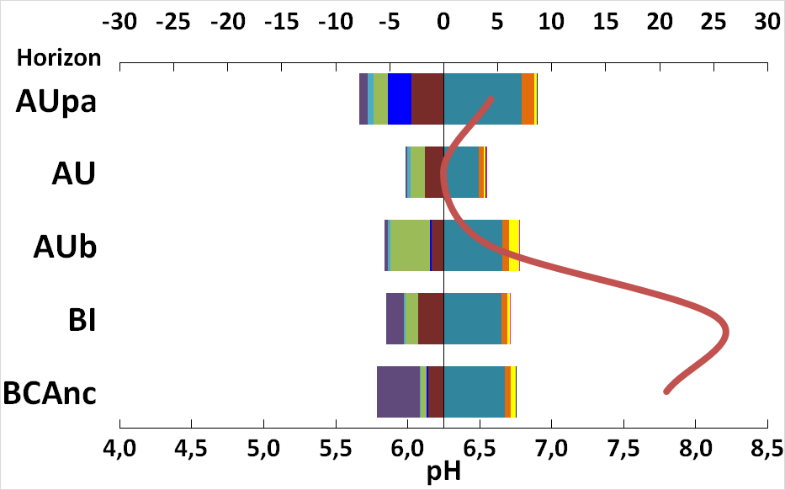
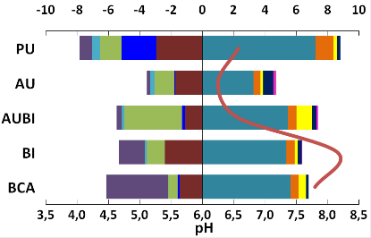
Сomposition of soil liquid phase, cmol_{с} L⁻¹
Haplic Phaeozems (transformed)
SO₄-Ca
salt
composition
SO₄-Ca
salt
composition
Middle part of the dump tailing
Haplic Phaeozems (natural)
Mine tailing in the vicinity of the spoil heap
SO₄-Al-Ca salt
composition
HCO₃-Cl-Ca
salt composition
HCO₃-Ca
salt composition
Mine subsidence

Slide 9
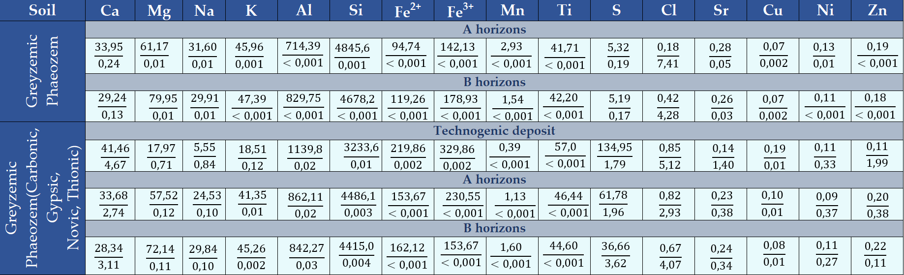
Mobility of Che in soil solutions (Greyzemic Phaeozems)
Greyzemic Phaeozems (natural site):
A horizons: Сl>Ca>S>Sr>Mg~Na~Ni>Cu>K~Si>Al~Fe~Mn~Ti~Zn
B horizons: Cl>Ca>S>Sr>Mg~Na>Cu>K~Al~Si~Fe~Mn~Ti~Ni~Zn
Greyzemic Phaeozems (transformed):
A horizons: Cl>Ca>S>Sr~Zn>Ni>Mg>Na>Al>Cu~K>Si>Fe>Mn>Ti
B horizons: Cl>S>Ca>Sr>Ni>Zn~Mg>Na>Al>Cu>Si>K>Fe>Mn>Ti
Technogenic deposit:
Сl>Ca>Zn>S>Sr>Na>Mg>Ni>K>Al>Si~Cu>Fe>Mn>Ti
*total Che content in soil (cmoL/kg)
** a share (%) of Che in soil solution from the total content in soil (under the line)

Slide 10
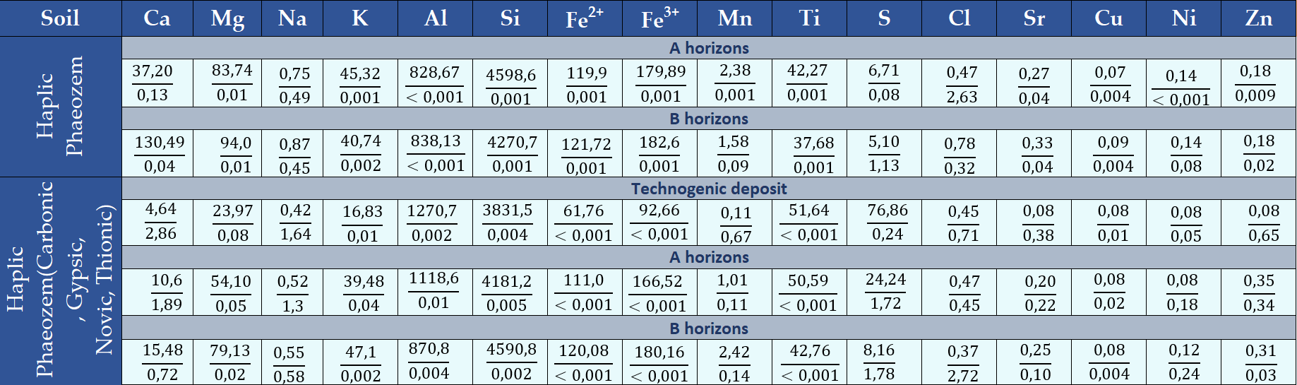
Mobility of Che in soil solutions (Haplic Phaeozems)
Haplic Phaeozems (natural site)
A horizons: Сl>Na>Ca>S>Sr>Mg>Zn>Cu>K~Si~Fe~Mn~Ti>Al>Ni
B horizons: S>Na>Cl>Mn>Ni>Ca~Sr>Zn>Mg>Cu>K>Si~Fe~Ti>Al
Greyzemic Phaeozems (transformed)
A horizons: Ca>S>Na>Cl>Zn>Sr>Ni>Mn>Mg>K>Cu>Al>Si>Fe>Ti
B horizons: Cl>S>Ca>Na>Ni>Mn>Sr>Zn>Mg>Cu~Al>Si~K>Fe>Ti
Technogenic deposit:
Сa>Na>Cl>Mn>Zn>Sr>S>Mg>Ni>Cu~K>Si>Al>Fe>Ti
*total Che content in soil, cmoL(+)/kg (above the line)
** a share (%) of Che in soil solution from the total content in soil (under the line)

Slide 11

Mobility of Che in soil solutions of natural and techogenically-transformed soils
Greyzemic Phaeozems (natural site)
$$\frac{Che concentration in soil soution(\frac{mg}{dm3})∗100}{mineralization of soil solution \left(\frac{mg}{dm3}\right)∗concentration of the Che in soil (\%)}$$
=
Soil horizons:
Kx
Haplic Phaeozems (natural site)
Soil horizons:
Cl>Ca>S>Sr>Mg>Na>Cu>Ni>P>Mn>K>Si>Zn>Al>Fe>Ti
Greyzemic Phaeozems (transformed)
Cl>S>Ca>Sr>Na>Mg>Zn>Cu>Al>P>Mn>Fe>K>Si>Ni>Ti
Soil horizons:
Haplic Phaeozems (transformed)
Soil horizons:
Cl>S>Ca>Mn>Sr>Ni>Mg>Zn>Na>Al>Cu>P>K>Si>Fe>Ti
Cl>Ca>S>Sr>Ni>Mn>Zn>Mg>Na>Cu>Al>Si>K>P>Fe>Ti
*very highly mobile (Kx > 10), highly mobile (Kx=1–10), mobile (0.1–1.0), slightly mobile or inert (<0.1).

Slide 12
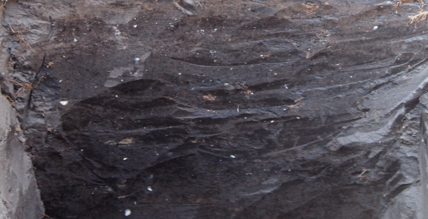
Liquid phase of technogenically transformed soils*
Horizon | Soil moisture, % |  | рН | The degree of saturation of soil solutions in relation to solid phases (number of times)
 |  |  |  | Fe(OH)₂ | Fe(OH)₃ | Al(OH)₃ | CaSO₄
Greyzemic Phaeozem (Carbonic, Gypsic, Novic, Thionic)
Technogenic deposit | 28,0 | 3,5 |  | 0,6 | >1000 | >1000 | 8,7
Abj | 28,5 | 3,7 |  | 1,5 | >1000 | >1000 | 3,5
BEb | 24,5 | 4,1 |  | >1000 | >1000 | >1000 | 11,6
Btb1 | 18,8 | 3,9 |  | 0,5 | >1000 | >1000 | 6,9
Btb2 | 17,2 | 4,1 |  | >1000 | >1000 | >1000 | 7,2
Haplic Phaeozem (Carbonic, Gypsic, Novic, Thionic)
TD | 20,5 | 3,9 |  | 1,1 | >1000 | >1000 | 1,5
Abj | 29,7 | 4,3 |  | >1000 | >1000 | >1000 | 23,7
Ayb | 20,2 | 4,7 |  | >1000 | >1000 | >1000 | 4,0
ABtb | 18,3 | 5,2 |  | >1000 | >1000 | >1000 | 13.5
Btb | 17,5 | 5,1 |  | >1000 | >1000 | >1000 | 2.0
Haplic Phaeozem (Carbonic, Gypsic, Novic, Thionic)
TD | 25,2 | 3,7 |  | 39,6 | >1000 | >1000 | 3,1
Abj | 29,0 | 3,7 |  | 0,9 | >1000 | >1000 | 1,7
Ayb | 29,7 | 6,4 |  | 315,1 | >1000 | >1000 | 7,9
ABtb | 23,5 | 6,6 |  | >1000 | >1000 | >1000 | 4,2
Btb | 24,8 | 5,5 |  | >1000 | >1000 | >1000 | 5,1
Mechanisms of formation of secondary gypsum in soils:
During the ion-exchange reactions:
SAC [Са²⁺]+H₂SO₄=SAC [H⁺]+CaSO₄
2. As a result of decomposition of carbonates in soils with sulfuric acid solutions: СаСO₃+H₂SO₄ +7О =CaSO₄+ Н₂О + СО₂
3. Due to the supply of water-soluble СаSO₄ with AMD and it precipitation in soils
*SAC – soil adsorption complex
oversaturated
unsaturated
Neogypsans in А horizon of Haplic Phaeozems, overlapped by the dump tailing
*according to data of soil solutions displaced by ethanol

Slide 13
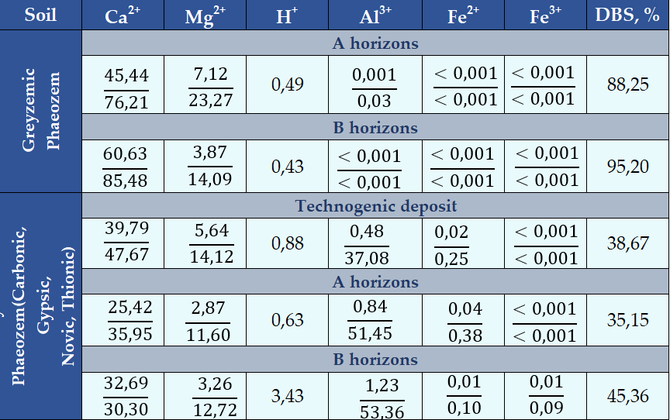
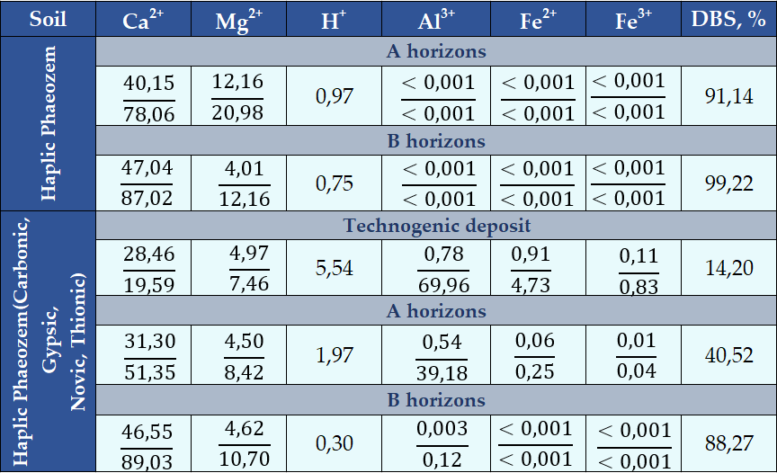

Transformation of cation-exchange complex
Greyzemic Phaeozems
Haplic Phaeozems
Average loss of exchangeable сations in SAC:
A horizons: Са²⁺ (-40,26%), Mg²⁺ (-11,67%)
B horizons: Са²⁺ (-55,18%), Mg²⁺ (-1,37%)
Average loss of exchangeable сations in SAC:
A horizons: Са²⁺ (-26,71%), Mg²⁺ (-12,56%)
*Degree of base
saturation (DBS) (%)
$$\frac{(Ca2++Mg2+)}{\begin{aligned}(Cа2++Mg2++Hydrolytic acidity) \\ \end{aligned}}$$
=
*SAC – soil adsorption complex
*a share (%) of exchangeable fraction of Che from the total Che content in soil (above the line),
** a share (%) of exchangeable fraction of Che from the total content of exchangeable cations in SAC (under the line)

Slide 14
Mineralogical composition of natural and techhogenically-transformed soils
Greyzemic Phaeozem (natural site)
Haplic Phaeozem (natural site)
Greyzemic Phaeozem (transformed)
Greyzemic Phaeozem (transformed)
Individual clay minerals:

Slide 15
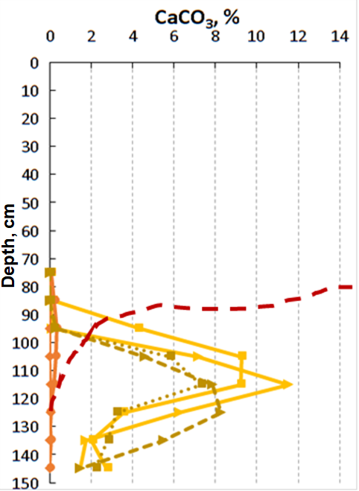
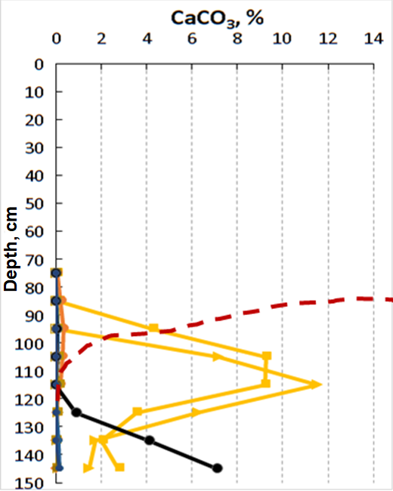
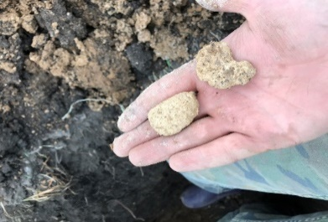
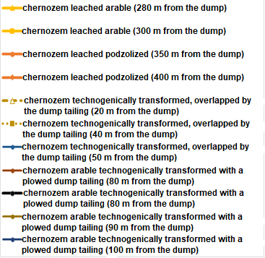
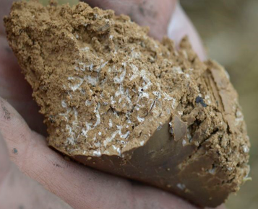
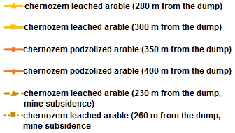
Vertical differentiation of carbonates in impacted by coal mining
Haplic Phaeozems (natural site)
– Haplic Phaeozems (mine subsidence)
Haplic Phaeozems (natural site)
– Haplic Phaeozems (transformed)
Neocalcans nodule in Bk horizon
soil effervescence boundary
soil effervescence boundary
Neocalcans micellar in Bk horizon

Slide 16
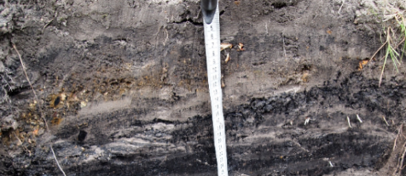
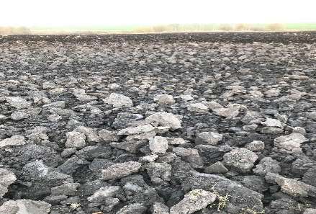
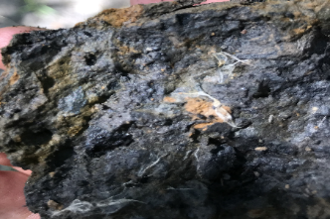
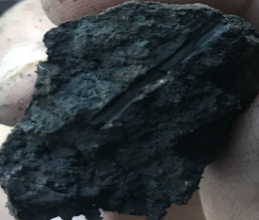
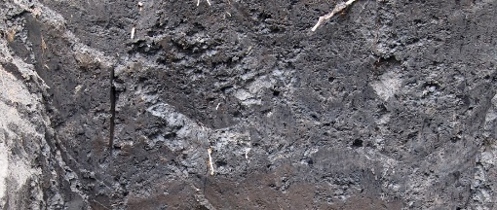
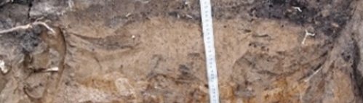
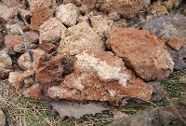

Alteration of soil morphology in coal mining areas of Moscow basin
Technogenically caused processes
General for Greyzemic Phaeozems and Haplic Phaeozems | Transformation of the soil profile | Physical destruction of the soil profile due to mining works and erosion. Formation of technogenic deposits (up to 50 cm in thickness and more) on the soil surface. Overlapping of soils by technogenic deposits.
 | Compaction | Filling of soil pore space with finely dispersed material. High compaction of soil mass and low porosity.
 | Сhanges in morphology of soil structural aggregates | Granular and cloggy aggregates were replaced by cloddy, lumpy, and nutty ones. Сhanges in morphology of Fe-neoformations in soils (nets and crusts).
 | Vertical migration of solutions and suspensions | Leaching and redeposition of dust and silt. Intensification of mobility of organo-mineral compounds.
 | Transformation of organic carbon profile | Slowing down the decomposition of organic matter (substitution of humus-accumulative process by humus-destructive process). Intensification of eluvial process (formation of black carbonaceous films on faces of soil peds). High content of organic matter of coal origin (carbonaceous particles) in the pore space of soils. Removal of soil organic matter.
Greyzemic Phaeozems | Changes in colour of the soil profile | Activation of acid hydrolysis (bleaching of the soil mass, increment of silans and skeletans on soil peds) in eluvial horizons (ВEL) along with intensive ferrugination in illuvial horizons (BT). Formation of ochreous and rusty-brown iron nodules and patches of Fe oxides and hydroxides on faces of structural units. Soils in subsidence has signs of gleying (grayish and smoke blue shades) throughout the profile.
Haplic Phaeozems | Formation of secondary gypsum | Formation of gypsum in soil profile.
 | Leaching of carbonates | Lowering of effervescence depth and upper boundary of Са-neoformations to the BС-C horizon or leaching of carbonates beyond the soil profile.

Slide 17
Conclusions
Long-term supply of sulfide-bearing technogenic material to the environment led to the significant geochemical transformation of soils. Releasing of acid mine drainage (AMD) with the high content of Cа, Fe and Al sulfates also affected chemical properties and morphological features of soils.
Properties of newly formed soils differ significantly from natural soils. We identified the transformation of the composition of soil solutions. Soils with the technogenic transformation of the profile were characterized by acidification and Cа-Al-SO₄ salinization of soil profile along with the increasing of the content of H⁺ and Al³⁺ ions and changes in the composition and the ratio of exchangeable cations. Solutions concentration and acidity increased in the series Haplic Phaeozems < Greyzemic Phaeozems. The mobility of Zn and Ni in solutions of transformed soils increases considerably.
Cation exchange lead to displacement of Cа²⁺ and Mg²⁺ ions by Al³⁺, H⁺, Fe²⁺ and, perhaps, by Fe³⁺ in soil adsorption complex (exchangeable H⁺ and Al³⁺ in soils up to 60-70%). Transformed soils were characterized by a very low degree of base saturation (less than 20%). In Greyzemic Phaeozems the intensification of podzolization process (bleaching of an eluvial horizon, the increment of silans and skeletans, and sometimes, the ferrugination of an illuvial horizon) could be noted.
AMD dissolves carbonates and the upper boundary of the carbonate horizon of the impacted Haplic Phaeozems lowered. Gypsum neoformations (neogypsans) appeared in leached Haplic Phaeozems.
Estimation of the saturation degree of liquid phases of transformed soils with poorly soluble compounds revealed a high oversaturation of soil solutions with Fe³⁺ and Al³⁺ hydroxides and CaSO₄ .
Due to AMD impact that had destroyed fine clay fractions of aluminosilicates, numerous clarified areas were formed, composed of quartz. The clay minerals of natural soils are represented by kaolinite, illite, vermiculite and mixed-layer minerals. The sharp increase in smectite fraction (up to 75-80%) and slightly in chlorite fraction was revealed in transformed soils.

Slide 18
Thank you for your attention!

