Slide 1

Possible controls on Arctic clouds by natural aerosols from long-range transport of biogenic emissions and ozone depletion events
Rupert Holzinger, Oliver Eppers, Kouji Adachi, Heiko Bozem, Markus Hartmann, Andreas Herber, Makoto Koike, Dylan Millet, Sho Ohata, and Frank Stratmann
¹Institute for Marine and Atmospheric Research, Utrecht (IMAU), Utrecht University, The Netherlands
²Johannes Gutenberg University of Mainz, Institute for Atmospheric Physics, Mainz, Germany
³Particle Chemistry Department, Max Planck Institute for Chemistry, Mainz, Germany
⁴Meteorological Research Institute, Tsukuba, Japan
⁵Leibniz-Institute for Tropospheric Research (TROPOS), Leipzig, Germany
⁶Alfred Wegener Institute Helmholtz Centre for Polar and Marine Research (AWI), Bremerhaven, Germany
⁷Department of Earth and Planetary Science, The University of Tokyo, Tokyo, Japan
⁸University of Minnesota, Saint Paul, MN, USA

Slide 2
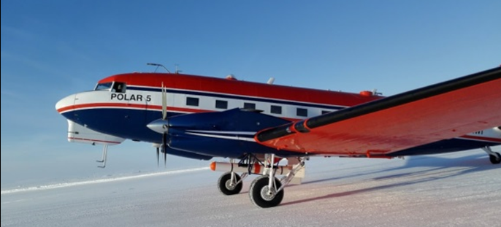
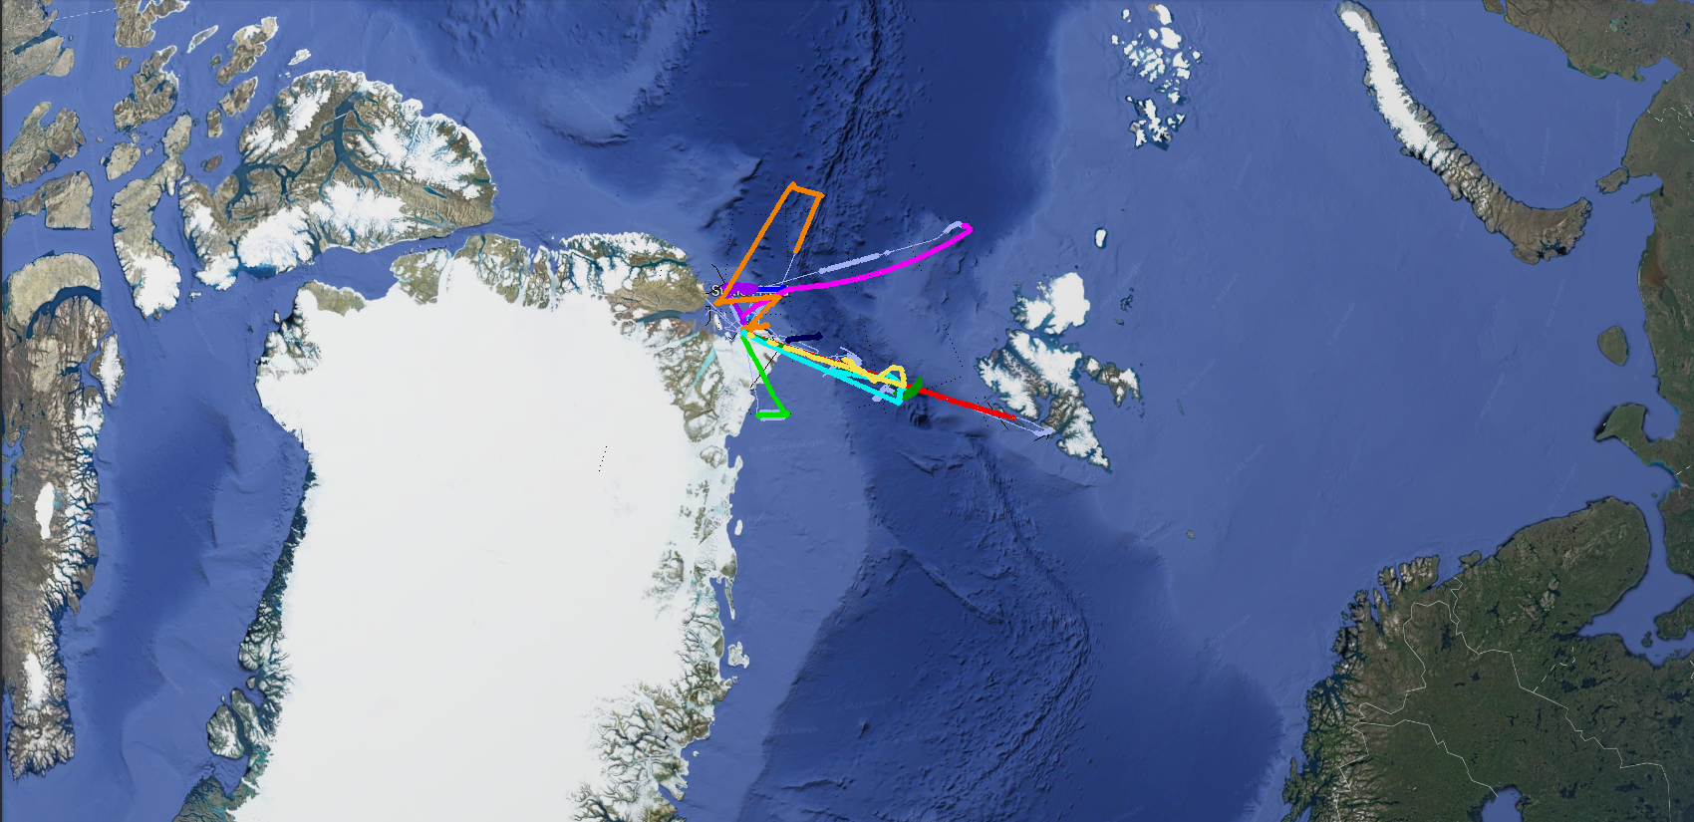

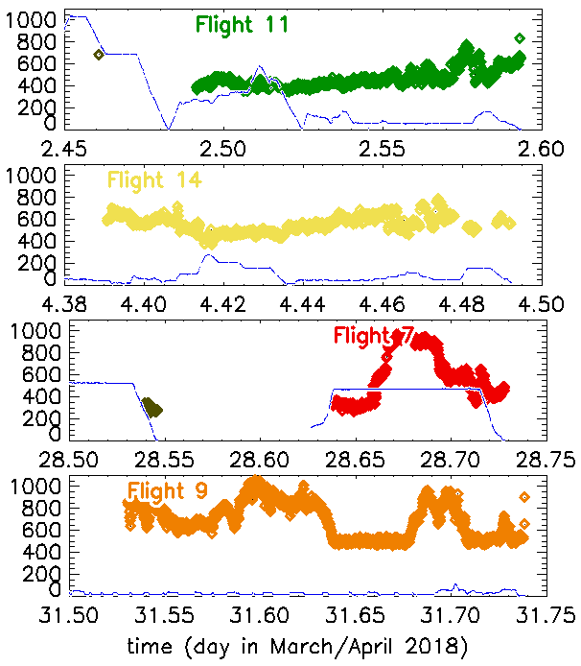
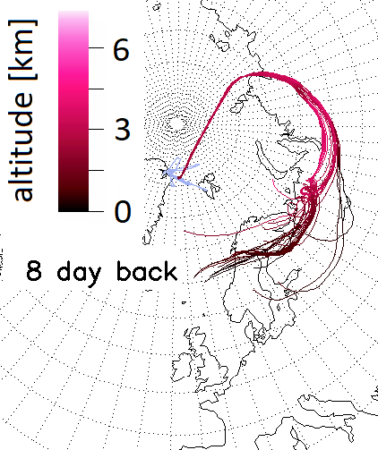
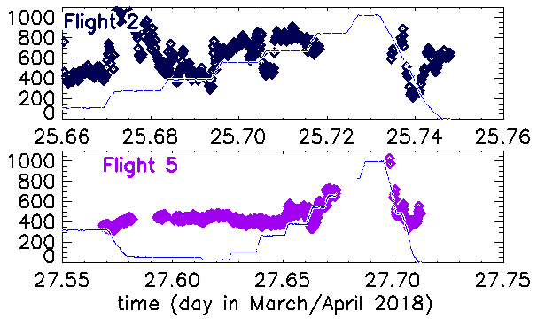
Lessons from airborne VOC measurements during PAMARCMIP
2018 concerning aged biogenic emissions and ozone depletion events
acetone is tracer for continental influence
acetone [ppt]

Slide 3
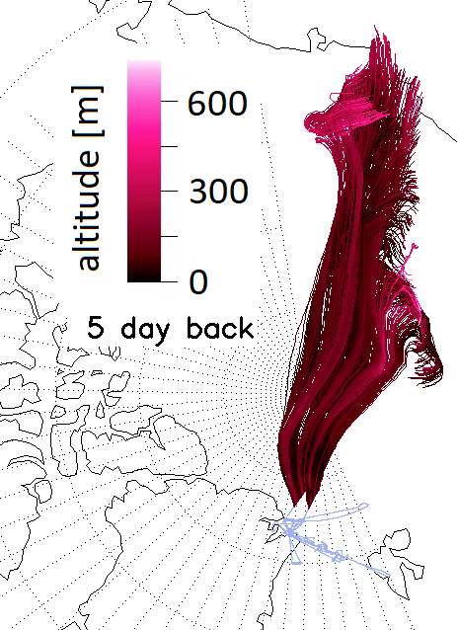
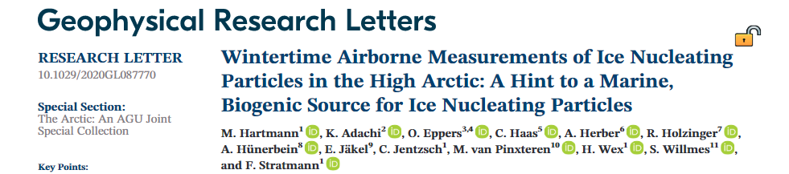
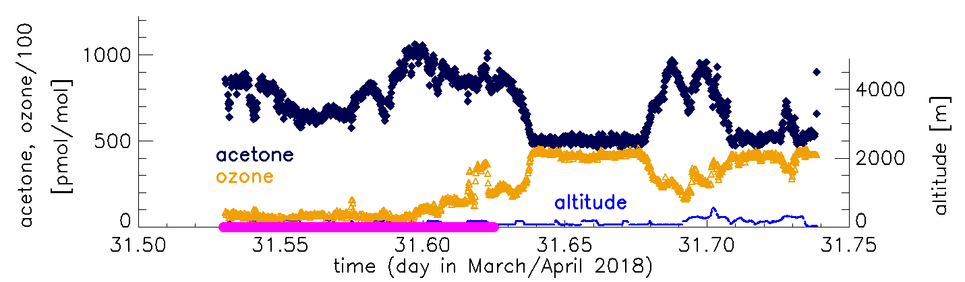
Lessons from airborne VOC measurements during PAMARCMIP
2018 concerning aged biogenic emissions and ozone depletion events
Do ODEs control clouds through emission of INP?

Slide 4
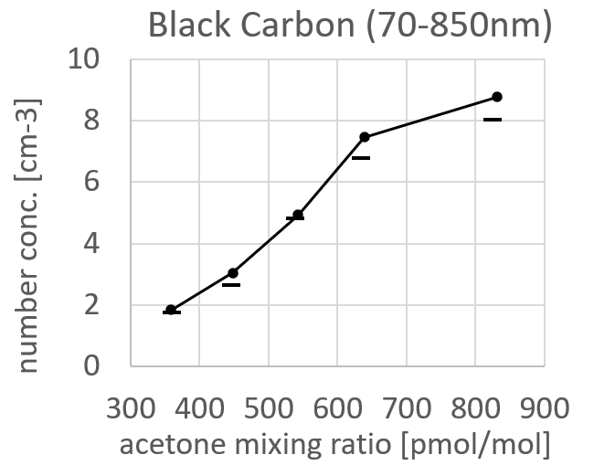
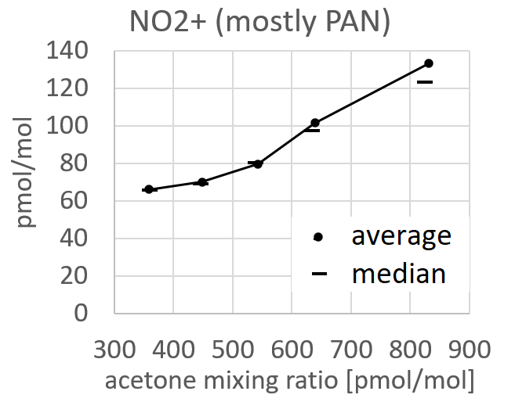
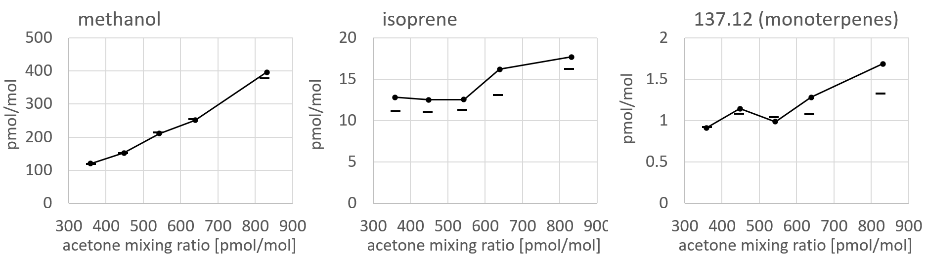
Lessons from airborne VOC measurements during PAMARCMIP
2018 concerning aged biogenic emissions and ozone depletion events

Slide 5
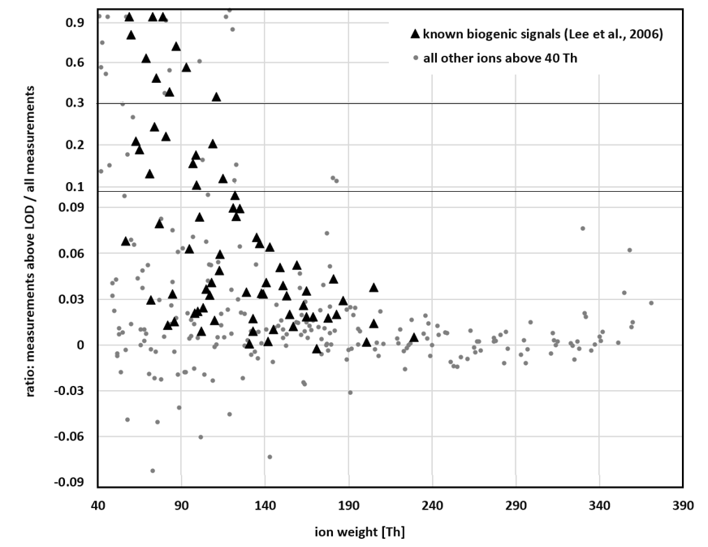
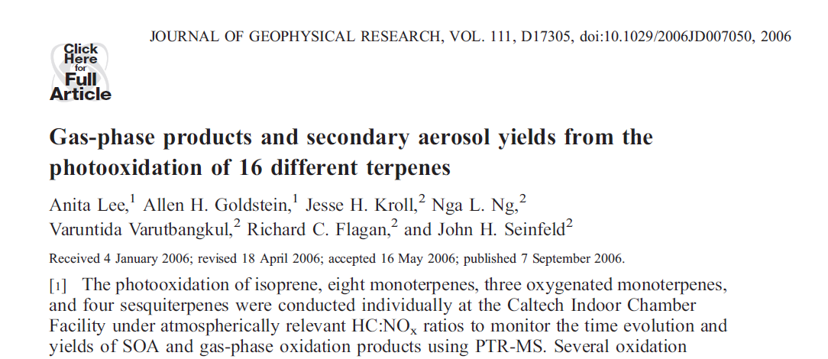
Lessons from airborne VOC measurements during PAMARCMIP
2018 concerning aged biogenic emissions and ozone depletion events
66% of biogenic above the LOD for more than 3% of the measurements.
..of all other ions 23% …
73 ions from photooxidation of isoprene,
11 monoterpenes,
4 sesquiterpenes

Slide 6
Lessons from airborne VOC measurements during PAMARCMIP
2018 concerning aged biogenic emissions and ozone depletion events
Are biogenic emissions an important source of CCN?
66% of biogenic above the LOD for more than 3% of the measurements.
..of all other ions 23% …
Is this important?
Condensable oxidation products:
similar levels as DMS
mass concentration ~20% of measured aerosols (185-850 nm)

