Slide 1

Current geodynamics and evolution of Tjörnes transform zone, North Iceland
Display materials
Bogoliubskii V.¹, Dubinin E.², Grokholsky A.³
1 – Lomonosov Moscow State University, Faculty of Geography, bogolubskiyv@yandex.ru
2 – Lomonosov Moscow State University, The Earth Science Museum, edubinin08@rambler.ru
3 – Lomonosov Moscow State University, The Earth Science Museum, andregro2@yandex.ru

Slide 2
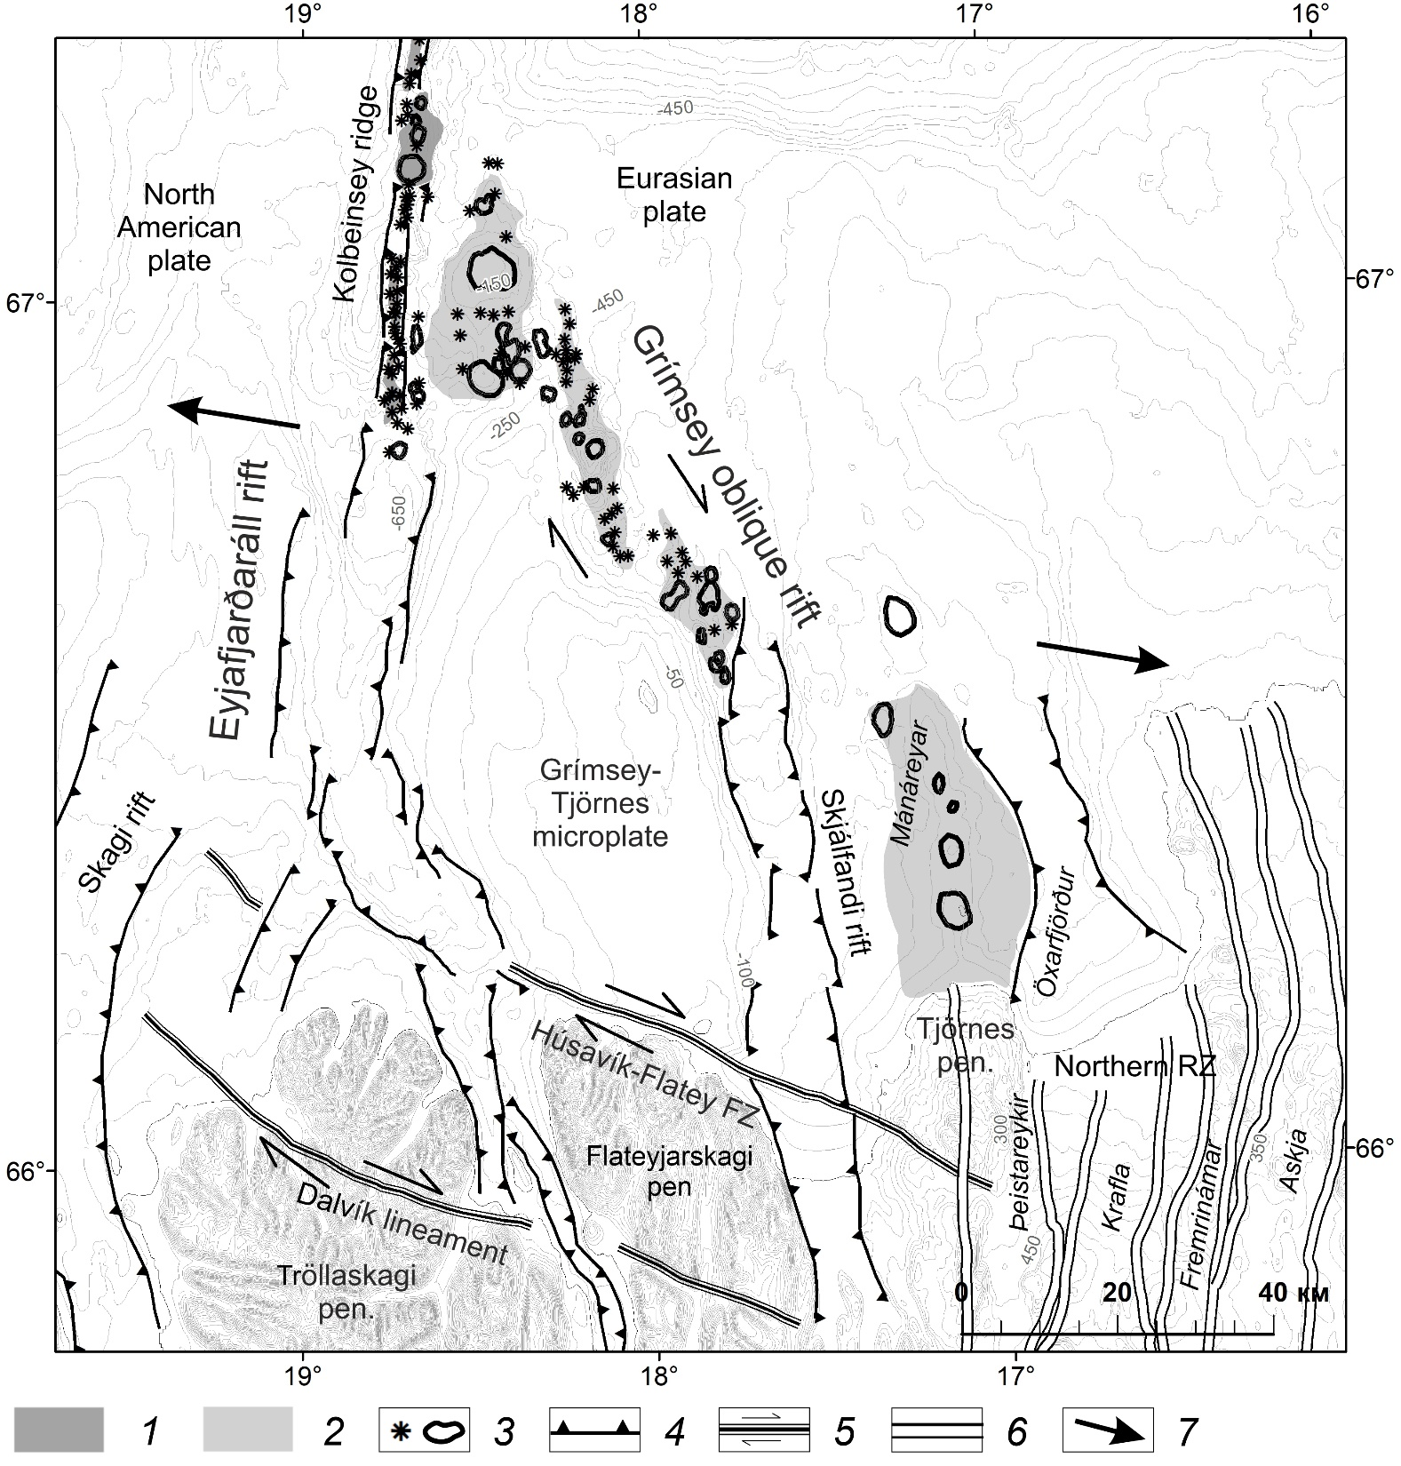
Tjörnes transform zone
1 – neovolcanic zone, 2 – volcanic plateaus, 3 – separate volcanoes, 4 – normal faults, 5 – strike-slip faults, 6 – volcanic systems of Iceland, 7 – extension direction

Slide 3
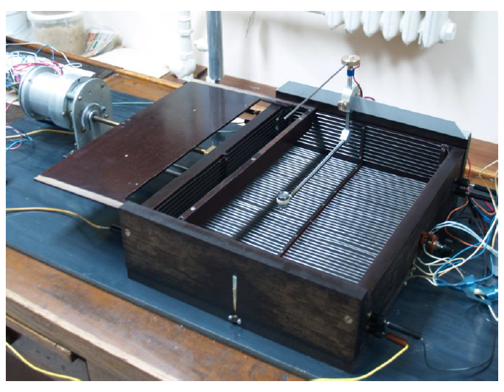

Physical modelling
Labarotory of Physical Modelling of The Earth Science Museum of MSU
Substance based on liquid and solid hydrocarbons
Resemblance criterion:
where τ_{s} – shift fluidity limit, ρ and Н – density and thickness of layer, respectivly(Shemenda, Grocholsky, 1994)
Extension by revolving piper

Slide 4
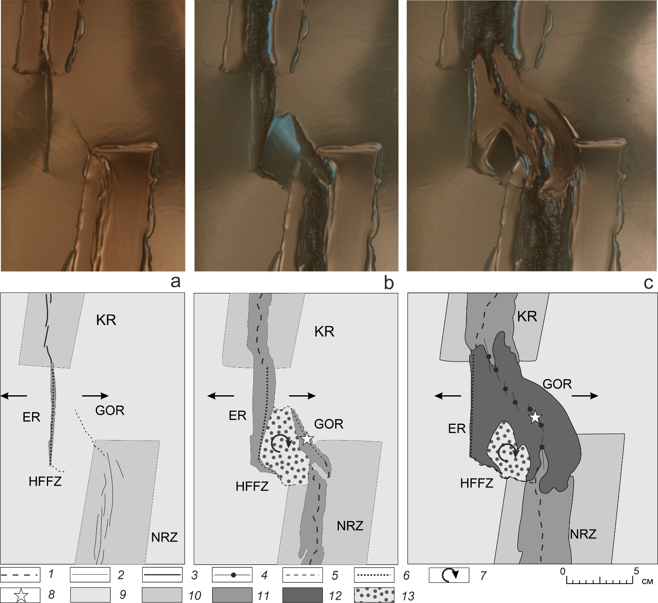
Results
Experiment 2452. Modelling of formation and development of TZT. Experiment stages and their interpretation. 1 – extension axis, 2 – volcanic segments, 3 – neovolcanic zones, 4 – volcanic segments of Grímsey oblique rift (GOR), 5 – transtensive zones, 6 – Eyjafjarðaráll amagmatic rift, 7 – microplate rotation, 8 – hotspot position, 9 – model plate, 10 – dilute zones, 11 – accreted model lithosphere, 12 model lithosphere generated by model lithosphere, 13 – block of Grímsey-Tjörnes microplate

Slide 5
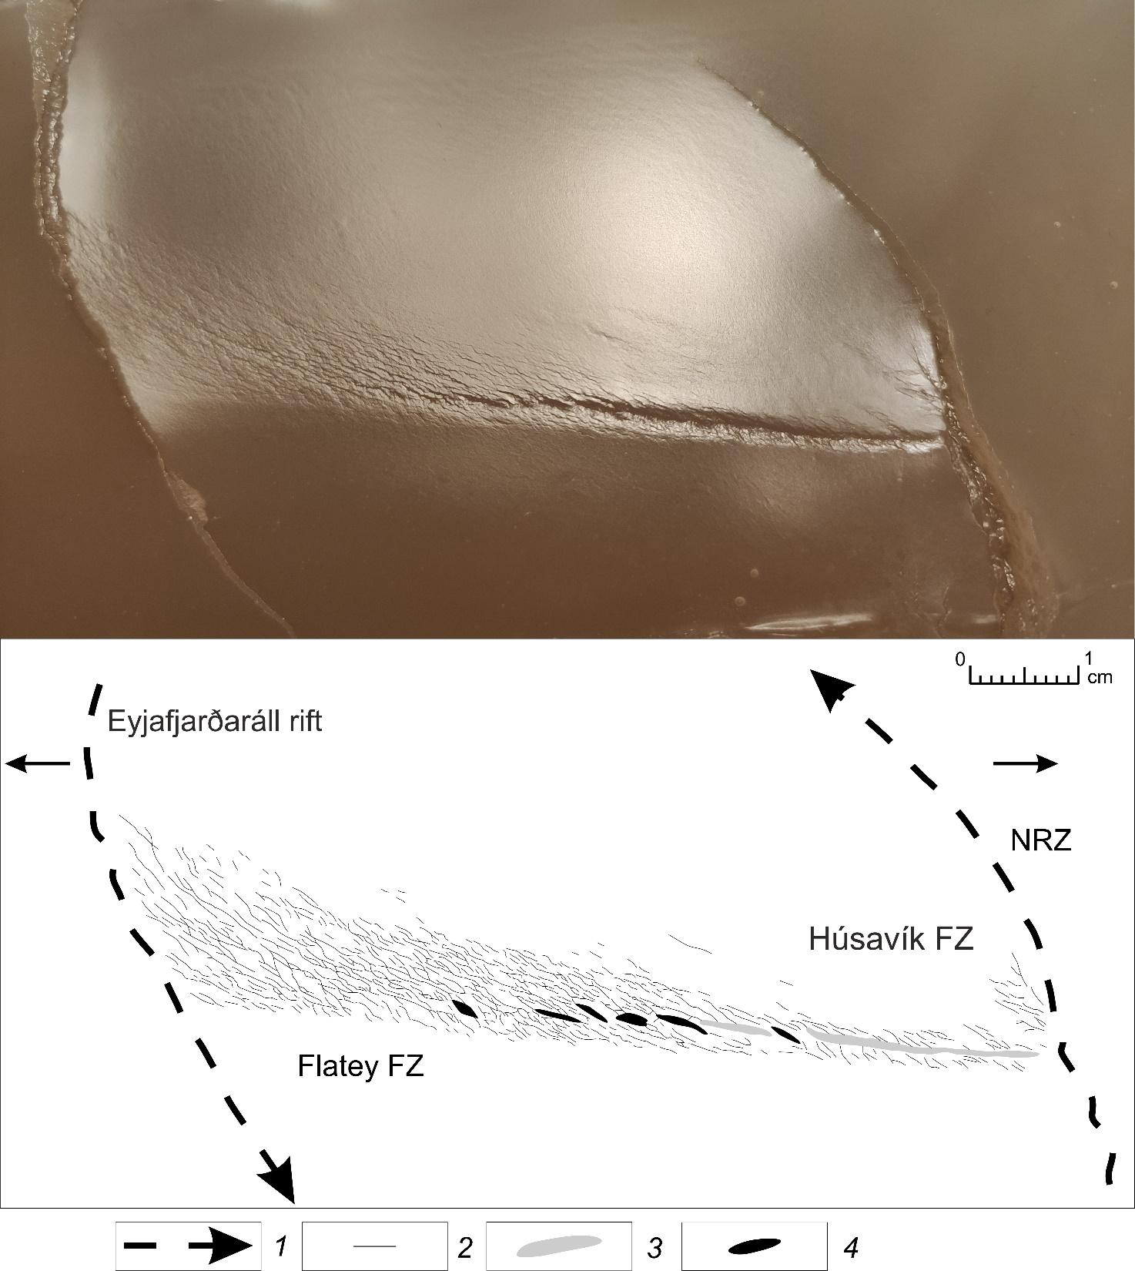
Results
Experiment 2607. Formation conditions of Húsavík-Flatey Fracture Zone. 1 – rift axis and their propagation directions, 2 – strike-slips, 3 – graben bottom, 4 – pull-apart basins

Slide 6
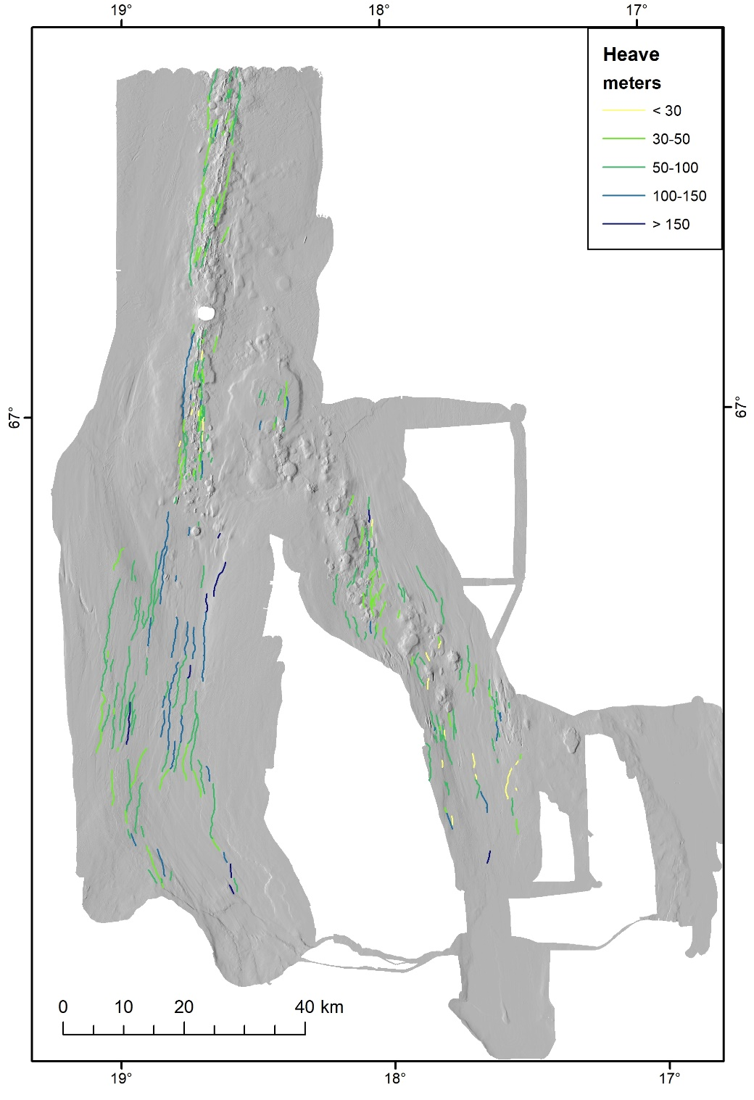
Morphometric analysis
Used parameters:
Heave
Throw
Visual length
Euclidean distance
Profile curvature (Curv=∂²z/∂²x)
An example of spatial distribution of one of parameters (heave)

Slide 7
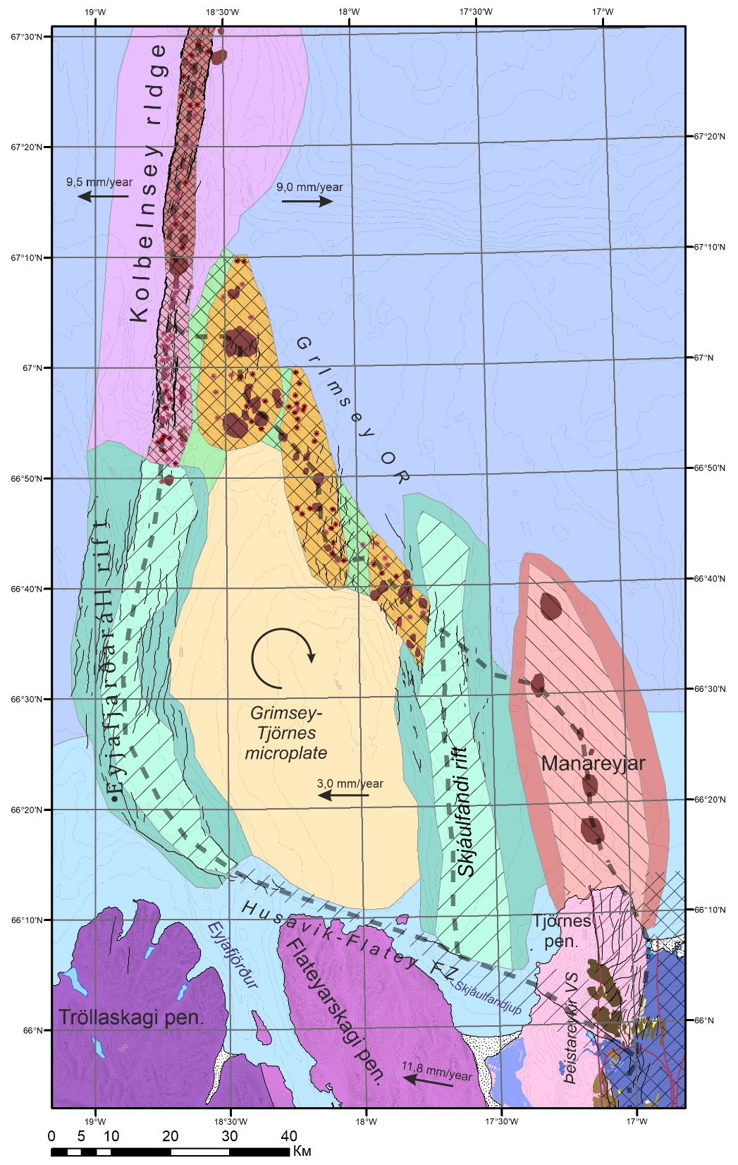
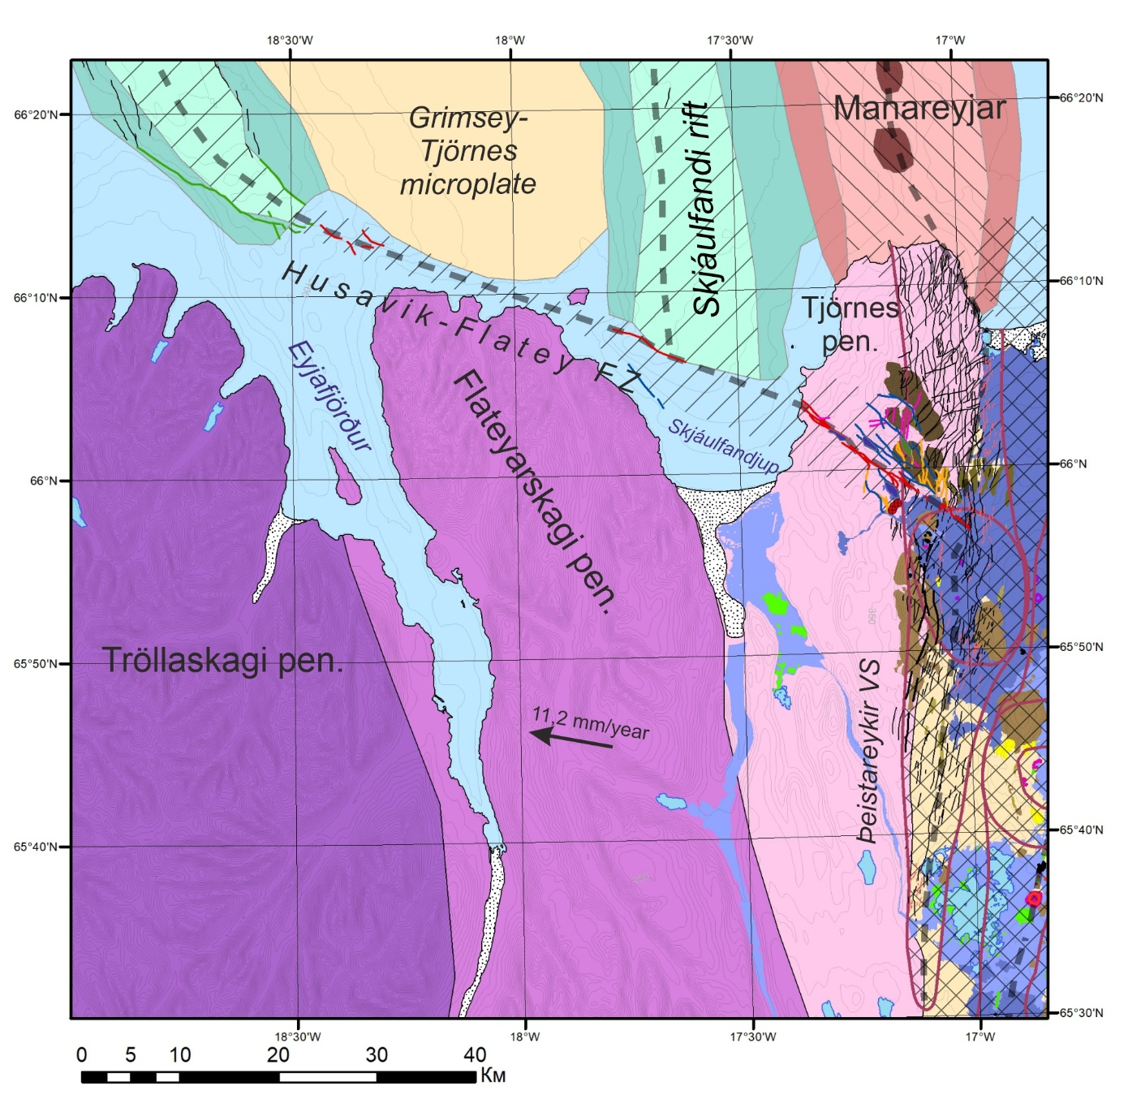
Tjörnes transform zone

Slide 8
