Slide 1

Diurnal anisotropy of polar neutron monitors, Dome C looks poleward
Alexander Mishev,
Agnieszka Gil, Stepan Poluianov and Ilya Usoskin
EGU22-1221

Slide 2
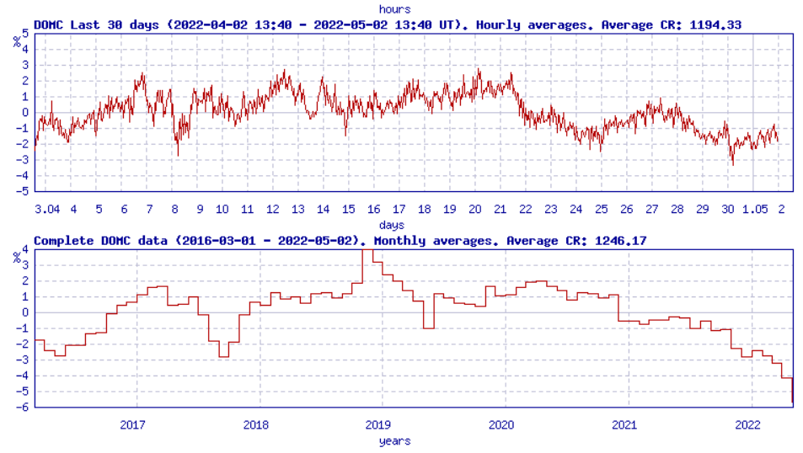
Motivation
Galactic cosmic rays (GCR) show a small local anisotropy detected as a diurnal variability of neutron monitor (NM) count rates. As the asymptotic directions of different NMs are diverse, the capability of the GCR diurnal variation observation is also various. Here we present that the Dome C (DOMC) NM is barely sensitive to the diurnal variation. Its amplitude is very small, 0.03%, in comparison to other polar NMs, for which the diurnal variability amplitudes vary from 0.16 to 0.4%. This fact is associated to the narrow asymptotic-direction cone of DOMC NM looking almost to the South pole with geographic latitude above 75º. Thus, DOMC NM is the only existing NM accepting cosmic-ray particles from the off-equatorial region, which makes this station a unique detector.
https://cosmicrays.oulu.fi/

Slide 3
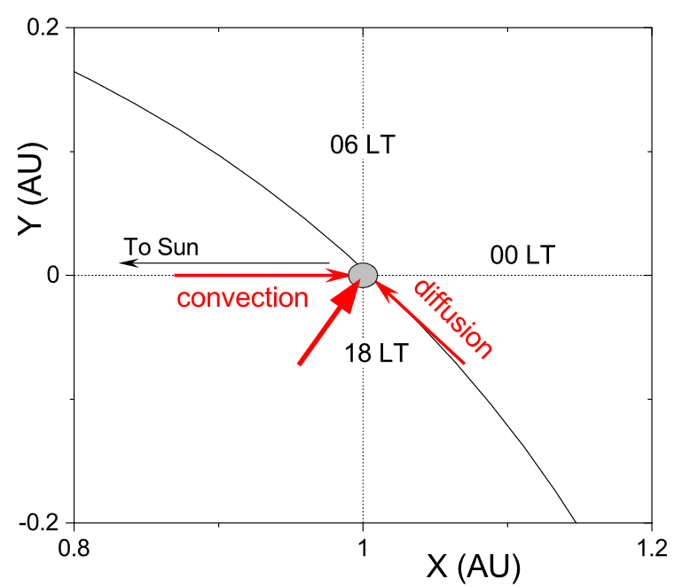
Simplified not-to-scale scheme of the GCR anisotropy in the vicinity of Earth (denoted as the grey circle): the plot corresponds to the ecliptic plane as viewed from the north. Two main mechanisms are: radial outward convection by the solar wind and inward diffusion along the HMF line. The summary anisotropy vector is shown by the thick red arrow. Other mechanisms, e.g., the Earth's movement, are not shown.

Slide 4
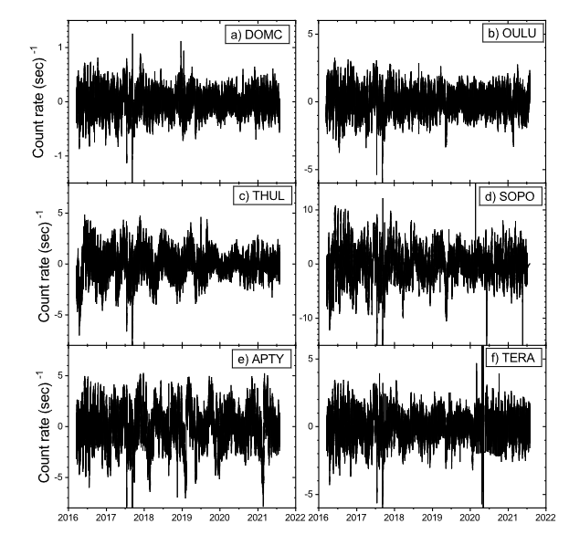
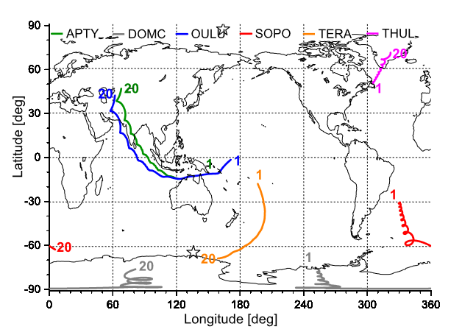
Asymptotic directions of the polar NMs considered here are represented by colored curves, as denoted on the top. Computations were made using the MAGNETOCOSMICS code for the date of 22-Aug-2016 for GCR particles with rigidity between 1 – 20 GV as denoted by the numbers near each curve. Locations of the geomagnetic poles (IGRF, epoch 2020) are indicated by stars.
High-pass (2 years) filtered hourly count rates, for the period 16-Mar-2016 – 31-Aug-2021, for six neutron monitors studied here: DOMC (a), OULU (b), THUL (c), SOPO (d), APTY (e), and TERA (f).

Slide 5
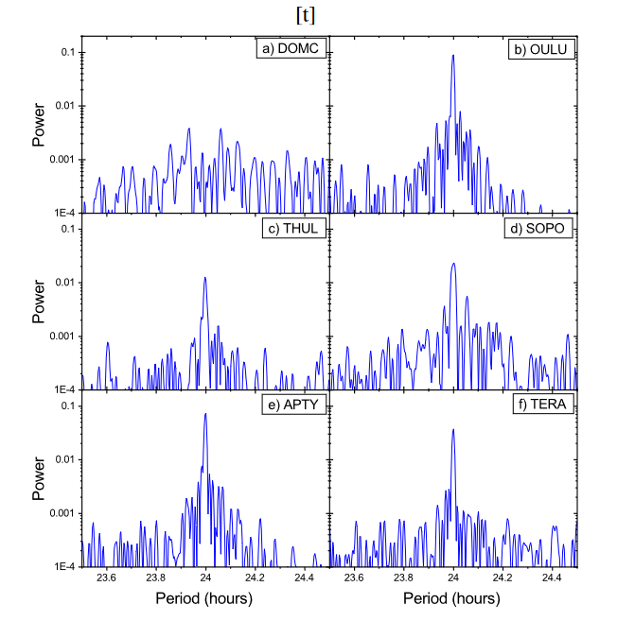
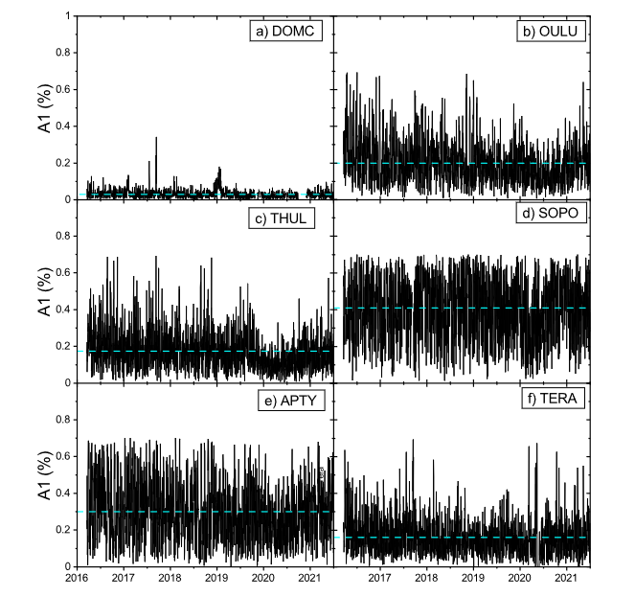
Amplitudes of the diurnal variability calculated for the period of 16-Mar-2016 – 31-Aug-2021 for six NMs: DOMC, OULU, THUL, SOPO, APTY, and TERA (panels a – f, respectively). The blue dashed line denotes the mean amplitude for each NM.
Power spectral density of the count rates for the six NMs: DOMC, OULU, THUL, SOPO, APTY, and TERA for the time interval between 16-Mar-2016 – 31-Aug-2021 around the 24-hr period

Slide 6
Summary
DOMC is the only NM with nearly absent diurnal variability in its data. This is because that this NM looks nearly vertically to the South-pole direction (latitudes above 75◦ south), as confirmed by the computations of its AD.
The global NM network within the geomagnetic field can serve as a giant spectrometer, using the Earth’s rotation to scan the space and evaluate the cosmic-ray anisotropy (see the “Spaceship Earth” concept, Bieber & Evenson, 1995).
NMs located at different locations with the corresponding rigidity cut-offs are sensitive to different parts of the incoming CR-particle spectrum and arrival direction since the response of each station depends on its location, particle rigidity, altitude and the angle of incidence of the incoming SEPs.
Thank you!

