Slide 1






Dynamic Rainfall Thresholds for Landslide Early Warning System in Progo Catchment, Java, Indonesia
Ratna Satyaningsih^{1,2}, Victor Jetten¹, Janneke Ettema¹, Ardhasena Sopaheluwakan³,
Danang Eko Nuryanto², Yakob Umer¹, Tri Astuti Nuraini², and Rian Anggraeni²
¹ Faculty of Geo-Information Sciences and Earth Observation, University of Twente, Enschede, The Netherlands
² Center for Research and Development, Agency for Meteorology Climatology and Geophysics (BMKG), Jakarta, Indonesia
³ Center for Applied Climate Services, Agency for Meteorology Climatology and Geophysics (BMKG), Jakarta, Indonesia
r.satyaningsih@utwente.nl | ratna.satyaningsih@bmkg.go.id

Slide 2
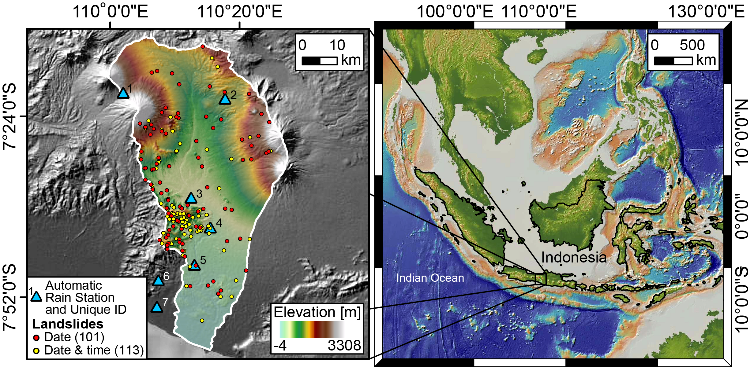
Progo Catchment
Credit: L. Lombardo

Slide 3
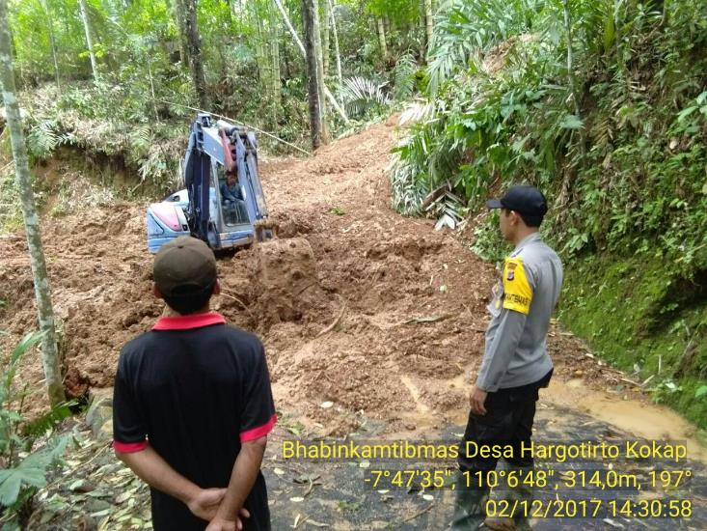
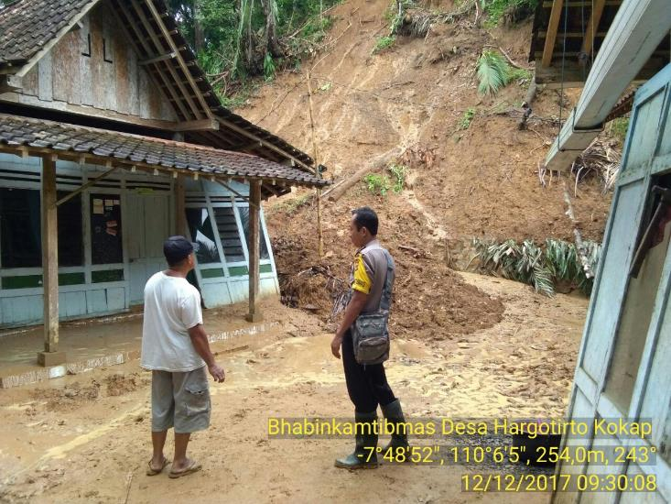
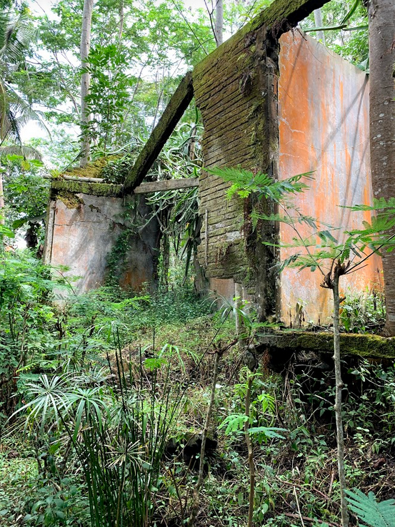
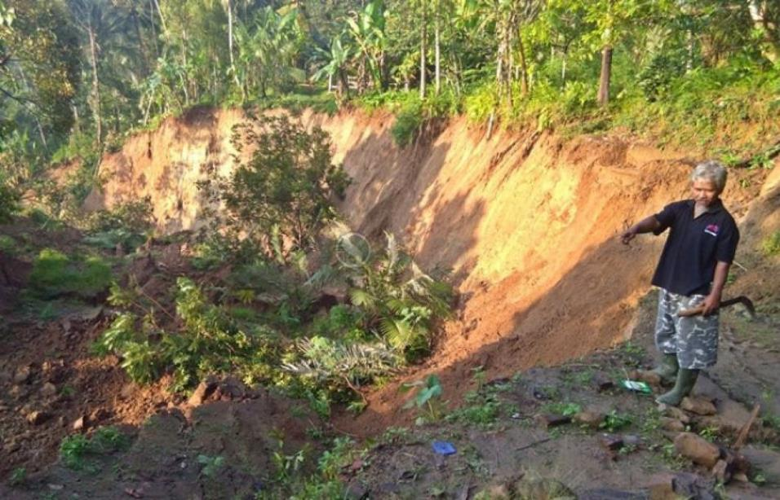
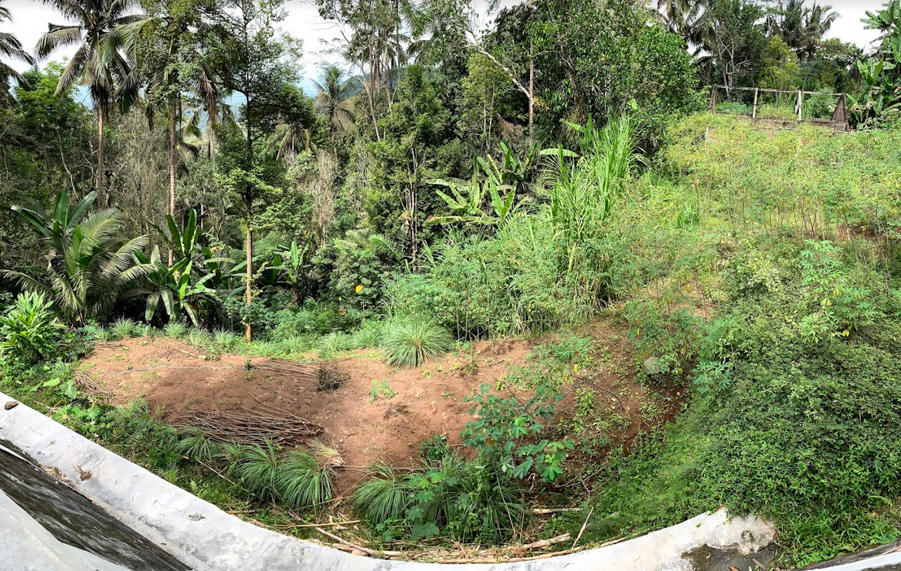
Landslides in the study area
Photo Source: Polres Kulonprogo
Photo Source: Polres Kulonprogo
03/02/2018
Notes:
These pictures show examples of landslides in the study area, blocking the road, causing damage to house, and destroying agricultural area.
The pictures on the right-hand side also indicate different soil characteristics although the sites are neighboring.

Slide 4
Datasets
Data | Period | Period | Source
Landslide data | 2012-2020 | 2012-2020 | National Agency for Disaster Management, Territorial police department, Center for Health Crisis, Volcanology Survey Indonesia, field survey
Rainfall | Resolution |  | Source
GSMaP-GNRT | 0.1°×0.1° | hourly | ftp://hokusai.eorc.jaxa.jp/GSMaP_GNRT/
CMORPH-CRT | 8 km×8 km | 30-min | ftp://ftp.cpc.ncep.noaa.gov/precip/CMORPH_V1.0/CRT/8km-30min/
Automatic rain stations data |  | 10-min | Indonesian Agency for Meteorology Climatology and Geophysics (BMKG)

Slide 5
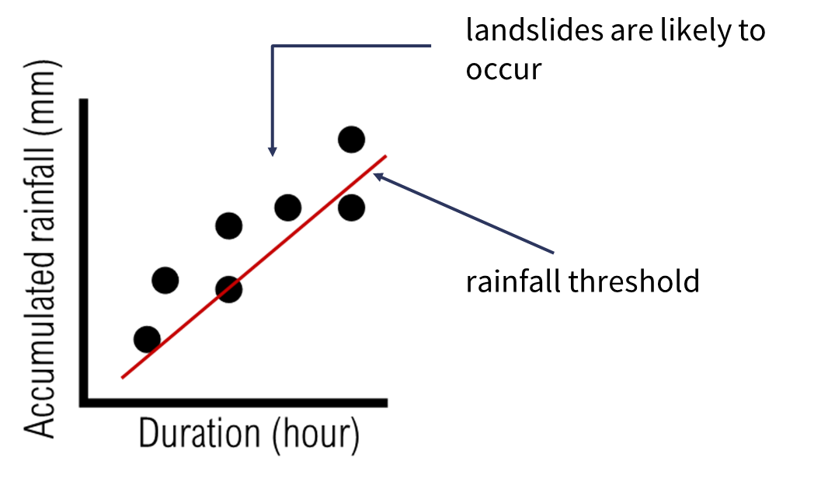

Method
Frequentist method (Brunetti et al. 2010, Peruccacci et al. 2012)
$$E=αD^{γ}$$
E : accumulated rainfall (mm)
D : duration D (hour)
⍺ : scaling constant (the intercept)
𝛾 : shape parameter that defines the slope of the threshold curve

Slide 6
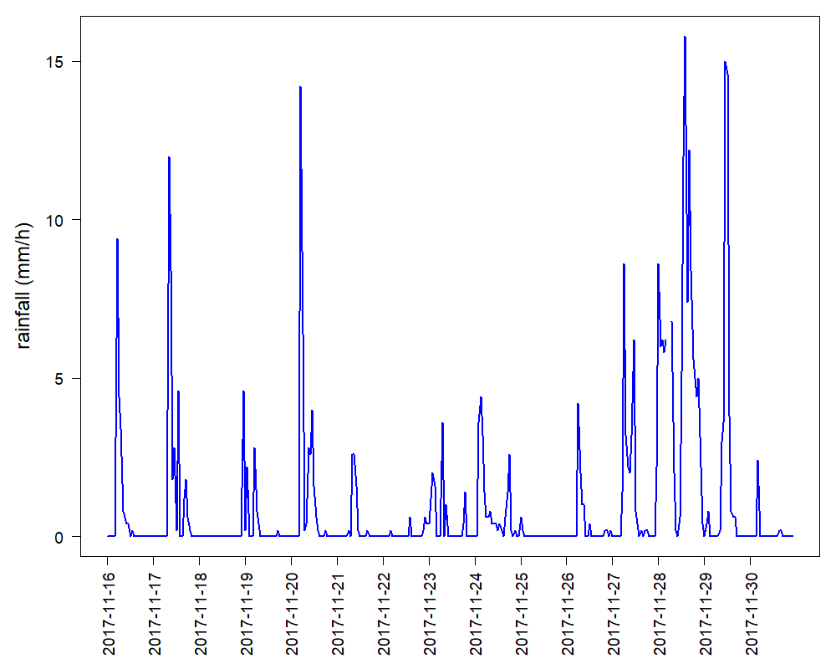
Rainfall events
Landslide
Rainfall event
E,D
Dry period
< 1mm/h, ≥ 24 hours

Slide 7
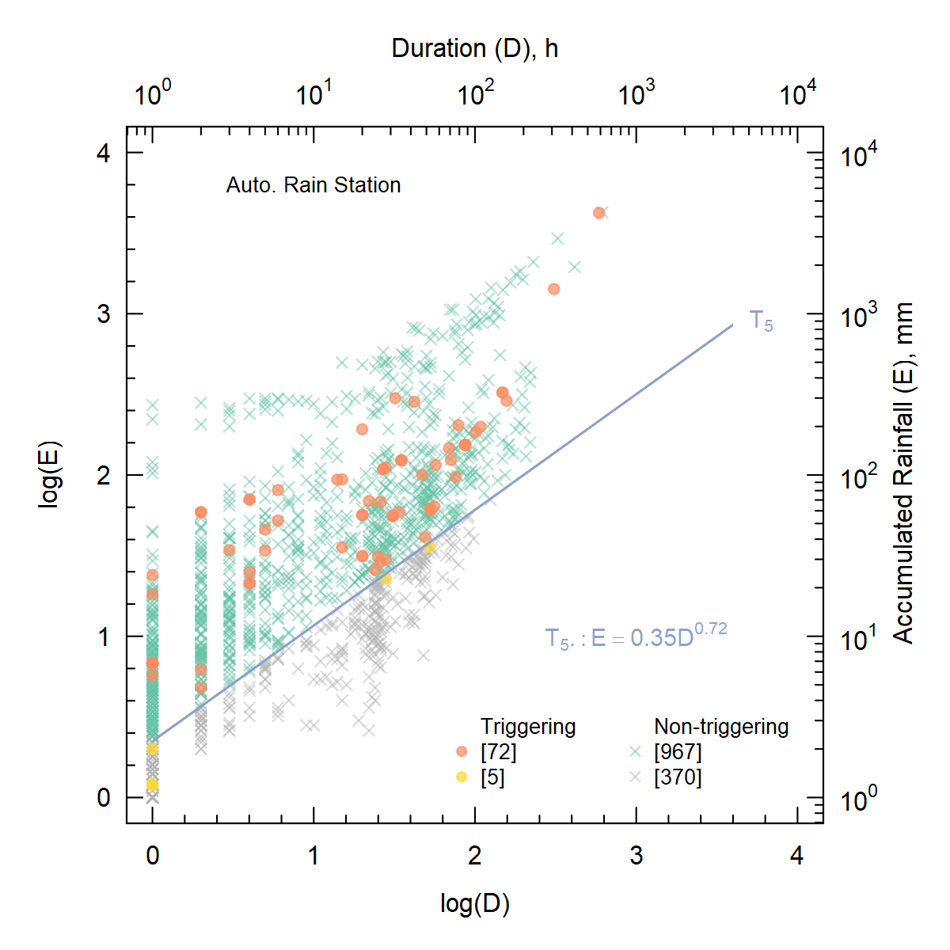
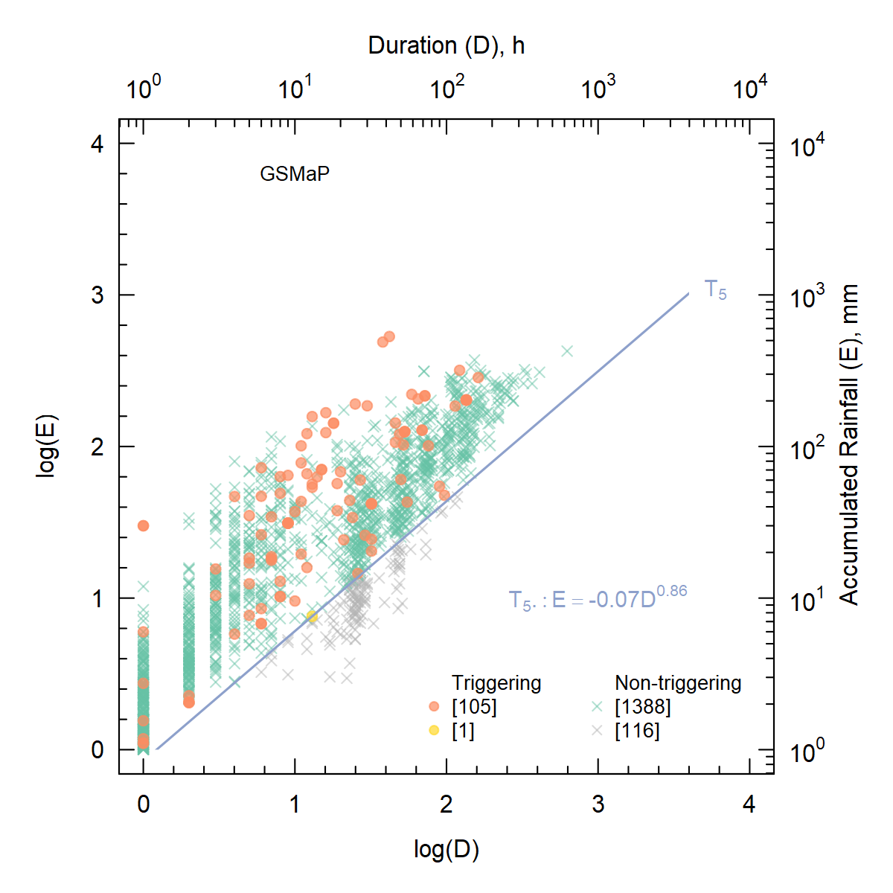
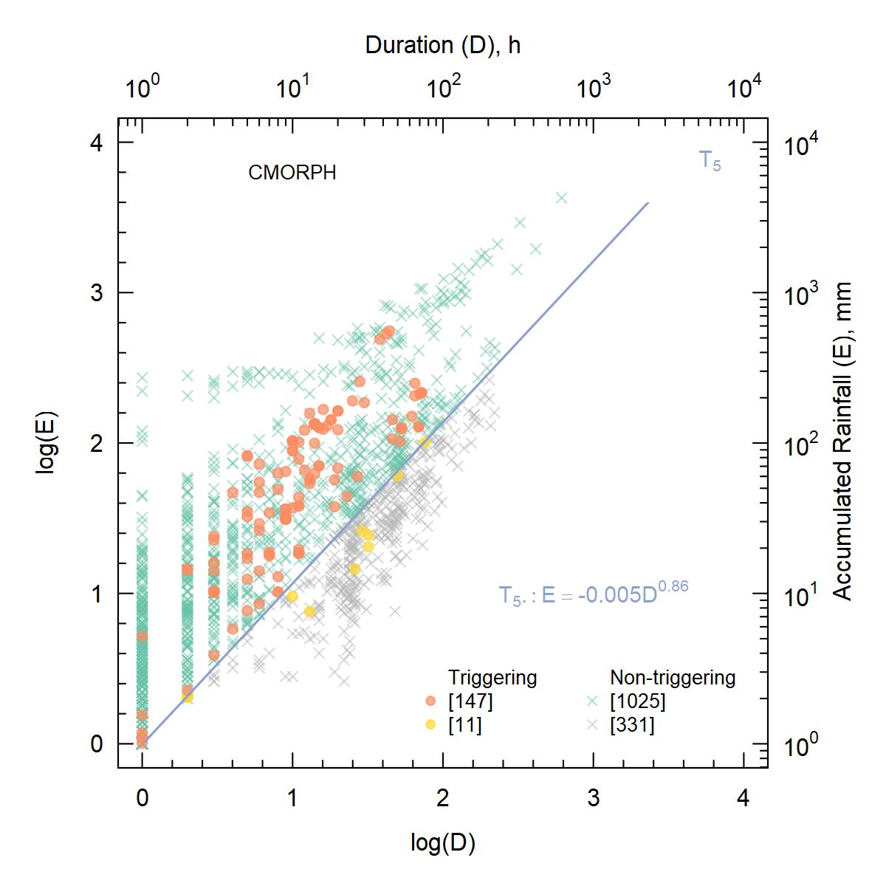
Rainfall Thresholds

Slide 8
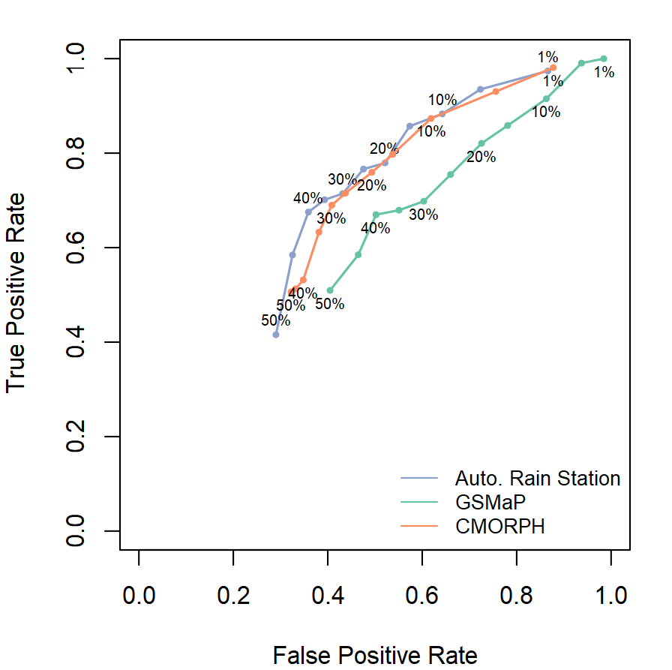


Rainfall Thresholds Performance
TP (True Positive): landslide-triggering rainfall events above threshold line
FN (False Negative): landslide-triggering rainfall events below threshold line
FP (False Positive): non-landslide-triggering rainfall events above threshold line
TN (True Negative): non-landslide-triggering rainfall events below threshold line
$$TPR=\frac{TP}{TP+FN}$$
$$FPR=\frac{FP}{FP+TN}$$

Slide 9
Key points and future work
Rainfall thresholds have been derived for the Progo Catchment using frequentist method as the basis for landslide early warning in the area
Exploring radar data
Simulating weather that representing the different characteristics triggering landslides
Applying output of weather forecast (1 km x 1 km, hourly)

Slide 10
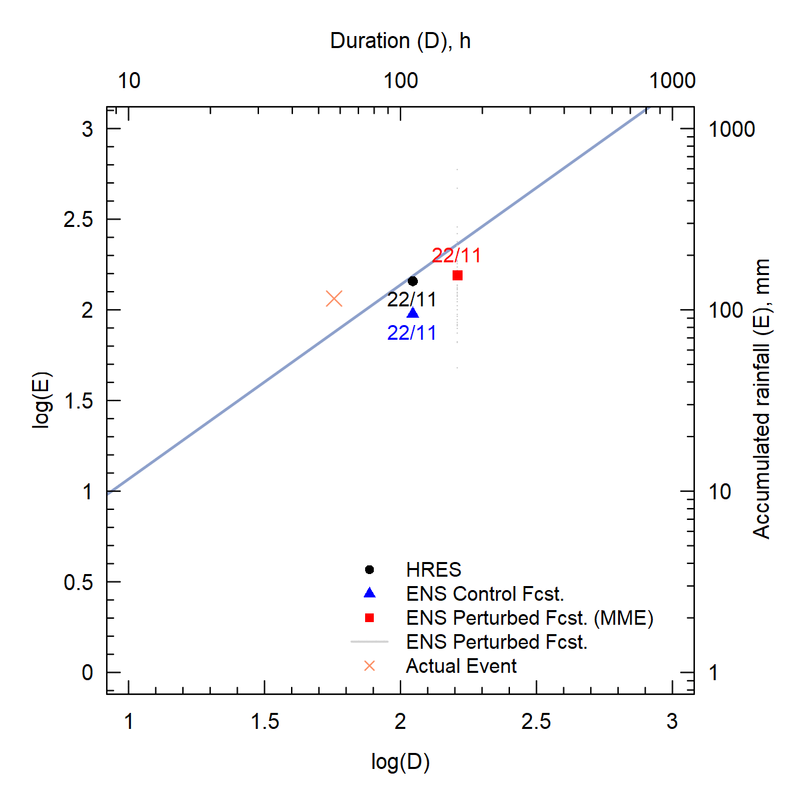
Notes:
These pictures show examples of landslides in the study area, blocking the road, causing damage to house, and destroying agricultural area.
The pictures on the right-hand side also indicate different soil characteristics although the sites are neighboring.

Slide 11
Related work presented in EGU2022
Landslide Early Warning System
Development of a local impact-based Landslide Early Warning System using physically-based multi-hazards modelling and machine learning in Java, Indonesia. [Session NH3.7]
Revisited Rainfall Threshold In the Indonesia Landslide Early Warning System [Session NH3.7]
Weather modeling/simulation
Simulation of a heavy rainfall-induced landslide event over Kulonprogo, Yogyakarta in Indonesia using WRF: Sensitivity to cloud microphysics parameterization [Session AS1.1]

Slide 12
Thank You
This study is within BILEWS (a Blueprint for Indonesian Landslide Early Warning System) project, funded by NOW-WOTRO

