Slide 1


Can litter quality explain landscape evolution: testing a soil-landscape evolution model
Xia Meng, Arnaud J.A.M. Temme, W. Marijn van der Meij, Annemieke M. Kooijman, Erik L.H. Cammeraat

Slide 2
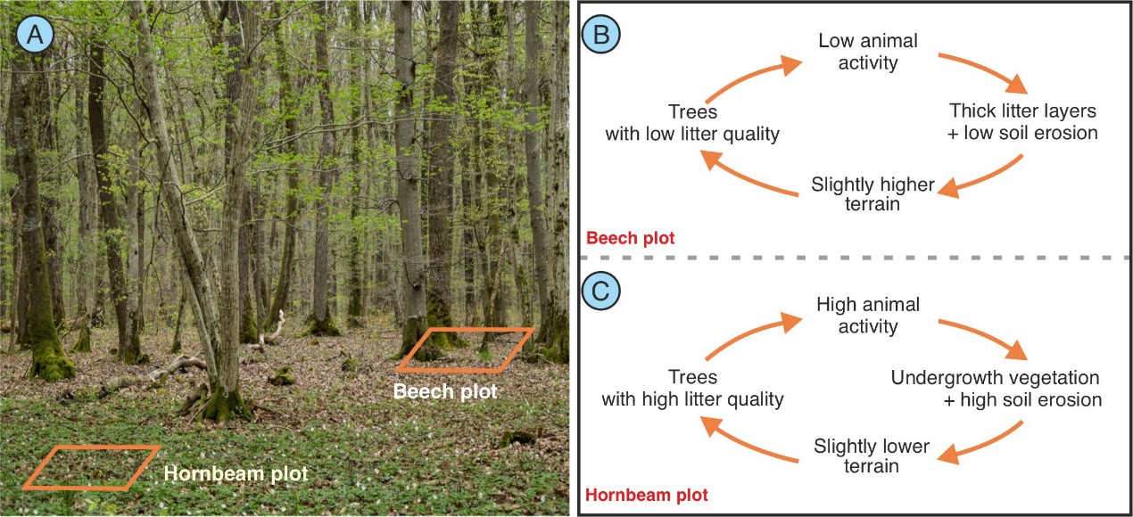
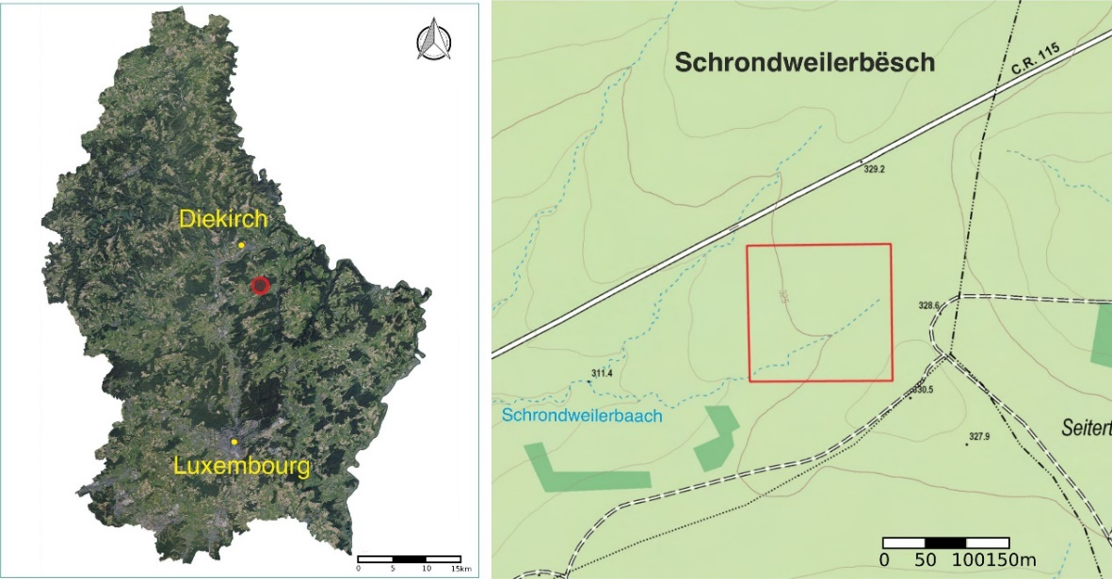
Study area
We hypothesize that the topographic differences among these patches are caused by long-term interactions between various litter and soil-landscape processes.

Slide 3
Model
Soil-landscape evolution models (SLEMs) have succeeded in incorporating soil development with landscape evolution but have the limited inclusion of biota and the impact of litter type is still lacking (Meng et al., Earth-Science Reviews, 2022)

Slide 4
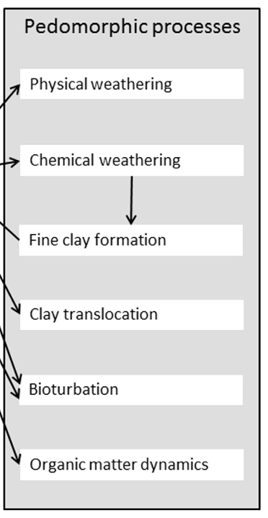
Model
Major procedures in including the litter type (the beech litter and hornbeam litter) into Lorica
The carbon cycling was adjusted to simulate beech and hornbeam litter with different decomposition rates.
Tree type was related to the Topographic Position Index (TPI) to determine their distribution on the top of soils.
The process of water erosion and deposition was calibrated using field measurements of erosion rates.
Pedomorphic processes simulated in Lorica (Temme and Vanwalleghem, 2016)

Slide 5
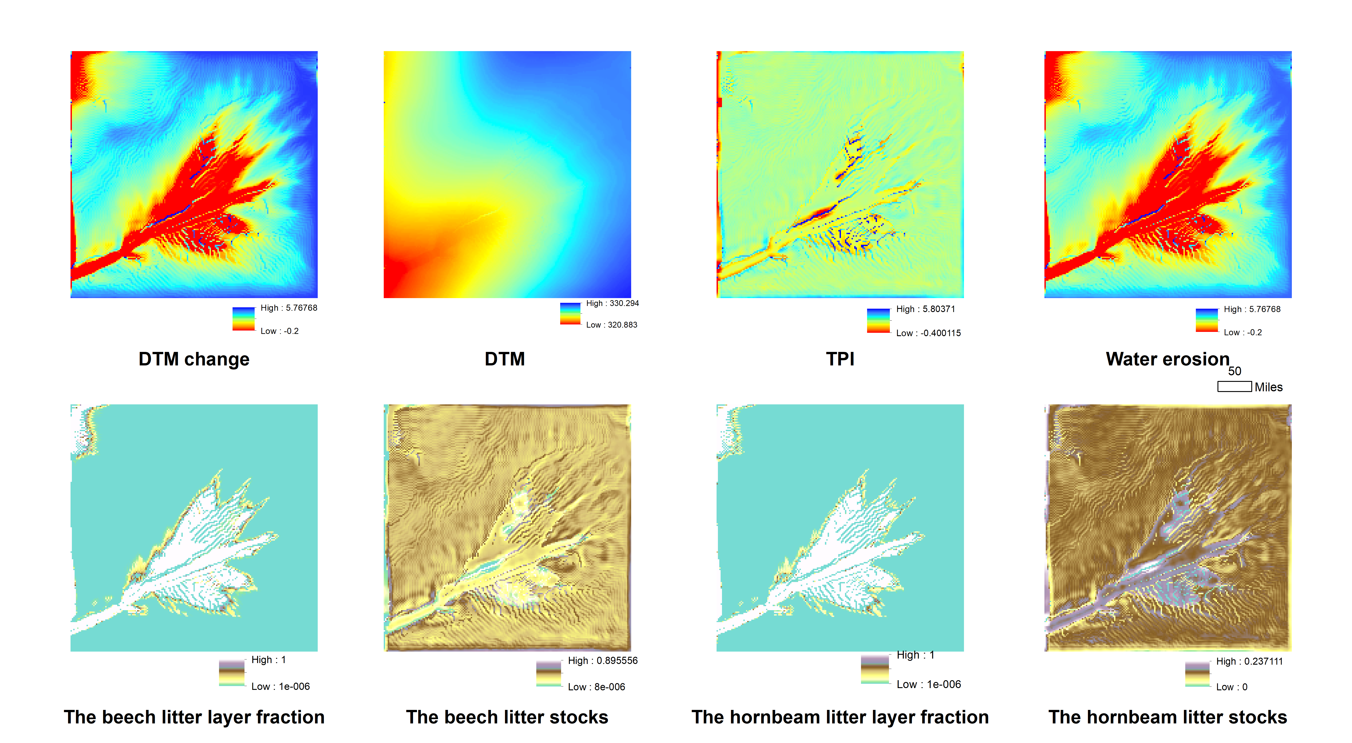
Results
Simulation time:4000 years scenario: water erosion and litter cycle input: smoothed original DEM

Slide 6
Thank you!

