Slide 1

Development of noise reduction method based on MSSA (Multi-channel Singular Spectrum Analysis) -Application to near field noise observed in Boso Peninsula, Japan-
EGU22-12240
Shu Kaneko¹, Toru Mogi², Chie Yoshino², and Katsumi Hattori^{2, 3, 4}
1. Graduate school of Science and Engineering, Chiba University Japan,
2. Graduate school of Science Chiba University, Japan,
3. Center for Environmental Remote Sensing, Chiba University, Japan,
4. Disaster Medicine Research Institute, Chiba University, Japan
2022/5/24 EGU2022

Slide 2
Abstract ①
The Boso Peninsula is one of the most tectonically active regions in Japan due to its location on a plate boundary. Focal zones of the past enormous earthquakes (1703 Genroku Kanto Earthquake (M8.2), the 1923 Taisho Kanto Earthquake (M7.9)) and slow slip events (SSE) region are located southwest and southeast of the peninsula, respectively. Therefore, it is important to survey the subsurface resistivity structure of these regions from a geophysical point of view. The magnetotelluric (MT) survey was conducted to clarify the resistivity structure from 2014 to 2016.
However, observed MT data was contaminated by artificial noise sources (e.g., leak current from DC-driven trains and power lines). Conventional noise reduction methods using remote reference (Gamble et al., 1979) and robust statistics such as BIRRP (Chave and Thomson. 2004) are inadequate to deal with the noise. The reason is that the noise included in Boso MT data is originated from a near field source and is coherent between the magnetic field and the electric field.

Slide 3
Abstract ②
Therefore, we propose a NEW method using MSSA(Multi-channel Singular Spectrum Analysis) to reduce the influence of the noise. MSSA can decompose multiple time series to several principal components (PCs). In our new method, choosing PCs based on the correlation between each component, they are discriminated into trend components, quasi-periodic components (=interested MT signal), and noise components. We applied MSSA to 7ch (5ch for observation site data (horizontal magnetic field, vertical magnetic field, and horizontal electric field) and 2ch for reference site data (horizontal magnetic field)) to extract 'clean' MT data from noisy Boso MT data. In this presentation, the results of time series and MT analysis applying this method will be presented.

Slide 4
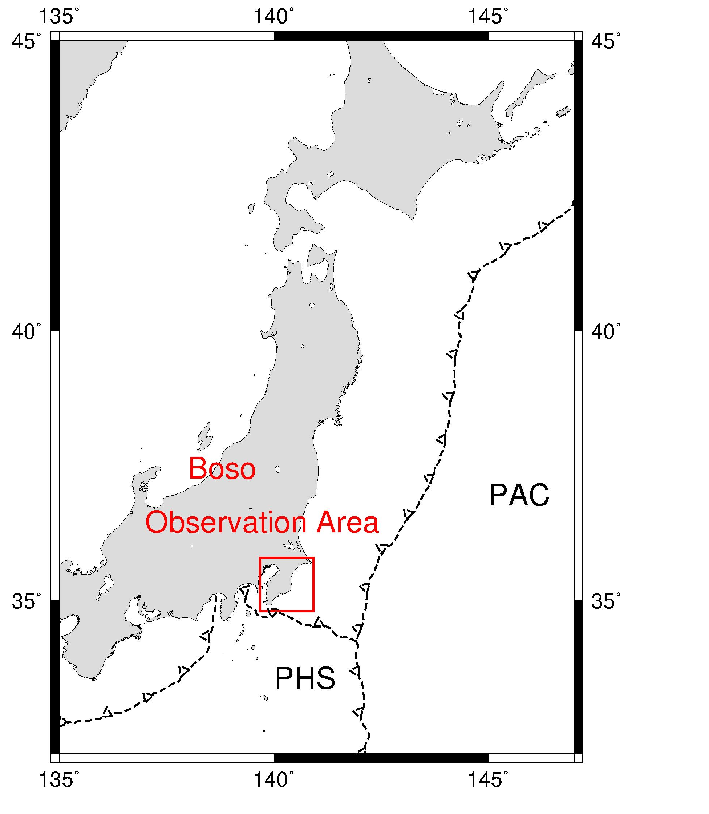
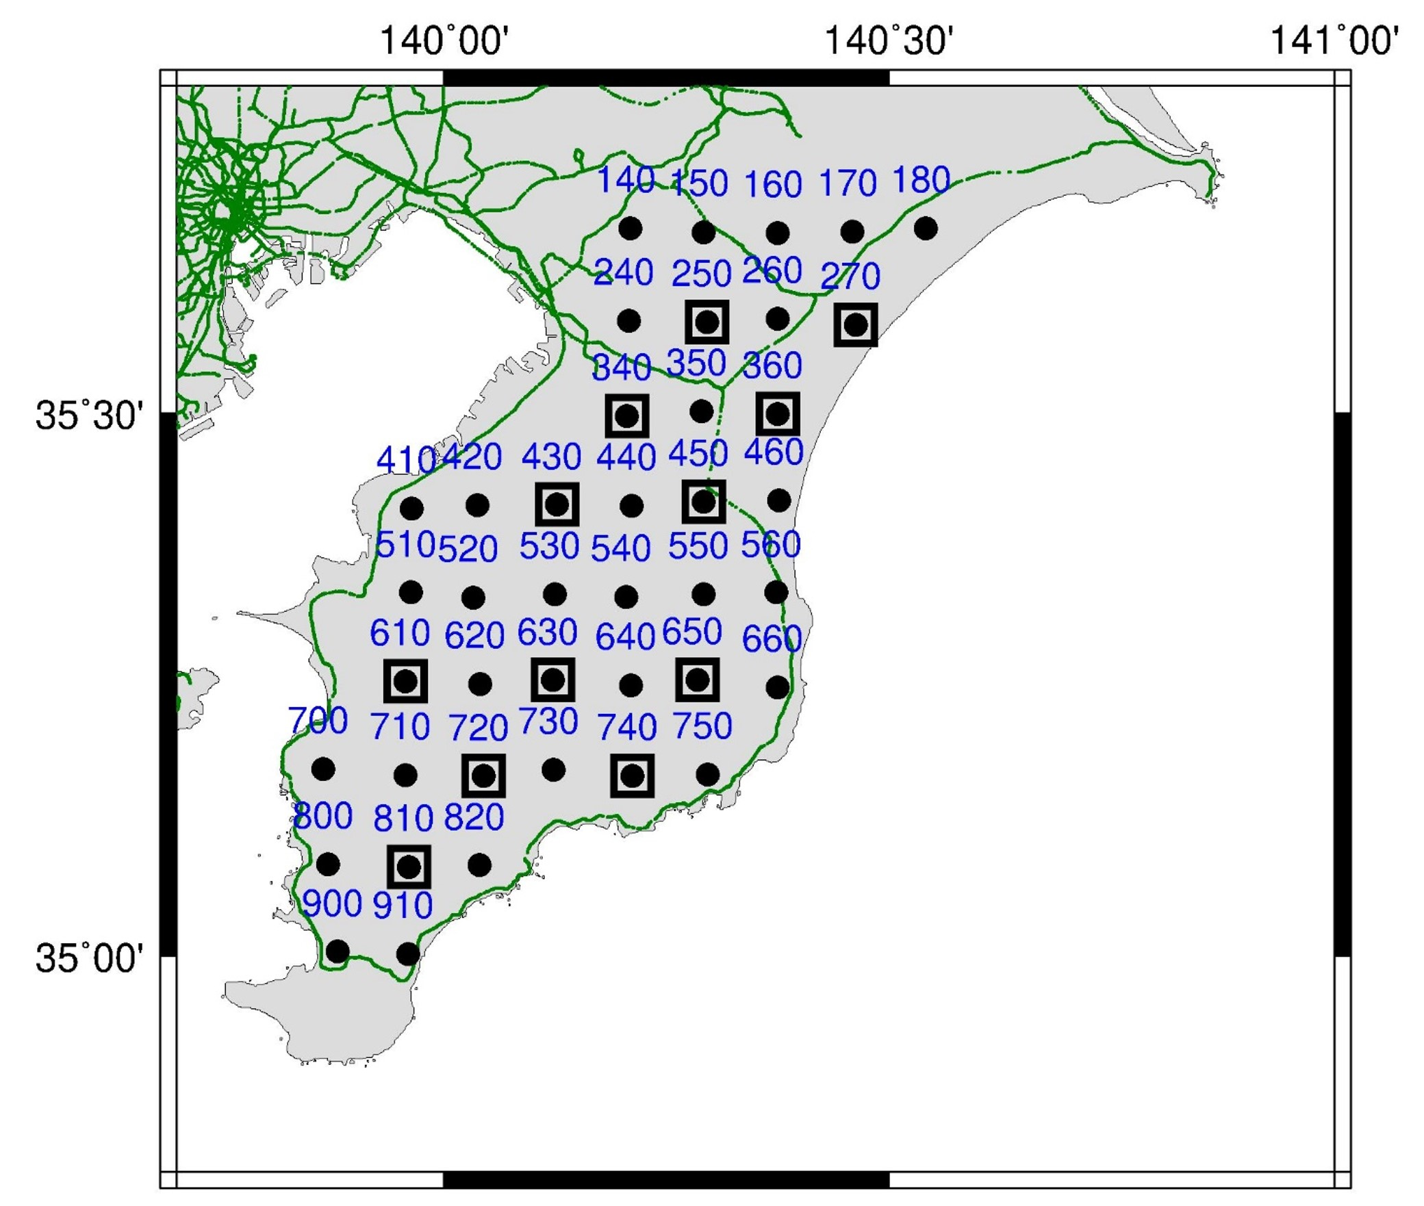
1.1 MT survey in Boso Peninsula, Japan
Purposes of the MT survey(2014-2016)
Subsurface resistivity structure
under the Boso peninsula
Especially
・Near the source region of earthquakes
・Slow Slip Events region（land part
The source region of Taisho Kanto earthquake, 1923
(Matsu’ura et al.,2007.)
Slow Slip Events region
e.g. Hirose et al.,2014
The source region of Genroku Kanto earthquake, 1703
(Sato et al.,2016.)
Triple junction of the plates
Figure 1. (a)
Map of Japan
Figure 1. (b) Map of Boso Peninsula
●：MTU site, 15, 150, 2400 Hz sampling
□：U43 site, 1 Hz sampling
：DC-electrified railways
Notes:
高圧送電線 面的に配置

Slide 5
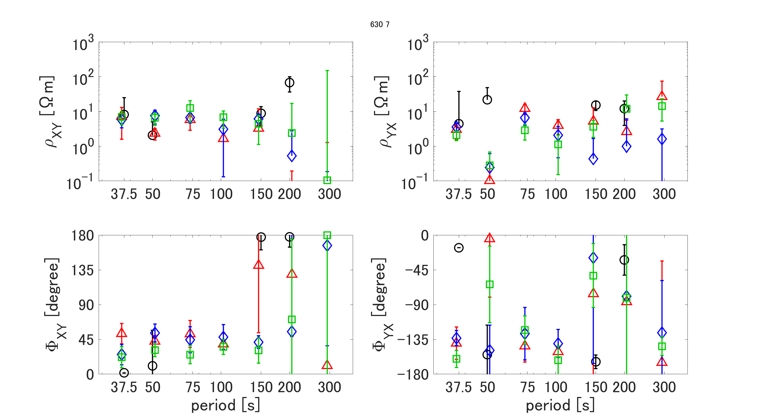
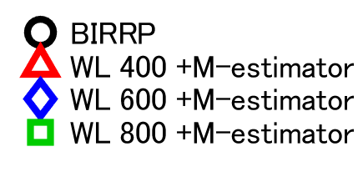
1.2 Previous noise reduction method using MSSA
Site 630 12-14（LT=UTC+9)
The response functions
scatter with WL
↓
The extraction of the MT signal is insufficient
Figure 2. An example of MT response function, Site 630, 12-14(LT). (a) and (b) are the apparent resistivities of Zxy and Zyx, respectively.(c) and (d) are the phases of Zxy and Zyx, respectively. The black circle is the BIRRP result. Red triangle, blue rhombus, and green rectangular are preprocessed by MSSA with WL 400, 600, and 800, then estimated by M-estimator, respectively.

Slide 6
1.2 Purpose of this study
Boso Peninsula
The influence of artificial noise sources
(e.g., leak current from DC-driven train and power line)
and
Conventional noise reduction method
・The process is based on the statistics in the frequency domain
-> Difficult to remove noise common to the E and H fields of the observation site
Development of an effective artificial noise reduction method
for the Boso Peninsula
Especially, improve noise reduction method using MSSA
to obtain more reliable MT signal

Slide 7
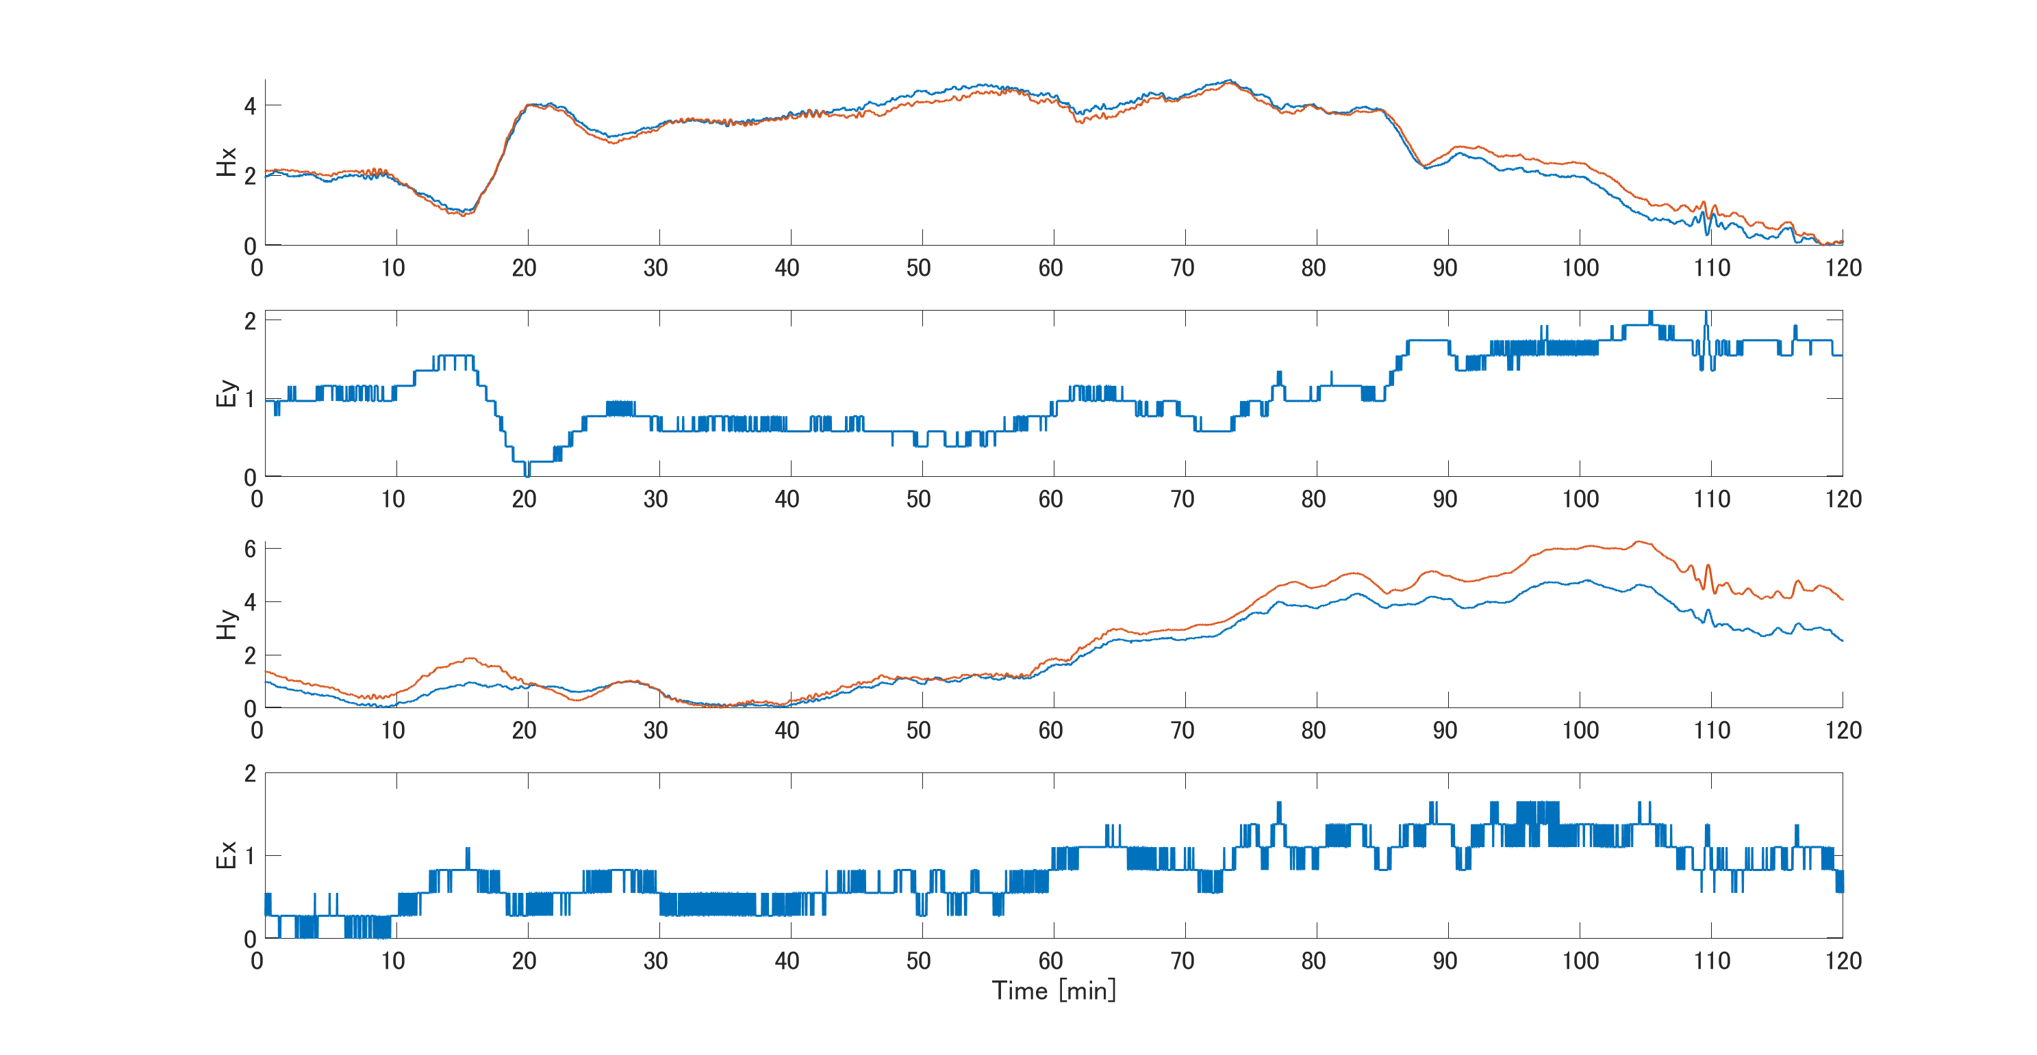
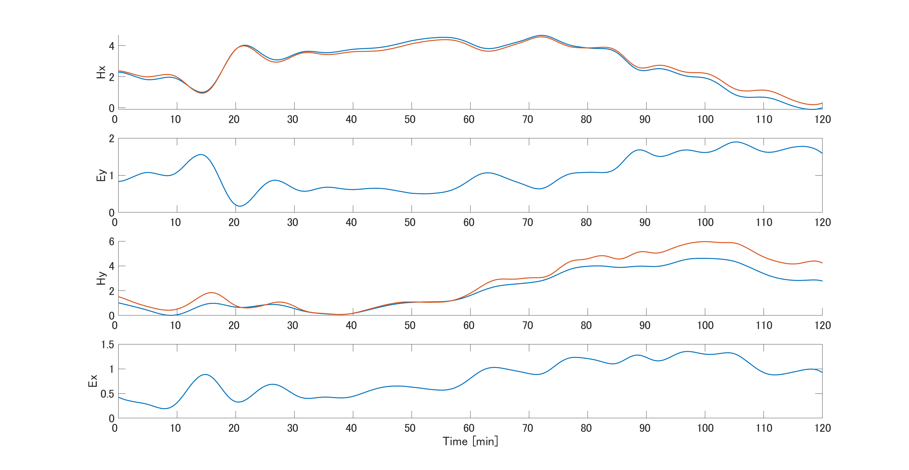
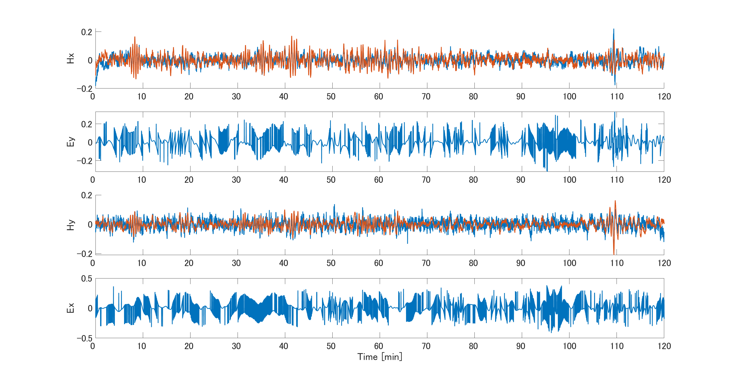
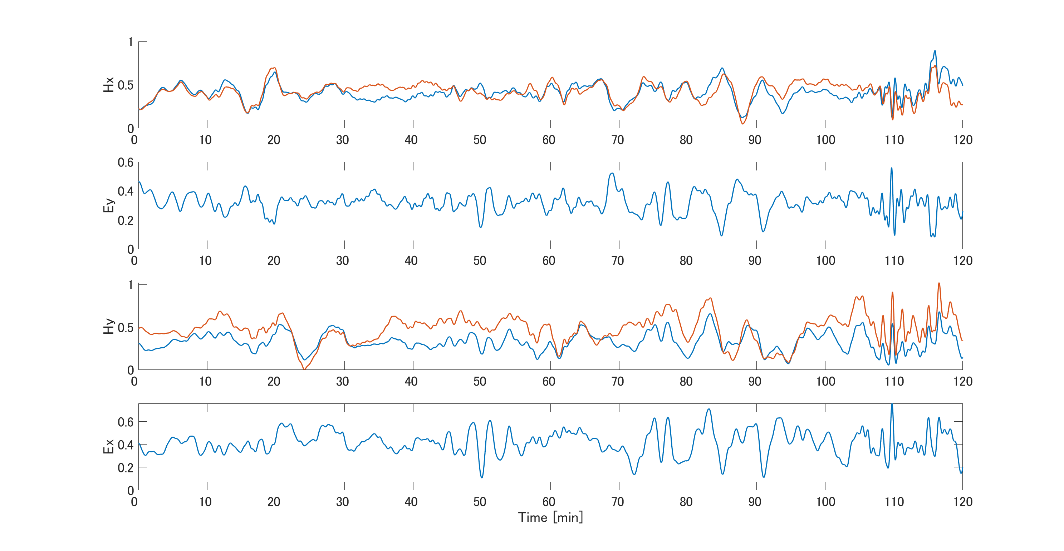
2.1 An overview of (Multi-channel Singular Spectrum Analysis: MSSA)
Advantages
・No model required
・No need to assume stationarity
Cautions
・Need appropriate data length (N),
・Need appropriate window length (WL)
・Need appropriate Grouping scheme
C channel
time series with data length N
Decompose with window length WL to Principal components(PCs)
Trend components
Noise components
Periodic component common to multiple channels
MSSA can decompose C channel time series with data length N to trend component, periodic component common to multiple channels, and noise component.

Slide 8
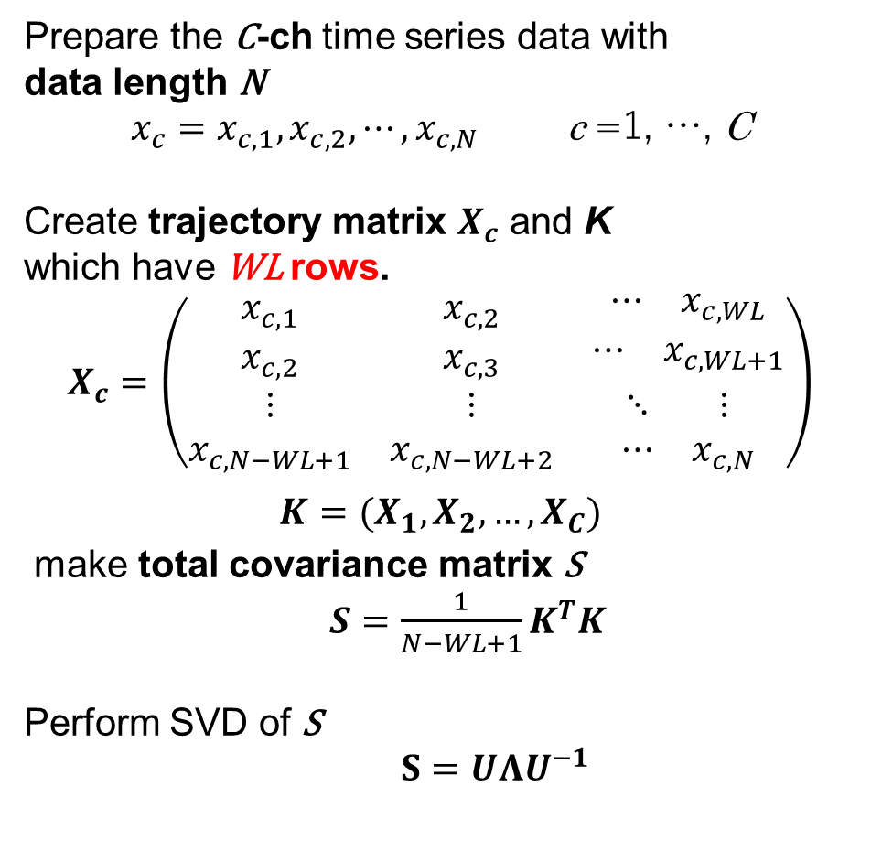
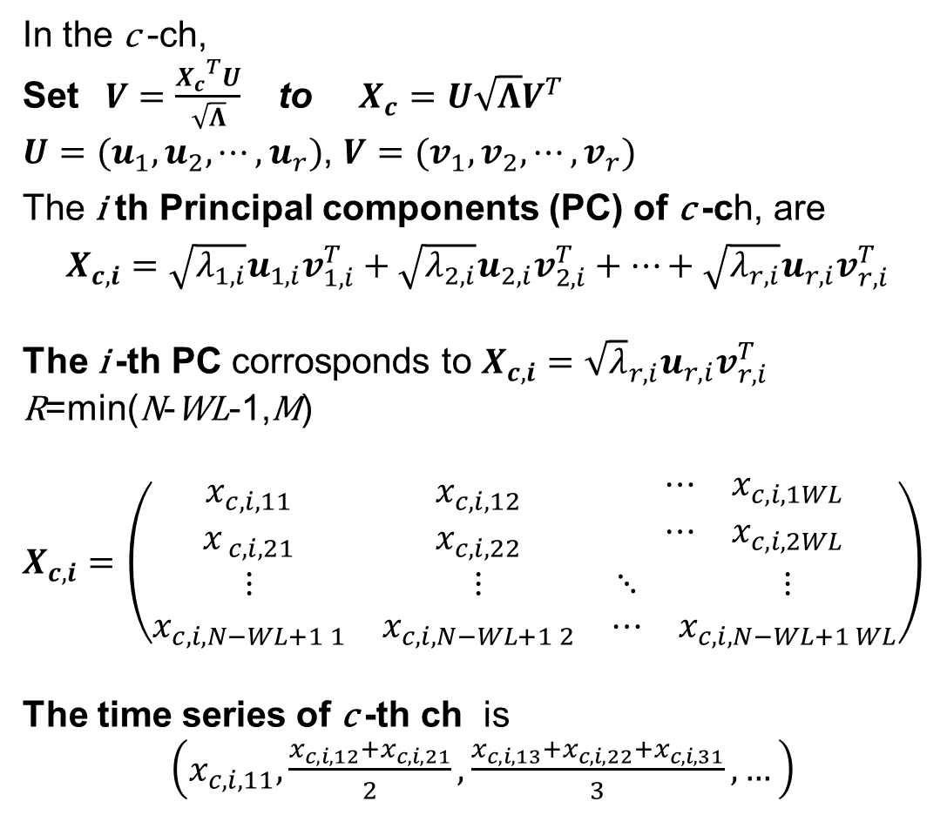
2.2 Multiple-channel Singular Spectrum Analysis: MSSA
Prepare the C-ch time series data with
data length N
$x_{c}=x_{c, 1}, x_{c, 2}, ⋯, x_{c, N}$ c =1, …, C
Create trajectory matrix $X_{c}$ and K
which have WL rows.
$$X_{c}=\left(\begin{matrix}x_{c, 1} & x_{c, 2} & \begin{matrix}⋯ & x_{c, WL}\end{matrix} \\ x_{c, 2} & x_{c, 3} & \begin{matrix}⋯ & x_{c, WL+1}\end{matrix} \\ \begin{matrix}⋮ \\ x_{c, N−WL+1}\end{matrix} & \begin{matrix}⋮ \\ x_{c, N−WL+2}\end{matrix} & \begin{matrix}⋱ & ⋮ \\ ⋯ & x_{c, N}\end{matrix}\end{matrix}\right)$$
$$K=(X_{1}, X_{2}, …, X_{C})$$
make total covariance matrix S
$S=\frac{1}{N−WL+1}K^{T}K$
Perform SVD of S
$S=UΛU^{−1}$
In the c -ch,
Set $V=\frac{{X_{c}}^{T}U}{\sqrt{Λ}}$ to $X_{c}=U\sqrt{Λ}V^{T}$
$U=(u_{1}, u_{2}, ⋯, u_{r})$, $V=(v_{1}, v_{2}, ⋯, v_{r})$
The i th Principal components (PC) of c -ch, are
$X_{c,i}={\sqrt{λ_{1,i}}u}_{1,i}v_{1,i}^{T}+\sqrt{λ_{2,i}}u_{2,i}v_{2,i}^{T}+⋯+\sqrt{λ_{r,i}}u_{r,i}v_{r,i}^{T}$
The i -th PC corrosponds to $X_{c, i}={\sqrt{λ}}_{r, i}u_{r, i}v_{r, i}^{T}$
R=min(N-WL-1,M)
$X_{c, i}=\left(\begin{matrix}x_{c, i, 11} & x_{c, i, 12} & \begin{matrix}⋯ & x_{c, i, 1WL}\end{matrix} \\ x_{ c, i, 21} & x_{c, i, 22} & \begin{matrix}⋯ & x_{c, i, 2WL}\end{matrix} \\ \begin{matrix}⋮ \\ x_{c, i, N−WL+1 1}\end{matrix} & \begin{matrix}⋮ \\ x_{c, i, N−WL+1 2}\end{matrix} & \begin{matrix}⋱ & ⋮ \\ ⋯ & x_{c, i, N−WL+1 WL}\end{matrix}\end{matrix}\right)$
The time series of c -th ch is
$\left(x_{c, i, 11}, \frac{x_{c, i, 12}+x_{c, i, 21}}{2}, \frac{x_{c, i, 13}+x_{c, i, 22}+x_{c, i, 31}}{3}, …\right)$
Notes:
次に特異スペクトル解析について説明します.

Slide 9
2.2 The scheme of noise reduction method using MSSA
Previous
H：magnetic field
E：electric field
Hr：reference magnetic field
x, y, and z：
North-South, East-West, and Vertical downward
Observed time series Hx, Hy, Hz, Ex, Ey, Hxr, and Hyr
1. MSSA with 7ch
Longer period signal
Shorter period signal
Detrended time series
Trend time series
Hx, Hy, Hxr, and Hyr
Hz, Ex, and Ey
In previous our noise reduction method using MSSA, the method has 2 MSSA.
One decomposes a longer signal and a shorter signal (= interesting period).
Another is to discriminate between MT signal and noise.
2. MSSA with 7ch
MT signal time series
MT analysis（M-estimator, Chave et al., 1987）

Slide 10
2.2 The scheme of noise reduction method using MSSA
New
H：magnetic field
E：electric field
Hr：reference magnetic field
x, y, and z：
North-South, East-West, and Vertical downward
Observed time series Hx, Hy, Hz, Ex, Ey, Hxr, and Hyr
1. MSSA with 7ch
Longer period signal
Shorter period signal
Detrended time series
Trend time series
Introduced to estimate reliable common magnetic field
Hx, Hy, Hxr, and Hyr
Hz, Ex, and Ey
2. MSSA with 4ch
However, in the previous method,
Signal discrimination is insufficient because of correlated noise in observed data.
To solve this problem, we introduced MSSA for magnetic field H after the first MSSA.
3. MSSA with 7ch
MT signal time series
MT analysis（M-estimator, Chave et al., 1987）

Slide 11
2.3 The guideline of grouping for PCs decomposed by MSSA
・MSSA② 4ch Create a common magnetic field
Add the principal components(PCs) with high eigenvalues and high correlation coefficients between the observed and reference magnetic fields.
・MSSA③ 7ch Estimate MT signal
Add the PCs with high eigenvalues and a high correlation between the reference magnetic field and the observed electric and vertical magnetic fields.
Notes:
固有値 >1

Slide 12
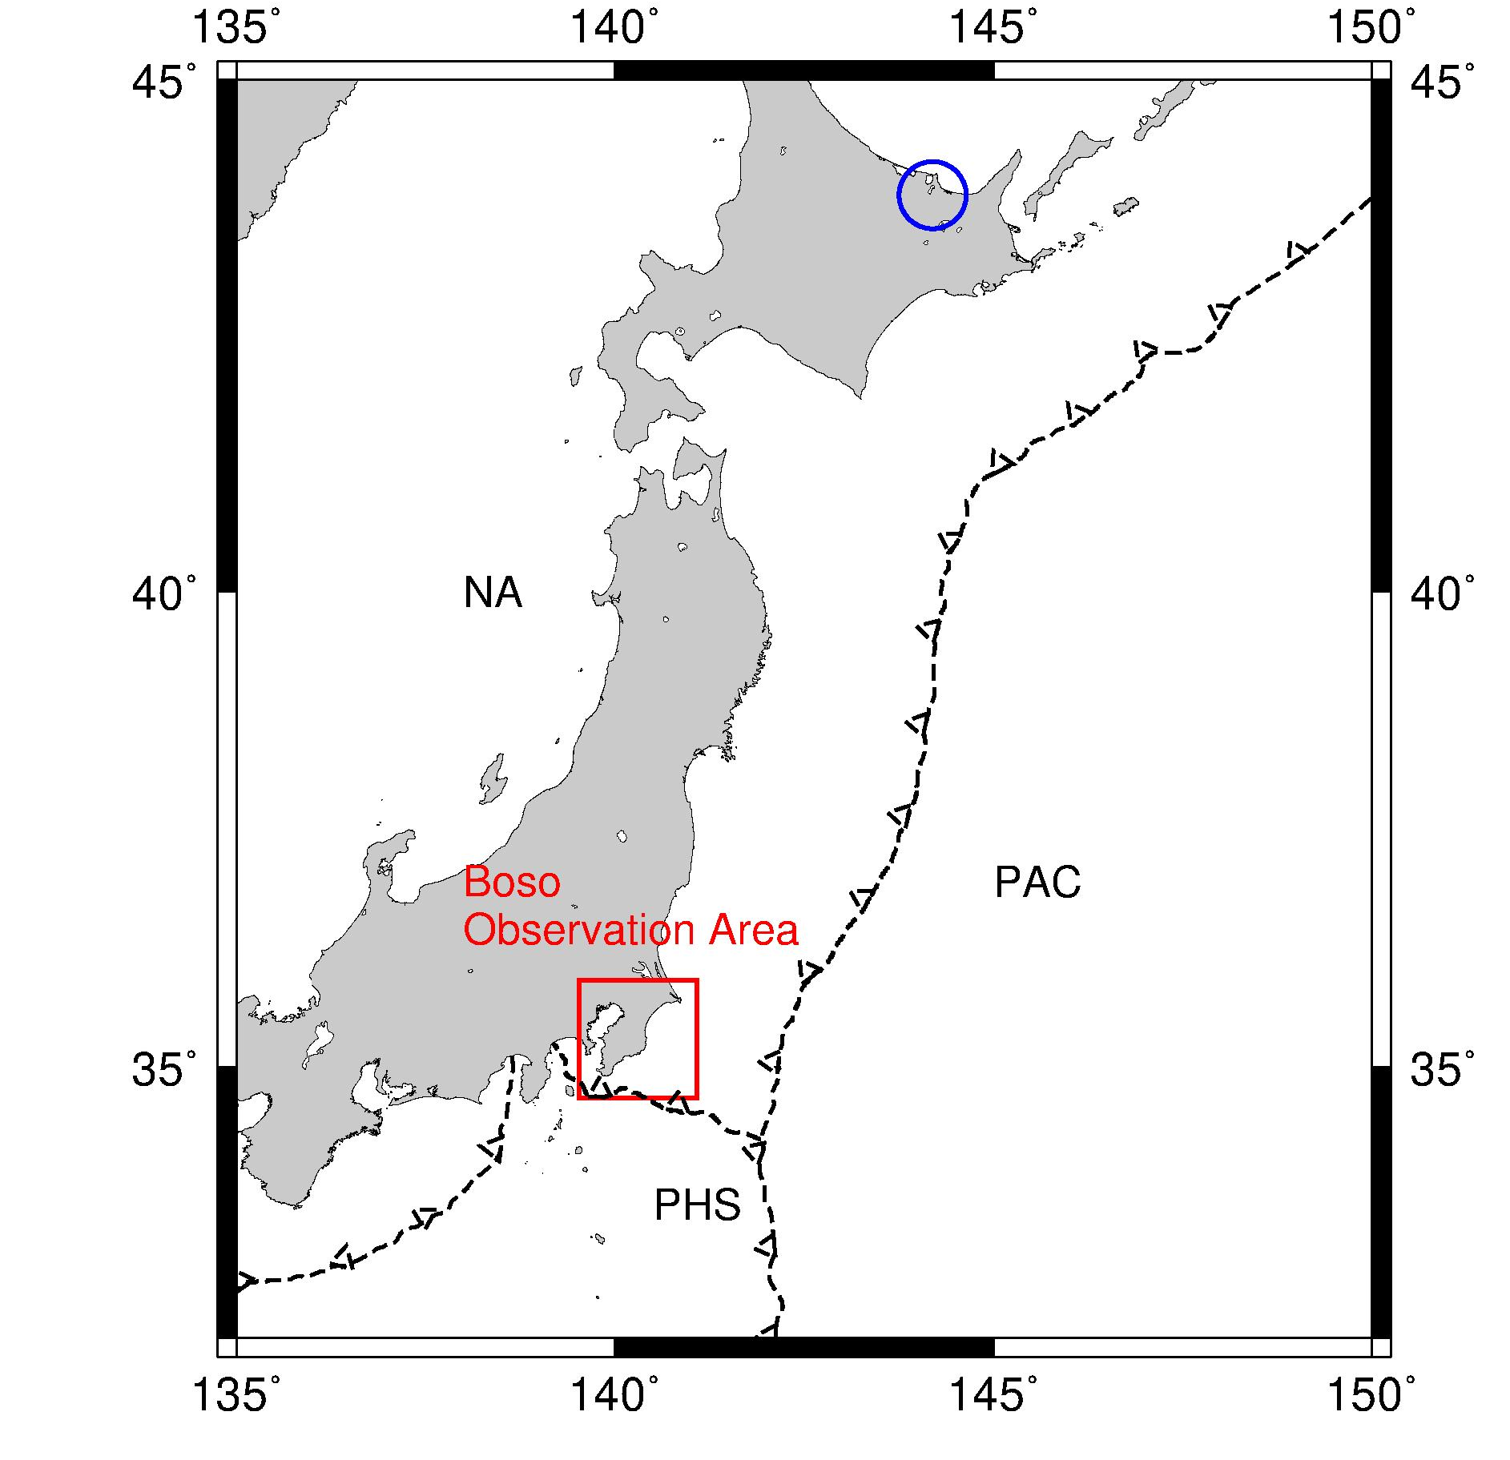
3. Data
Site | Date
630 | 2015/12/21 – 2016/1/26
720 | 2015/12/23 - 2016/1/19
・Time：2-4 (LT, nighttime), 12-14 (LT, daytime)
(Data length N = 7200)
・Window length (WL ) : 400, 600, 800
・Instrument ：U43 (Tierra Technica co., fluxgate magnetometer, 1 sec sampling
・Reference：Mamanbetsu (MMB) observatory of JMA, Shimazu co., fluxgate magnetometer 1 sec sampling
630
Spike noise in nighttime
Correlated rectangular noise in daytime
MMB
720
Quiet in the nighttime
Boso
●：MTU site,
15, 150, 2400 Hz sampling
□：U43 site, 1 Hz sampling
：DC-electrified railways

Slide 13
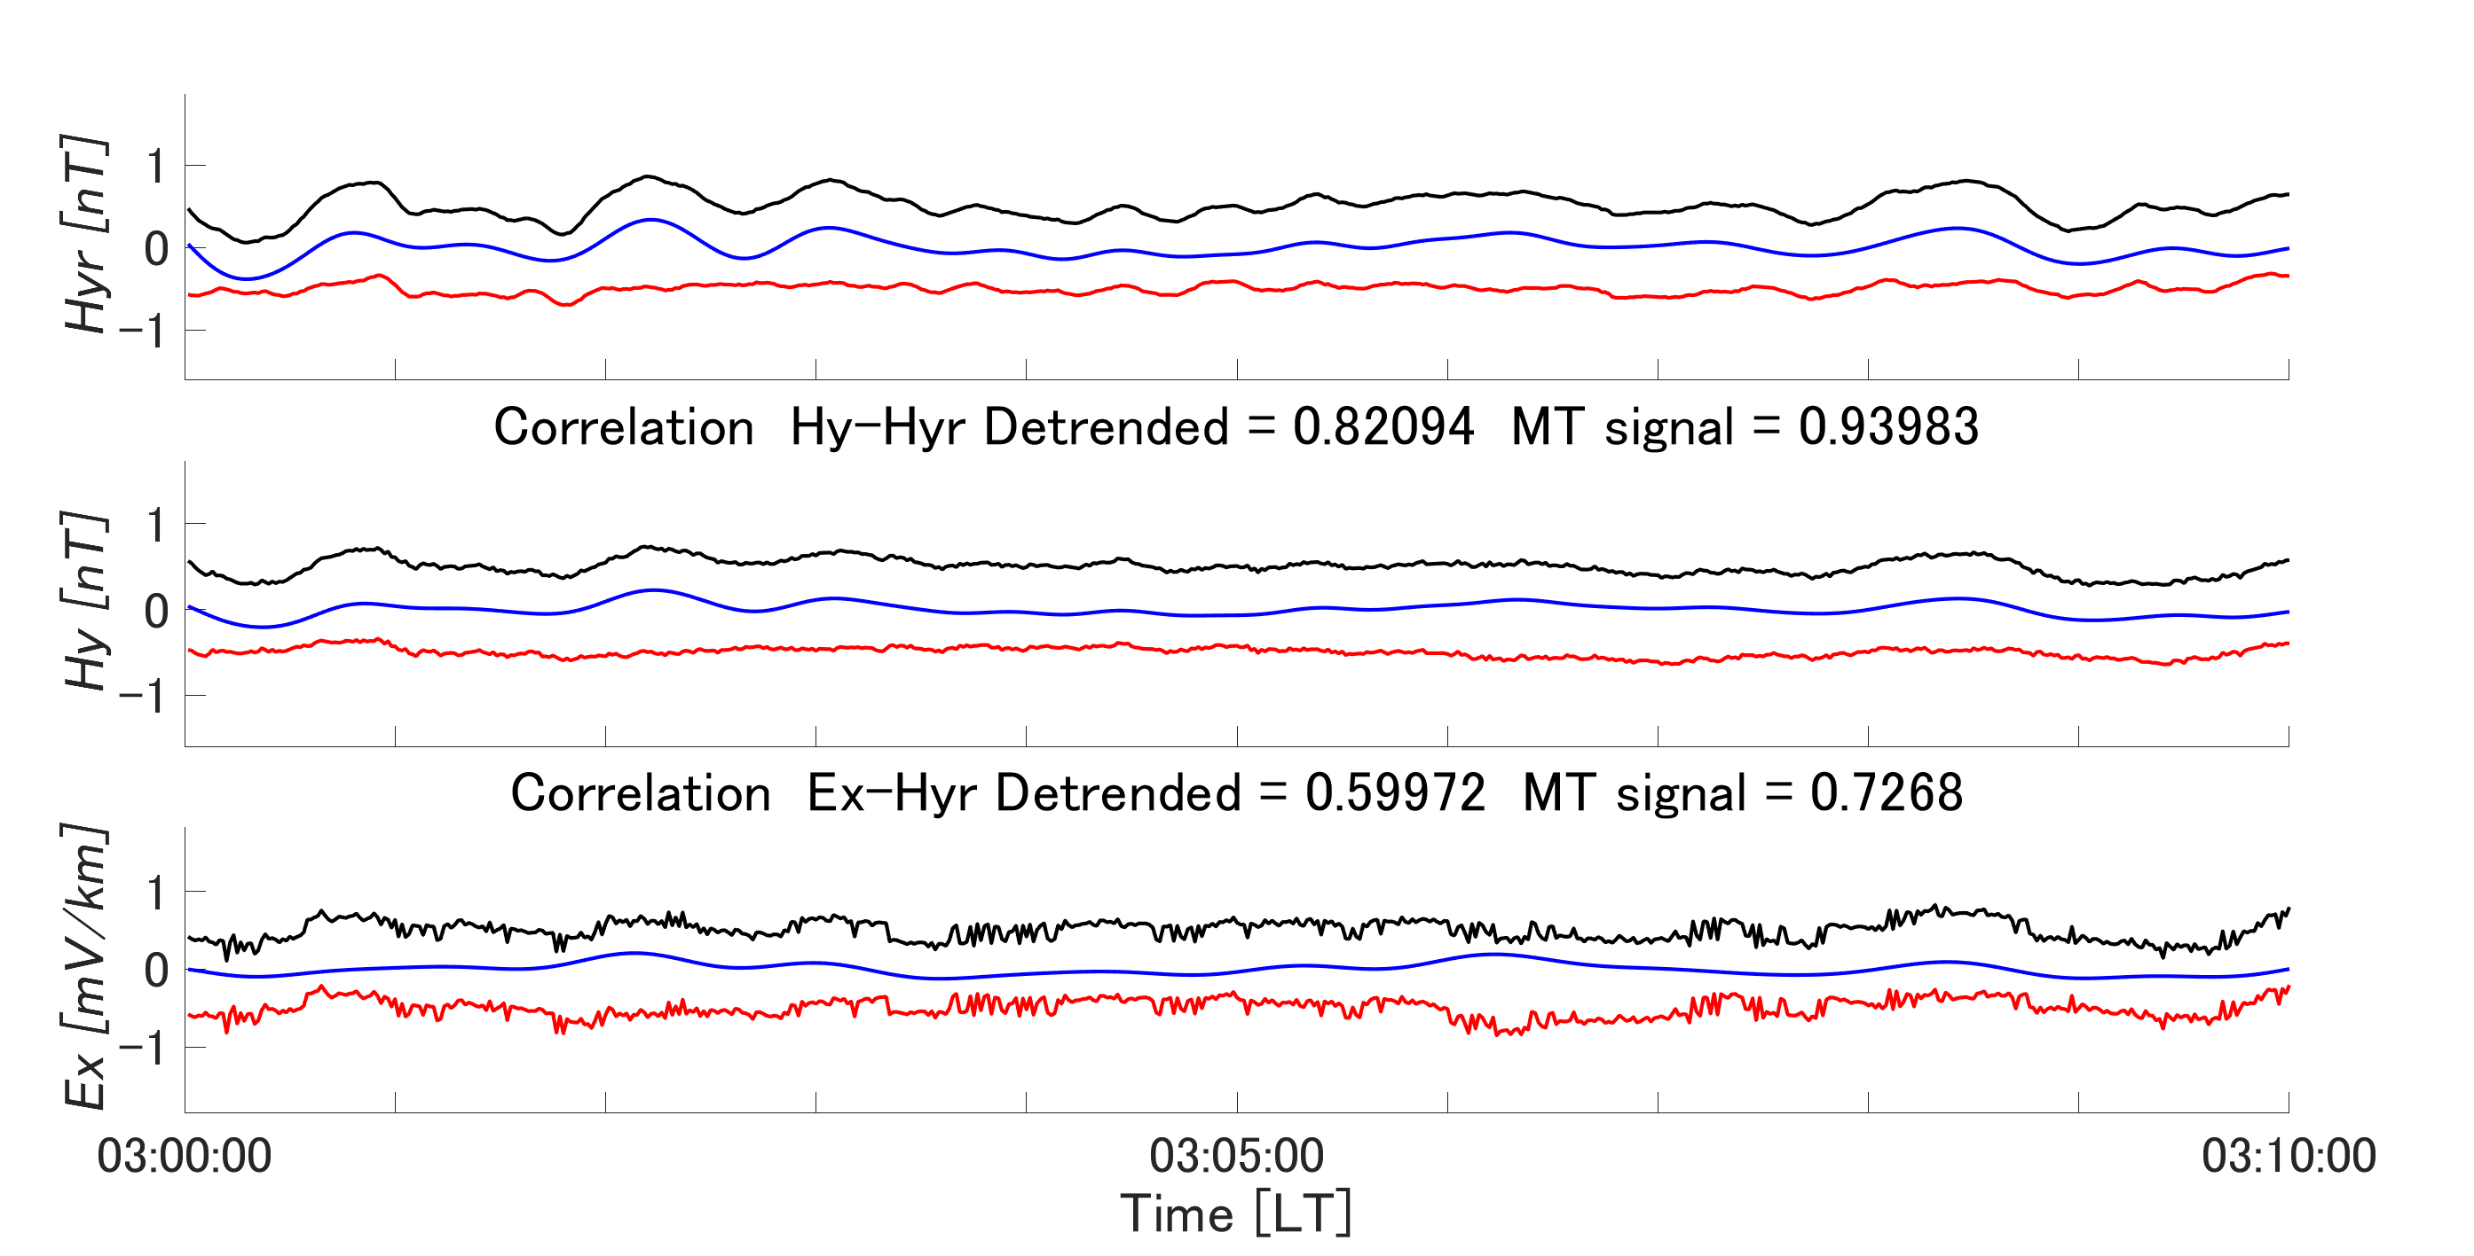
4. An example of estimated MT signal (24/Dec/2015) WL=800 site 720 LT 03:00~03:10
Detrended time series
MT signal
Noise
(a)
(b)
(c)
Figure 2. An example of applying this method at WL=800 to low-noise observed data (Site 720, 12/24/2015, 03:00-03:10 (LT)). (a),(b),(c) are reference magnetic field Hyr (nT), the Boso magnetic field Hy (nT), and the Boso electric field Ex (mV/km). The black, blue, and red lines are detrended time series, MT signal estimated by the improved method, and noise signal. The blue lines for each component indicate similar variations in each component. As a result, the correlations between Hy and Hyr and Ex and Hyr are improved. For data with low noise, the common signal (i.e., MT signal) can be estimated by this method.

Slide 14
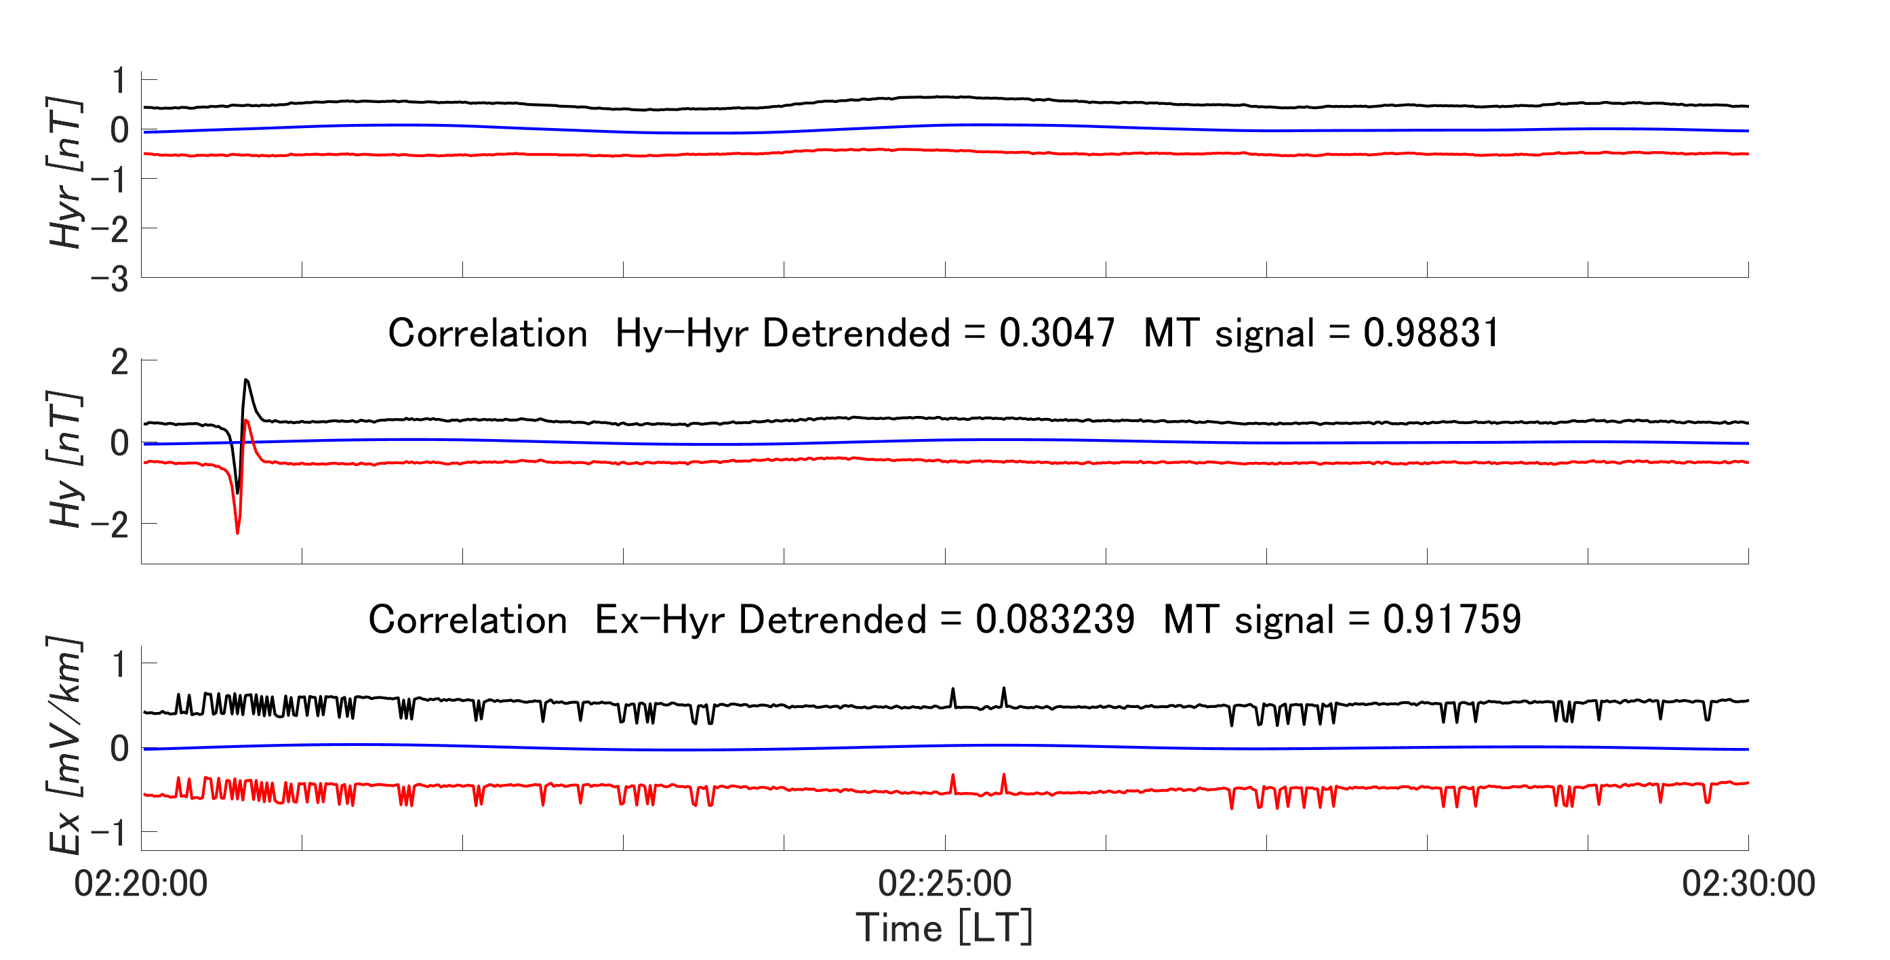
4. An example of estimated MT signal (2/Jan/2016) WL=800 site 630 LT 02:00~02:10
Detrended time series
MT signal
Noise
(a)
(b)
2.78 nT
(c)
Figure 3. An example of applying this method at WL=800 to data with spike noise in H, Site 630, 02:00-02:10, 1/2/2016 (LT). (a),(b),(c) show the reference magnetic field Hyr (nT), the Boso magnetic field Hy (nT), and the Boso electric field Ex (mV/km). The black, blue, and red lines represent the detrended time series, the MT signal estimated with the present method, and the noise signal. The blue line of Hy shows that the spike noise in Hy has been removed by this method. As a result, the correlation between Hy and Hyr and between Ex and Hyr is improved. In other words, this method can remove the effect of spike noise.
Notes:
About 1 nT

Slide 15
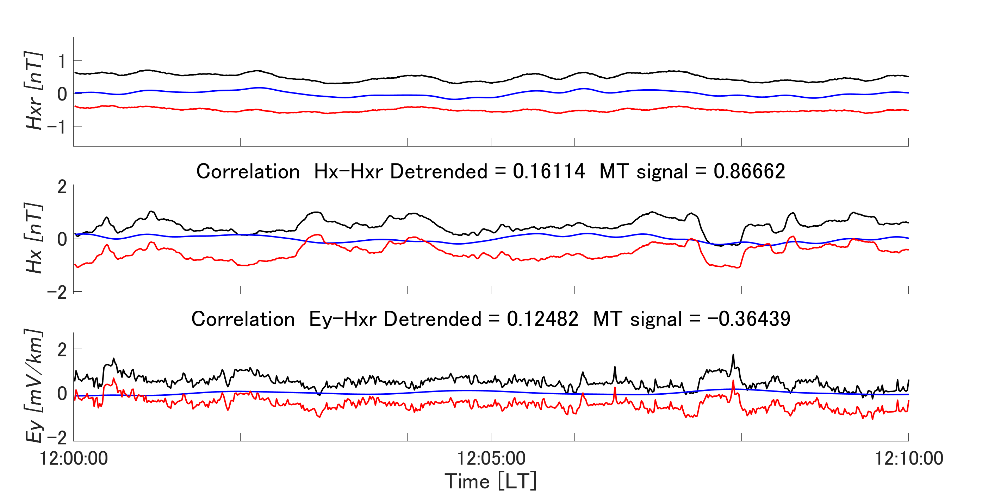
4. An example of estimated MT signal (4/Jan/2016) WL=800 site 630 LT 12:00~12:10
Detrended time series
MT signal
Noise
(a)
(b)
0.98 nT
(c)
1.0 mV/km
Figure 4. An example of applying this method at WL=800 to data containing rectangular noise correlated to H and E, Site 630, 1/4/2016, 12:00-12:10 (LT). (a),(b),(c) is the reference magnetic field Hxr (nT), the Boso magnetic field Hx (nT), and the Boso electric field Ey (mV/km). The black, blue, and red lines are the detrended time series and the MT and noise signals estimated by this method. The blue lines for Hx and Ey indicate that the correlated noise in the black lines for Hx and Ey has been removed by this method. It also shows that the correlation between Hx and Hxr and the correlation between Ey and Hxr are improved. In other words, this method can also remove the effect of correlated rectangular noise.
Notes:
About 1 nT

Slide 16
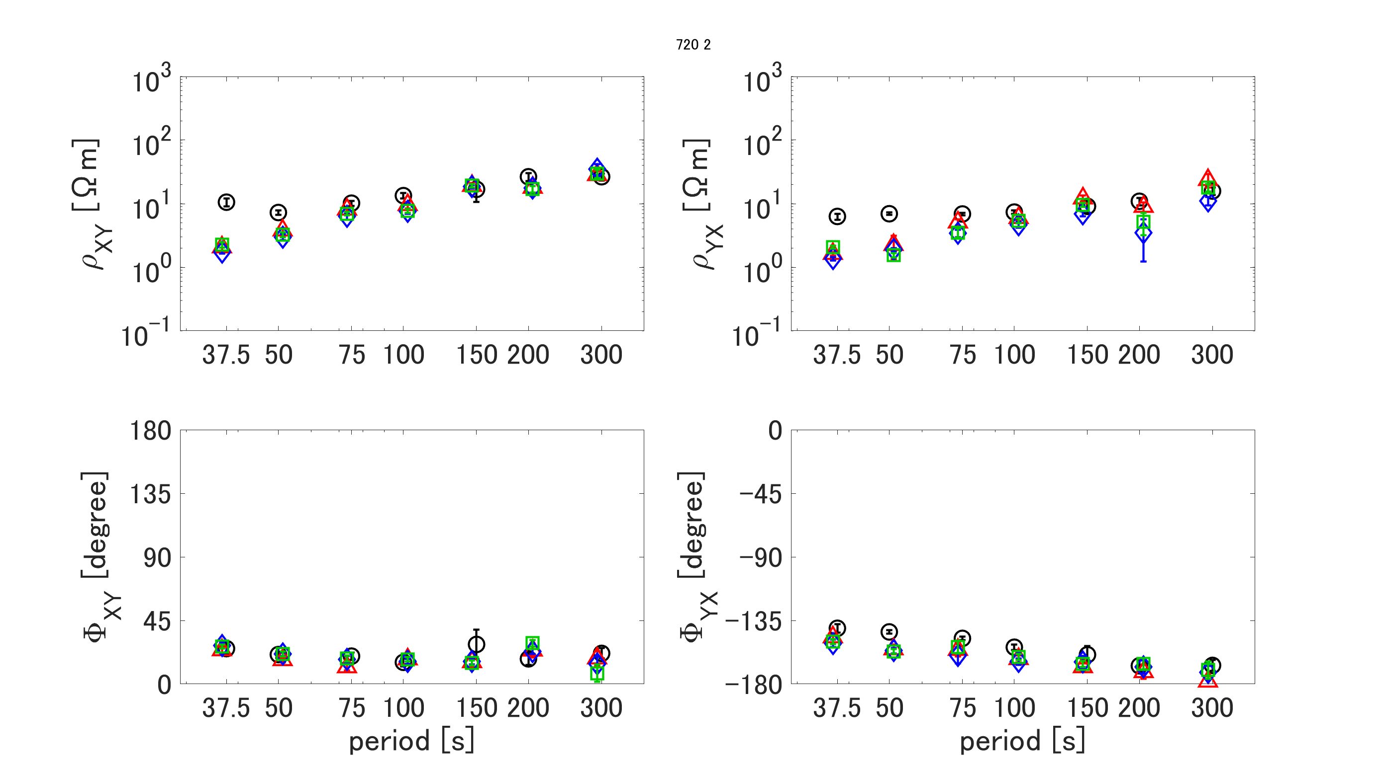
5. An example of MT response function, Site 720 (low noise)
(a)
(b)
Apparent resistivity
(c)
(d)
Phase
Figure 5. An example of MT response function, Site 720, 2-4 (LT) (Low noise data set). (a) and (b) are apparent resistivity of Zxy and Zyx, respectively. (c) and (d) are phases of Zxy and Zyx, respectively. The black circle is the BIRRP result. The red triangle, blue rhombus, and green rectangle are preprocessed by MSSA with WL 400, 600, and 800, then estimated by M-estimator, respectively. In the results, all curves are smoothly estimated by this method, and the difference based on the WL is slight. It shows that if the noise is less in the data, the difference in each WL’s MT response function is almost identical.
Notes:
0.001%

Slide 17
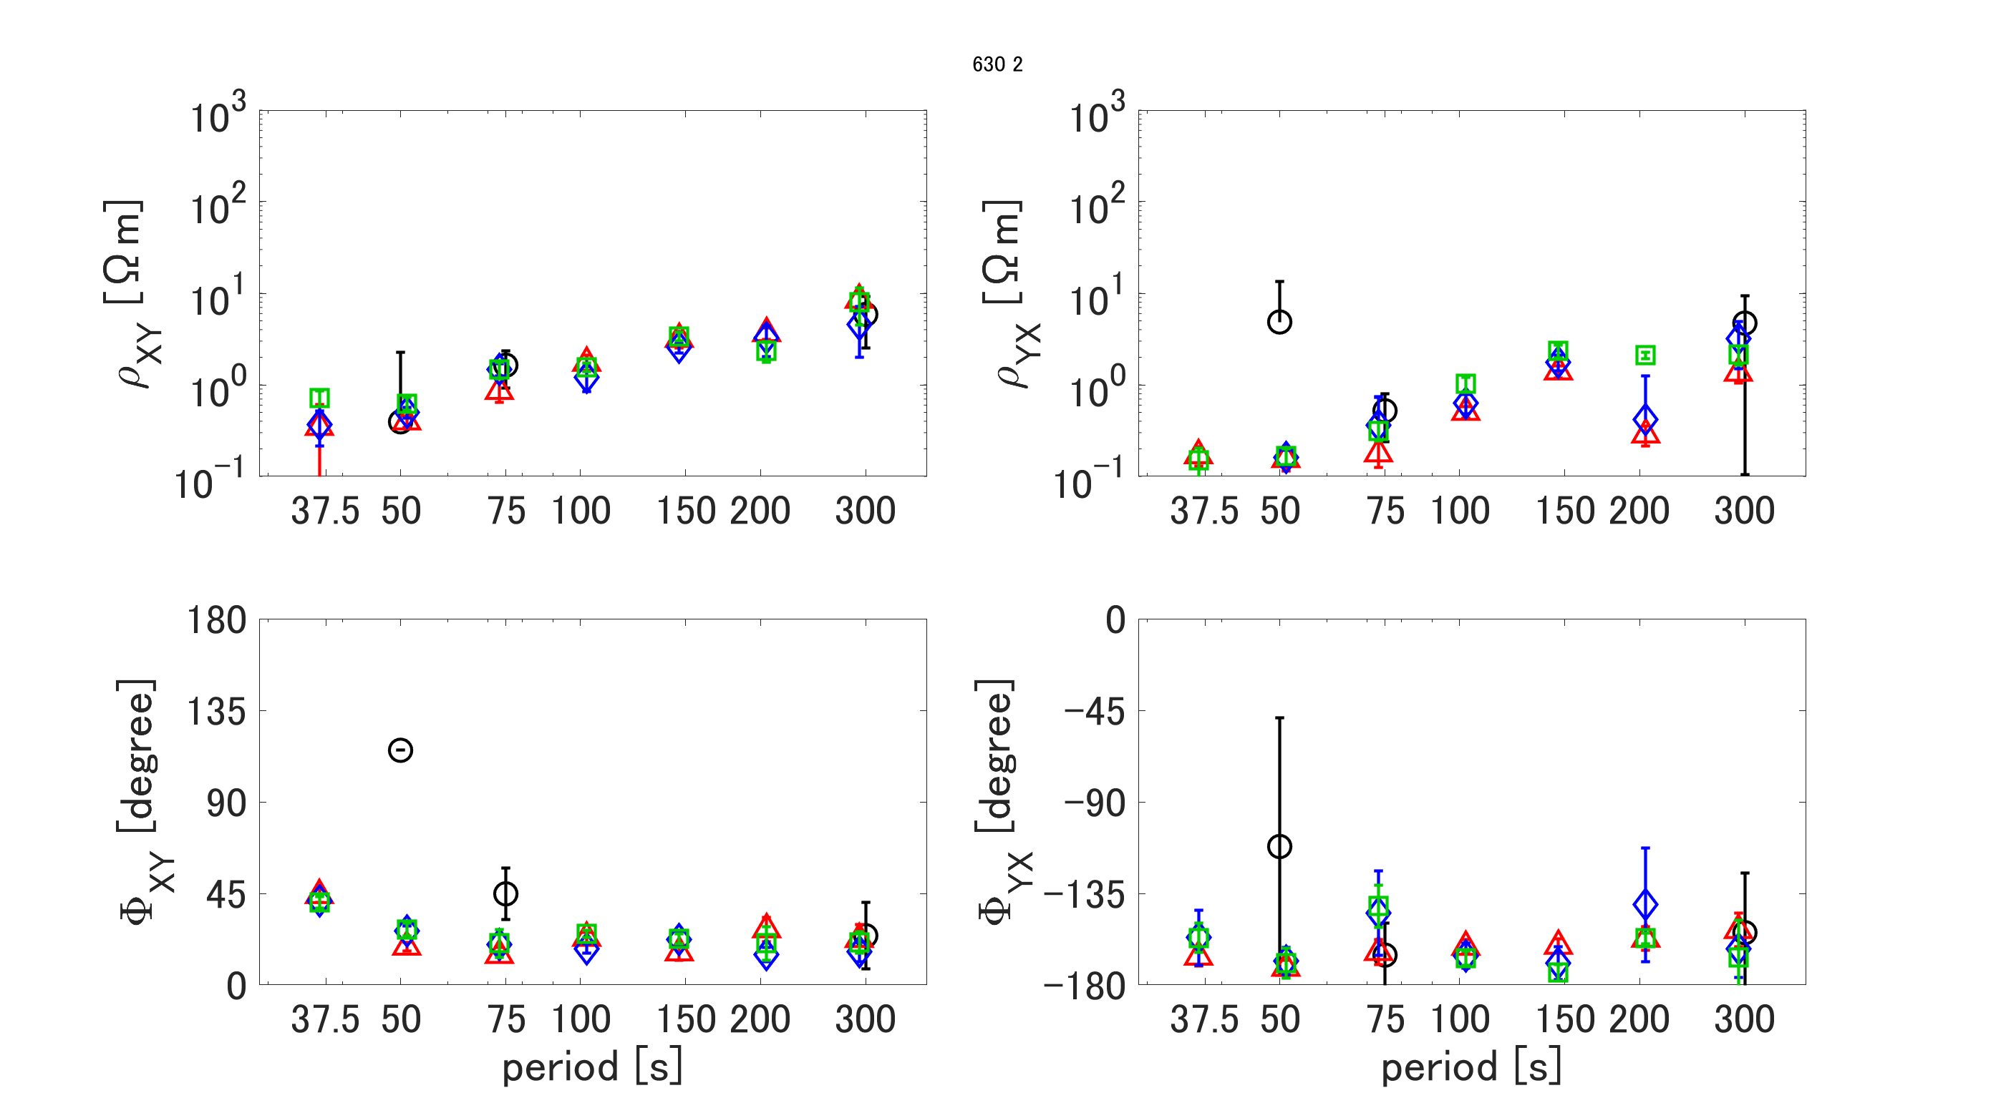
5. An example of MT response function, Site 630 nighttime (spike noise included)
(a)
(b)
Apparent resistivity
(c)
(d)
Phase
Figure 6. An example of MT response function, site 630, 2-4 (LT). (a) and (b) are apparent resistivity. (c) and (d) are the phases of Zxy and Zyx, respectively. Black circles are the result of BIRRP. The red triangles, blue diamonds, and green squares were preprocessed by MSSA at WL400, 600, and 800, respectively, and estimated by M-estimator. The results show that all curves are estimated smoothly by this method, and the difference based on WL is slight. It indicates that this method can improve time series containing correlated rectangular noise and estimate MT response functions with periods that cannot be estimated even by BIRRP.
Notes:
0.001%

Slide 18
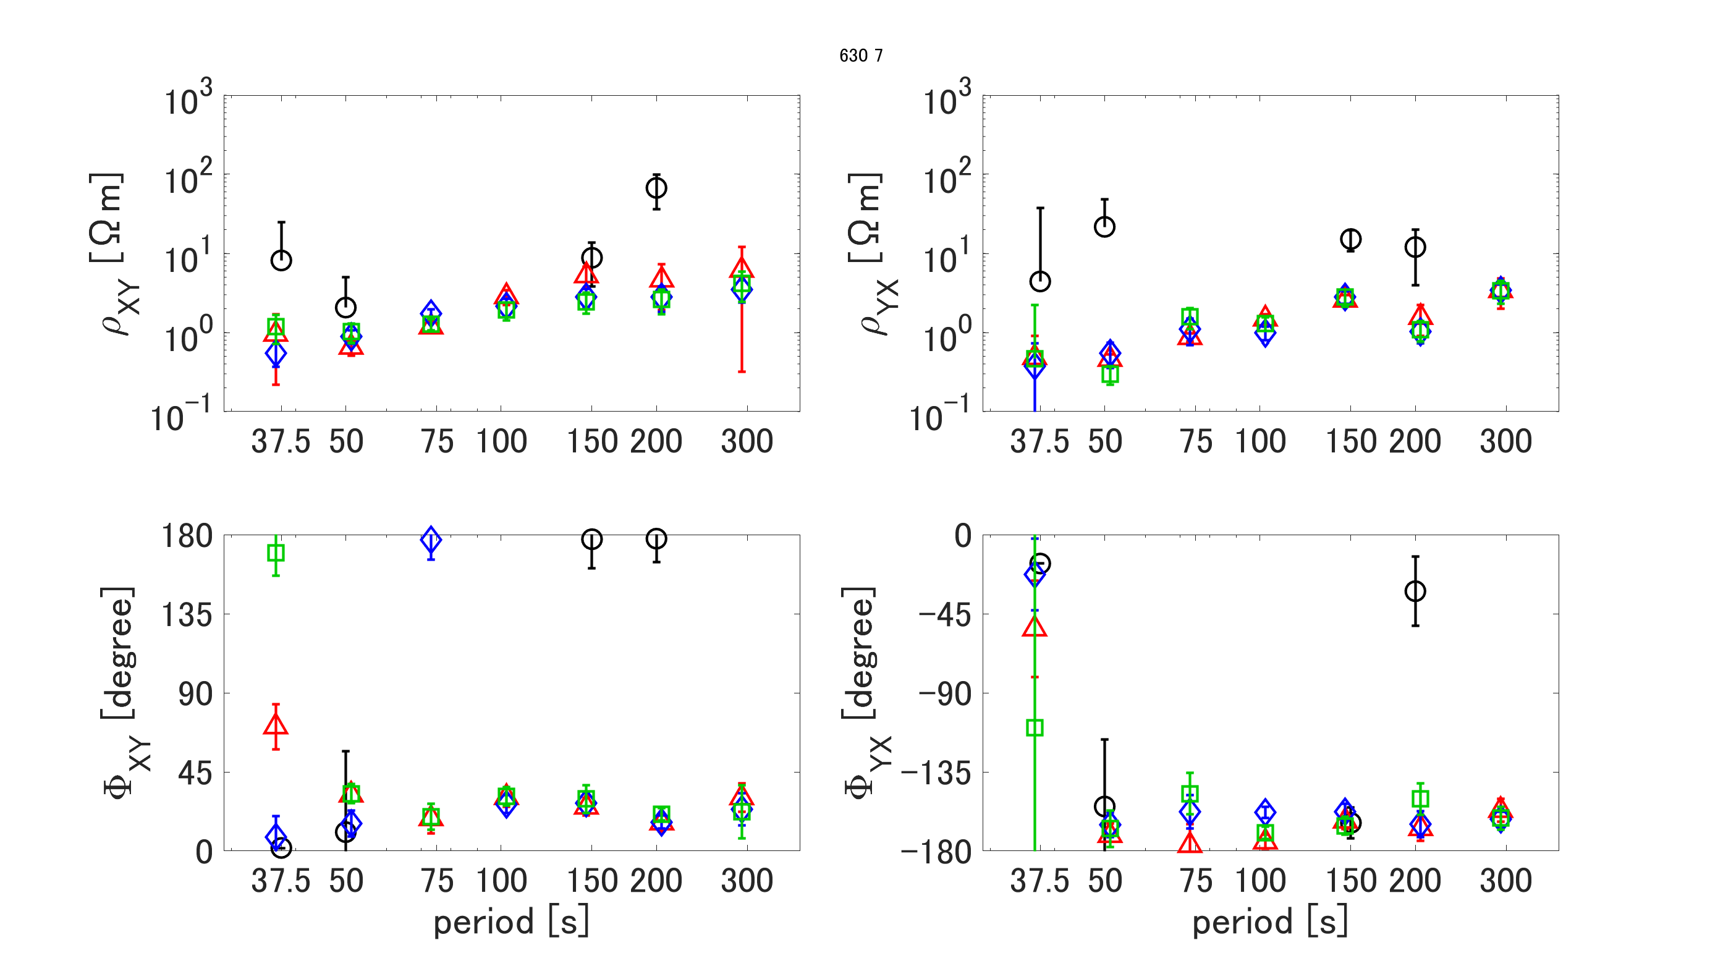
5. An example of MT response function, Site 630 daytime (correlated noise included)
(a)
(b)
Apparent resistivity
(c)
(d)
Phase
Figure 7. An example of MT response function, Site 630, 12-14 (LT). (a) and (b) are apparent resistivity of Zxy and Zyx, respectively. (c) and (d) are the phase of Zxy and Zyx, respectively. The black circle is the BIRRP result. The red triangle, blue rhombus, and green rectangle are preprocessed by MSSA with WL 400, 600, and 800, then estimated by M-estimator, respectively. In the results, all curves are smoothly estimated by this method, and the difference based on the WL is slight. It shows that this method, in particular, 4ch MSSA processing, can improve the time series, which contains correlated rectangular noise, then can estimate MT response function even BIRRP can not, range from period 75 ~ 300 seconds.
Notes:
0.001%

Slide 19
5. An example of MT response function Zyx Site 630
Previous method
(2 times MSSA)
New method
(3 times MSSA to obtain reliable common H)
(a)
Daytime（12～14（LT) ）
(b)
(c)
Nighttime（2～4（LT) ）
Daytime（12～14（LT) ）
Apparent resistivity
(d)
(e)
(f)
Phase
Figure 8. A comparison of MT response function, Site 630. (a) and (d) are apparent resistivity and phase of Zyx estimated by the previous method for daytime data, respectively. (b) and (e) is the apparent resistivity and phase of Zyx estimated by a new method for nighttime data, respectively. (c) and (f) is the apparent resistivity and phase of Zyx estimated by a new method for daytime data, respectively. The black circle is the BIRRP result. The red triangle, blue rhombus, and green rectangle are preprocessed by MSSA with WL 400, 600, and 800, then estimated by M-estimator, respectively. In the results, all curves processed by the new method are smoothly estimated, and the difference based on the WL of the curves is slight. It shows that this method, in particular, 4ch MSSA processing, can improve the time series, even if the data contains correlated rectangular noise. Then the new method can estimate MT response function even BIRRP can not, ranging from period 75 to 300 seconds.
Notes:
0.001%

Slide 20
5. Conclusion
We are developing a noise reduction method to extract MT signals from MT data that contains correlated noise.
After removing long-period signals from the time series decomposed by MSSA, MSSA with 4ch (Hx, Hy, Hxr, and Hyr) was introduced to extract a common (=global) magnetic field.
This method can remove the correlated noise, even if correlated noise have 1 nT for the magnetic field and 1 mV/km for the electric field.
The MT response function was estimated by M-estimator for the time series after removing the noise using this method. The results showed that the MT response curves were almost the same for nighttime (2-4 (LT)) and daytime (12-14 (LT)), with periods ranging from 75 to 300 seconds.
The variation of the MT response function between WL s was also smaller even if the original data contained the correlated noise.
In other words, this improved method can extract MT signals and is effective as an artificial noise reduction method for Boso MT data.

