Slide 1




The value of complementary data for physically consistent hydrological models in mountain regions
Paul Schattan, Benjamin Winter, Larissa van der Laan, Abror Gafurov, Gertraud Meißl, Giovanni Cuozzo,
Felix Greifeneder, Valentina Premier, Matthias Huttenlau, Johann Stötter, and Kristian Förster
paul.schattan@uibk.ac.at
EGU Vienna, 24th May 2022

Slide 2
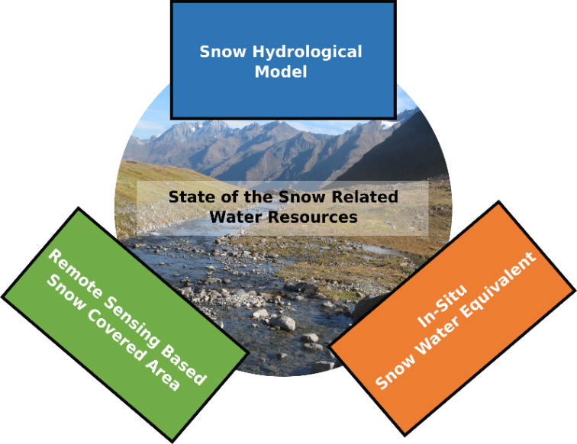
The concept of complementary data
Combination of complementary components with pros/cons
  Hydrological model adapted to current research question
  Meteorological data
  Remote sensing data
  Representative in-situ data
Modular Python framework
(SUPRA Tool) including
  NetCDF Storage (NEST)
  Meteo preprocessing (GAMS)
Flexible usage of different elements

Slide 3
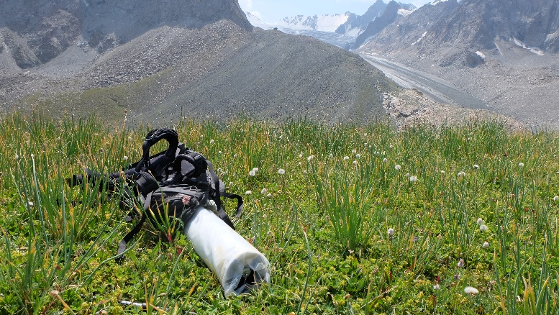
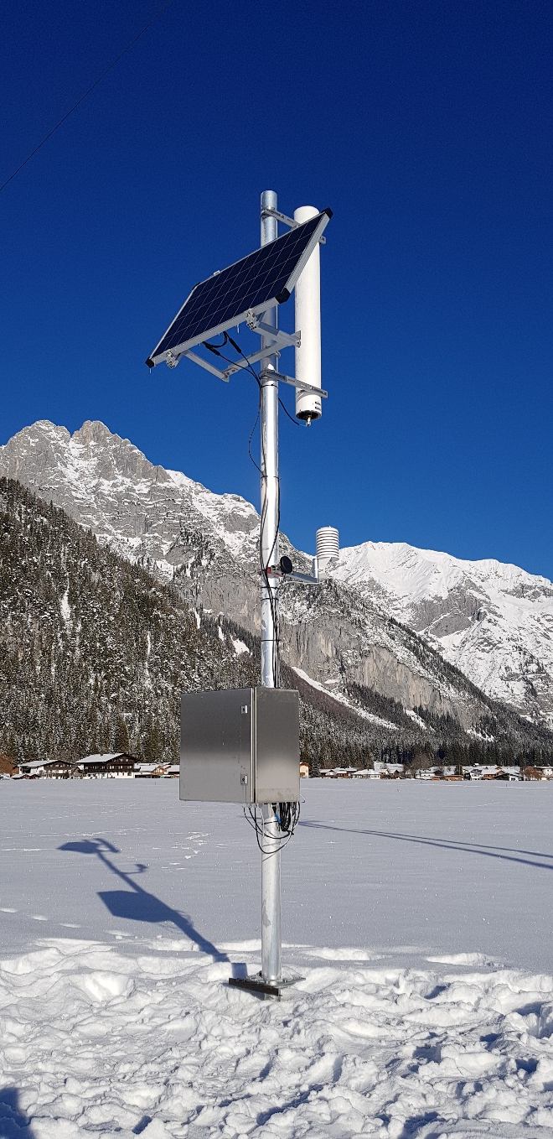
Datasets
Forcing data
  INCA 1x1 km grid provided by ZAMG
  (Austrian meteorological service)
  ERA5-Land Reanalysis (9x9 km)
  (Copernicus/ECMWF)
In-Situ snow observations by Cosmic-Ray Neutron Sensing (CRNS) (Footprint: 250 m)
Remote sensing data
  Modis Snow Covered Area (1x1 km)
  Surface Soil Moisture for Europe (1x1 km)
  (Copernicus Global Land Service)

Slide 4
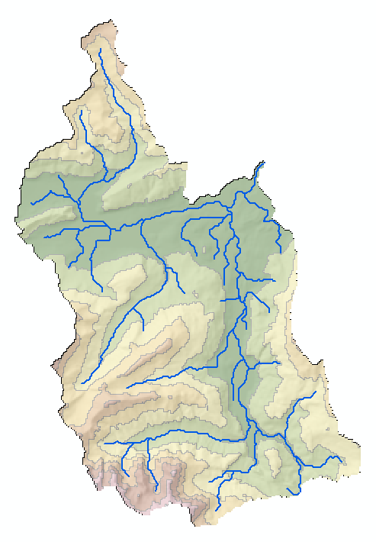
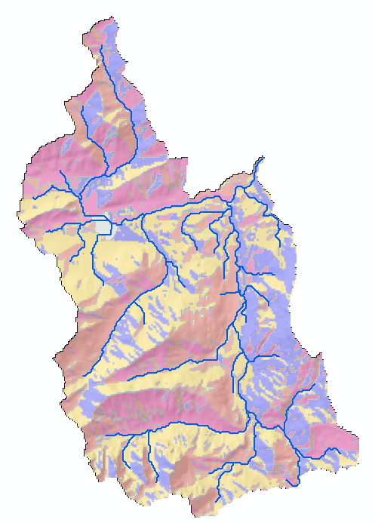
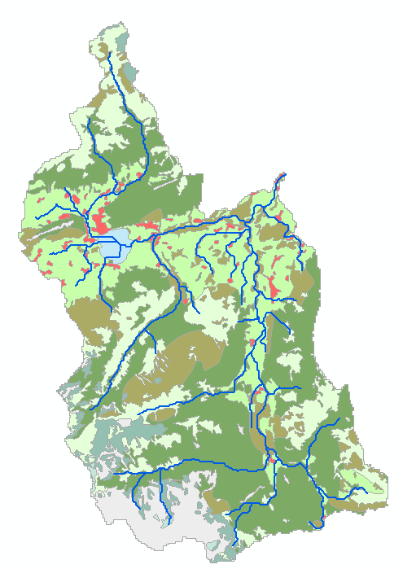
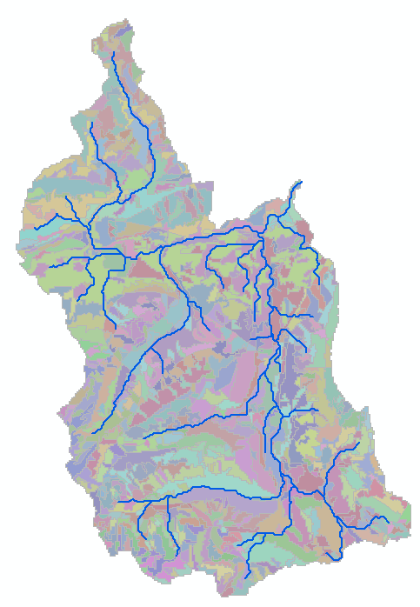
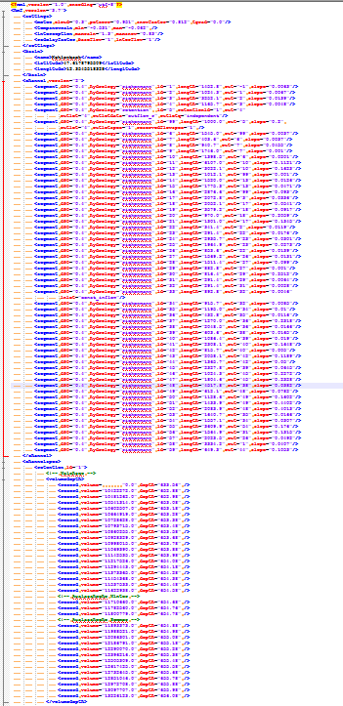
Model: HQsim
Model interface of average values based on hydrological response units (HRU)
Calculation of soil processes (Contributing Area, Mualem-van Genuchten); Groundwater (linear storages) and runoff concentration (time–area diagrams)
Hydrological routing (Rickenmann flow formula) based on stream segments with possible complex reservoir control options
HRUs

Slide 5
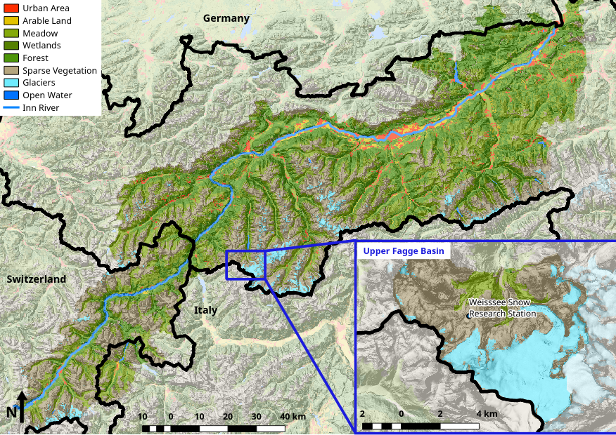
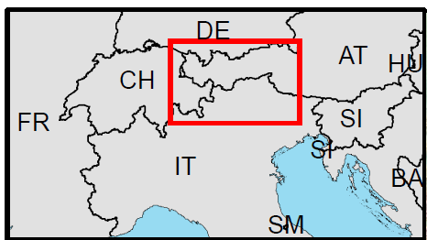
Case study: Inn River

Slide 6
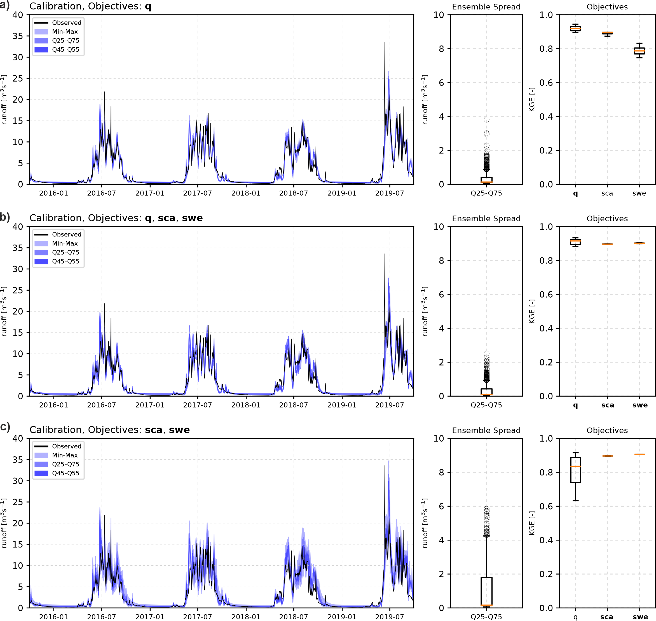
The value of complementary data
Upper Fagge (52 km²)
Meteo Input: INCA (1x1 km)

Slide 7
The value of complementary data
Upper Fagge (52 km²)
Meteo Input: INCA (1x1 km)
Calibration without runoff data

Slide 8
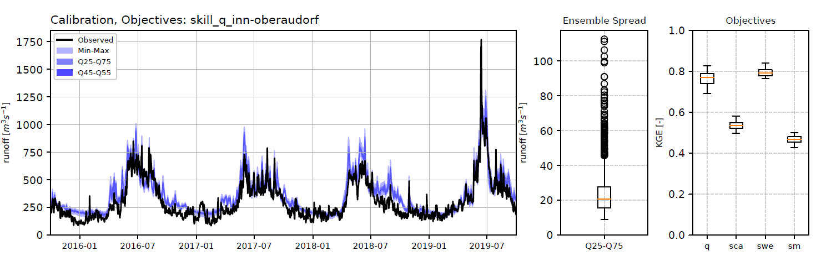
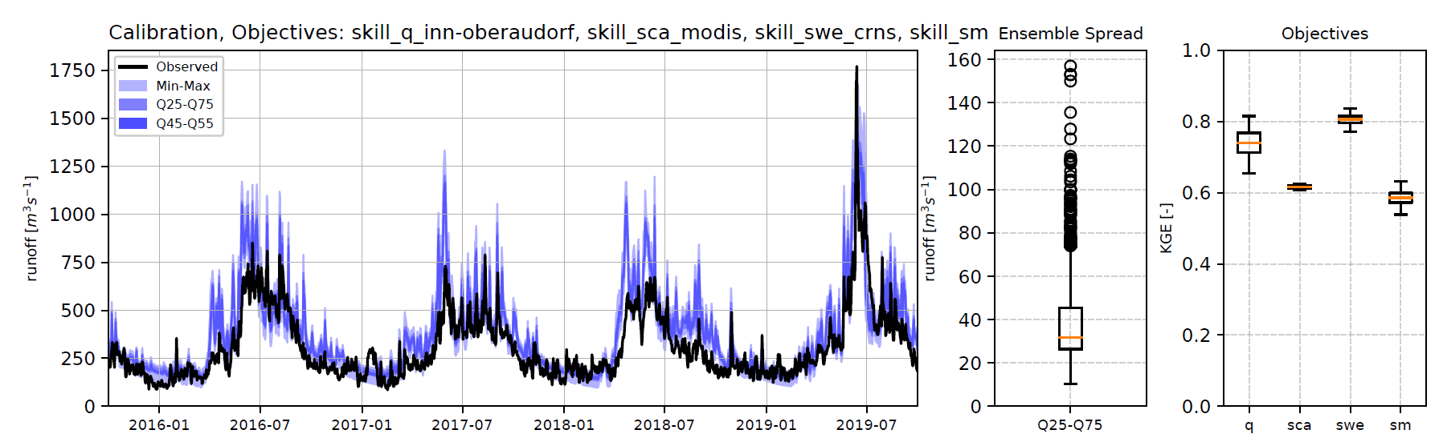
The value of complementary data
Inn River (10,000 km²)
Meteo Input: ERA5-Land (9x9 km)

Slide 9
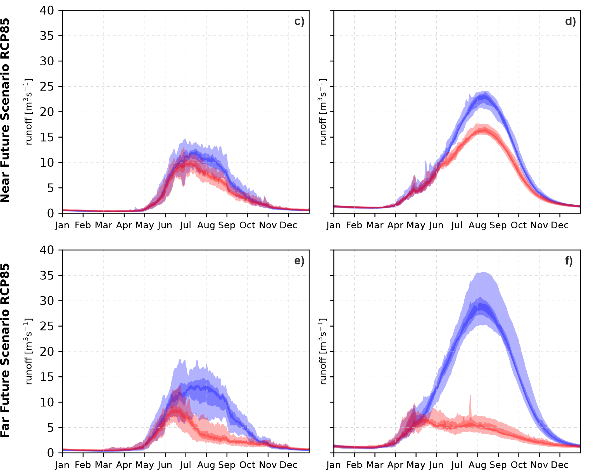
Why the choise of the model matters
Upper Fagge (AT)
Ensemble=28
Ala Archa (KG)
Ensemble=8
Near Future
Dynamic Glaciers
Static Glaciers
Far Future

Slide 10
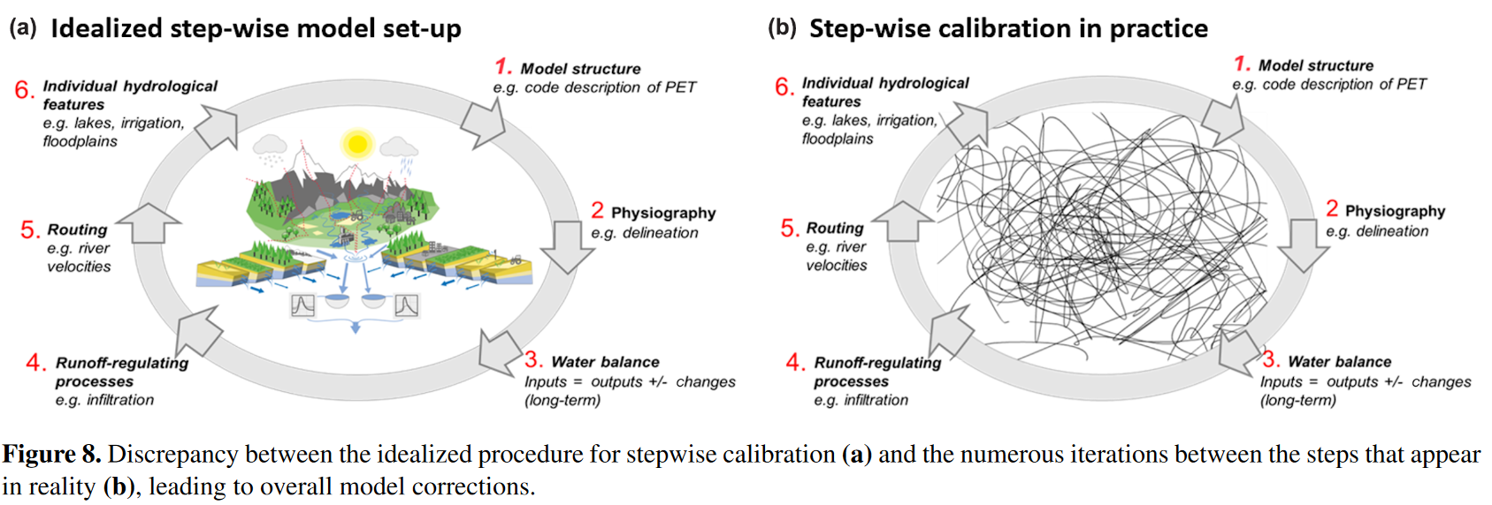
Take home messages
Using complementary data is a suitable strategy for physically meaningful representations of hydrological processes, in particular in mountain regions
Data and models need to be carefully chosen
BUT: Hydrological modelling remains a step-wise process…
Archeimer et al., 2019 (https://hess.copernicus.org/articles/24/535/2020/hess-24-535-2020.pdf)

