Slide 1

Stochastic downscaling of THE 2m temperature with a GENERATIVE ADVERSARIAL NETWORK (GAN)
M. Langguth, B.Gong, Y. Ji, A. Mozaffari, K. Mache and M.G. Schultz
2022-05-23 I Michael Langguth | Jülich Supercomputing Centre (JSC)

Slide 2
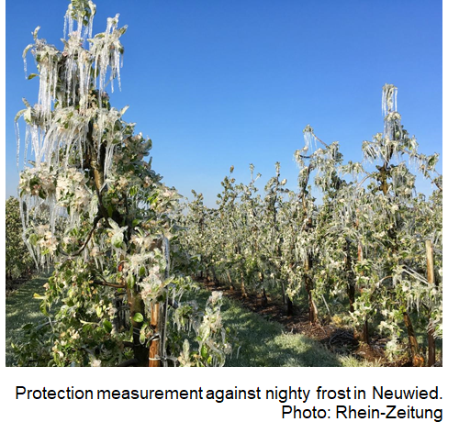

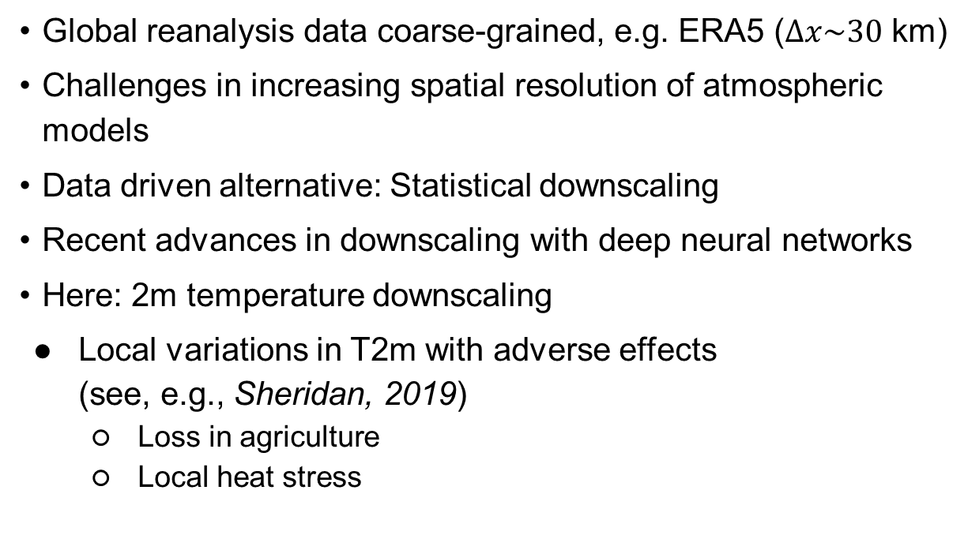
MOTIVATION
Why should we care about downscaling? Why do we focus on 2m tempertaure?
Global reanalysis data coarse-grained, e.g. ERA5 ($∆x\sim 30$ km)
Challenges in increasing spatial resolution of atmospheric models
Data driven alternative: Statistical downscaling
Recent advances in downscaling with deep neural networks
Here: 2m temperature downscaling
Local variations in T2m with adverse effects (see, e.g., Sheridan, 2019)
Loss in agriculture
Local heat stress

Slide 3
outline
Work of IntelliCW-team within the ESDE group
Brief introduction of the ESDE-group
Weather forecasts with data-driven video prediction models
Short-range forecasting of 2m temperature
Precipitation nowcasting
Statistical downscaling in the MAELSTROM-project

Slide 4
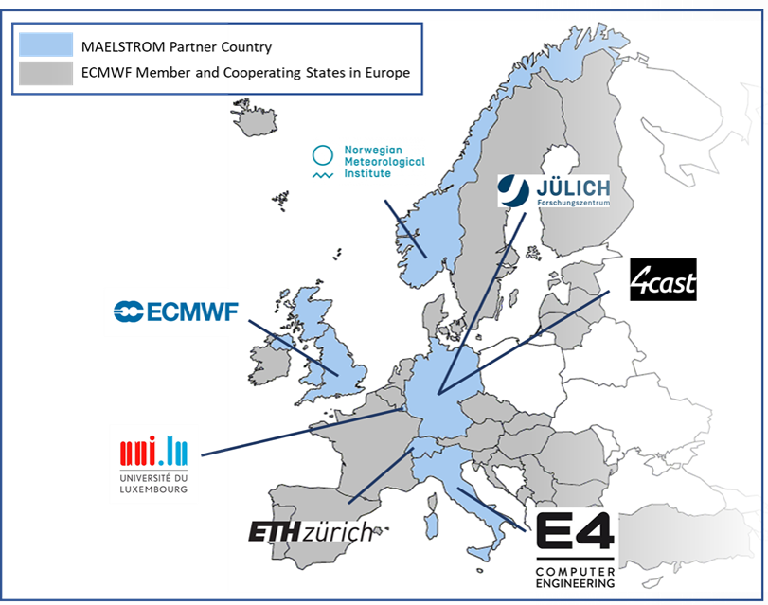
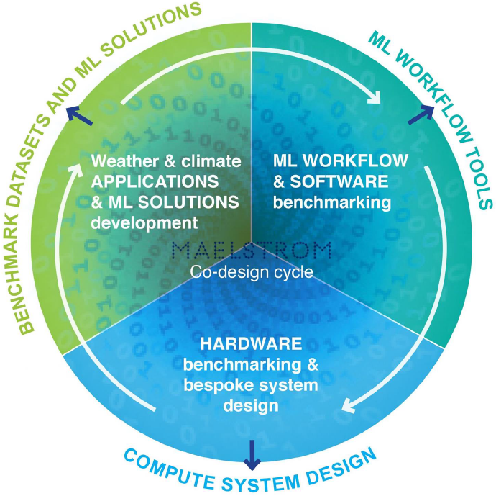

Statistical downscaling in the MAELSTROM-project
Brief introduction to the MAELSTROM project
Acronym for MAchinE Learning for Scalable meTeoROlogy and cliMate
Interdisciplinary project of different universities, institutions and companies funded by EuroHPC Joint Undertaking → coordination by ECMWF
Ultimate goal: Develop ML solutions for (operational) weather and climate applications using bespoken system designs and ML workflow tools (co-design cycle)
ESDE group leads work package 1: ML solutions for weather and climate
Our application (AP5): “Improve local weather prediction in forecast post-processing” → statistical downscaling of meteorological fields
$$E\left(X_{high} | Y_{low}\right)= ℱ(Y_{low},θ)$$
$$X_{high}:Predictants \left(fine scale\right), Y_{low}:Predictors \left(coarse scale\right), \\ ℱ:mapping function, θ:function parameters$$

Slide 5
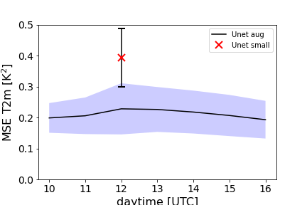
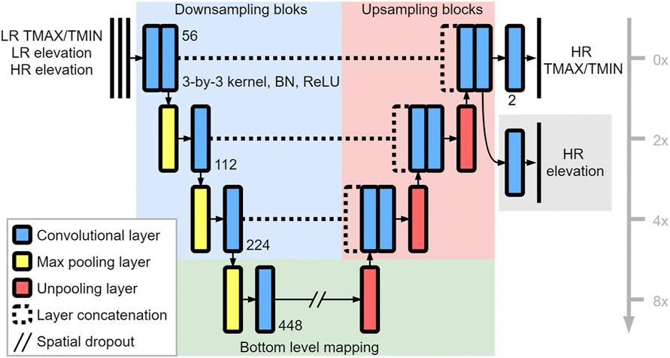
Statistical downscaling in the MAELSTROM-project
Current status in statistical downscaling of 2m temperature
Details on approach:
U-shaped encoder-decoder convolutional network following Sha et al., 2020
Map (coarsened) T2m on 0.8°-grid back onto 0.1°-grid (dataset: short-range forecasts of IFS HRES)
Add surface elevation as informative predictor
Limitations
No dynamical predictors → Limit application by daytime and season
No temporal coherence
Synthetic downscaling task

Slide 6
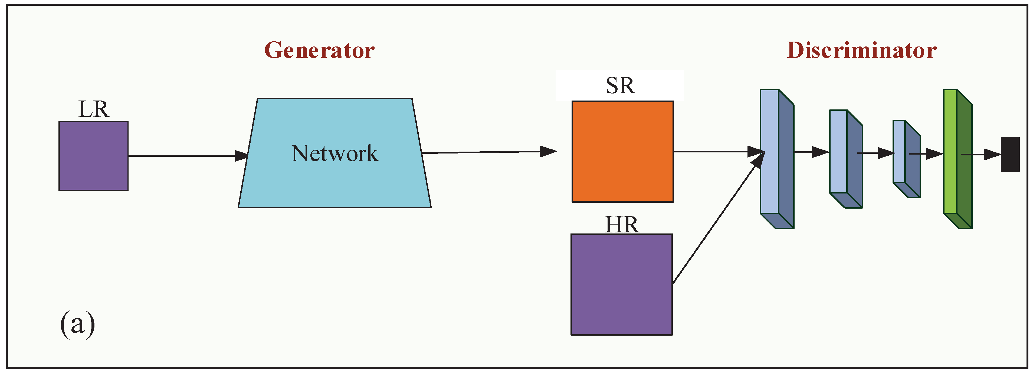
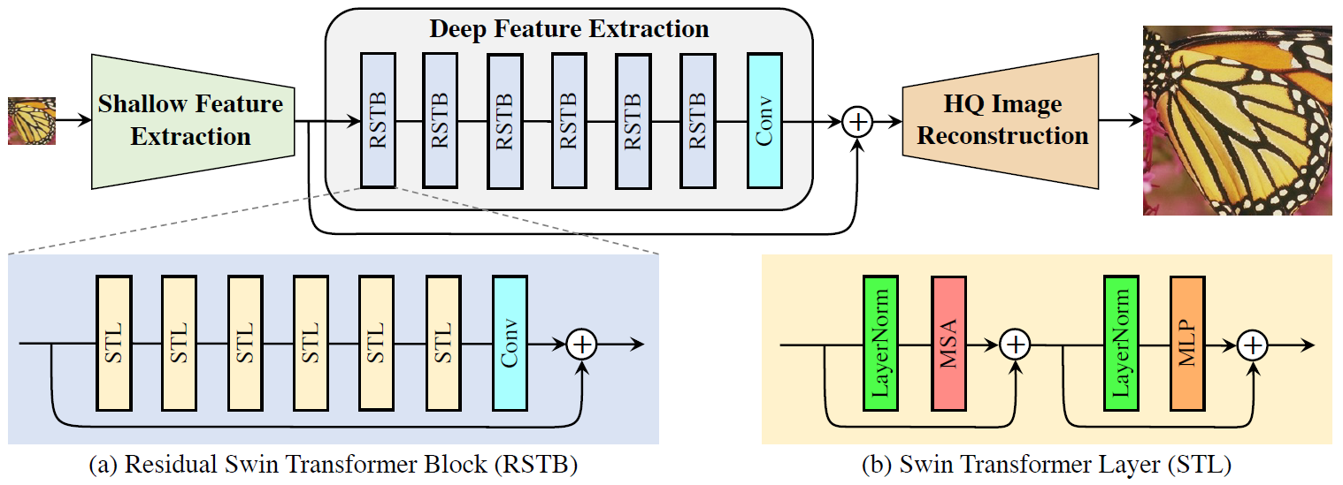
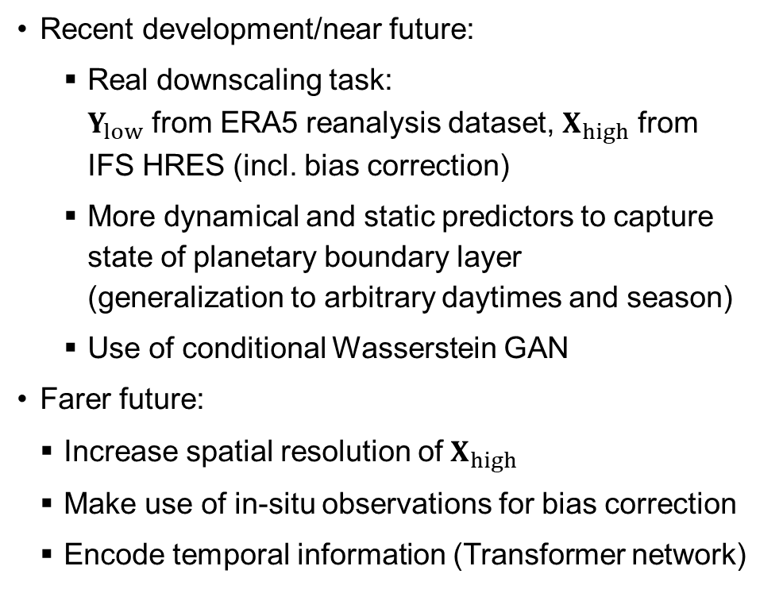
Statistical downscaling in the MAELSTROM-project
Visions for statistical downscaling of 2m temperature
Recent development/near future:
Real downscaling task: $Y_{low}$ from ERA5 reanalysis dataset, $X_{high}$ from IFS HRES (incl. bias correction)
More dynamical and static predictors to capture state of planetary boundary layer (generalization to arbitrary daytimes and season)
Use of conditional Wasserstein GAN
Farer future:
Increase spatial resolution of $X_{high}$
Make use of in-situ observations for bias correction
Encode temporal information (Transformer network)
High-level illustration of conditional Generative adversarial network architecture for downscaling/super-resolution (from Du et al., 2021)
High-level illustration of Swin Transformer architecture for downscaling/ super-resolution (from Liang et al., 2021)

Slide 7
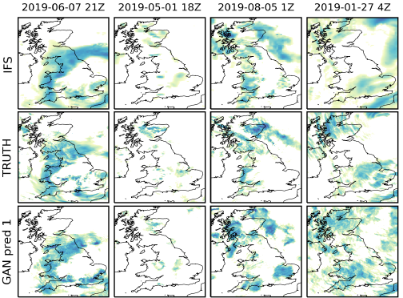
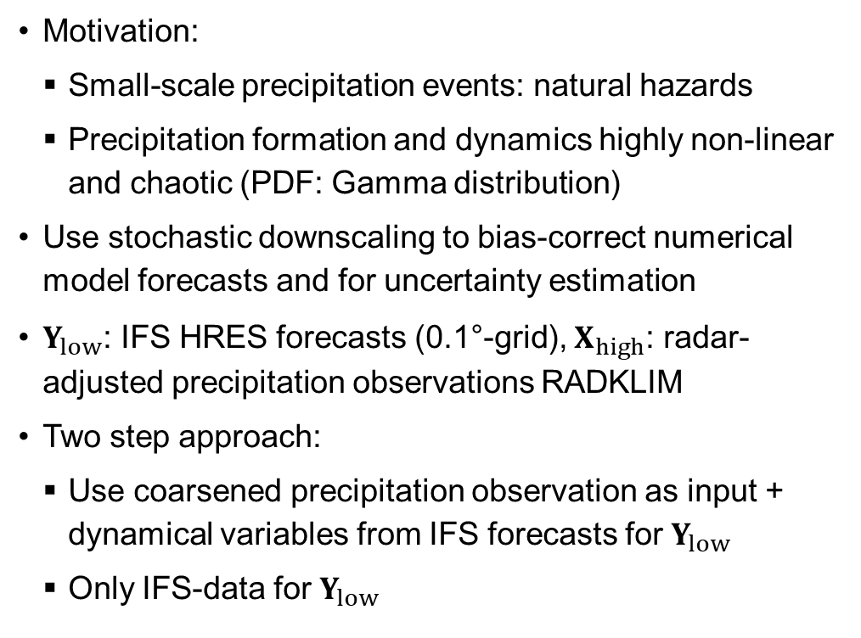
Statistical downscaling in the MAELSTROM-project
Visions for statistical downscaling of precipitation
Motivation:
Small-scale precipitation events: natural hazards
Precipitation formation and dynamics highly non-linear and chaotic (PDF: Gamma distribution)
Use stochastic downscaling to bias-correct numerical model forecasts and for uncertainty estimation
$Y_{low}$: IFS HRES forecasts (0.1°-grid), $X_{high}$: radar-adjusted precipitation observations RADKLIM
Two step approach:
Use coarsened precipitation observation as input + dynamical variables from IFS forecasts for $Y_{low}$
Only IFS-data for $Y_{low}$
Examples of GAN-prediction (bottom) for precipitation conditioned on IFS forecasts (top). Observations are displayed in the middle row. From Harris et al., 2022.

Slide 8


Statistical downscaling in the MAELSTROM-project
Challenges for statistical downscaling
Downscaling is inherently uncertain and small-scale atmospheric processes are poorly understood
Vibrant challenges:
Find informative set of predictors
Proper data handling/ processing (embedding/representations via Fourier or Wavelet transformation?)
Handle uncertainty of non-Gaussian predictands (proper scoring function for loss)

