Slide 1
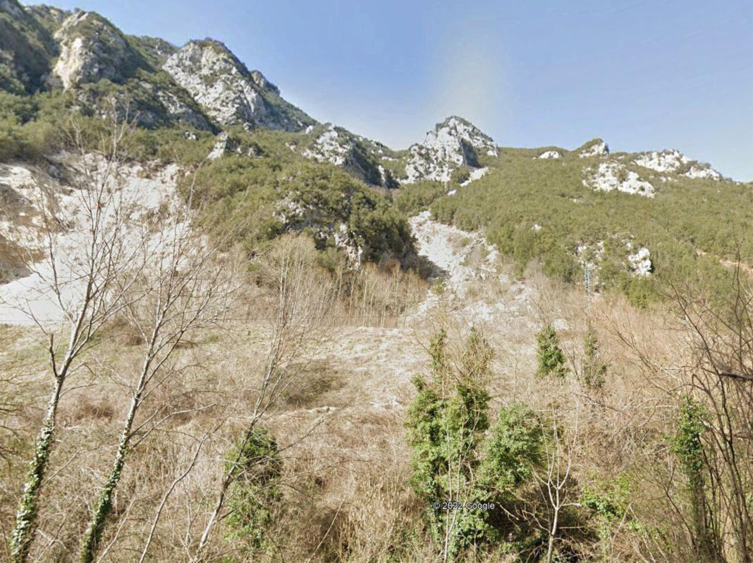



EGU- General Assembly 2022
NH3.6- Space and Time Forecasting of Landslides
23-27 May 2022
From landslide mapping to susceptibility modeling: a test in central Italy
Margherita Bufalini¹, Chiara Martinello², Chiara Cappadonia², Gilberto Pambianchi¹, Edoardo Rotigliano², and Marco Materazzi¹
¹School of Science and Technology – Geology Division, University of Camerino, Camerino, Italy
²Dipartimento di Scienze della Terra e del Mare, Università degli Studi di Palermo, Palermo, Italy

Slide 2
EGU- General Assembly 2022 NH3.6- Space and Time Forecasting of Landslides
From landslide mapping to susceptibility modeling: a test in central Italy
Margherita Bufalini¹, Chiara Martinello², Chiara Cappadonia², Gilberto Pambianchi¹, Edoardo Rotigliano², and Marco Materazzi¹
Goal:
Exploit the CARG landslide inventory for landslide susceptibility assessment.

Slide 3
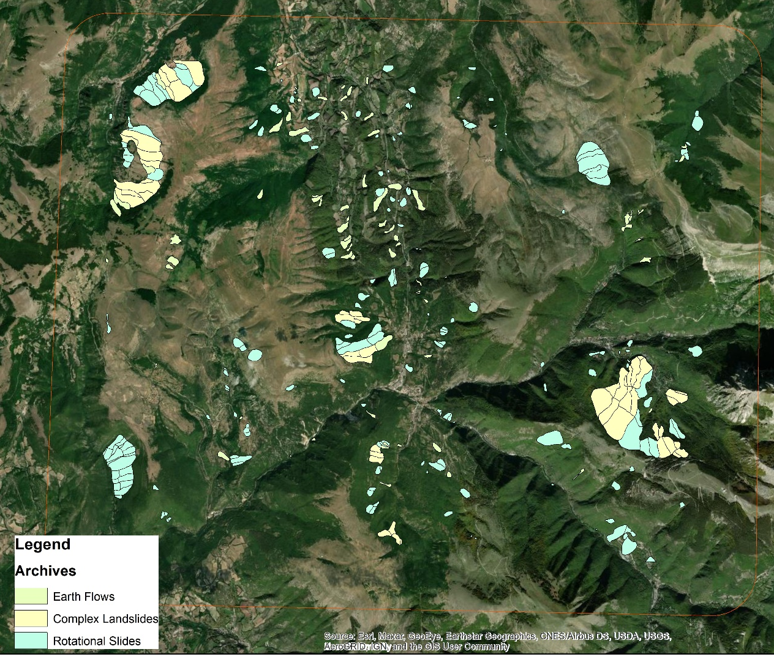
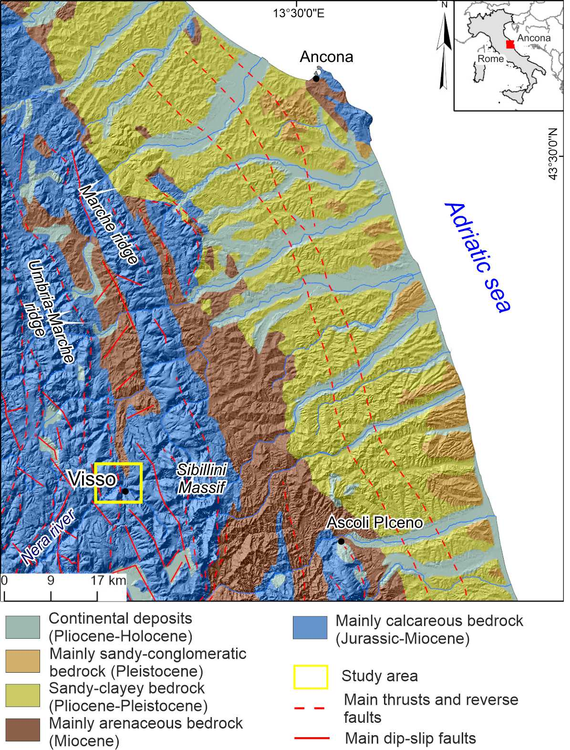
EGU- General Assembly 2022 NH3.6- Space and Time Forecasting of Landslides
From landslide mapping to susceptibility modeling: a test in central Italy
Margherita Bufalini¹, Chiara Martinello², Chiara Cappadonia², Gilberto Pambianchi¹, Edoardo Rotigliano², and Marco Materazzi¹
Study Area:
The area of Visso (Marche, Italy) was chosen as the study area.
Categorized in 3 Archives:
Rotational Slides (198 cases);
Earth Flows (91 cases);
Complex Landslides (51 cases).

Slide 4
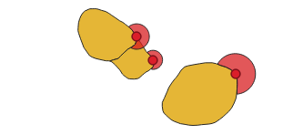
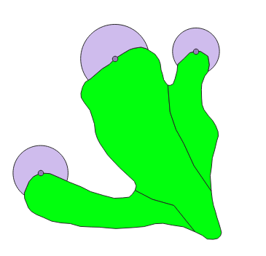
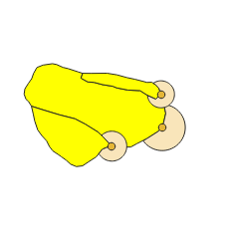
EGU- General Assembly 2022 NH3.6- Space and Time Forecasting of Landslides
From landslide mapping to susceptibility modeling: a test in central Italy
Margherita Bufalini¹, Chiara Martinello², Chiara Cappadonia², Gilberto Pambianchi¹, Edoardo Rotigliano², and Marco Materazzi¹
Diagnostic Area: Buffered Landslide Identification Points (BLIP)
Rotational Slides [198]
Blip (1/4 instability length)
Earth Flows [91]
Blip (1/6 instability length)
Complex Landslides [51]
Blip (1/6 instability length).

Slide 5
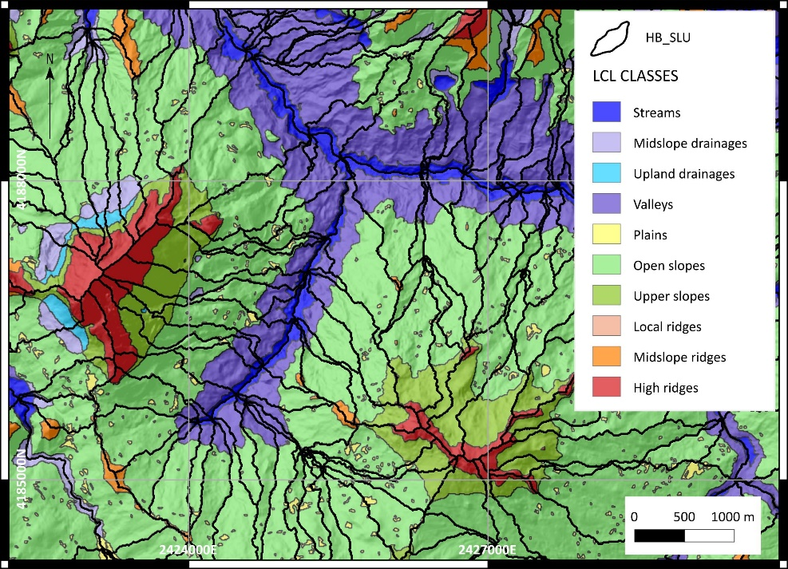
EGU- General Assembly 2022 NH3.6- Space and Time Forecasting of Landslides
From landslide mapping to susceptibility modeling: a test in central Italy
Margherita Bufalini¹, Chiara Martinello², Chiara Cappadonia², Gilberto Pambianchi¹, Edoardo Rotigliano², and Marco Materazzi¹
Mapping units: LCL_SLU
Martinello, C., Cappadonia, C., Conoscenti, C. et al. Landform classification: a high-performing mapping unit partitioning tool for landslide susceptibility assessment—a test in the Imera River basin (northern Sicily, Italy). Landslides 19, 539–553 (2022). https://doi.org/10.1007/s10346-021-01781-8
Chiara Martinello, Chiara Cappadonia, Christian Conoscenti, Valerio Agnesi & Edoardo Rotigliano (2021) Optimal slope units partitioning in landslide susceptibility mapping, Journal of Maps, 17:3, 152-162, DOI: 10.1080/17445647.2020.1805807

Slide 6
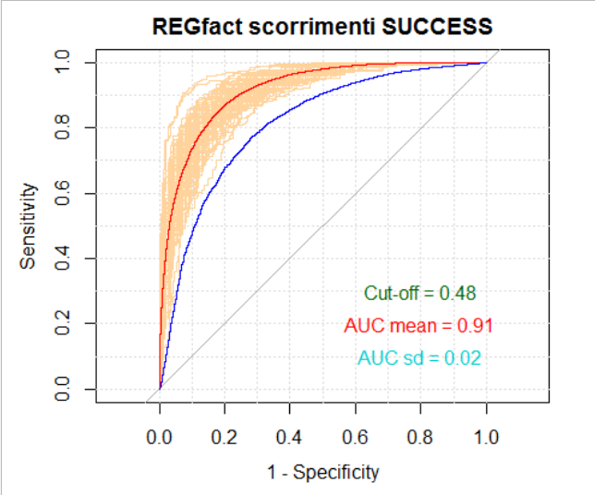
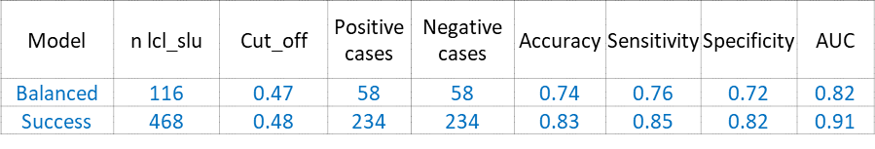
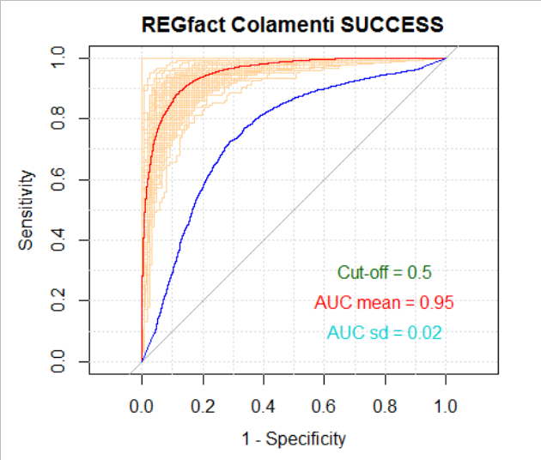
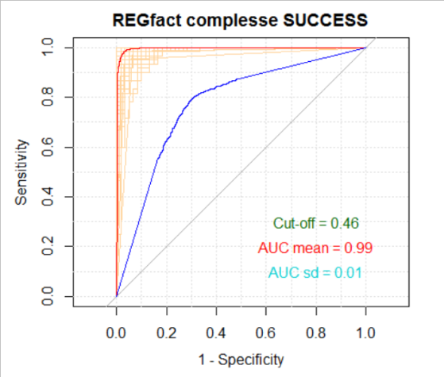
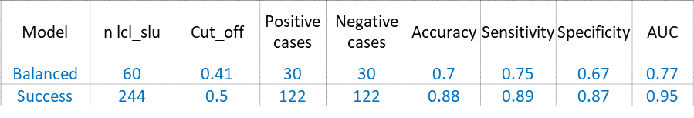
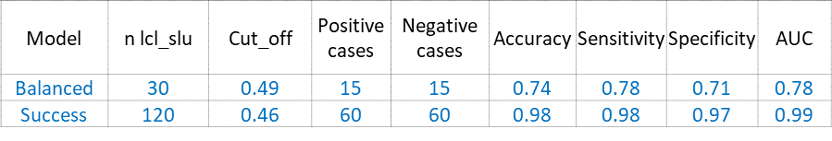
EGU- General Assembly 2022 NH3.6- Space and Time Forecasting of Landslides
From landslide mapping to susceptibility modeling: a test in central Italy
Margherita Bufalini¹, Chiara Martinello², Chiara Cappadonia², Gilberto Pambianchi¹, Edoardo Rotigliano², and Marco Materazzi¹
REGfact Rotational Slides SUCCESS
Results
REGfact Earth Flows SUCCESS
REG FACT Rotational Slides: Elevation + Easterners ( sin(aspect)) + Northerners ( cos(aspect)) + Plan Curvature + Profile Curvature + Slope + Topographic Wetness Index + Corine + Landform Classification + Lithology
REGfact Complex Landslides SUCCESS
Success
Validation
REG FACT Earth Flows: Elevation + Easterners ( sin(aspect)) + Northerners ( cos(aspect)) + Plan Curvature + Profile Curvature + Slope + Stream Power Index + Corine + Landform Classification + Lithology

Slide 7
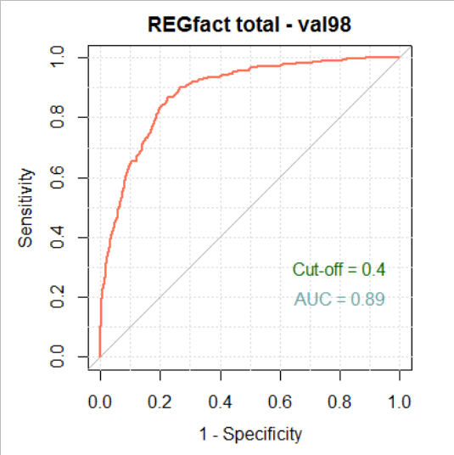
EGU- General Assembly 2022 NH3.6- Space and Time Forecasting of Landslides
From landslide mapping to susceptibility modeling: a test in central Italy
Margherita Bufalini¹, Chiara Martinello², Chiara Cappadonia², Gilberto Pambianchi¹, Edoardo Rotigliano², and Marco Materazzi¹
Results
Finally, for potential use in territorial planning, an integrated map was produced by adding up the single-landslide susceptibility scores and ranking the output on a classical 0-1 scale. The final map reaches an AUC value of 0.89, confirming the high performance of the models.
Model | n lcl_slu | Cut_off | Positive cases | Negative cases | TP | FP | TN | FN | Accuracy | Sensitivity | Specificity | PPV | NPV | AUC
val98 | 3565 | 0.4 | 272 | 3293 | 236 | 738 | 2555 | 36 | 0.78 | 0.87 | 0.78 | 0.24 | 0.99 | 0.89

Slide 8
EGU- General Assembly 2022 NH3.6- Space and Time Forecasting of Landslides
From landslide mapping to susceptibility modeling: a test in central Italy
Margherita Bufalini¹, Chiara Martinello², Chiara Cappadonia², Gilberto Pambianchi¹, Edoardo Rotigliano², and Marco Materazzi¹
Conclusions
The results of the test in the “Visso” map suggest as potentially very worth processing the landslide inventories already available from the CARG project to assess landslide susceptibility on a regional to national scale.

Slide 9
EGU- General Assembly 2022 NH3.6- Space and Time Forecasting of Landslides
From landslide mapping to susceptibility modeling: a test in central Italy
Margherita Bufalini¹, Chiara Martinello², Chiara Cappadonia², Gilberto Pambianchi¹, Edoardo Rotigliano², and Marco Materazzi¹
Thank you for you attention

