Slide 1
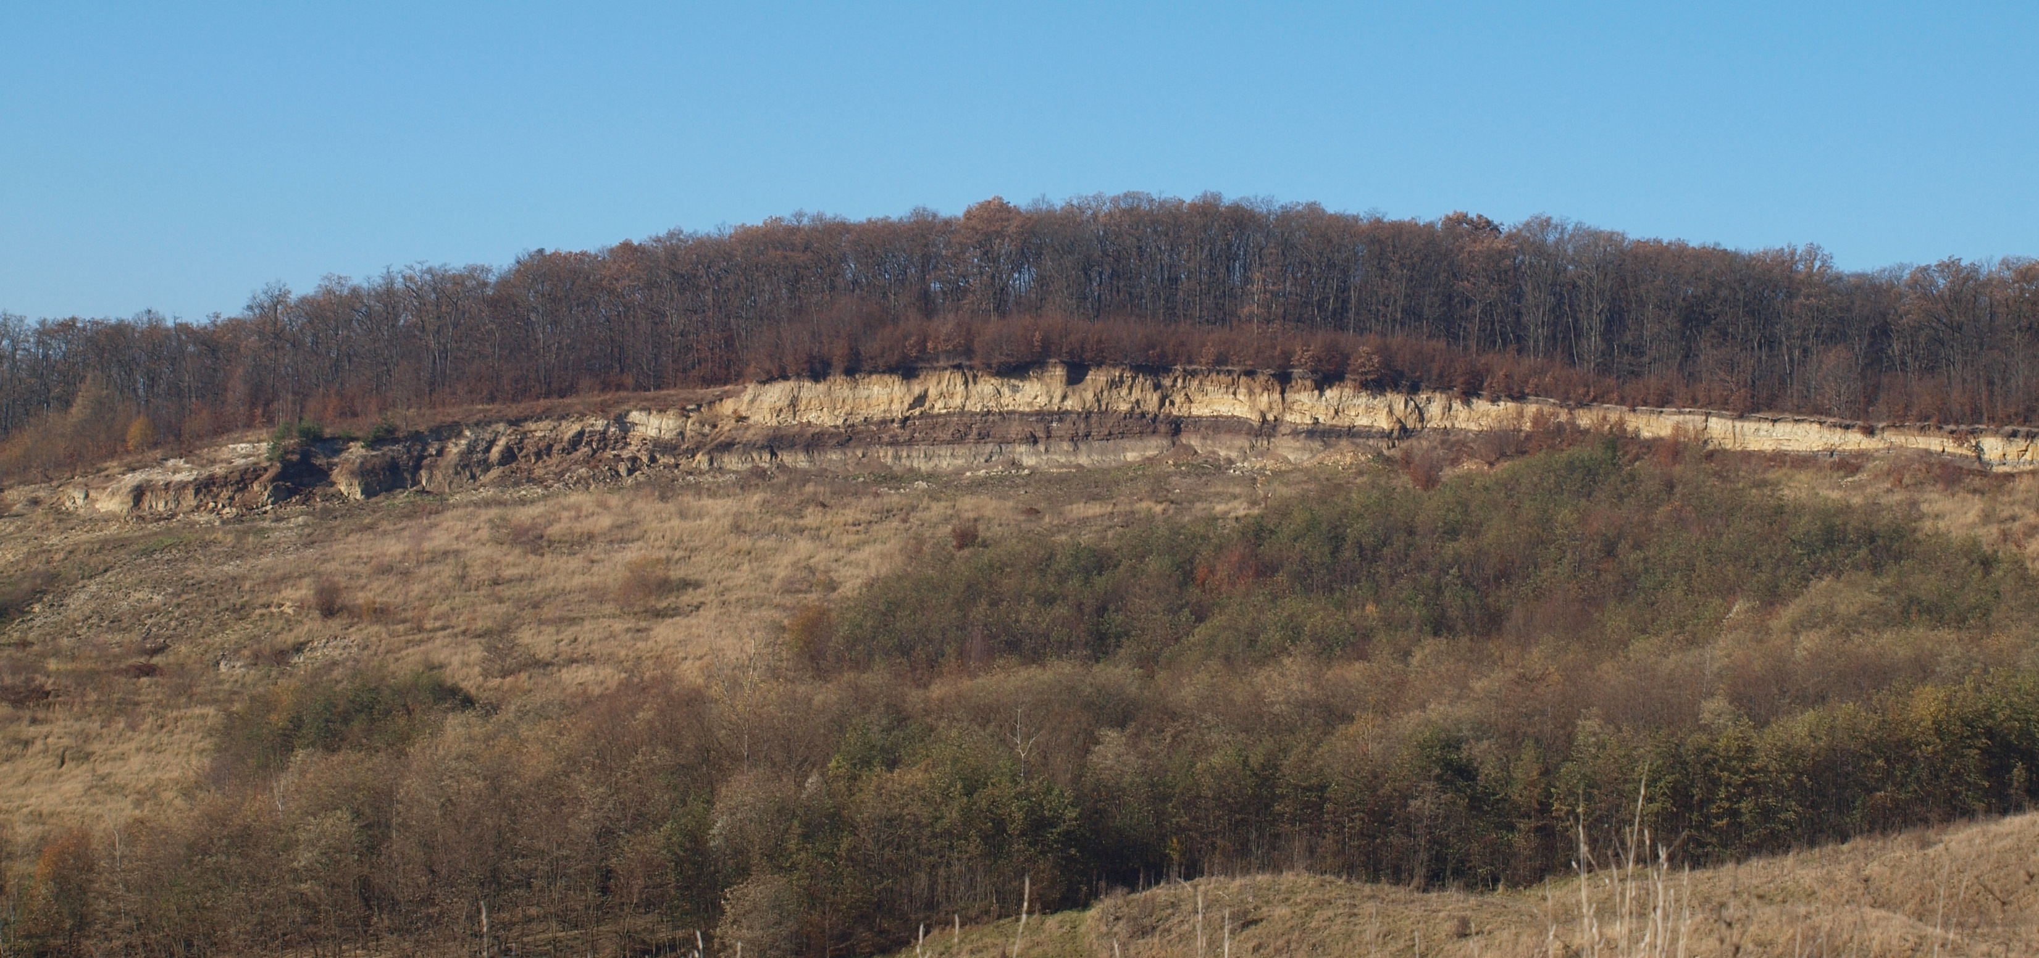






Preliminary results from the endemic mollusc-bearing Brașov Basin (Pliocene, Transylvanian Lake System, Romania)
Dániel Botka*
MOL Plc.
ELTE TTK Dept. of Palaeontology
Anna Magasi
ELTE TTK Dept. of Palaeontology
Loránd Silye
Babeș-Bolyai Univ., Dept. of Geology
Bálint Szappanos
Hungarian Malacological
Society
Imre Magyar
MOL Plc.
MTA-MTM-ELTE Research Group for Paleontology
EGU General Assembly, Vienna-online, 23-27 May 2022

Slide 2
Introduction
1.
2.
3.
4.
5.
Mixed Pannonian and Pliocene faunas in the museum collections
Revision of the TLS mollusc fauna is unavoidable
Transitional position between two large bioprovinces (Lake Pannon and Eastern Paratethys)
No proper age constraints from this part of the Carpathian-Pannonian region

Slide 3
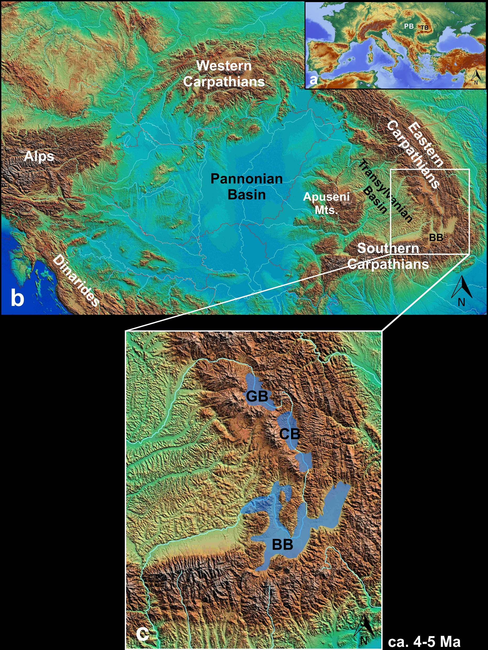
Geological background
1.
2.
3.
4.
5.
Nyáraspatak (Iarăși)
Pliocene Transylvanian Lake System
formed in intramontane basins
BB: Brasov Basin
CB: Ciuc Basin
GB: Gheorgheni Basin
Blue: water covered areas ca. 4-5 Ma ago
Localities of Jekelius (1932) rediscovered
9 localities
6 sedlogs
14 samples
ca. 10 kg sediment/sample

Slide 4
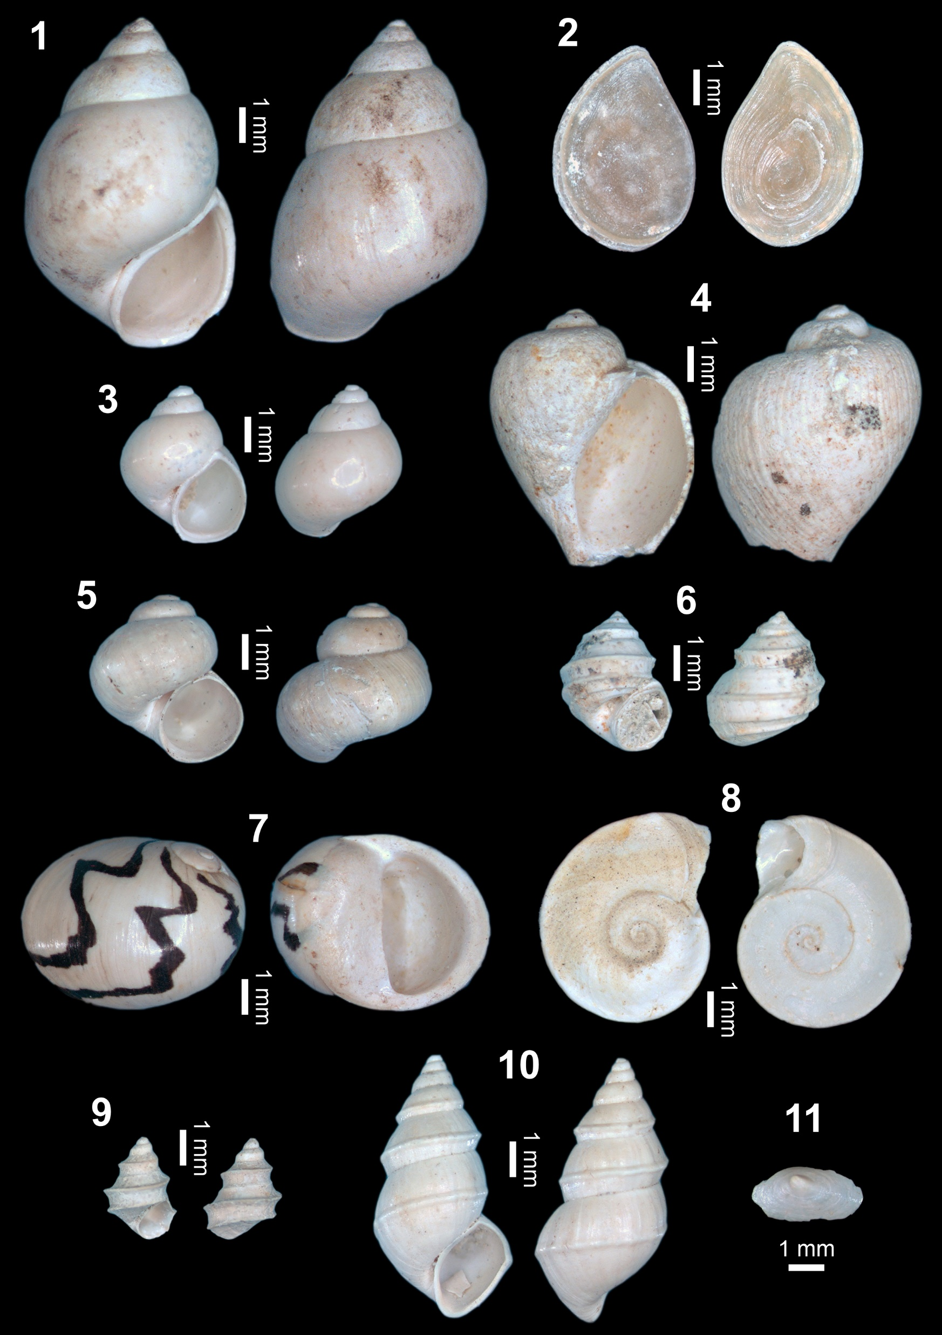
Mollusc fauna
1.
2.
3.
4.
5.
Vargyas (Vârghiș)
22 taxa
Frequent species:
1. Neumayria labiata
2. Neumayria labiata operculum
3. Tanousia adnata
4. Radix cf. obtusissima
5. Valvata piscinalis
6. Valvata eugeniae
7. Theodoxus semiplicatus
8. Gyraulus transsylvanicus
9. Pyrgula eugeniae
10. Pyrgula prisca
11. Acroloxus alutae
Felsőrákos
(Racoșul de Sus)
14 taxa
Nyáraspatak
(Iarăși)
6 taxa

Slide 5
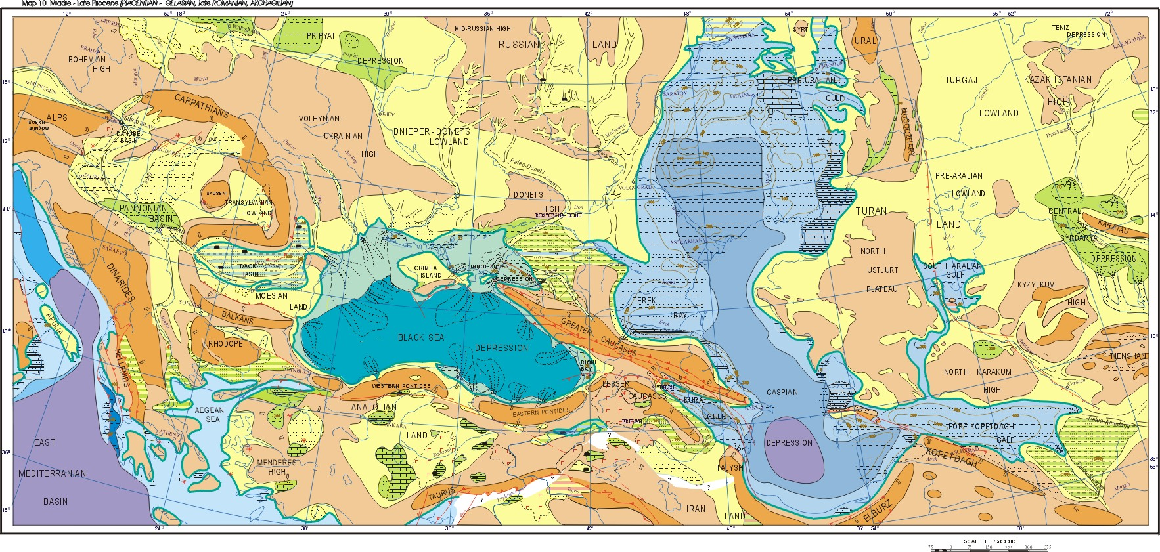
Palaeogeography
1.
2.
3.
4.
5.
Relict cardiid bivalves of marine origin
Migration of freshwater snails
Endemic radiation (ca. 70% endemism)
Dacian origin?
Affinity with Paludina Lake?
Northern part of Persani Mts. covered
ca. 4-5 Ma
Popov et al. (2004)

Slide 6
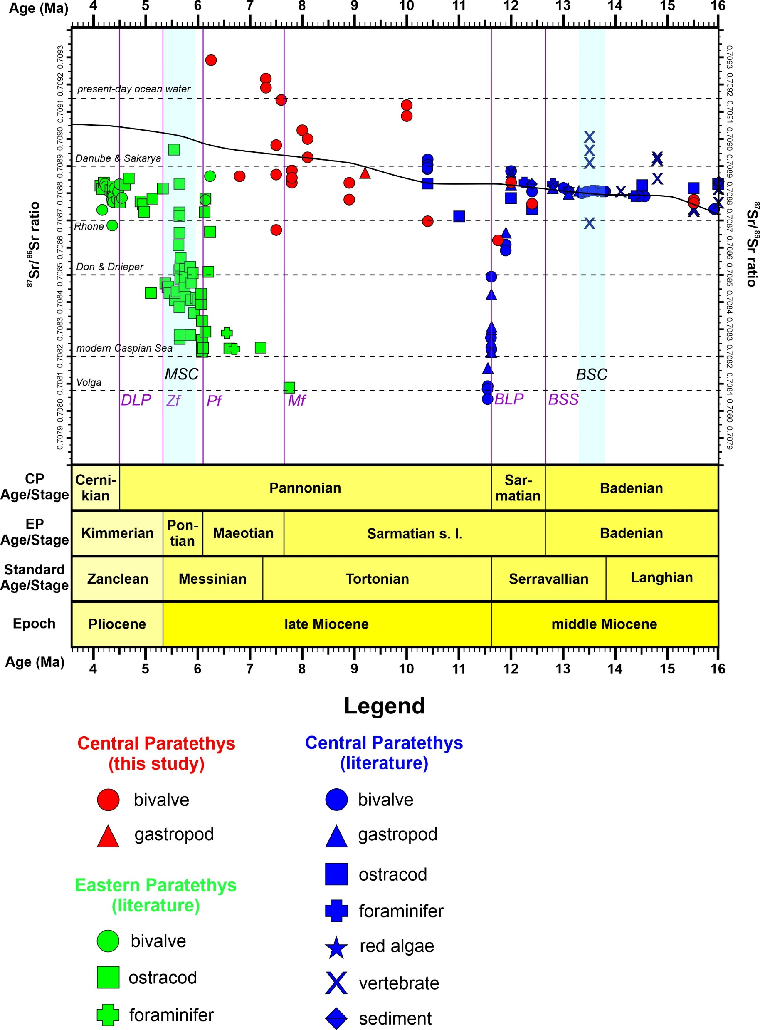
Future plans
1.
2.
3.
4.
5.
Popov et al. (2004)
⁸⁷Sr/⁸⁶Sr isotopic measurements
Mollusc studies cont. (revision!)
Comparison with Paludina and Dacian faunas

Slide 7




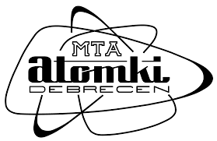
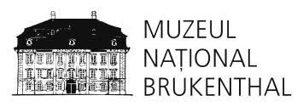
Acknowledgements
Museum collections: Bálint Péterdi (MBFSZ, Budapest), Liana Săsăran (Babeș-Bolyai University, Cluj-Napoca), Iulia Stefanescu (Gábor Bethlen College, Natural History Museum, Aiud), Nicolae Trif (Brukenthal Museum, Sibiu), Călin Alexandru Gabriel & Sarolta Lőrincz (Romanian Geological Survey, Bucharest), István Vári (István Molnár Museum, Cristuru Secuiesc), Hunor Szász (Rezső Haáz Museum, Odorheiu Secuiesc)
Romanian literature and field targets: Ferenc Wanek (Sapientia University, Cluj-Napoca), Monica Baciu (Babeș-Bolyai University, Cluj-Napoca), Tímea Szlepák (MBFSZ, Budapest)
Field work: László Demeter (Museum of Baraolt Basin, Baraolt)
Sr-isotopic measurements: Anikó Horváth (ATOMKI, Debrecen)
Financial support: ÚNKP-21-3, ELTE
Thank you for the attention!

