Slide 1



1860 CE: The Turning Point
The onset of relative sea-level rise in southwestern Norway
M. Holthuis, F.C. Nixon, M. Kylander, W. van der Bilt, J. Martin, T. Lakeman
Norwegian University of Science and Technology
max.holthuis@ntnu.no
Notes:
At EGU I present a small part of my PhD research. It is work in progress, and therefore I will cover some interim results. I study Late Holocene relative sea level (RSL) change at the Norwegian University of Science and Technology, under the supervision of Chantel Nixon, Malin Kylander and Willem van der Bilt. In this presentation I will show you something about the onset of sea level rise in southwestern Norway around 1860 CE.

Slide 2
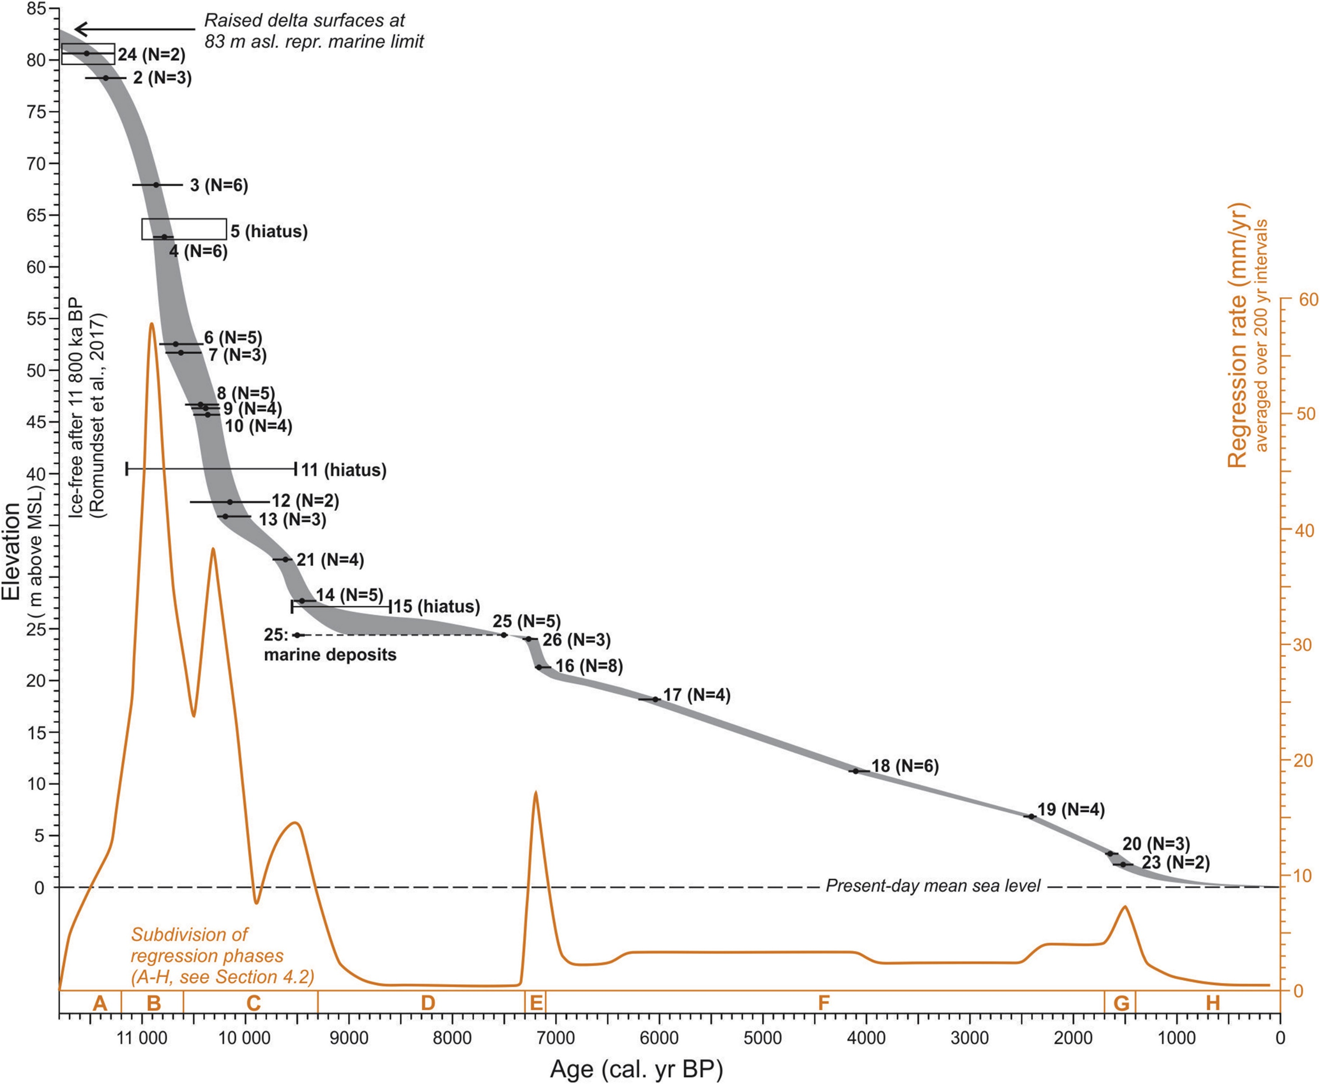
???
Romundset, A., Lakeman, T. R., & Høgaas, F. (2018). Quantifying variable rates of postglacial relative sea level fall from a cluster of 24 isolation basins in southern Norway. Quaternary Science Reviews, 197, 175-192.
Notes:
Relative sea level (RSL) change in Norway has been studied thoroughly and a lot of data on RSL change after the last deglaciation is available. For almost all of the time, RSL has been falling up to present levels. However, the last 2000 years are badly constrained, and not a lot of data is available. Somehwere during these last 2000 years, something really interesting must have started: Sea level in southwestern Norway started to rise!

Slide 3
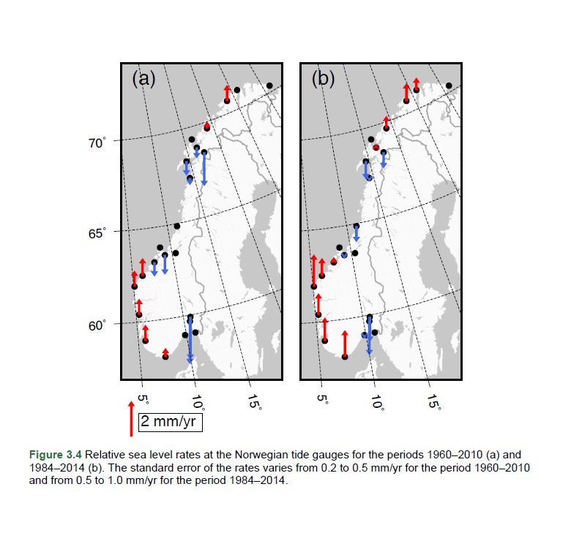
1984-2014
1960-2010
Simpson, M. J., Nilsen, J. E. Ø., Ravndal, O. R., Breili, K., Sande, H., Kierulf, H. P., ... & Vestøl, O. (2015). Sea Level Change for Norway: Past and Present Observations and Projections to 2100. Norwegian Centre for Climate Services report, 1, 2015.
Notes:
Here you see data from the tide gauge network of Norway. This network has been installed approximately 100 years ago. Since the start of the tide gauge measurements, relative sea level (RSL) rise has been observed in north and southwest Norway. This rise has been accelerating over time. This acceleration is expected to continue, until the whole Norwegian coastline experiences RSL rise at the end of this century.

Slide 4
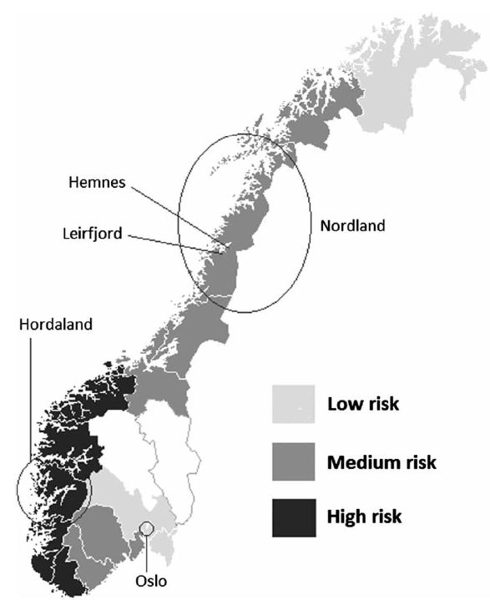
But when did this start?
1860 (1831-1886) CE
Almås, A. J., & Hygen, H. O. (2012). Impacts of sea level rise towards 2100 on buildings in Norway. Building Research & Information, 40(3), 245-259., 2012
Notes:
Even though Norway is a mountaineous country, large areas are under high risk of relative sea level (RSL) rise. A lot of communities and important infrastructure in Norway are located at the coast, close to present day sea level. Therefore, it is very important to study recent sea level change. By generating more RSL data in the last 2000 years and by finding the switch from RSL fall to RSL rise, we will give sea level modellers the input data they need to improve their sea level models and improve the predictions for future change.
So when did this switch happen?
My current data points to 1860 (1831-1886) CE as the start of the onset of RSL rise in southwestern Norway.

Slide 5
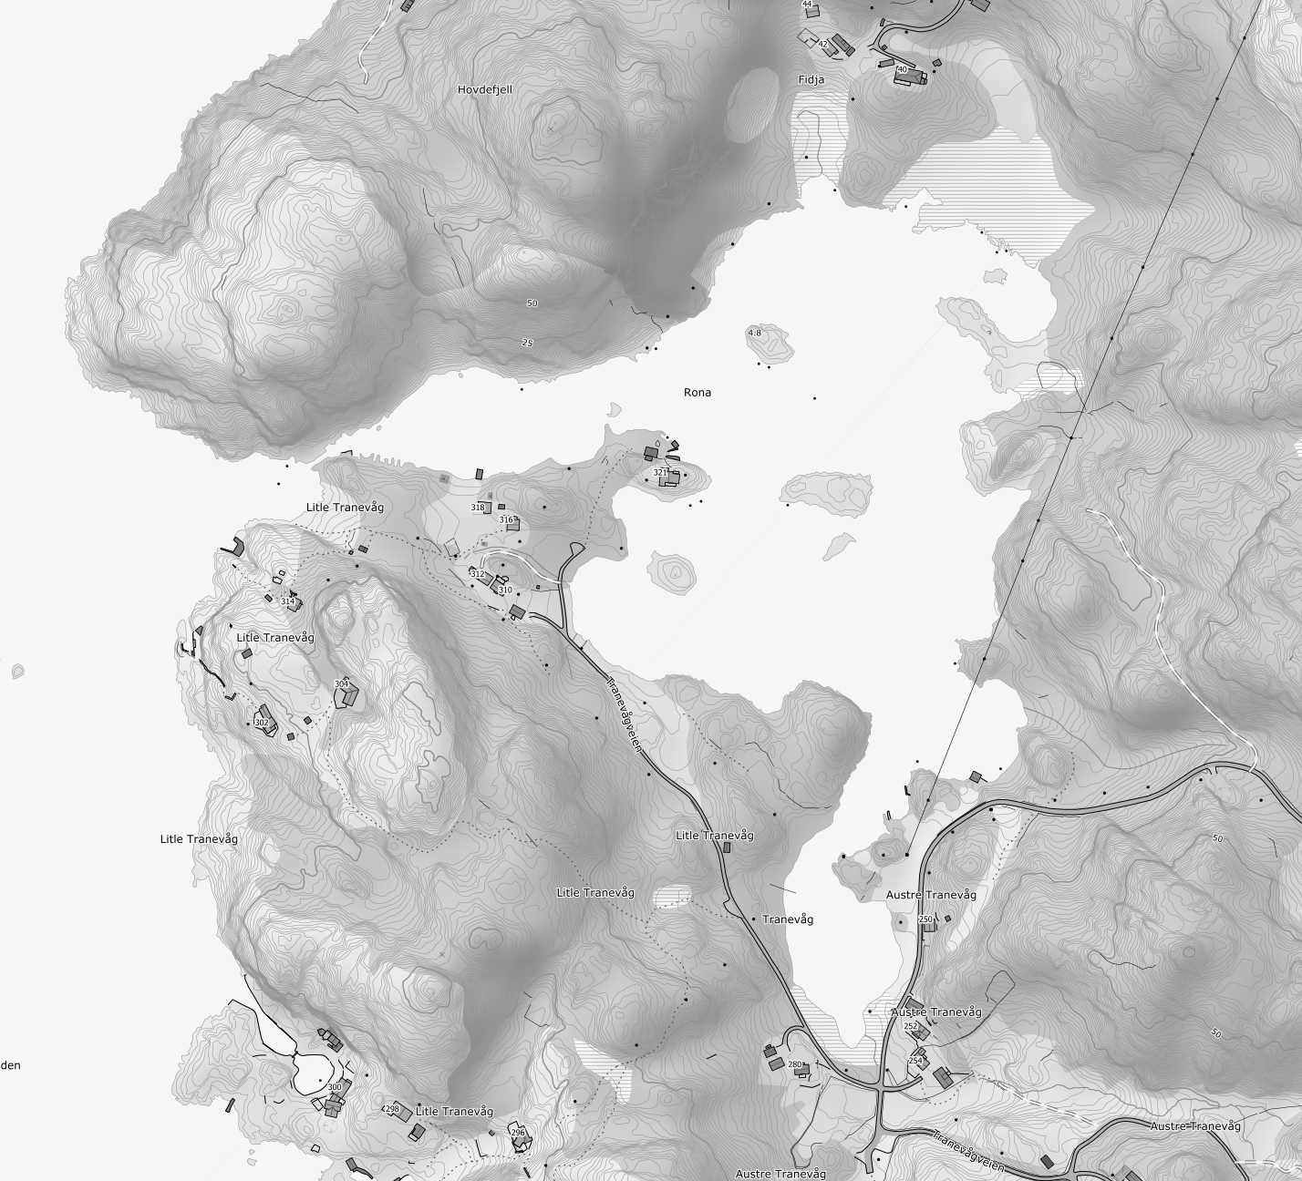
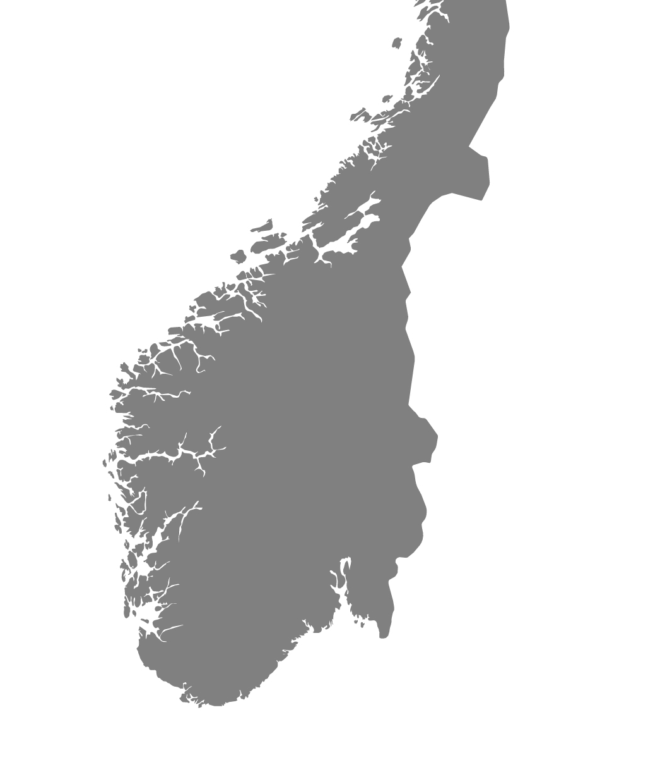
TV21-RC2
https://hoydedata.no
https://vemaps.com/norway
Notes:
I will show you one of the cores we have been working on. It has been taken from a fringing salt marsh in an intertidal basin from southwestern Norway. This basin has a narrow inlet to the sea, and therefore changes in sea level will be very well recorded in the sediments.

Slide 6
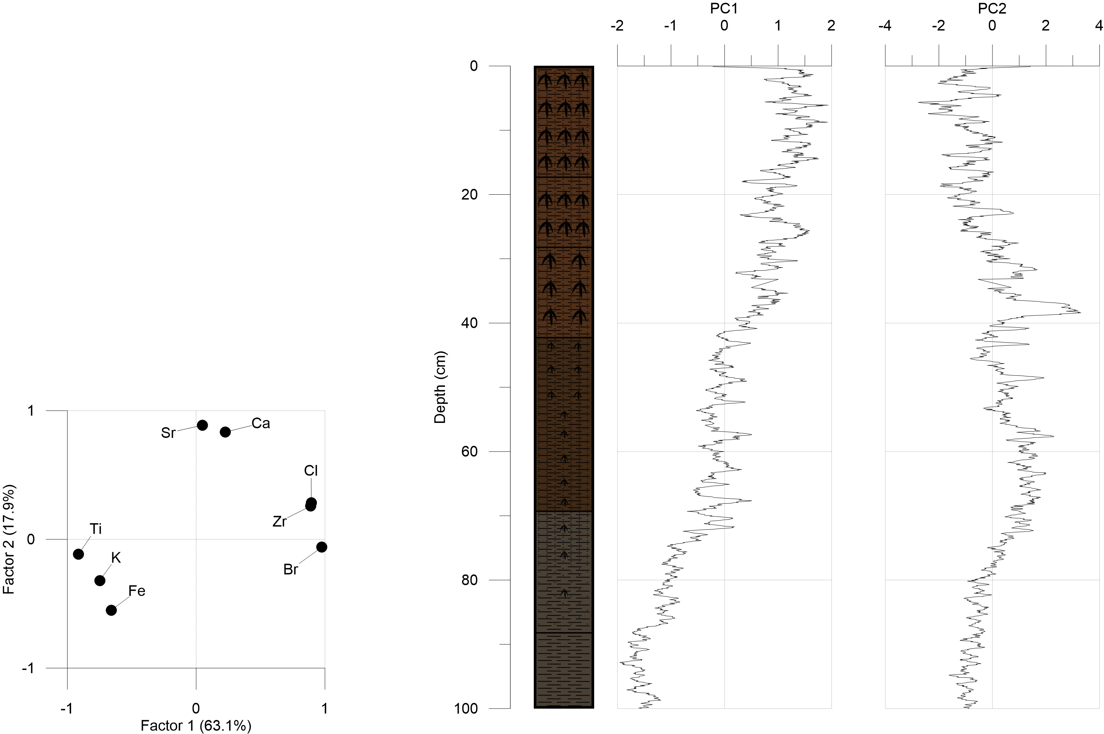

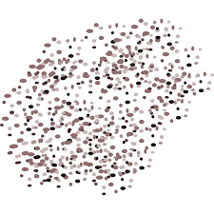


PC1 pos =
3.26 mm/yr
Sea level rise
PC1 neg =
1860 (1831-1886) CE
>2.00 mm/yr
PC2 pos =
PC2 neg =
<1.00 mm/yr
Notes:
Here you see a Principal Component Analysis (PCA) of the normalized X-Ray Fluorescence (XRF) data of the core. I used a centred-log ratio over 8 elements to normalize the data.
Component 1 represent the organic fraction related to peat and peat decomposition on the positive side, and the inorganic fraction on the negative side.
Component 2 represents marine sediment influx on the positive side, and terrestrial sediment influx on the negative side.
On the right side of the graph, I’ve also given an indication of accretion rates over sections of the core, which increase significantly above 42 cm. The accretion rates have been calculated from an age-depth model based on historical Pb-values and radiocarbon dates.
Above 42 cm depth, PC1 becomes solely positive and PC2 becomes first strongly positive, but then slowly goes back to negative values. In combination with the significantly increased accretion rates, we interpreted this as the development and expansion of the salt marsh, in a reaction to relative sea level rise. Based on the age-depth model, this must have started at 1860 (1831-1886) CE.

Slide 7
1860 CE: The Turning Point
The onset of relative sea-level rise in southwestern Norway
M. Holthuis, F.C. Nixon, M. Kylander, W. van der Bilt, J. Martin, T. Lakeman
Norwegian University of Science and Technology
max.holthuis@ntnu.no
Notes:
Since this is only one core at one location, verifying this result will be the next step in this research. This will be done by complementary analysis, e.g. grain size analysis, presence/absence of foraminifera & testate amoebae, and C/N analysis. Furthermore, the XRF analysis and the aforementioned analysis will also be executed on cores form other intertidal basins along the southwestern and northern Norwegian coastline to verify and determine the onset of relative sea level rise in those areas.
Thank you for taking a look at the display material of this presentation. I hope it gave you a little insight in what we do, and if you have any questions, you will find my mail address on the slide. If your interested in some more detailed data concerning the presented core, please take a look at the last 2 slides in the display material.

Slide 8
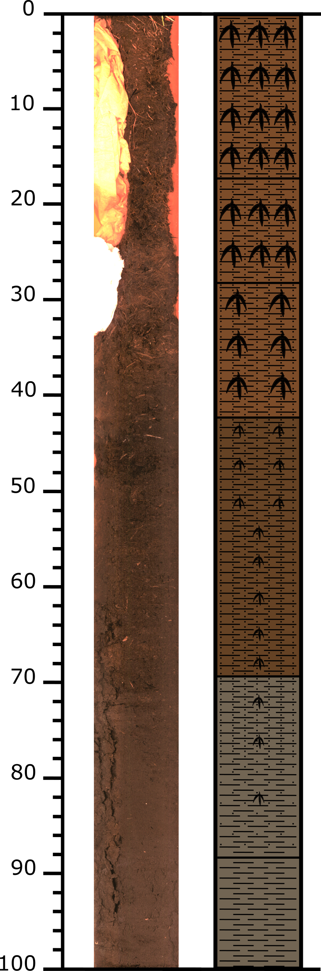
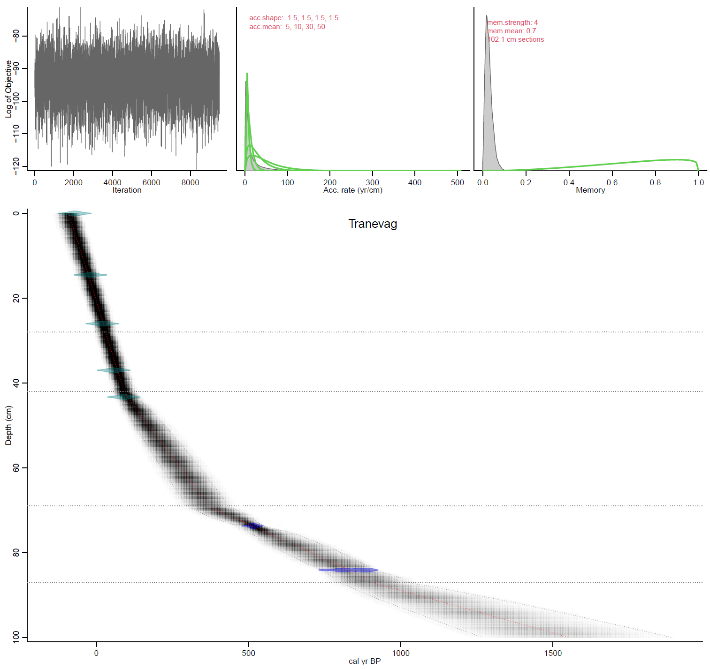
TV21-RC2
-26.5 (-53.5 - -1.5) cal a BP
XRF Pb-derived
dates
23 (-1 - 48) cal a BP
69 (44 - 95) cal a BP
99 (72 - 129) cal a BP
At 42 cm depth: start RSL rise?
90 (63-118) ca a BP
1860 (1832-1887) AD
523 (473 - 561) cal a BP
C14 dates
827 (740 - 907) cal a BP
Input dates for age-depth model from: Lilienthal, O. E. (2019). The onset of relative sea-level rise in the late 19th century at Tranevåg salt marsh, southern Norway (Master's thesis, NTNU).
Program used = Rbacon (2020)

Slide 9
Interval (cm) | Age range (CE) | Age range (cal a BP) | Accretion rate (mm/yr)
0-14.5 | 2021-1976.5 | -71 - -26.5 | 3.26
14.5-26 | 1976.5-1927 | -26.5 - 23 | 2.32
26-37 | 1927-1881 | 23 - 69 | 2.39
37-43 | 1881-1851 | 69 - 99 | 2.00
43-74 | 1851-1427 | 99 - 523 | 0.73
74-84 | 1427-1123 | 523 - 827 | 0.33
-71 cal a BP
3.26 mm/yr
-26 cal a BP
2.32 mm/yr
23 cal a BP
2.39 mm/yr
69 cal a BP
2.00 mm/yr
99 cal a BP
0.73 mm/yr
523 cal a BP
0.33 mm/yr
827 cal a BP

