Slide 1
TCDSE: A Novel Decision Support Environment for Risk Informed Urban Planning in Tomorrow’s Cities

Slide 2
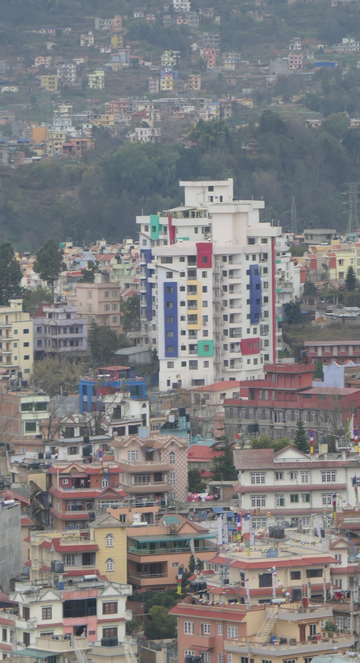
The Tomorrow’s Cities Challenge- How are we different?
More than 2 billion new citizens will populate urban centres. Over 95% will be in the global south.
To enhance sustainable urban development through risk-informed planning and decision-making in cities …
…. by understanding of the consequences of today’s decisions on tomorrow’s risk
Jade
Grass
We focus on future development – not just past mistakes
We acknowledge multiple hazards and multiple disciplines
We recognise the risk burden on poor and marginalised communities

Slide 3
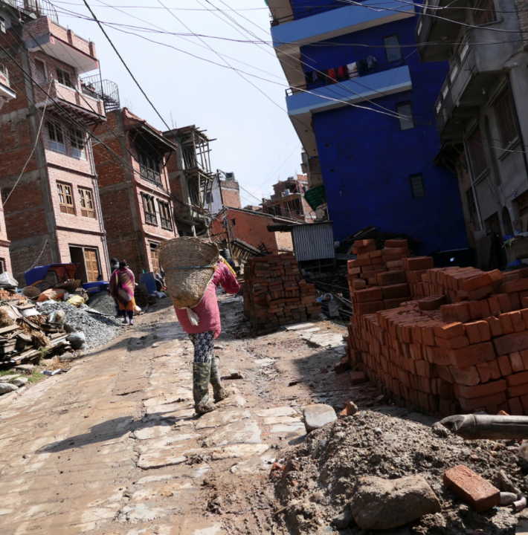
“Our mission is to reduce disaster risk for the poor in tomorrow’s cities”

Slide 4
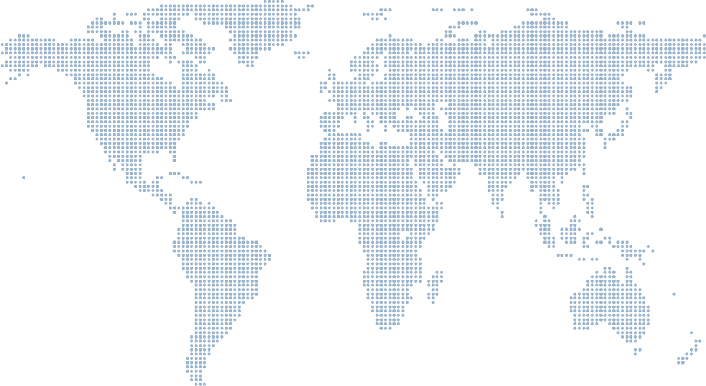
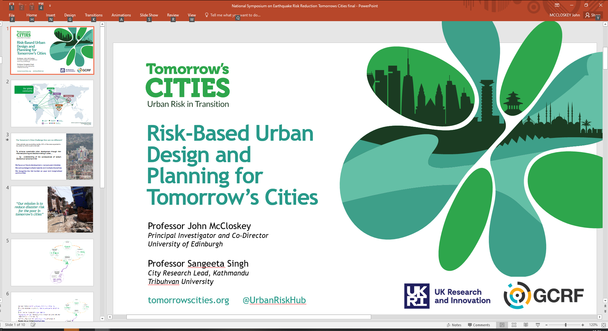
Collaborating UK organisations: University of Edinburgh Kings College London University of Bristol Institute of Development Studies University College London University of East Anglia Leeds Beckett University University of Cambridge University of Nottingham University of Plymouth University of Leeds British Geological Survey Overseas Development Institute University of Reading The Met Office
Edinburgh
13
Istanbul
Istanbul
Kathmandu
Nairobi
Quito
Nairobi
Quito
“Our mission is to reduce disaster risk for the poor in tomorrow’s cities”
…. by understanding of the consequences of today’s decisions on tomorrow’s risk
Advisory Board
International Collaborator
Principle investigator
City-Hub
City-Hub Collaborator

Slide 5
The Tomorrow’s Cities Decision Support Environment..
.. Supporting risk-sensitive and pro-poor urban planning and design in tomorrow’s cities

Slide 6
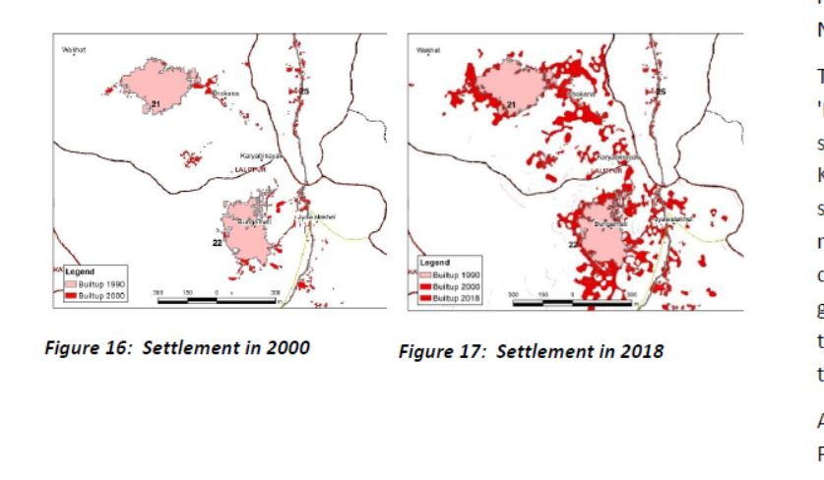
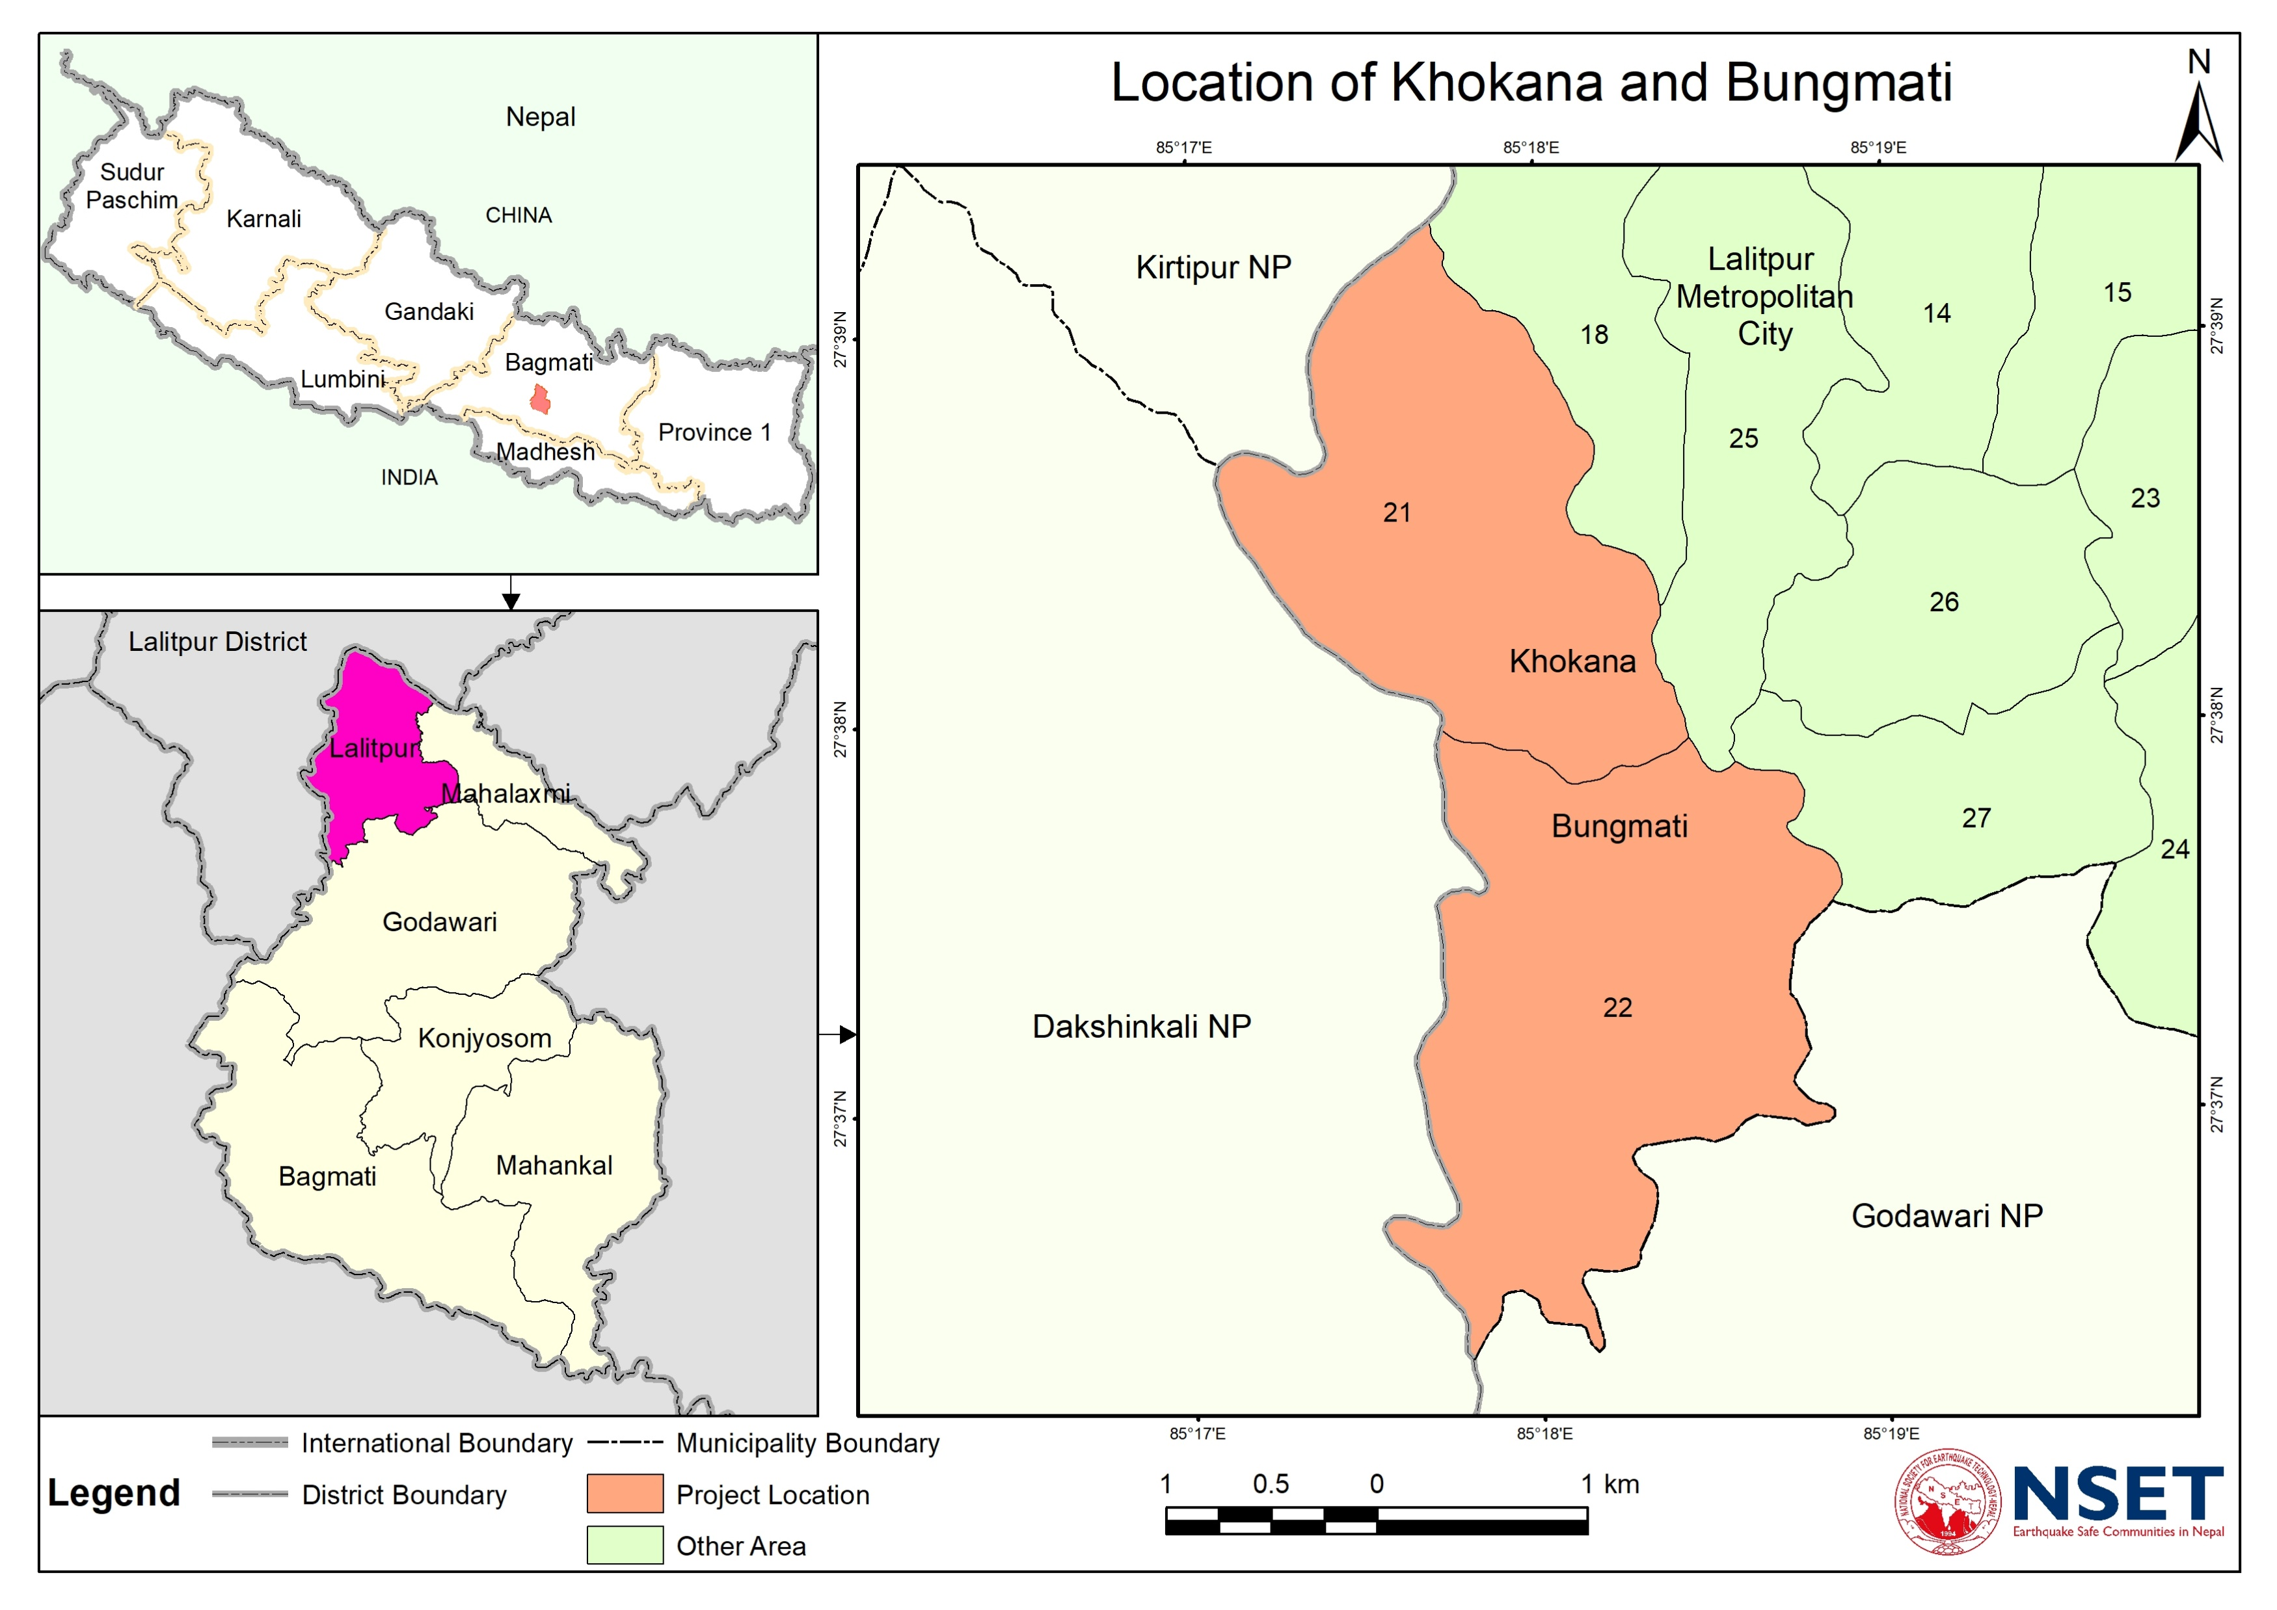
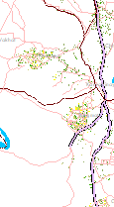
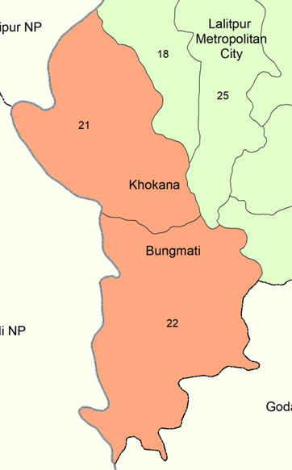
Study Area and need of exposure map Lesson1:Current exposure and trends are important to start with
Settlement in 2000
Settlement in 2018
Location Map
Data source: NSET, 2022 and KVDA, 2019

Slide 7
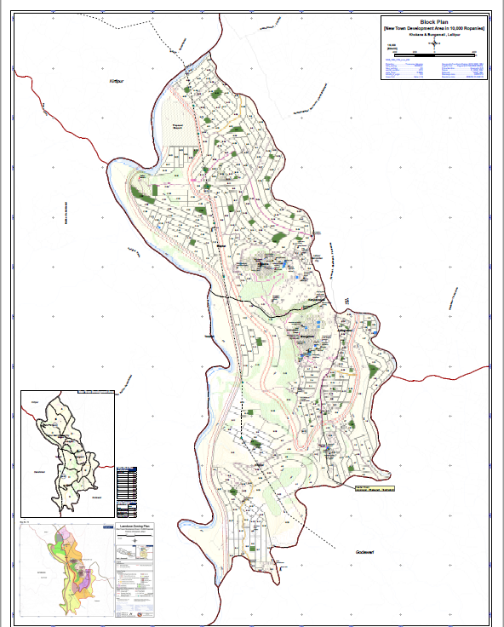
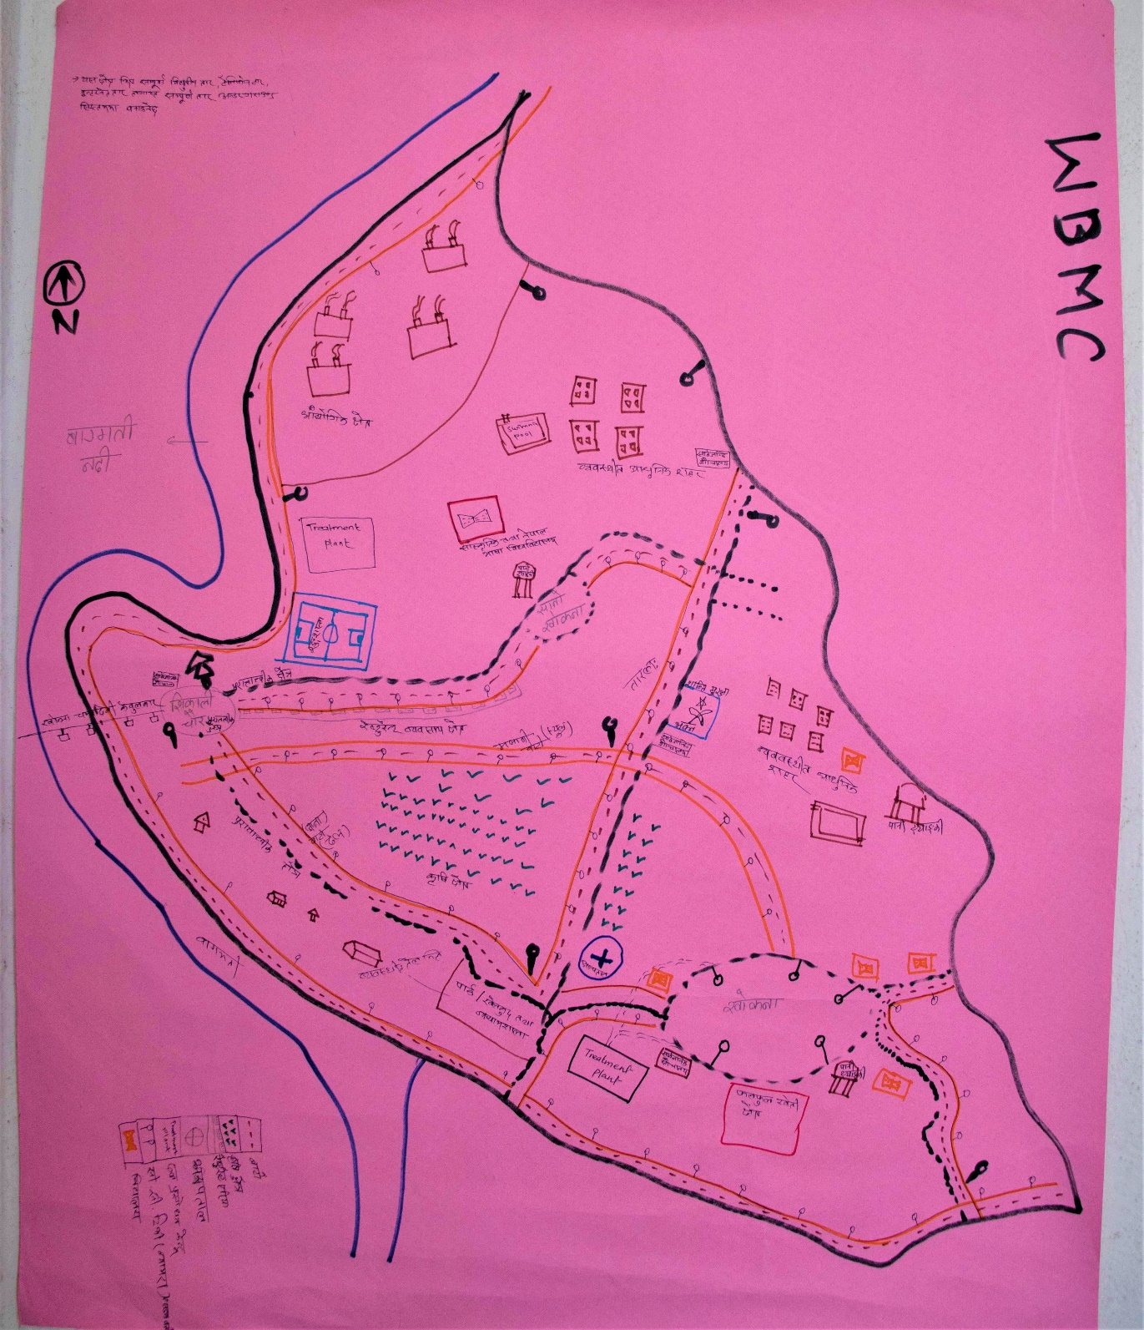
1. Future Visioning

Slide 8
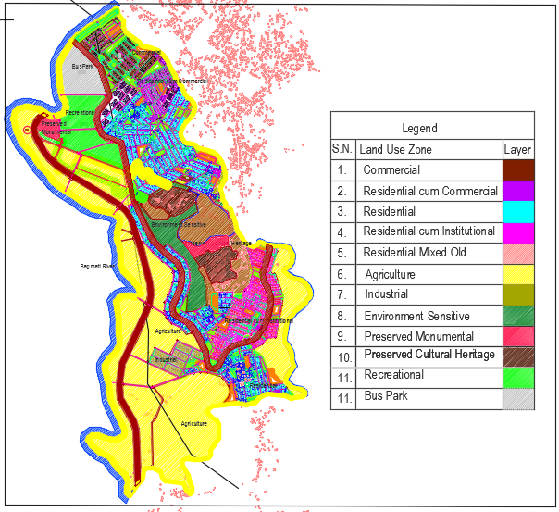
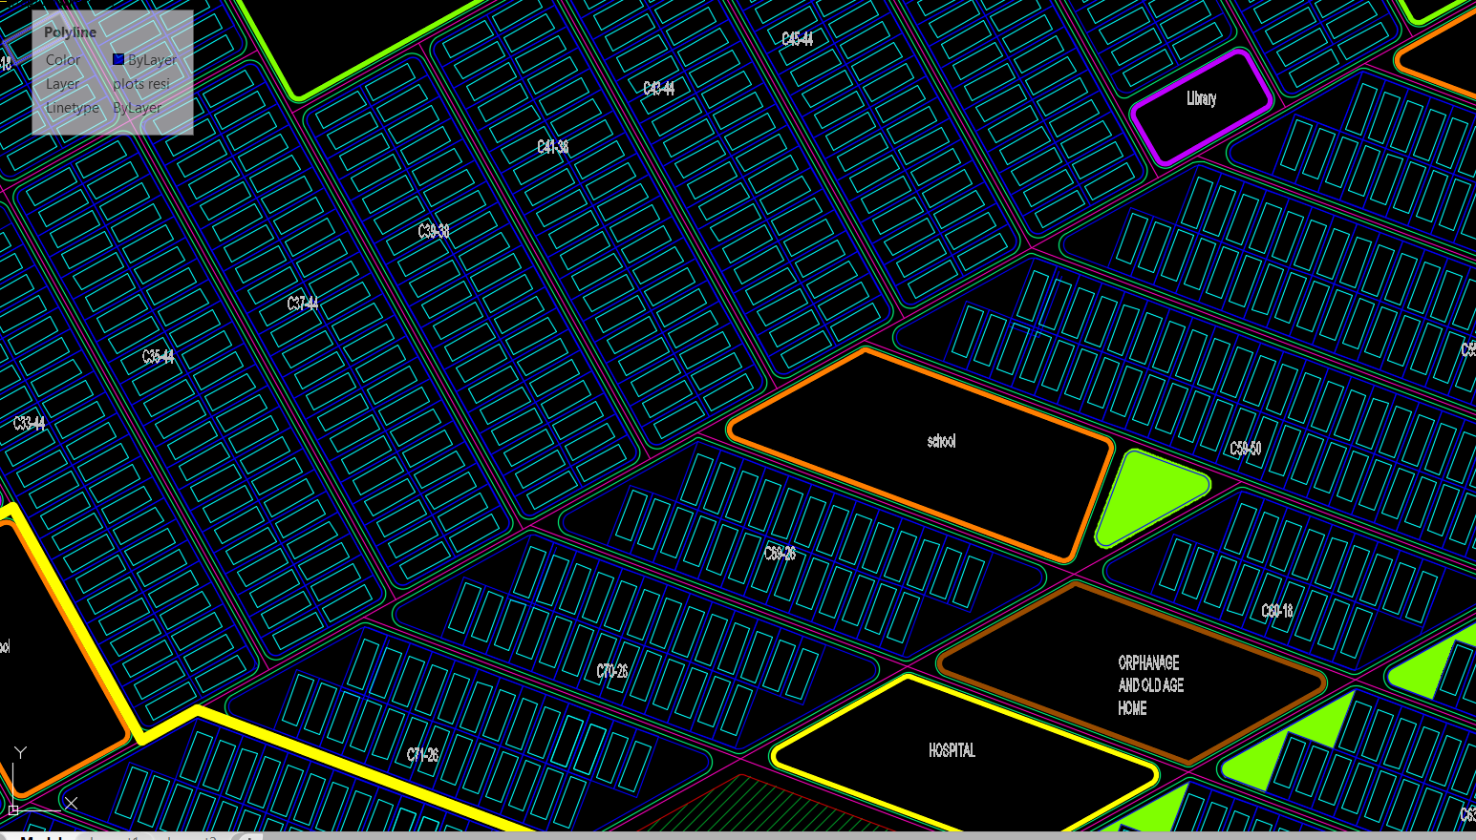
2. Visioning Scenarios
Option 1

Slide 9
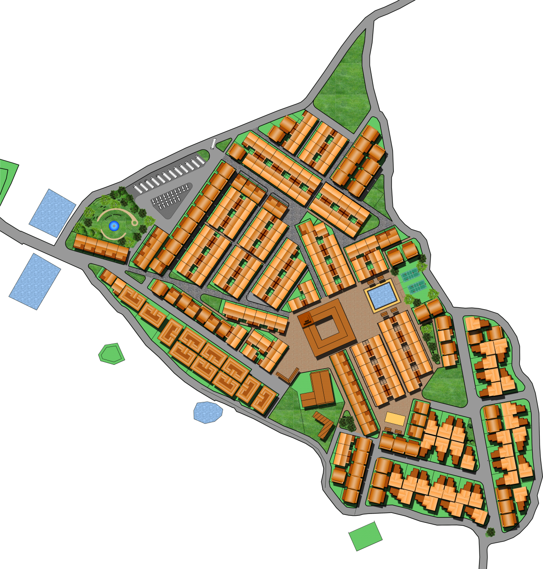

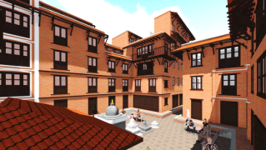
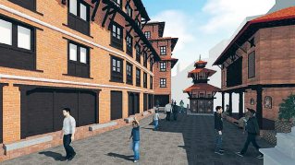
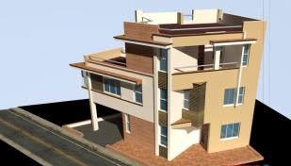
NEW SETTLEMENT AREA
MASTER PLAN
1
2
A
B
8
INDEX
0 – ADMINISTRATION
1 – MAIN ENTRY
2 – LODGE AREA
3 – WATERBODY+COMMUNITY SPACE
4 – MUSEUM+VIEW TOWER
5 – COURTYARD SPACE
6 - SCHOOL+CHAPACHHEN
7 – MARKET AREA
8 – SITE EXIT & ENTRY TO KHOKANA CORE
A – BUS STOP & PARKING
B – MEMORIAL & PARK SPACE
C – CHILDREN PARK
3
0
7
6
4
C`
5
MASTER PLAN

Slide 10
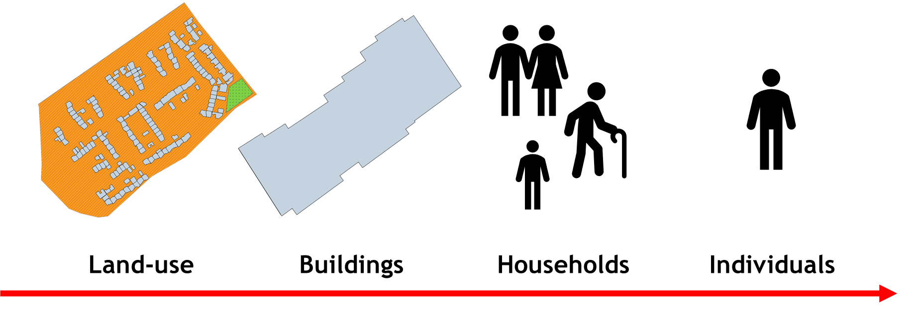

Detail is critical

Slide 11
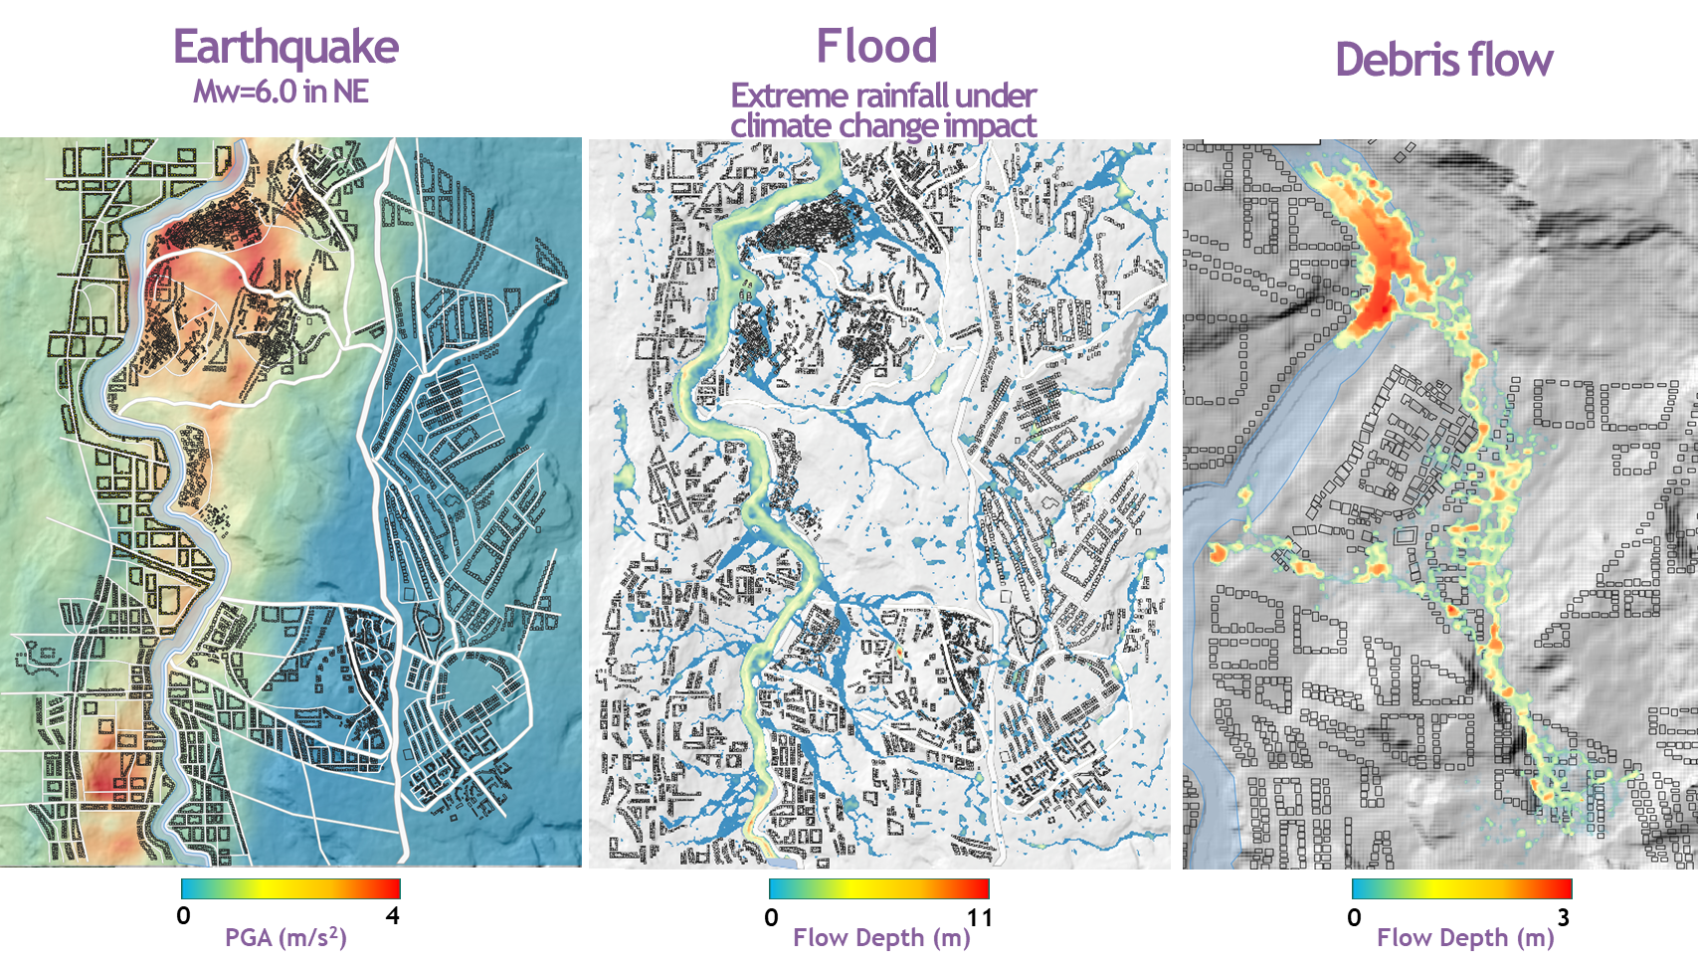
3. Computational Model

Slide 12
4. Risk Agreement

Slide 13
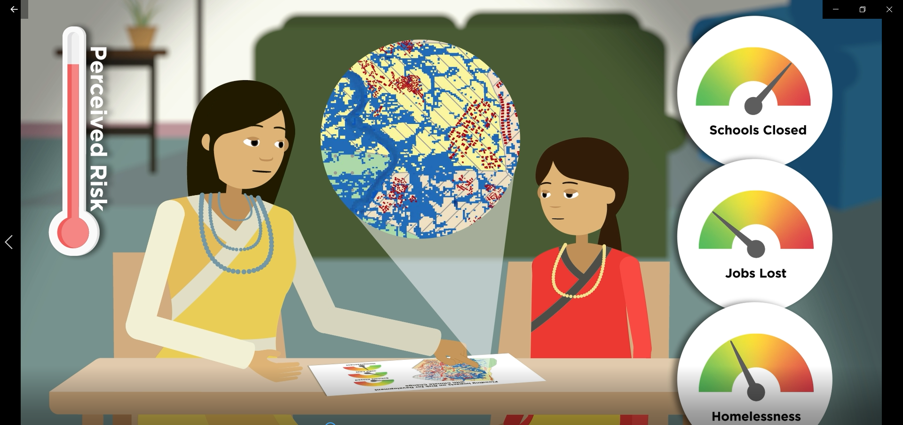
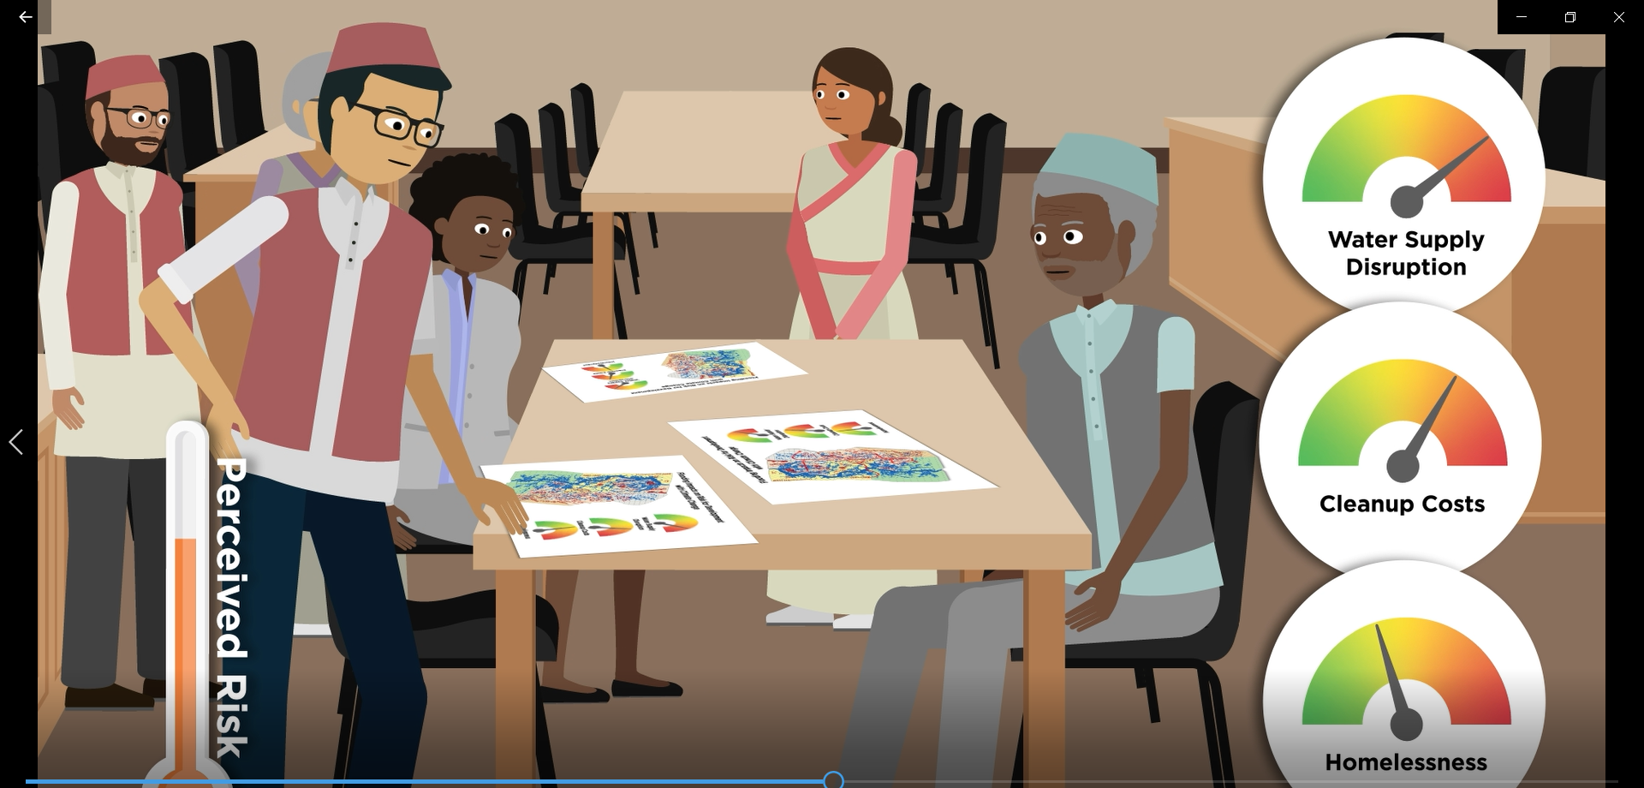
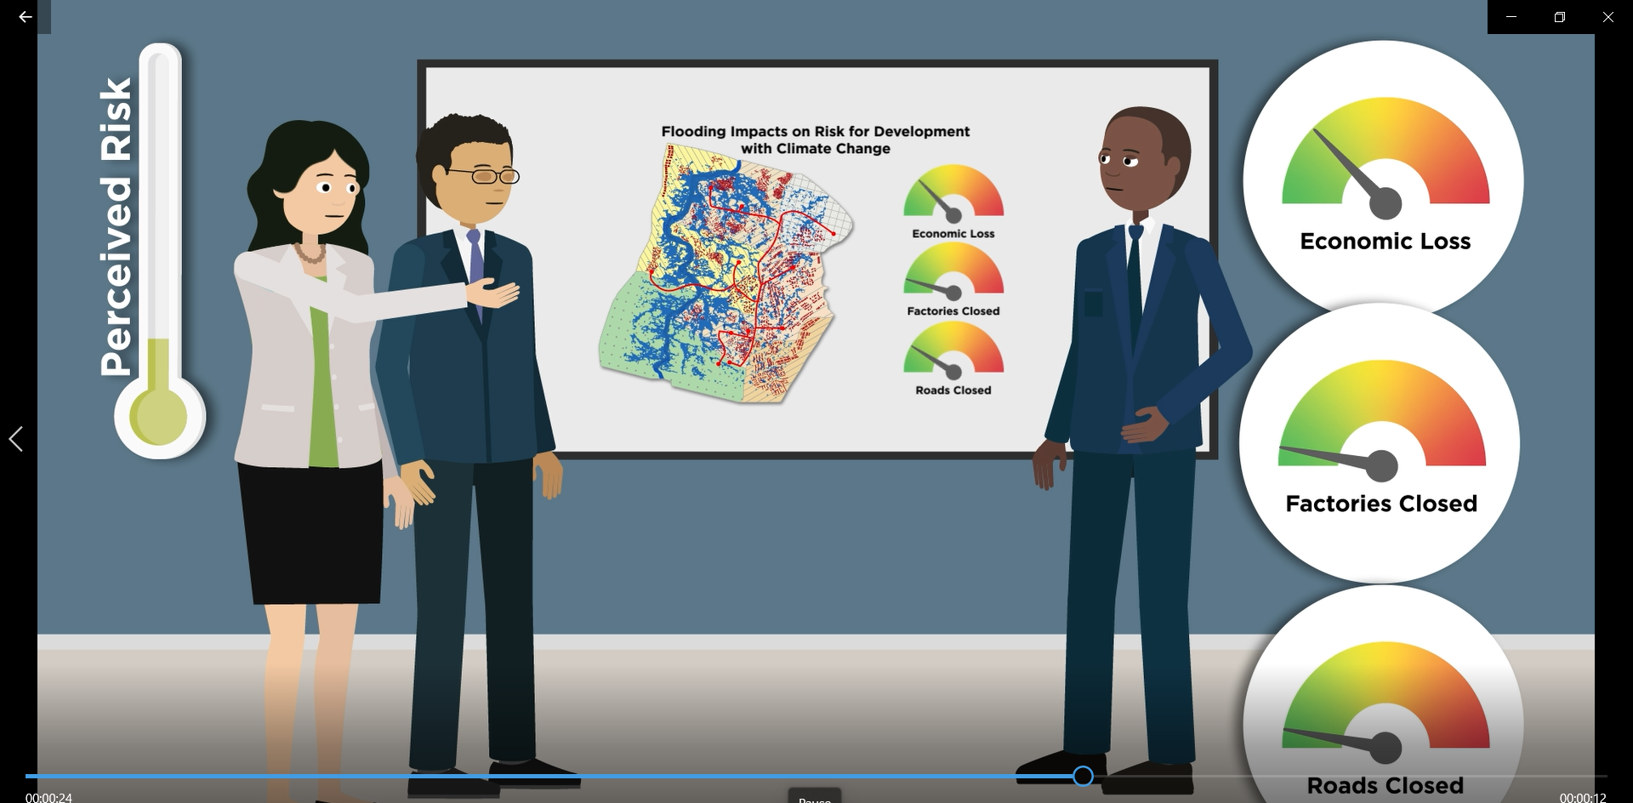
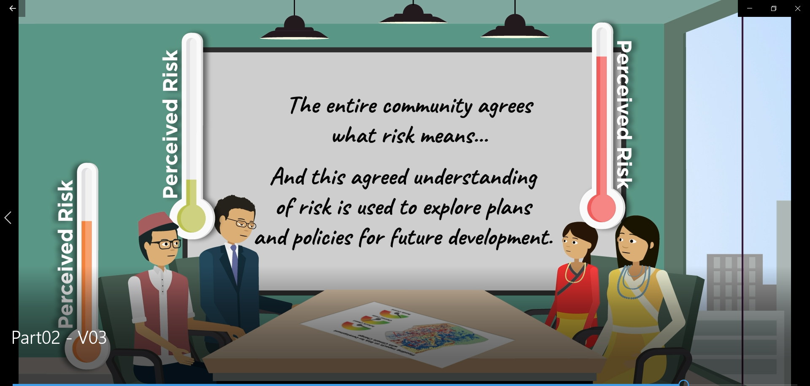
4. Risk Agreement

Slide 14
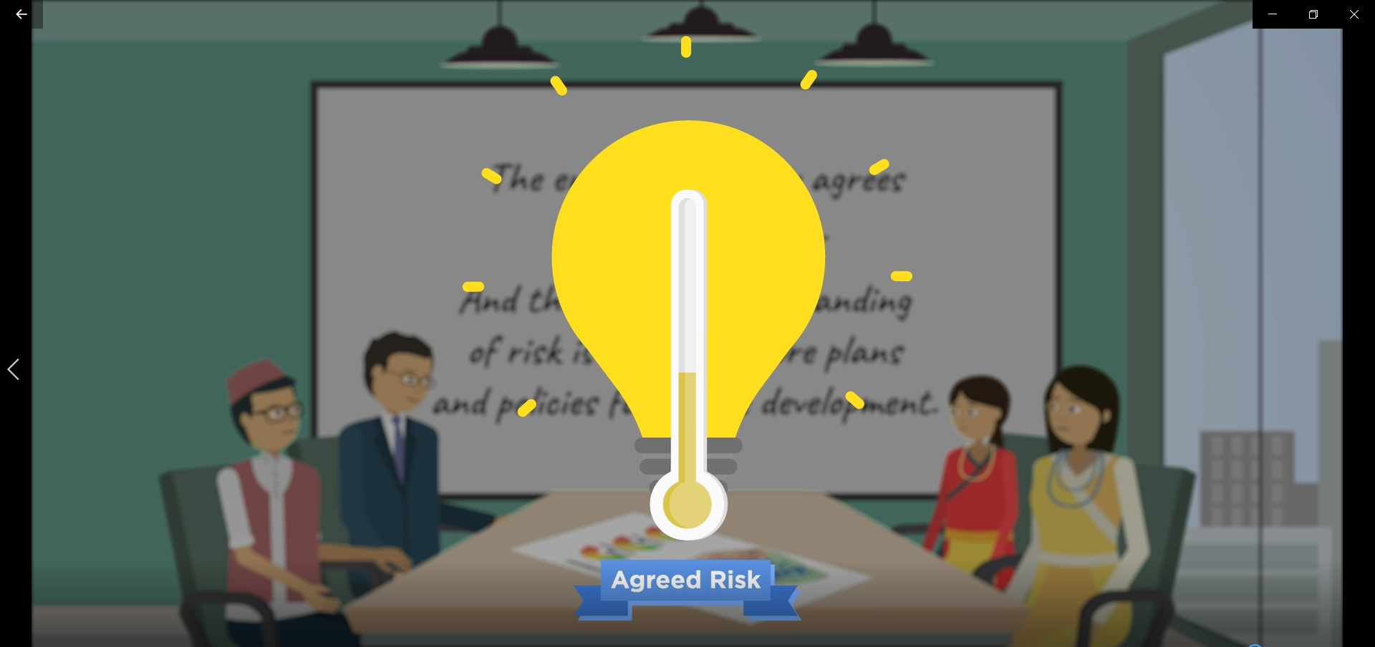
4. Risk Agreement

Slide 15
The Tomorrow’s Cities Decision Support Environment..
.. Supporting risk-sensitive and pro-poor urban planning and design in tomorrow’s cities

Slide 16
The Tomorrow’s Cities Decision Support Environment..
Mapping future exposure to multiple hazards in Tomorrow’s Cities: the Khokana, Kathmandu, Nepal case study
Aditi Dhakal, et al.
Characterising the dynamic physical vulnerability of Tomorrow’s Cities to multiple natural hazards
Roberto Gentile et al
A State-of-the-Art Approach to Modeling Future Multi-Hazard Risk, supporting People-Centred Decision Making
Gemma Cremen et al.
Physics based simulations of multiple hazards for risk sensitive land use planning
Luke Jenkins, et al.
Unleashing the power of the interdisciplinary in disaster risk reduction: reflections from an early career researcher group developing a risk-informed decision support environment for Tomorrow’s Cities
Maria Evangelina Filippi, et al.
A Novel Decision Support Environment for Risk Informed Urban Planning in Tomorrow’s Cities
John McCloskey, et al.

