Slide 1


Spatiotemporal post-fire change analysis using optical and SAR imagery
2022.05.25
Yeji Lee, Junse Oh, Su Young Kim, Yoon Taek Jung and Sang-Eun Park
Geoinformation engineering, Sejong University

Slide 2


Introduction
Background
Previous studies on permafrost fires have dominated the vegetation recovery
Permafrost fires affect not only vegetation, but also permafrost active layer
Objective
Monitoring the post-fire changes in permafrost active layer using optical and SAR
Method
Optical Imagery classification
Time series backscatter analysis
Interferometric SAR deformation
Monitoring the active layer changes related to fire!
Active layer
What happen?
Permafrost

Slide 3
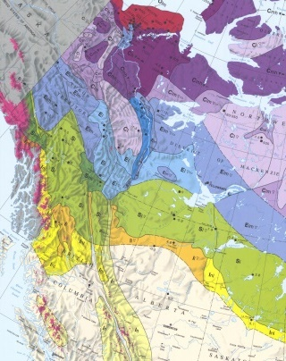
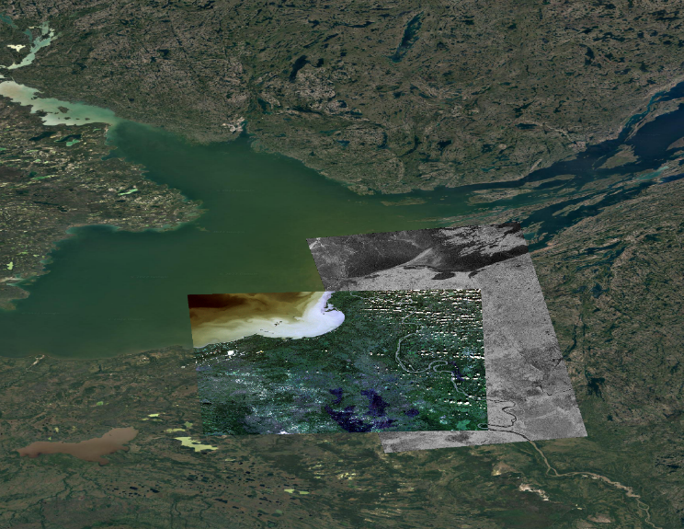
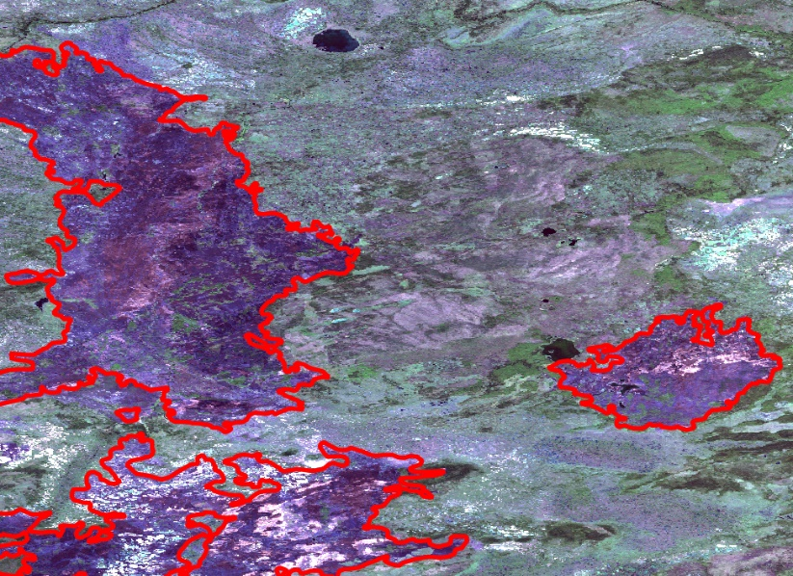
Study area & dataset
Study area
South northwest Territories, Canada
Fire perimeter
Sentinel-1
Study
area
Sentinel-2
Dataset
2017
2018
2019
2020
2021
Five-year Sentinel-1 and Sentinel-2 were used to monitor the active layer changes related to fires
Sentinel-1
2017.03.27~2021.12.31 Total 128 scenes
Sentinel-2
2017.08
2017.07
2018.07
2019.07
2020.07
2021.07

Slide 4
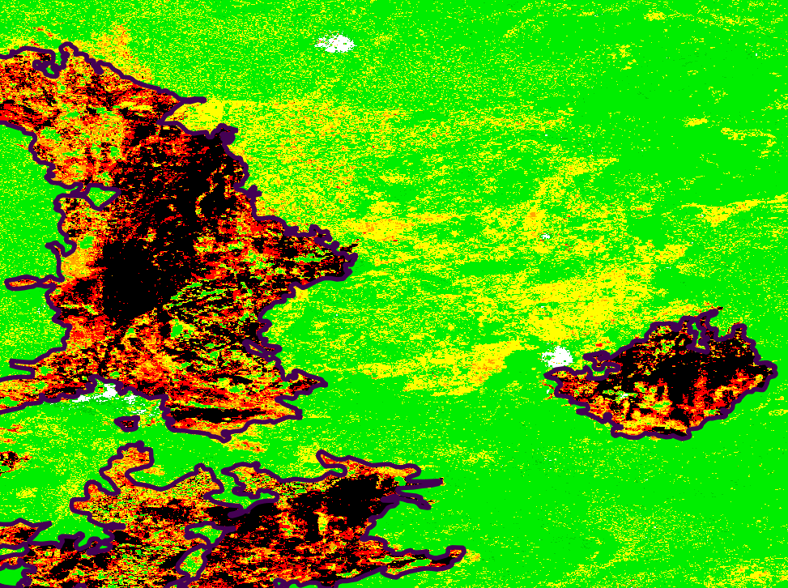
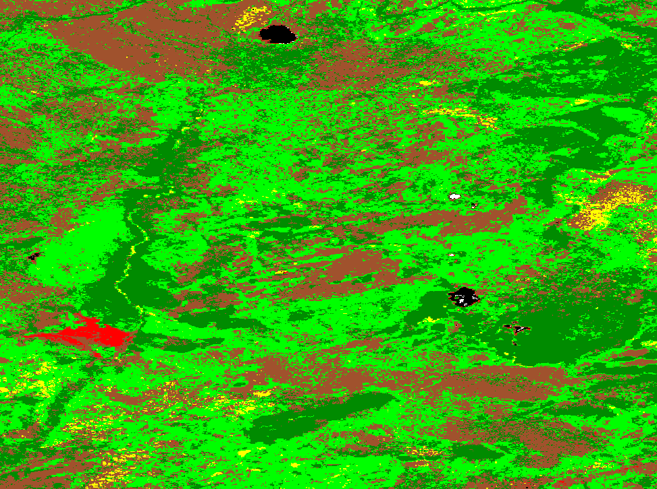
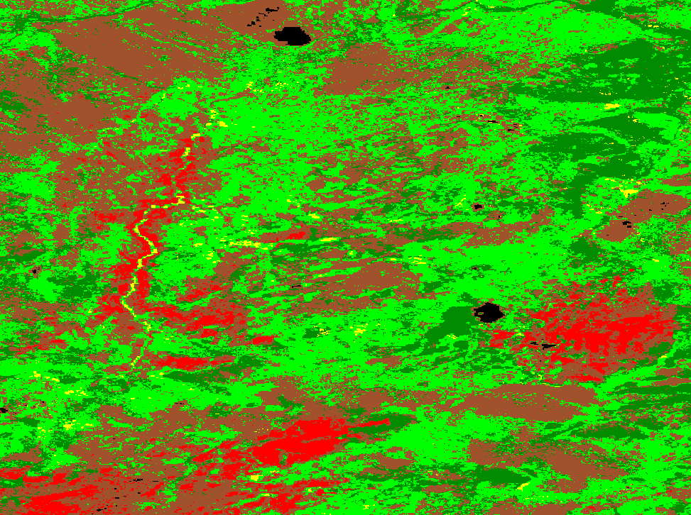
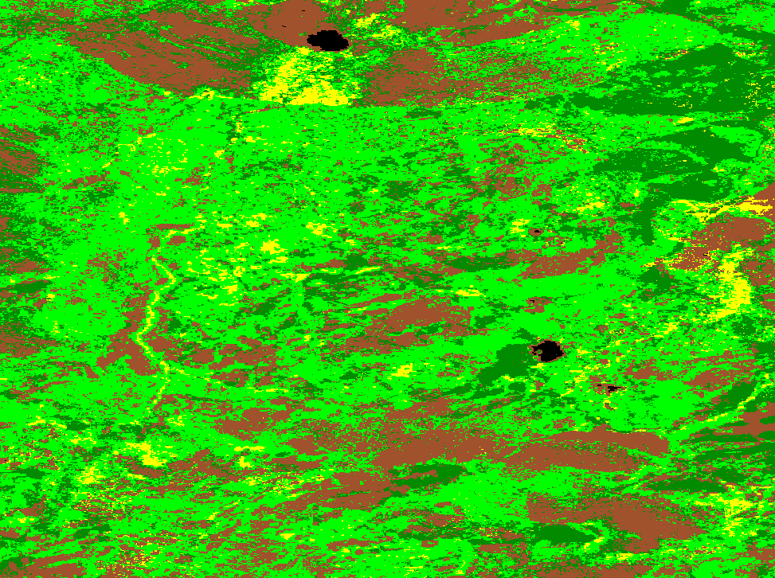
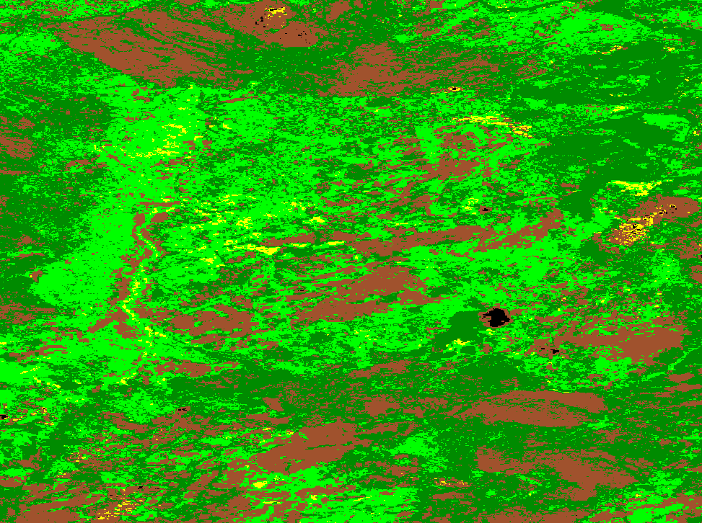
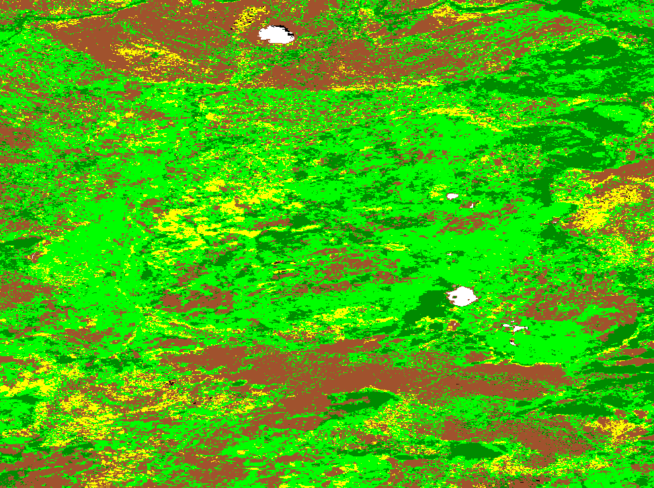
Results – Optical classification
Sentinel-2 classification
1. Burn severity map using dNBR
2. Time series land cover change map
High
Moderate
Water
Dense forest (DF)
Sparse forest (SF)
high
low
Low
Unburned
Regrowth
Grass (GA)
Sparse grass (SG)
Burned area (BA)
17.07.24
(pre-fire)
18.07.27
(post-fire)
•••
21.07.31
(post-fire)
20.07.31
(post-fire)
19.07.19
(post-fire)
Over time, the vegetation in the area where the fire occurred is gradually recovering

Slide 5
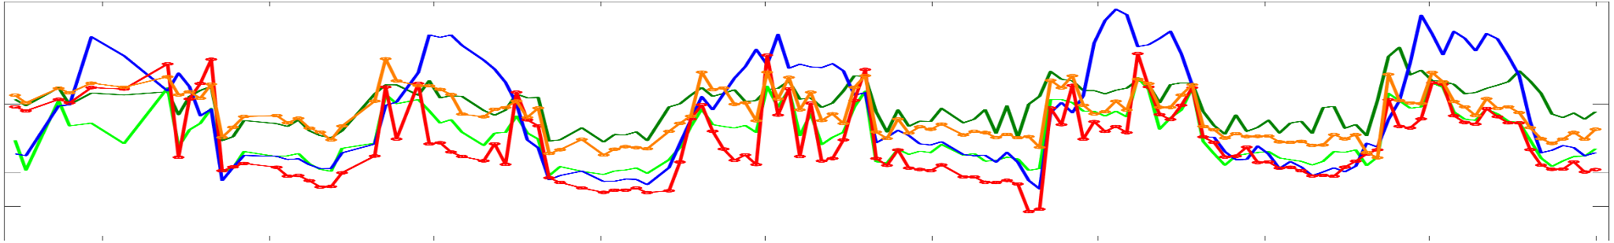


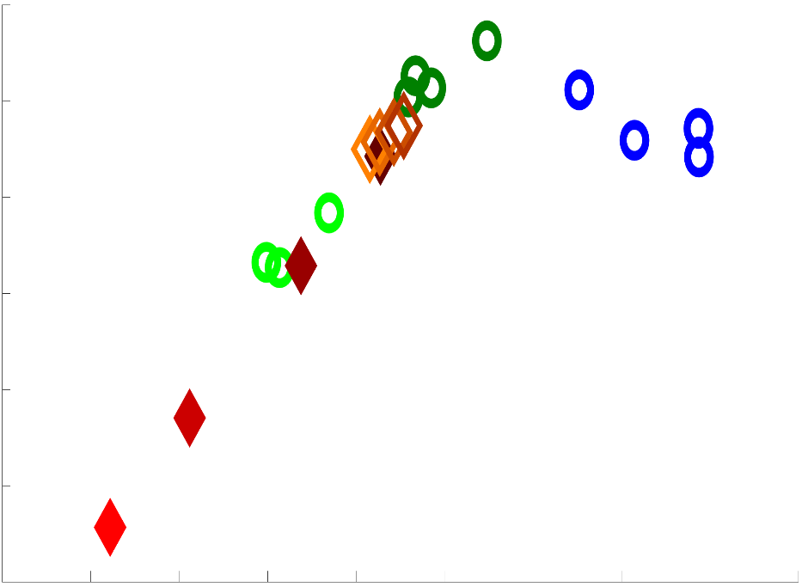
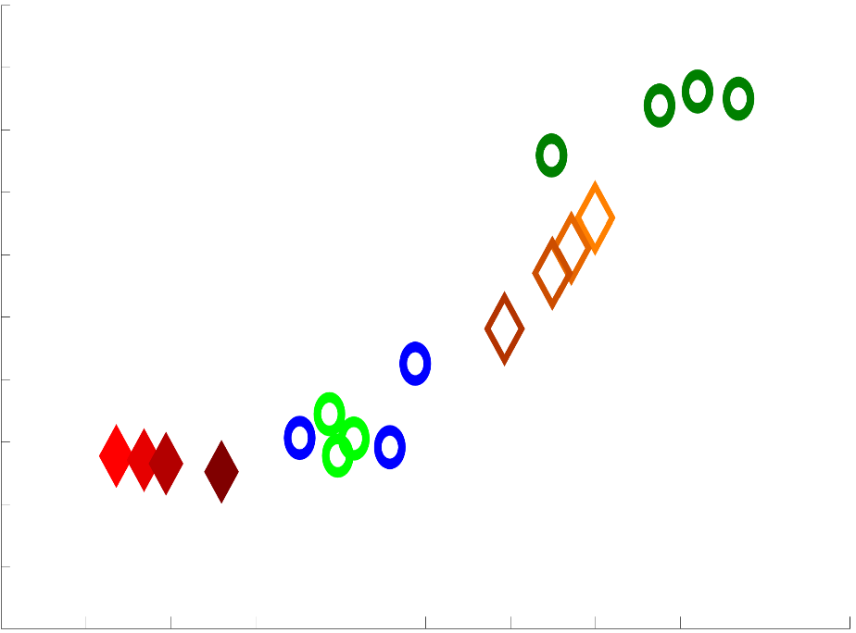
Results – Time series Sentinel-1
Time series backscattering coefficient
High Severity
Moderate Severity
Dense forest
Sparse forest
Sparse grass
-4
-6
-8
-10
VV Scattering Power [dB]
-12
-14
-16
-18
17-07
18-01
18-07
19-01
19-07
20-01
20-07
21-01
21-07
22-01
Summer season
Winter season
-14
Severity
Dense forest
-17
Severity
Over time
Over time
-15
-18
High
High
-16
Moderate
Sparse grass
Moderate
-19
VH Scattering Power [dB]
VH Scattering Power [dB]
-17
Sparse forest
Burned areas go to
dense forest over time
-20
-18
-19
-21
Burned areas go to
sparse forest & sparse grass over time
-20
-22
-13
-12
-11
-10
-9
-8
-7
-6
-5
-15
-14
-13
-12
-11
-10
VV Scattering Power [dB]
VV Scattering Power [dB]

Slide 6
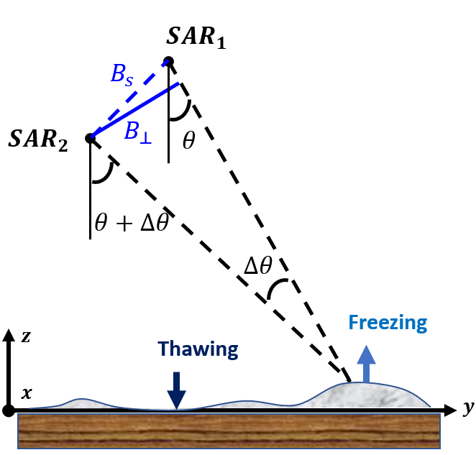
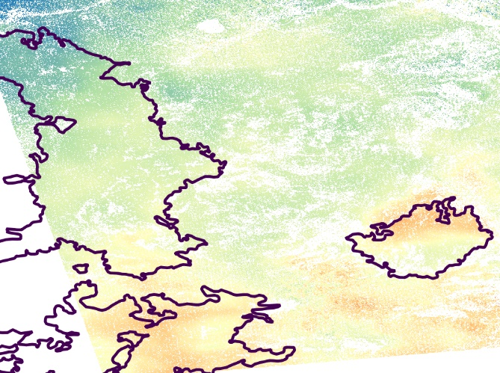
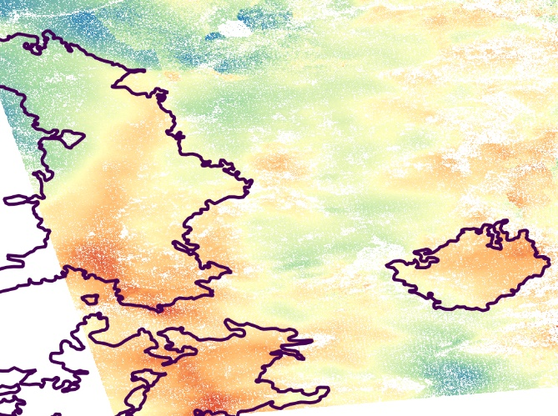

Results – InSAR deformation
Differential Interferometry SAR
2017
2020
Pre-fire
Post-fire
$$∆φ$$
Frost heave
Active layer
thickness
Active layer
Permafrost
Burn severity map
17~18 freezing season
20~21 freezing season
High
Moderate
LOS displacement [cm]
LOS displacement [cm]
high
low
0
6
0
6
Low
Unburned
Regrowth
Uplift deformation was occurred associated with the burn severity

Slide 7
Conclusion
Summary
In this study, post-fire permafrost changes were observed by using optical and SAR
Optical imagery classification showed vegetation recovery after permafrost fires
Winter SAR data showed that the active layer changes associated with burn severity
Future work
Further analysis of multi-frequency SAR is needed for a better understand the effects of permafrost fires
Additional analysis will be performed using the L-band ALOS-2 and the X-band TerraSAR-X in future work

Slide 8
Thank you!

