Slide 1





Local Physical Chemistry Statements for Low cost sensor added value
Janice Scheffler,
Massimo Vieno, Michael Flynn, Stuart Lacy, Sebastian Diez, Francis D. Pope, Pete Edwards, and Christine F. Braban
EGU 2022 – AS3.1 – 24/05/2022

Slide 2
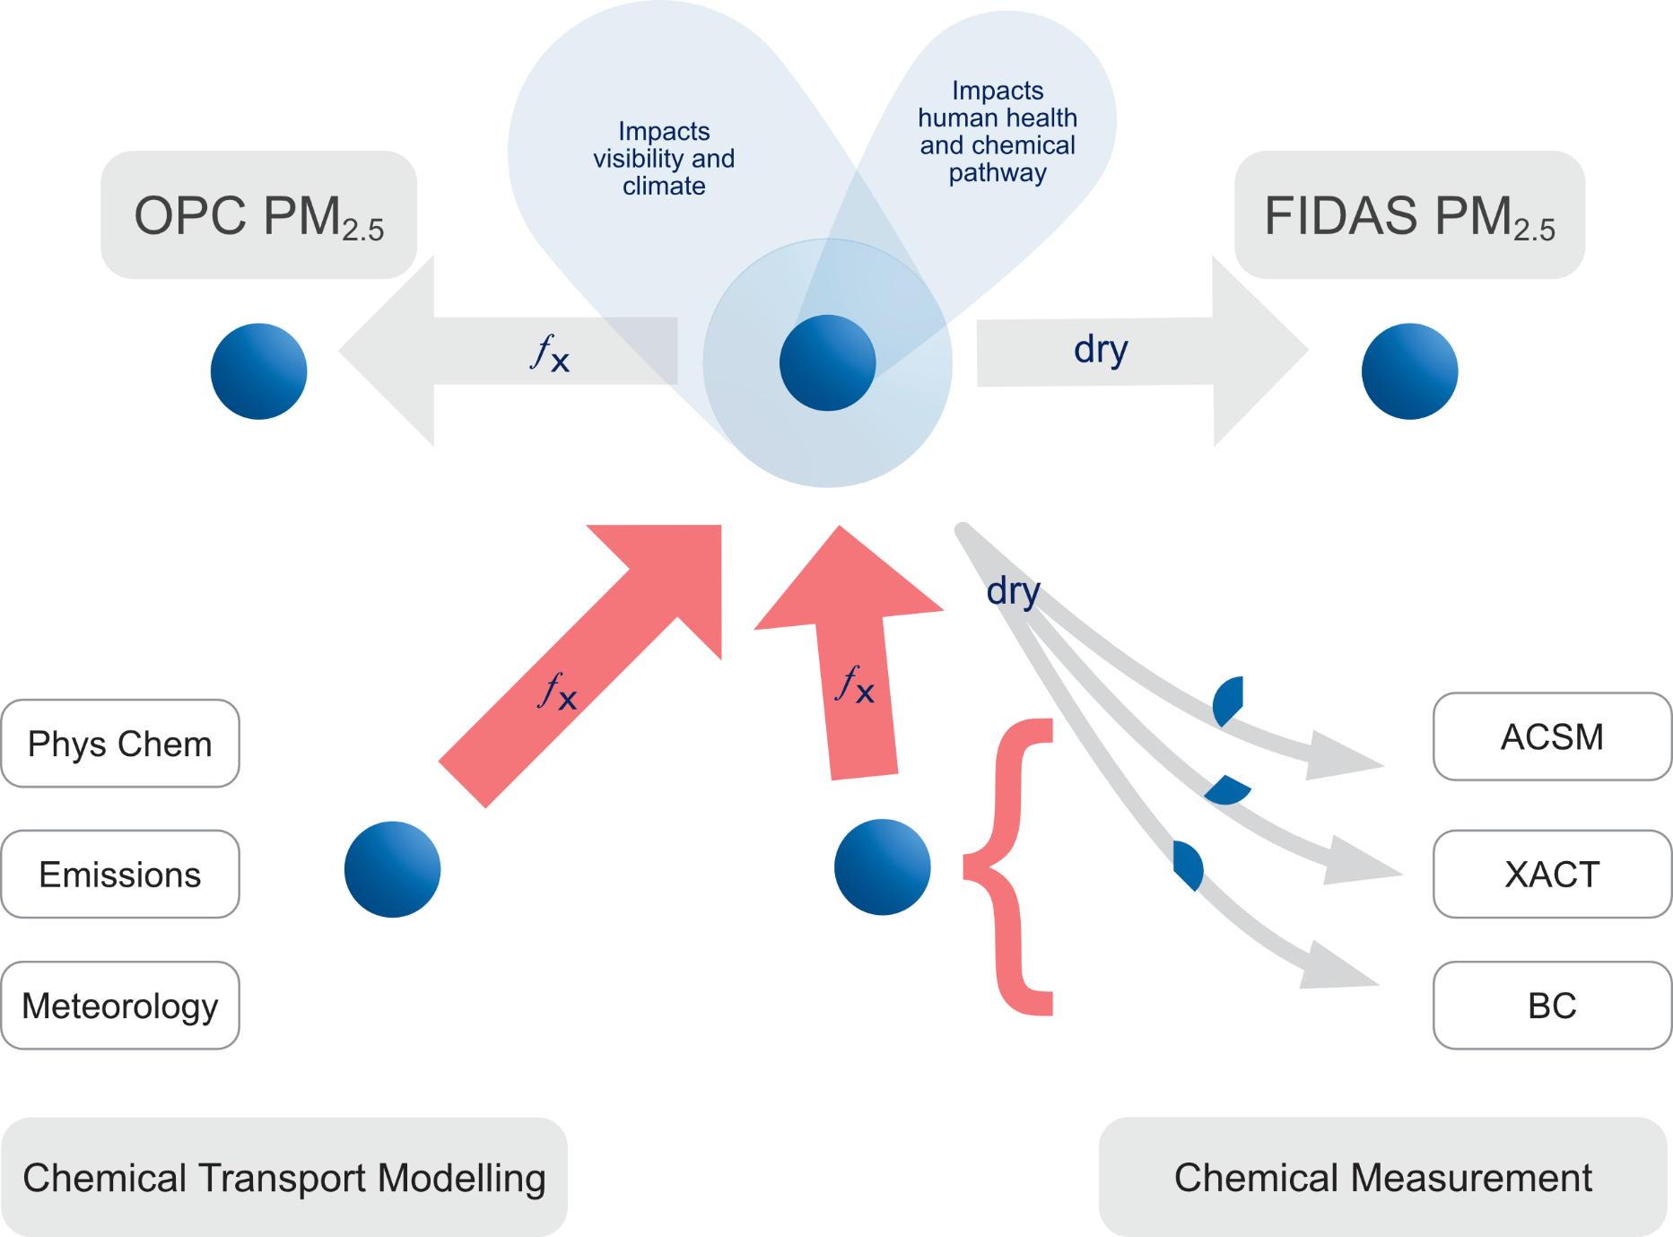
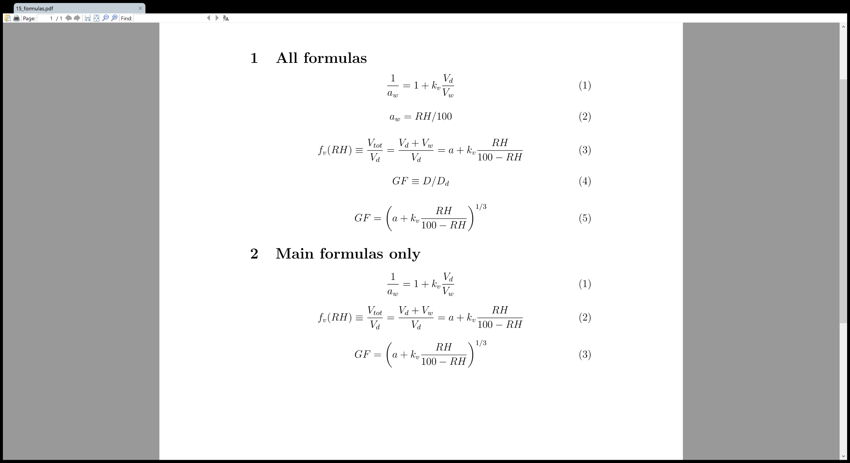
Approach
Snider et al. (2016) use κ-Köhler theory with hygroscopicity parameter κ (Petters and Kreidenweis, 2007) to calculate diameter D growth factors GF for chemicals depending on relative humidity
Calculate water mass for organics and inorganic salts
BC and metal oxides assumed to be insoluble

Slide 3
Approach
Snider et al. (2016) use κ-Köhler theory with hygroscopicity parameter κ (Petters and Kreidenweis, 2007) to calculate diameter D growth factors GF for chemicals depending on relative humidity
Calculate water mass for organics and inorganic salts
BC and metal oxides assumed to be insoluble

Slide 4
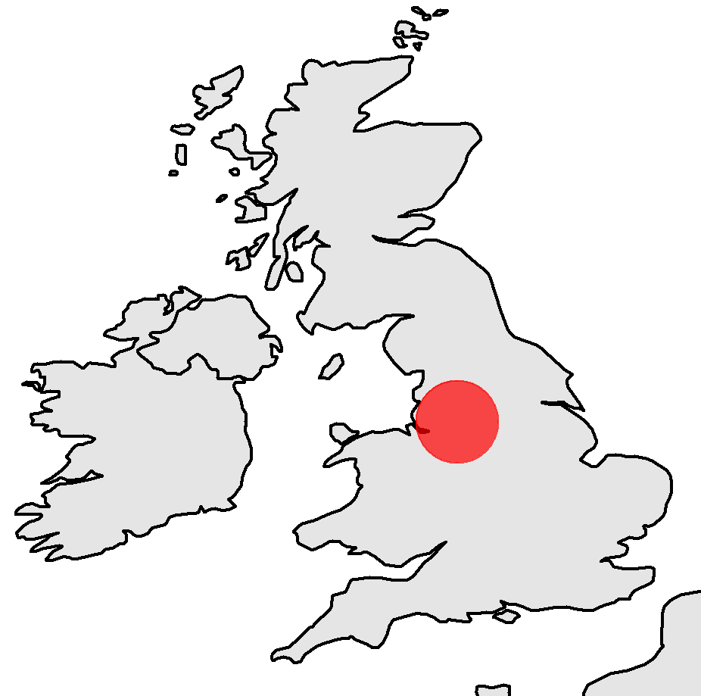
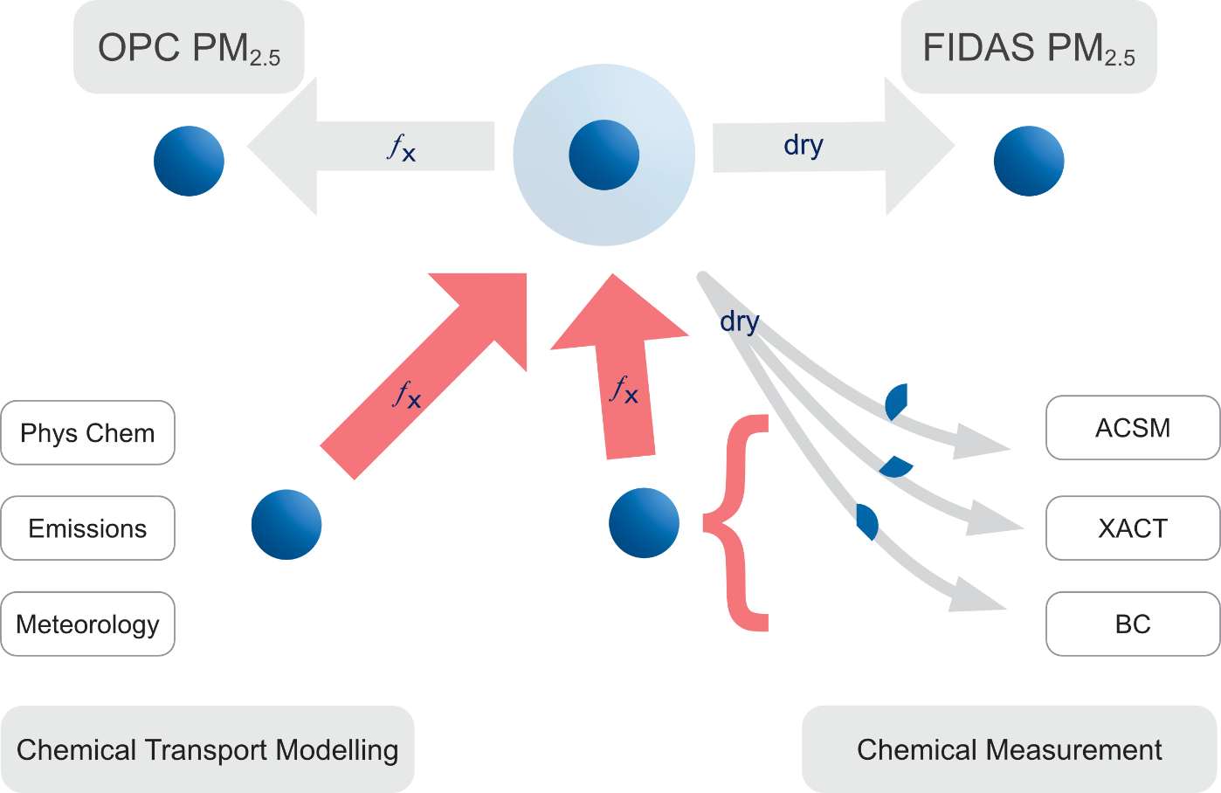
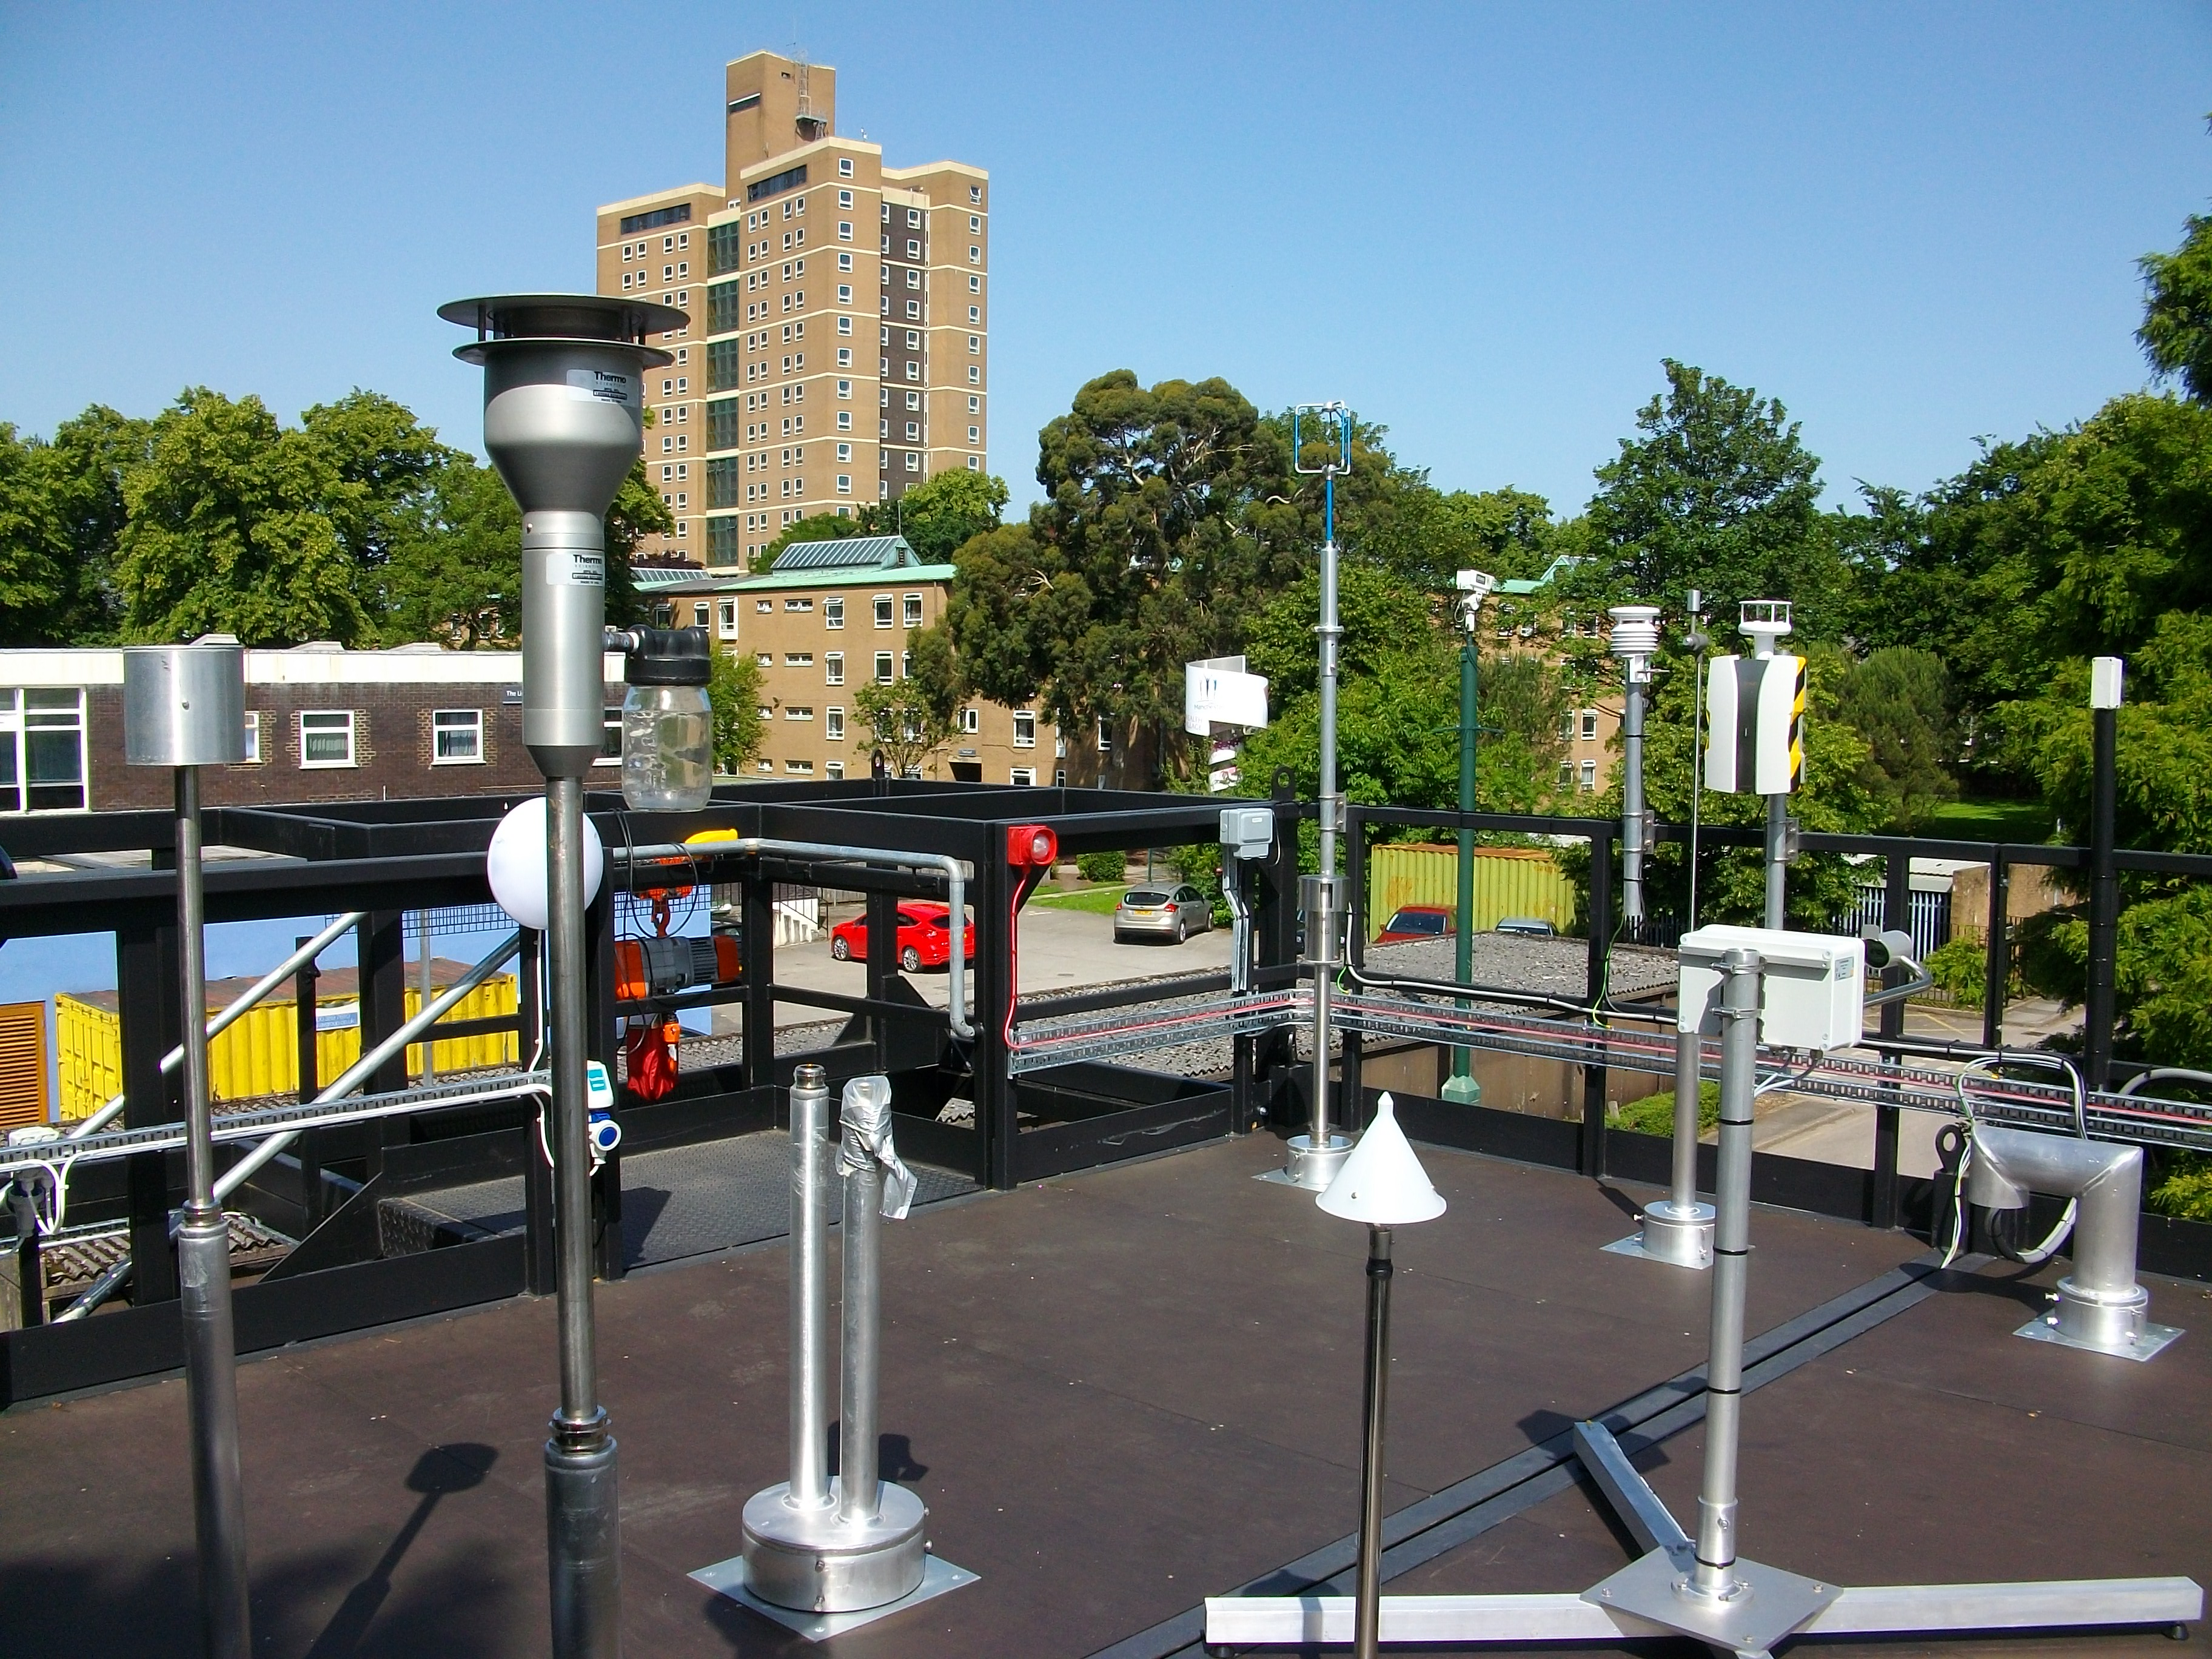
Manchester supersite (20/02/2021 to 08/03/2021)
Purple Air
Meteorological
observation
NH₄, NO₃, SO₄
metal oxides
black carbon
EMEP4UK
NaCl proxy: measurement from Auchencorth Moss supersite
Photo: Michael Flynn

Slide 5
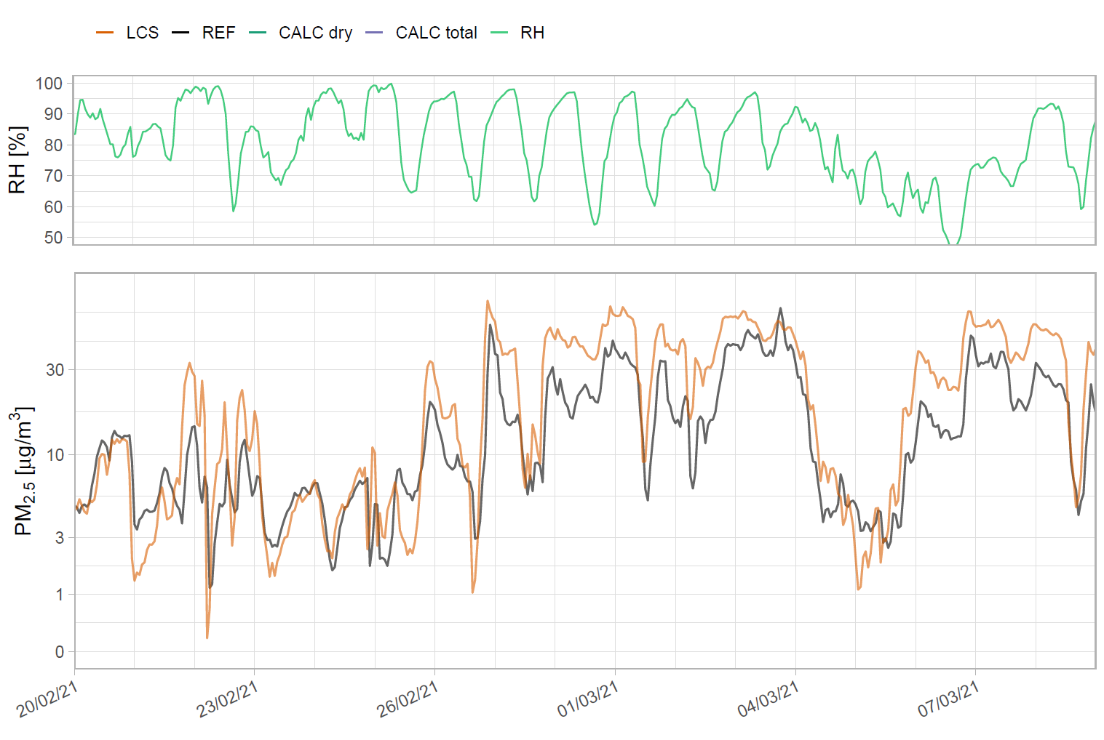
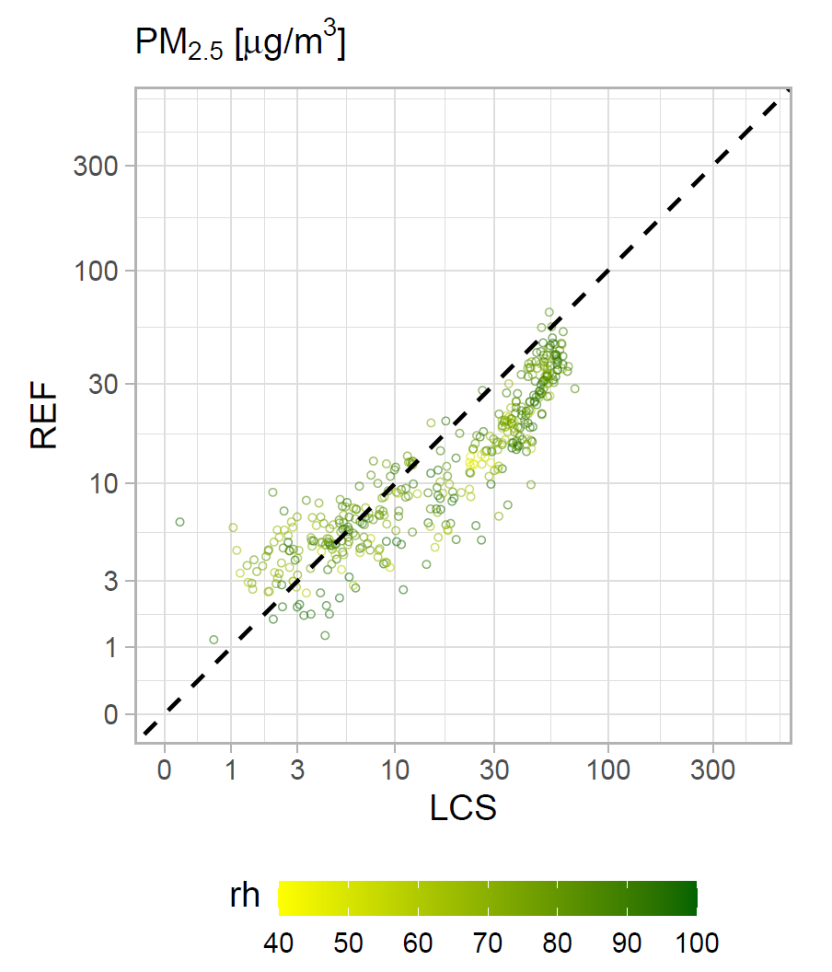
Traditional approach

Slide 6
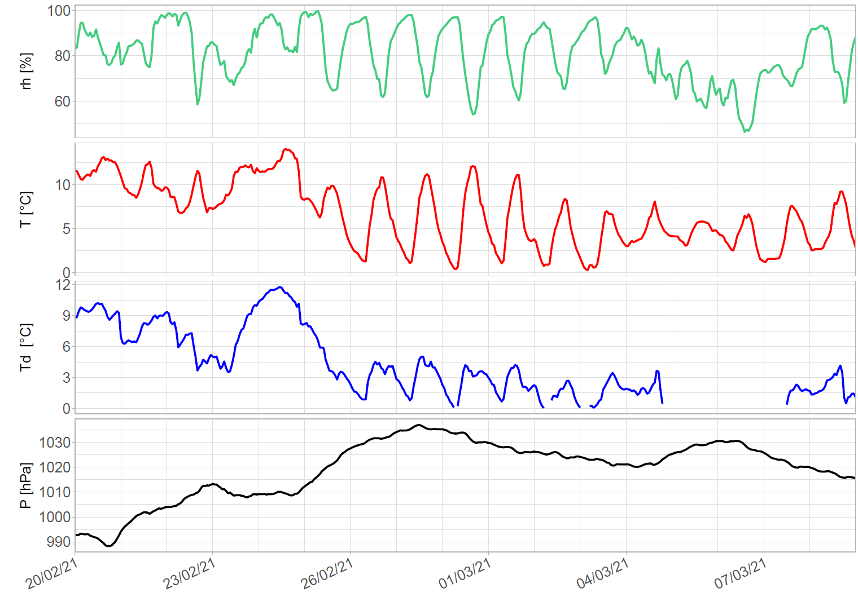
Local Physical Chemistry Statement (LPCS) approach
Weather
Growth factors
Calculate growth factors for hygroscopic PM_{2.5} components
Calculate water associated with hygroscopic chemicals depending on RH

Slide 7
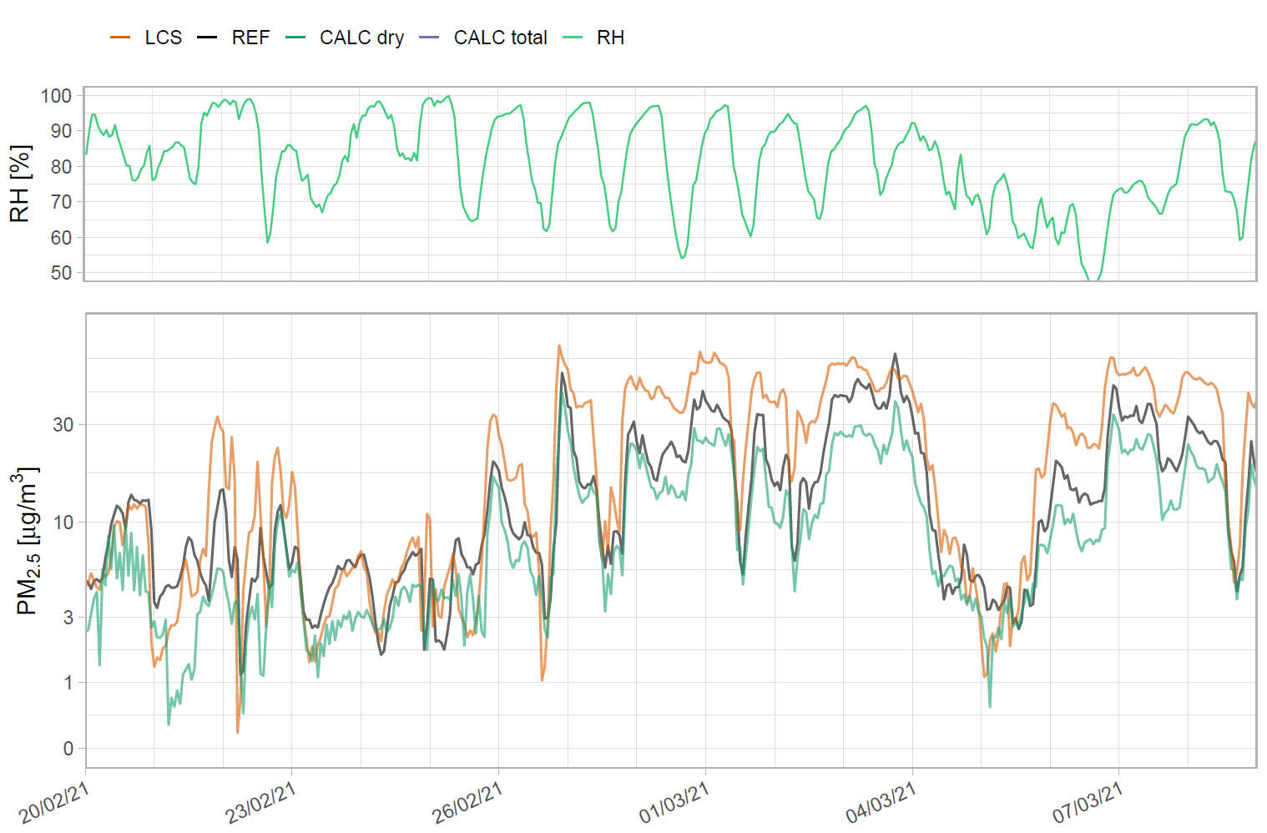
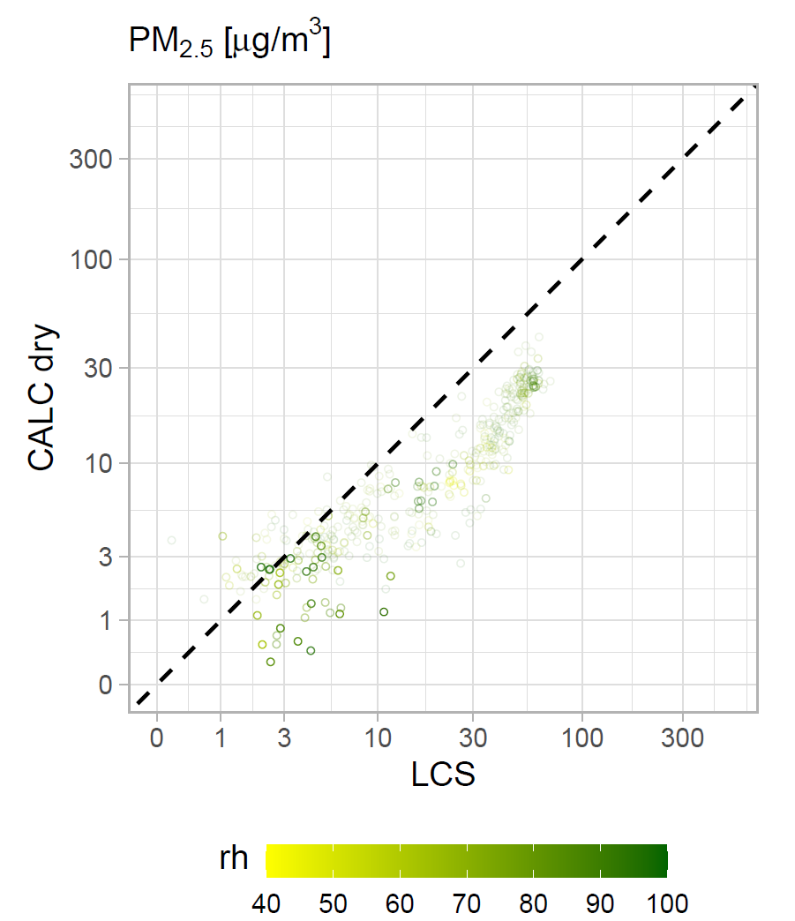
Local Physical Chemistry Statement (LPCS) approach
High transparency = lots of missing data
Compare time series and scatter plots of LCS with sum of dried PM_{2.5} components (CALC dry) and dried PM_{2.5} components plus water associated with PM_{2.5} (CALC total)

Slide 8
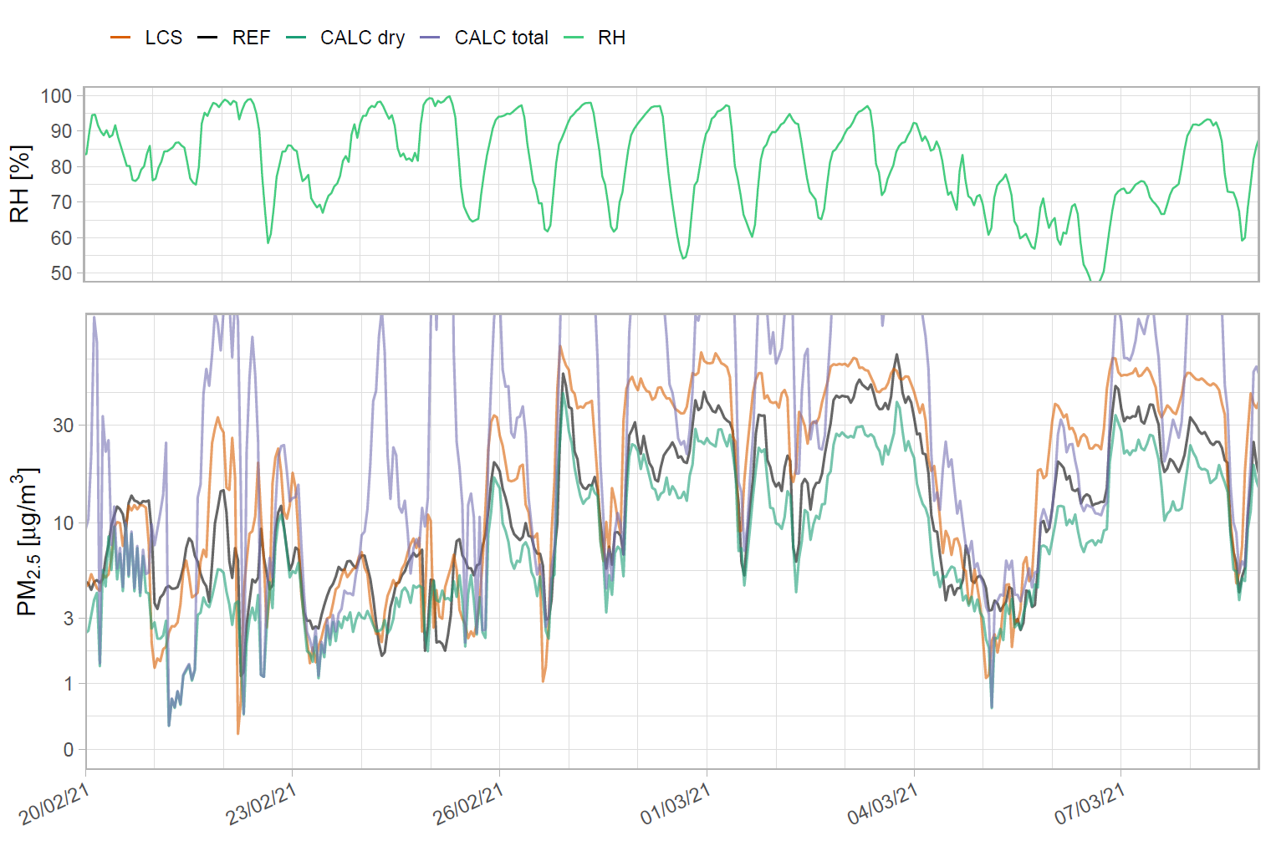
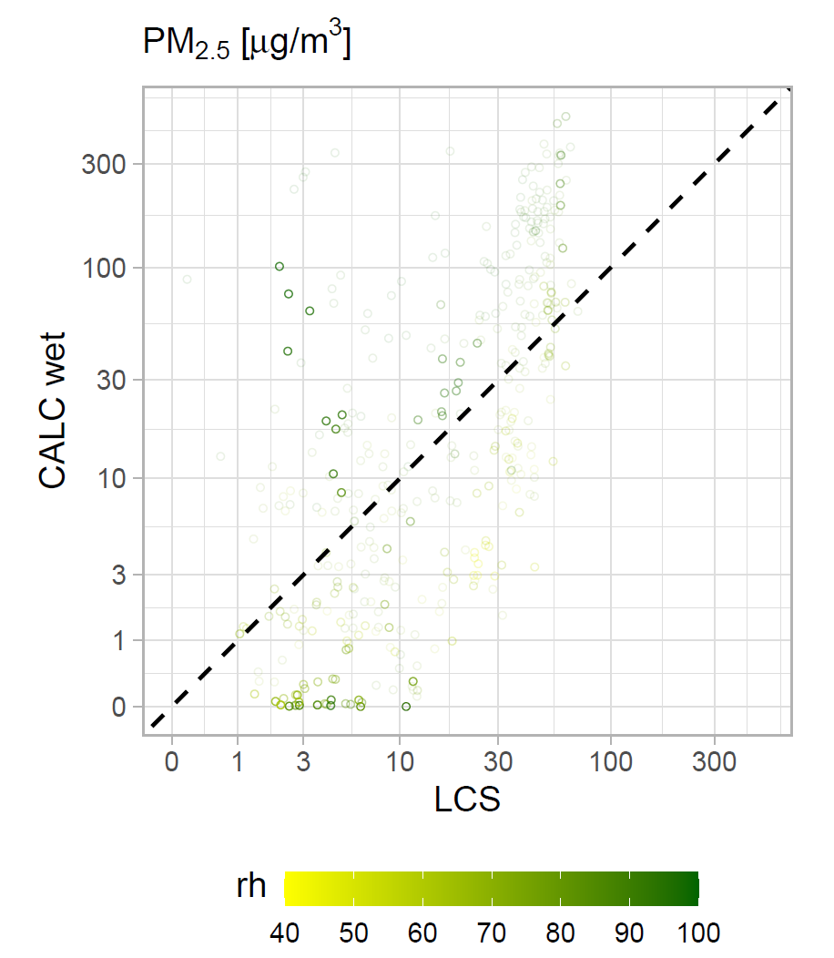
Local Physical Chemistry Statement (LPCS) approach
High transparency = lots of missing data
Compare time series and scatter plots of LCS with sum of dried PM_{2.5} components (CALC dry) and dried PM_{2.5} components plus water associated with PM_{2.5} (CALC total)

Slide 9
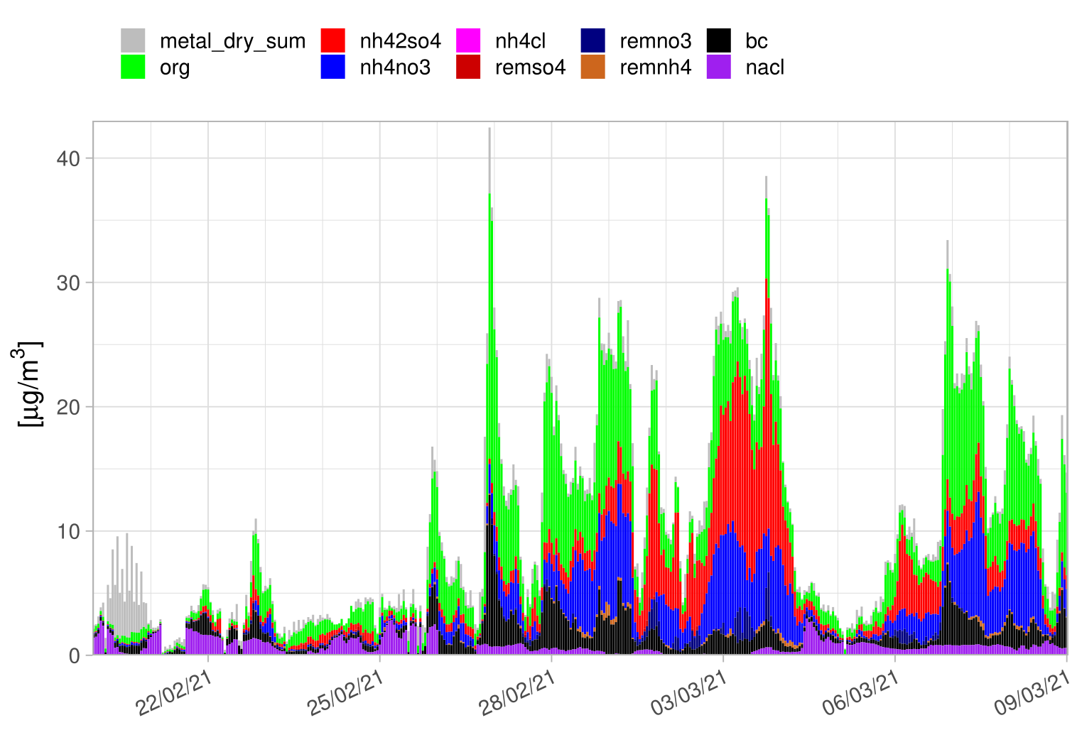
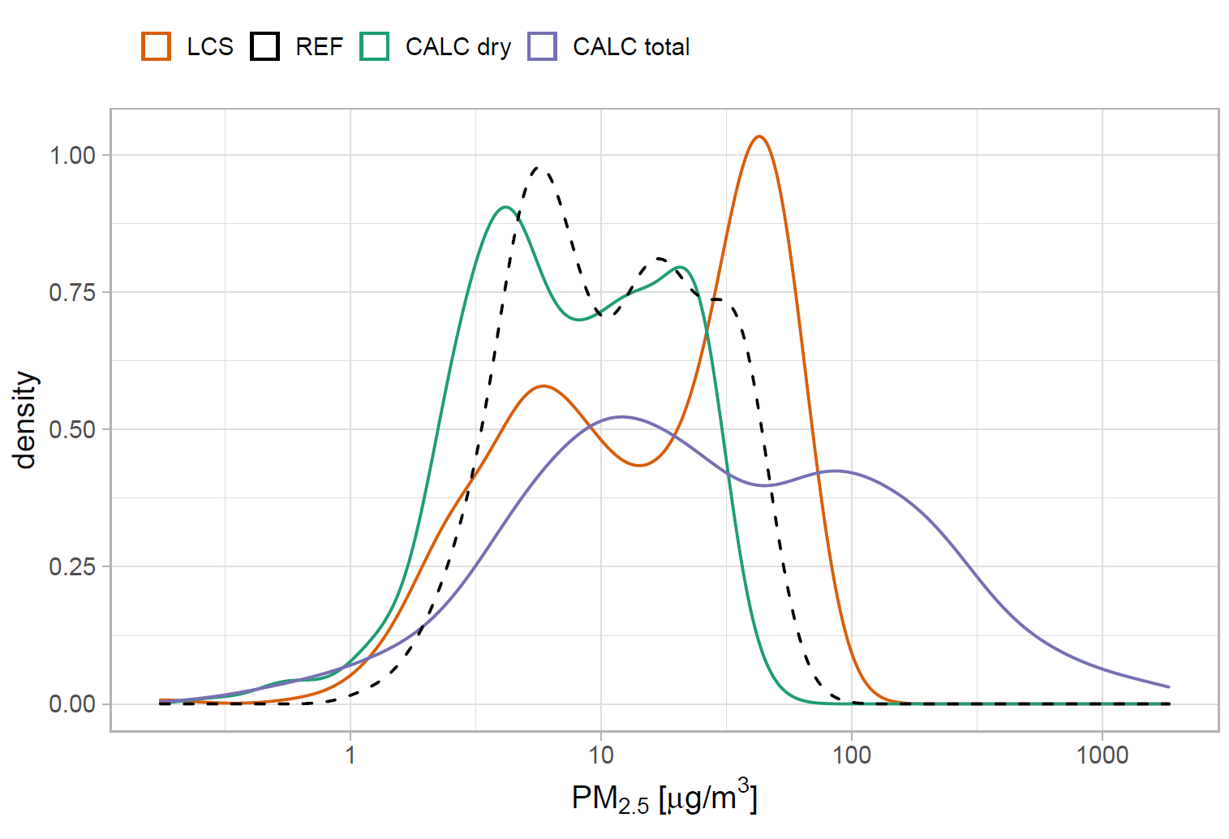
Local Physical Chemistry Statement (LPCS) approach
The chemical speciation hints at periods where overestimation is to be expected
The density distribution shows the overall performance of the sensor.

Slide 10
Local Physical Chemistry Statement
Background of Tool
modelled or forecast PM composition, RH, T
Information about unusual conditions for location or time period
Data report contains:
  Time series of mass concentration for LCS and chemicals
  Density distribution
  Correlation of predicted vs measured PM_{2.5} mass concentration
  Information about local sources or conditions
User upload:
Location of measurements
Type of location
LCS data (csv)
gives power to non-expert user to interpret results of their LCS
chemically sense-checks why and when the algorithm is working
contact: jansch@ceh.ac.uk
Thank you!

Slide 11
Additional slides

Slide 12
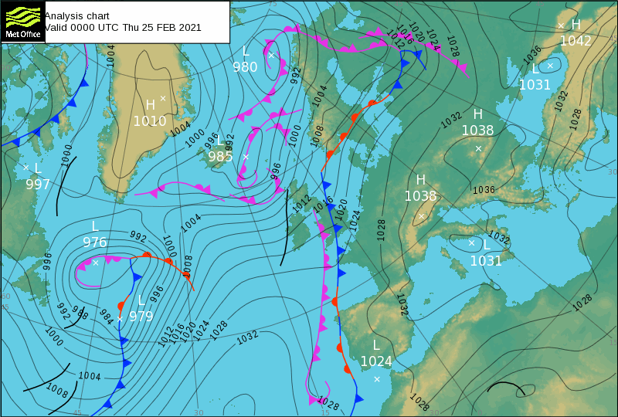
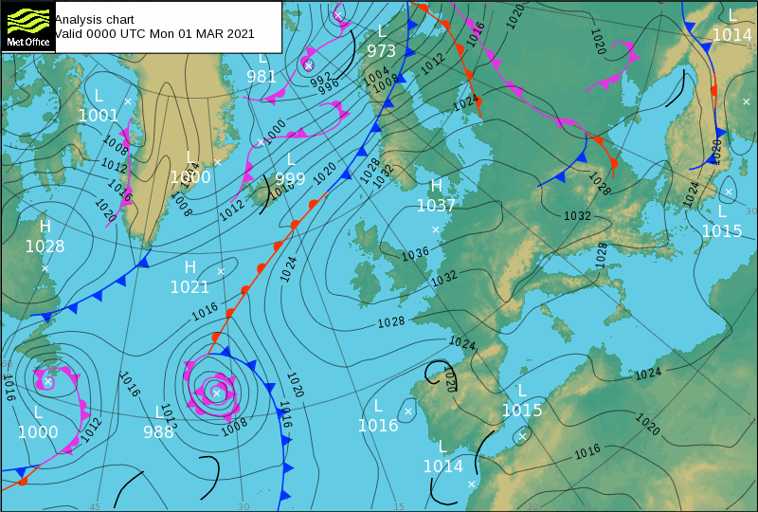
Example period – Manchester – 20/02/2021 to 08/03/2021
Weather

Slide 13
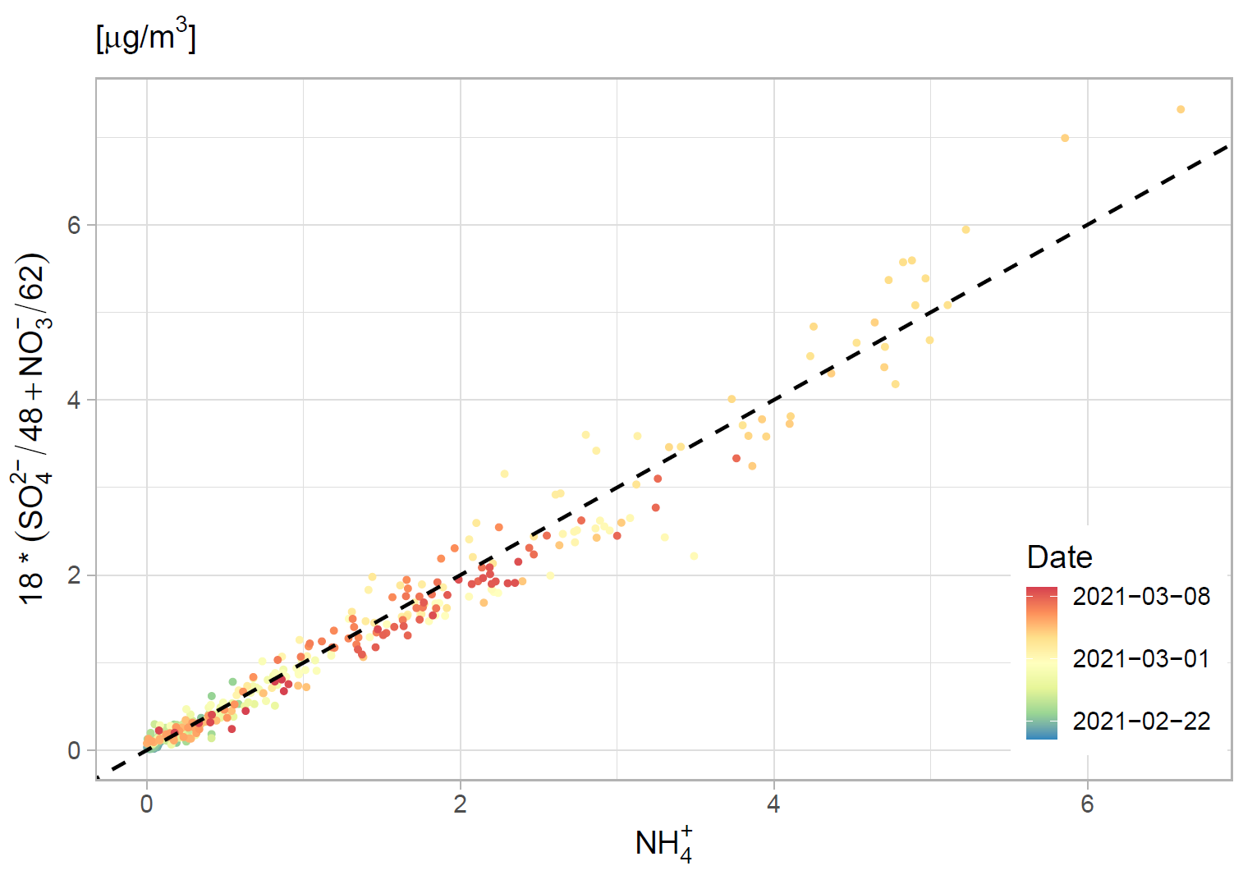
Ion balance

Slide 15
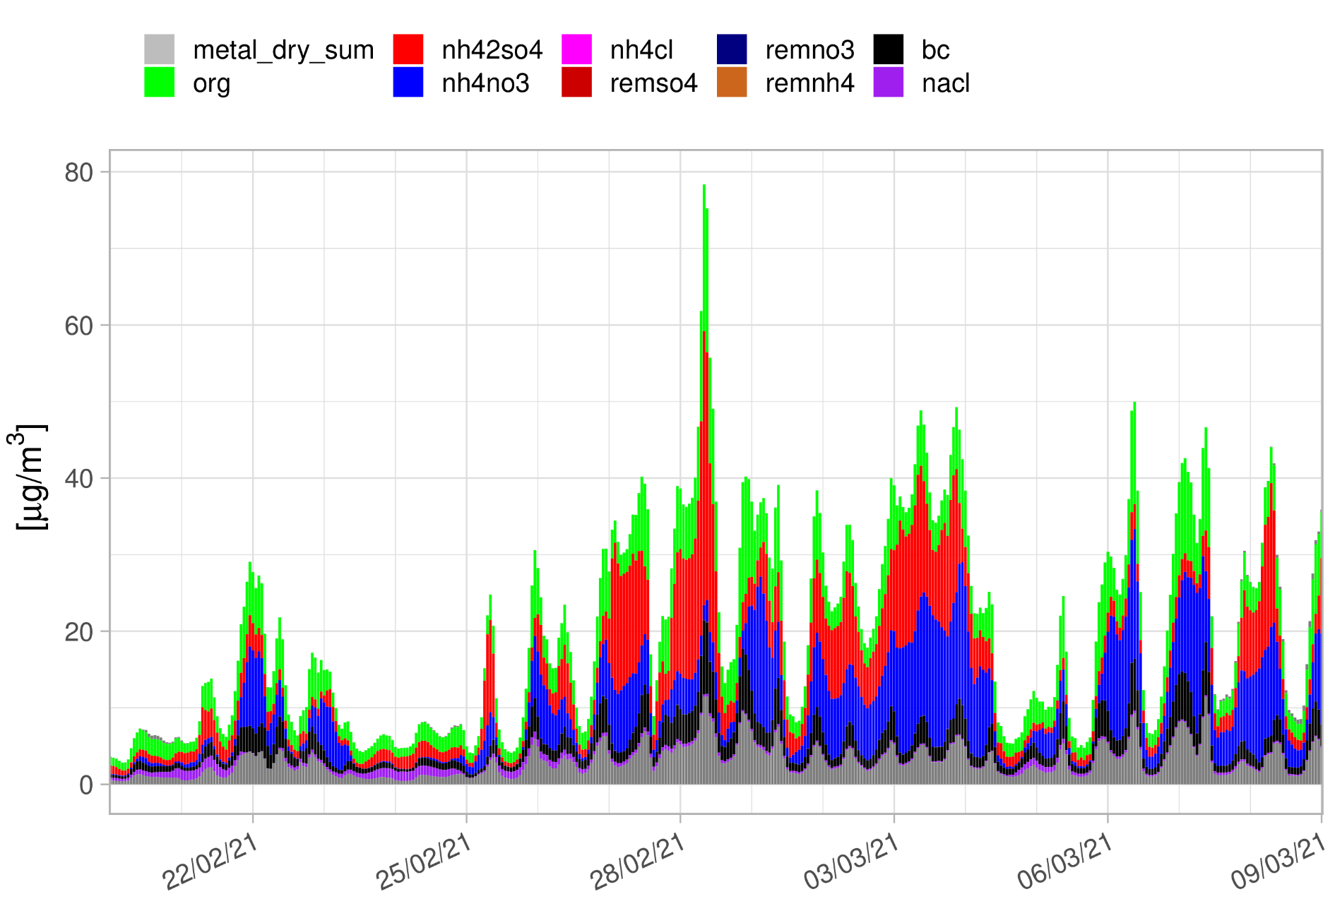
EMEP4UK

Slide 16
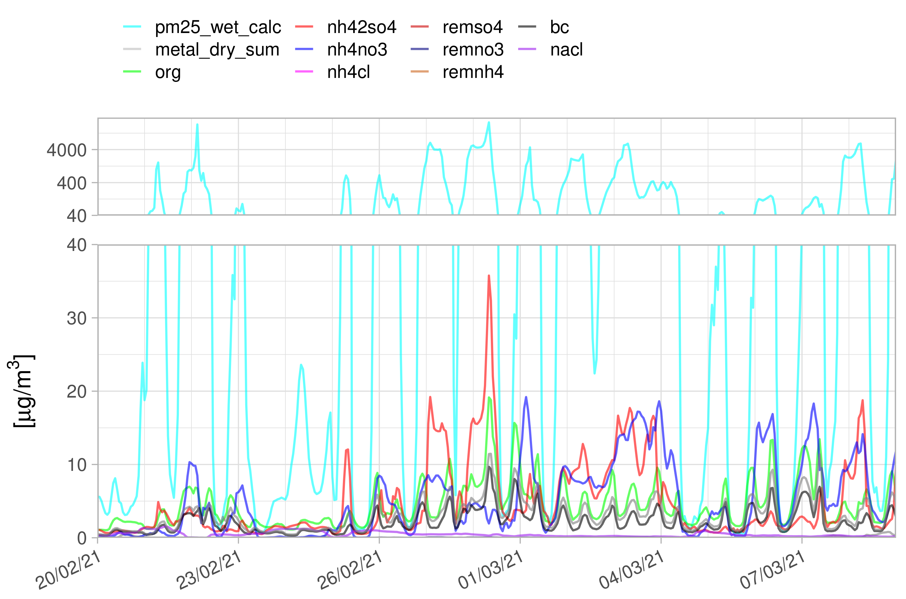
EMEP4UK

Slide 17
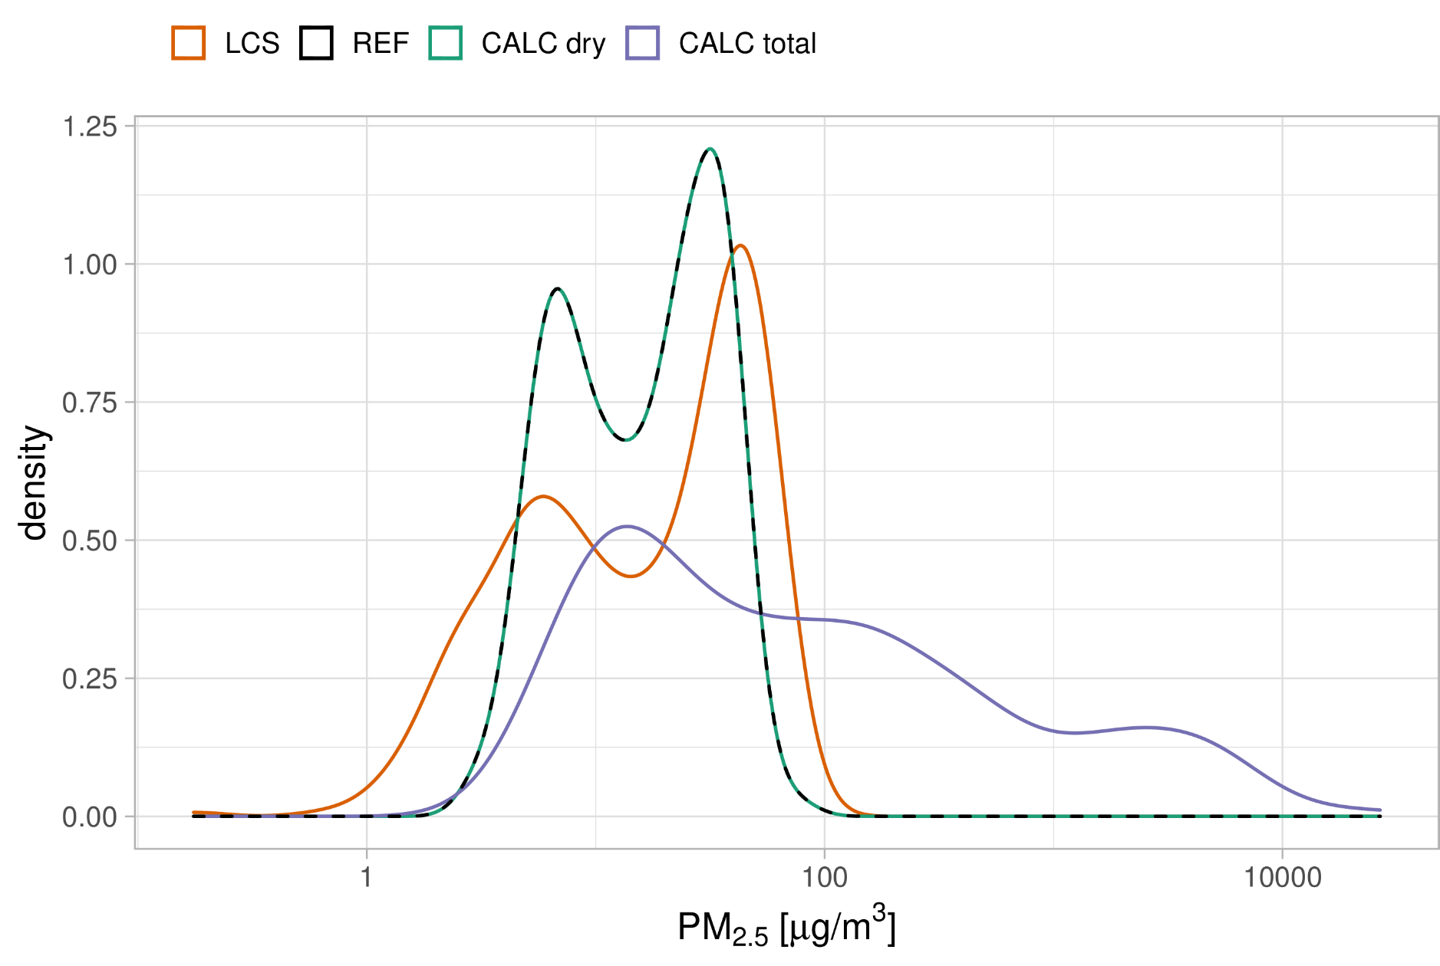
EMEP4UK

Slide 18
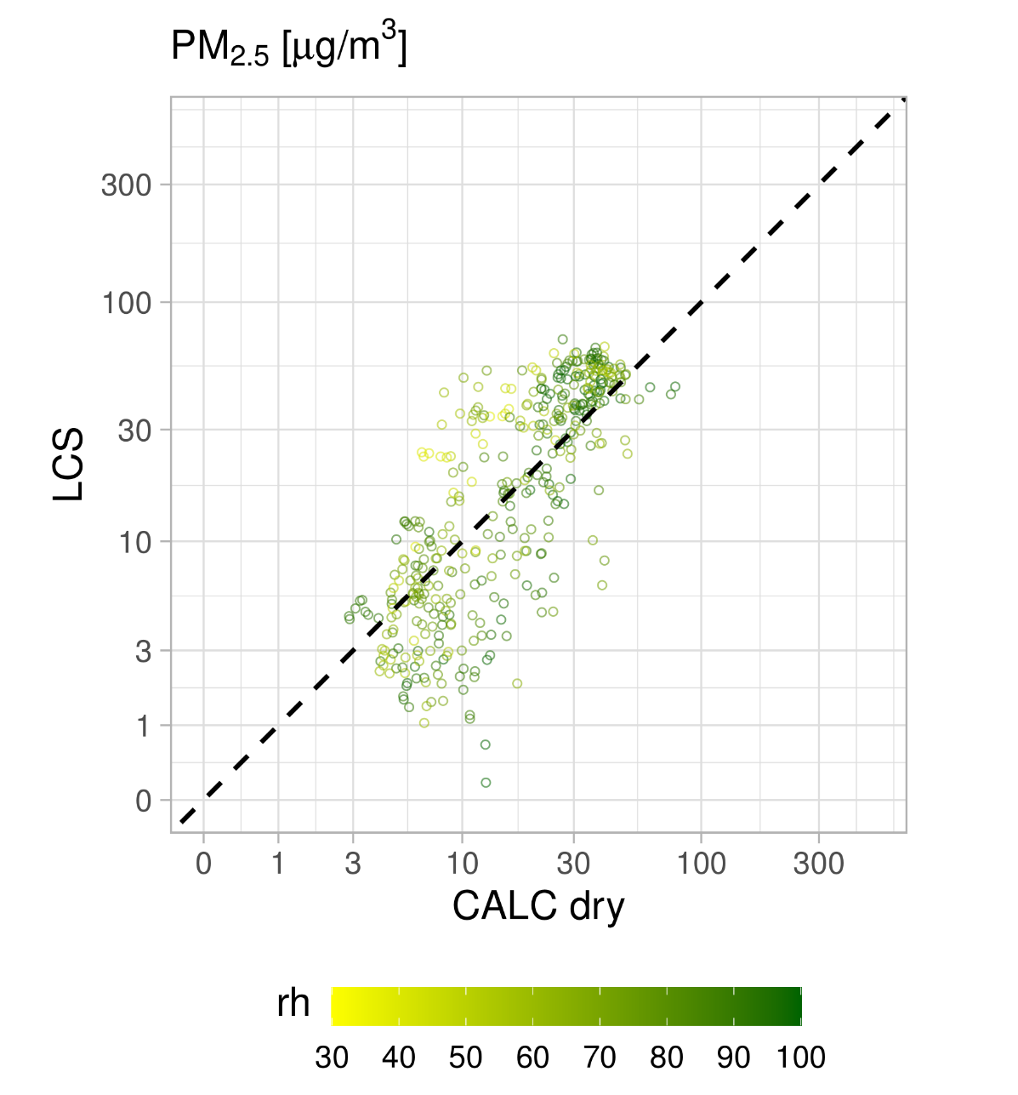
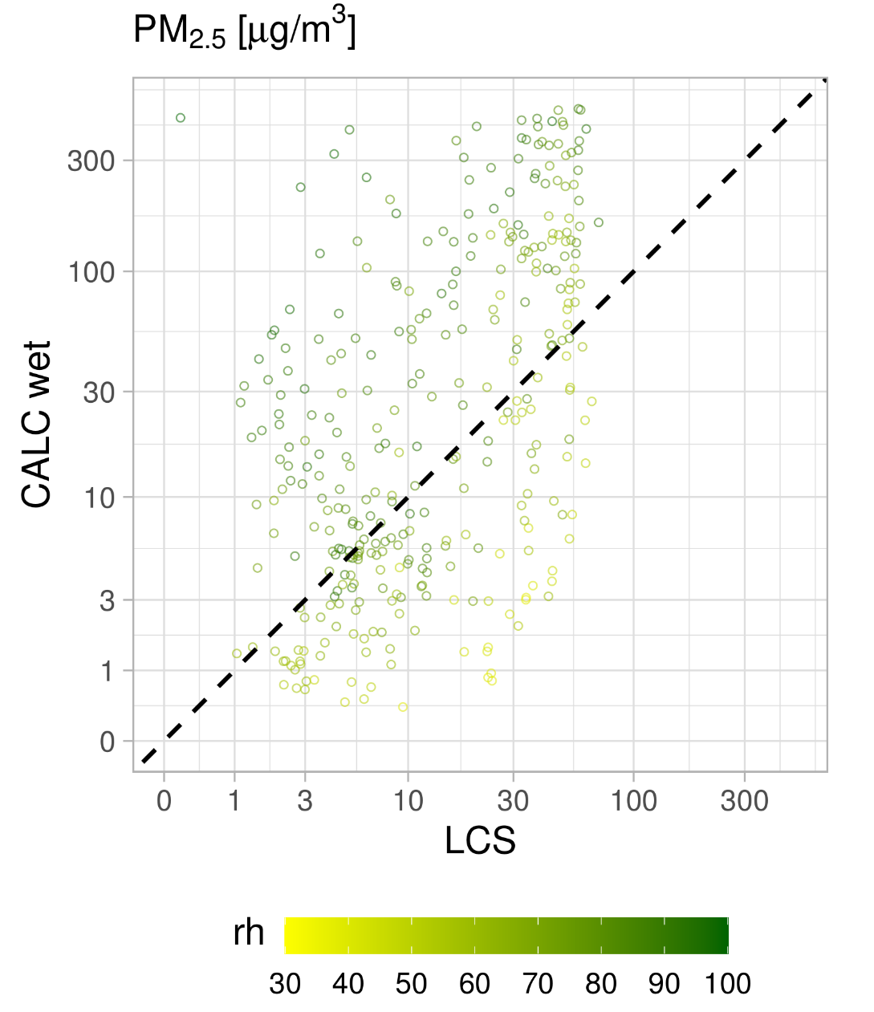
EMEP4UK

