Slide 1
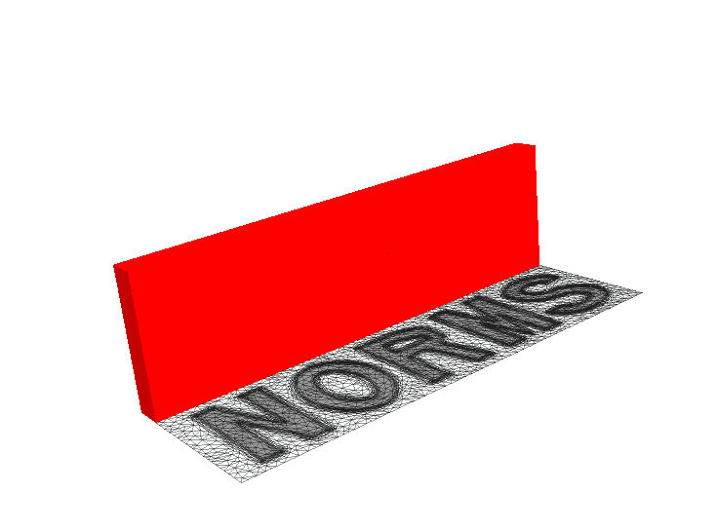
Geothermal reservoir modelling by using dynamic unstructured meshes for improved heat recovery in highly heterogeneous reservoirs
P. Salinas, G. Regnier, C. Jacquemyn, C. C. Pain, M. D. Jackson, Imperial College London

Slide 2
Outline
Why dynamic mesh optimization?
Dynamic mesh optimization for geothermal simulations
Conclusions
Dynamic mesh optimisation for geothermal reservoir modelling. P. Salinas, G. Regnier, C.Jacquemyn, C.C. Pain and M.D. Jackson. Geothermics 94 (2021) 102089 doi: 10.1016/j.geothermics.2021.102089
Slide 2
Notes:
2

Slide 3
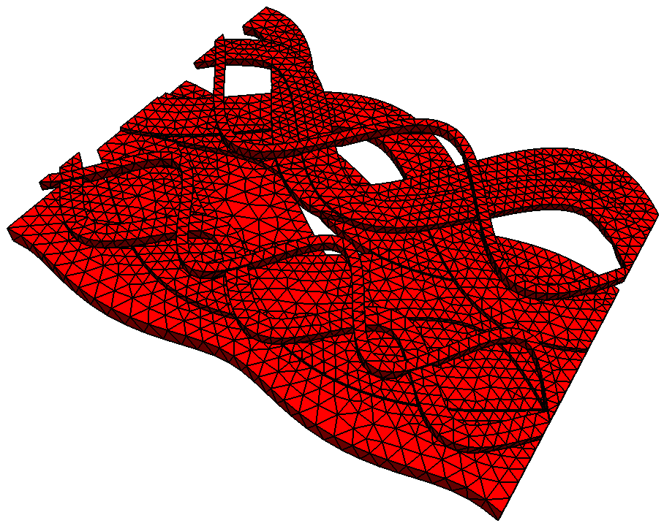
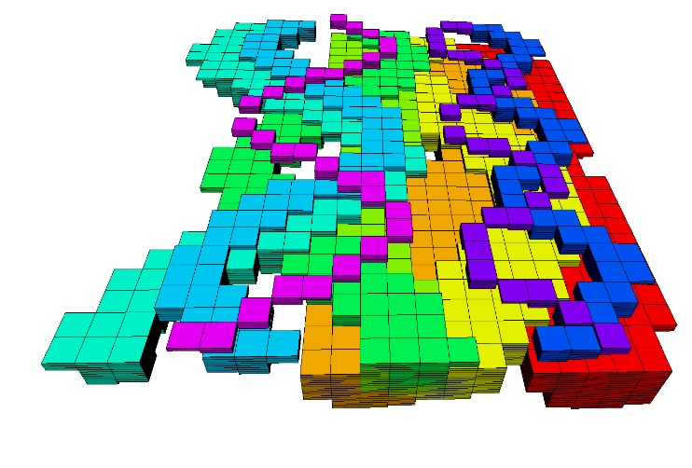
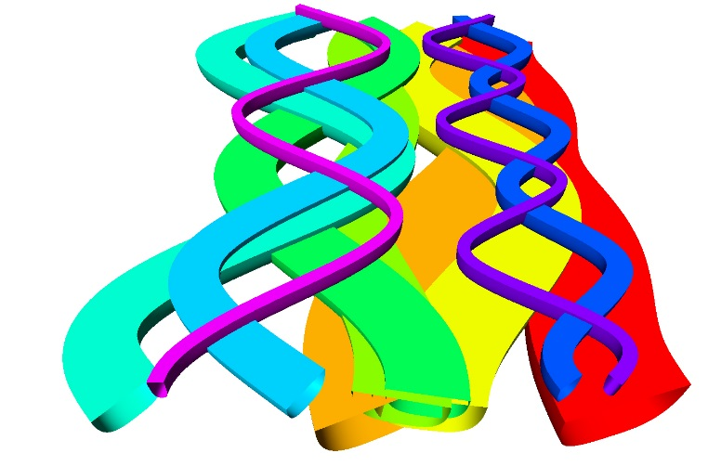
Dynamic mesh optimization for CFD
Works in parallel using dynamic load balancing
Reference: A decade of progress on anisotropic mesh adaptation for computational fluid dynamics (F. Alauzet, A. Loseille)
Use in many other CFD areas
Reduces the computational cost
Increase the quality of the solution increasing the resolution where necessary
For porous media:
Geology represented using surfaces
No need to interpolate geological properties between meshes
Geology representation is independent of the resolution
12056-14964 grid cells
Slide 3

Slide 4
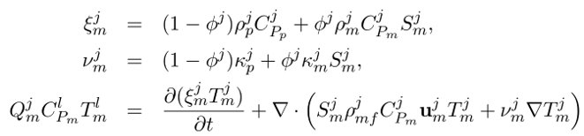

Heat transport equations
Heat transport with temperature and pressure dependent density
Slide 4

Slide 5
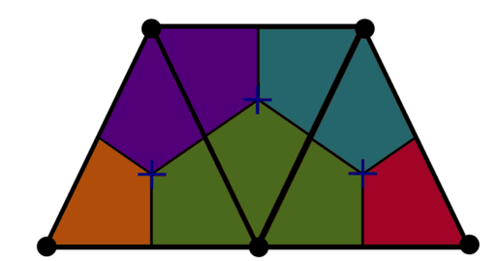
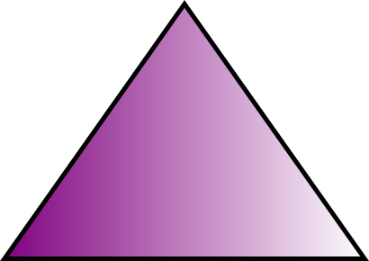
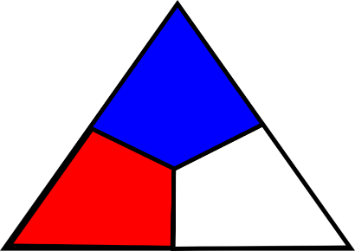
Numerical discretisation: A double control pressure formulation
P_{N} (DG) P_{N+1}
P₀ (DG) P₁CV)
Main difference with common CVFEM
Pressure and Velocity
Linear FE Pressure
Linear CV Pressure
Height
Velocity nodes
Pressure nodes
Implicit wells implementation
1D representation of wells
Multiple pressures implementation
Pressure of the domain
Pressure of the wells
Wells and domain are connected by interchanging mass/heat
For the interchange of mass/heat between the wells and domain
The Peaceman correction is used
Slide 5

Slide 6
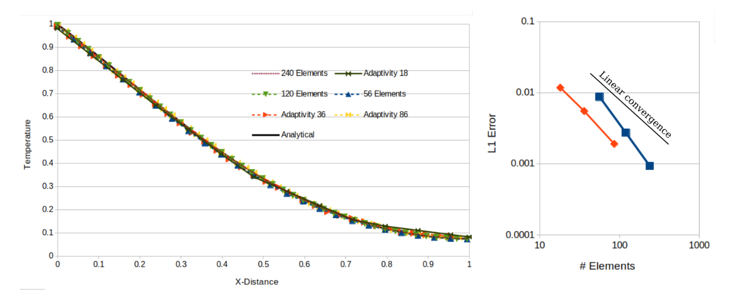
1D Validation
Validation against analytical solution for advection-diffusion problem with a fixed and DMO
Slide 6

Slide 7
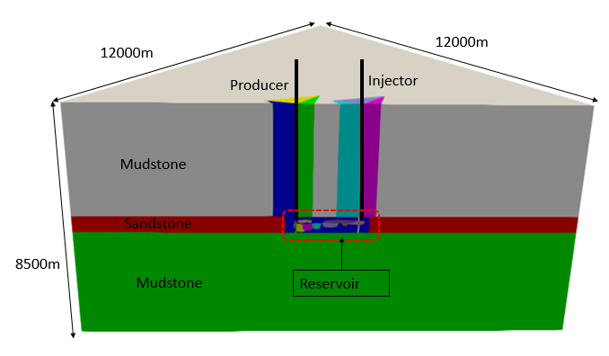
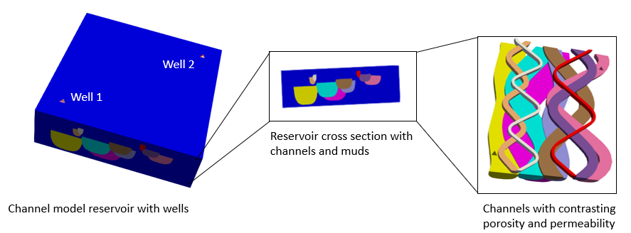
Applications: Channelised system
Boundary conditions need to be far away from the domain of interest to ensure realistic results
DMO can easily do this by focusing the resolution in the domain of interest while having big elements far away
Slide 7
Notes:
7

Slide 8
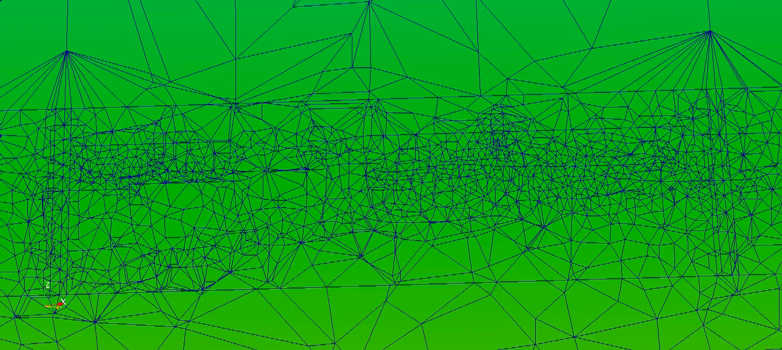
Applications: Channelised system
Notes:
8

Slide 9
Applications: Channelised system
#ele start end time
Coarse 4225 4225 0.5hrs
Adaptive 4225 314600 2.1hrs
Fine 524958 524958 15.5hrs

Slide 10
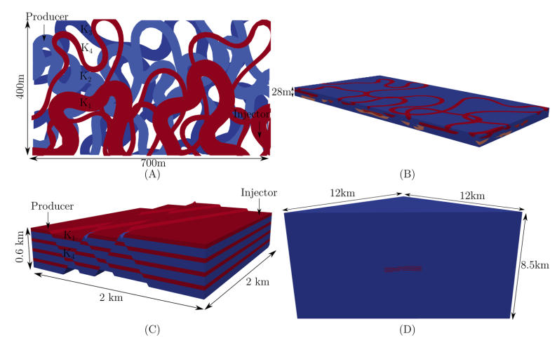
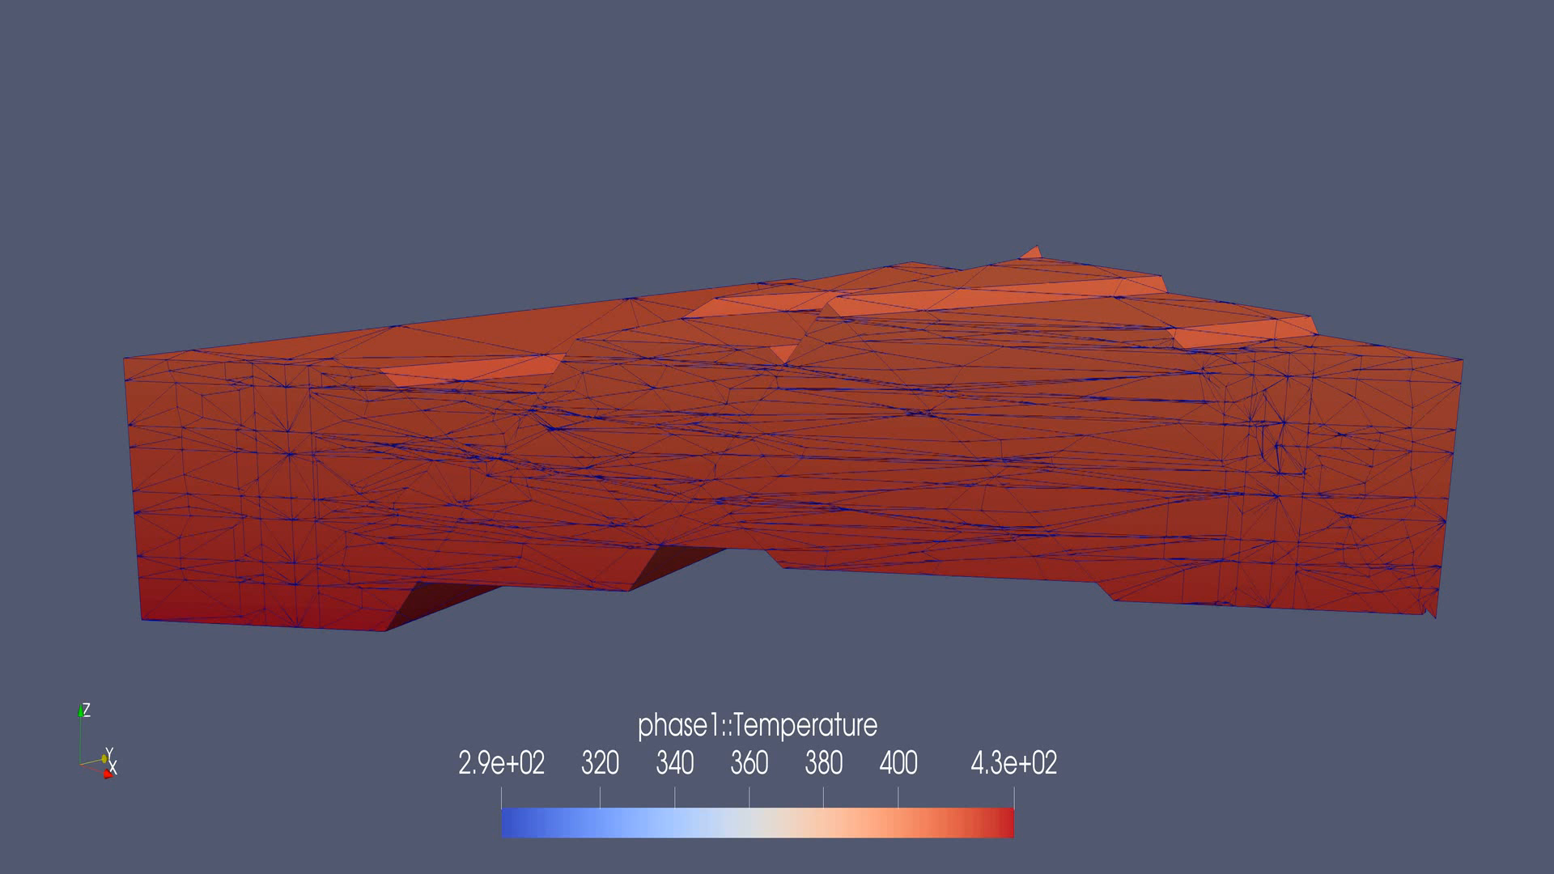
Application: Faulted model
Reservoir comprising interbedded layers of contrasting (high and low) permeability, offset across conjugate faults
The simulation models an area very big around the reservoir with higher detail of petrophysical properties only at the reservoir of interest
Slide 10
Notes:
10

Slide 11
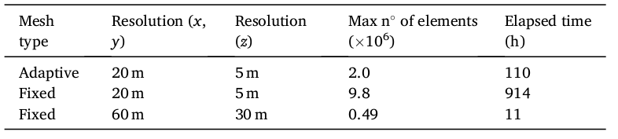
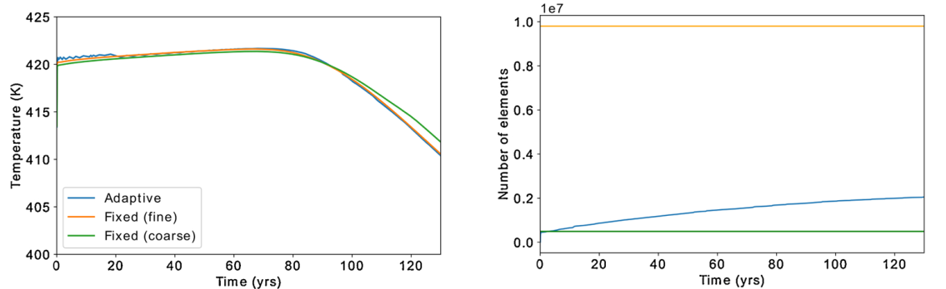
Application: Faulted model
Simulations run in a single core
DMO provides the same resolution as the fixed fine case while requiring far fewer elements and also ~x9 less computational time
The initial oscillation in the DMO case is within the precision requested to DMO (1% accuracy in Temperature)
Slide 11
Slide 11
Notes:
11

Slide 12
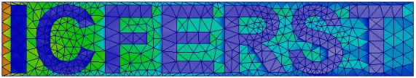

Conclusions
Surface based modelling with dynamic mesh optimization is a powerful tool for multiphase flow in porous media
DMO proves to be very useful to model different length scales in realistic reservoirs
The mesh no longer needs to be decided a priori. Instead, it is created based on the dynamics of the reservoir, increasing resolution whilst reducing computational cost
DMO has a great potential to reduce the computational cost while enabling to represent geology realistically using unstructured meshes and SBM
Website
For more information visit:
http://multifluids.github.io/
Slide 12

Slide 13
References
Dynamic mesh optimisation for geothermal reservoir modelling. P. Salinas, G. Regnier, C.Jacquemyn, C.C. Pain and M.D. Jackson. Geothermics 94 (2021) 102089 doi: 10.1016/j.geothermics.2021.102089
Vanishing artificial diffusion as a mechanism to accelerate convergence for multiphase porous media flow. P. Salinas, C.C. Pain, H. Osman, C. Jacquemyn, Z. Xie, M.D. Jackson. Comput. Methods Appl. Mech. Engrg. 359 (2020) 112535
A discontinuous control volume finite element method for multi-phase flow in heterogeneous porous media. P. Salinas, D. Pavlidis, Z. Xie, H. Osman, C.C. Pain, M.D. Jackson. Journal of Computational Physics 352 (2018) 602–614
Improving the Robustness of the Control Volume Finite Element Method with Application to Multiphase Porous Media Flow. P.Salinas, D. Pavlidis, Z. Xie, A. Adam, C. Pain and M.D. Jackson; Int J Numer Meth Fluids. (2017) doi: 10.1002/fld.4381
Reservoir Modeling for Flow Simulation by Use of Surfaces, Adaptive Unstructured Meshes, and an Overlapping-Control-Volume Finite-Element Method M.D. Jackson, J.R. Percival, P. Mostaghimi, B. Tollit, D. Pavlidis, C.C. Pain, J. Gomes, A.H. Elsheikh, P. Salinas, A. Muggeridge and M. Blunt; SPE Reservoir Evaluation & Engineering (2015) doi: 10.2118/163633-PA
Slide 13

