Slide 1





Stromboli Volcano observations through the Airborne
X-band Interferometric SAR (AXIS) system
P. Berardino¹, A. Natale¹, C. Esposito¹, G. Palmese², R. Lanari¹, S. Perna^{1, 3}
¹Institute for Electromagnetic Sensing of the Environment (IREA), National Research Council (CNR), Napoli (Italy)
²Elettra Microwave S.r.l., Napoli (Italy)
³Dipartimento di Ingegneria (DI),Università degli Studi di Napoli ‘‘Parthenope’’, Napoli (Italy)
Notes:
1

Slide 2

Outline
The AXIS system
The campaigns
Results
Conclusions
Notes:
2

Slide 3
Acknowledgment
The work has been carried out within the agreement between
DIPARTIMENTO DELLA PROTEZIONE CIVILE and IREA-CNR"
Notes:
3

Slide 4
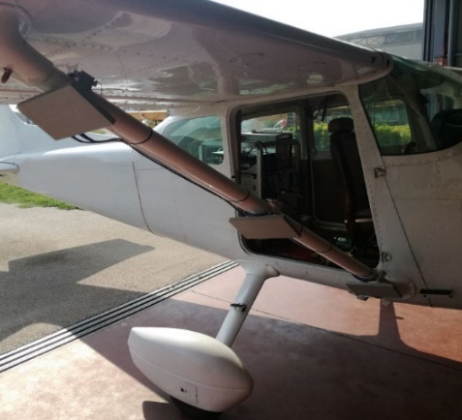
The AXIS system
The Interferometric SAR AXIS system
is mounted onboard a Cessna172 aircraft
Main characteristics of the AXIS system
Band | X
Technology | FMCW
Carrier frequency [GHz] | 9.55
Bandwidth [MHz] | 200
Number of transmitting antennas (Tx) | 1
Number of receiving antennas (Rx) | 2
PRF [Hz] | 1200
Antennas’ sizes (azimuth × range) [cm] | 24.6 x 12.6
Polarization | VV
Single-pass interferometry | YES
X-band RF layout
RX
TX
RX
Applanix INS/GPS specifications
Position [m] | 0.05
Velocity [m/s] | 0.005
Roll & Pitch [deg] | 0.005
True Heading [deg] | 0.008
AXIS embeds the Applanix Navigation Unit
C. Esposito, A. Natale, G. Palmese, P. Berardino, R. Lanari, S. Perna, “On the Capabilities of the Italian Airborne FMCW AXIS InSAR System”, Remote Sens. 2020, 12, 539.
Notes:
4

Slide 5
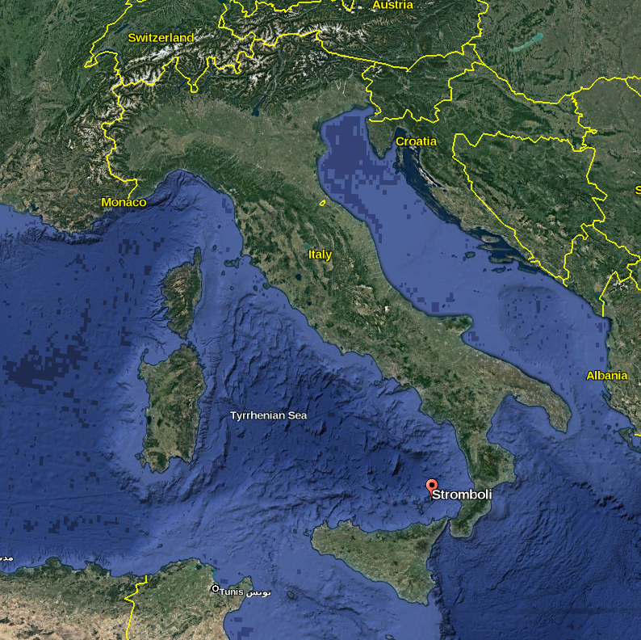
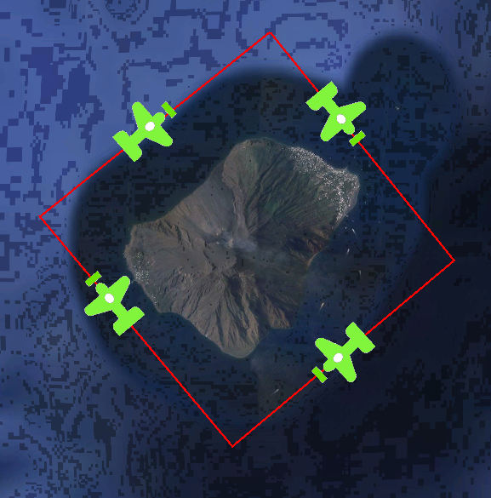
The campaigns
Site
Stromboli, Sicily (South Italy)
3 flight campaigns
July 2019
October 2019
June 2021
Radar data acquired along four flight directions (SW-NE, NW-SE, NE-SW, SE-NW) as to describe flight circuits around the island and to illuminate the Stromboli volcano under different points of view.
Notes:
5

Slide 6
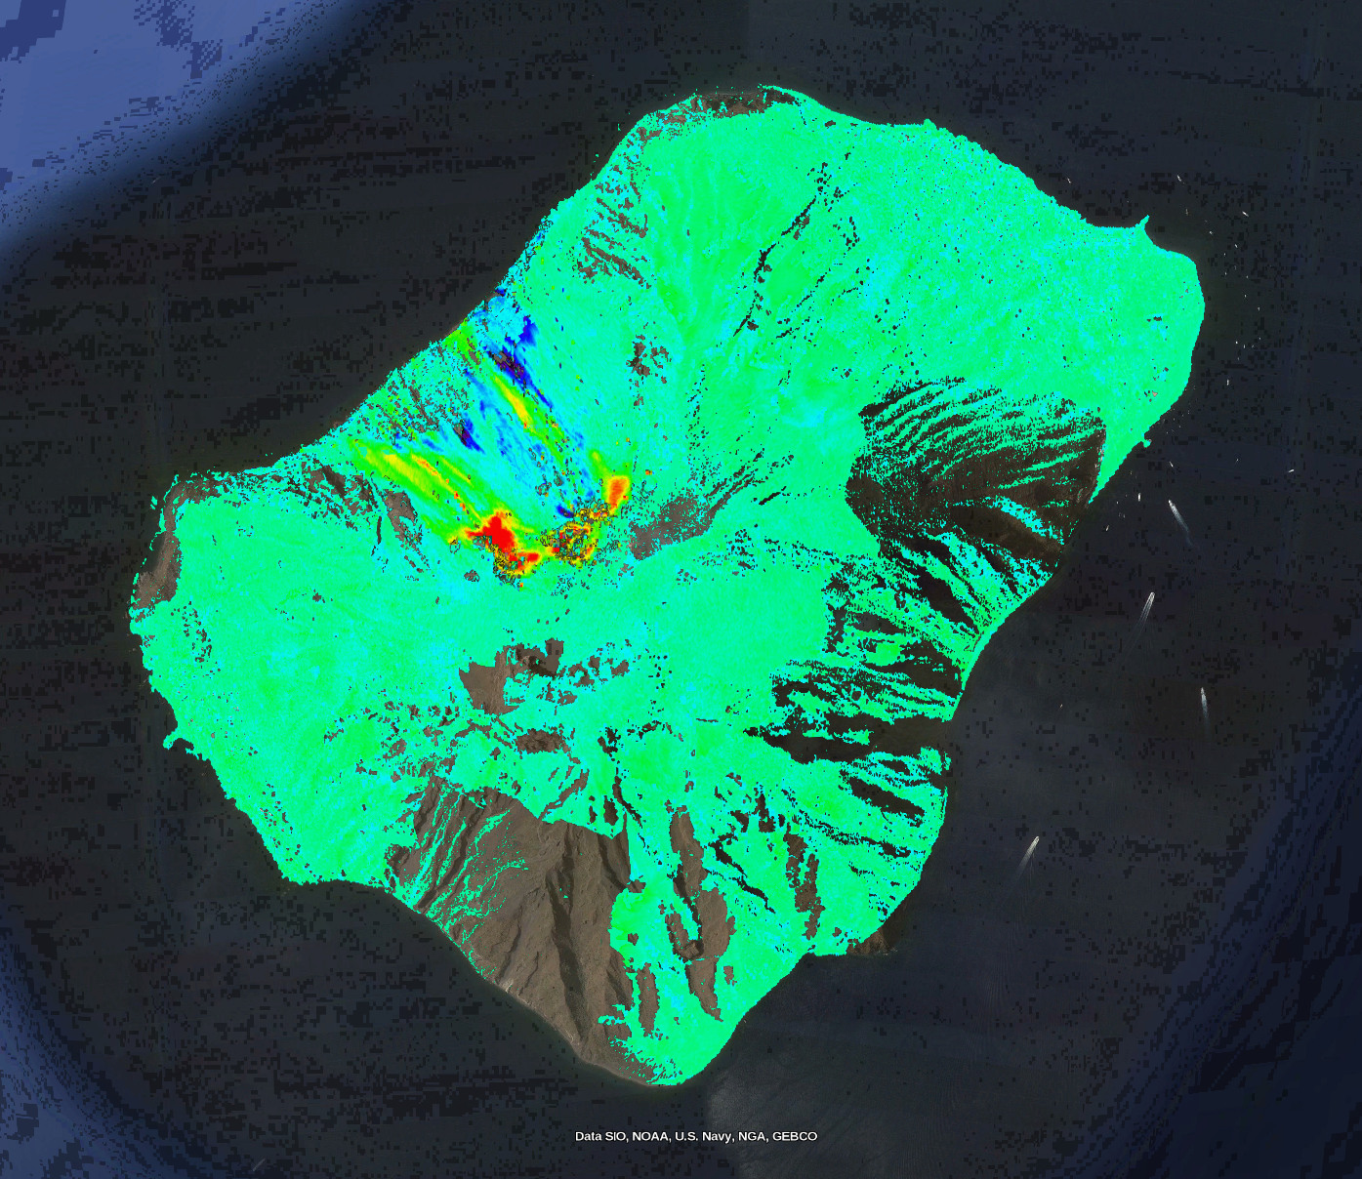
Results
InSAR DEM Elevation difference
flight campaigns
July 2019
October 2019
-20 m
+20 m
6

Slide 7
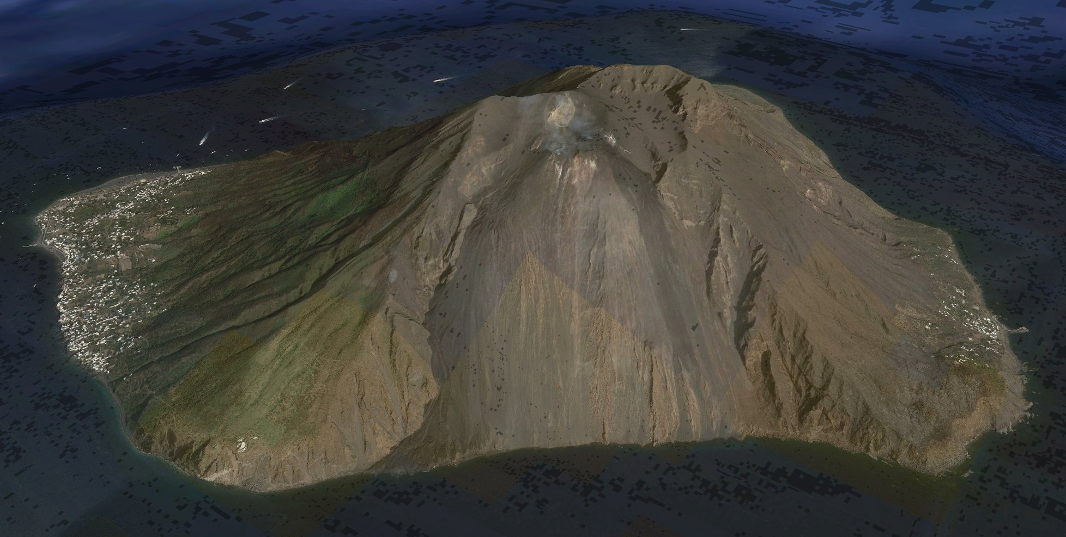
Results
InSAR DEM Elevation difference
flight campaigns
July 2019
October 2019
-20 m
+20 m

Slide 8
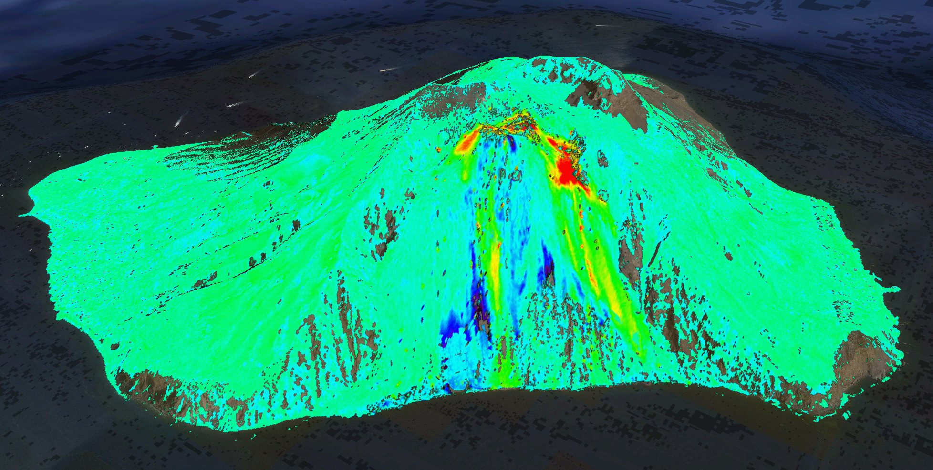
Results
InSAR DEM Elevation difference
flight campaigns
July 2019
October 2019
-20 m
+20 m

Slide 9
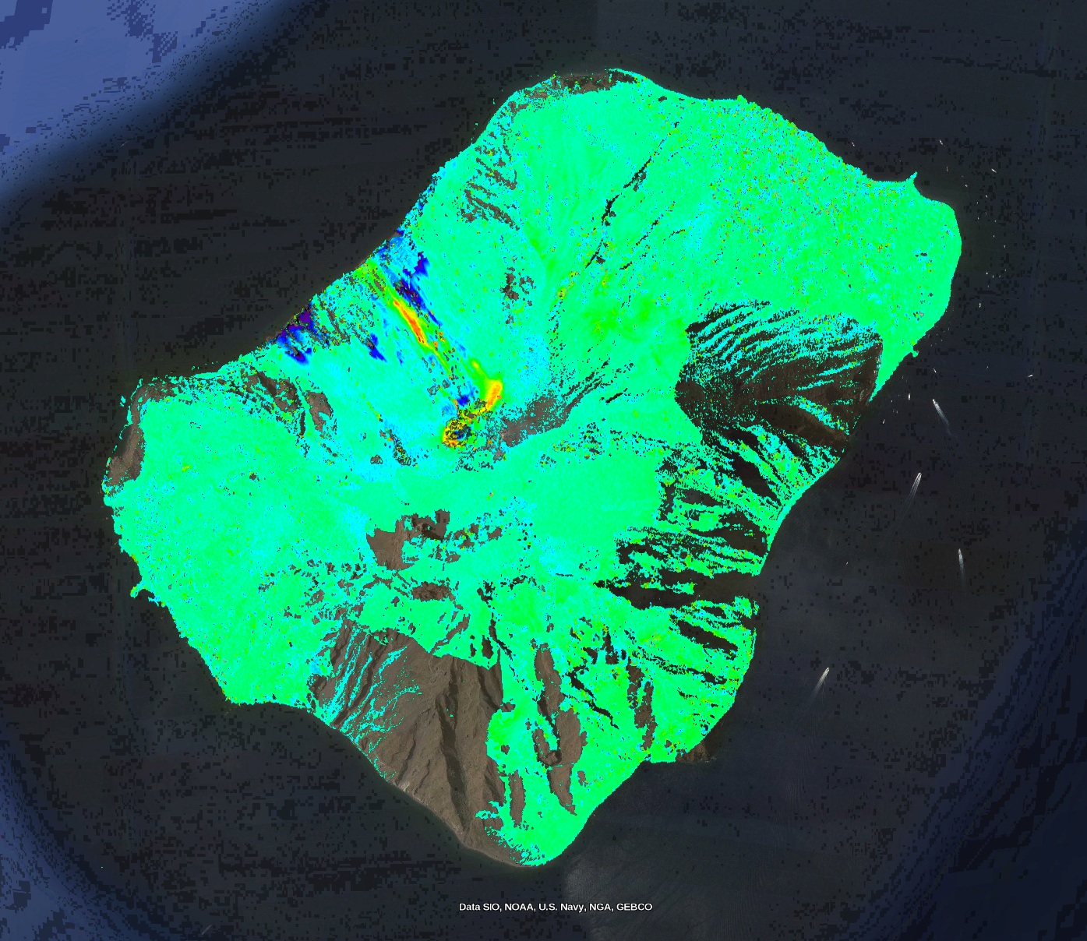
Results
InSAR DEM Elevation difference
flight campaigns
October 2019
June 2021
-20 m
+20 m

Slide 10
Results
InSAR DEM Elevation difference
flight campaigns
October 2019
June 2021
-20 m
+20 m

Slide 11
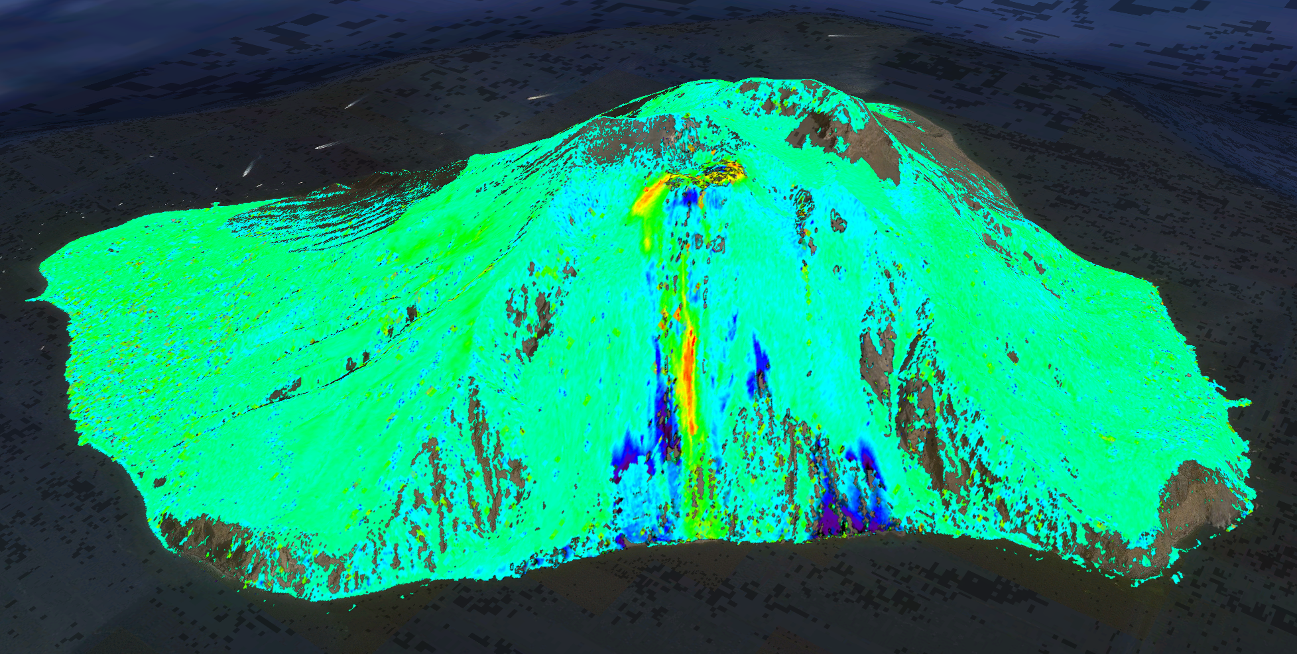
Results
InSAR DEM Elevation difference
flight campaigns
October 2019
June 2021
-20 m
+20 m

Slide 12
Conclusions
We have presented the results relevant to multiple radar surveys carried out over the
Stromboli Island, in Italy, through the Italian Airborne X-band Interferometric SAR (AXIS) system.
AXIS system is based on the Frequency Modulated Continuous Wave (FMCW) technology, and is equipped with a three-antenna single-pass interferometric layout
The considered dataset has been collected during three different acquisition campaigns:
July 2019
October 2019
June 2021
The radar data were acquired along four flight directions (SW-NE, NW-SE, NE-SW, SE-NW), as to describe flight circuits around the island and to illuminate the Stromboli volcano under different points of view.

