Slide 1
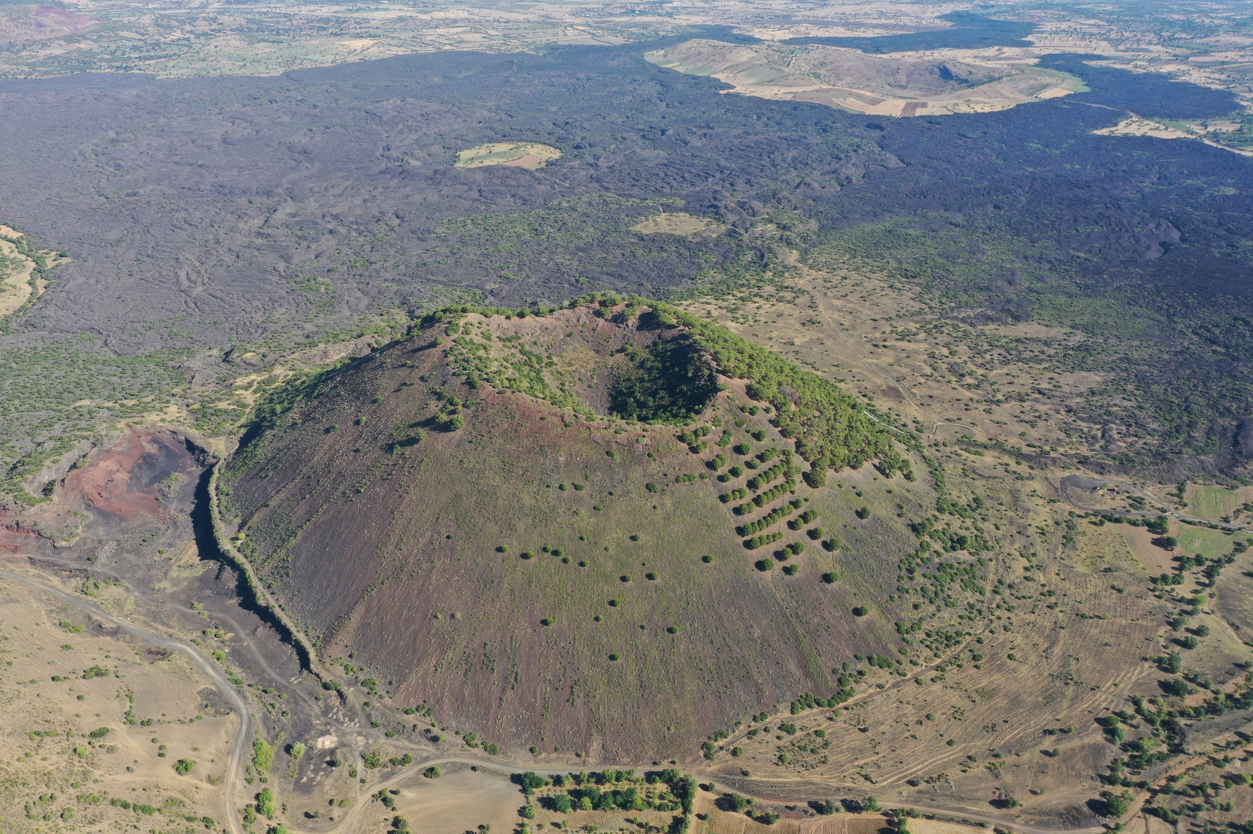
Eco-hydro-geomorphic evolution of the Sandal Divlit cinder cone, Kula, Turkey
O. YETEMEN¹, A. AVCIOGLU¹, Y.S. CELIK², I. SIMSEK¹,, M. KOLBUKEN¹, I.Y. YEO³, K.P. CHUN⁴, T. GORUM¹, and O.L. SEN¹
Eurasia Institute of Earth Sciences, Istanbul Technical University, Turkey.
Department of Geomatics Engineering, Istanbul Technical University, İstanbul, Turkey
School of Engineering, The University of Newcastle, Callaghan, Australia
Department of Geography and Environmental Management, The University of the West England, Bristol, UK

Slide 2
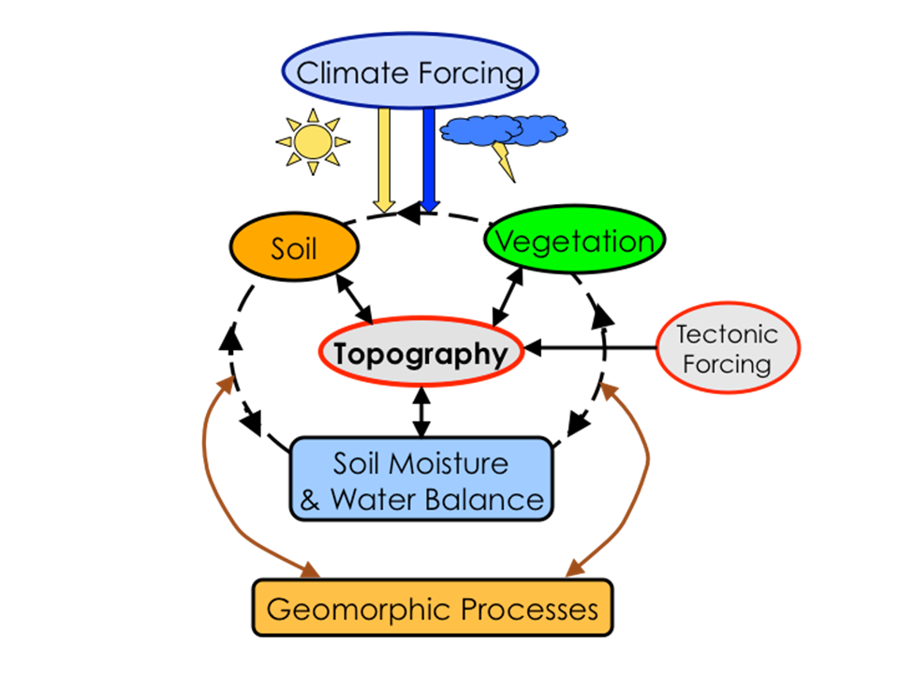
CLIMATE-SOIL-VEGETATION-TOPOGRAPHY SYSTEM:
Soils, vegetation, and landforms co-evolve through nonlinear interactions
Istanbulluoglu 2008

Slide 3
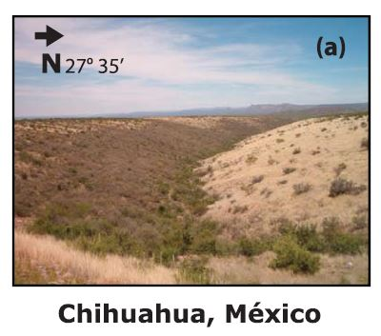
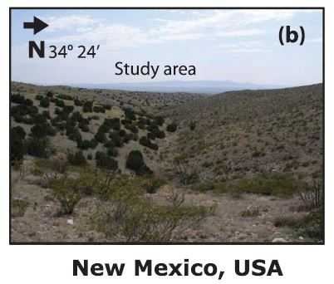
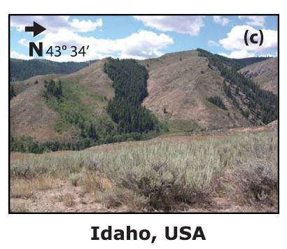
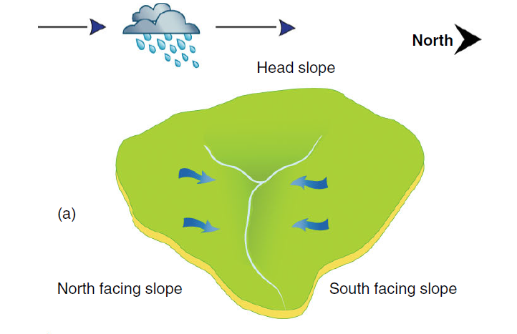
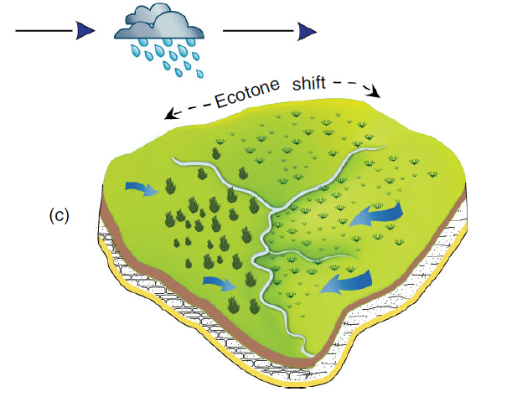
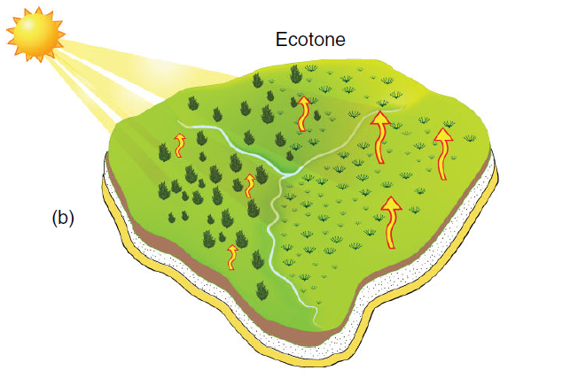
Aspect-related vegetation differences have been recognized for a long time.
Gutiérrez-Jurado et al., 2013
  They result in valley/hillslope asymmetry over geologic timescales!
Gutiérrez-Jurado et al., 2006

Slide 4
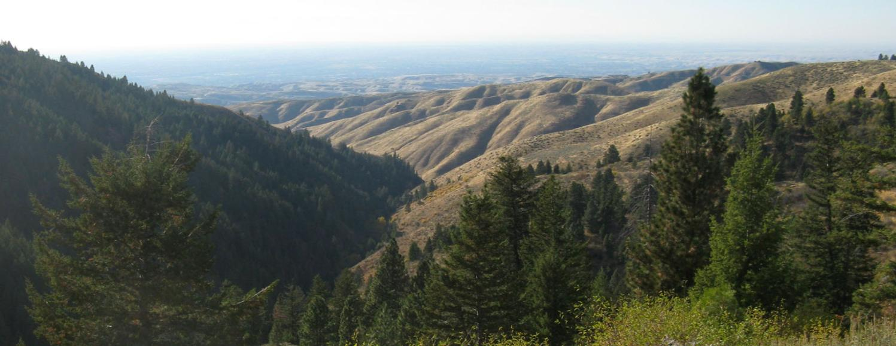


Hillslope Asymmetry: Cause and Origin
Due to solar insolation, semiarid landscapes experience differentiation in vegetation type and density on opposing hillslopes.
Xeric and sparse vegetation
on equatorward aspects
Mesic and denser canopy
exists at poleward aspects
Equatorward slopes more
prone to erosion due to less
vegetation cover leading to
gentler slopes.
N
$${θ }_{n}$$
$${θ }_{s}$$
Dry Creek, Idaho, USA
Dry Creek Foothills showing different vegetation pattern on north-facing and south-facing slopes (Pierce and Poulos, 2013)

Slide 5
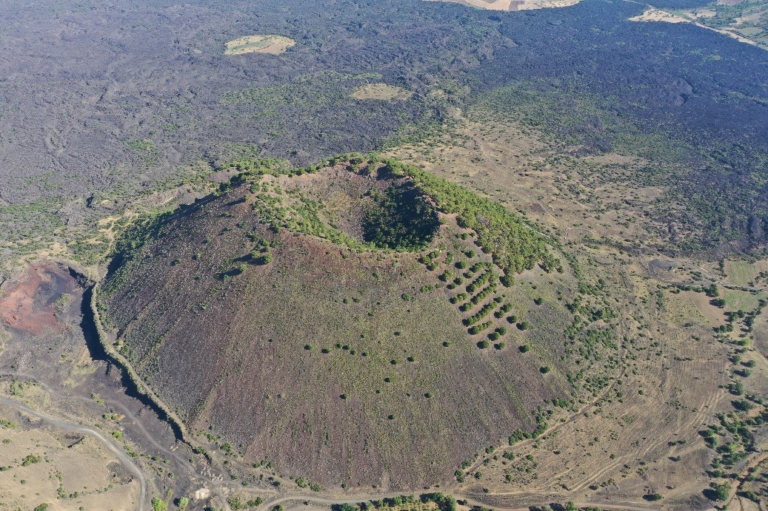
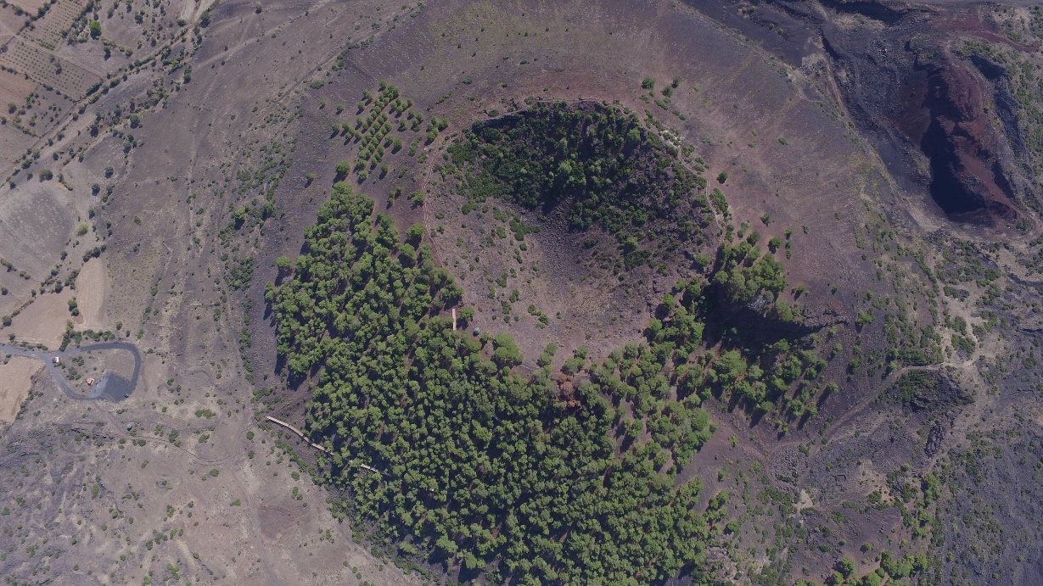
Cinder cones are natural laboratories to study hillslope asymmetry!
      They are smaller.
      More uniform climate and lithology.
      Relatively known initial conditions.
      We know their ages, and they are relatively young!
Sandal Divlit cinder cone is the youngest cinder cone in the region, ~4ky!

Slide 6
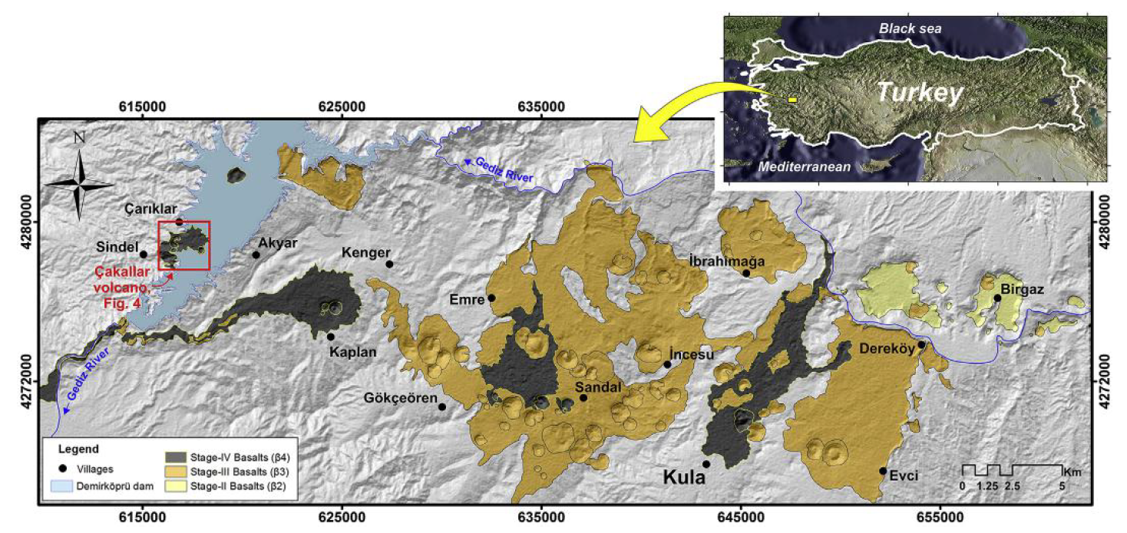
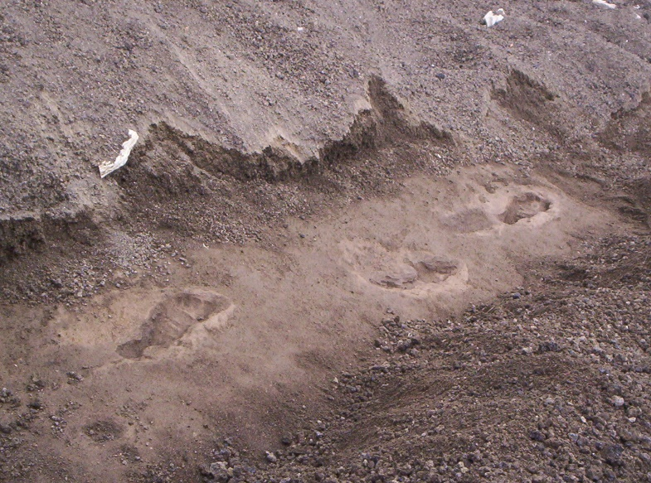
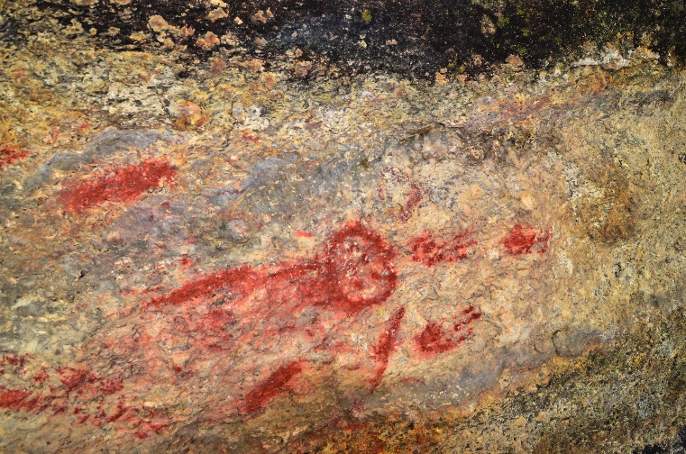
Location
  There are 80 cinder cones!
  Three volcanic eruption stages!
Ulusoy et al., 2019. QSR
  Human footprints on the volcanics!

Slide 7
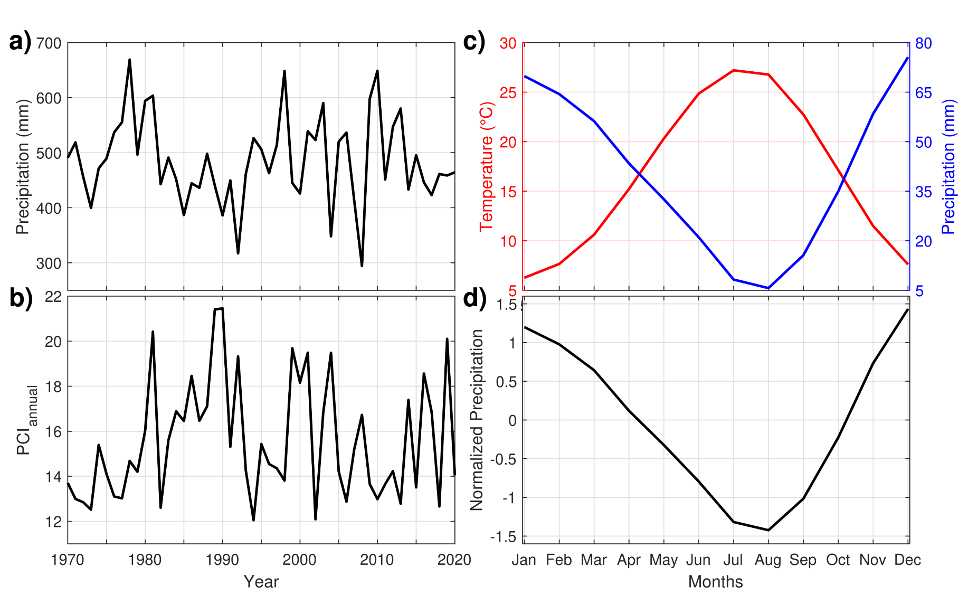
Climatology
  MAT: 14.3 °C
  MAP: 584.7 mm

Slide 8
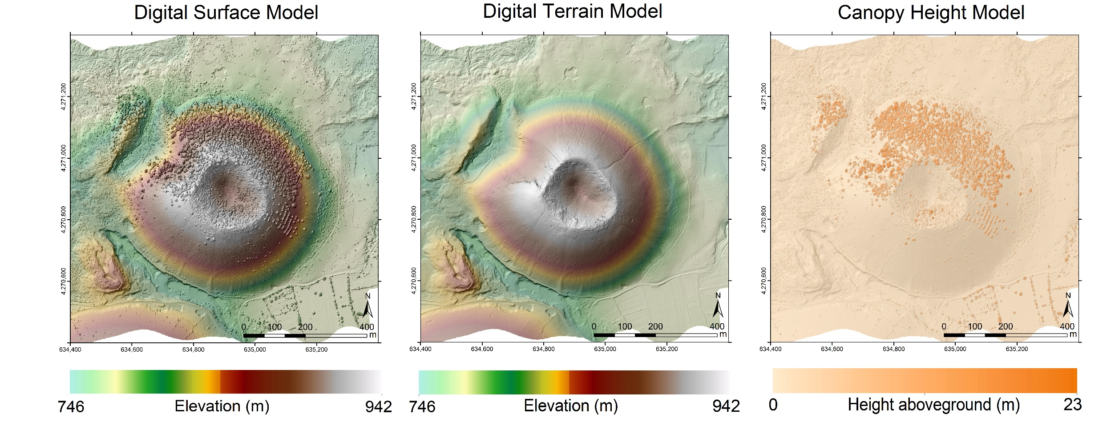
LiDAR of the Cinder Cone (Sandal Divlit)

Slide 9
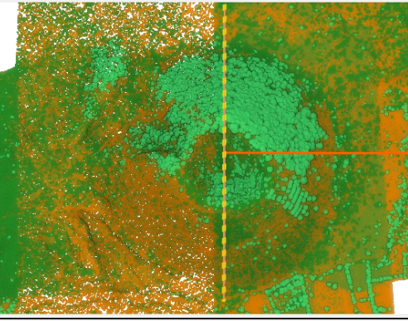
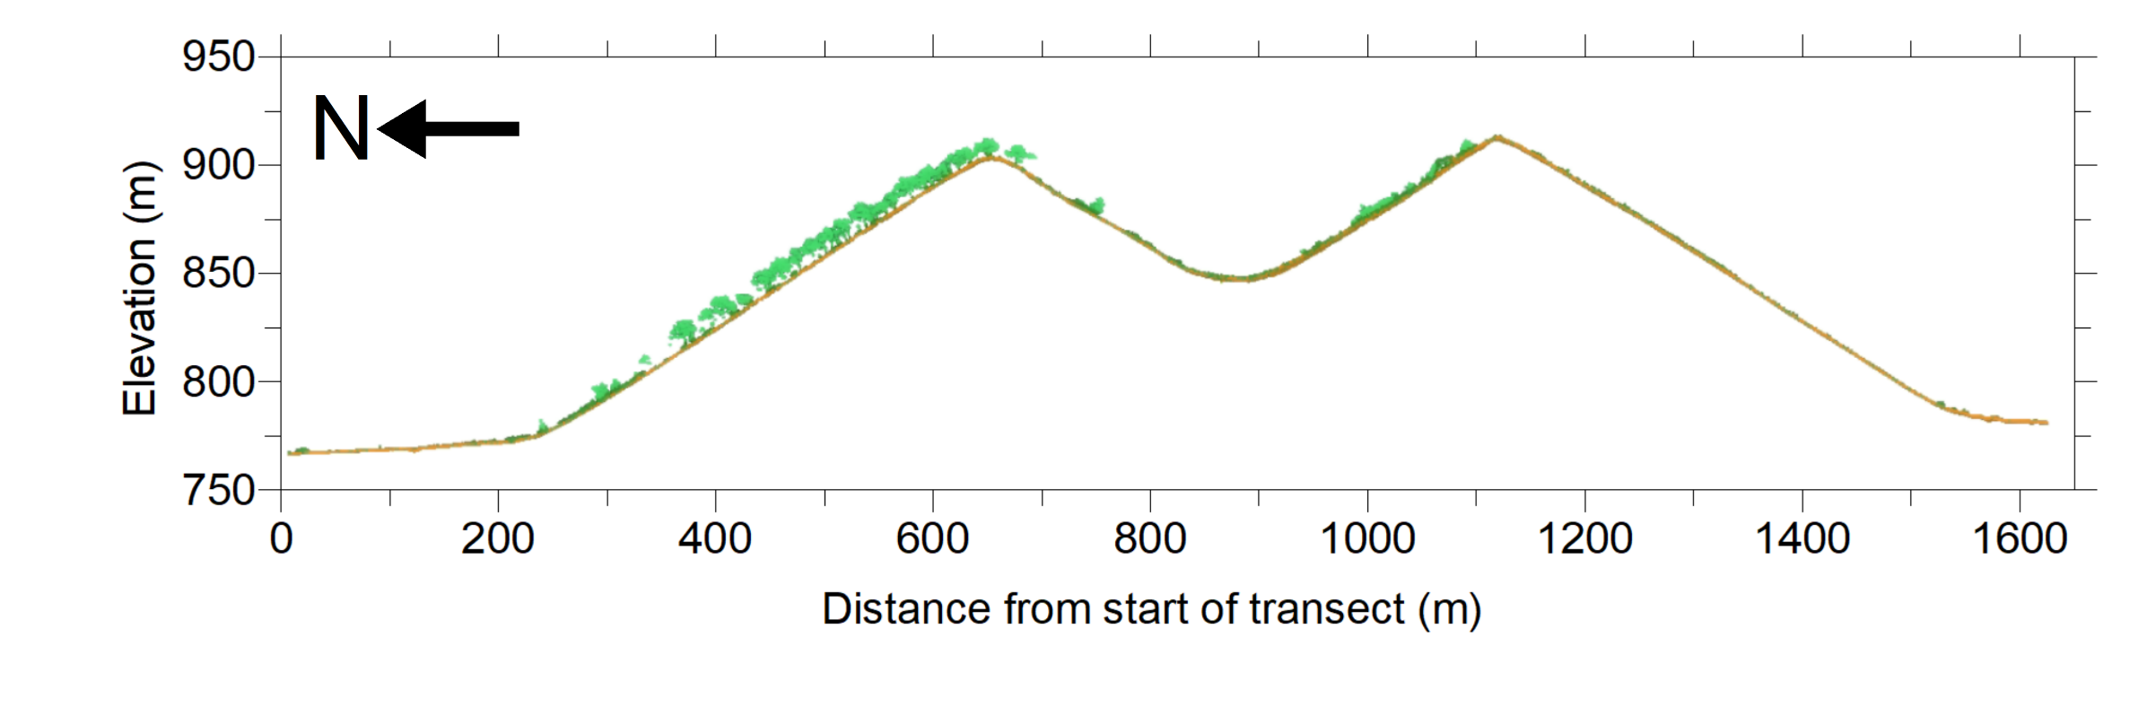
Vegetation transect along N-S direction

Slide 10
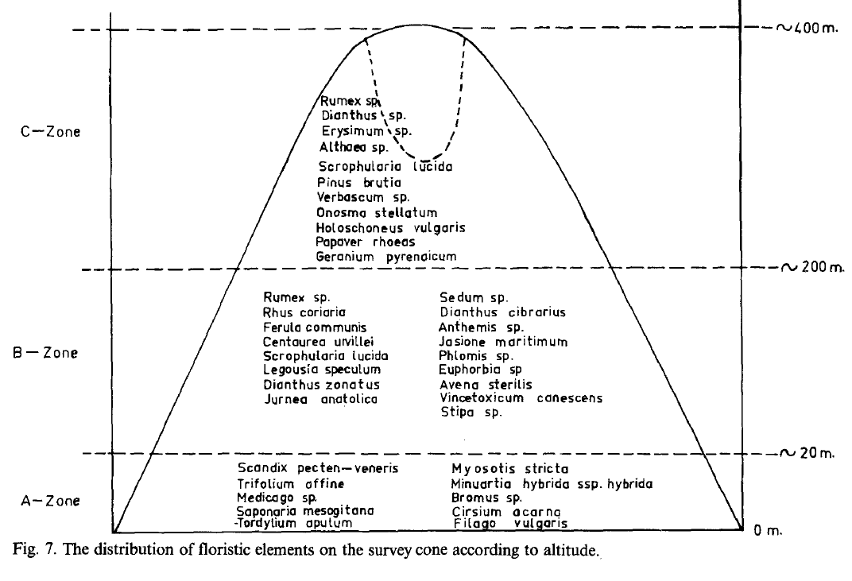
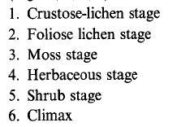
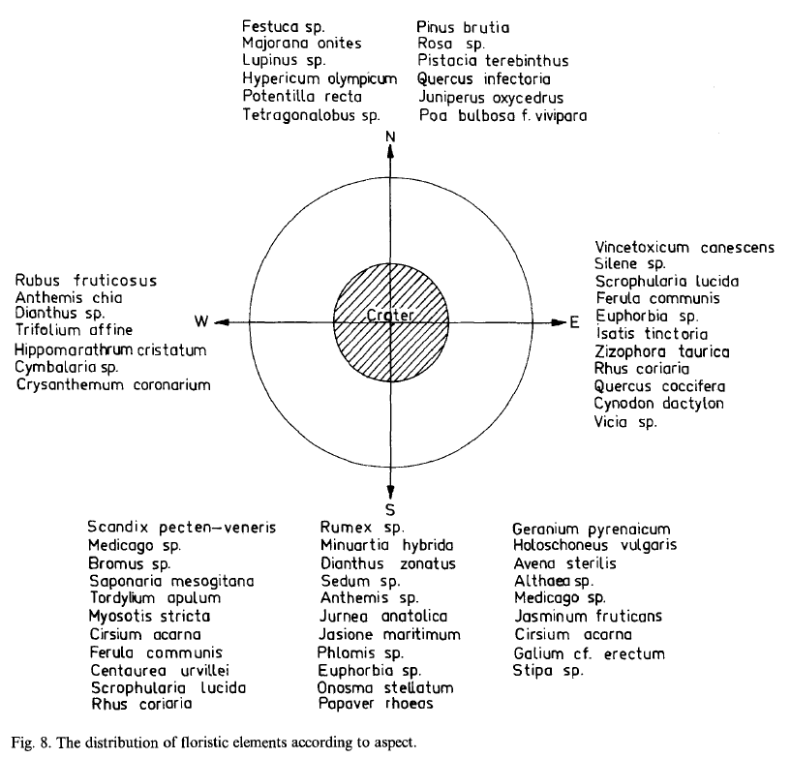
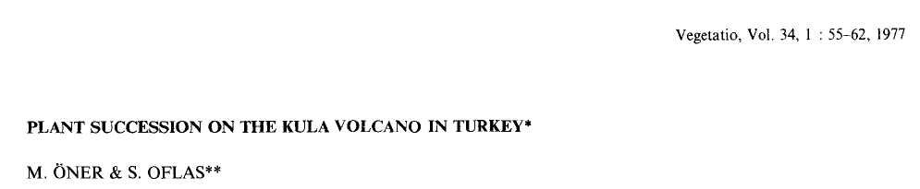
Vegetation succession and current setting

Slide 11
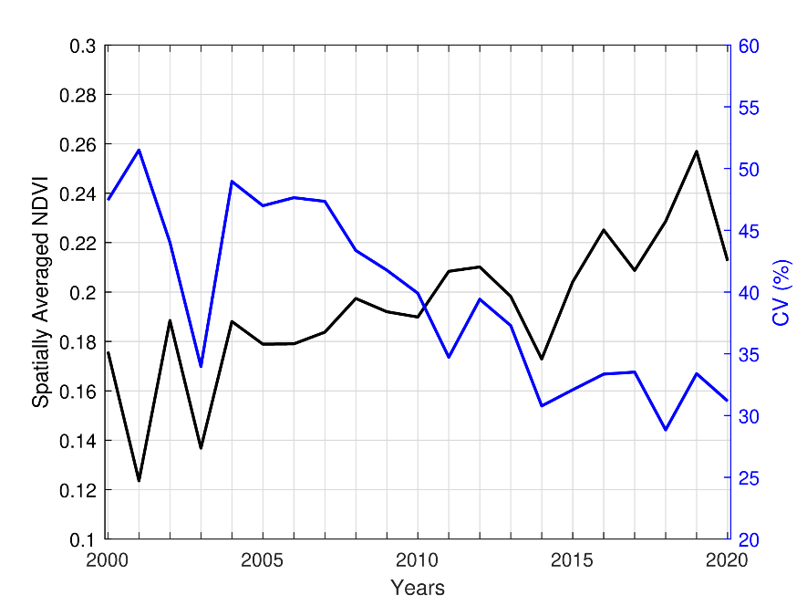
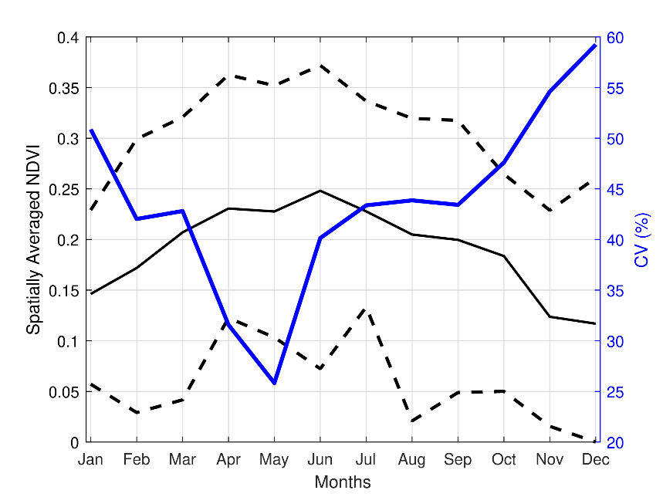
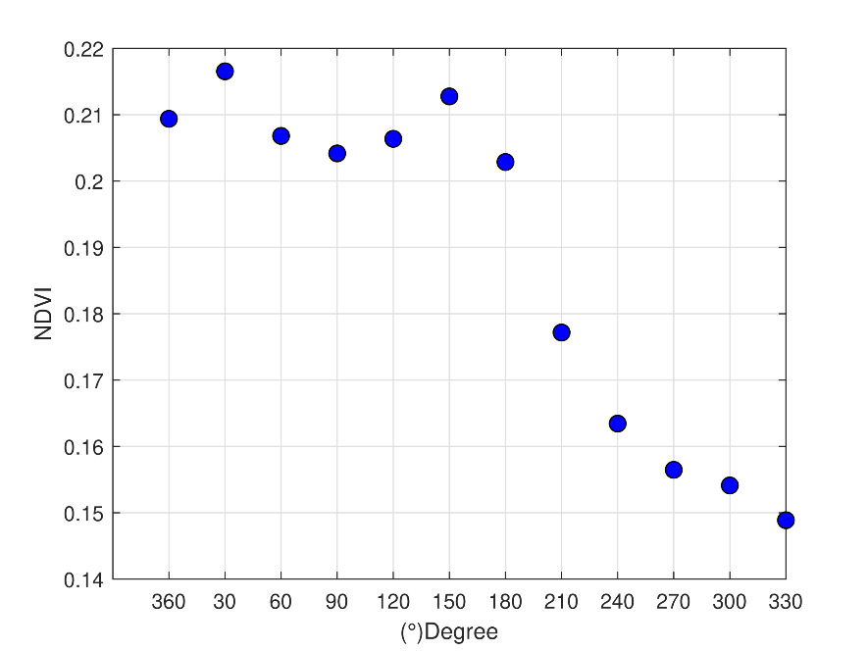
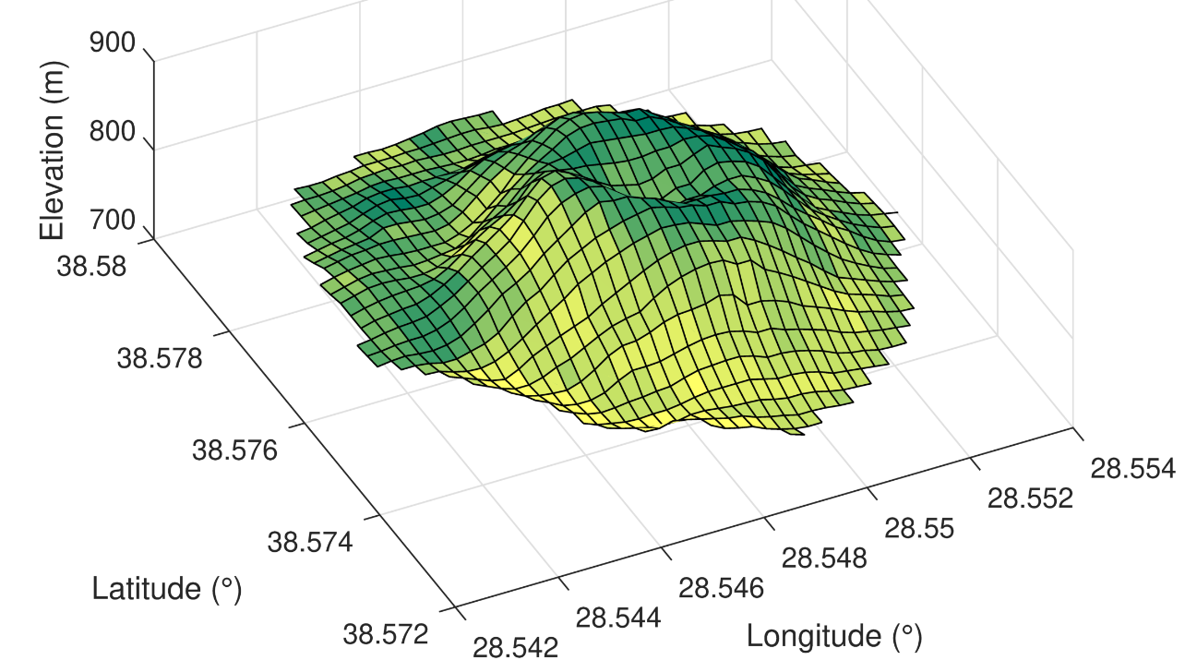
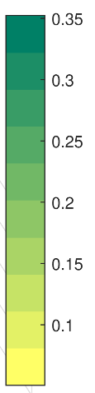
NDVI (2000-2020) GEE (Google Earth Engine)

Slide 12
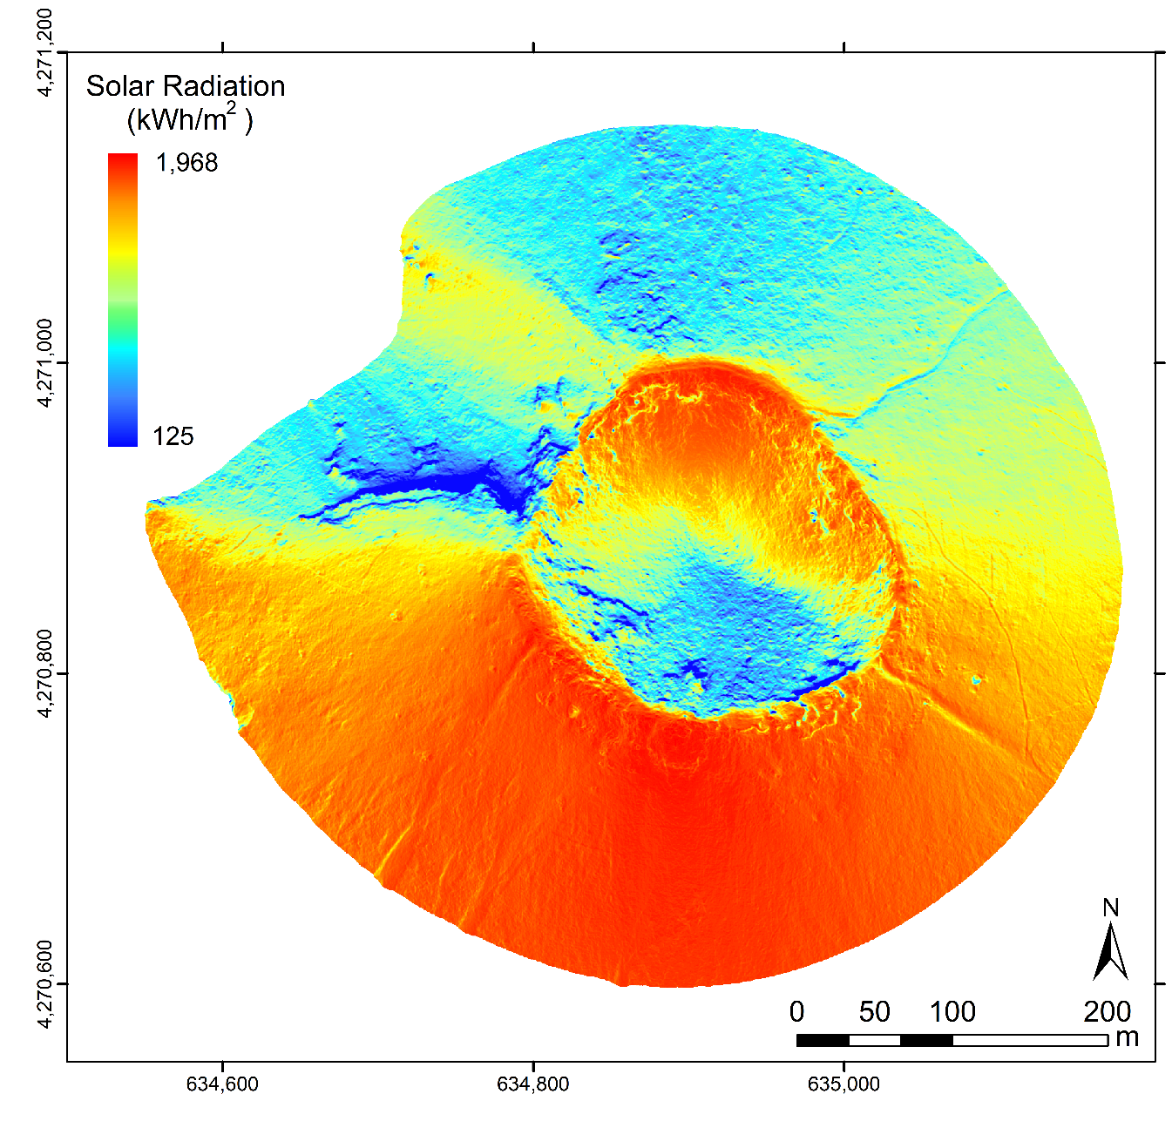
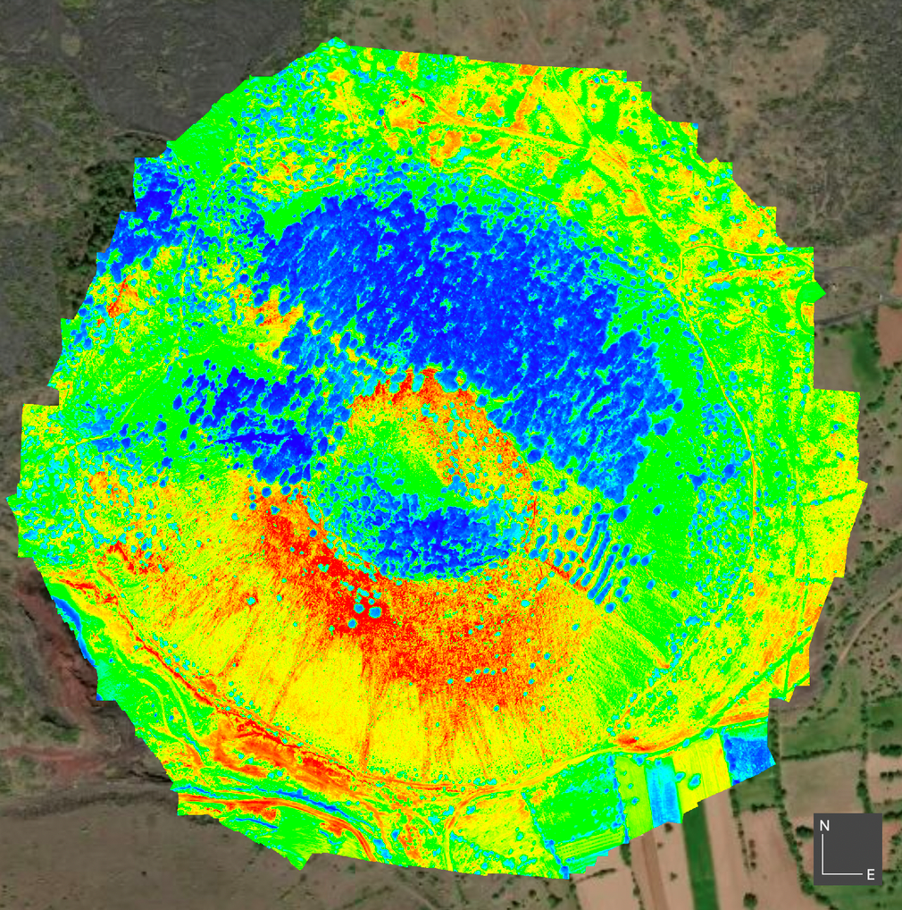
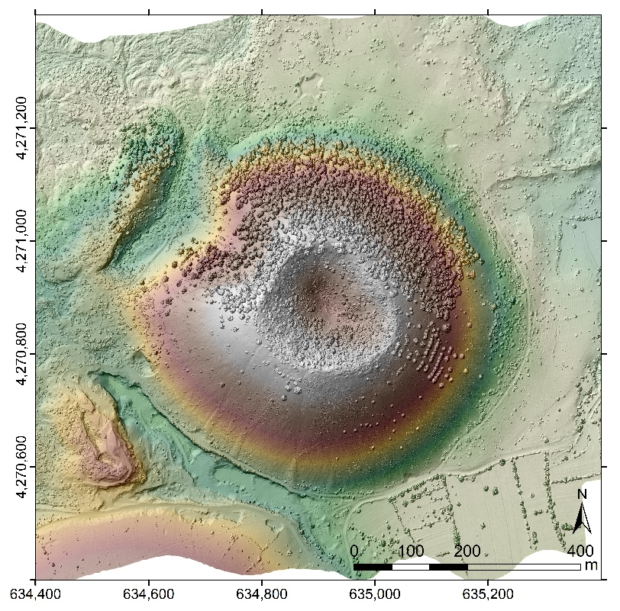
Solar Radiation (ArcGIS) & Thermal Image
  Solar radiation (half-hourly)
  Transmissivity: 0.58
  The ratio of diffuse radiation: 0.35
  26 April 2022 at 11:00 am

Slide 13
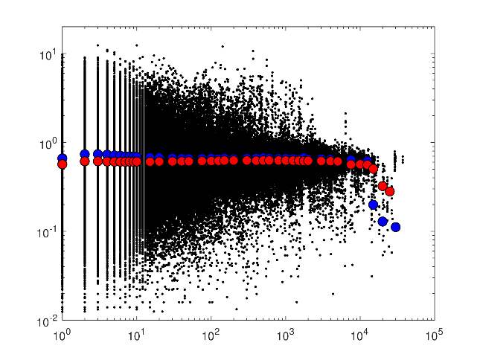
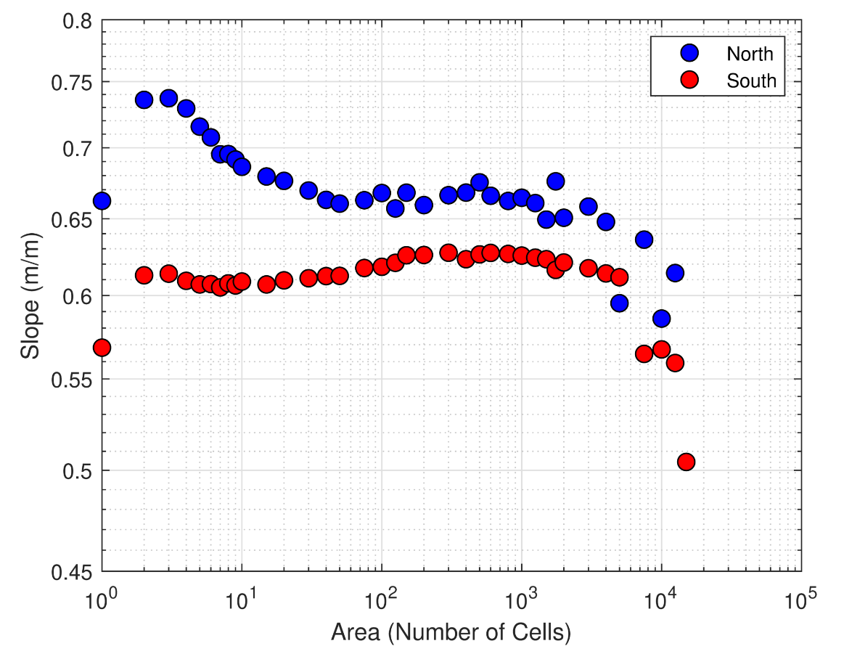
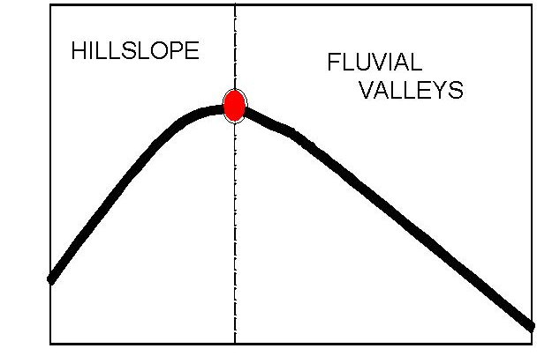
Slope-area Relation
Diffusive
Elevation
S: local slope
A: drainage area
θ: concavity index
Fluvial
Distance from basin divide
Valley Head
Slope
Convex hillslopes
Concave valleys
Area

Slide 14
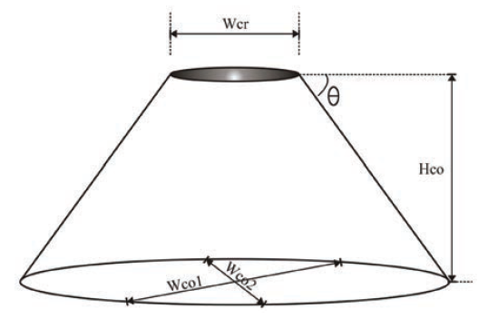
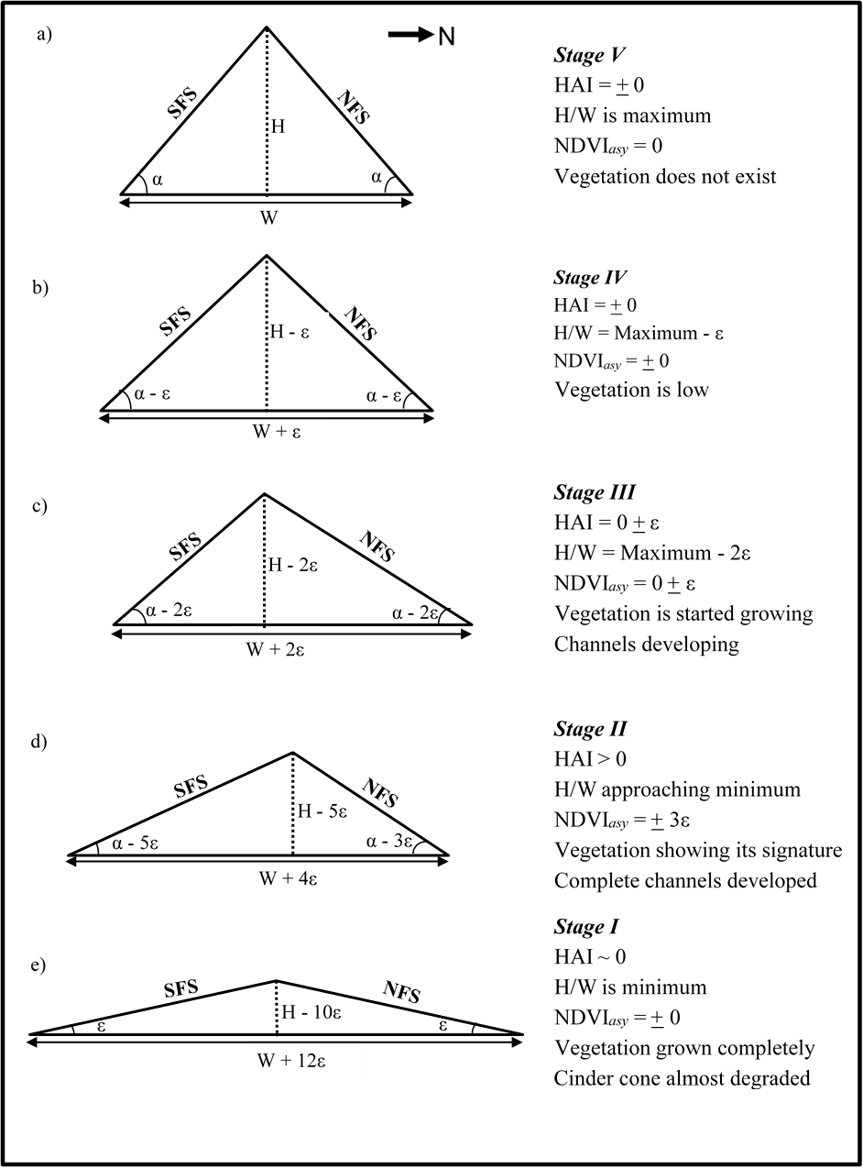
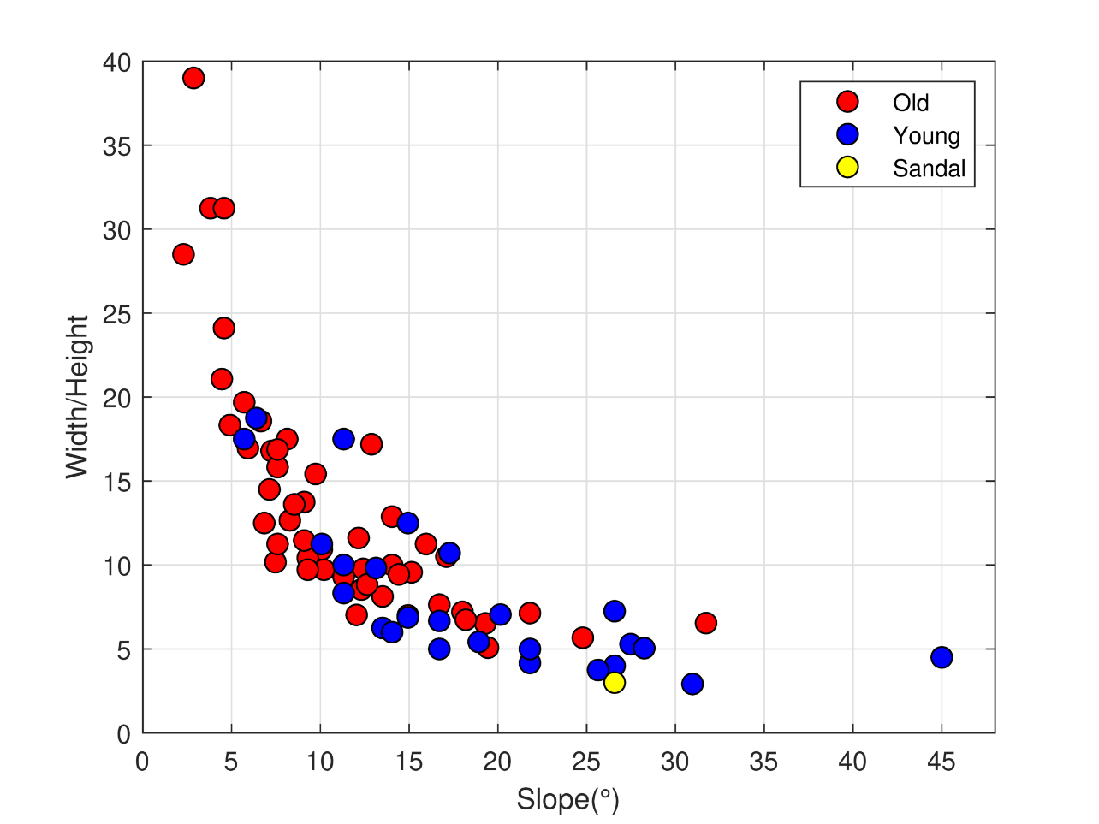
Cinder Cone: Geomorphometry
Kumari, 2021
Şen et al., 2014

Slide 15
Conclusions
    South-facing slopes receives more solar radiation than north-facing slopes (up to 16 times).
    North-facing slopes have denser vegetation cover than south-facing slopes.
    Less vegetation cover on south-facing slopes lead to more erosion and steeper north-facing slopes.
    Aspect-related vegetation differences imprint themselves on geomorphic processes.

Slide 16

    Thank you!

