Slide 1







Project PORO-CLIM initial results:
Towards a new oceanic crustal record of magma productivity throughout initiation of the
North Atlantic Igneous Province (NAIP)
Hazel Knight, Stephen M Jones, John R Hopper, Brian M O’Reilly and Thomas Funck
Notes:
Good morning, I’m Hazel, a PhD researcher from the University of Birmingham. Today I’m going to talk about project PORO-CLIM, and our aim is to assess the link between the initiation of the North Atlantic large Igneous Province (or NAIP) and the Paleocene-Eocene Thermal Maximum global climate change event (or PETM). Our project is one of several on-going studies looking at the relationship between these two events, but we take a novel approach focusing on the processes within Earth’s mantle that actually generated the magma.

Slide 2
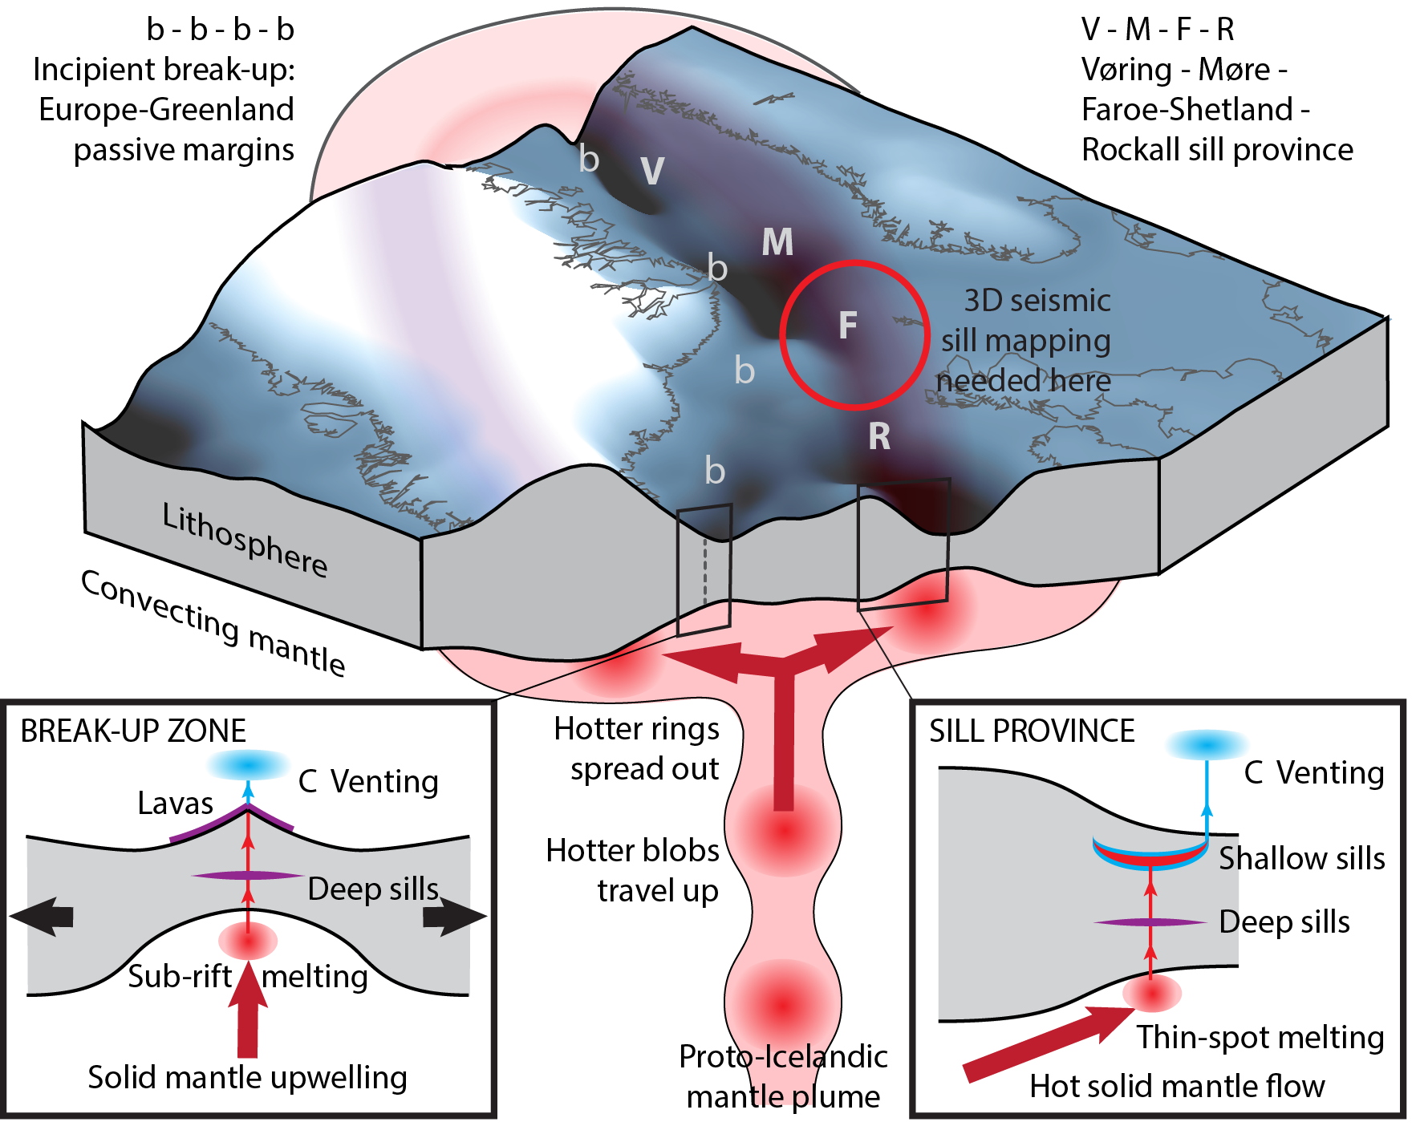

Could NAIP carbon solely drive the PETM ?
NAIP sill province emplacement
= Magma Productivity
Carbon dioxide and thermogenic methane
= Carbon flux
PETM global climate change
Notes:
NAIP carbon emissions are thought to be the most likely carbon source responsible for driving the PETM. The emissions include both carbon dioxide released directly from NAIP magma, and also thermogenic methane generated when the magma interacted with sedimentary rocks. The open question is whether the igneous province alone supplied sufficient emissions to drive the PETM, or whether additional carbon sources or feedbacks are also required. To answer this question, we need a record of NAIP carbon emissions that is independent of PETM climate records. As we are talking about carbon released from igneous activity, such a record will be contained within a record of the magmatic productivity of the NAIP.

Slide 3
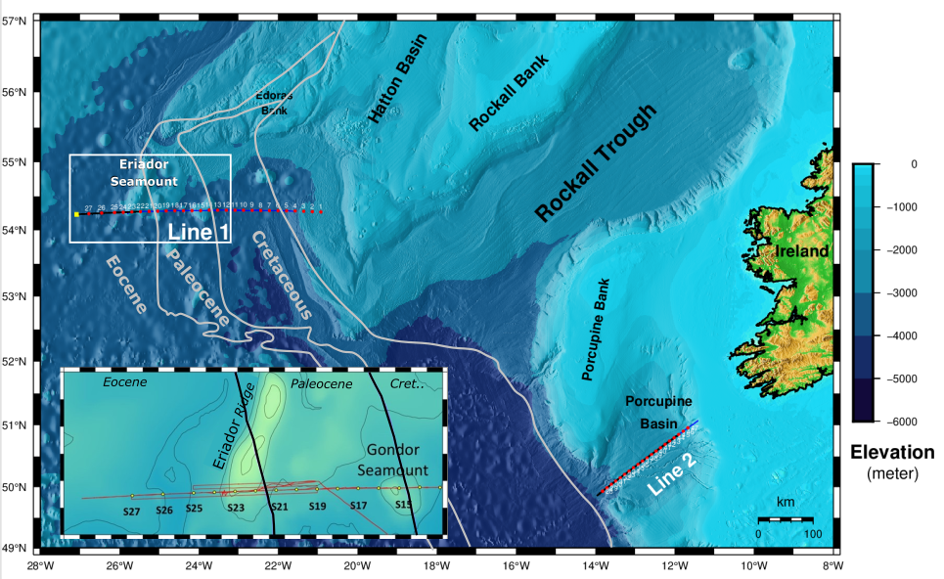
Continuous latest Cretaceous to earliest Eocene record
Notes:
Project PORO-CLIM is using oceanic crustal thickness as a measure of magmatic productivity. This is a tried and tested method: mid-ocean ridge plate boundaries continually record magmatic production through the generation of new oceanic crust, with thicker crust produced when magmatic productivity is higher, and thinner crust when magmatic productivity is lower. By measuring the variations in oceanic crustal thickness across the latest Cretaceous to early Eocene time period of NAIP emplacement, we aim to test whether a peak in magmatic productivity occurred that might drive the PETM.
To achieve this, in May 2021 the PORO-CLIM data acquisition cruise collected a new geophysical dataset across the little-studied Porcupine and Rockall Plateau passive margins in the NE Atlantic. Here we present Profile 1, a 400 km long, deep seismic profile across the Rockall Margin, which crosses oceanic crust of the age range of NAIP development. This combined reflection and wide-angle seismic dataset gives us the first continuous, sub-million-year magmatic productivity record throughout the entire waxing and waning phases of any of the worlds LIPs.
More specifically, Profile 1 contains the first whole crustal seismic record across Eriador Ridge, which is thought to be the ridge of thickened oceanic crust that corresponds to the magmatic productivity pulse that formed the continental NAIP sill province. So Eriador Ridge likely represents the volcanic pulse that relates to the PETM.

Slide 4
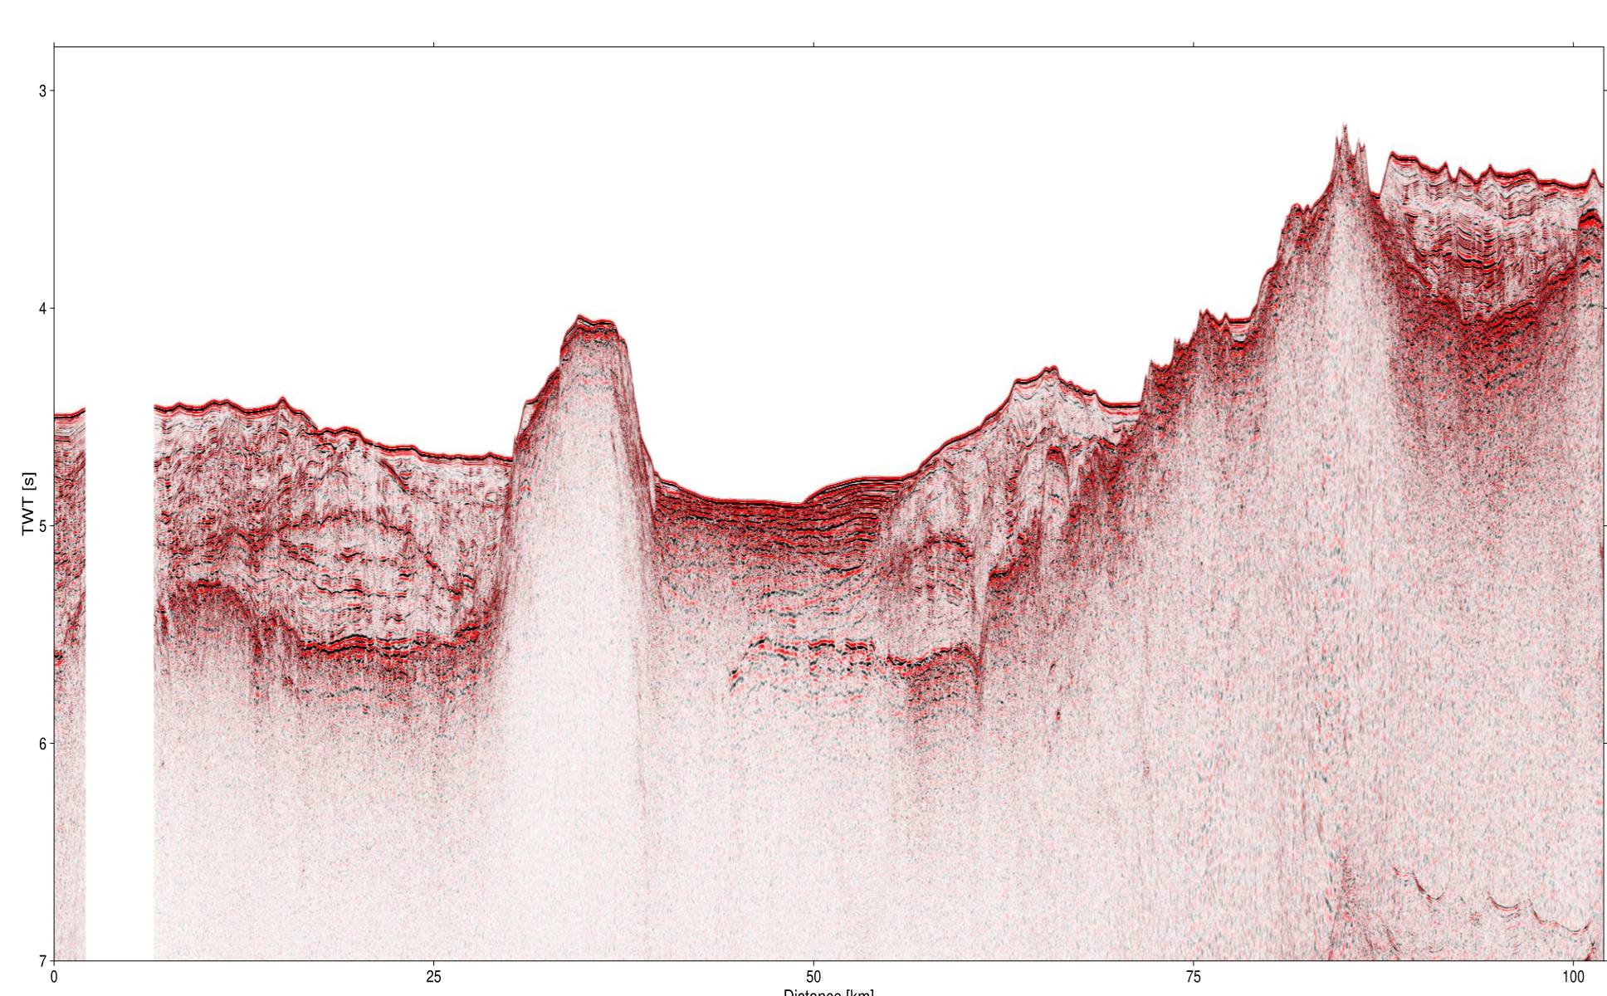
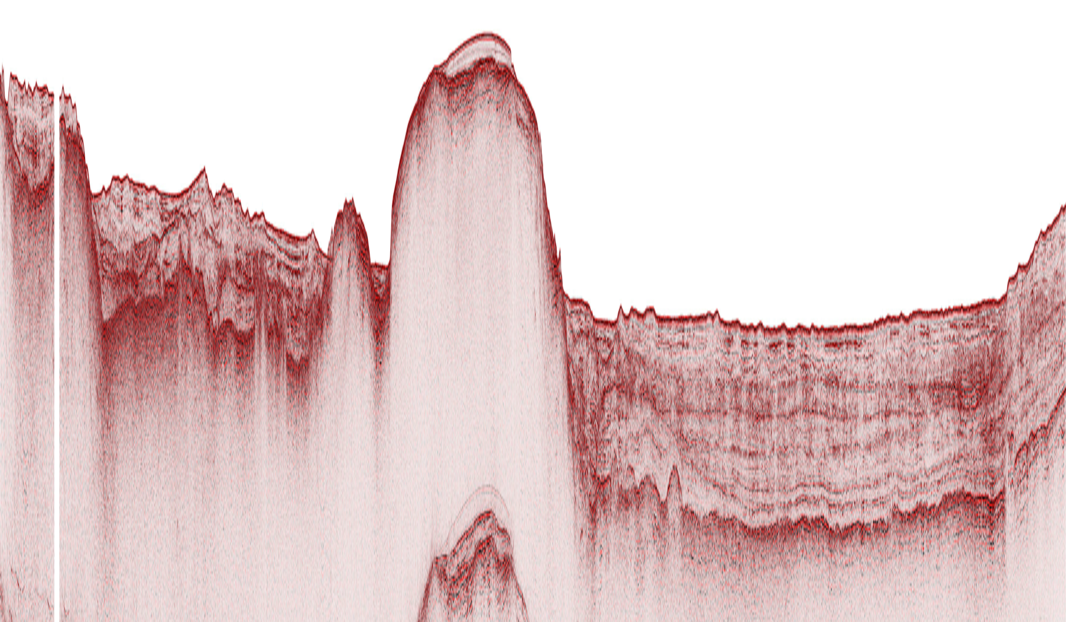
Eriador Ridge = PETM pulse?
Eocene
Palaeocene
C
C24r
C25n
Paleocene
Eocene
Boundary?
Seamount
3
Eriador Ridge
4
TWTT (S)
5
6
25 km
Increasing productivity
Notes:
I am only 6 months into my PhD, and analysis of the dataset is on-going, but here I present the initial implications. Here is the reflection seismic section along Profile 1 with the top of igneous oceanic crust marked by the black dots. Initial results from magnetic anomaly modelling confirm Cretaceous crust in the east to Eocene crust in the west and allow us to identify a tentative position for the Palaeocene-Eocene boundary marked here. So Eriador Ridge is earliest Eocene in age. This result agrees with the mantle plume model for NAIP formation, where the maximum magma production near the province centre occurs at the Paleocene-Eocene boundary, and maximum magma production at greater distances from the province centre, such as our study area, occurs progressively later.
Eriador Ridge shows a previously unknown double peak structure. These peaks may potentially be the result of two distinct pulses of anomalously hot mantle, separated by c. 1 Myr, which would imply multiple bursts of gas release from the NAIP around the Palaeocene-Eocene boundary. More generally, this seismic profile shows an overall increase in magmatic production through latest Cretaceous to Paleocene, as expected with LIP initiation, and it also shows pulsed magmatic productivity on a <5 Myr scale through the Paleocene and Eocene, that can explain the observed pulses in continental NAIP emplacement

Slide 5
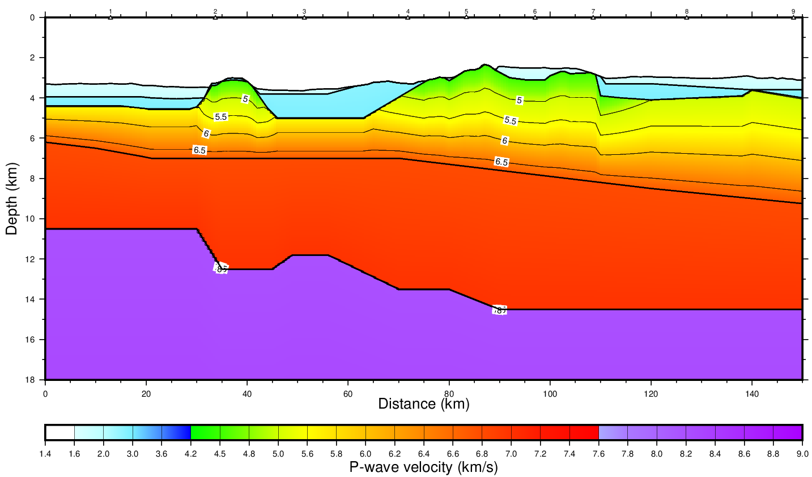
Oceanic crustal thickness model
Continuous latest Cretaceous to earliest Eocene dataset
Eriador Ridge is thickened oceanic crust formed around Paleocene-Eocene boundary
Magma productivity record will allow independent estimation of NAIP carbon flux, and relationship to PETM
Notes:
Preliminary velocity modelling of our wide-angle seismic data confirms that Eriador Ridge follows the expected seismic velocity structure for unusually thick oceanic crust, which supports our hypothesis that it represents a magma productivity pulse in response to a pulse of hot mantle beneath the plate. When this oceanic crustal thickness model is completed later this year, it will provide a quantitative record of magma productivity through time, which will eventually allow an accurate estimate of NAIP carbon flux.

Slide 6




Thank you!
Please feel welcome to contact me
HKK761@student.bham.ac.uk
@hazelk_42

Slide 7
Plume pulses and V-shaped ridges
Notes:
Extra slide if more detail wanted; Eriador Ridge = one arm of V-shaped ridge which formed in response to plume pulse at PETM time?

