Slide 1

Quantifying the spatial and temporal non-CO₂ effect of aviation by using algorithmic climate change functions
Simone Dietmüller, Sigrun Matthes, Volker Grewe, Katrin Dahlmann, Patrick Peter, Hiroshi Yamashita
DLR, Institute of Atmospheric Physics, Oberpfaffenhofen, Germany
TU Delft, The Netherlands
EGU 2022, 25/05/2022

Slide 2
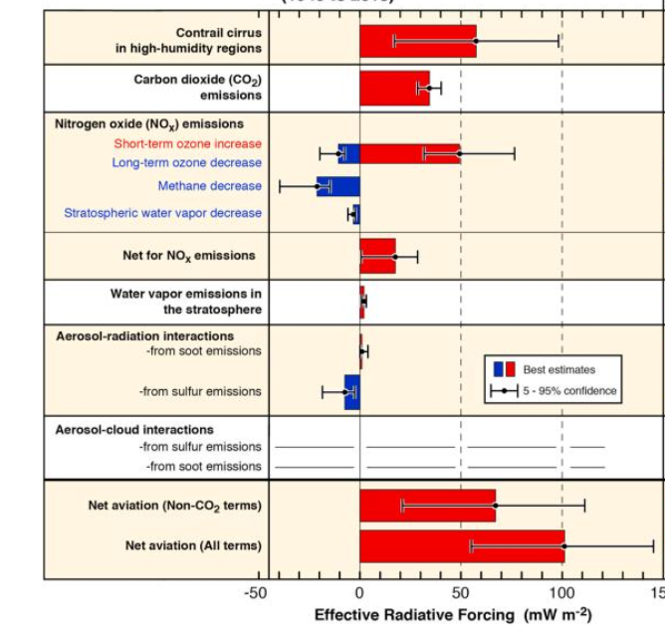
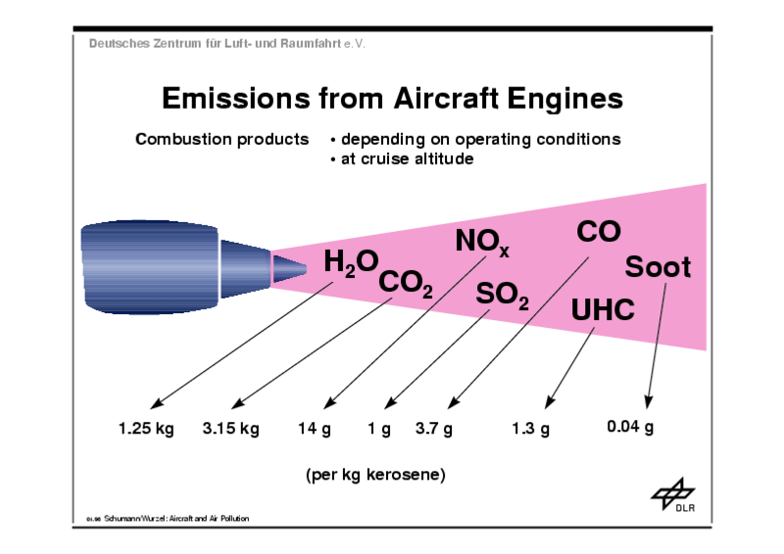
Climate impact of aviation emissions
Radiation forcing (RF) from individual aviation emissions
Emission of aviation
Lee et al. 2021
Aviation emission impact climate by CO₂ and non-CO₂ effects (e.g. ozone, contrail-cirrus, aerosol)
Cooling
Warming
Non-CO₂ emissions responsible for 2/3 of aviation’s total RF

Slide 3
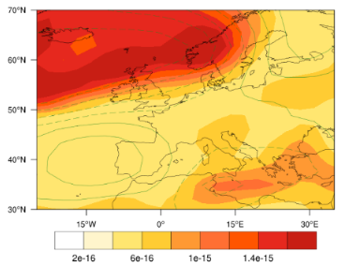
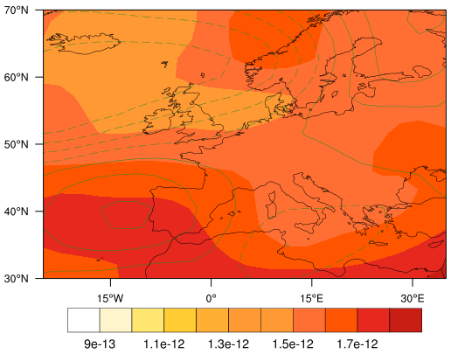
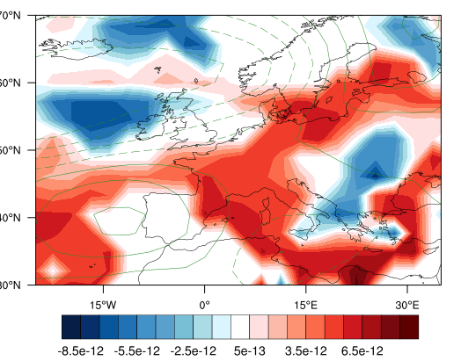
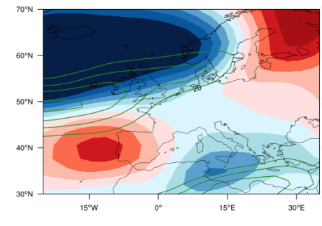
Algorithmic Climate Change functions (aCCFs)
Prototype algorithmic climate change functions (aCCFs) of non-CO₂ effects give climate impact of aviation emissions at a specific location and time
aCCFs can be calculated for contrail-cirrus, water vapour, NO_{x}-induced changes of ozone and methane
aCCFs enable calculating climate impact based on meteorological parameters from numerical weather prediction data
Climate change from meteorological input data by using aCCFs
METEO
Water vapour aCCF
NO_{x}-induced aCCF
Contrail aCCF
geopotential
aCCFs
Calculated by mathematical formulas -> computational efficient
[K/kg(fuel)]
[K/kg(NO2)]
[K/km(contrail)]
Water vapour and NO_{x} induced aCCF is positive (warming)
Contrail (daytime) aCCF warming/cooling impact in areas where contrails can form
aCCFs characterize sensitivity of atmosphere to aviation emissions at specific location (position, altitude) and time. ⇒ MET product for climate-optimized trajectory planning
FLYATM4E WP1 - Advisory Board 19/05/22

Slide 4
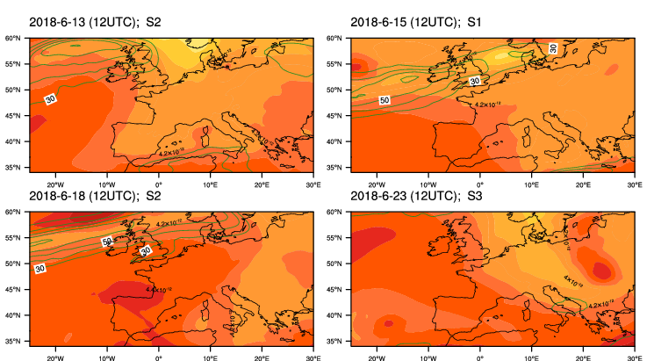
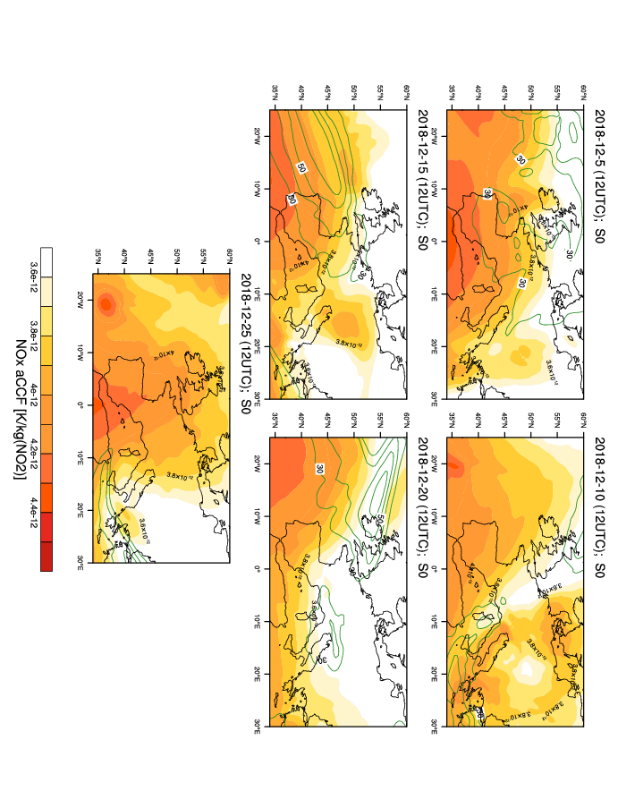
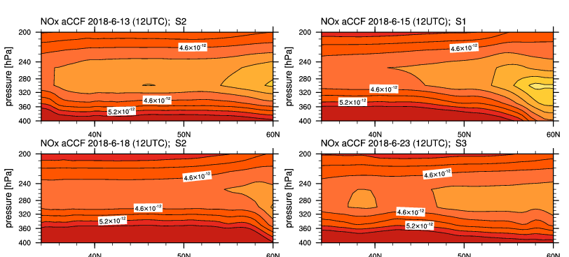
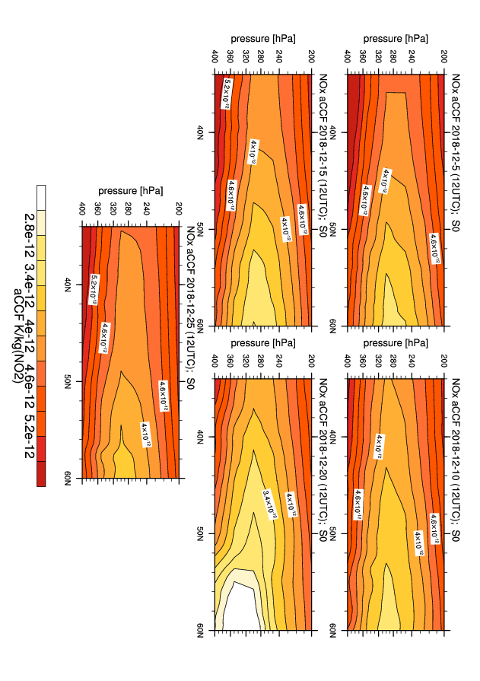
Analysis of NO_{x}-induced aCCFs
June 2018, 12 UTC, ERA5 0.28°
December 2018,12 UTC, ERA5 0.28°
NO_{x} induced aCCF positive (warming)
Variation in NO_{x} aCCF with
different synoptical conditions
different season (Higher values in summer. Day to day variability higher in winter)
with cruise altitude (vertical gradients higher in winter)
250 hPa
Vertical cross section at 0°

Slide 5
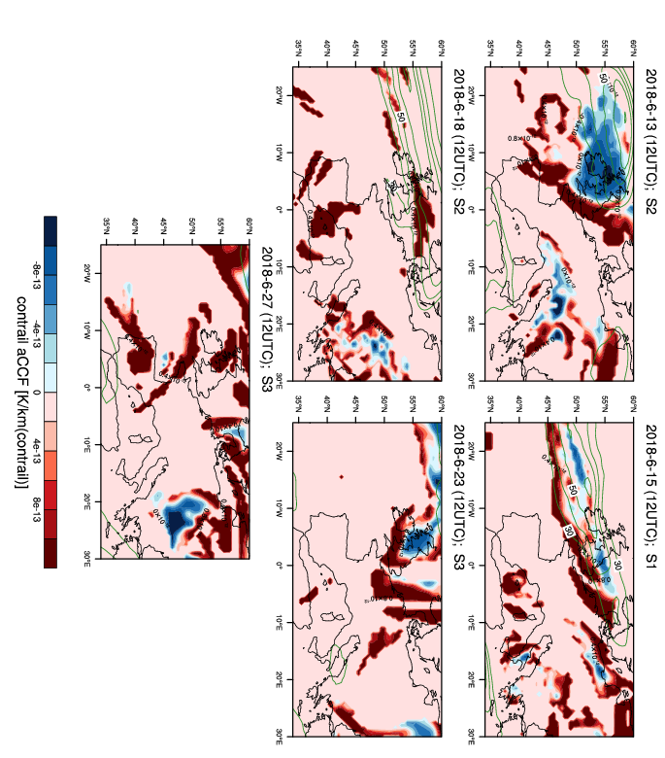
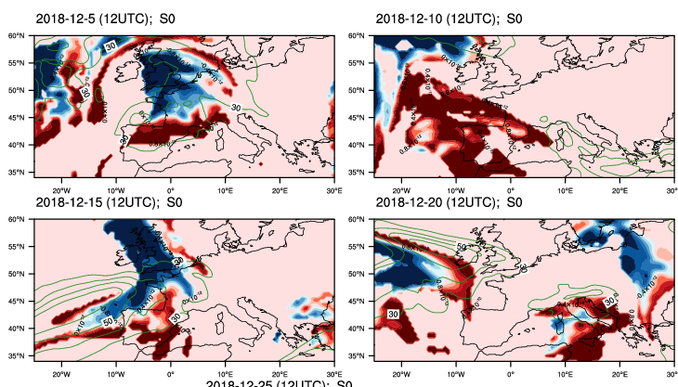
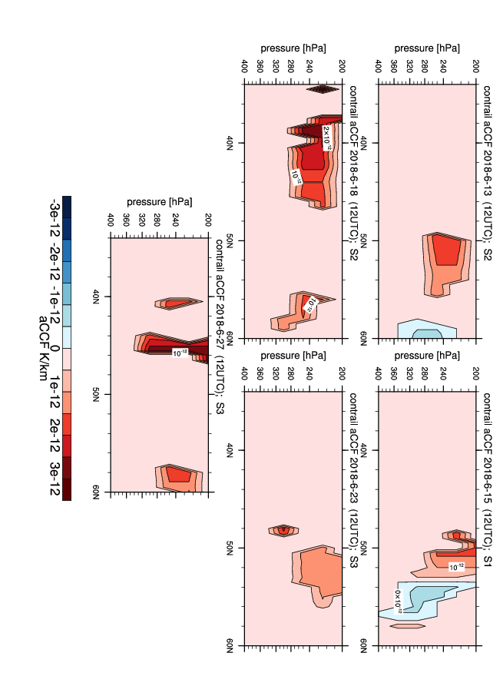
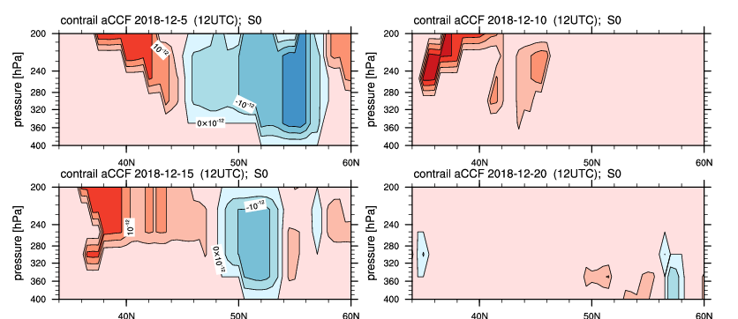
Analysis of contrail aCCFs
June 2018, 12 UTC, ERA5 0.28°
December 2018, 12 UTC, ERA5 0.28°
Contrail (daytime) aCCFs warming or cooling effect, in areas of contrail formation
Strong day-to-day variation in contrail aCCFs
Seasonal variation in contrail aCCFs:
contrail formation higher in winter
more areas with cooling contrails in winter
Variation with cruise altitude
250 hPa
Vertical cross section at 0°

Slide 6
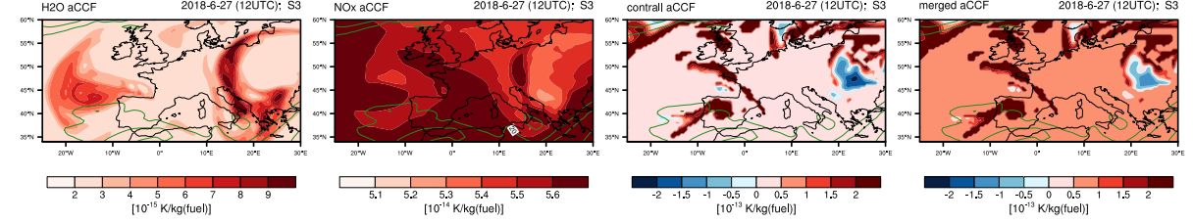
Generation of merged non-CO₂ aCCFs
Merged non–CO₂ aCCFs combine contrail-cirrus, total NO_{x} and water vapour aCCFs (taking assumptions on technical specifications of emission indices and physical climate metric)
Summary
aCCFs enable climate-optimized trajectory planning
Individual water vapour, NO_{x} induced and contrail-cirrus aCCFs show large variations with different meteorological situations, seasons and altitudes
Merged non-CO₂ aCCFs are generated. Large influence of contrails aCCFs.
With merged aCCFs specific weather situations with large mitigation potential can be identified.

