Slide 1
The updated CICERO Simple Climate Model
– an open-source emulator contribution to the AR6 process
Marit Sandstad, Ragnhild Bieltvedt Skeie, and Bjørn Hallvard Samset
Emulators and simple climate models: development and applications - EGU
27th May 2022, Vienna, Austria Online

Slide 2
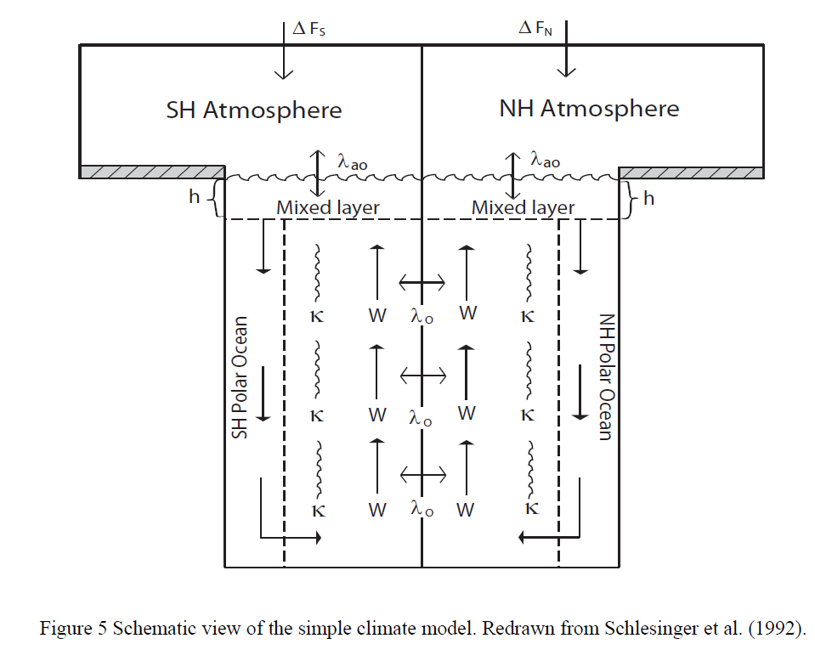
CO₂, CH₄, N₂O, CFCs, HCFCs,…, NOx, CO, VOCs, BC, OC …
Simplified expressions
CO2, N2O, CH4: Etminan et al 2016.
Short-lived components, scaled with emissions.
Global emissions
Concentrations
Radiative forcing
Global temperature change
Ocean heat content
CO₂: Carbon Cycle routine
(Joos et al. 1996)
Other components: Simplified expressions emissions (Tg) to (ppb)
Lifetime of gases.
Natural emissions of N2O and CH4. Has to assume variable with time to match observations.
Short-lived: Aerosols, ozone etc: Skip concentrations, directly from emissions to forcing.
Energy balance/upwelling diffusion model

Slide 3
IPCC WG3 -scenarios
600 ensemble members tuned to fit present day temperature
Builds on work and methodology of Skeie et al 2018, with a 30400 consistent parametersets
From those, pick subdistribution of 600 to fit current temperature with aerosol and ECS value cutoffs.
Used in iiasas climate-assessment for WG3

Slide 4
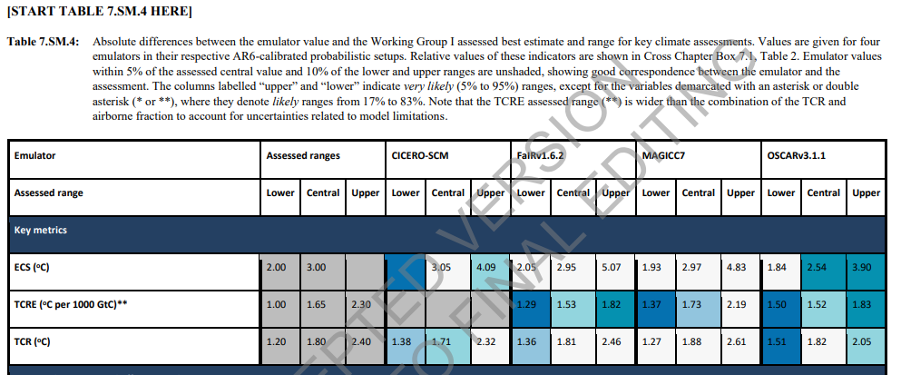
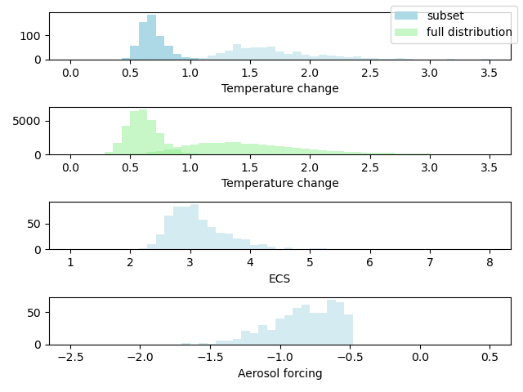
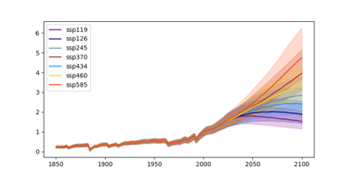

Slide 5
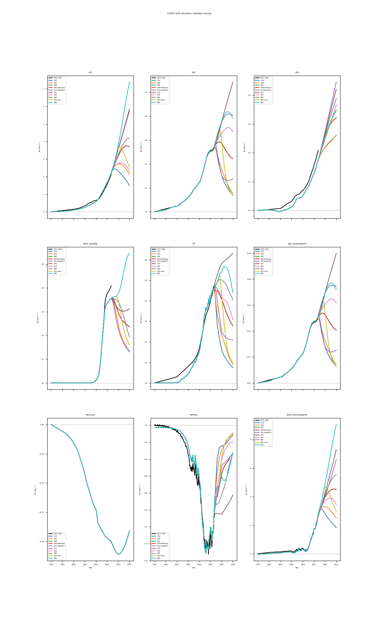
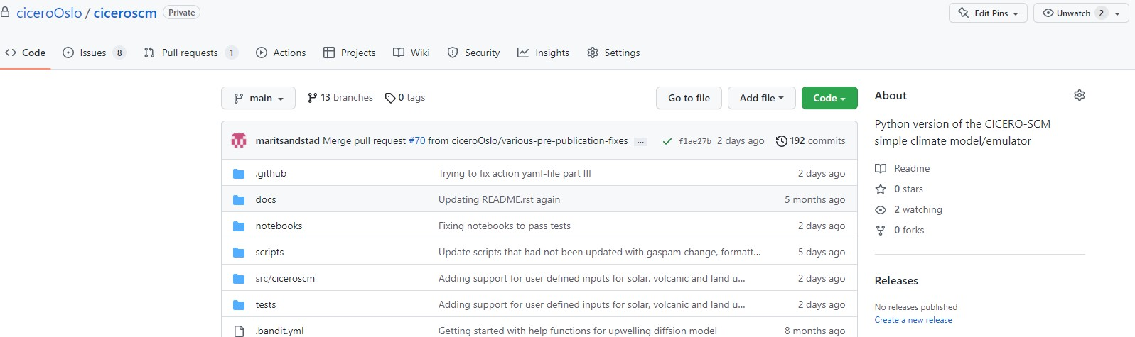
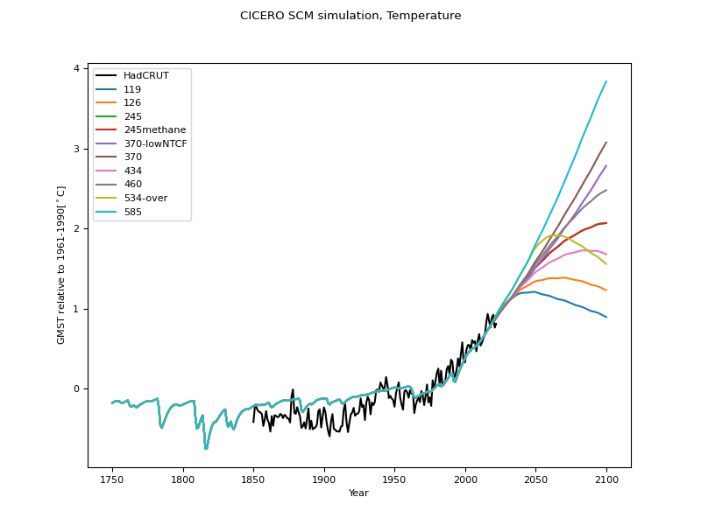
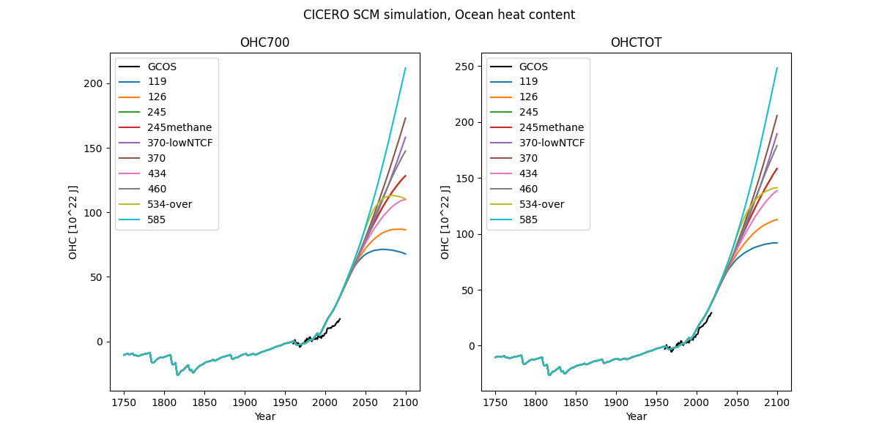
Coming soon – publicly available python version

Slide 6
Sources
F. Joos, M. Bruno, Pulse response functions are cost-efficient tools to model the link between carbon emissions, atmospheric CO2 and global warming”, Physics and Chemistry of the Earth, Vol 21, Issues 5–6, 1996, Pages 471-476, ISSN 0079-1946, https://doi.org/10.1016/S0079-1946(97)81144-5.
Schlesinger, M. E., X. Jiang and R. J. Charlson, 1992. Implications of Anthropogenic Atmospheric Sulphate for the Sensitivity of the Climate System. Reprinted form &OLPDWH&KDQJH and (QHUJ\3ROLF\. American Institute of Physics, New York
Etminan, M., Myhre, G., Highwood, E. J., and Shine, K. P. (2016), Radiative forcing of carbon dioxide, methane, and nitrous oxide: A significant revision of the methane radiative forcing, Geophys. Res. Lett., 43, 12,614– 12,623, doi:10.1002/2016GL071930.
Skeie, R. B., Berntsen, T., Aldrin, M., Holden, M., Myhre, G. (2018), Climate sensitivity estimates – sensitivity to radiative forcing time series and observational data, Earth Syst. Dynam., 9, 879–894, 2018 https://doi.org/10.5194/esd-9-879-2018
Smith, C., Z.R.J. Nicholls, K. Armour, W. Collins, P. Forster, M. Meinshausen, M.D. Palmer, and M. Watanabe, 2021: The Earth’s Energy Budget, Climate Feedbacks, and Climate Sensitivity Supplementary Material. In Climate Change 2021: The Physical Science Basis. Contribution of Working Group I to the Sixth Assessment Report of the Intergovernmental Panel on Climate Change [Masson-Delmotte, V., P. Zhai, A. Pirani, S.L. Connors, C. Péan, S. Berger, N. Caud, Y. Chen, L. Goldfarb, M.I. Gomis, M. Huang, K. Leitzell, E. Lonnoy, J.B.R. Matthews, T.K. Maycock, T. Waterfield, O. Yelekçi, R. Yu, and B. Zhou (eds.)]
Smith, C.J., R.J. Kramer, G. Myhre, K. Alterskjær, W. Collins, A. Sima, O. Boucher, J.-L. Dufresne, P. Nabat, M. Michou, S. Yukimoto, J. Cole, D. Paynter, H. Shiogama, F.M. O'Connor, E. Robertson, A. Wiltshire, T. Andrews, C. Hannay, R.L. Miller, L. Nazarenko, A. Kirkevåg, D. Olivié, S. Fiedler, R. Pincus, and P.M. Forster, 2020: Effective radiative forcing and adjustments in CMIP6 models. Atmos. Chem. Phys., 20, no. 16, 9591-9618, doi:10.5194/acp-20-9591-2020.
Von Scuckman, K., Cheng, L., Palmer, M. D., Hansen, J., Tassone, C., Aich, V., Adusumilli, S., Beltrami, H., , Boyer, T., Cuesta-Valero F. J., Desbruyères, D., Domingues,C., García-García, A., Gentine, P., Gilson, J., Gorfer, M., Haimberger, L., Ishii, M., Johnson, G. C., Killick, R., King, B. A., Kirchengast, G., Kolodziejczyk, N., Lyman, J., Marzeion, B., Mayer M., Monier M., Monselesan D. P., Purkey S., Roemmich D., Schweiger A., Seneviratne, S. I., Shepherd A., Slater D. A., Steiner A. K., Straneo, F., Timmermans, M.-L., and Wijffels, S.E., Heat stored in the Earth system: where does the energy go?, Earth Syst. Sci. Data, 12, 2013–2041, 2020, https://doi.org/10.5194/essd-12-2013-2020
Morice, C. P., Kennedy, J. J., Rayner, N. A., Winn, J. P., Hogan, E., Killick, R. E., et al. (2021). An updated assessment of near-surface temperature change from 1850: the HadCRUT5 data set. Journal of Geophysical Research: Atmospheres, 126, e2019JD032361. https://doi.org/10.1029/2019JD032361
Forster, P., T. Storelvmo, K. Armour, W. Collins, J.-L. Dufresne, D. Frame, D.J. Lunt, T. Mauritsen, M.D. Palmer, M. Watanabe, M. Wild, and H. Zhang, 2021: The Earth’s Energy Budget, Climate Feedbacks, and Climate Sensitivity. In Climate Change 2021: The Physical Science Basis. Contribution of Working Group I to the Sixth Assessment Report of the Intergovernmental Panel on Climate Change [Masson-Delmotte, V., P. Zhai, A. Pirani, S.L. Connors, C. Péan, S. Berger, N. Caud, Y. Chen, L. Goldfarb, M.I. Gomis, M. Huang, K. Leitzell, E. Lonnoy, J.B.R. Matthews, T.K. Maycock, T. Waterfield, O. Yelekçi, R. Yu, and B. Zhou (eds.)]. Cambridge University Press, Cambridge, United
Kingdom and New York, NY, USA, pp. 923–1054, doi:10.1017/9781009157896.009
https://github.com/ciceroOslo/ciceroscm

Slide 7
Thank you
Marit Sandstad
www.cicero.oslo.no
@CICERO_klima

