Slide 1

Nonlinear Solver Acceleration Based on Machine Learning Applied to Multiphase Porous Media Flow
Vinicius L S Silva
Pablo Salinas
Matthew D Jackson
Christopher C Pain
Publication in Computer Methods in Applied Mechanics and Engineering (CMAME)

Slide 2
INTRODUCTION
In this work, a machine learning acceleration to dynamically control the numerical relaxation is evaluated.
The machine learning is trained based on the parameters of the reservoir model scaled to a dimensionless space.
For the machine learning training, data from a multiphase flow simulation in a simple two-dimensional layered reservoir is used, which considerably simplifies this step.

Slide 3
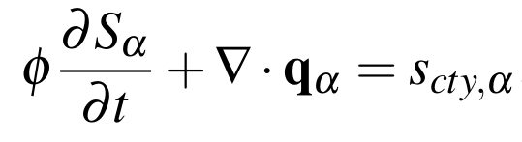
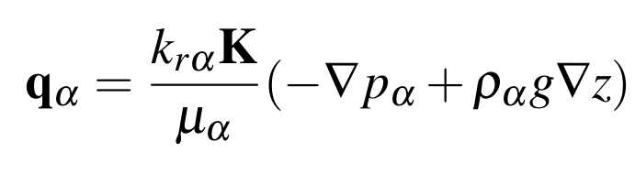


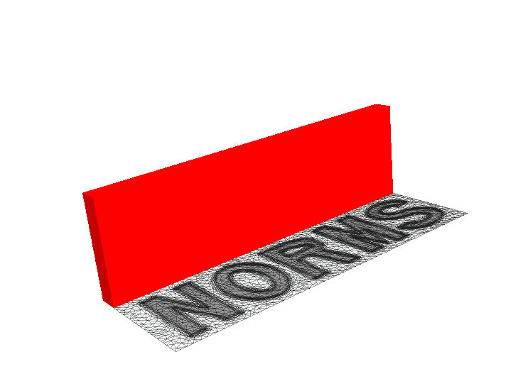
MATHEMATICAL MODEL AND NUMERICAL SOLUTION
We report here the formulation for incompressible and immiscible flow with gravity and capillary pressure.
The solution of the equations reported here are implemented in the open-source code IC-FERST (Imperial College Finite Element Reservoir SimulaTor).

Slide 4
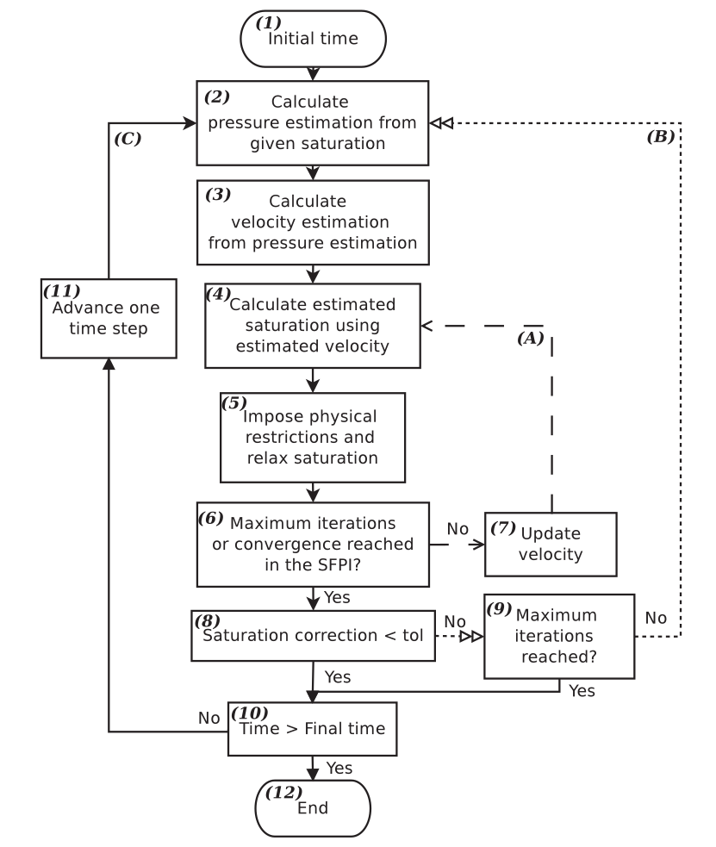




NONLINEAR SOLVER
Time loop
Outer loop
Relaxation:
Inner loop
- index representing the inner-loop current iteration
- saturation before relaxation
- saturation after relaxation
- importance of S^{k-2} (here constant β = 0.4).
- relaxation parameter
Reprinted from: Salinas, P., et al., 2017 "Improving the convergence behaviour of a fixed‐point‐iteration solver for multiphase flow in porous media." International Journal for Numerical Methods in Fluids

Slide 5
NONLINEAR SOLVER
An important question is how the the relaxation factor (ω) is chosen. The value of ω plays an important role in the convergence of the nonlinear loops but it is not known a-priori and is problem specific.
We propose a machine learning model to generate the values of ω based on the physics of the system scaled to a dimensionless space.
The main goal is to reduce computational cost by diminishing the number of nonliner iterations.

Slide 6
MACHINE LEARNING ACCELERATION
Inputs of the ML model
Physics of the system scaled to a dimensionless space
Number of inner nonlinear iterations
Want to minimize
Machine Learning
model
After training we can set the number of inner nonlinear iterations to a low value and calculate the corresponding relaxation factor.
Output of the ML model
ω (Relaxation parameter)

Slide 7
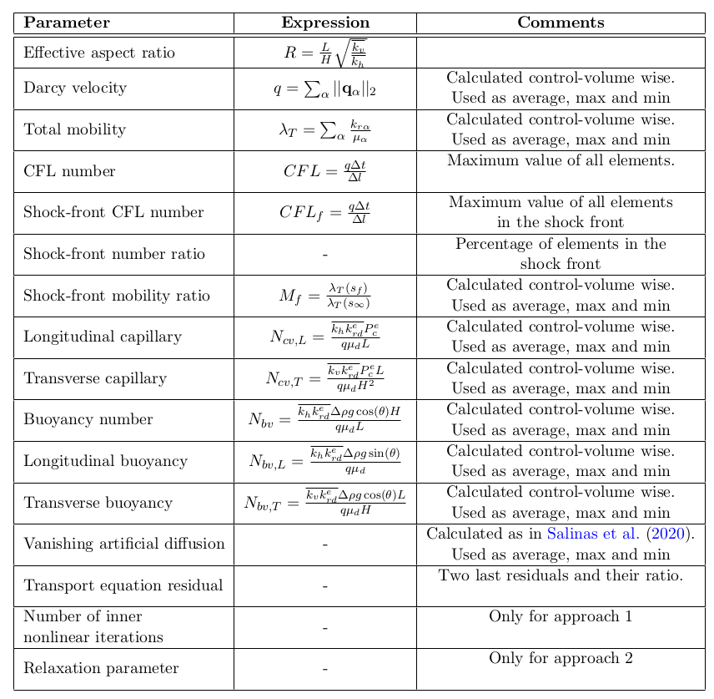
INPUT AND OUTPUT PARAMETERS
Salinas, P., Pain, C., Osman, H., Jacquemyn, C., Xie, Z., Jackson, M., 2020. Vanishing artificial diffusion as a mechanism to accelerate convergence for multiphase porous media flow. Computer Methods in Applied Mechanics and Engineering 359, 112535.

Slide 8
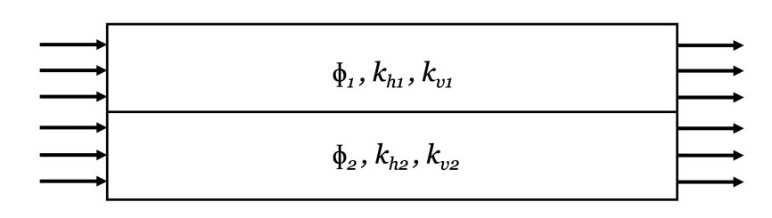
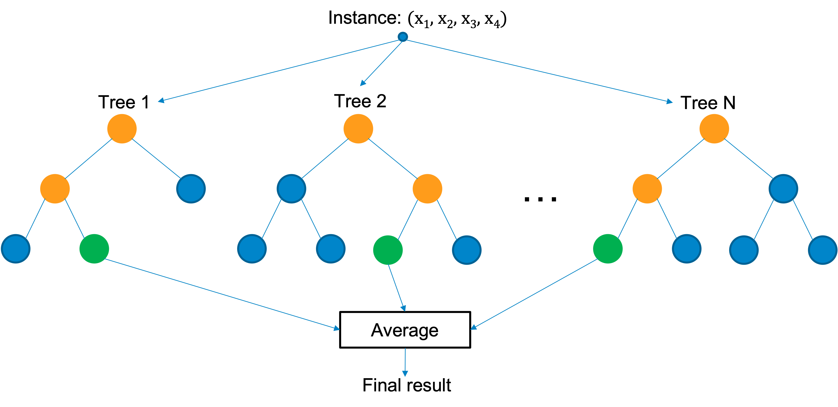
TRAINING PROCESS AND MACHINE LEARNING MODEL
The machine learning acceleration is trained using a simple two-layer reservoir model.
The machine learning model is a random forest regressor. The loss function is the mean square error.

Slide 9
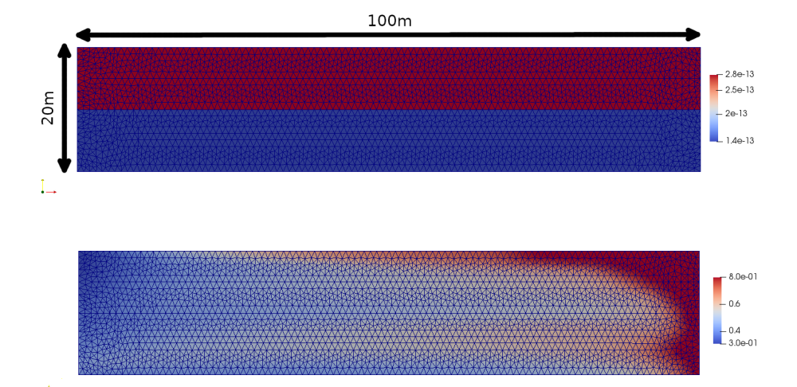
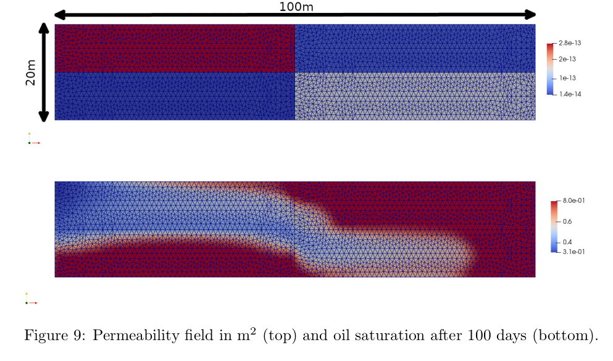
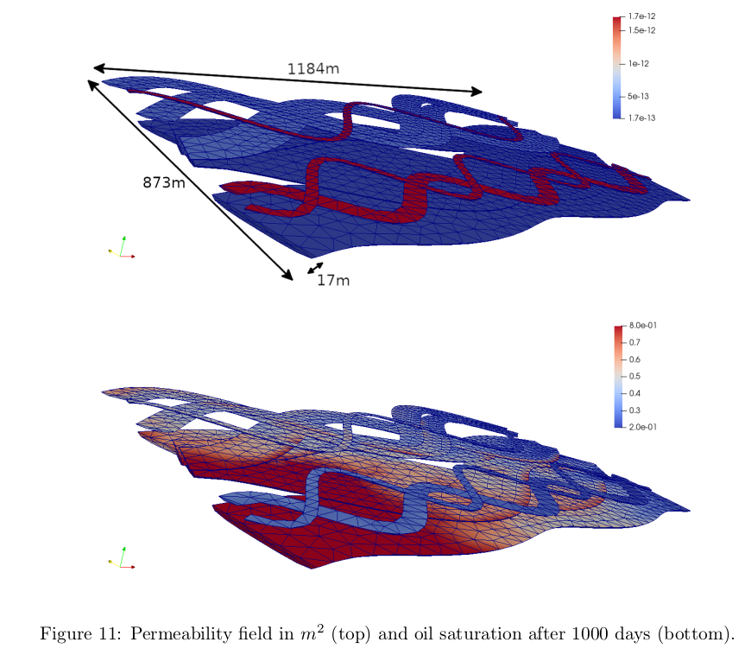
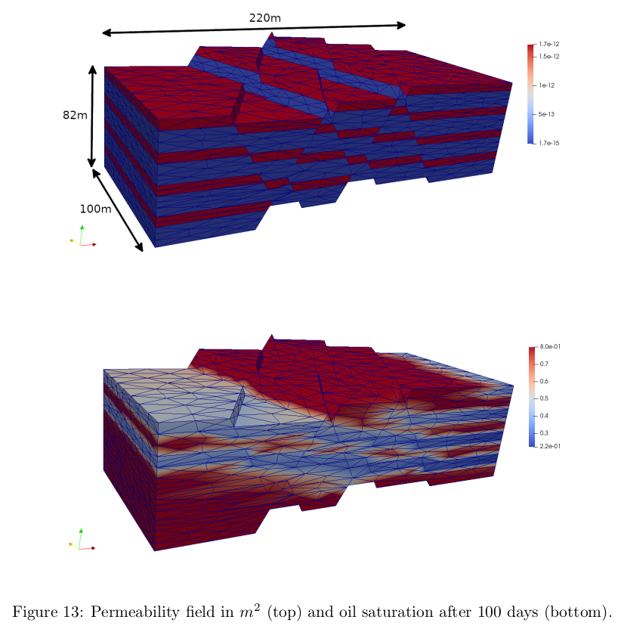
TEST CASES
Two layers
reservoir
Four quadrants
reservoir
Channelized reservoir
Faulted
reservoir

Slide 10
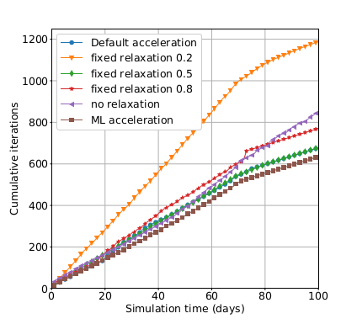
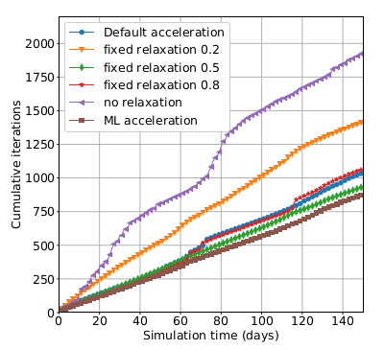
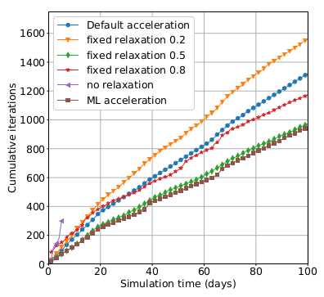
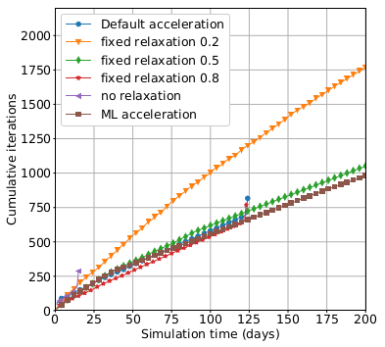
RESULTS
Two layers
reservoir
Four quadrants
reservoir
Faulted
reservoir
Channelized reservoir

Slide 11
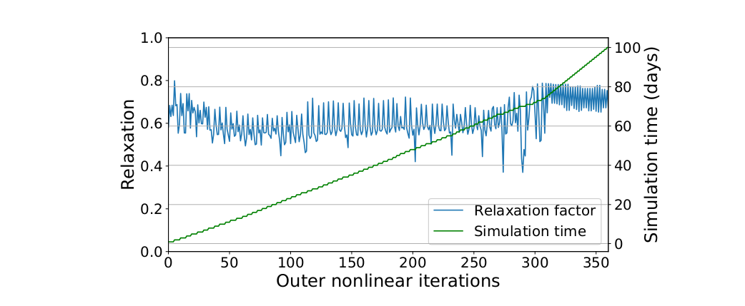
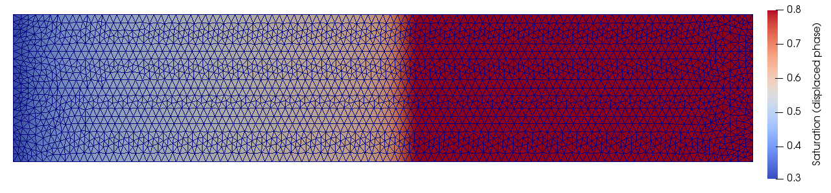
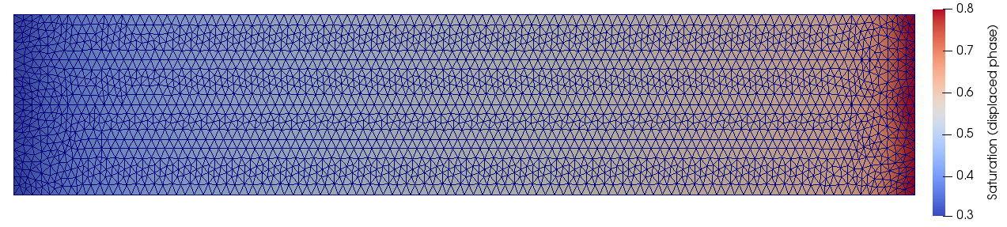
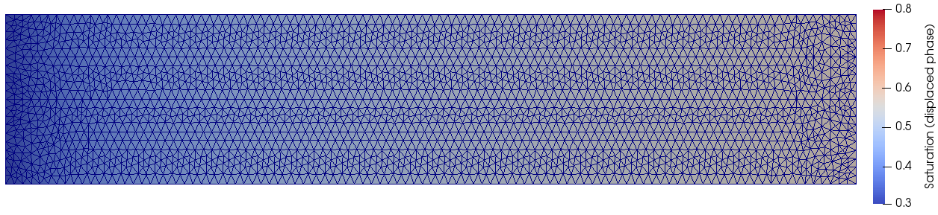
RESULTS
Values of the relaxation parameter generated by the machine learning acceleration (Two layers reservoir)

Slide 12
RESULTS
Reduction in runtime and number of nonlinear iteration
Cases | Runtime | Nonlinear iterations
Two layers reservoir | 19% | 13%
Four quadrants reservoir | 34% | 37%
Channelized reservoir | 9% | 10%
Faulted reservoir | 85% | 81%
When compared with the default dynamic relaxation presented in IC-FERST (Salinas et al., 2017)
Salinas, P., et al., 2017 "Improving the convergence behaviour of a fixed‐point‐iteration solver for multiphase flow in porous media." International Journal for Numerical Methods in Fluids

Slide 13
CONCLUSION
The approach presented here shows an easy way to deal with nonlinear systems without requiring as much effort as a tailored nonlinear solver.
Only a simple two-dimensional layered reservoir can be used for training and the machine learning model do not need to be retrained when applied to other reservoirs.
The presented methodology ensures that it is applicable to other types of nonlinear solvers as long as they are based on numerical relaxation.
The presented acceleration technique was able to reduce simulation time by 37% on average, and up to 85% in the best case while also increasing its robustness.
Published paper:
Silva, V.L.S., Salinas, P., Jackson, M.D. and Pain, C.C., 2021. Machine learning acceleration for nonlinear solvers applied to multiphase porous media flow. Computer Methods in Applied Mechanics and Engineering, 384, p.113989.

