Slide 1


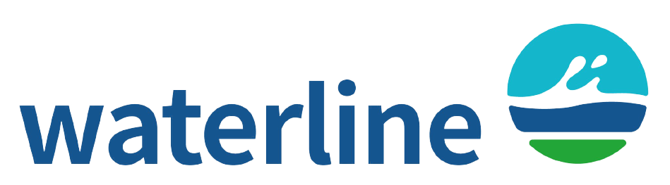
Integrated irrigation and drainage approach to overcome summer droughts in Nordic conditions
Kedar Ghag¹, Amirhossein Ahrari¹, Syed Mustafa¹, Anandharuban Panchanathan², Toni Liedes³,
Björn Klöve¹, and Ali Torabi Haghighi¹
¹University of Oulu, Water, Energy and Environmental Engineering, Oulu, Finland
(kedar.ghag@oulu.fi / kedarssghag@gmail.com)
²University of Oulu, Center for Machine Vision and Signal Analysis, Oulu, Finland.
³University of Oulu, Intelligent Machines and Systems, Oulu, Finland.

Slide 2
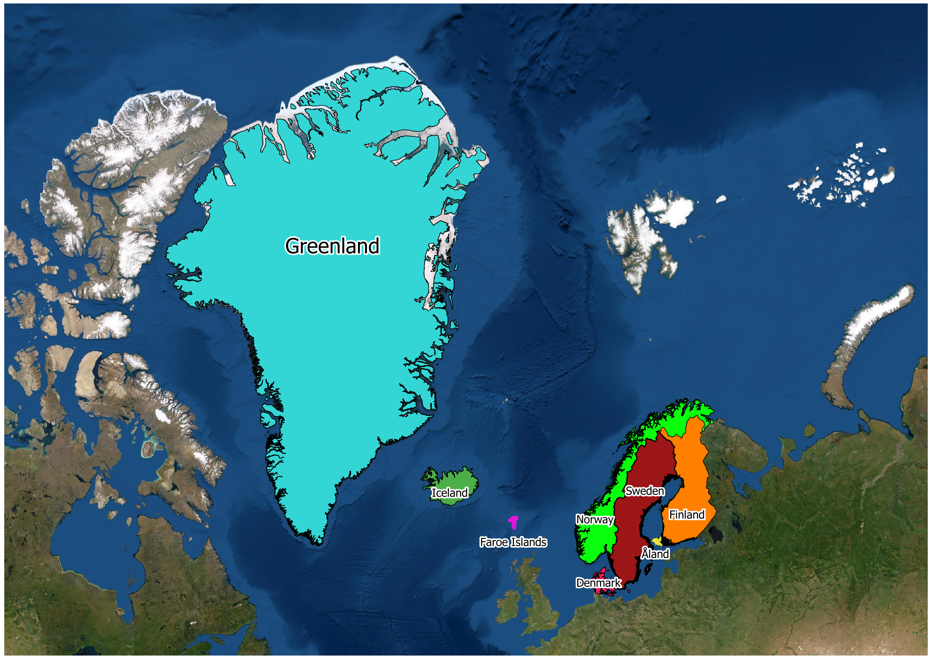
Background
Climate change is altering the hydro-climatic parameters for instance,
Precipitation
Soil Moisture
Temperature
Global prediction for Northern Europe,
Increasing trend of Precipitation during winter and autumn
Declining trend in Summer
Declining mean soil moisture Summer agriculture Drought
Summer agriculture Drought - highlighted locally due to substantial yield losses besides excessive rainfall as a common issue.
potential alternatives and need further investigation
- supplemental irrigation,
- controlled drainage during water-sensitive growth stages of crops, or
- crop selection.

Slide 3
Aim of the study
To classify annual potato crop yield and categorize the years of extreme crop yield
To quantify irrigation requirement of the crop during the entire cropping period each year
To quantify drainage requirement of the crop during the entire cropping period each year
Investigating the requirement of integrated irrigation and drainage approach in the region

Slide 4
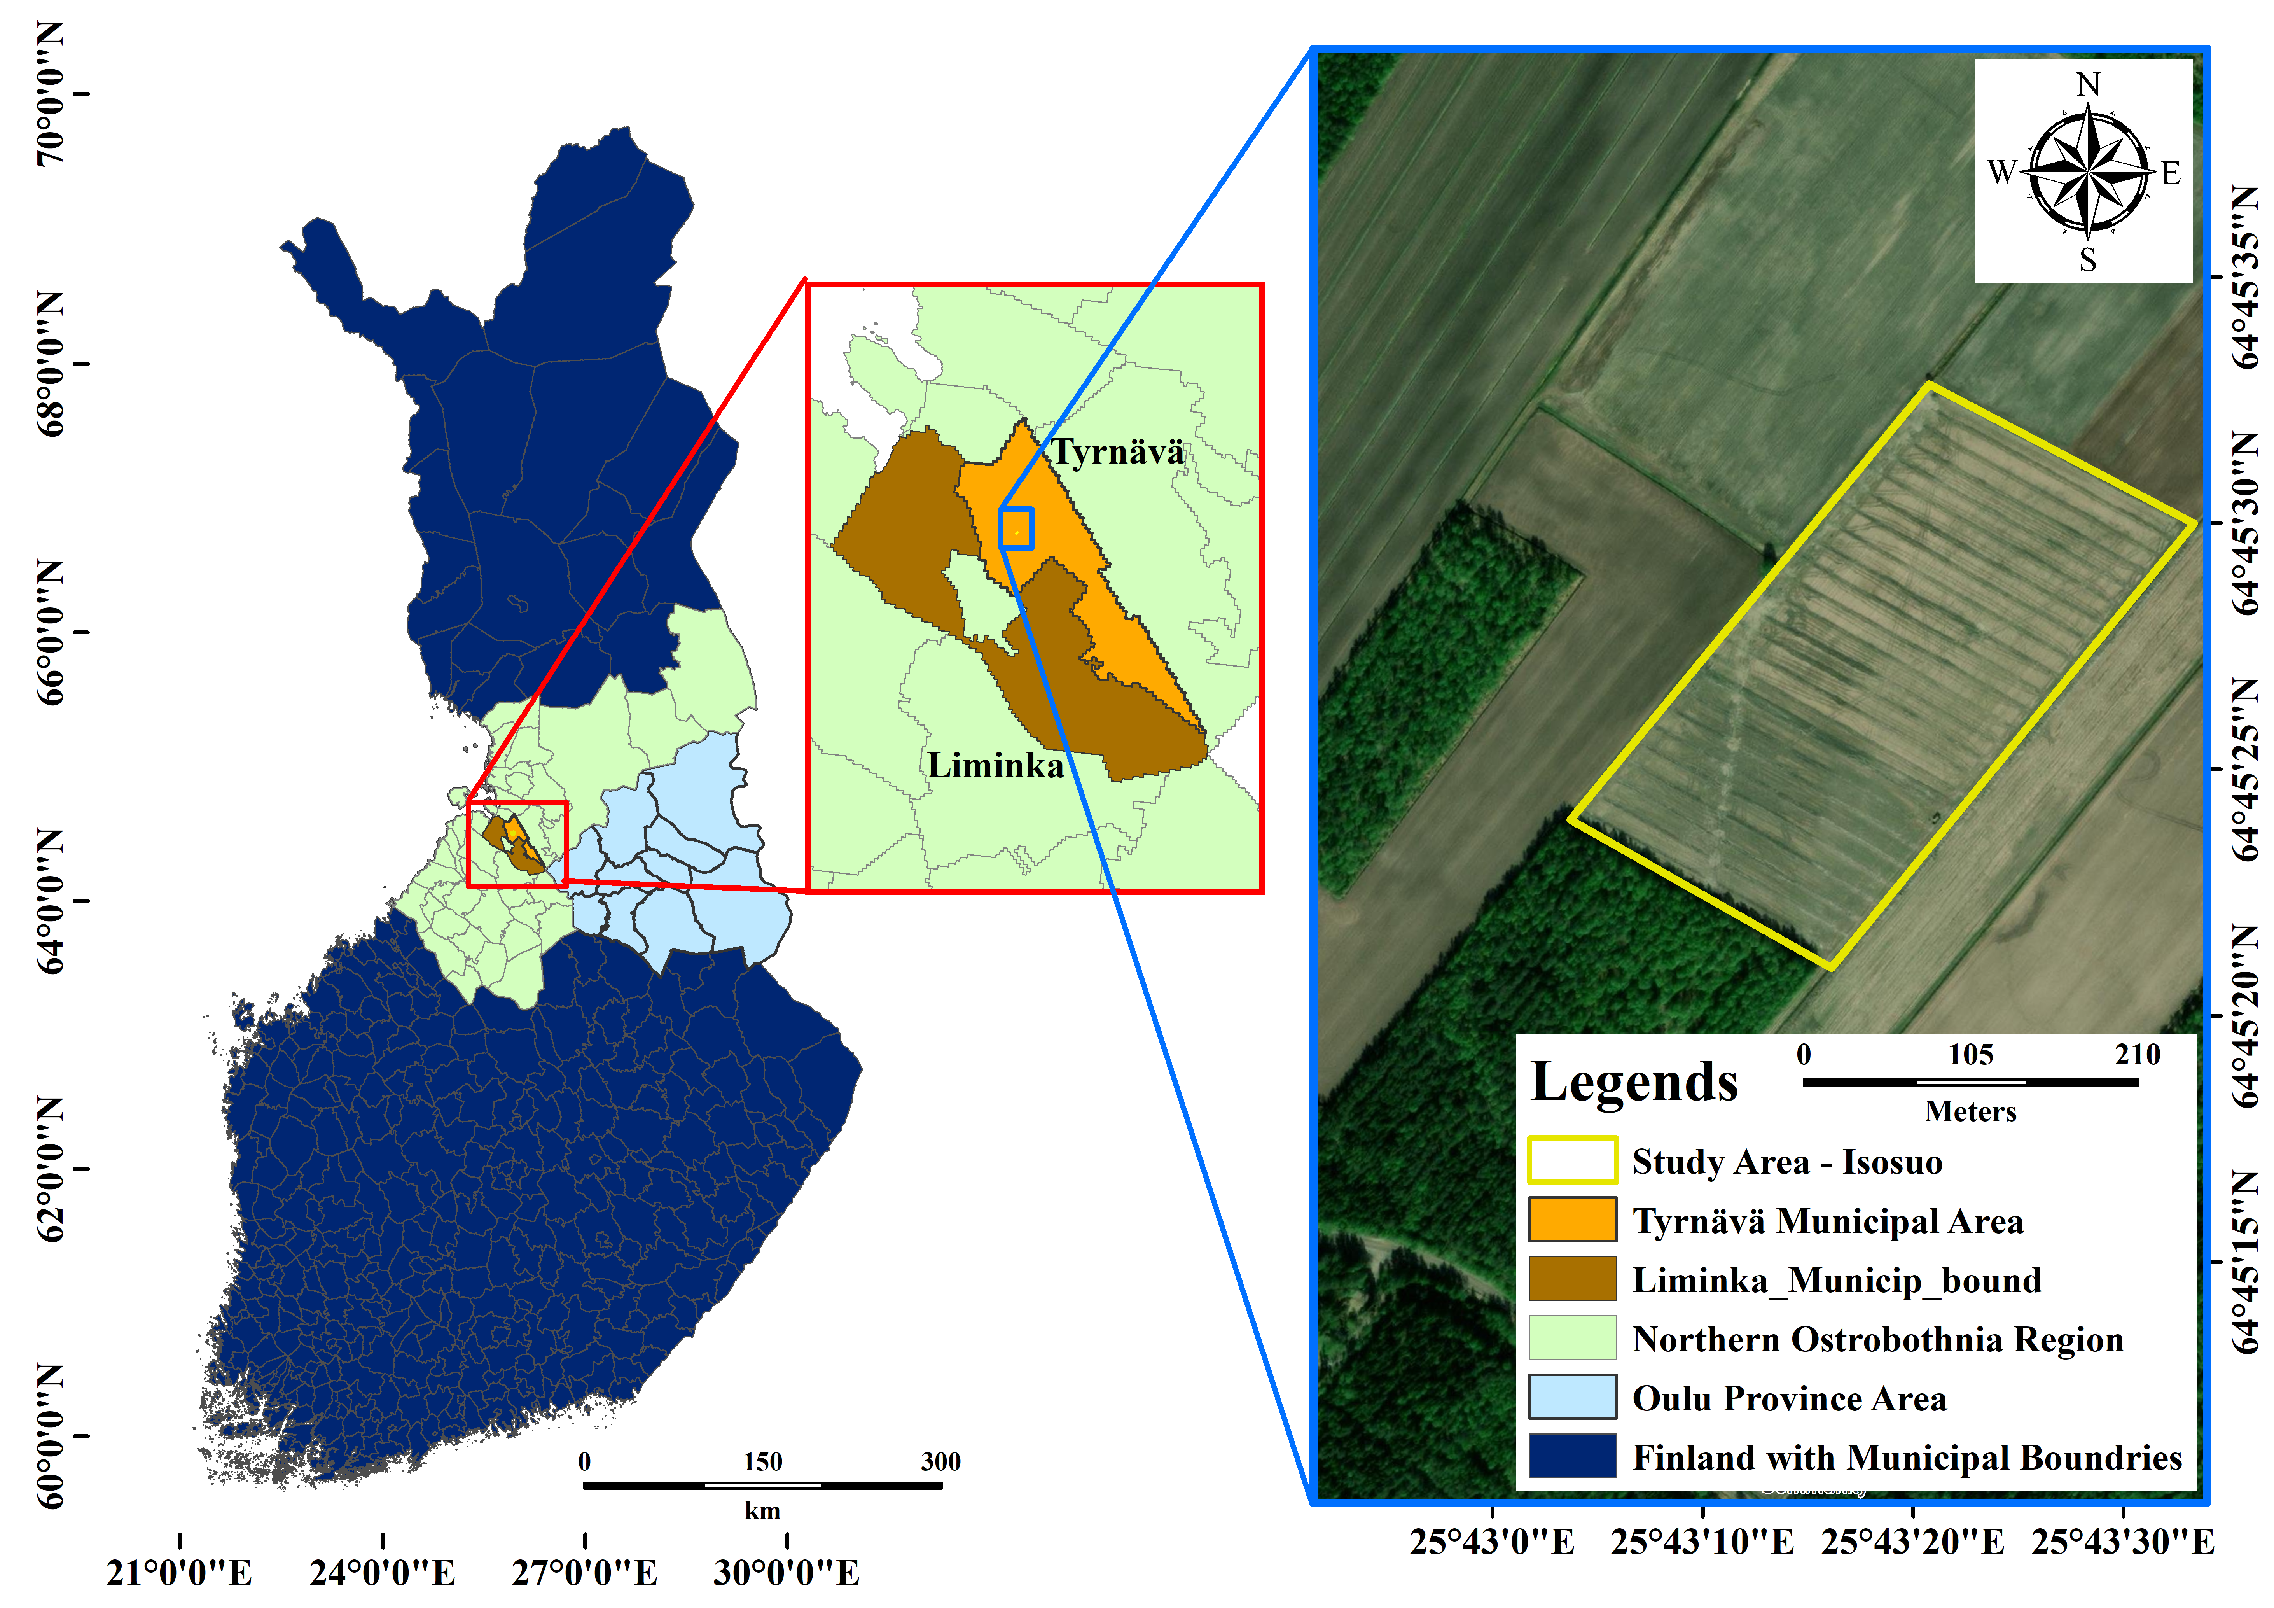
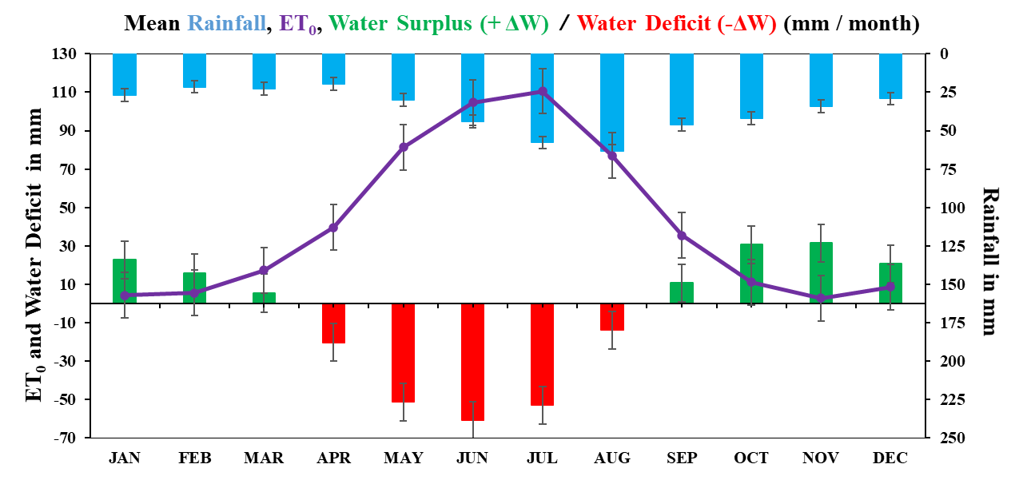
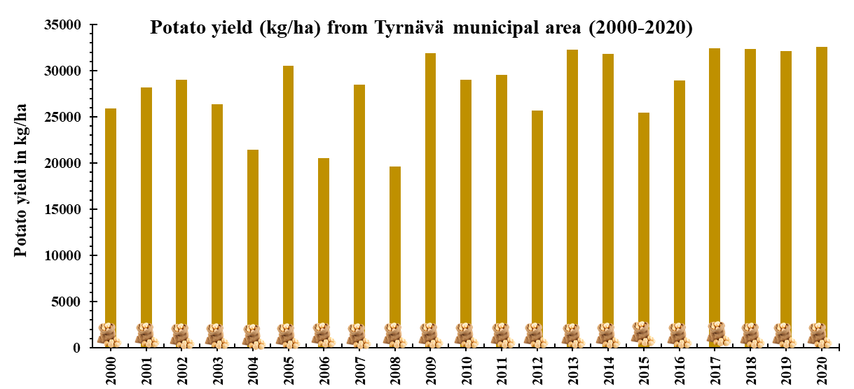
Case study area details
One among the high quality potato seeds regions in EU since 1995^{[1]}
Mostly Rainfed agriculture
Shallow groundwater level (around 1 to 2 m bgl)
Tile drainage system
Evapotranspiration,
in summer =>> water deficit
in winter =>> water surplus
Uneven trend of annual potato yield in the region significantly until 2016
[1] https://projects.luke.fi/ruokafakta/en/field-crops/high-quality-seed-potato-production-area/

Slide 5
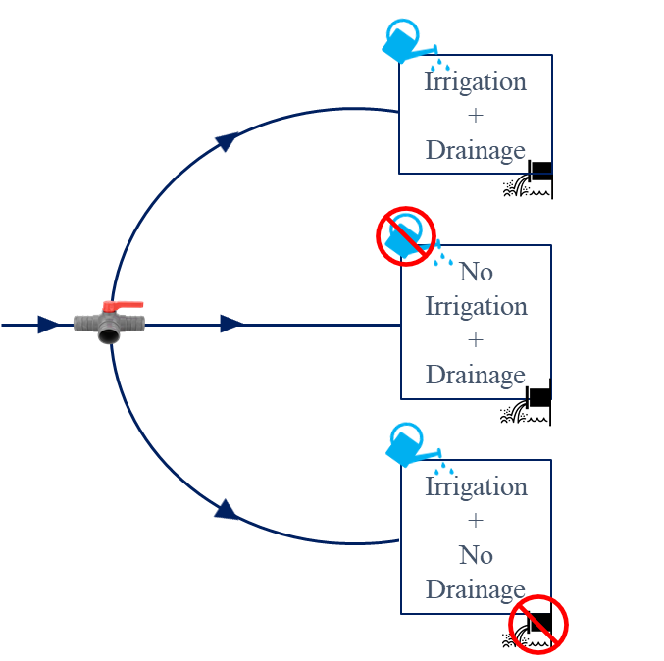
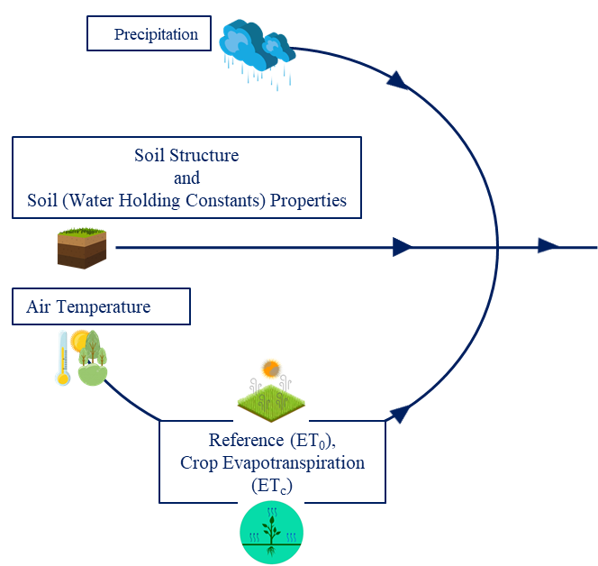
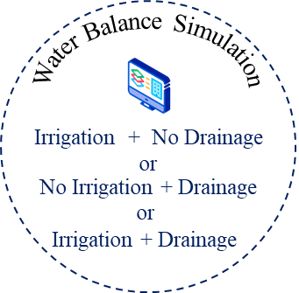
Methodology
Modified version from a published article,
Mustafa, Syed Md Touhidul, Kedar Ghag, Anandharuban Panchanathan, Bishal Dahal, Amirhossein Ahrari, Toni Liedes, Hannu Marttila et al. "Smart drainage management to limit summer drought damage in Nordic agriculture under the circular economy concept." Hydrological Processes (2022): e14560.

Slide 6
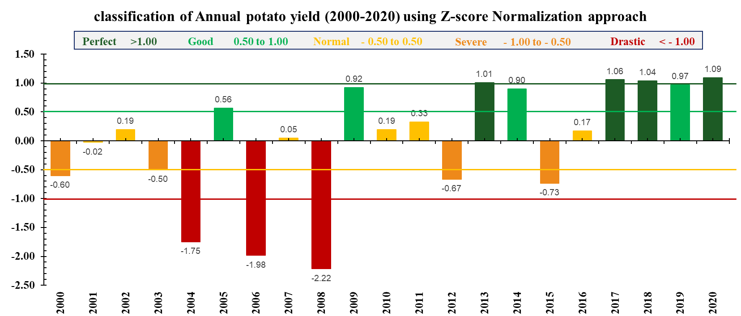
Results

Slide 7
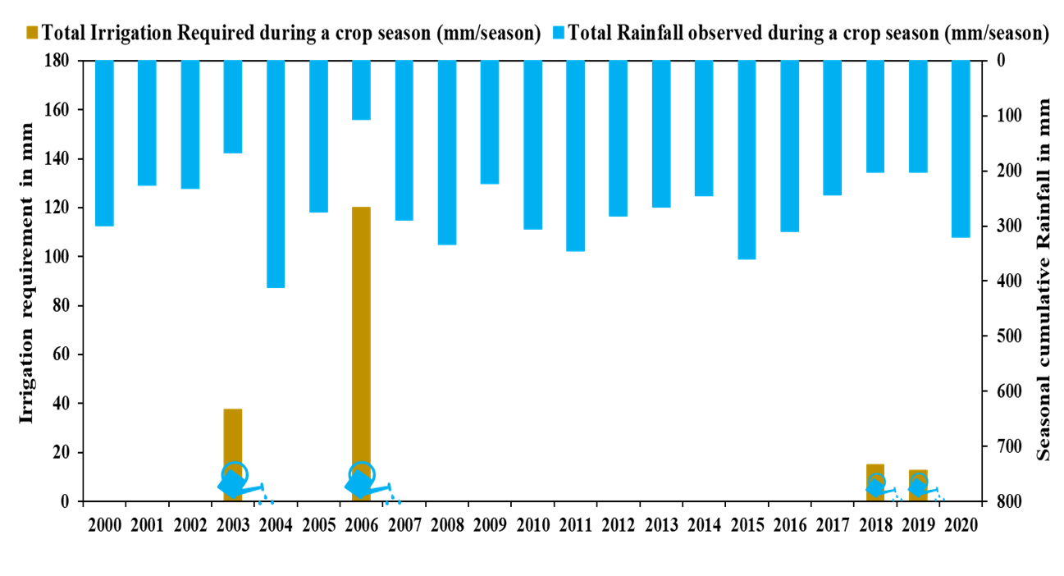
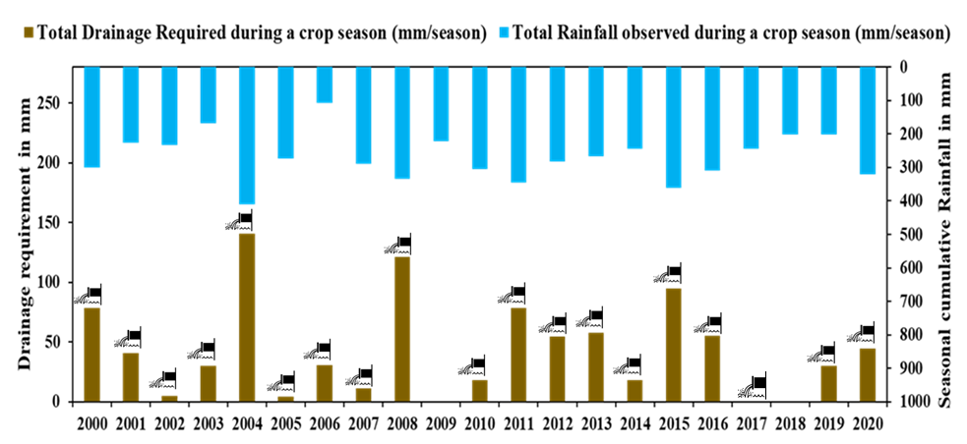
Results
Total Irrigation Requirement observed during 2000 - 2020
Around 20% of the mentioned period (2003, 2006, 2018, and 2019),
the potato fields required supplemental irrigation between 12-120 mm during the entire season.
Total seasonal drainage requirement observed during 2000 - 2020
except for 2009, and 2018 an annual average of 44 mm of drainage was required due to extreme rainfall events.
2003, 2006, and 2019 showed irrigation as well as drainage requirements during the cropping season.

Slide 8
Summary and Conclusions
Summer drought is recurring phenomena in the Nordic agricultural conditions.
Water stressed situations during short periods of summer drought have shown significant impcat of the annual crop yield in the recent past
Supplemental irrigation requirement is observed to be necessary actions need to be implemented for better crop yield in the regionin few years
However, drainage is still major requirement in the region to maintain optimal soil moisture.
Therefore, integrated irrigation and drainage approach could help to protect crop yield in the regional agriculture from frequent summer drought conditions
The findings of the study will benefit to increasing the sustainability of agricultural yield by reducing the negative impact of summer droughts.

Slide 9
Integrated irrigation and drainage approach to overcome summer droughts in Nordic conditions
Kedar Ghag¹, Amirhossein Ahrari¹, Syed Mustafa¹, Anandharuban Panchanathan², Toni Liedes³,
Björn Klöve¹, and Ali Torabi Haghighi¹
¹University of Oulu, Water, Energy and Environmental Engineering, Oulu, Finland
(kedarssghag@gmail.com / kedar.ghag@oulu.fi )
²University of Oulu, Center for Machine Vision and Signal Analysis, Oulu, Finland.
³University of Oulu, Intelligent Machines and Systems, Oulu, Finland.

