Slide 1

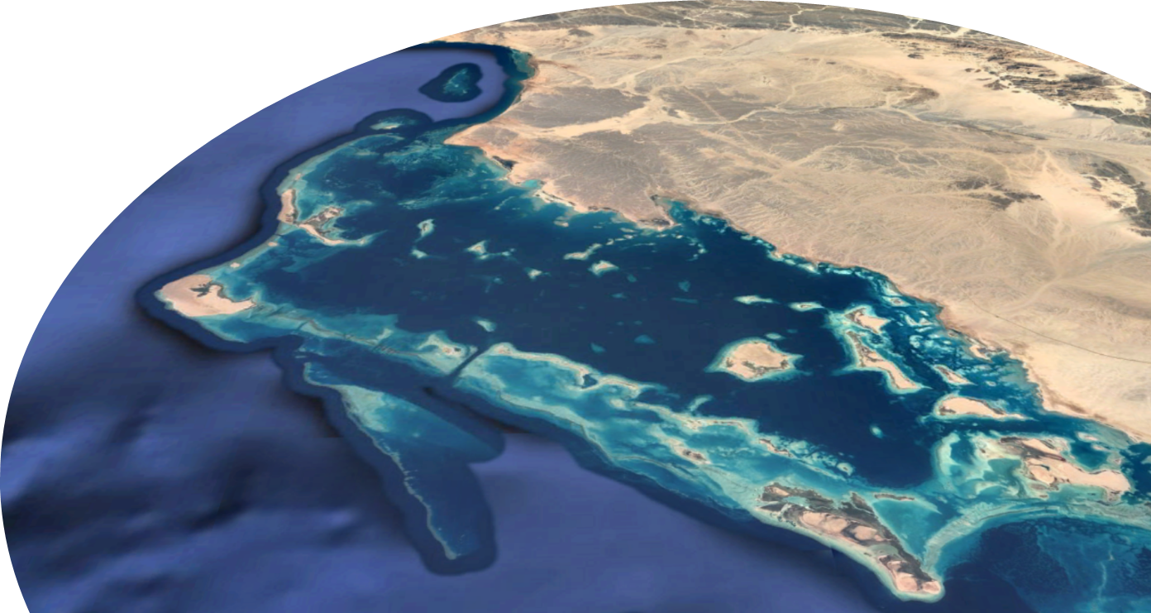



Late Pleistocene to Holocene Architecture of a Land-attached Carbonate Platform Lagoon in the African-Arabian Desert Belt
Al Wajh platform, N Red Sea, Saudi Arabia
EGU22-12421
Indah Putri, Alexander Petrovic, Rangelys Sifontes, and Volker Vahrenkamp
King Abdullah University of Science and Technology (KAUST), Saudi Arabia
indah.putri@kaust.edu.sa

Slide 2
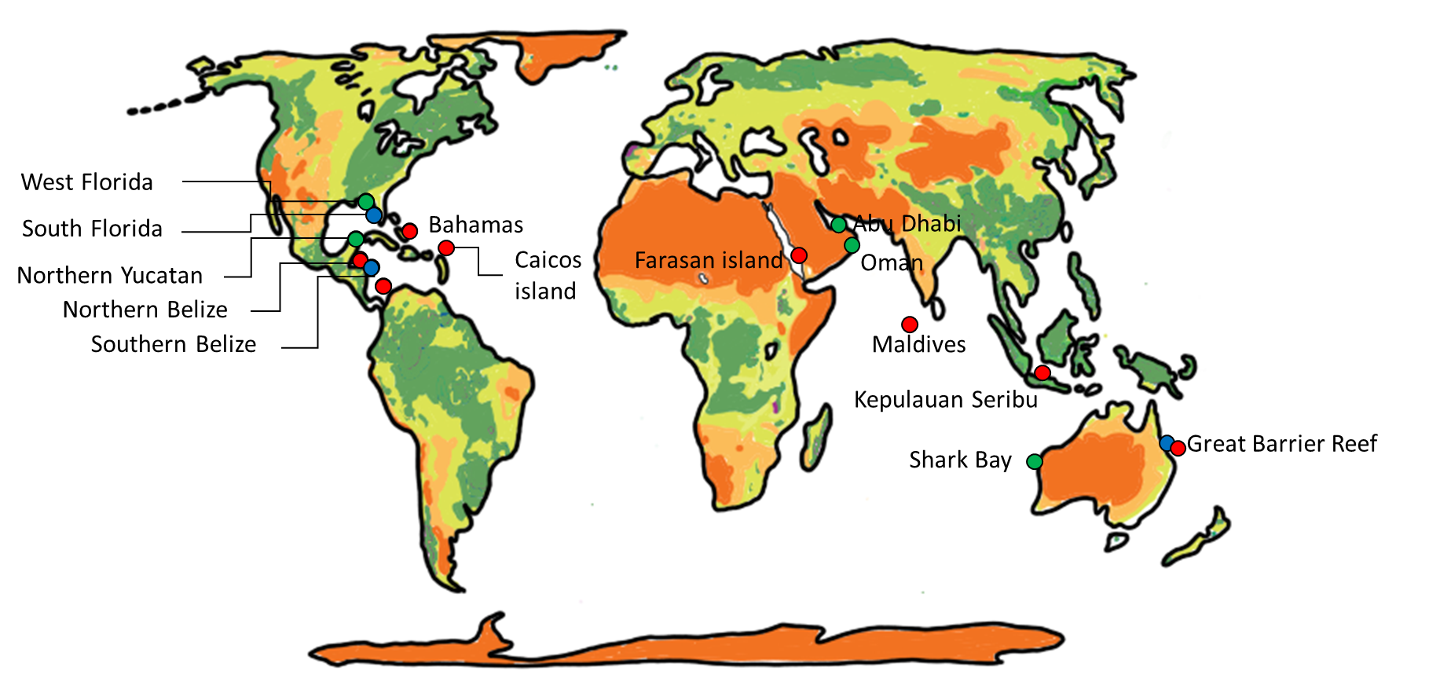
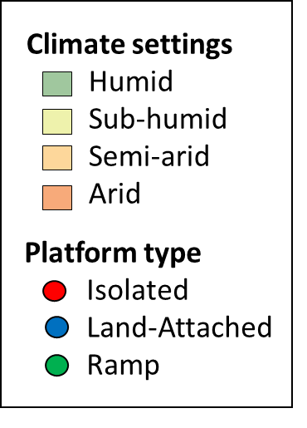
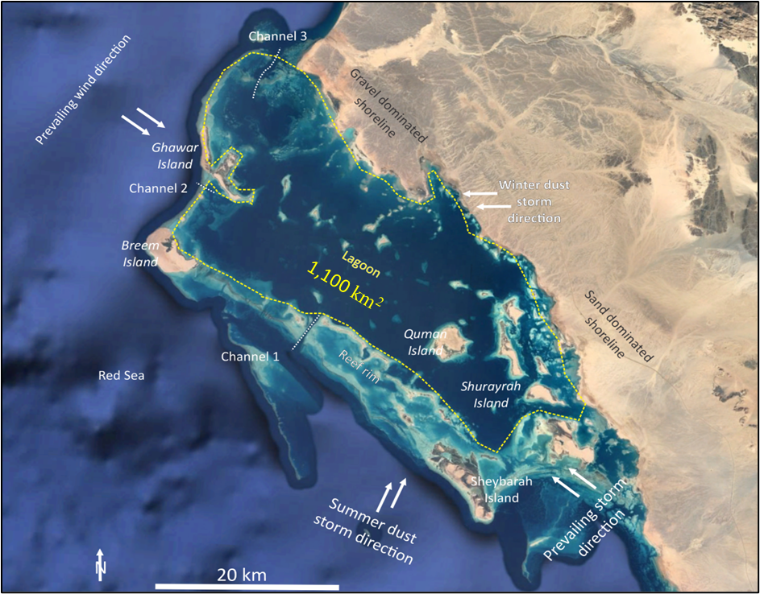
Modern carbonate studies around the world
Land-attached carbonate platform in arid setting is underexplored
Al Wajh
Thornthwaite-Type Global Climate Classification (Feddema, 2005)

Slide 3
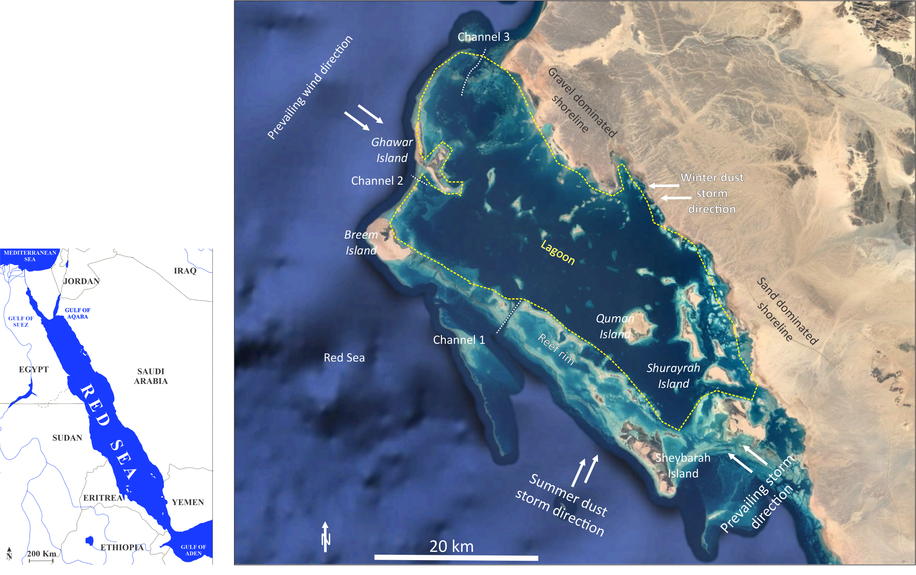
Why Al Wajh Platform ?
Rift Basin
Land-attached carbonate platform
Arid climate

Slide 4
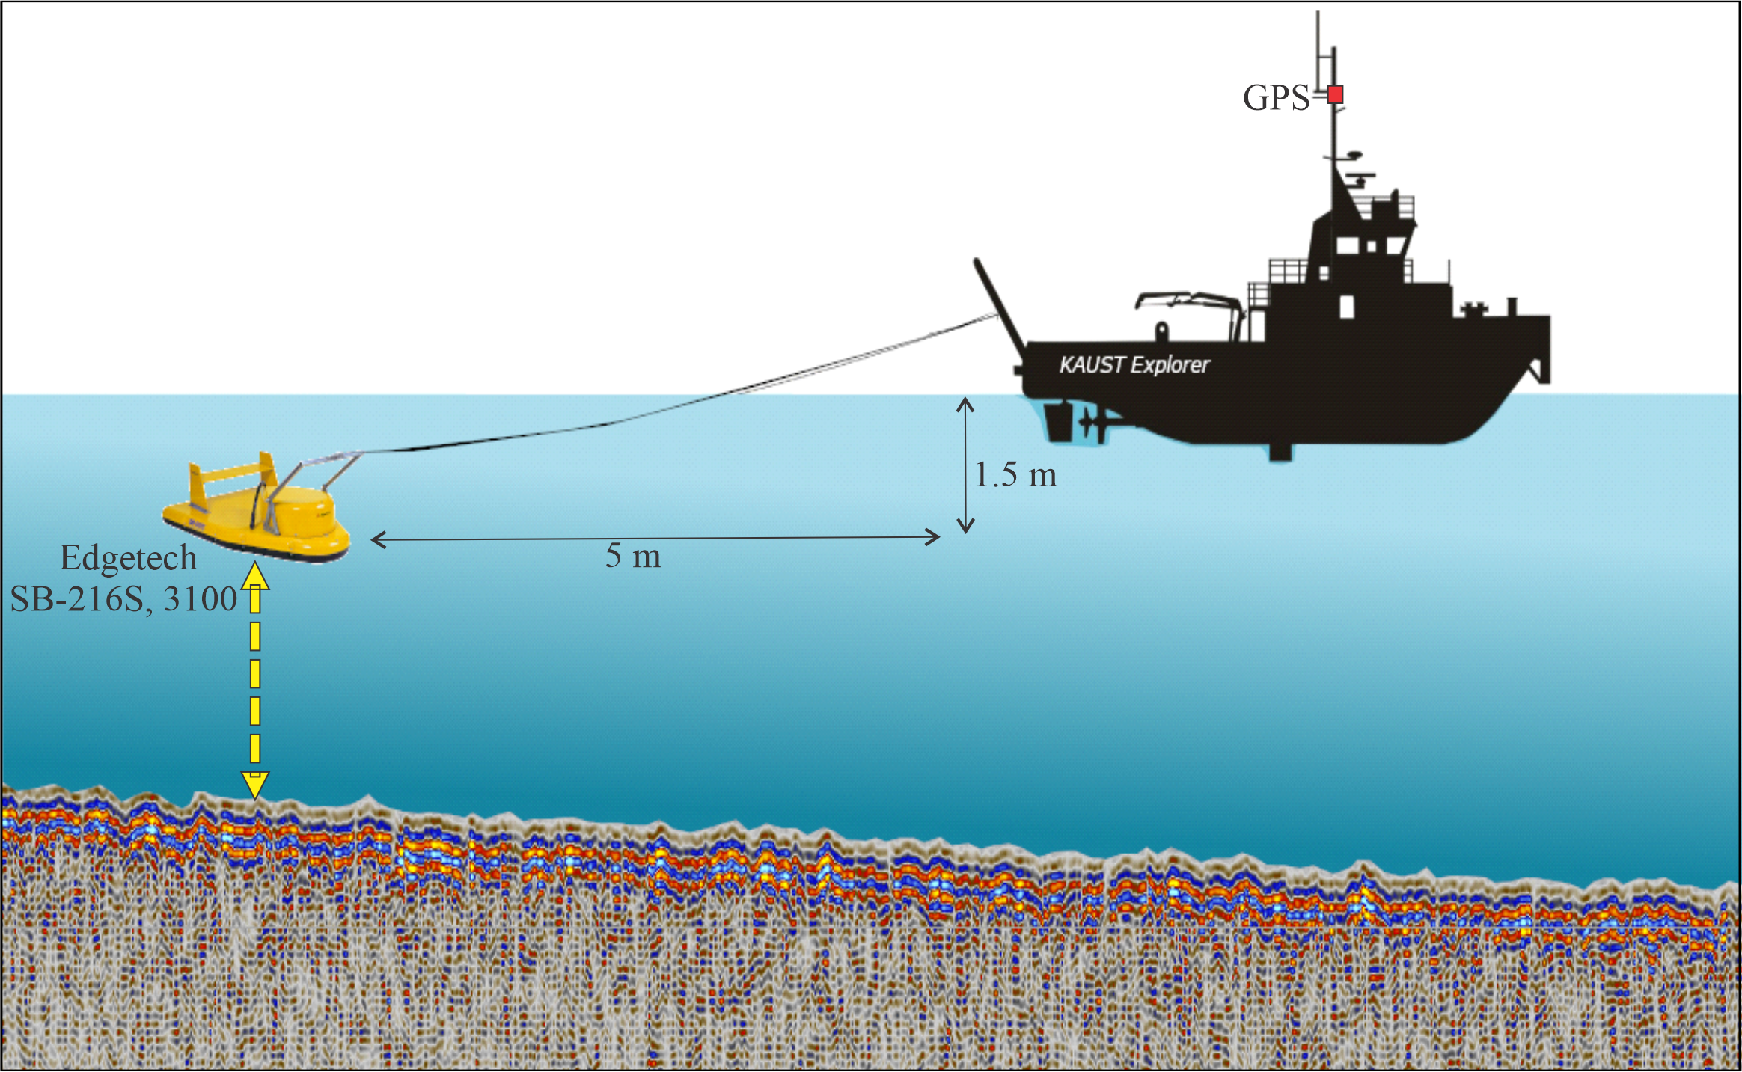
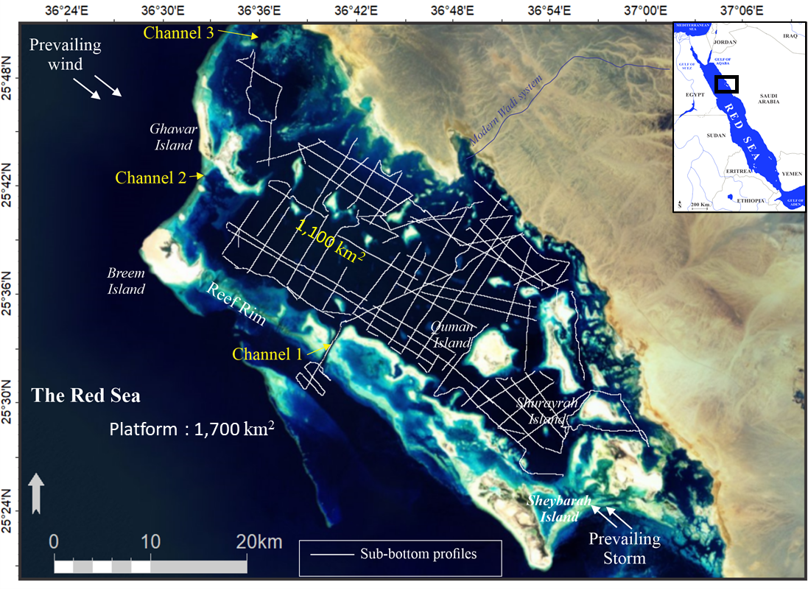
How to Investigate Al Wajh Platform Architecture?
Acquisition (2018 and 2019)
SBP Lines
Database :
700 km Sub-bottom profiling (SBP)
Red Sea sea-level and climate

Slide 5
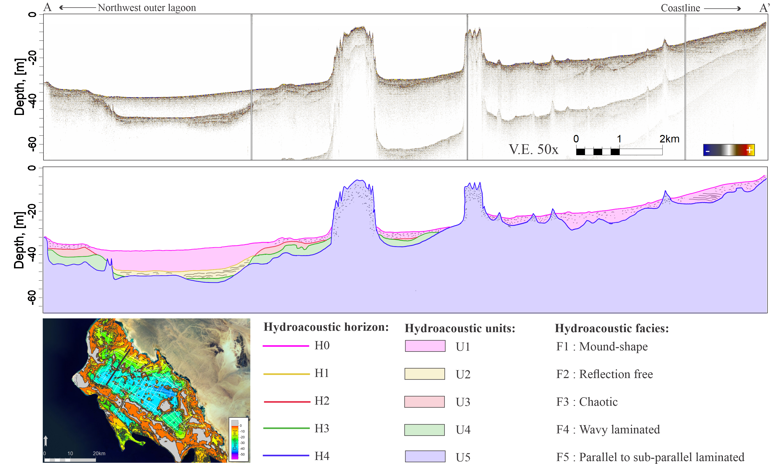
Al Wajh Lagoon Architecture
SE
NW
Water column
Sea floor
Multiple
A’
A

Slide 6
Al Wajh Lagoon Architecture
SE
NW
U4
U3
Sea floor
U2
U5 “Holocene”
V.E. 50x
2 km
U1 “Pre-MIS 5e”
Horizon :
Units :
A’
H5
H4
H3
H2
H1
U5 : Holocene
U4 : ?
U3 : ?
U2 : ?
U1 : Pre-MIS 5e
A

Slide 7
Al Wajh Lagoon Architecture
SE
NW
Sea floor
No karst morphology
Big Depression
Horizon :
Units :
A’
H5
H4
H3
H2
H1
U5 : Holocene
U4 : ?
U3 : ?
U2 : ?
U1 : Pre-MIS 5e
A

Slide 8
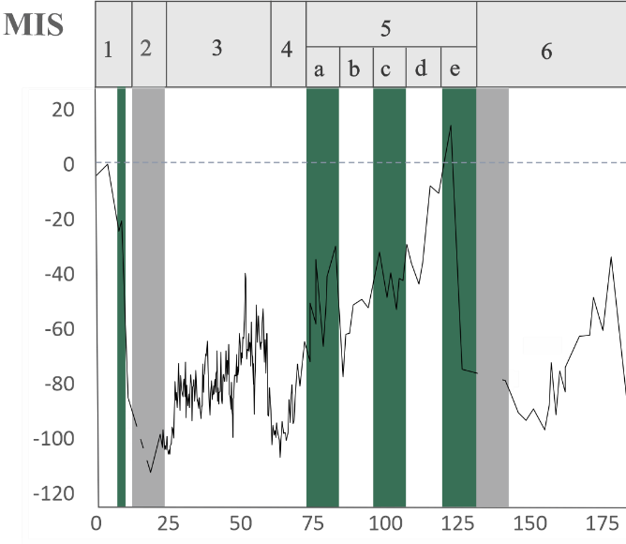
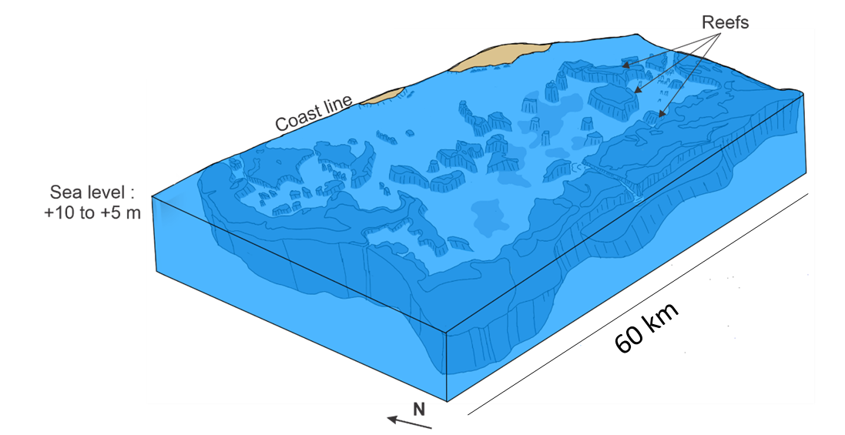
Depositional Model of Al Wajh Platform
10
0
Sea Level
-20
Depth (m)
-40
-60
U1
High Sea Level & Pluvial → Carbonate, Siliciclastic, Erosion
U1 : Pre MIS 5e (~125 ka BP)
Sea Level
Sea Level (m)
Arid
Pluvial
V.E. 50x
Age (ka BP)
Siddall, 2003; Fleitmann et al., 2004; Nicholson et al., 2020

Slide 9
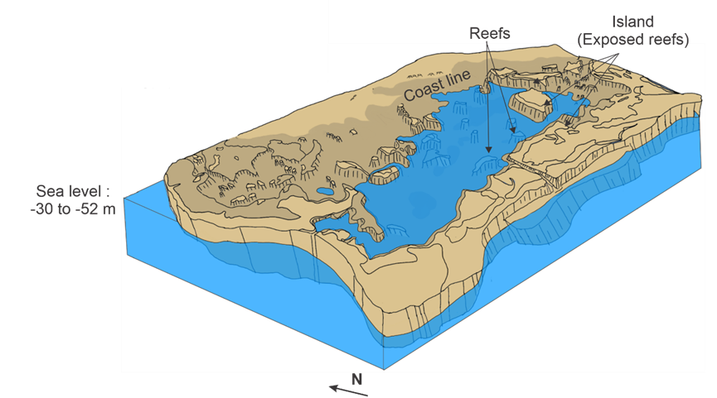
Depositional Model of Al Wajh Platform
10
0
-20
Depth (m)
-40
Sea Level
-60
U2
U1
Intermittent Sea Level & Pluvial → Carbonate, Siliciclastic, Erosion
U2 : MIS 5c (~100 ka BP)
Sea Level (m)
Sea Level
60 km
Arid
Pluvial
V.E. 50x
Age (ka BP)
Siddall, 2003; Fleitmann et al., 2004; Nicholson et al., 2020

Slide 10
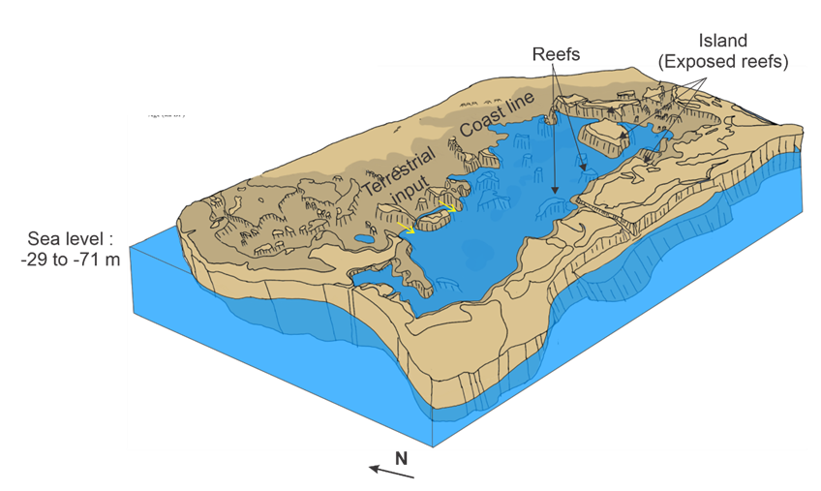
Depositional Model of Al Wajh Platform
10
0
-20
Depth (m)
Sea Level
-40
-60
U3
U2
U1
Intermittent Sea Level & Pluvial → Carbonate, Siliciclastic, Erosion
U3 : MIS 5a (~75 ka BP)
Sea Level (m)
Sea Level
60 km
Arid
Pluvial
V.E. 50x
Age (ka BP)
Siddall, 2003; Fleitmann et al., 2004; Nicholson et al., 2020

Slide 11
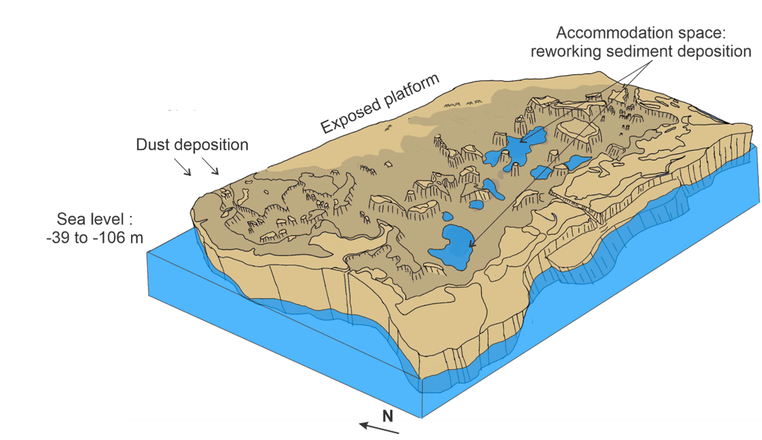
Depositional Model of Al Wajh Platform
10
0
-20
Depth (m)
-40
Sea Level
-60
U4
U3
U2
U1
Low Sea Level & Arid → No/little carbonate accumulation, siliciclastic
U4 : MIS 3 (~50 ka BP)
Sea Level (m)
Sea Level
60 km
Arid
Pluvial
V.E. 50x
Age (ka BP)
Siddall, 2003; Fleitmann et al., 2004; Nicholson et al., 2020

Slide 12
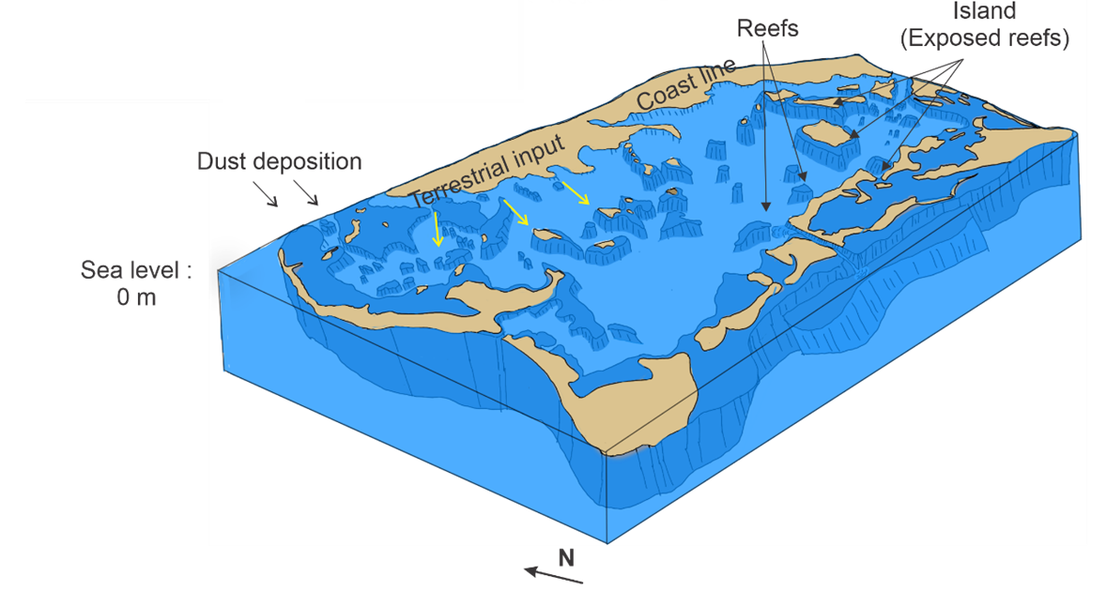
Depositional Model of Al Wajh Platform
10
0
Sea Level
-20
Depth (m)
-40
-60
U5
U4
U3
U2
U1
Intermittent sea level + Arid→ Carbonate, siliciclastic, erosion
U5 : Holocene (Present day)
Sea Level
Sea Level (m)
60 km
Arid
Pluvial
V.E. 50x
Age (ka BP)
Siddall, 2003; Fleitmann et al., 2004; Nicholson et al., 2020

Slide 13
Take home messages
Al Wajh Show complex interplay between climate and sea level
  Carbonate deposition
  Siliciclastic deposition (terrestrial and aeolian)
  Little evidence of karstification
  Insights of this study will improve our understanding of other carbonate platforms under similar conditions.

Slide 14


indah.putri@kaust.edu.sa

