Slide 1

Urban emissions of N₂O and CH₄ estimated using airborne AirCore observations
Xin Tong¹, Steven van Heuven¹, Bert Scheeren¹, Bert Kers¹, Ronald Hutjes³, and Huilin Chen^{1,2}
¹ Centre for Isotope Research (CIO), Energy and Sustainability Research Institute Groningen (ESRIG), University of Groningen, Groningen, The Netherlands
² Joint International Research Laboratory of Atmospheric and Earth System Sciences, School of Atmospheric Sciences, Nanjing University, Nanjing, China
³ Water Systems and Global Change, Department of Environmental Sciences, Wageningen University and Research
^{Contact: Xin.Tong@rug.nl}

Slide 2
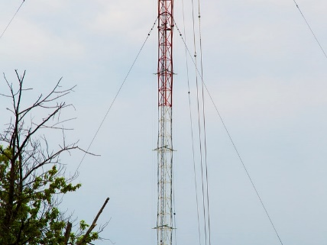
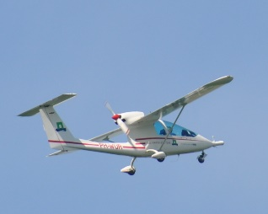
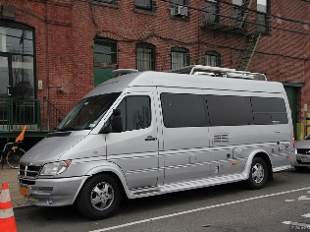
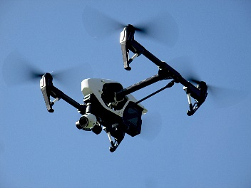
Introduction
Year
Tall tower
station
In-situ aircraft measurements
Limited and difficult for N₂O
Restricted by heavy and power-consuming instrumentation
Short-term drift calibration often requires cal-gas tank on-board
Airborne AirCore
Continous and simultaneous measurements of N₂O and CH₄
Easy employable on lightweight aircrafts
More campaign
Season
Aircraft
week
Mobile van
Time scale
Day
Drone
Hour
Limited continuous N₂O measurements from local to regional scales
min
ha
regional
national
global
Spatial scale

Slide 3
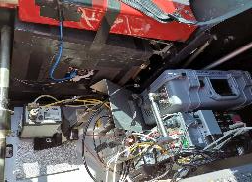
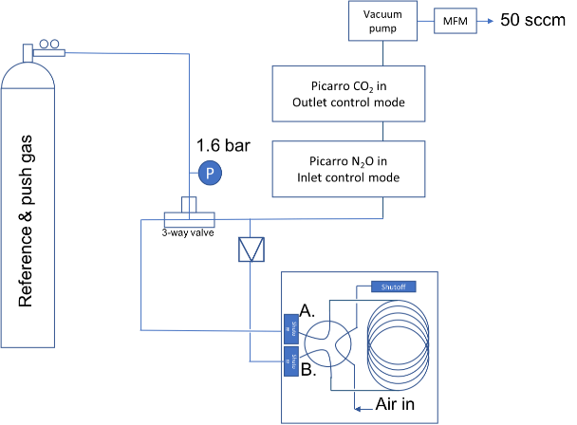

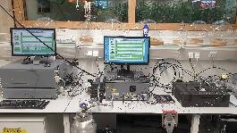
AirCore measurements of N₂O, CH₄, CO₂, CO
AirCore design
Skyarrow on-board measurements
Two coupled Picarro measurements
AirCore
Licor7810
3D sonic anemometer
Pressure built up in the coil with a constant sampling rate
10 flights over Utrecht and Groningen regions
going through N₂O analyzer and then CH₄ analyzer with a constant flow rate
Notes:
wfefwrvrwv

Slide 4
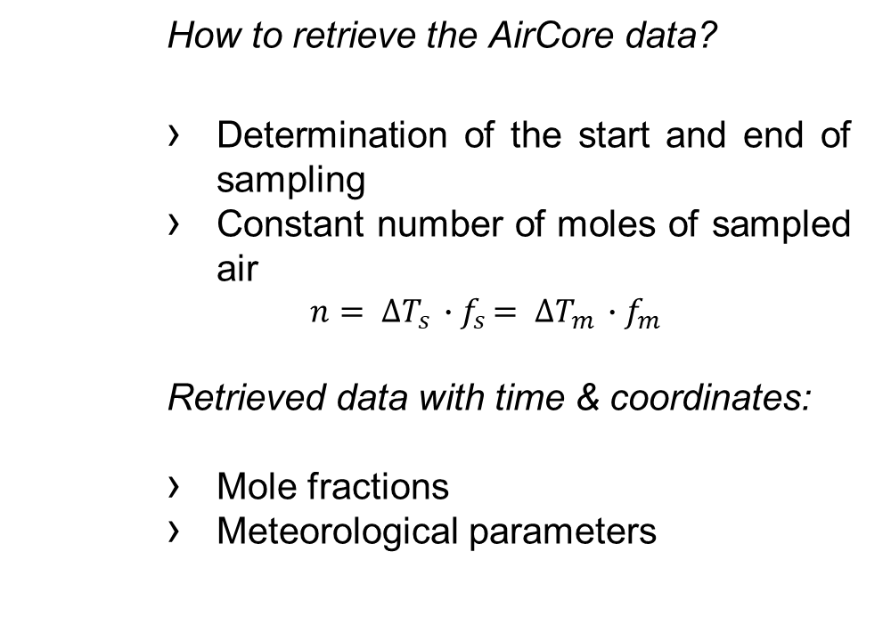
Retrieved AirCore data
How to retrieve the AirCore data?
Determination of the start and end of sampling
Constant number of moles of sampled air
$$n= ∆T_{s} ∙f_{s}= ∆T_{m} ∙f_{m}$$
Retrieved data with time & coordinates:
Mole fractions
Meteorological parameters
Notes:
Vbrbrgbrbrt b

Slide 5

Flux calculation-mass balance approach
F = $\int_{−x}^{x}{\int_{Z=ground}^{z=PBL}{\left(c−c_{bg}\right)}}$
Adjusted boundary layer height considering entrainment:
$z$ = $\frac{\left(3∗z_{PBL}+z_{e}\right)}{4}$
An example of June 1st
Subtract the emissions in southeast
Notes:
Take an example of June 1

Slide 6
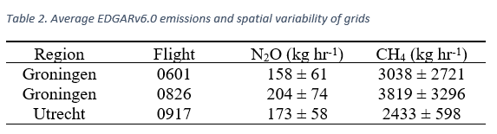
EDGAR inventory emission estimates
N₂O emissions
Not significantly different for two cities
CH₄ emissions
Groningen > Utrecht
Larger spatial variabilities from Groningen city than from Utrecht city

Slide 7
Comparison of estimates and inventories
N₂O and CH₄ urban emissions from Groningen city vary from day to day
N₂O: 48~135 kg hr⁻¹
CH₄: 1400~7400 kg hr⁻¹
N₂O estimates are roughly lower than average EDGAR emissions
CH₄ estimates averaged from three flights over Groningen city are in the same order of magnitude of average EDGAR emissions

Slide 8
Conclusions and outlooks
We show that airborne AirCore observations are successfully used to quantify urban N₂O and CH₄ emissions; easy employable and precise.
We find that our estimates are roughly comparable with average EDGAR v6.0 inventory emissions for N₂O and CH₄.
The variation in the emission estimates indicates that a significant number of flight are required to reduce the uncertainties.

Slide 9
Thank you for your attention

Slide 10
AirCore retrieve
Determination of the start and end of Picarro profiles:
Smoothing in-situ airborne measurements of CH4 or CO2 by licor
The comparison of in-situ measurements of CH4 or CO2 and AirCore measurements
Max correlation coefficient, r, as the indicator

