Slide 1



On temporal resolution of performance indicators of water resources systems
Sai Veena^{*1},Riddhi Singh^{1,2}
1 Department of Civil Engineering, Indian Institute of Technology Bombay, Mumbai, India
2 Interdisciplinary Programme in Climate Studies, Indian Institute of Technology Bombay, Mumbai, India
Scan QR Code to access the abstract

Slide 2
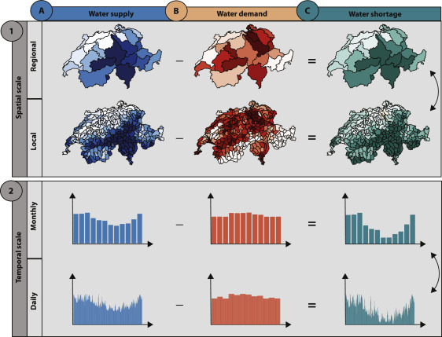
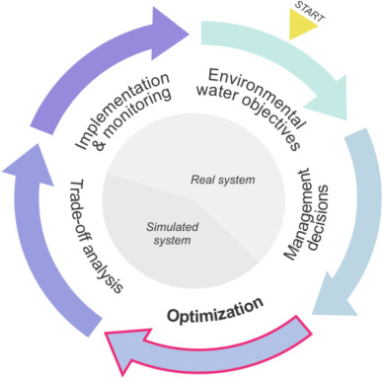
Spatio-temporal resolution of data and models substantially impact water scarcity evaluations
Framework for the assessment of the effect of 1) spatial data resolution and 2) temporal data resolution on water shortage estimates. (Brunner et al., 2019)
Position of the optimization process within the adaptive water management framework (Derepasko et al., 2021)
Brunner et al. (2019) Scale matters: Effects of temporal and spatial data resolution on water scarcity assessments. Advances in Water Resources
Derepasko, et al. (2021) Considering scale within optimization procedures for water management decisions: Balancing environmental flows and human needs. Environmental Modelling & Software
Notes:
Gaudard highlights that the selection of the correct temporal scale of objectives is crucial for reservoir operation, which varies for each case study. Like, objectives calculated for longer time periods (for drought management) often need to be complemented with objectives for smaller time period (like flood control) This is also highlighted by Brunner. While the impact of the temporal scale on hydrological processes and models have been studied extensively in the literature, there is less focus on the implications for water management strategies for multiple temporal scales of the objective functions. Recently, Derepasko et al. (2021) reviewed the implications of temporal and spatial scale choice through multiple stages of optimization model development. The selected questions identified related to management objectives are "How are management objectives defined? What is the temporal scale of the considered objectives?". In this study, I attempt to address this question to quantify the multiobjective gains due to difference in operation at multiple temporal resolution. We also attempt this question from the motivation of information obtained from stakehoders as they prefer annual satisfaction of demands. The extra water is assumed to be stored in other storage structures like lakes, ponds, check dams and other small dams in the command area
We used discharge time series simulated using the hydrological model PREVAH (Viviroli et al., 2009b) to quantify water supply in the catchments at the regional and local scale and at a monthly and daily temporal resolution

Slide 3
We devise three problem formulations to understand the effect of temporal resolutions on objective function
Other transfers
MEF
Donor
Excess releases
Many objective optimization using the Borg MOEA
Reliability, resilience, vulnerability of demand satisfaction
Reliability of maintaining minimum environmental flows (MEF)
Reliabiltiy of non exceedance of high flow thresholds downstream
Demand Satisfaction
Fortnightly (FN)
Water
transfer
Seasonal (SN)
Other transfers
Annual (AN)
MEF
Recipient
Excess releases
Demand Satisfaction
Inter-basin water transfer model and objective functions adopted from Veena et al. (2021)
Veena, et al. (2021) Improving Information-Based Coordinated Operations in Interbasin Water Transfer Megaprojects: Case Study in Southern India. Journal of Water Resources Planning and Management.
Notes:
This requires lake as additional storage
Lakes are a major component of hydrologic connectivity. Water storage of lakes is rarely being studies though they form an important component of the system in management
of water resources. Storage of excess releases from the reservoir to the lakes or other structures have been studied in the literature. Establishment of artificial lakes for managing water resources is also an alternative where lakes are used as reservoirs as proposed by Beijing government which can also be used for artificial recharge. Green infrastructure as lakes are used for flood mitigation in countries like China based on its national policy to increase the storage capacity of lakes. On the basis of these studies, we validate the assumption of storage of excess water releases from the reservoirs in lakes or other storage structures in the command area. With this validation of assumption of additional storage structures, the lakes in the command area are shown in the figure.
We identify operational transfer strategies for the INS-IBWT project at three different temporal resolutions defined as 15-day (fortnightly, FN), The defined IBWT model is used discussed in the beginning. Stochastic uncertainties are incorporated. Objective functions are defined for different temporal resolutions and identify candidate operational strategies using stochastic multi-objective evolutionary search algorithm and their performance trade-offs under historically observed uncertainties. We also find the dependency structures of decision variables using multi-way correlation coefficient. Here the decision variables are transfer of water that is the same every month.

Slide 4
Calculating demand reliability at multiple temporal resolutions
Reservoir storage
Water released for demand satisfaction
FN demand
FN formulation
Unsatisfied seasonal demand
SN formulation
Unsatisfied annual demand
AN formulation
Notes:
Due to its much higher demand, the three problem formulations are applied to the recipient basin only

Slide 5
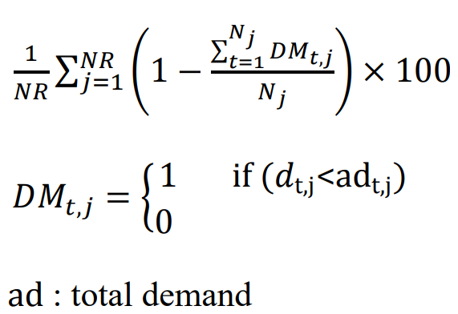
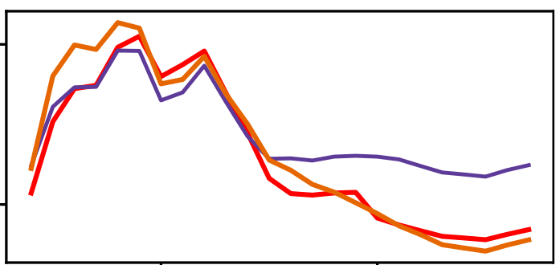
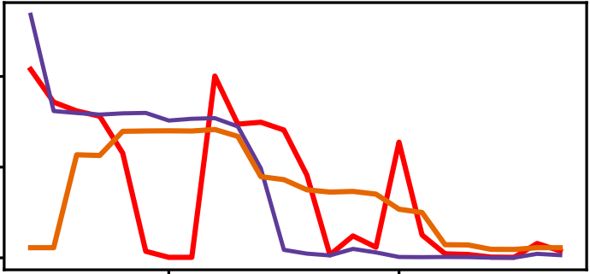
Calculating demand reliability at multiple temporal resolutions
Reservoir storage
Water released for demand satisfaction
FN demand
FN formulation
Unsatisfied seasonal demand
Demand Reliability
SN formulation
Unsatisfied annual demand
AN formulation
Storage vs. time
Demand releases vs. time
 | Time steps in a year | Time steps in planning horizon of 15 years (T)
FN | 24 | 360
SN | 3 | 45
AN | 1 | 15
Jun
Dec
Jun
Dec
Notes:
Due to its much higher demand, the three problem formulations are applied to the recipient basin only

Slide 6
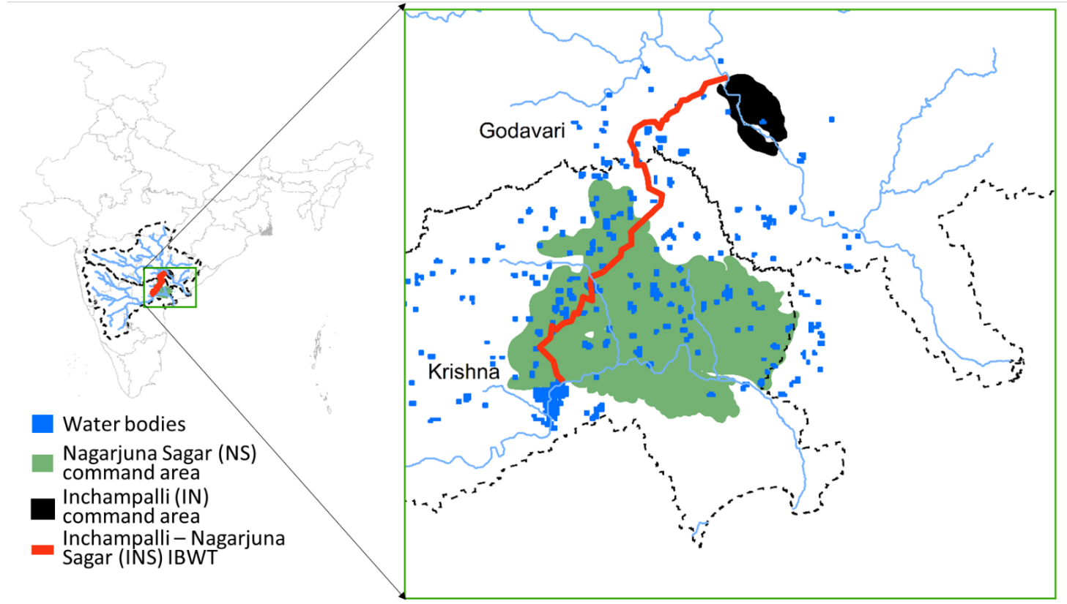
Lakes as additional storage structures
Water storage of lakes form an important component of the system in management of water resources.
Green infrastructure as lakes are used for flood mitigation in countries like China based on its national policy to increase the storage capacity of lakes

Slide 7
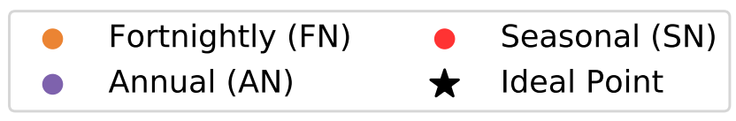
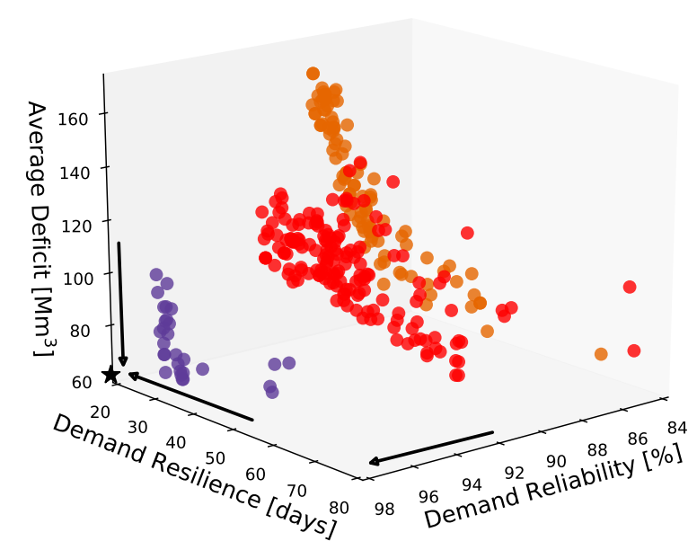
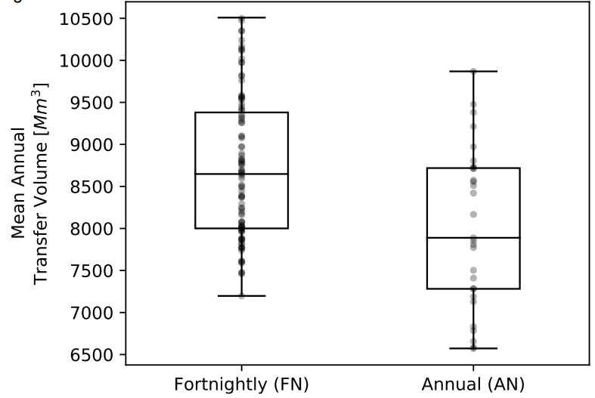
Comparing performance of Pareto approximate strategies from FN, SN, AN
Low volumes of transfer proposed by AN formulation
Annual volumes of water transferred as suggested by the Pareto approximate strategies obtained FN, AN formulations
Secondary Storage per FN period; Annual formulation: 1741 Mm³ ; Seasonal formulation: 998 Mm³
Notes:
Using secondary storages represents a decentralized management system while increasing the size of the already existing large NS reservoir puts emphasis on centralized management.
We find substantial trade-offs in the performance of objective functions across transfer strategies obtained from the stochastic multi-objective optimization. We compare the
FN resolution (orange circles) against the Pareto approximate sets discovered through the Seasonal resolution (red triangles) and Annual resolution (blue squares). Strategies discovered through multi-objective search at Annual resolution outperform the strategies at FN and Seasonal resolution across the three demand satisfaction measures averaged across both basins. This suggests that at Annual resolution, frequency of demand satisfaction is higher compared to FN and Seasonal resolution.
A key advantage of the Annual resolution strategies is that they are able to obtain high performance levels across all objectives. Figure b and c shows the performance of
the FN (orange lines) and Annual (blue lines) strategies across all objectives. It is possible to manage floods while achieving much higher benefits for demand satisfaction across both basins at Annual resolution compared to FN resolution and also maintain environmental flow reliability. As expected, the Annual resolution strategies favour demand satisfaction in both the basins. However, Annual resolution strategies fail in flood reliability in both the basins.

Slide 8
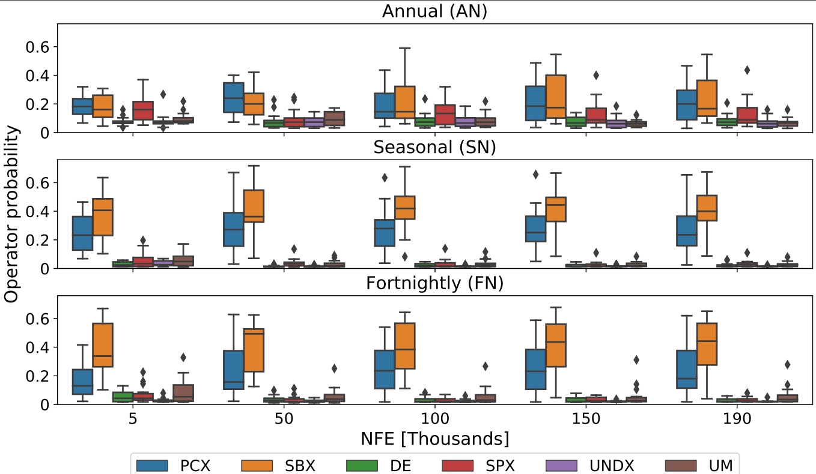
Temporal resolution impacts the search dynamics of the Borg MOEA
Operator Probability
Figure: Variability of multiway correlation between combinations of decision variables for multiple resolutions
Operator probability vs. number of function evaluations (NFE) for six operators of Borg MOEA.
Boxplots indicate the variability of the probability of operator across 15 seeds
Notes:
Multiway correlation coefficient is the correlation between multivariate variables. Using this coefficient, we find the decreasing order of correlation between decision variables for different
combinations as Annual with coefficient of 0.56, Seasonal with coeff of 0.28 and FN with coeff of 0.22. The correlation for a particular resolution across multiple combinations
is almost constant but significant differences found between different temporal resolutions. This dependency structure (high correlation) of water transfers increases the
performance of the system. To our knowledge, this is the first study that analyses the dependence structure between decision variables.

