Slide 1



Clustering urban areas by a geological point of view:
The Urban Geo Footprint Tool
Lentini A. (1), Galve J.P. (1), Benjumea-Moreno, B. (2), Bricker S. H. (3), Chiessi V. (4), Devleeschouwer X. (5), Guarino P.M. (4), Kearsey T. (3), Leoni G. (4), Pizzino L (6), Giordano G. (7), Puzzilli L.M. (4), La Vigna F. (4)
University of Granada “UGR” – Science department (Spain)
Geological Survey of Spain – IGME (Spain)
British Geological Survey (UK)
Geological Survey of Italy - ISPRA (Italy)
Geological Survey of Belgium (Belgium)
National Institute of Geophysics and Volcanology (Italy)
University of “Roma Tre”– Science department (Rome, Italy)

Slide 2

INTRODUCTION
The Urban Geo Footprint (UGF) is a project currently developed in the framework of the EuroGeoSurveys Urban Geology Expert Group (UGEG) and it is focused on the geo-environmental pressures in urban areas.

Slide 3
INTRODUCTION: AIMS
To set up a classification tool to identify the geological features of urban areas
To understand why urban areas are having different threats, and thus to assess the cities’ geo-resilience
To improve the European collaboration
To improve citizens' awareness of both the resources and the threats associated with geology
To support decision makers (e.g. urban planning, hazards prevention)
Notes:
Trets

Slide 4

BASIC ASSUMPTIONS
it will give a measure of how much the geological setting and the geographical features influence the city itself.
Every parameter is to be considered with a “negative” meaning. Thus, the higher is the parameter value, the higher is the negative influence on city setting to be expected

Slide 5

METHODS: UGF tool STRUCTURE
The UGF tool is composed by these 5 drivers:
Deep processes pressure
Subsoil anthropic pressure (SAP)
Exogenous processes pressure
Superficial processes pressure
Geology pressure
Geology
Exogenous processes
Deep processes
= Urban Geo Footprint (UGF)
Superficial processes
Subsoil anthropic pressure
UGF SCORE INDEX result derives by the sum of the 5 DRIVERS SCORES

Slide 6
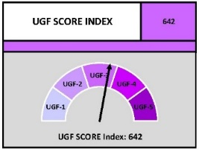
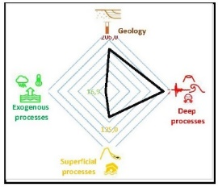
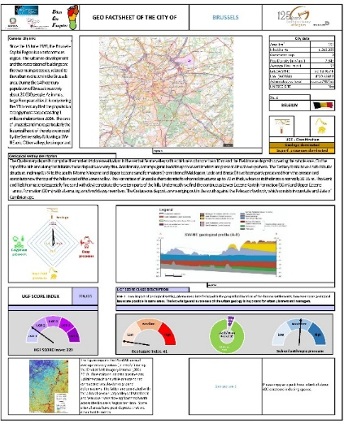
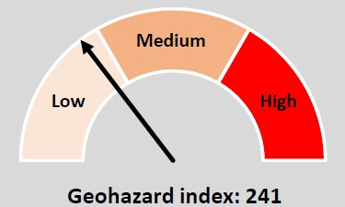
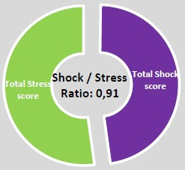
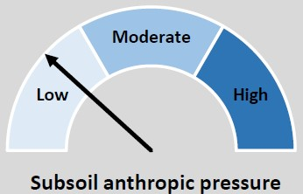
By means of a user-friendly spreadsheet (with self-calculating scores) the UGF tool produces this main result: The City Geo Factsheet

Slide 7
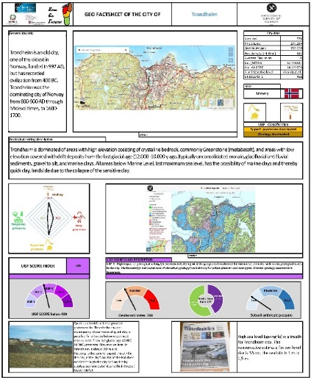
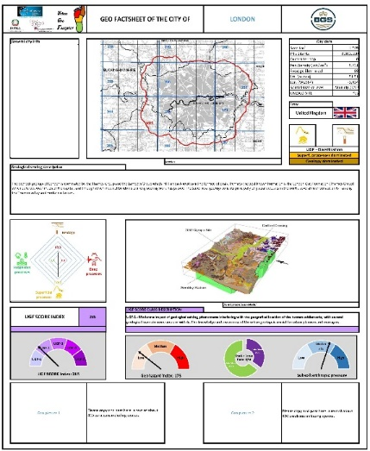
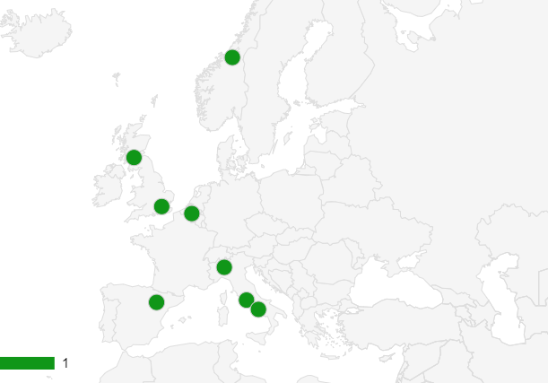
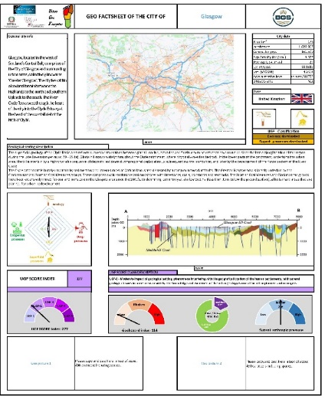
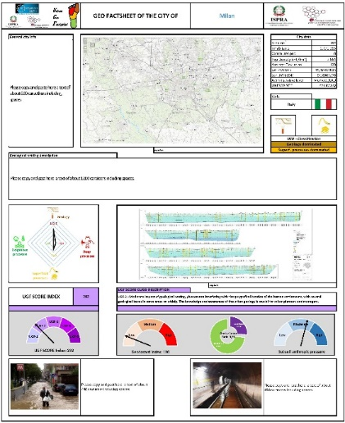
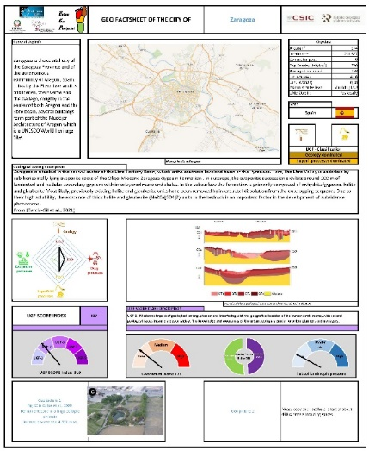
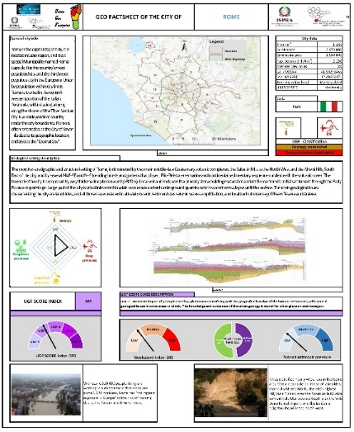
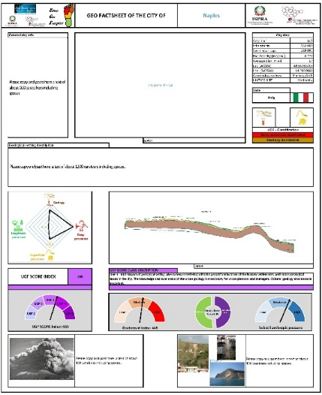
RESULTS

Slide 8
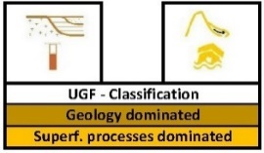
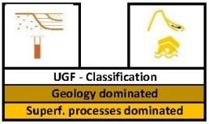
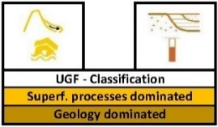
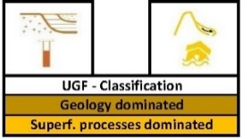
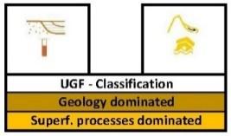
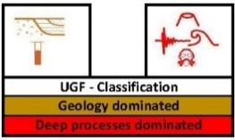
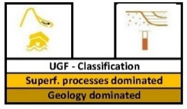
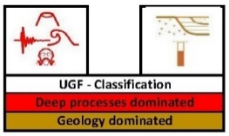
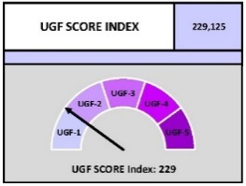
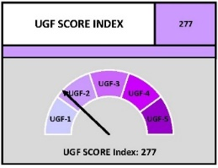
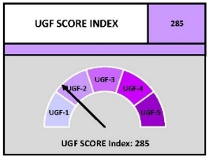
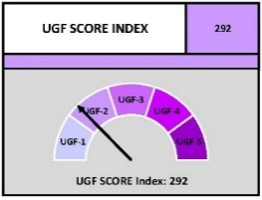
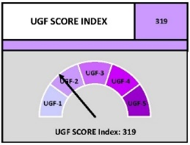

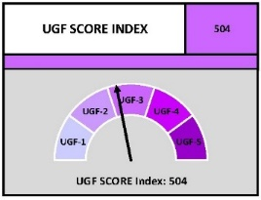
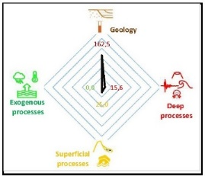
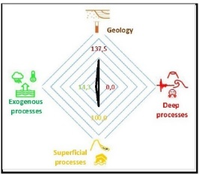
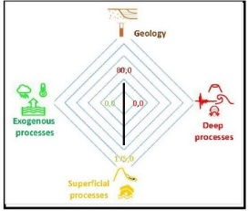
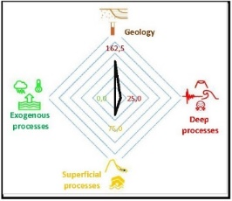
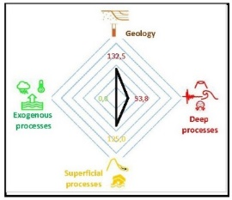
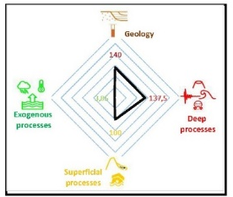
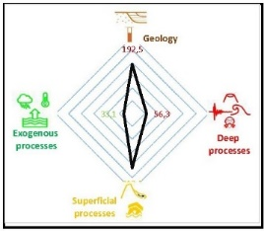
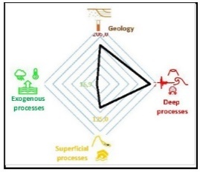
RESULTS
BRUSSELS | GLASGOW | LONDON | MILAN | ZARAGOZA | ROME | TRONDHEIM | NAPLES
229 | 277 | 285 | 292 | 319 | 393 | 504 | 642
Notes:
Trndheim permastrost

Slide 9
FUTURE STEPS
An advanced analysis of the drivers is being prepared
Collaborations in testing the tool in other cities are very welcome ☺
azzurralentini@gmail.com
azzurralentini@correo.ugr.es
Francesco La Vigna (ISPRA – Geological Survey of Italy)
francesco.lavigna@isprambiente.it

Slide 10
Deep processes pressure
Subsoil anthropic pressure
Exogenous processes pressure
Geology pressure
Superficial processes pressure
Thank you
azzurralentini@gmail.com
azzurralentini@correo.ugr.es

