Slide 1
Geologic and Tectonic units in the Iranian Plateau from present and future satellite missions
Carla Braitenberg, Tommaso Pivetta, Alberto Pastorutti, Magdala Tesauro
University of Trieste
25 May 2022
EGU 2022
Link abstract: https://meetingorganizer.copernicus.org/EGU22/EGU22-12459.html

Slide 2
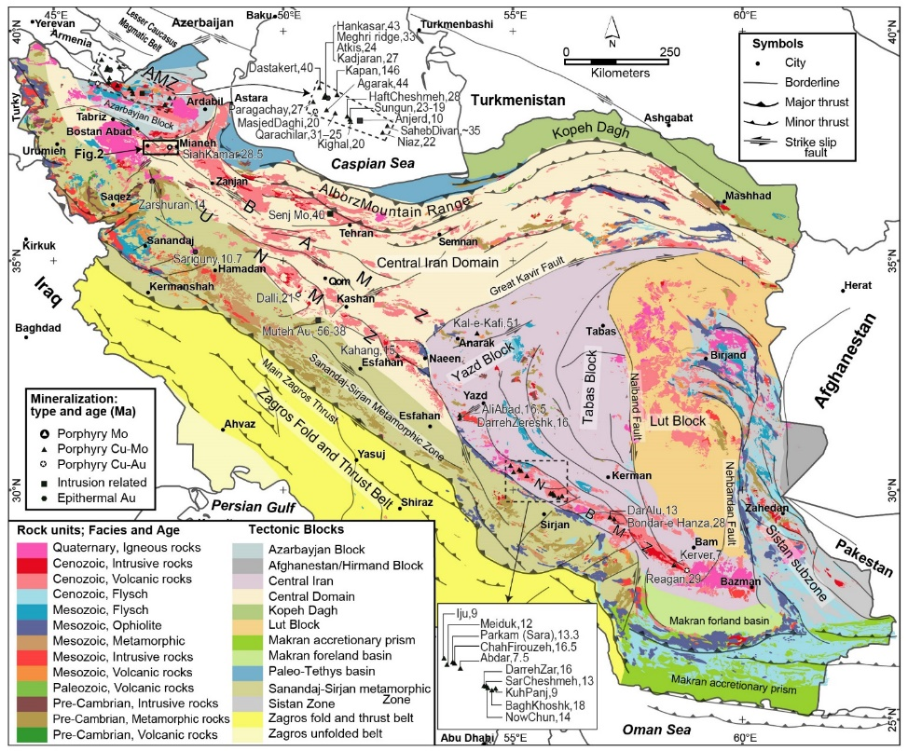
Aim of study
Define crustal densities so that topography corresponds to the heights expected for given crustal thickness in the framework of isostasy.
Identify crustal density variations, separating lower crust, mid crust intrusions, surface sediment basins.
Define position of crustal dense bodies in relation to Iran magmatic range
Method: integrate seismic Moho and gravity field as constraint for an isostatic model.
Loads are the topography and the crustal density inhomogeneities.
Model: The flexural thin plate isostatic model is used. Regression analyses between gravity, topography, seismic Moho depth.
Crustal bodies identification: gravity field complement to isostatic crustal thickness effect.
Isostatic model-crustal bodies sum up to total gravity field on the Iran plateau scale
Geology map: Simplified tectono-geological map of Iran with the main Cu, Au and Mo ore deposits and their ages modified from Rabiee et al., (2019). Lithology is based on maps from the Huber (1977) with additional information from Berberian and King (1981). A. Rabiee pers. Comm.

Slide 3
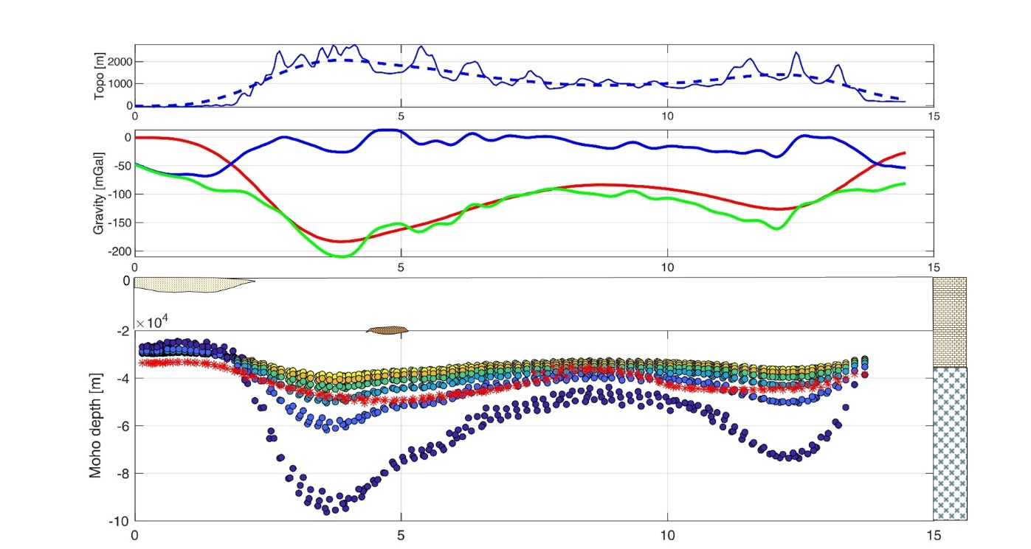

Model framework for an area with little constraints on crustal structure.
Data: Satellite gravity field, seismic Moho, surface geology.
Topo and Topo filtered 300 km
Residual
«Root effect»
Bouguer shifted
Sediment basin
Crustal intrusion
Reference
Crust-mantle
column
*=Kaviani
Seismic Moho: Kaviani et al., 2020

Slide 4
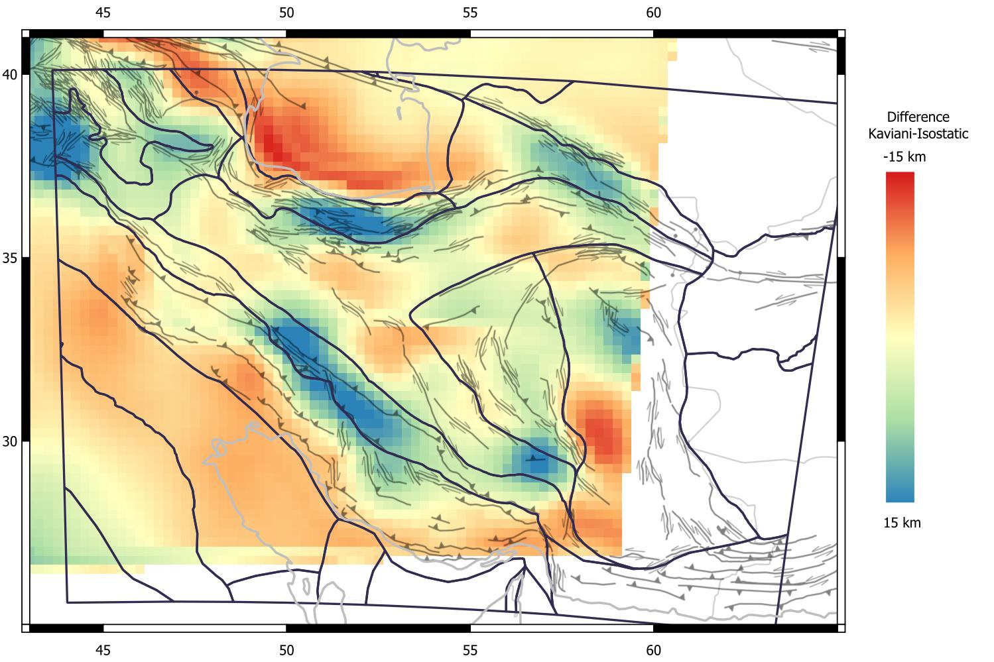
Difference Moho Kaviani - Isostatic model (Δρ=200kg/m³)
Alborz
Fold belt
Isostatic Moho
shallower
Zagros
Thrust Zone
Zagros
Syntaxis
Isostatic Moho
deeper

Slide 5
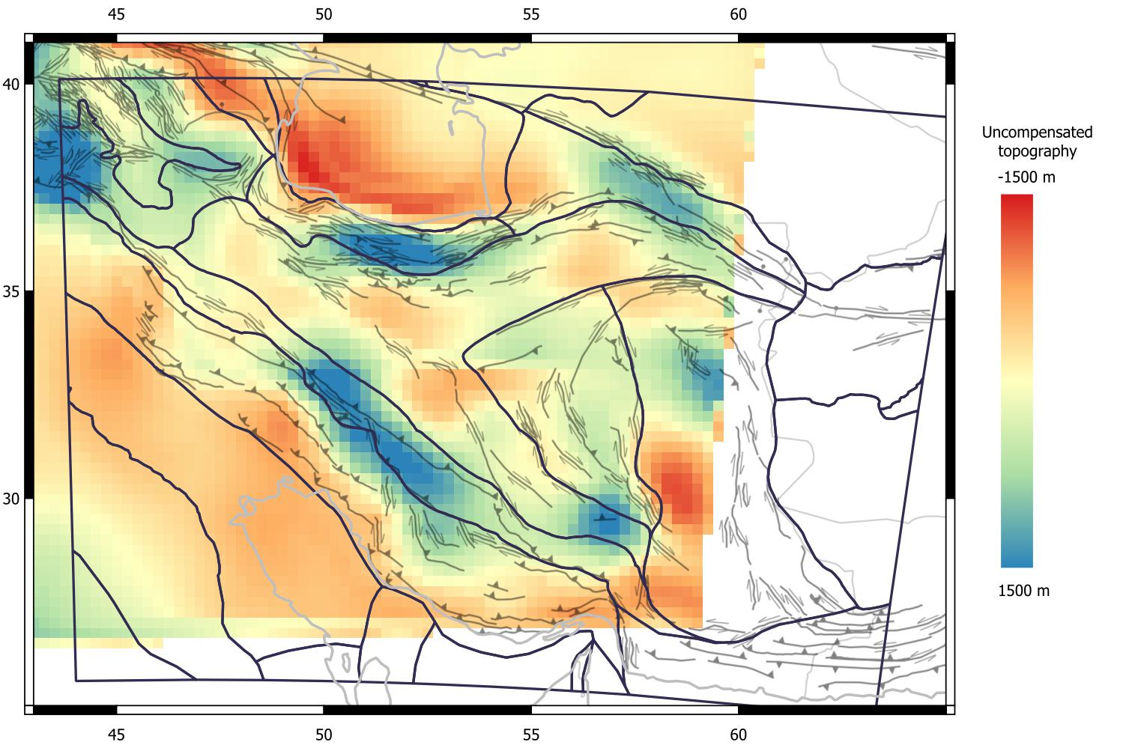
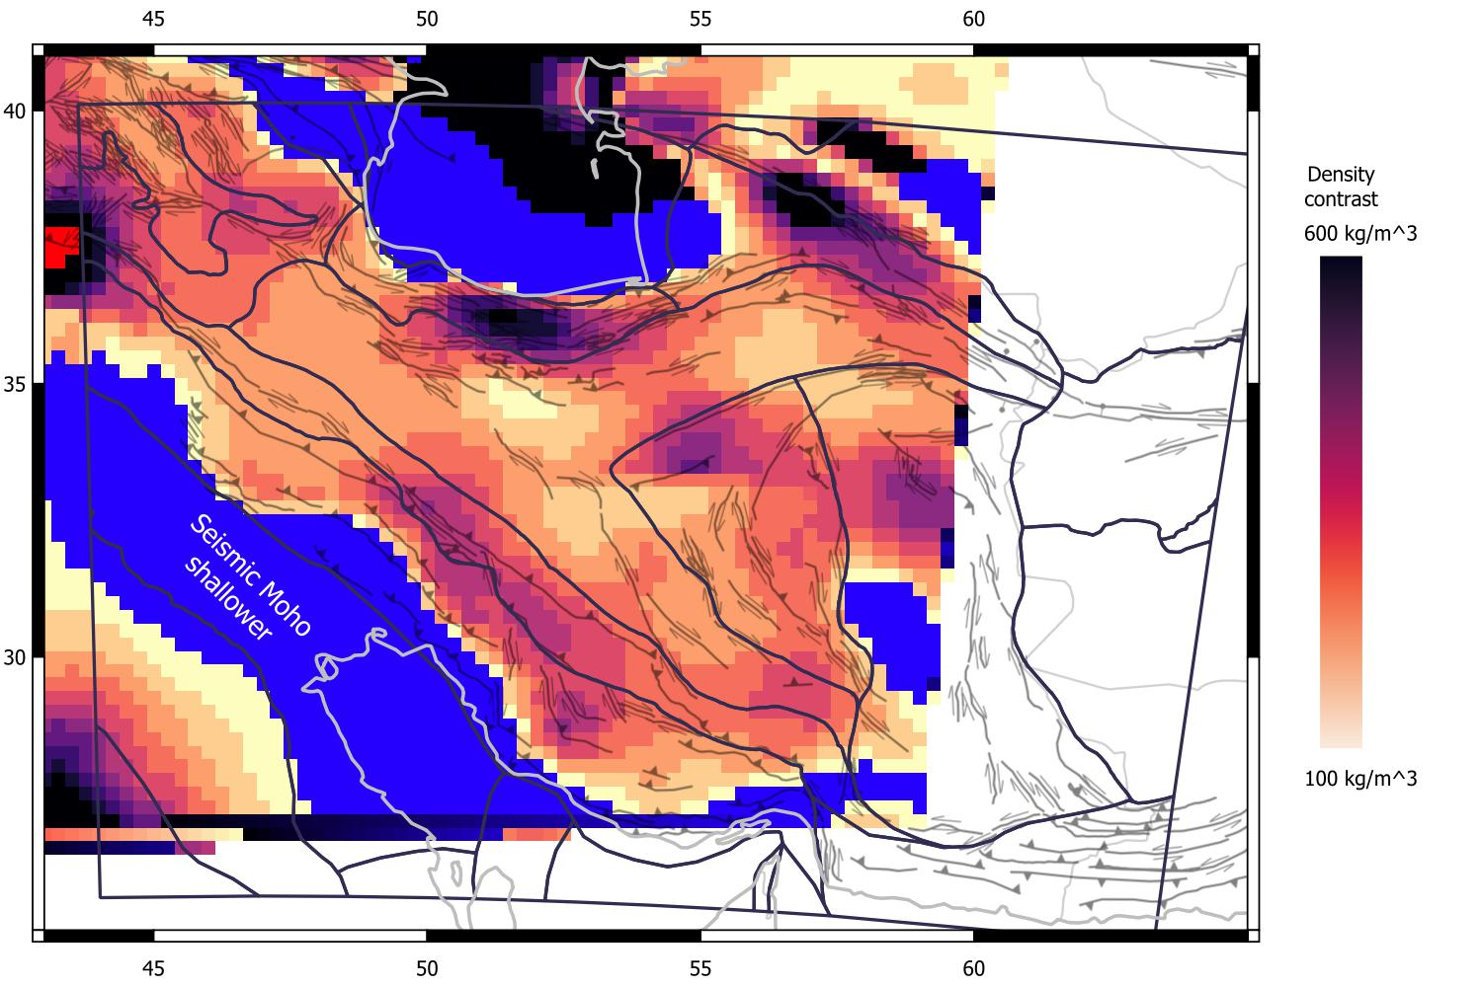
Uncompensated topography
- Kaviani model
Modelled as reduction in in lower crustal density
Alborz
Fold belt
Zagros
Thrust Zone
Alborz
Fold belt
Zagros
Thrust Zone
Bandar Abbas
Syntaxis
Bandar Abbas
Syntaxis
Comments: Zagros, Sanandaj-Sirjan zone and Central Iran Domain, South Caspian Sea, has mostly density contrast of 200-300 kg/m³.
Seismic Moho: Kaviani et al., 2020

Slide 6
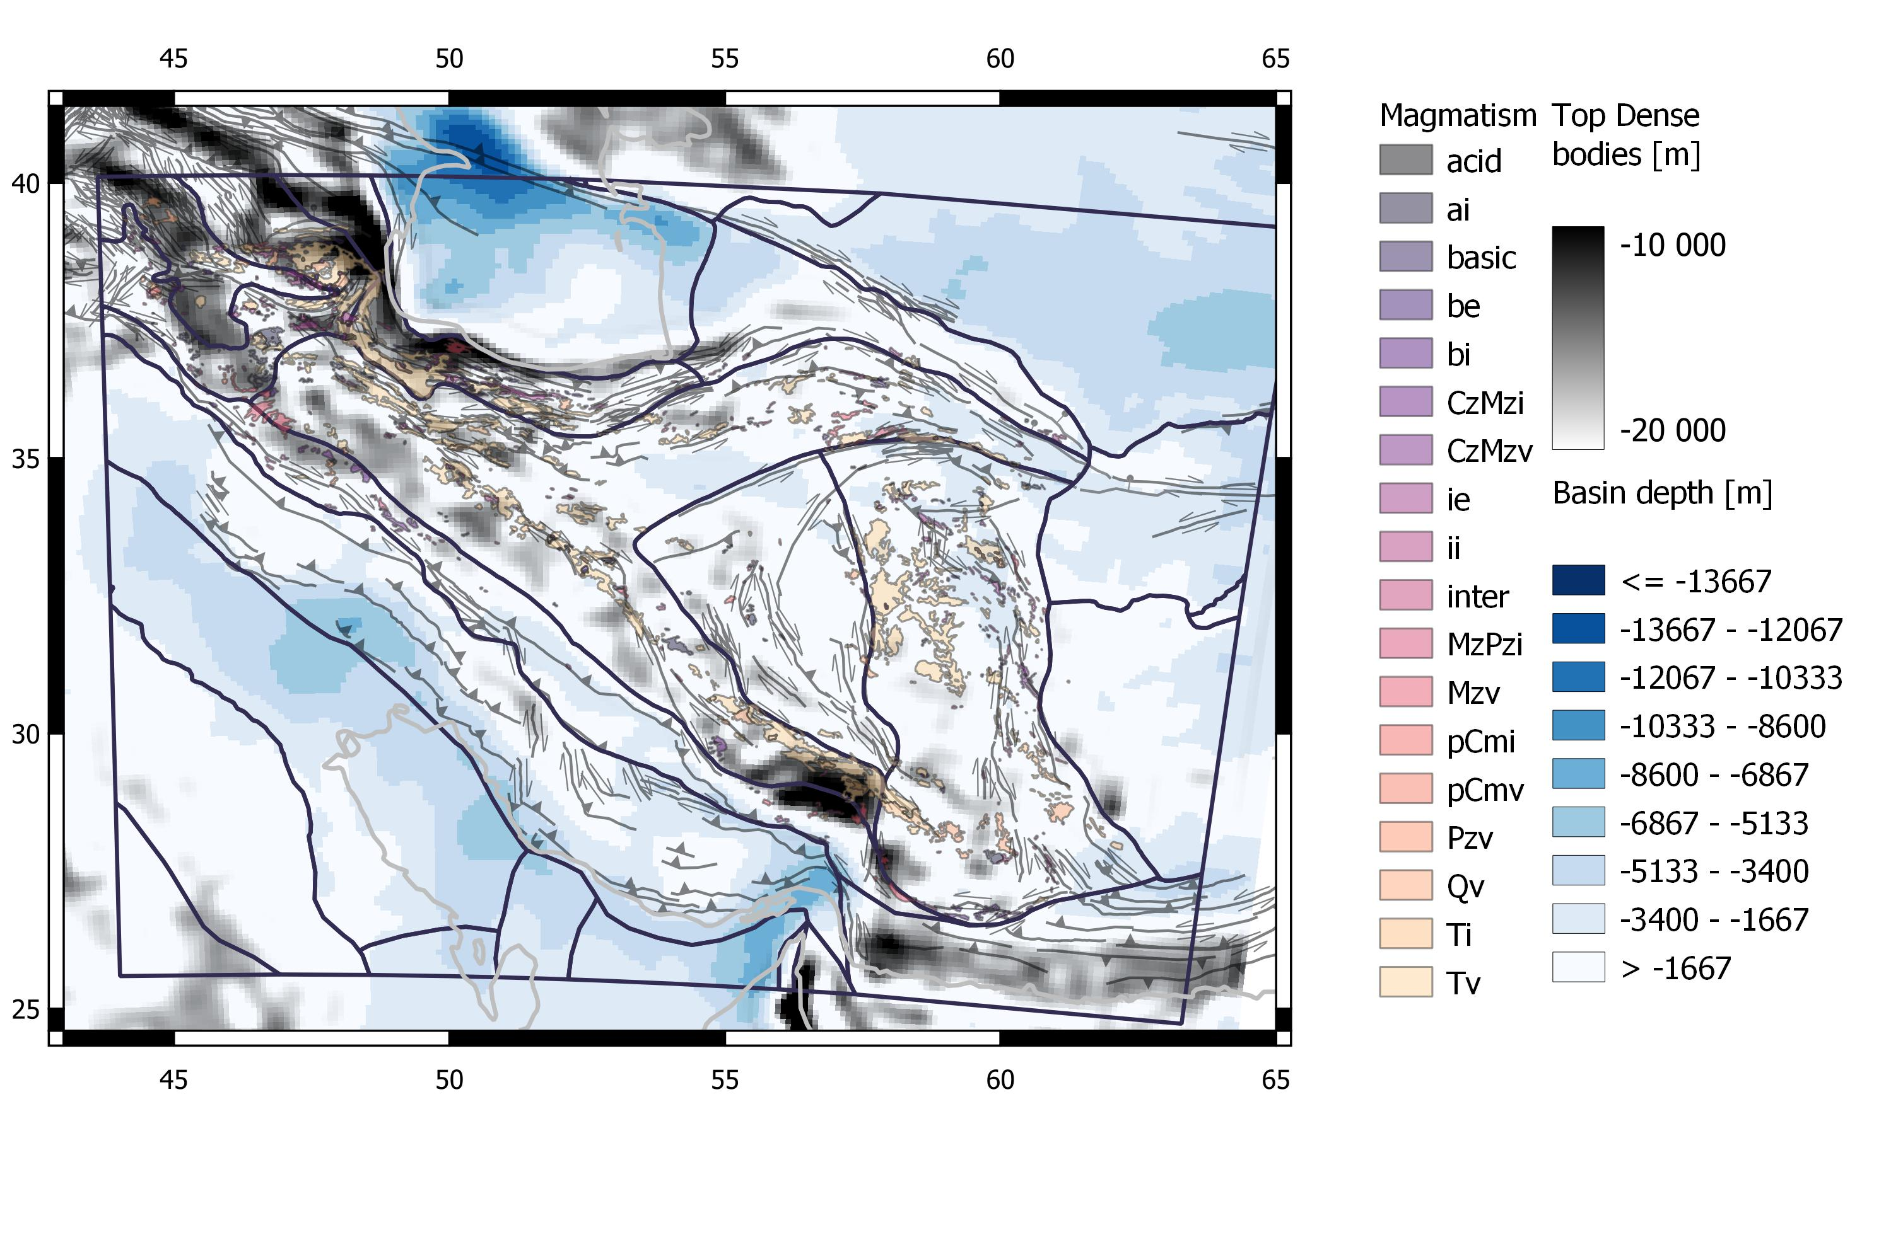
Sediment basin thickness and intracrustal bodies from residual gravity field
Magmatism: USGS Open-File Report 97-470G

Slide 7
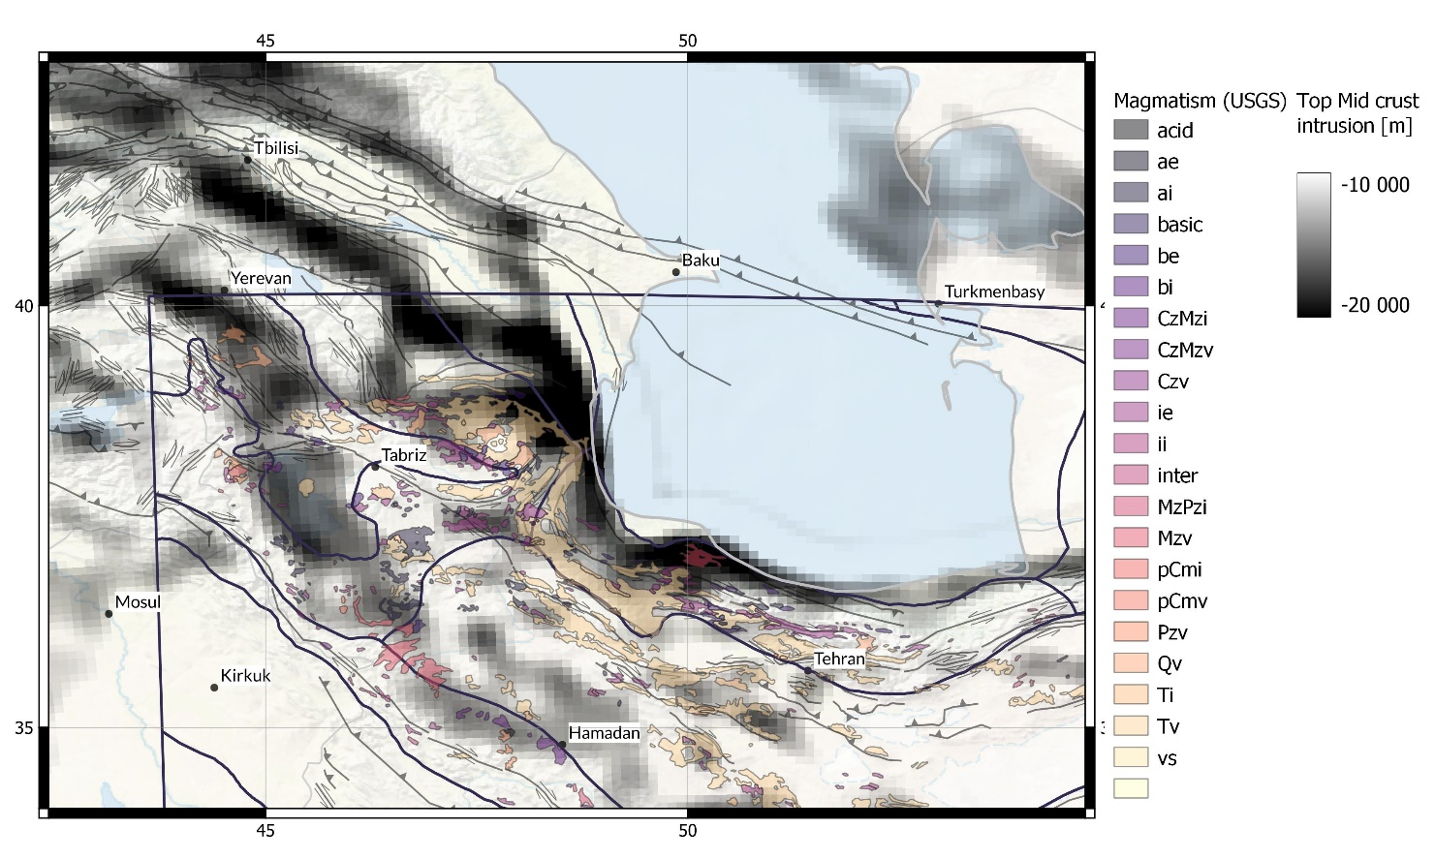
Intracrustal dense bodies and magmatism- detail Lesser Caucasus magmatic arc
Proterozoic basement Complex
Anatolide-Tauride terrain
S-ward extension of Volcanic arc?
Lesser Caucasus
Somkheto-Karabakh magmatic arc
Neothethys obduction
Greater Caucasus
Alborz
Fold belt
Zagros
Thrust Zone
Lesser Caucasus: Cavazza et al., 2019, Geosc.Front.

Slide 8
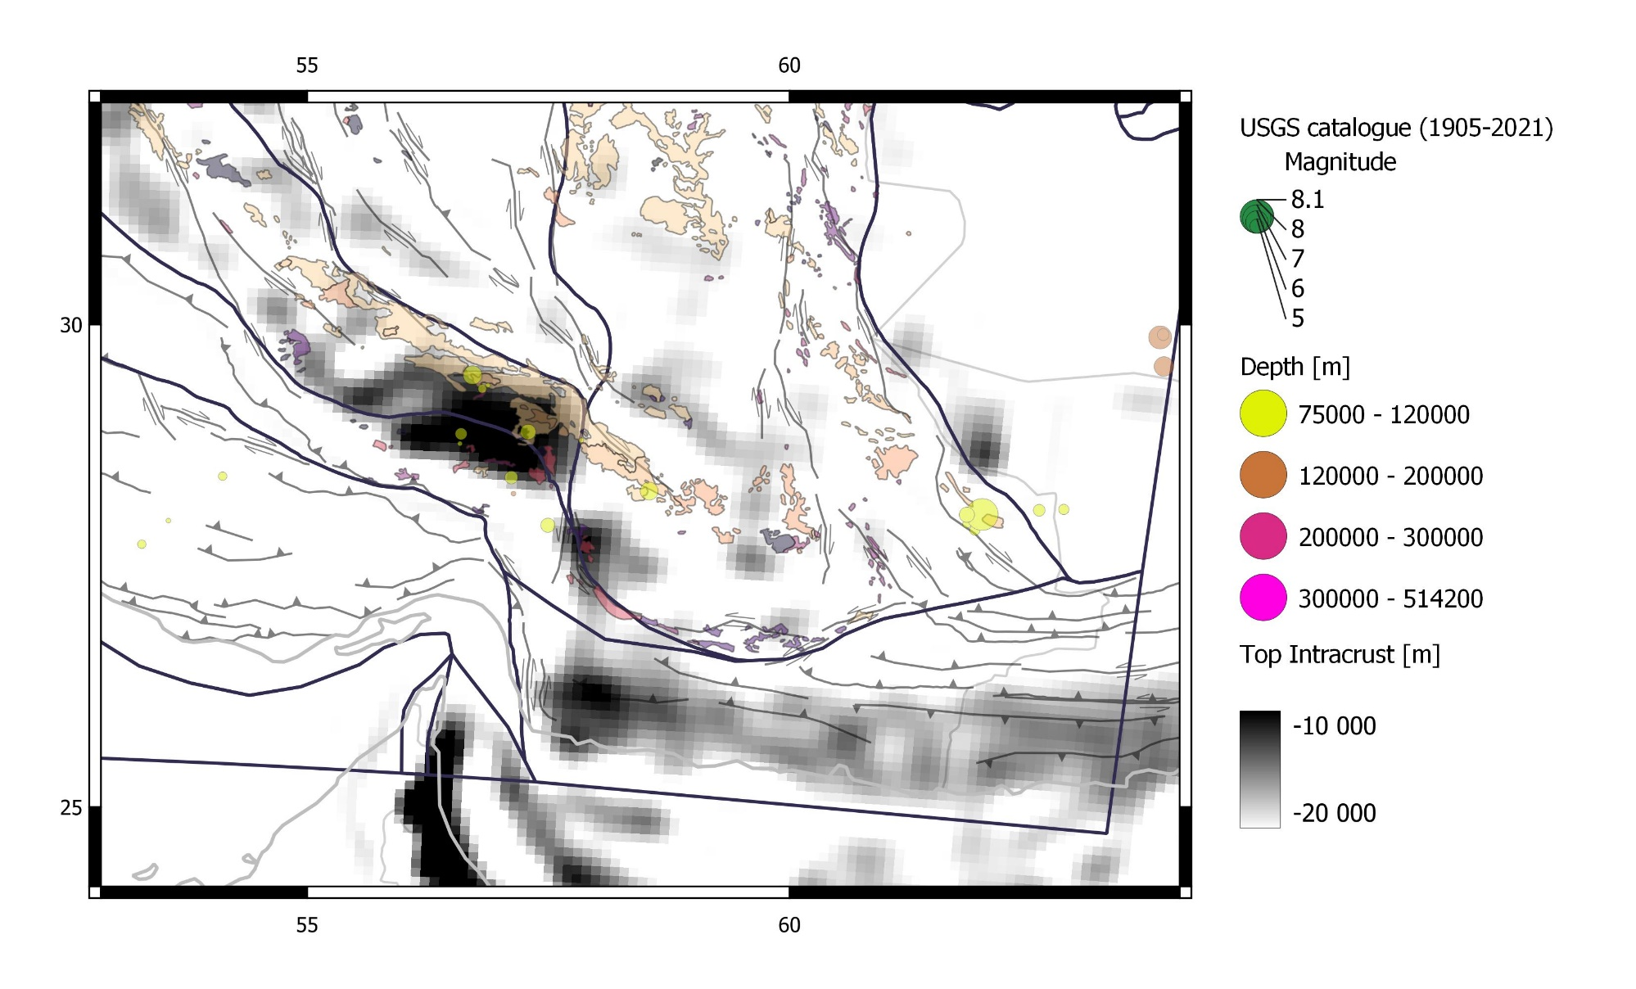
Intracrustal bodies-Bandar Abbas Syntaxis > subcrustal cluster of deep earthquakes below crustal-depth seismicity (not shown)
Lut block
Bandar Abbas
Deep EQs
SE Zagros
Hormuz
Macran accretionary wedge

Slide 9
Conclusion
Generally consistency between topography and isostatically expected crustal thickness
Intracrustal dense layer along Lesser Caucasus Volcanic Arc and parallel 80 km south of it. Somkheto-Karabakh magmatic arc dated Bajocian to Santonian must affect about 10-15 km thickness of crust. Strong rheology presumable.
SE-Zagros-Macran transition forms Bandar Abbas Syntaxis, localized intracrustal dense body. Matches position of localized hypocenters between 75 and 100 km.

