Slide 1



A ‘fully automated’ clustering algorithm for stress inversions (CluStress)
Lukács Kuslits, Lili Czirok, and István Bozsó
”Fully automated” clustering algorithm for stress inversions (CluStress)
Lukács Kuslits¹, Lili Czirok², and István Bozsó¹
¹ ELKH Institute of Earth Physics and Space Science, Sopron, Hungary
² University of Sopron, Roth Gyula Forestry and Wildlife Management Sciences Doctoral School, Sopron, Hungary

Slide 2
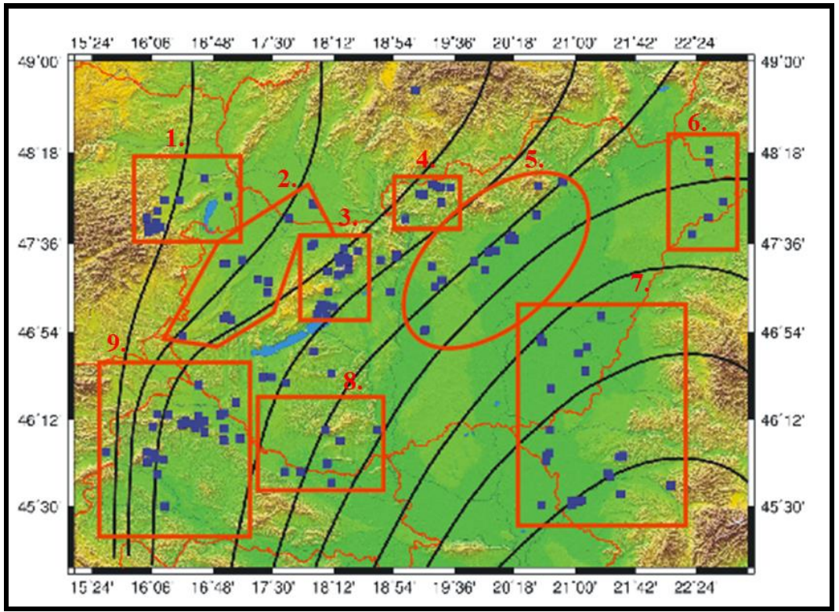
Motivation
Motivation
Stress field estimation requires the homogeneity of the stress field
Typically ~100 earthquakes in each region, often still manual clustering
Input data: 3 spatial coordinates; rake values
Goal: automated algorithmic clustering
Czirok (2016)
1

Slide 3
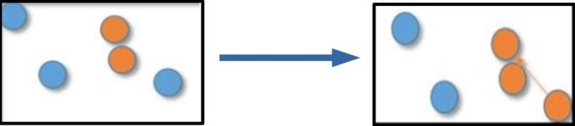
Basic principles for a new type of clustering algorithm
Basic principles for a new type of clustering algorithm
Based on existing algorithms (Hierarchical, HDBSCAN)
Preprocessing of point-to-point Euclidean distance values (statistics based)
Find nearest point groups
Nearest-neighbor-based linkage
2

Slide 4
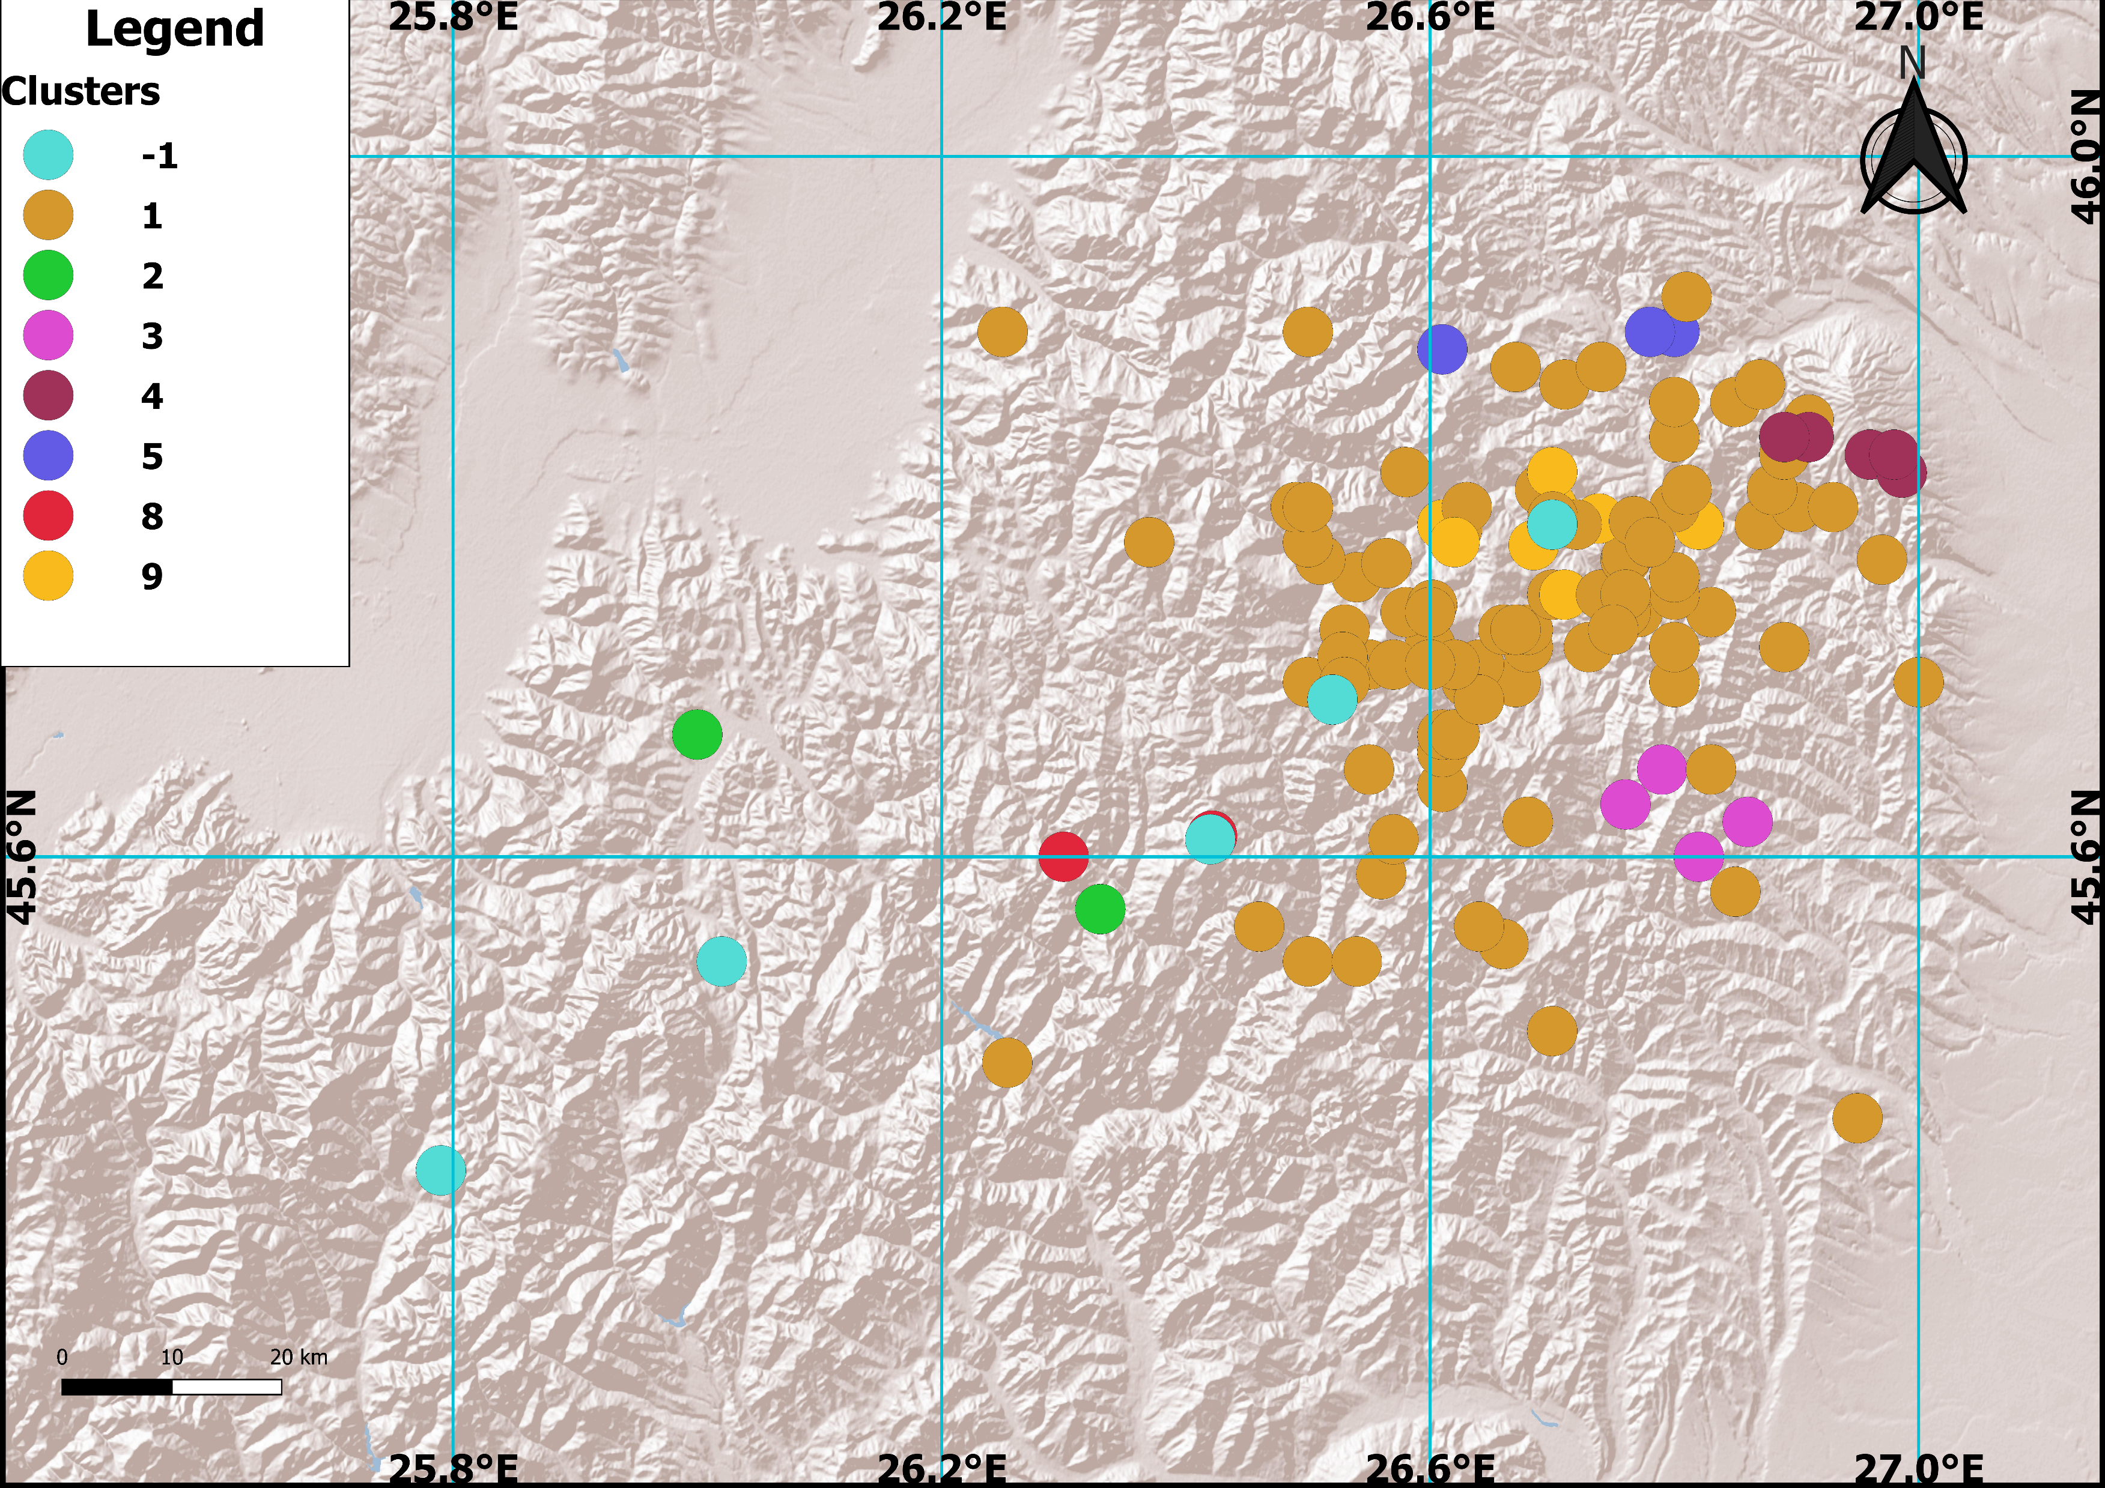
Results for earthquakes in the Vrancea Zone (Carpathian Bend)
Results for earthquakes in the Vrancea Zone (Carpathian Bend)
3

Slide 5
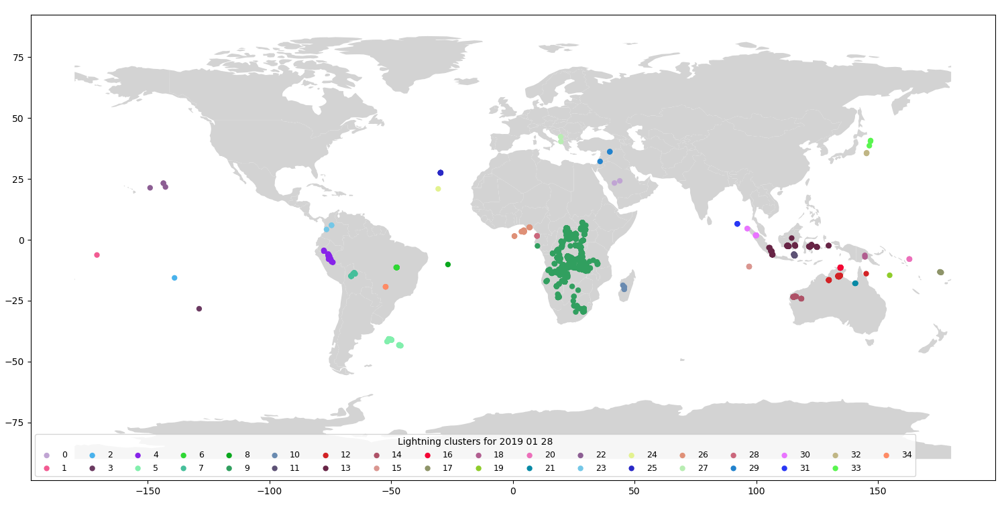
Results for global lightning data
Results for global lightning data
4

Slide 6
Documentation
Documentation
Lili Czirok 'Studying the stress field variations in the Vrancea-zone using clustering-based stress inversions’ Pattern recognition and statistical models applied to earthquake occurrence, Thu 10:21-10:28
Publication in rev.: 'Cluster analysis for the study of stress patterns in the Vrancea-zone (SE-Carpathians)' Pure and Applied Geophysics
Lili Czirok (2016). Analysis of stress relations using focal mechanism solutions in the Pannonian Basin. GEOSCIENCES AND ENGINEERING: A PUBLICATION OF THE UNIVERSITY OF MISKOLC, 5(8), 65-84.
GitHub: https://github.com/lukacskuslits/clu-stress
Python library: pip install clu-stress
kuslits.lukacs@epss.hu
5

Slide 7
Thank You for Your attention!

