Slide 1
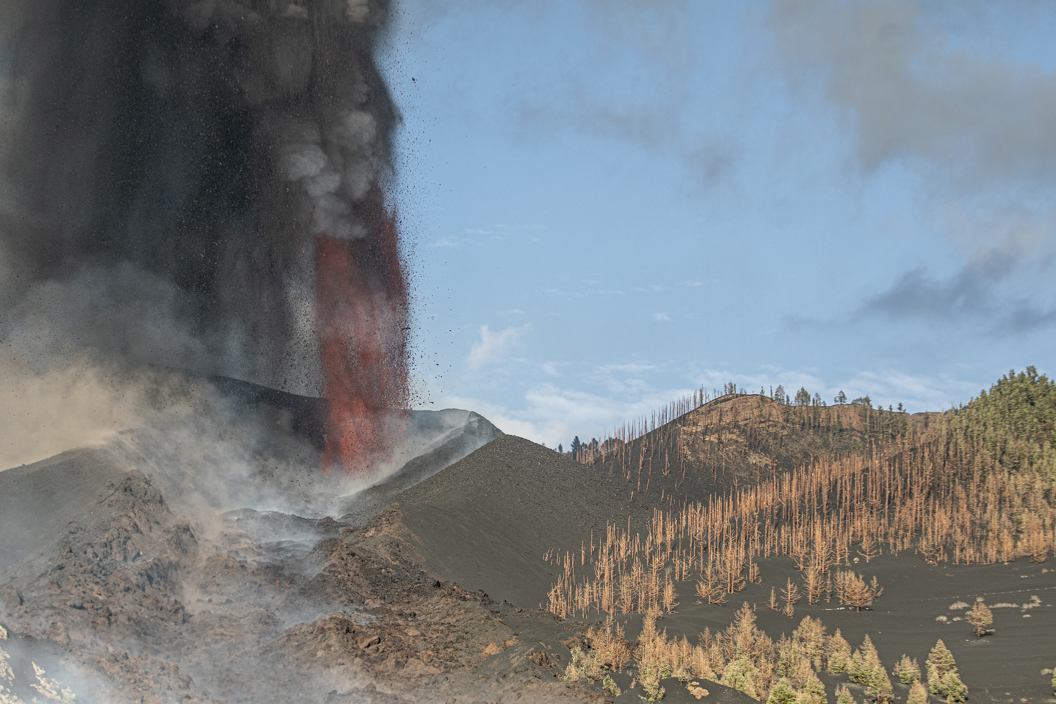
EGU General Assembly 2022 | Vienna, Austria & Online | 23–27 May
The 2021 Cumbre Vieja eruption:
an overview of the geochemical monitoring program
N. M. Pérez, P. A. Hernández, G. V. Melián, E. Padrón, M. Asensio-Ramos, J. Barrancos,
G. D. Padilla, F. Rodríguez, L. D'Auria, C. Amonte, M. Alonso, A. Martín-Lorenzo, D. Calvo, C. Rodríguez, W. Hernández, B. Coldwell, M. J. Pankhurst (INVOLCAN)
and International Collaborative Research TEAM
(Manchester Univ, Palermo Univ., UCL, INGV, IPGP, Azores Univ., New Mexico Univ.,
Durham Univ., Tokyo Univ., Tokyo Institute of Technology)

Slide 2
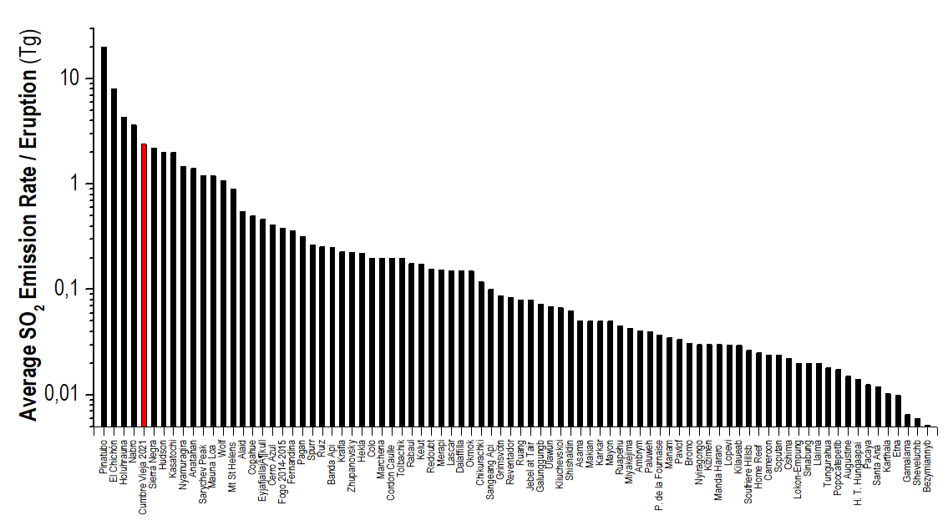
EGU General Assembly 2022 | Vienna, Austria & Online | 23–27 May
2021 Cumbre Vieja Eruption
The most important eruption of Europe during the last 75 years!
Emisiones de SO₂ (>10 kt) de erupciones volcánicas ocurridas durante el periodo 1978-2014
(Hayer C. et al.,EGU 2022)

Slide 3
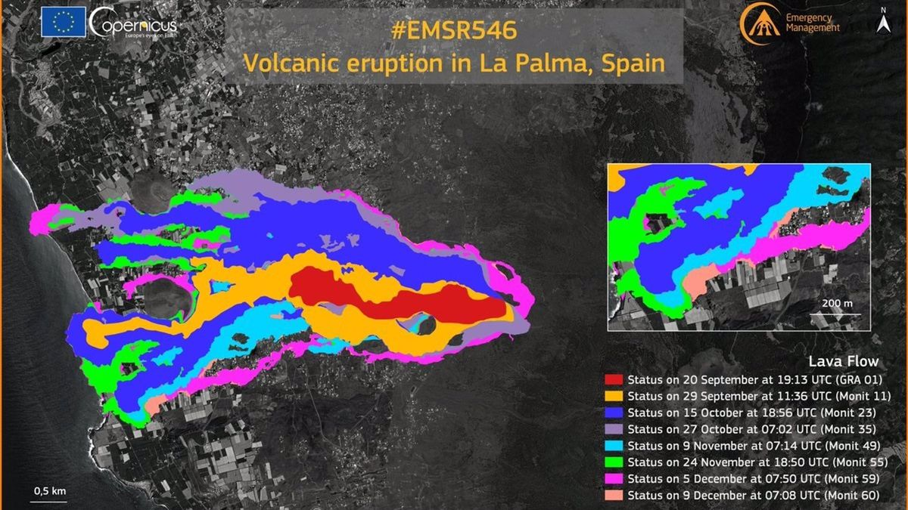
EGU General Assembly 2022 | Vienna, Austria & Online | 23–27 May
The most important eruption of Europe during the last 75 years!
7.000 persons displaced 1.548 buildings demolished
69,867 km roads destroyed 348,86 ha of agriculture land lost
Fuente: Copernicus & Cabildo Insular de La Palma

Slide 4
EGU General Assembly 2022 | Vienna, Austria & Online | 23–27 May
Volcanic plume
Soil degassing
Groundwater
Ash-Leachates
Geochemistry
Seismology
Volcano Surveillance
Lavas
Geodesy
Geophysics
Petrology & Volcanology
Tephra
Thermography
Stratigraphy
INVOLCAN was able to cover most of the volcano monitoring activities for the 2021 Cumbre Vieja eruption thanks to its own resources + a marvelous collaborative research program with national and overseas scientists.

Slide 5
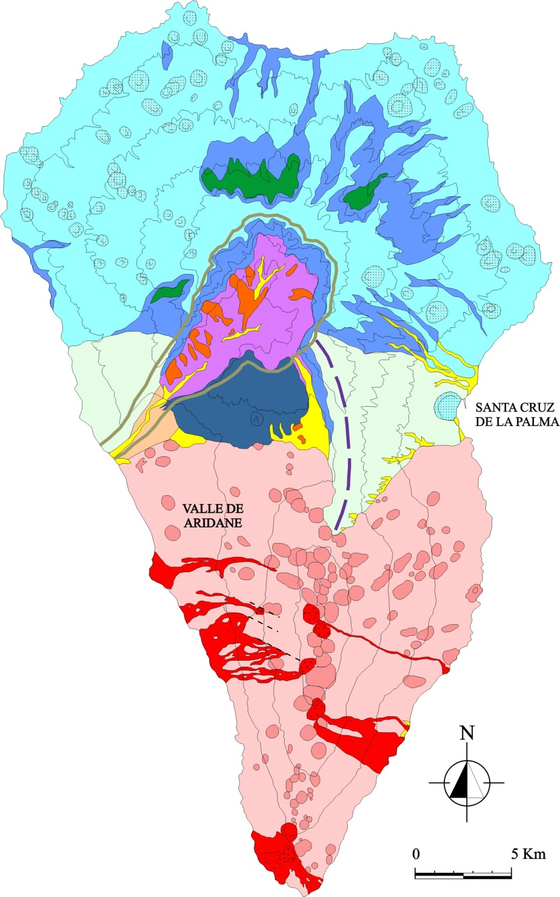
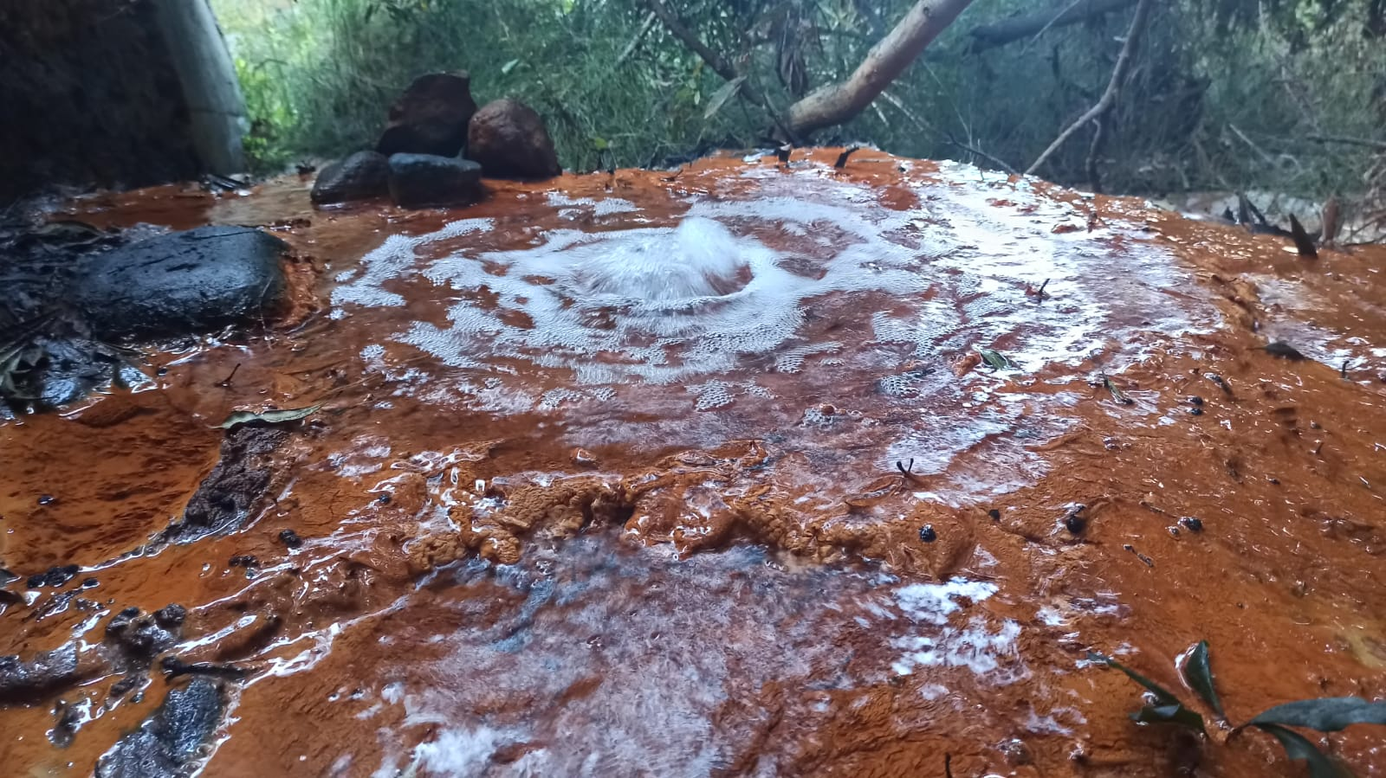
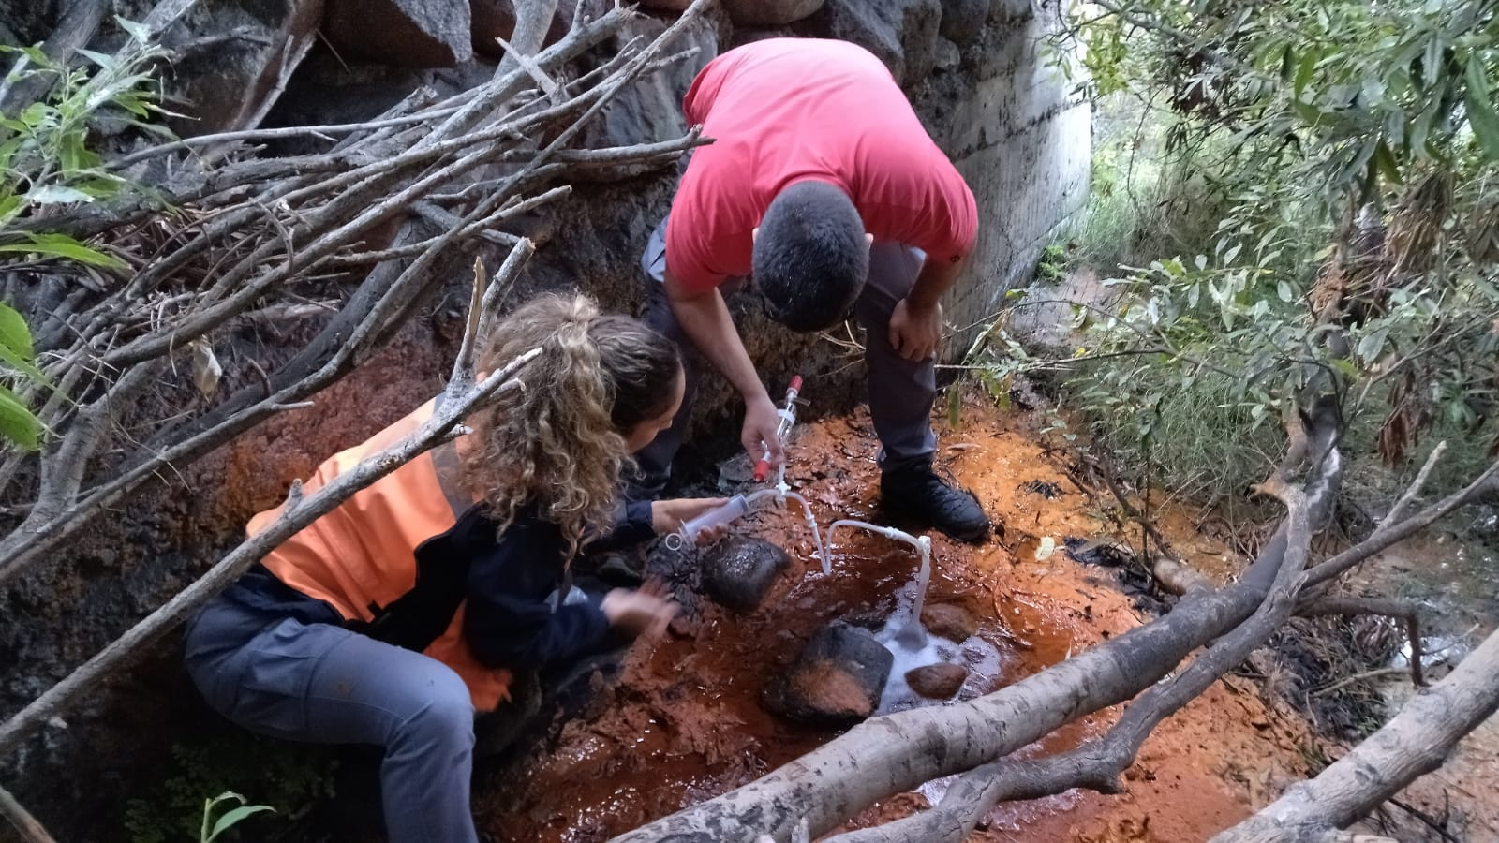
EGU General Assembly 2022 | Vienna, Austria & Online | 23–27 May
Helium-3 emission monitoring (Dos Aguas)
Dos Aguas
(Navarro 1993)

Slide 6
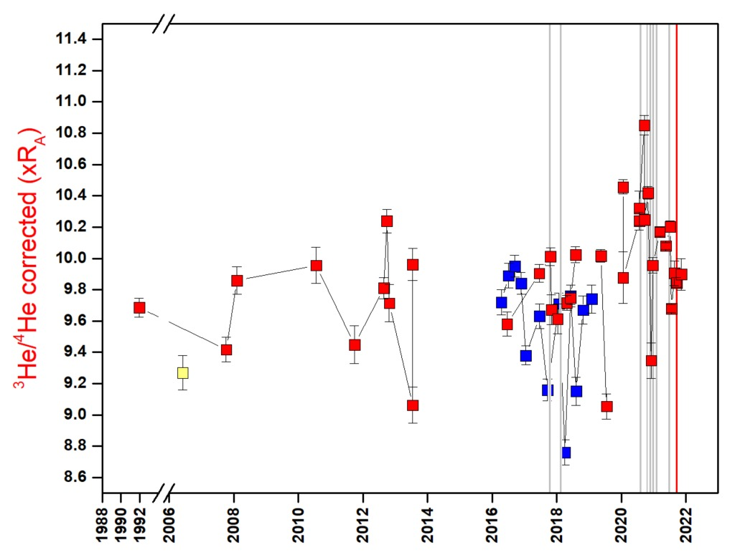


EGU General Assembly 2022 | Vienna, Austria & Online | 23–27 May
Helium-3 emission monitoring (Dos Aguas)
Lower MANTLE > 9 Ra
> 10 Ra
∼ 9,7 Ra
MORB value = 8 ± 1 Ra
(Pérez N. M. et al., 1994; Padrón E. et al., 2015; Day J. & Hilton D., 2020; Torres-González P. et al., 2020; Padrón E. et al., 2022)

Slide 7
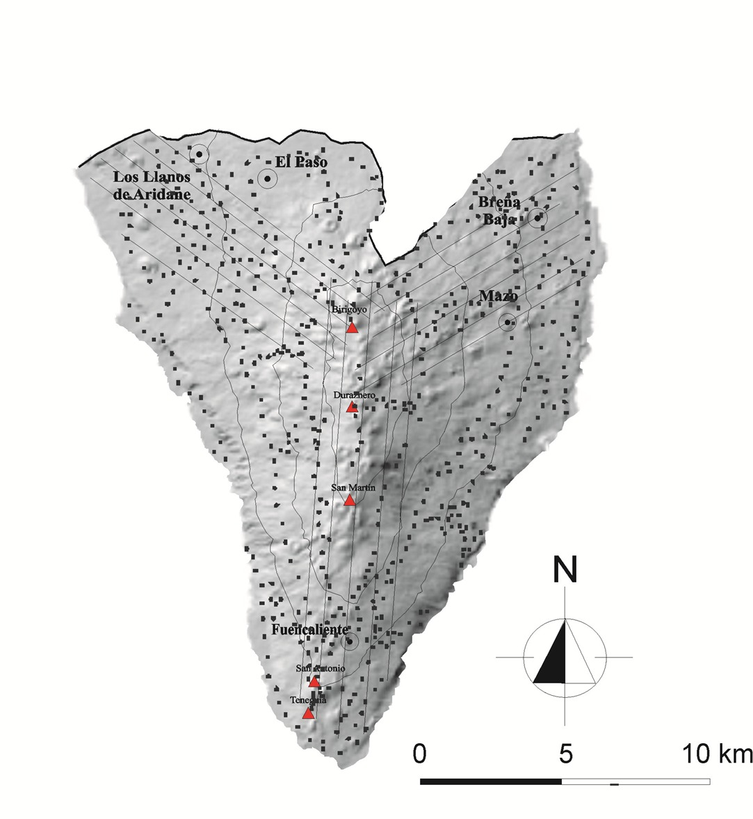
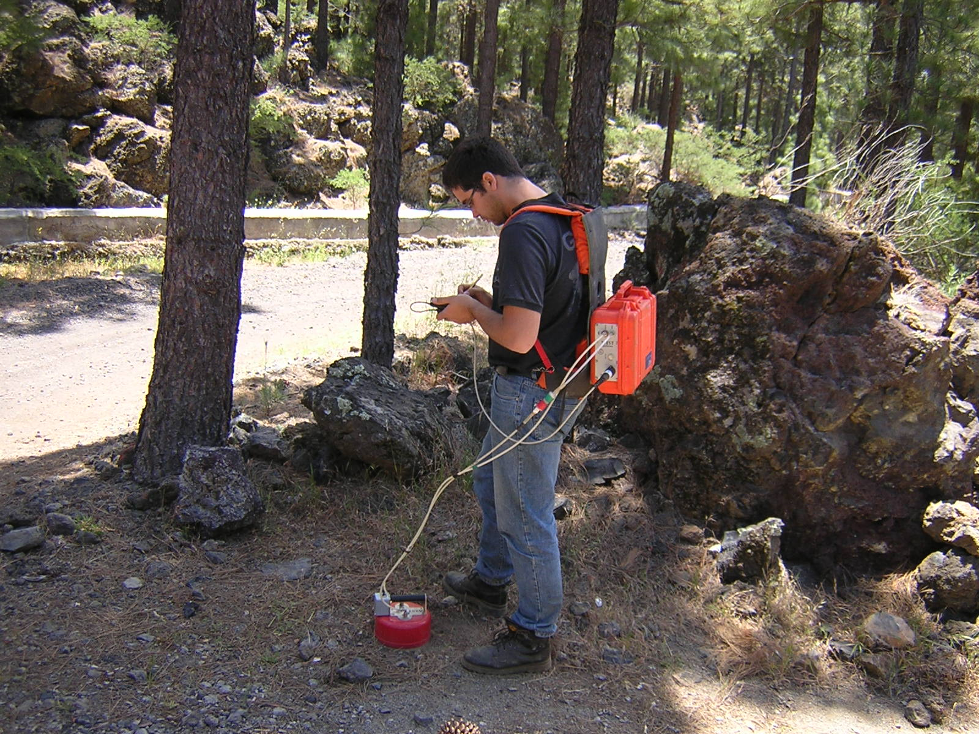
EGU General Assembly 2022 | Vienna, Austria & Online | 23–27 May
Diffuse CO₂ degassing monitoring

Slide 8
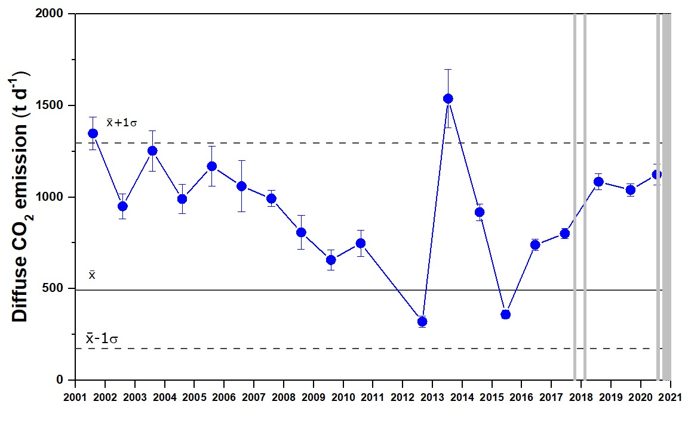
EGU General Assembly 2022 | Vienna, Austria & Online | 23–27 May
Diffuse CO₂ degassing monitoring
before the 2021 Cumbre Vieja eruption
(Padrón E. et al., 2015; Santana de León et al., 2022)

Slide 9
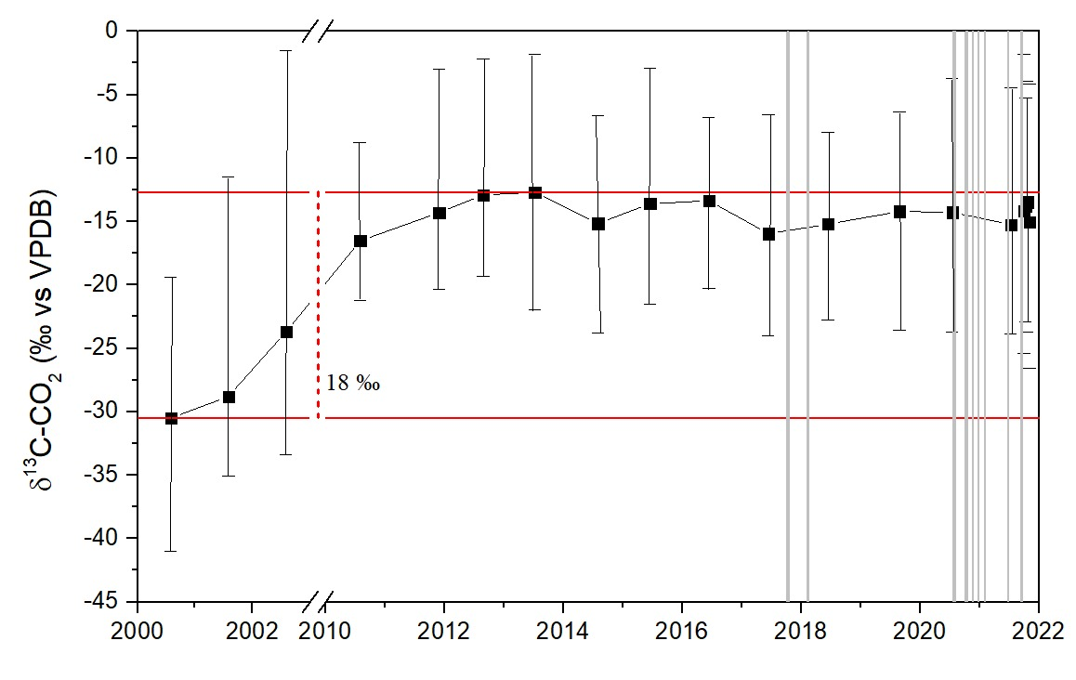
EGU General Assembly 2022 | Vienna, Austria & Online | 23–27 May
Diffuse CO₂ degassing monitoring
δ¹³C-CO₂ of the soil atmosphere before the 2021 Cumbre Vieja eruption
(Padrón E. et al., 2015; Santana de León et al., 2022)

Slide 10
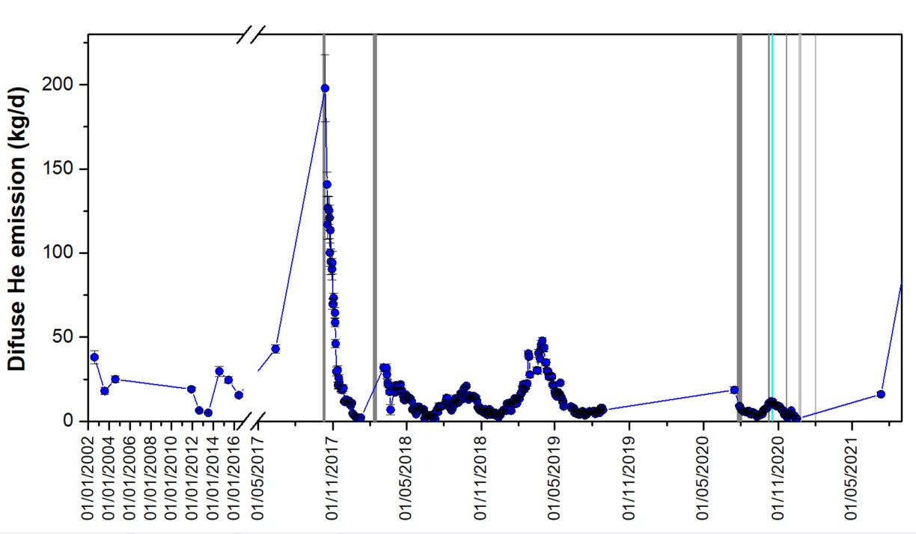
EGU General Assembly 2022 | Vienna, Austria & Online | 23–27 May
Diffuse ⁴He degassing monitoring
before the 2021 Cumbre Vieja eruption
(Melián G. V. et al., 2022)

Slide 11
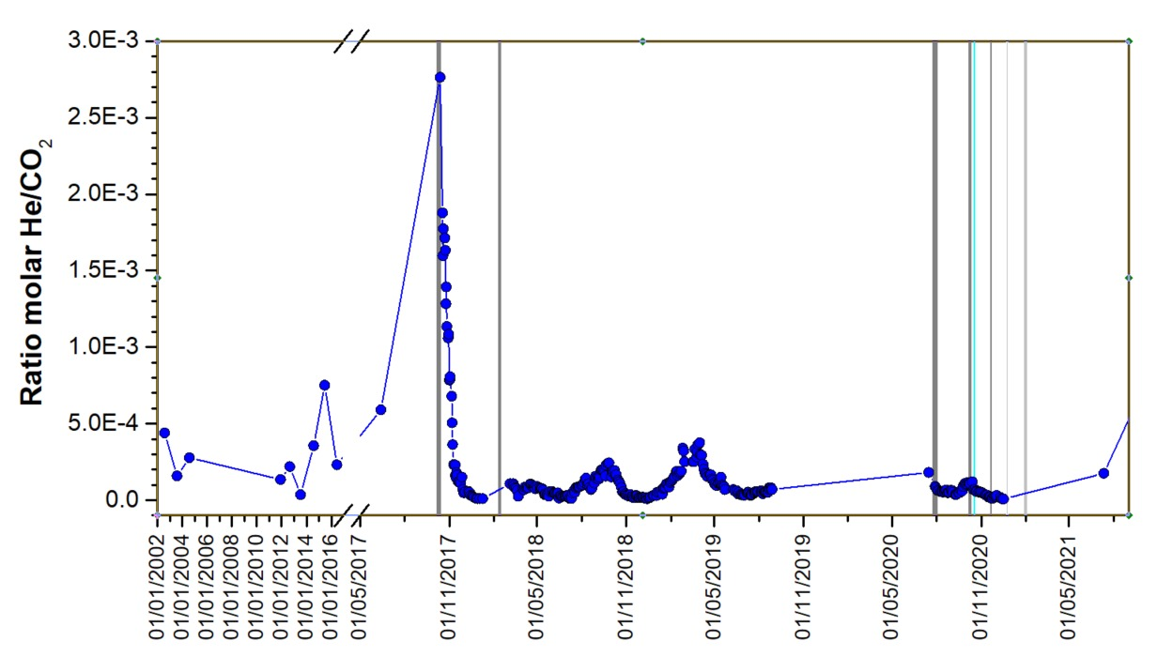
EGU General Assembly 2022 | Vienna, Austria & Online | 23–27 May
Diffuse ⁴He/CO₂ ratio degassing monitoring
before the 2021 Cumbre Vieja eruption
(Melián G. V. et al., 2022)

Slide 12
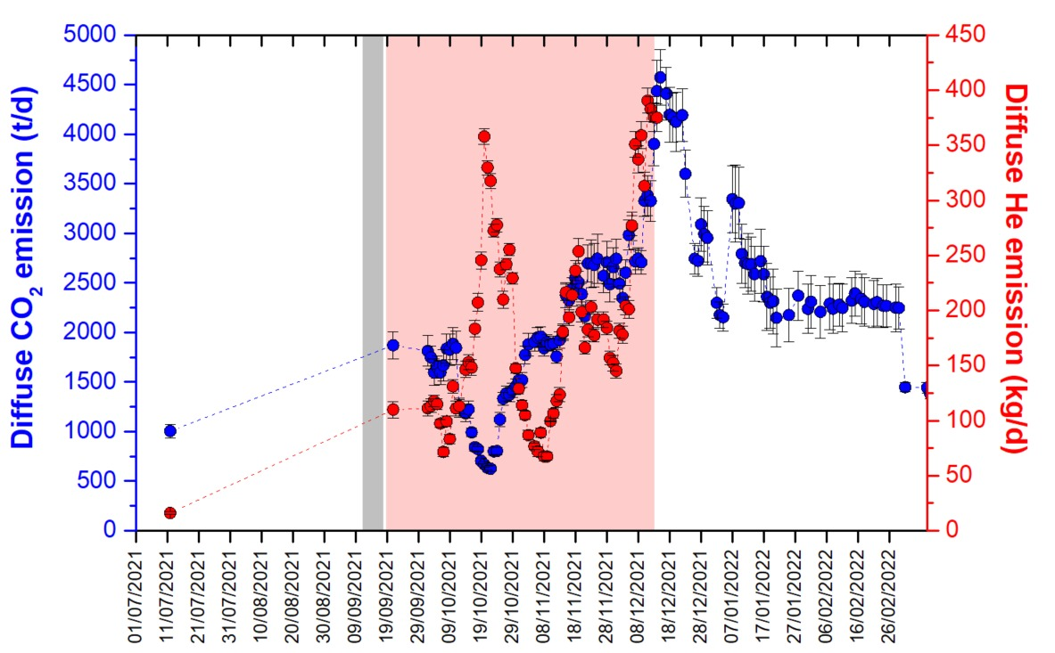
EGU General Assembly 2022 | Vienna, Austria & Online | 23–27 May
Diffuse CO₂ and ⁴He degassing monitoring
during and after the 2021 eruption
(Santana de León et al., 2022 ; Melián G. V. et al. 2022)

Slide 13
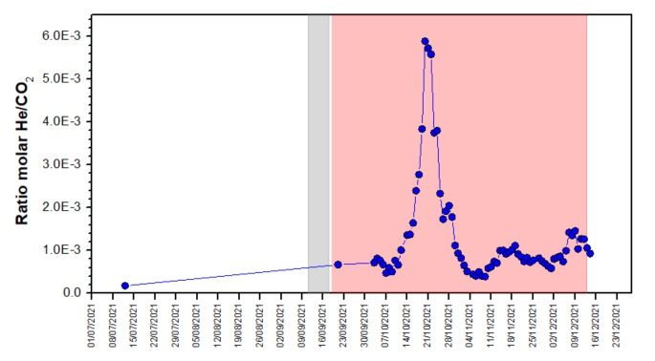
EGU General Assembly 2022 | Vienna, Austria & Online | 23–27 May
Diffuse ⁴He/CO₂ ratio degassing monitoring
during and after the 2021 eruption
(Santana de León et al., 2022 ; Melián G. V. et al. 2022)

Slide 14
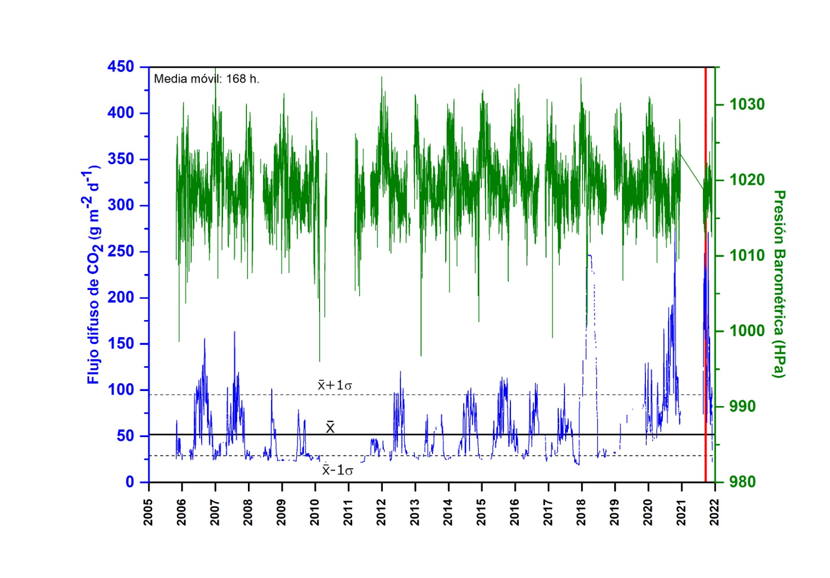
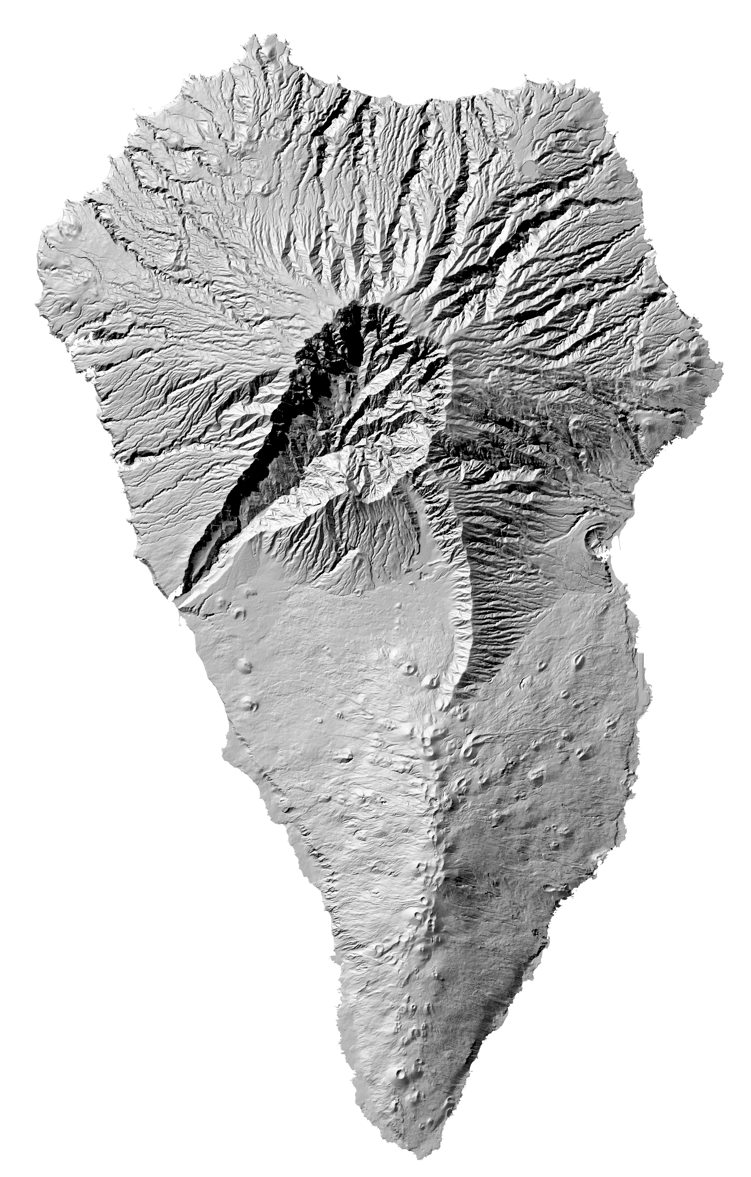
EGU General Assembly 2022 | Vienna, Austria & Online | 23–27 May
Continous geochemical monitoring
Soil CO₂ efflux measurements at LPA04
(Rodríguez-Pérez C. et al. 2022)

Slide 15
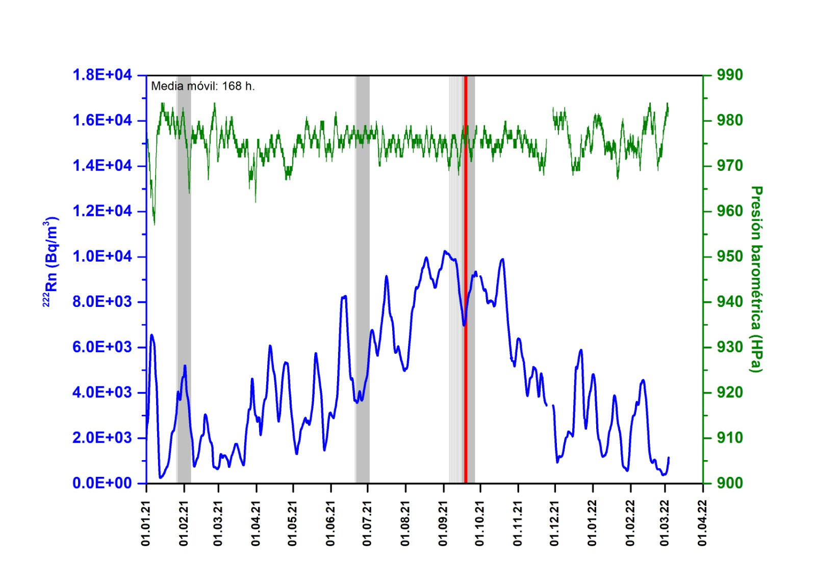
EGU General Assembly 2022 | Vienna, Austria & Online | 23–27 May
Continous geochemical monitoring
Soil gas ²²²Rn activity measurements at LPA01
(Di Nardo D. et al. 2022)

Slide 16
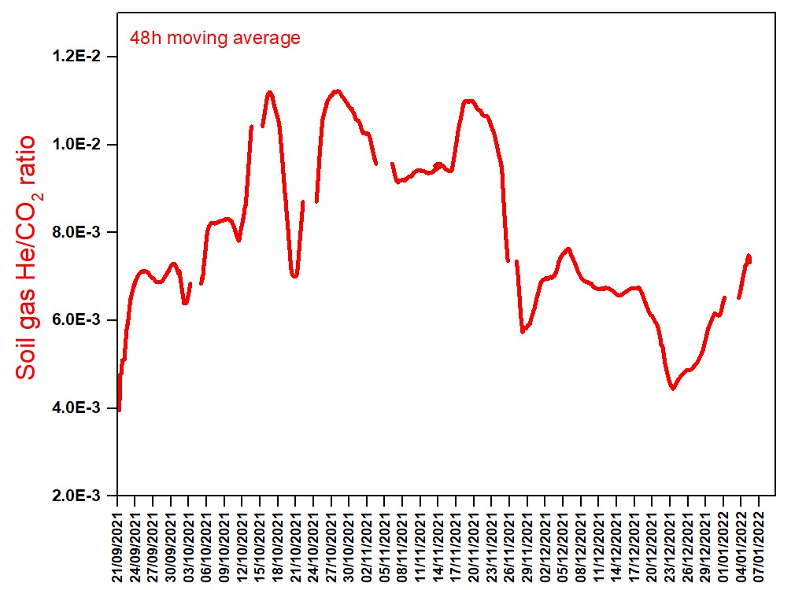
EGU General Assembly 2022 | Vienna, Austria & Online | 23–27 May
Continous geochemical monitoring
Soil gas ⁴He/CO₂ ratio measurements at LPA10

Slide 17
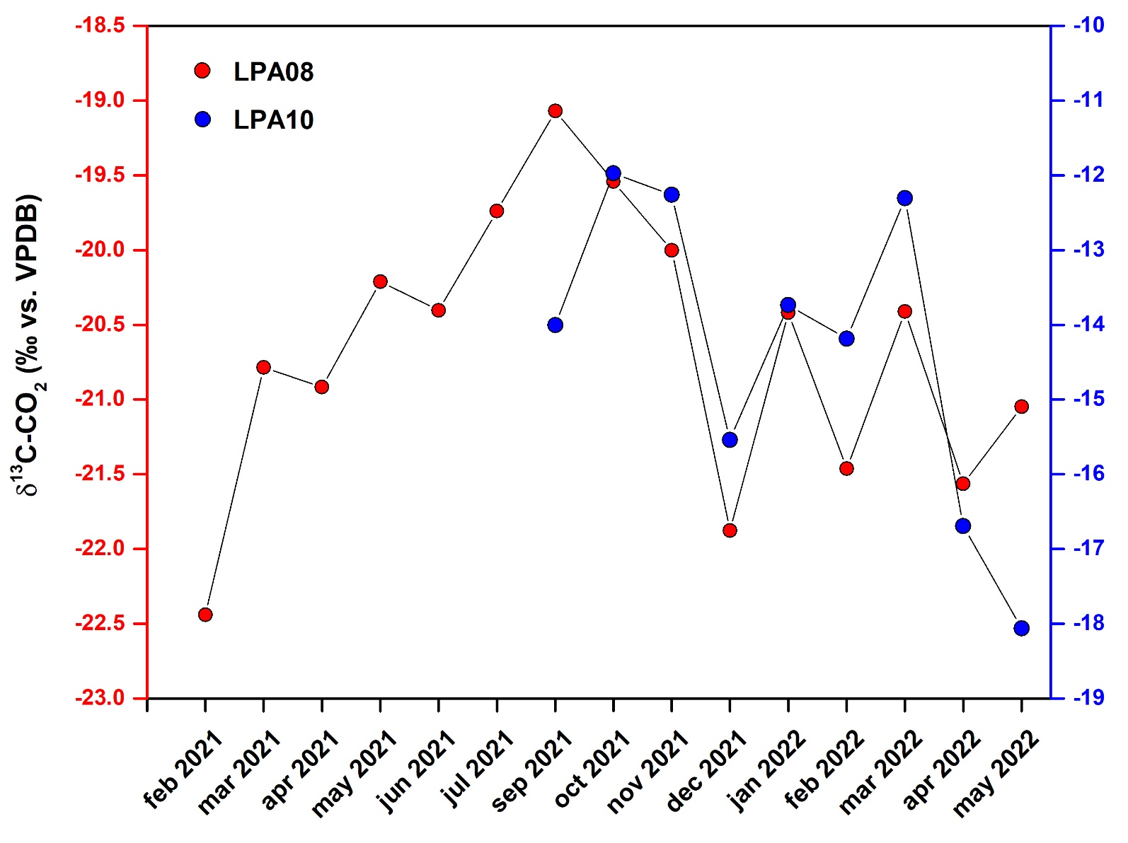
EGU General Assembly 2022 | Vienna, Austria & Online | 23–27 May
Continous geochemical monitoring
δ¹³C-CO₂ of soil gas atmosphere at LP08 y LP10
Monthly ave. δ¹³C-CO₂
~ 3.5 ‰
~ 6 ‰
(Asensio-Ramos M. et al. 2022)

Slide 18
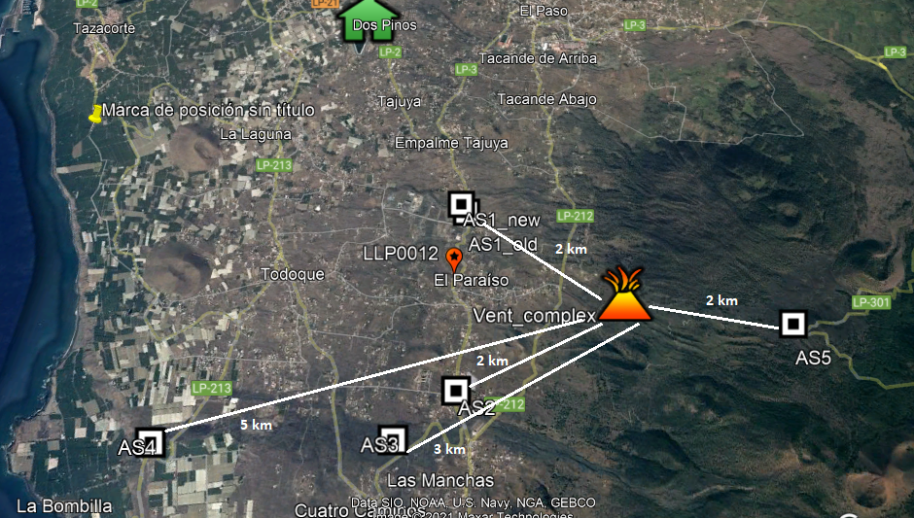
EGU General Assembly 2022 | Vienna, Austria & Online | 23–27 May
Plume geochemical monitoring
Ash-lechates analysis
(Rodríguez F.. et al. 2022)

Slide 19
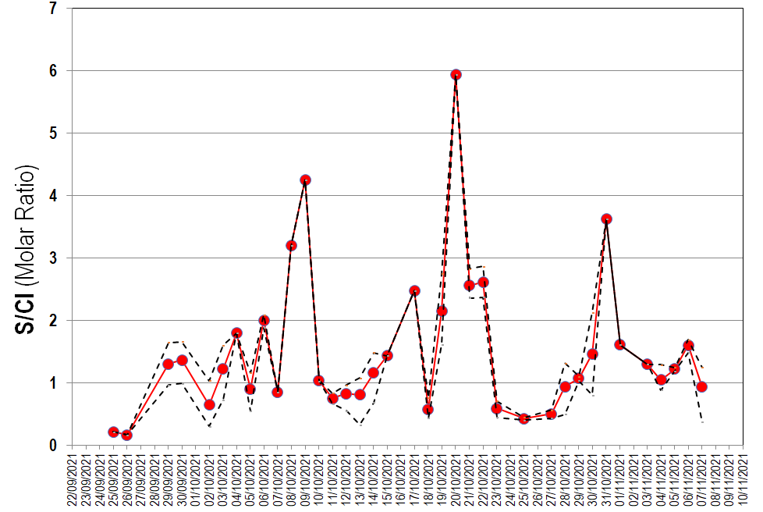
EGU General Assembly 2022 | Vienna, Austria & Online | 23–27 May
Plume geochemical monitoring
Ash-lechates analysis
ash-rich phase

Slide 20
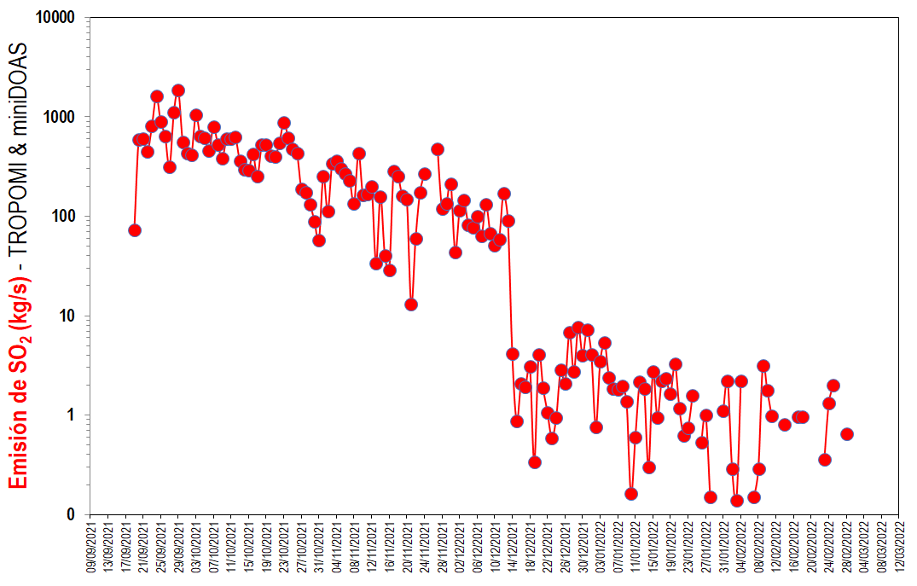


EGU General Assembly 2022 | Vienna, Austria & Online | 23–27 May
Plume geochemical monitoring
Temporal evolution of SO₂ emission
estimated from TROPOMI and miniDOAS measurements
(Hayer C. et al., 2022; Albertos V. T.. et al., 2022)

Slide 21
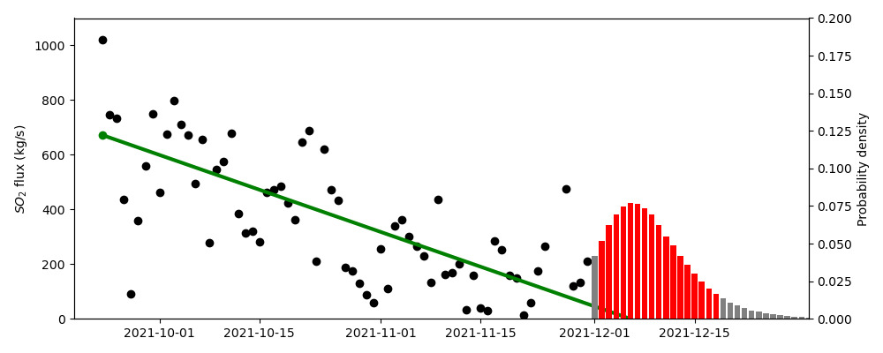

EGU General Assembly 2022 | Vienna, Austria & Online | 23–27 May
Plume geochemical monitoring
Forecasting the end of the 2021 Cumbre Vieja eruption
using TROPOMI and miniDOAS measurements
Realized on 30/11/2021
13/12/2021
December 2 - 20, 2021
(90% of probability)

Slide 22
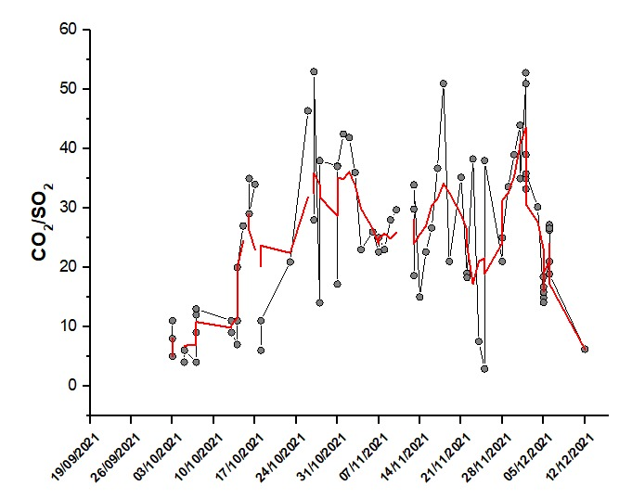




EGU General Assembly 2022 | Vienna, Austria & Online | 23–27 May
Plume geochemical monitoring
CO₂/SO₂ ratio FTIR measurements
Ave. CO₂/SO₂ = 25
(Pardo Cofrades A. et al., 2022)

Slide 23
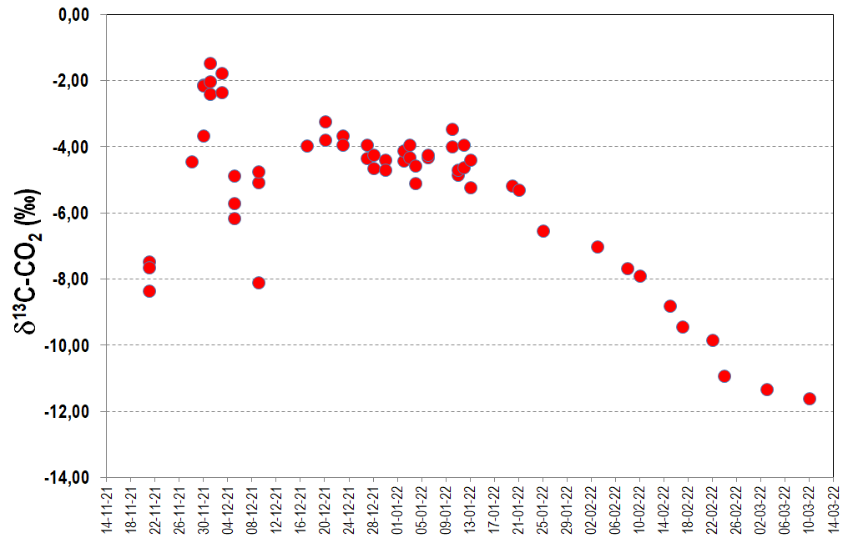

EGU General Assembly 2022 | Vienna, Austria & Online | 23–27 May
Plume and fumarole geochemical monitoring
δ¹³C-CO₂ measurements
Mixing with hydrothermal CO₂
[CO₂]
< 600 ppm
Mixing with
biogenic CO₂

Slide 24
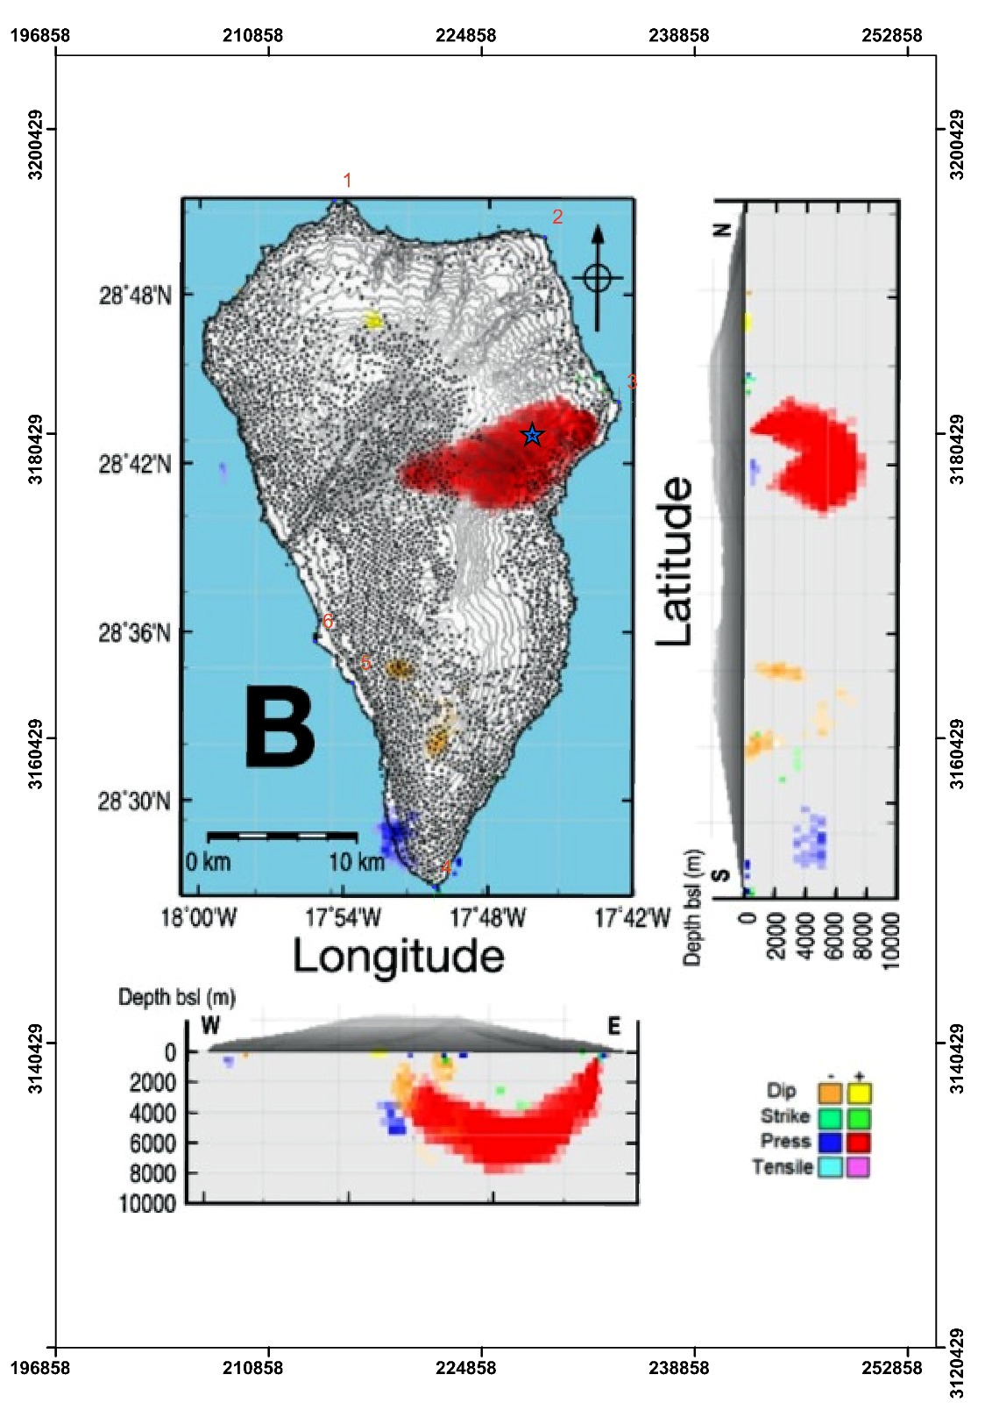
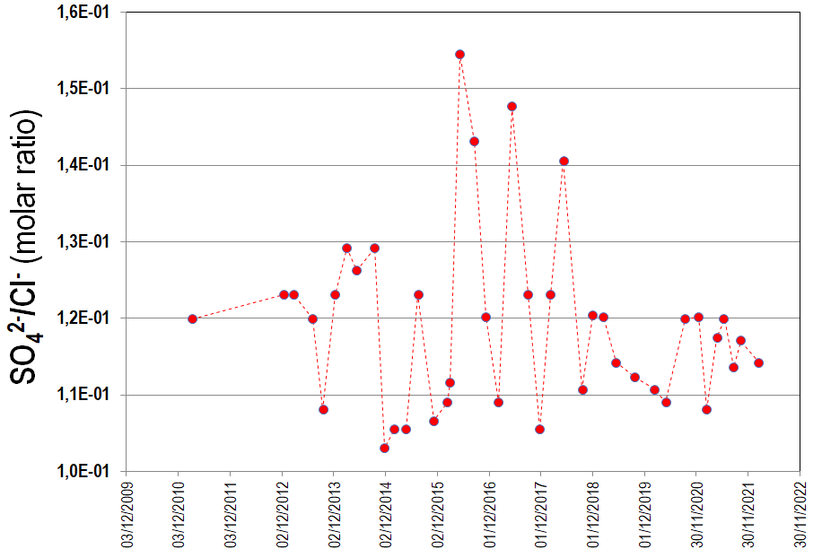
EGU General Assembly 2022 | Vienna, Austria & Online | 23–27 May
Groundwater geochemical monitoring
Temporal evolution of SO₄²⁻/Cl⁻ molar ratio
(Leal V. et al., 2021)
(Fernández J. et al., 2021)

Slide 25
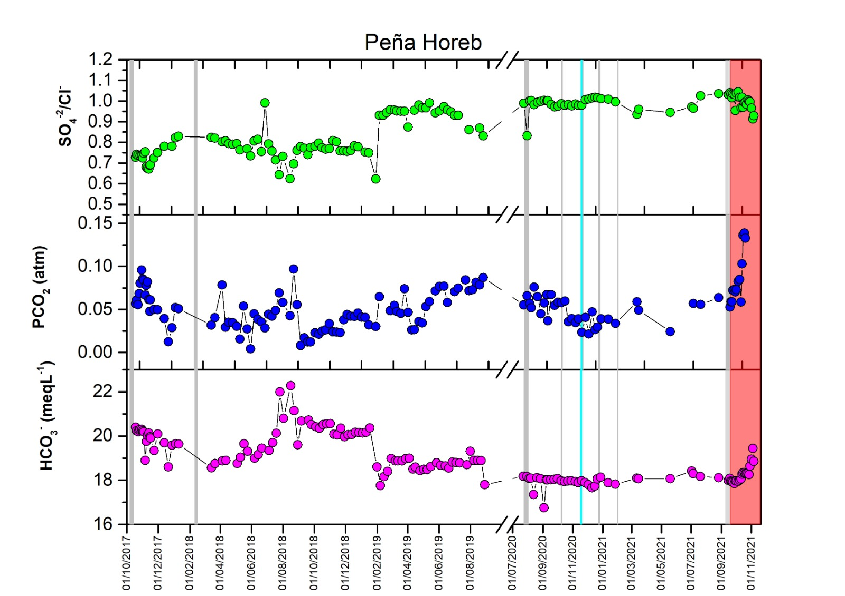
EGU General Assembly 2022 | Vienna, Austria & Online | 23–27 May
Groundwater geochemical monitoring
(Leal V. et al., 2021)

Slide 26
EGU General Assembly 2022 | Vienna, Austria & Online | 23–27 May
Conclusions
Soil gas geochemistry monitoring of the entire building of Cumbre Vieja volcano (220 km²) has proven to be useful for volcanic surveillance during inter-eruptive, pre-eruptive, eruptive and post-eruptive phases, and its application is tremendously helpful at volcanic systems with not visible geothermal features.
Groundwater geochemical monitoring at La Palma has also provided good indicators of volcanic activity changes.
Plume SO₂ monitoring has been fundamental to forecast the end of the 2021 Cumbre Vieja eruption and plume gas geochemistry was consistent with high volatile contents predicted from petrological analyses.
The analysis of pristine ash leachates did provide important information on the eruption processes; therefore, it is a suitable complement for monitoring the chemical composition of volcanic gases discharged from this eruption.

Slide 27
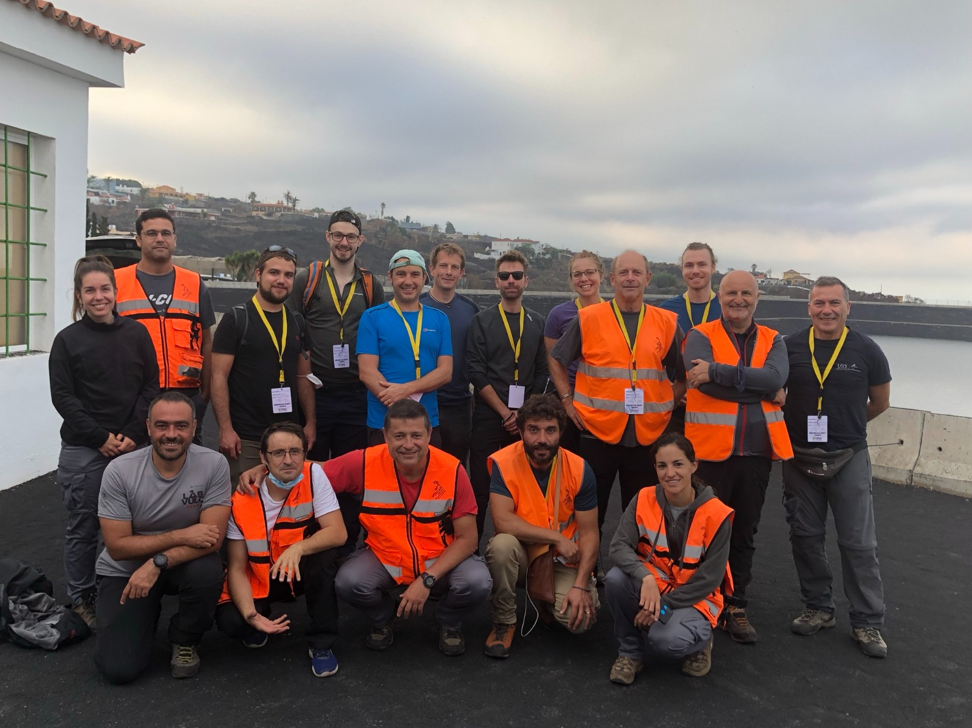
EGU General Assembly 2022 | Vienna, Austria & Online | 23–27 May
INVOLCAN · Cumbre Vieja 2021 · Internacionalization
179 researchers of 70 overseas universities and scientific institutions from 20 countries
1. Australia
2. Austria
3. Belgium
4. Canada
5. Cape Verde
6. Denmark
7. Finland
8. France
9. Germany
10. Iceland
11. Italy
12. Japan
13. New Zeland
14. Norway
15. Portugal
16. Russia
17. Singapore
18. Switzerland
19. UK
20. USA

Slide 28








EGU General Assembly 2022 | Vienna, Austria & Online | 23–27 May
Thank you for your attention!

