Slide 1
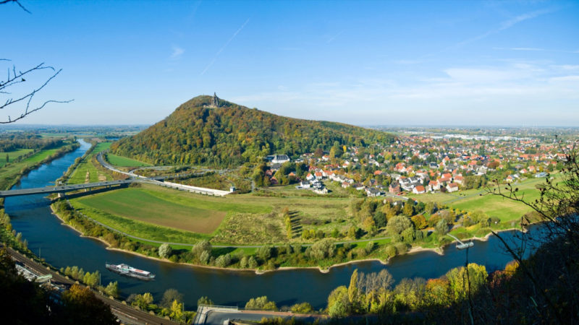

Geothermal exploitation in the inverted part of the Lower Saxony Basin: A case study from the Minden area
Olga Knaub^{1,2},Alexander Jüstel^{1,2}, Gregor Bussmann¹, Florian Wellmann^{1,3}, Peter Kukla^{1,2}
1: Fraunhofer IEG, Fraunhofer Research Institution for Energy Infrastructures and Geothermal Systems IEG, Am Hochschulcampus 1, 44801 Bochum, Germany;
2: RWTH Aachen University, Geological Institute, Wüllnerstraße 2, 52062 Aachen, Germany;
3: RWTH Aachen University, Department for Applied Geophysics 1: Computational Geoscience, Geothermie und Reservoirgeophysik (CGGR), Mathieustr. 30, 52074 Aachen, Germany;
Notes:
Hello everyone, I am going to present, in representation of Olga Knaub, who had a painful appointment with a dentist these days, the first results of her master thesis investigation the geothermal potential in the Minden area, located at the edge of the North German Basin. The thesis is written at RWTH Aachen University under the supervision of Prof. Peter Kukla and Prof. Florian Wellmann

Slide 2
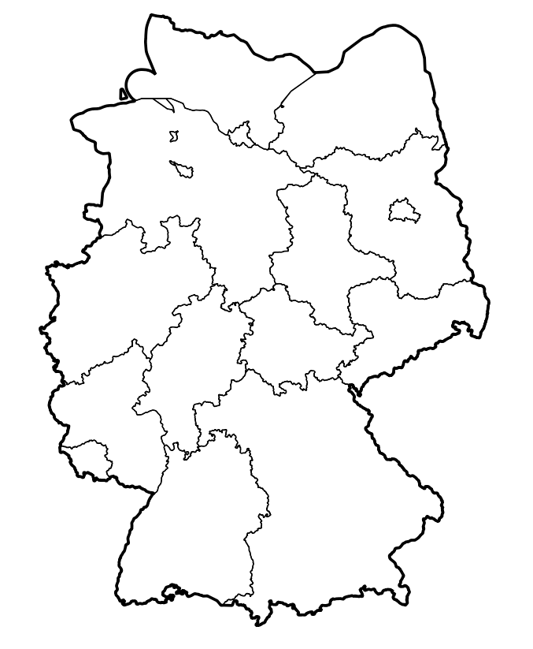
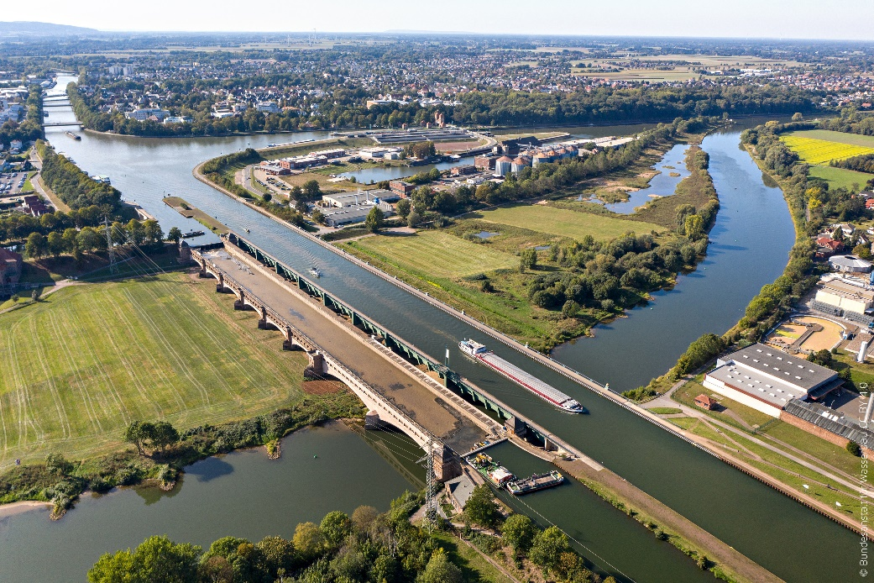
Motivation
Minden
Industry in Minden requires alternatives to fossil energy sources
Domestic and commercial heat demand could partially be compensated with geothermal energy
Characterizing the structures below the city of Minden and the potential Mesozoic reservoirs
https://upload.wikimedia.org/wikipedia/commons/a/ac/Alte_Kanalbr%C3%BCcke_Minden_Mittellandkanal_%2851022243452%29.jpg
https://www.sat1nrw.de/wpcontent/uploads/2018/08/minden-800x450.jpg
Notes:
The beautiful city of Minden is located at the intersection between the river Weser and the so-called Mittelland Channel in the northern part of Northrhine Westfalia virtually between the metropolitan area of the Ruhrgebiet and the Hannover/Bremen area. This has made it interesting for different kinds of industries to settle down. Within the framework of the heat transition in Germany, these companies now aim at switching to more alternative resources such as geothermal energy. In addition, the heat demand could be partially compensated by geothermal energy.
The aim of this study is to characterize the structural framework of the subsurface below the city of Minden and to characterize the potential Mesozoic reservoirs in this area.

Slide 3
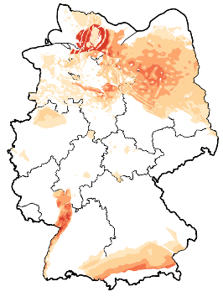
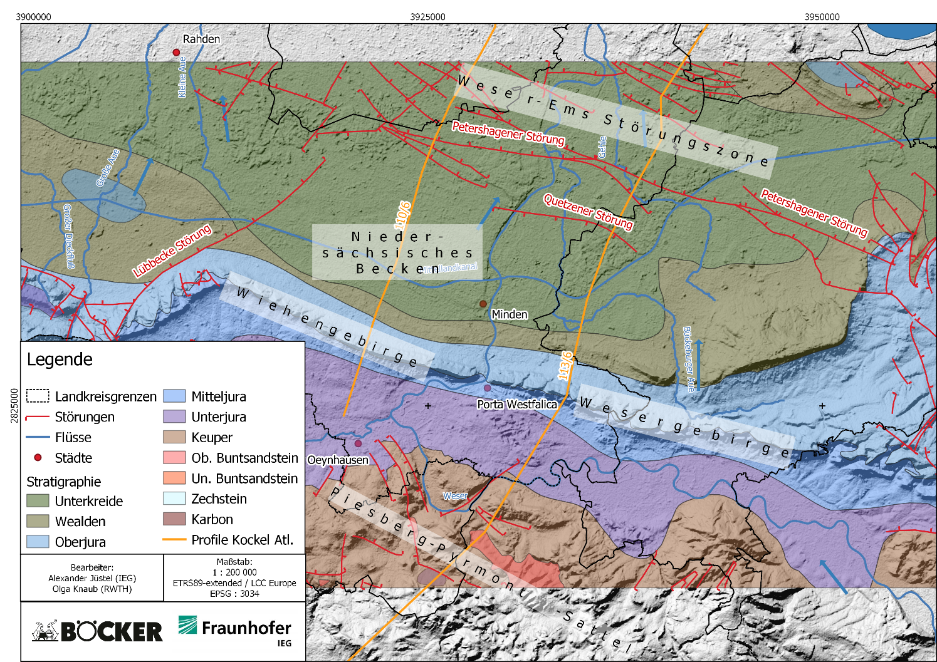
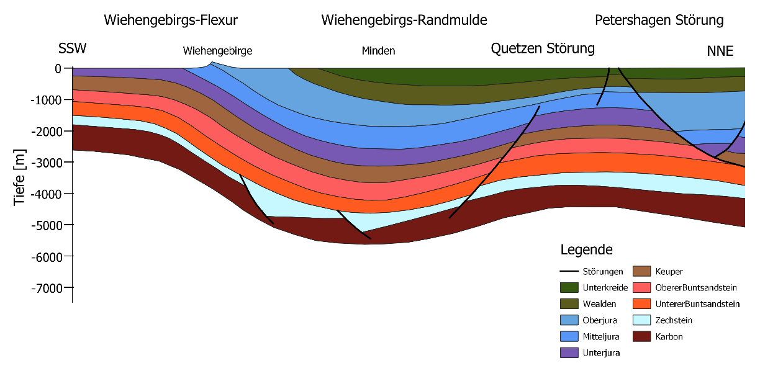
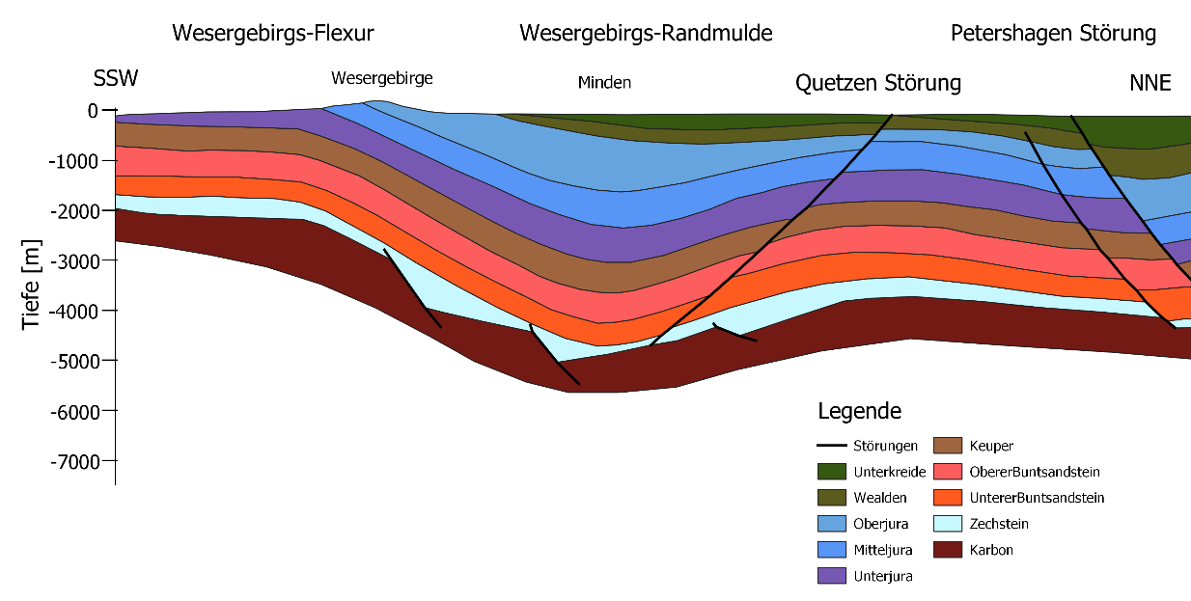
Geological Setting
Profil 110
Suchi et al., 2014
Geotectonic Atlas of Northern Germany
Profil 113
Geotectonic Atlas of Northern Germany
Notes:
The area of Minden is located at the southern margin of the North German Basin within the inverted part of the Lower Saxony Basin. According to the Geotectonic Atlas for Northern Germany, Synclinal Structur, the Wiehen- and Weser Mountains Marginal Syncline is present in the subsurface. It actually is a monocline as it flattens out to the south. Lower Cretaceous rocks are outcropping in center of Minden while Jurassic rocks of the aforementioned mountain chains crop out at the margin of the city, you have seen these in the previous slide. The Triassic consists of the Upper and Middle Bunter Sandstone with its thick Solling, Hardegsen, Detfurht and Volpriehausen Sandstones

Slide 4
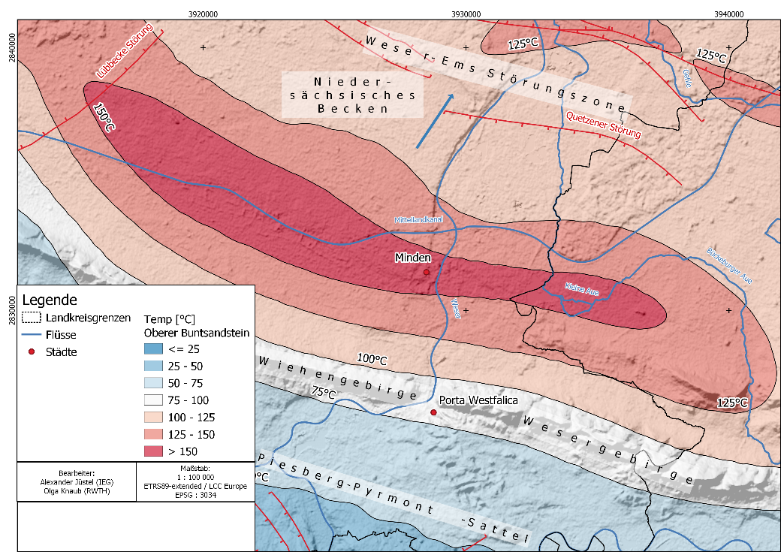
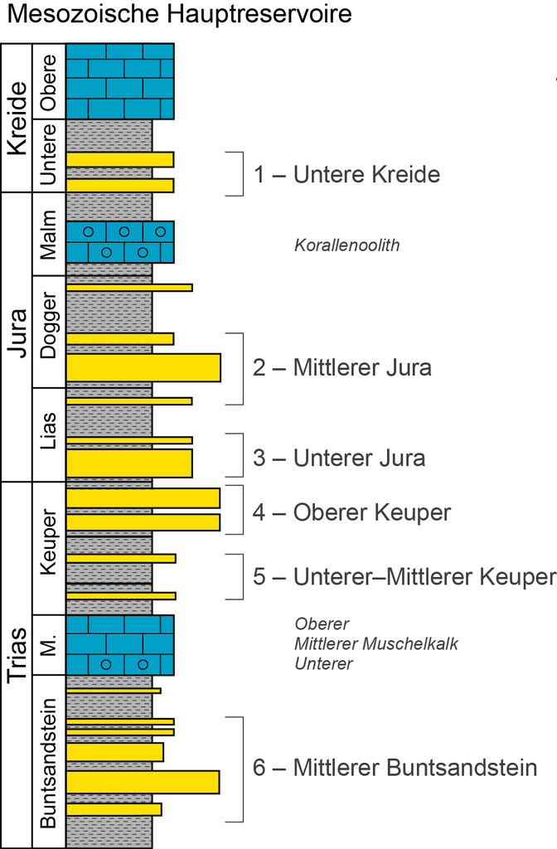
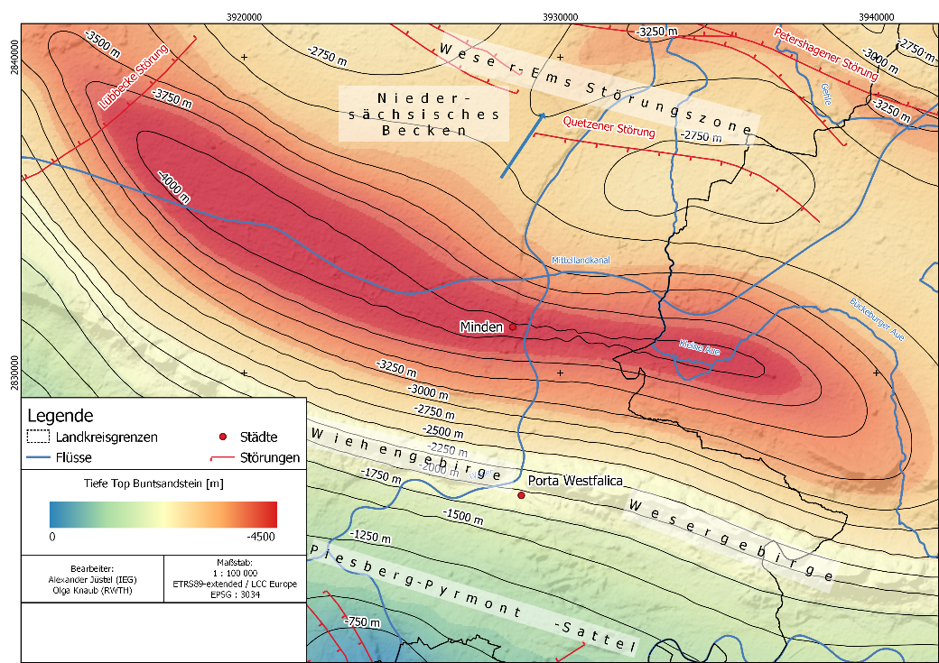
Evaluation of the geothermal potential
Notes:
In order to evaluate the geothermal potential, the first step was to create a structural model of the Minden area including the main Mesozoic reservoirs in the area. In comparison to the southern part of NRW where Lower Carboniferous and Upper/Middle Devonian Carbonates are the main reservoirs, the focus will be put on sandstone reservoirs as they have been extensively studied within the North German Basin. The reservoirs include Lower Cretaceous Sandstones, Sandstones from the Jurassic, the Keuper with ist Rhät Sandstone intersected recently in Hamburg Wilhelmsburg and the Middle Bunter Sandstone Formations. The depth map here in the center displays the depth of the top Middle Bunter Sandstone units with depths beyond 4000 m in the center of the syncline. Translating this to temperatures with a geothermal gradient of 35°C/km results in temperatures beyond 150°C in the center of the Syncline.

Slide 5
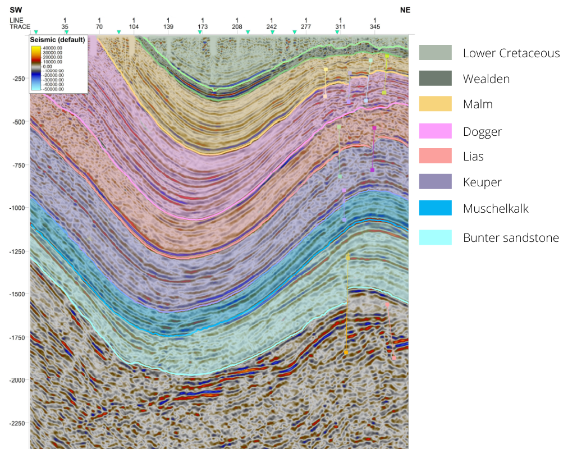
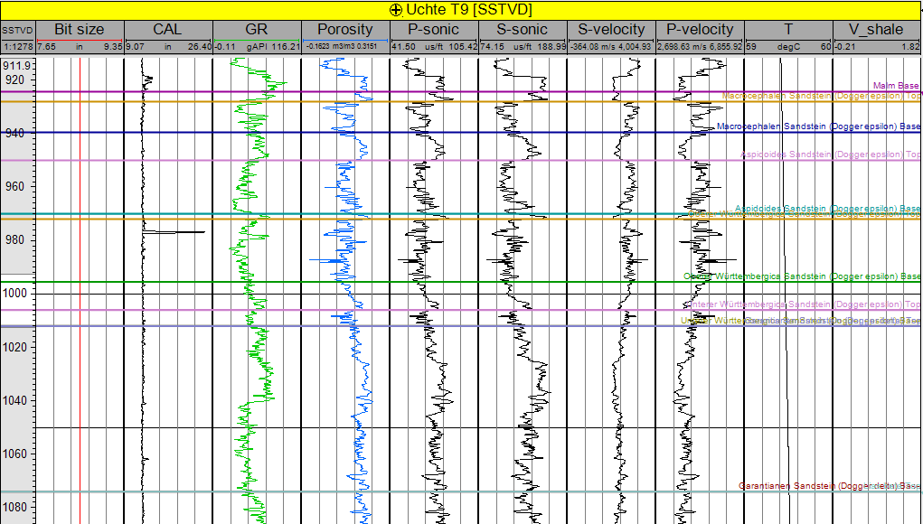

Evaluation of the geothermal potential
 | Thickness [m] |  |  | Porosity [%] |  |  | Permeability [mD]
 | min | max | mean | min | max | mean | min | max | mean
Callovium
-Porta-sandstone | ? | ? | 20^{(II)} | 10^{(II)} | 30^{(II)} | 23.37^{(II)} | ? | ? | ?
Bathonium
-Aspidoides facies | 10* | 56* | 28.76* | 10.18* | 21* | 14* | 100^{(I)} | 1000^{(I)} | 846.2^{(I)}
-Upper Württembergica facies | 5* | 25^{(V)} | 13.78* | 5.13* | 20.98* | 14* | 100^{(I)} | 1000^{(I)} | 846.2^{(I)}
Bajocium
-Garantianen facies | 8* | 43^{(VI)} | 29.81* | 6.25* | 22.23* | 15.53* | ? | 500^{(IV)} | ?
Karnium
Stuttgart-Formation | 11* | 33* | 20.5* | 0.87* | 38.5^{(I)} | 30^{(I)} | 40^{(XI)} | 4659.2^{(I)} | 1279.6^{(I)}
Solling | 2* | 20*^{,(VIII)} |  | 7^{(VI)} | 30^{(VII)} | 20^{(IV)} | 0.02 ^{(IX)} | 1000^{(X)} | 577^{(VIII)}
Detfurth | 5* | 39^{(VI)} |  | 1.02* | 30^{(VII)} | 21^{(VI)} | 3.04 ^{(IX)} |  | 577^{(VIII)}
Volpriehausen | 3.5* | 23.5* |  | 4.77* | 30^{(I),(VII)} |  |  |  | 577^{(VIII)}
Line A
Well A
Data provided by:
Zechstein, Rotliegend
Carboniferous
^{(I)}Franz et al. (2015), ^{(II)} Ebel, R. & Ehling, A. (2012), ^{(III)} Kunkel & Agemar (2019), ^{(IV)} Franz et al. (2018), ^{(V)}Bininda, R. (1986), ^{(VI)}Reinhold et al. (2011),
^{(VII)} Franz et al. (2012), ^{(VIII)}May et al. (2004), ^{(IX)}Tischner, T. & Hesshaus, A. (2015), ^{(X)}Putnis, A. & Mauthe, G. (2001), ^{(XI)} Agemar et al. (2009)
Notes:
In a next step, seismic data passing SW-NE through the city of Minden intersecting the synclinal structure was obtained from the LBEG in Hannover. This allowed for a better comparison of the data from the Kockel Atlas and a characterization of the different seismic facies in the subsurface. In addition to published hydraulic properties of the different reservoir units, geophysical logs from adjacent oil and gas fields were provided by LBEG for further characterization of the hydraulic properties of the reservoir units.

Slide 6
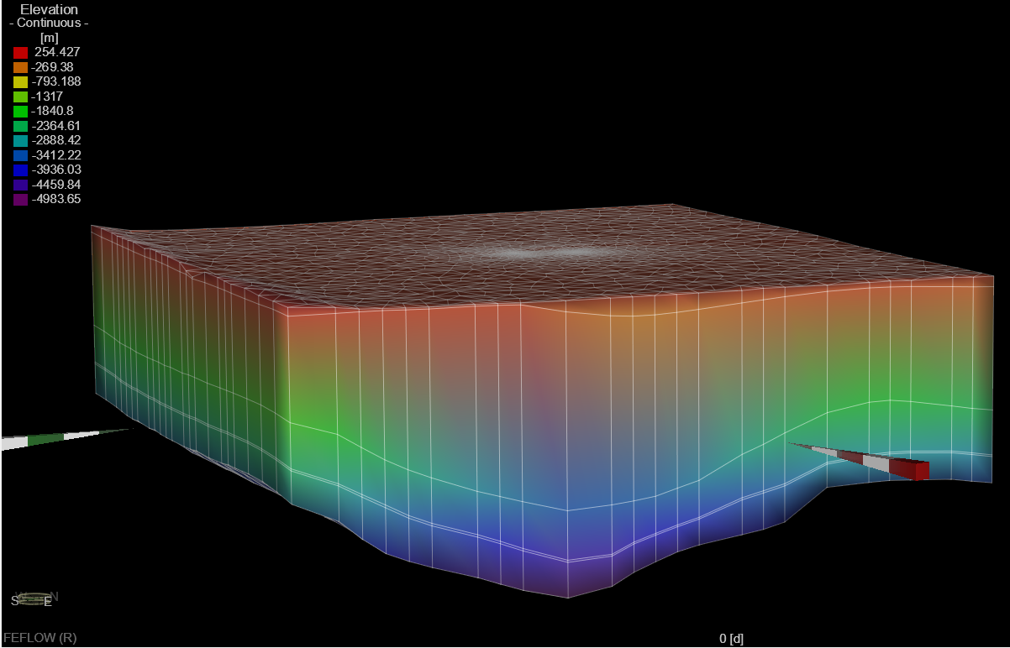
Conclusions
Next steps: TH modeling using FEFLOW
Mesozoic reservoirs are present at depths corresponding to temperatures beyond 150°C
Reservoir properties indicate that commercial production may be possible
Wiehengebirgs Syncline
Notes:
The final step in the thesis of Olga will be TH modeling using the FEFLOW software package.
The preliminary results of the study show that there is a considerable potential for the production of geothermal energy as Mesozoic reservoirs may occur in depths corresponding to temperatures beyond 150°C. The evaluation of relatively nearby oil and gas wells indicate that the sandstone unit show considerable porosity. No conclusive statements can be made about the permeability of the reservoirs yet. It also has to be noted that the wells targeted different structural settings.
Well, we have many good news and hope that we can initiate more geothermal activity at the margin of the North German Basin with this study

