Slide 1
Downscaling GCM data using a bias-correction method for the
Eastern Mediterranean.
Ezgi Akyuz¹, Burcak Kaynak², and Alper Unal¹
akyuzezg@itu.edu.tr, kaynakbu@itu.edu.tr, alper.unal@itu.edu.tr
Eurasia Institute of Earth Sciences, Climate and Marine Sciences, Istanbul Technical University, Istanbul, Turkey
School of Civil Engineering, Department of Environmental Engineering, Istanbul Technical University, Istanbul, Turkey

Slide 2
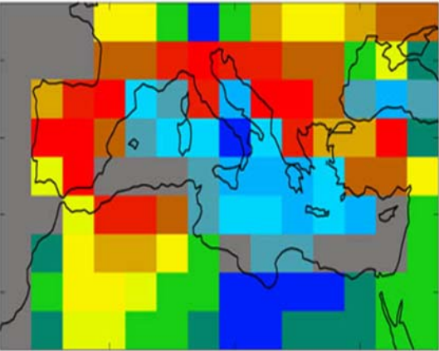
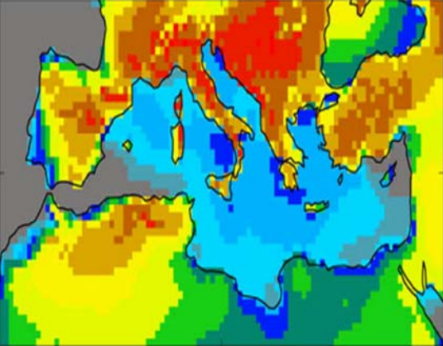
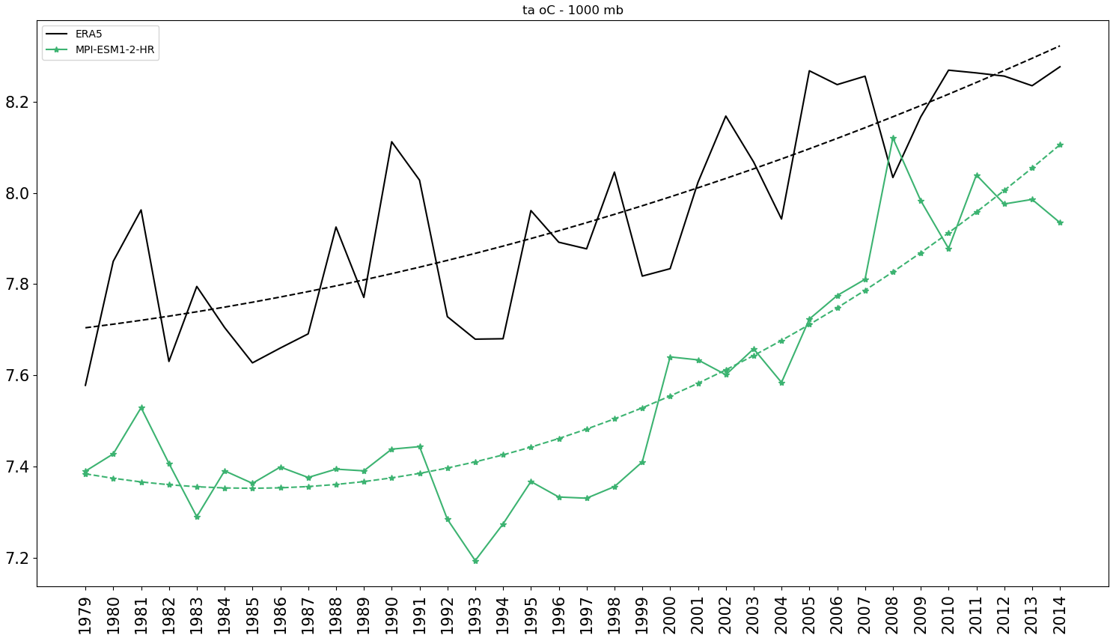
Motivation
Future climate scenarios from GCMs have wide application areas such as air pollution, health, agriculture, water management.
GCMs have coarse resolution (mostly 250-500 km)^{1,2}
For these application areas (air pollution for our focus):
Bias corrected and downscaled high-resolution dataset are needed
Existing biases pass from low resolution to higher resolution model results (biases should be corrected)
The impact of biases may lead to higher uncertainties in the results if they are not corrected (i.e. air pollutant concentration levels)
¹ IPCC, n.d.
² WCRP CMIP6, n.d.

Slide 3
Aim and Scope
to determine the impact of climate change on agricultural emissions and agriculture-related pollutant concentrations in future.
  Ammonia (NH₃) emissions mostly originated from agricultural activities are directly related to the temperature changes.
  Other changes are expected in secondary organic and inorganic aerosol formation from agricultural emissions and ozone concentrations.
High-resolution meteorology data downscaled from GCMs is required for the air quality modelling for future scenarios (future work).
to minimize the uncertainty, the biases in the GCMs have been corrected using Multi-Model Ensemble (MME) instead of using individual GCM results (this study).
In this scope,
A new bias-corrected dataset has been created and downscaled for the Mediterranean region using an RCM to obtain a high-resolution meteorology dataset.
  The temperature change in this region has been evaluated for the past (this study) and will be evaluated for the future periods.

Slide 4


Methodology to Previous Work
Xu et al., 2021
$$MPI−ESM1−2−HR$$
$$GCM={GCM}_{LT}+GCM^{′}$$
Original model simulation
Non-linear long-term trend
Interannual
variability
$${GCM}_{mvt} = {MME}_{LT}− \left(\overline{{MME}_{LT\left|H\right.}}− \overline{{ERA5}_{LT\left|H\right.}}\right)+ GCM^{′}×r_{s}$$
Bias corrected model simulation
Non-linear long-term trend of MME
Corrected
Interannual variability
Bias

Slide 5
Methodology – Inputs
No | Models | 18MME¹ (Xu,2021) | 30MME² (this study)
1 | ACCESS-CM2 | X | X
2 | ACCESS-ESM1-5 | X | X
3 | AWI-CM-1-1-MR | X
4 | BCC-CSM2-MR | X | X
5 | CAMS-CSM1-0 |  | X
6 | CanESM5 | X | X
7 | CAS-ESM2-0 |  | X
8 | CESM2 | X
9 | CESM2-WACCM | X | X
10 | CIESM |  | X
11 | CMCC-CM2-SR5 |  | X
12 | CMCC-ESM2 |  | X
13 | EC-Earth3 | X | X
14 | EC-Earth3-Aerchem |  | X
15 | EC-Earth3-CC |  | X
16 | EC-Earth3-Veg | X | X
17 | FGOALS-F3-L | X
18 | FGOALS-G3 | X | X
19 | FIO-ESM-2-0 |  | X
20 | GFDL-ESM4 |  | X
21 | IITM.IITM-ESM |  | X
22 | INM-CM4-8 |  | X
23 | IPSL-CM6A-LR | X | X
24 | KACE-1-0-G |  | X
25 | KIOST-ESM |  | X
26 | MIROC6 | X | X
27 | MPI-ESM1-2-HR | X | X
28 | MPI-ESM1-2-LR | X | X
29 | MRI-ESM2-0 | X | X
30 | NESM3 |  | X
31 | NorESM2-LM | X | X
32 | NorESM2-MM |  | X
33 | TaiESM1 |  | X
Xu et al. 2021 methodology was used with different number of the GCMs and both datasets^{1,2} were downscaled for the Mediterranean Region.
1985-2014 interval is evaluated as historical
MPI-ESM1-2-HR Model¹ is selected for interannual variability
Corrected parameters
      Air temperature (ta)
      Zonal wind (ua)
      Meridional wind (va)
      Relative humidity (hur)
      Geopotential height (zg)
      Sea surface temperature (tos)
      Sea-level pressure (psl)
      Surface pressure (ps)
Monthly data for long-term trends
6-hr/daily data for other calculations

Slide 6
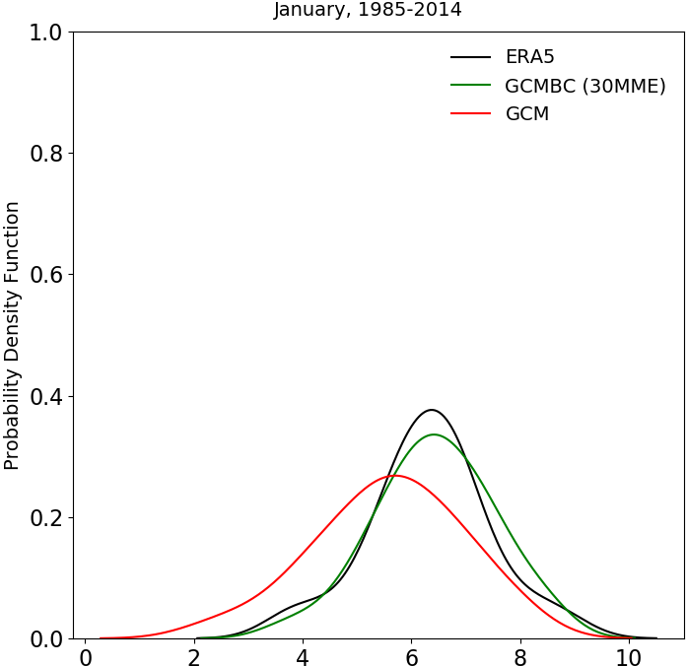
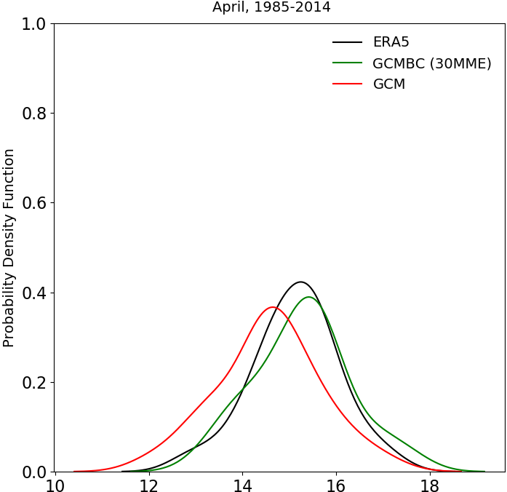
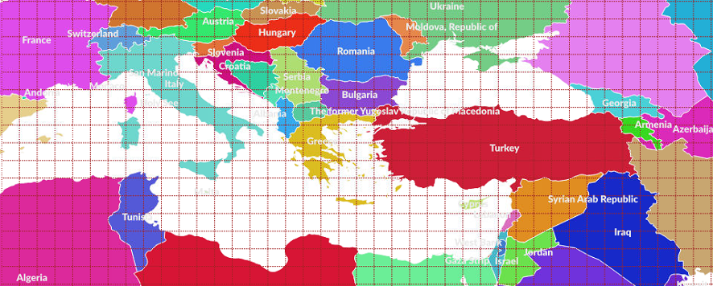
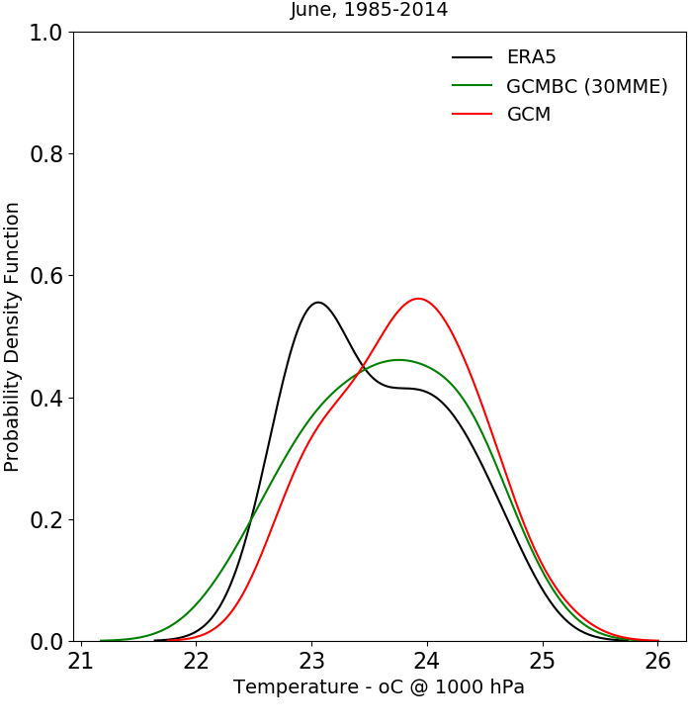
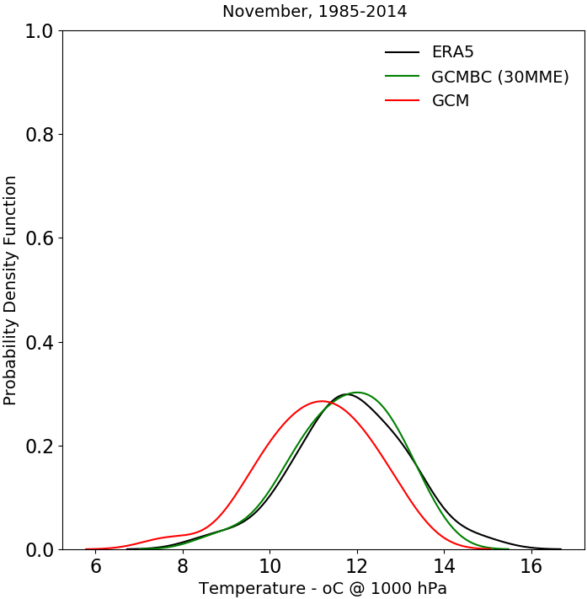
Results – After Bias Correction – Med. Reg. Average for 30MME
Due to the higher agricultural activities, increased temperatures, and higher ammonia emissions in the summer months → June has been selected for the downscaling for this study.
Other summer months will be included and evaluated for future scenarios in the further stages of the research.

Slide 7
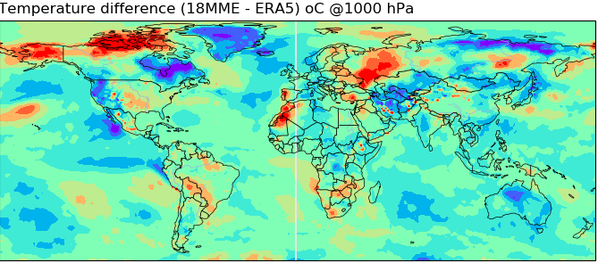
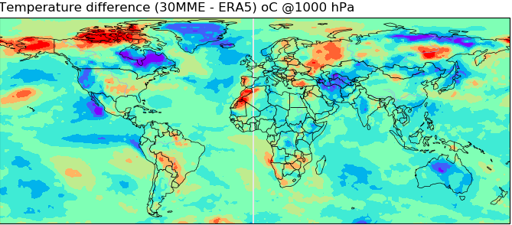
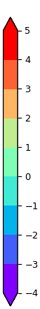
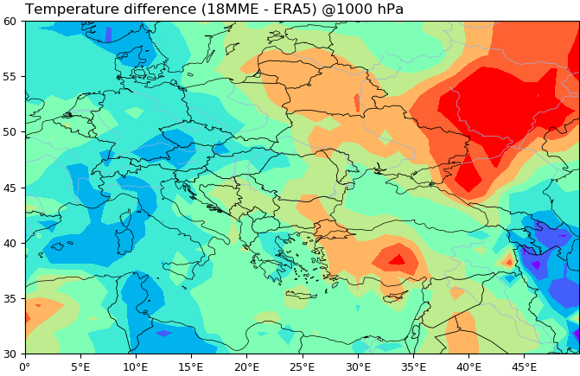

Methodology – After Bias Correction
18MME: Bias corrected dataset (Xu, 2021)
30MME: Bias corrected dataset created (this study)
(- 9.05 ºC) – 8.3 ºC
(-10.2 ºC) – 7.9 ºC
*
*
¹ Xu et al., 2021

Slide 8
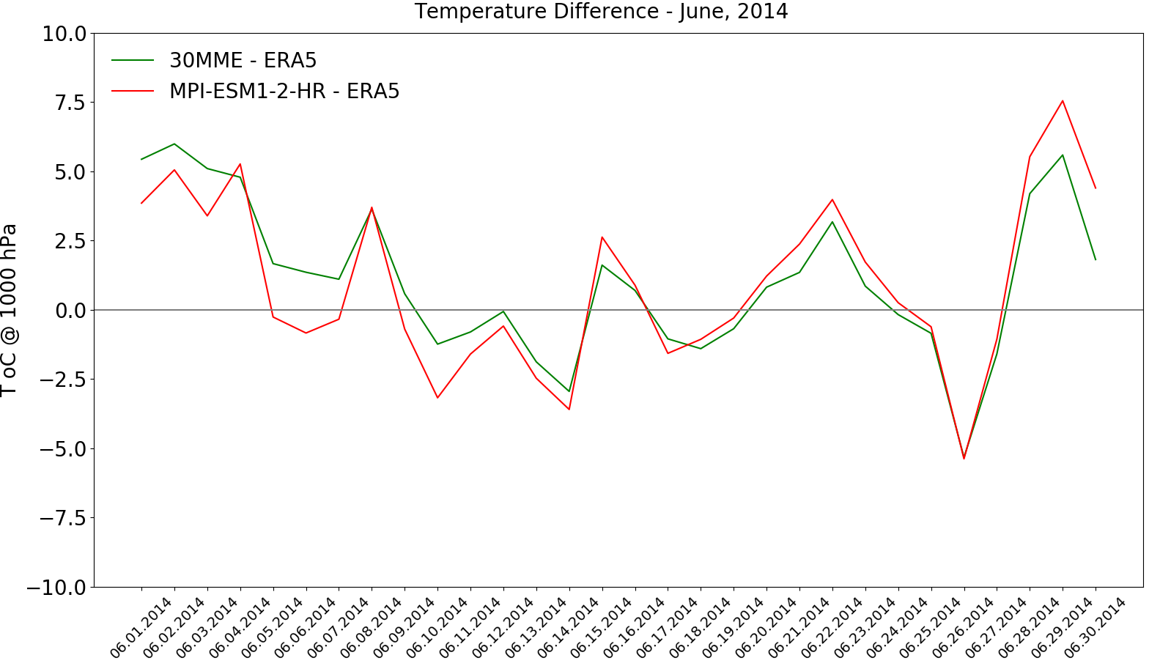
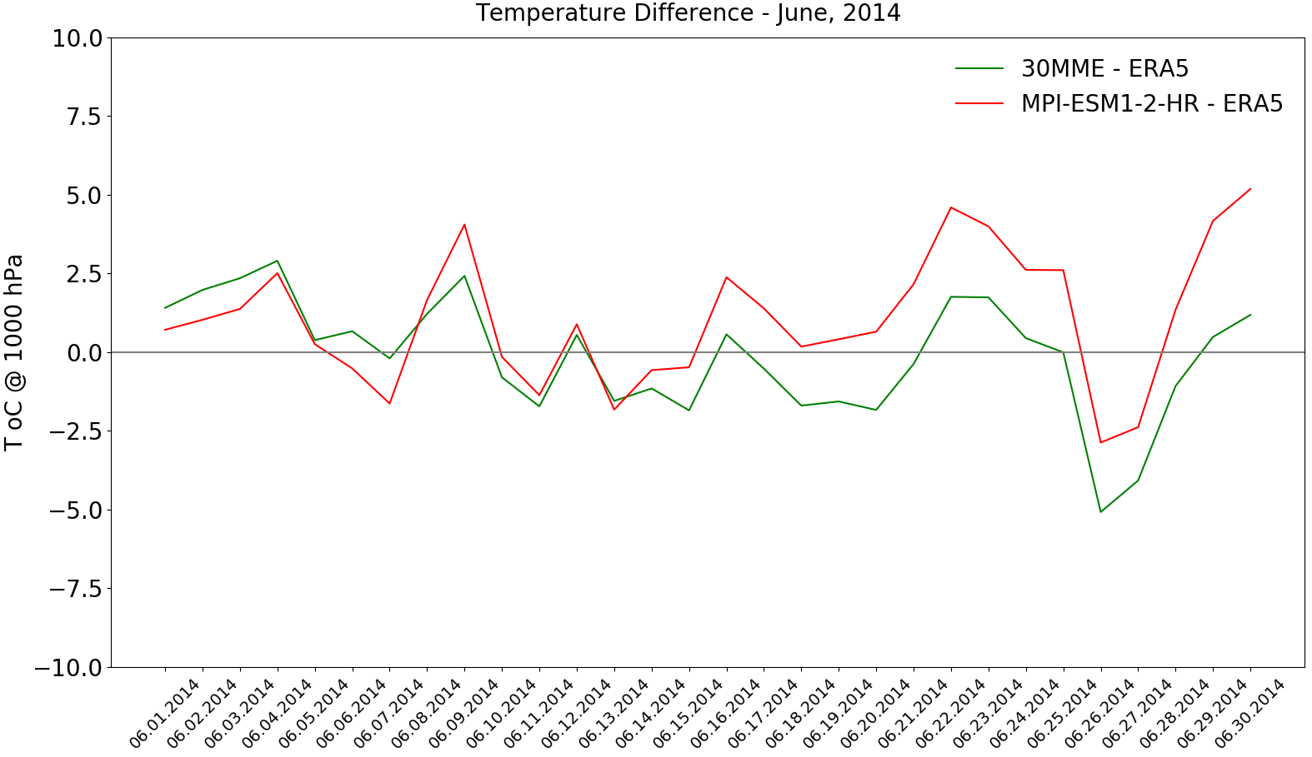
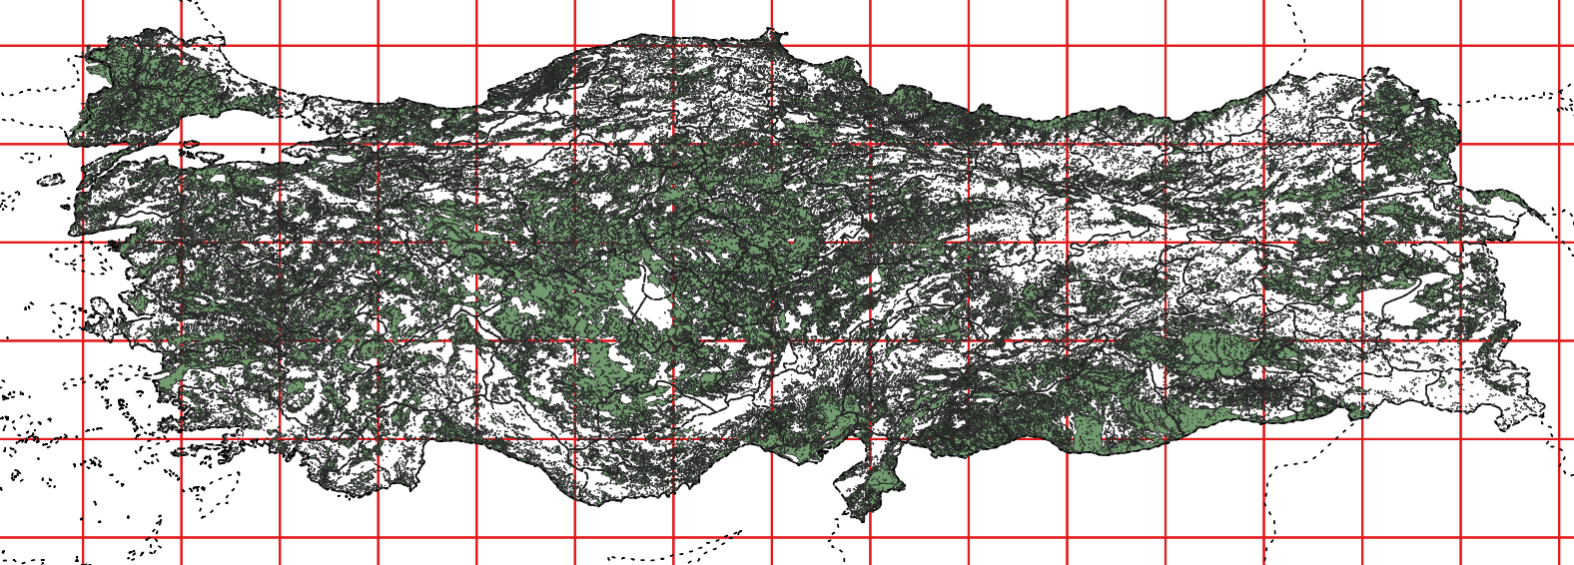
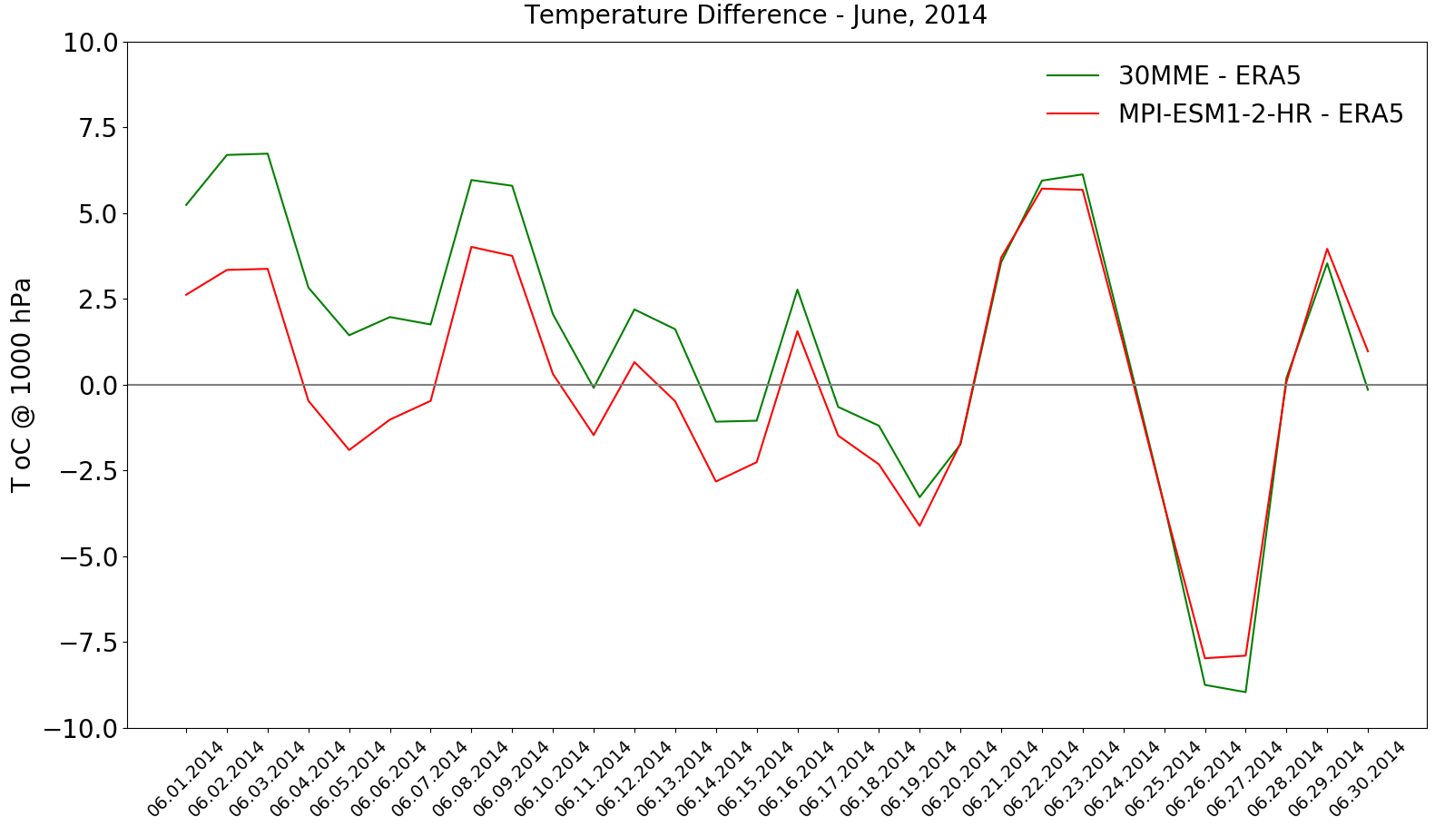
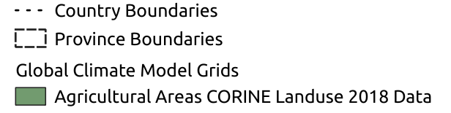
Results – Bias Corrected Data
ta @ 1000 hPa
The impact of the climate change on agricultural area will be determined in the future. Selected grids are the examples for large agricultural areas. Agricultural ammonia emissions are directly related to the temperature changes. Thus, the impact of the bias correction over these grids have been evaluated.
(CORINE landuse dataset, 2018)

Slide 9
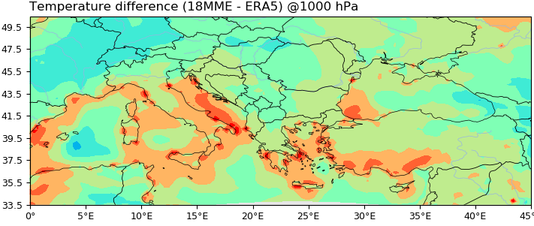
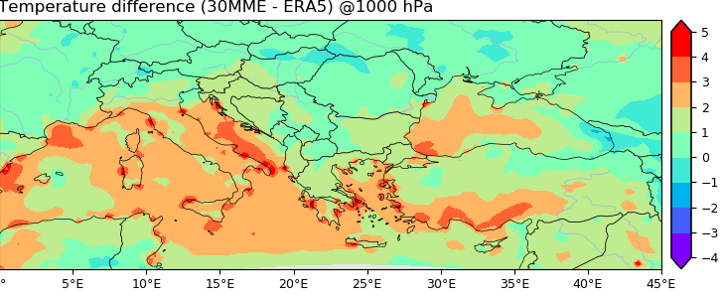
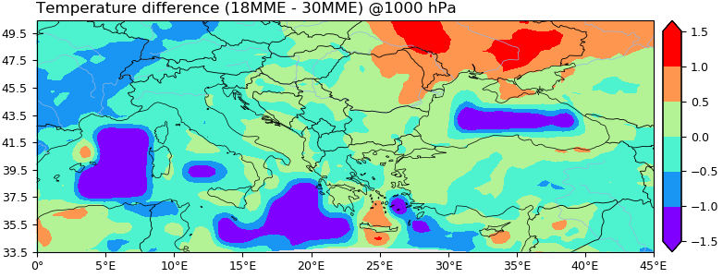
Results – WRF results GCMBC vs ERA5 (36×36km)
2014 June
18MME overestimates over lands while 30MME overestimates over the sea.
Over western and northern parts of Turkey and Algeria, south-west of Italy, southern part of Greece, higher values (up to 0.5ºC) are estimated with 18MME, underestimations are mainly observed over France. Over the north-eastern part of Turkey and north part of Algeria, temperature differences are up to 1ºC.
Over lands, WRF results with 30MME are closer to ERA5 compared to 18MME results.
(* Xu et al., 2021)

Slide 10
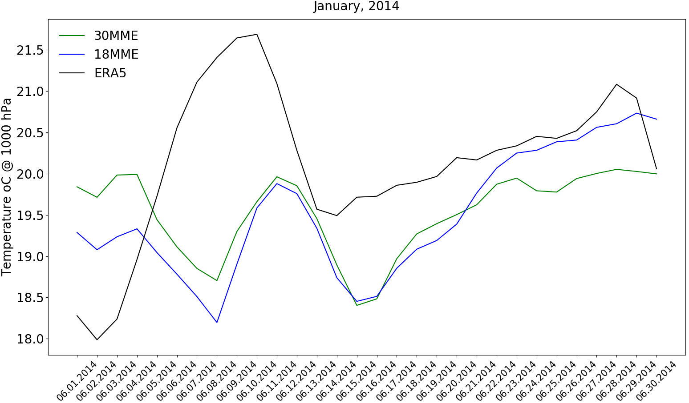
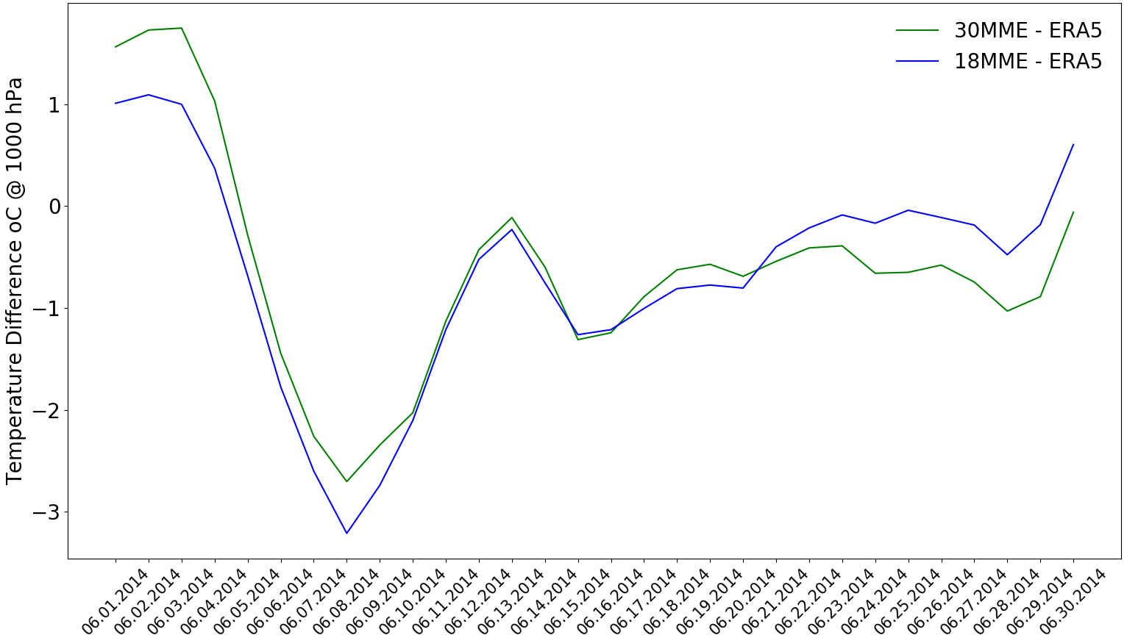
Results – WRF results Med. Reg. Average
Daily domain averages → small differences between two datasets (18MME and 30MME).
Maximum temperature difference between the datasets and ERA5 are observed in June 7, 2014 (for both).

Slide 11
Conclusions / Ongoing works
The methodology of Xu et al. was replicated with a focus on Eastern Mediterranean using 30 GCMs in this study in order to minimize uncertainty in future scenarios. Both 18MME (Xu et al., 2021) and 30MME (this study) datasets were downscaled for the focus region.
For June, 2014
  Bias corrected datasets have differences (1.25º×1.25º);
    Global:
      (- 9.1) – 8.3ºC between 18MME and ERA5
      (-10.2) – 7.9ºC between 30MME and ERA5
    Mediterranean Region:
      Higher differences are mainly observed over Turkey, Italy, and Algeria
Using different GCMs has mostly decreased the difference between ERA5 over lands while it has increased the difference over sea (36×36km).
Smaller differences have been found in the domain averages of both datasets for Mediterranean Region with a maximum difference (3 ºC) between ERA5 on June 7, 2014. The difference between the datasets and the reanalysis data changes between (-1) – 1ºC for the rest of the days of June.
Ongoing works
Observations vs GCMBC comparison after WRF
Future scenario SSP245 and SSP585
Smaller domain investigation with 4×4km grid size resolution

Slide 12
References
IPCC, n.d. What is a GCM? https://www.ipcc-data.org/guidelines/pages/gcm_guide.html, Accessed date: 22 April 2022.
Xu, Z., Han, Y., Tam, CY. et al. (2021). Bias-corrected CMIP6 global dataset for dynamical downscaling of the historical and future climate (1979–2100). Sci Data 8, 293. https://doi.org/10.1038/s41597-021-01079-3
CORINE, 2018. Corine Land Cover Raster Data [WWW Document]. URL. https://land.copernicus.eu/pan-european/corine-land-cover/clc2018?tab=download, Accessed date: 18 April 2022.

Slide 13
Thank you!

Slide 14
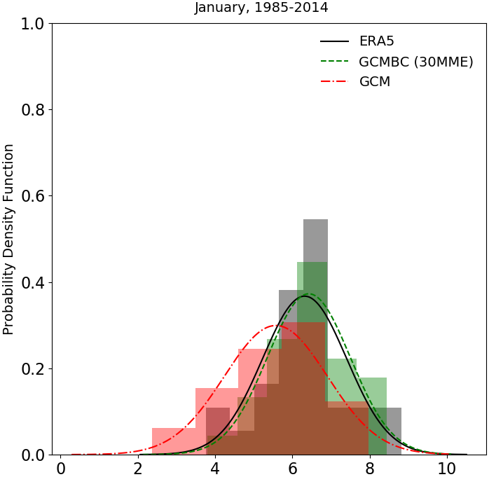
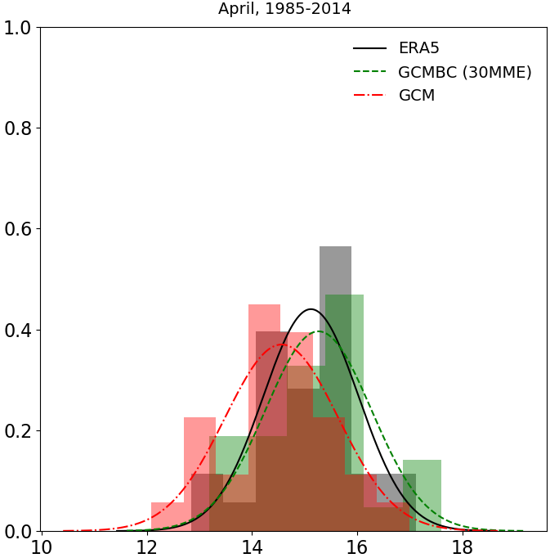
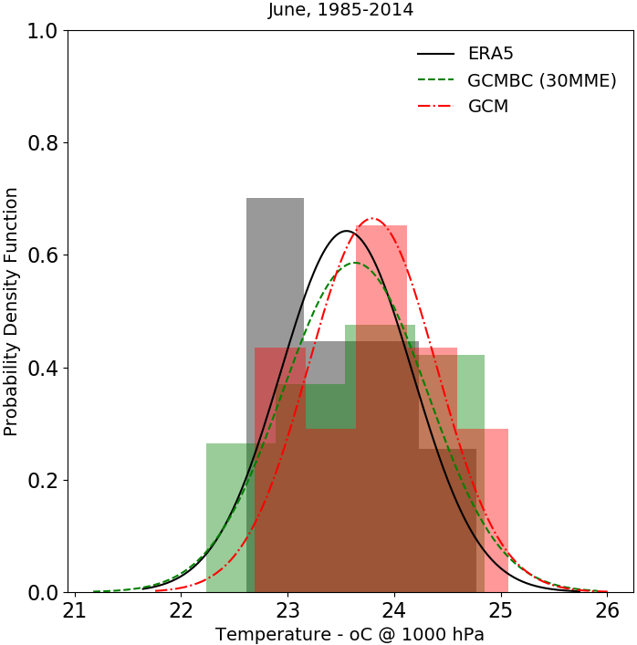
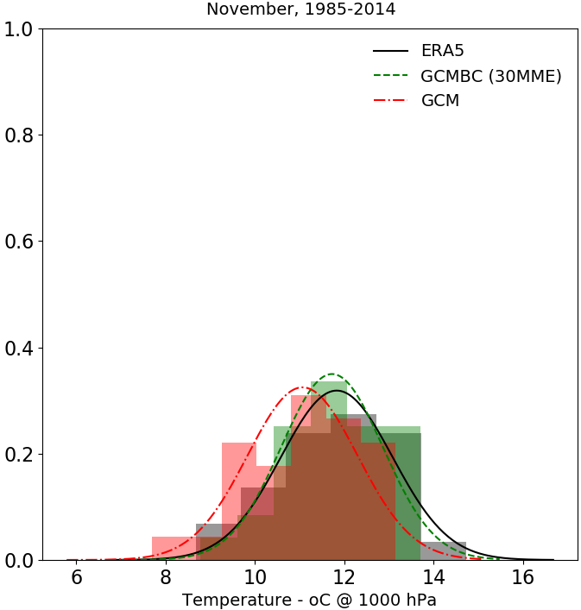
Results – After Bias Correction – Med. Reg. Average 30MME
Notes:
Will be drawn for Med Reg

